Slide 1
Data Profiling: How Do We Do It? What Are We Missing? What The Heck Do We Do with The Results?
Team: MikeC, BenW, MartyI, Rashawn, MichaelL, Xiaozhu, WillC, Probir, TimH, Stephane, NathanT, Laksono, Yukon, Ramesh, MichaelB, Bart, BillW, DaveM, DavidC, DavidB, TiffanyC, Tao and others

Slide 2
Agenda for Today
Quick Introduction
History
Usages/Requirements
What can we do with it?
What Information We Need?
What are our primary issues?
Memory Allocators

Slide 3
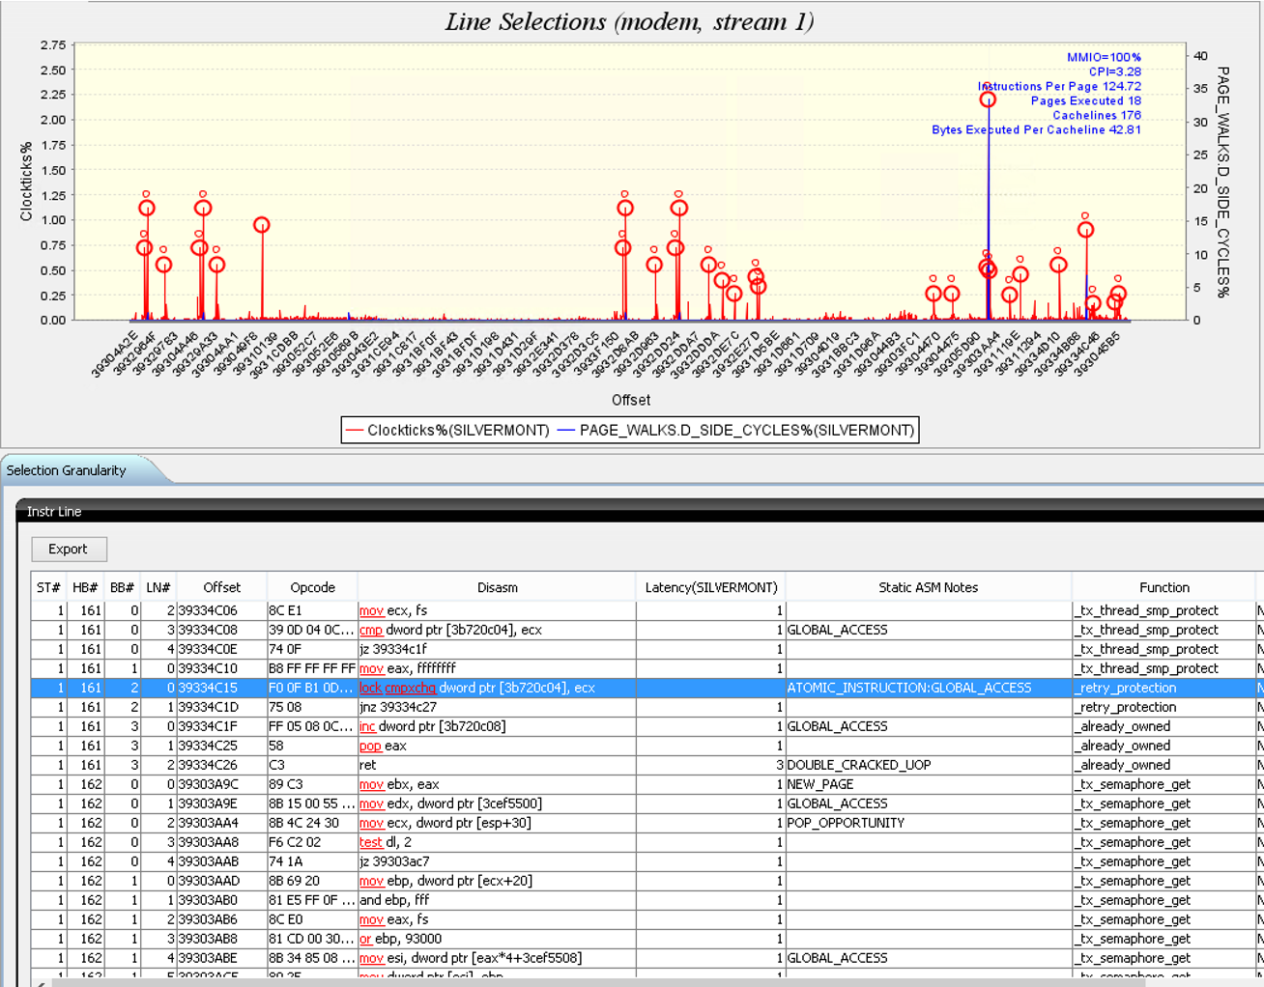
Importance of Data Reordering
Metric | PGO | PGO + Full Interprocedural Opt
Back End Bound Cost | 43% | 49%
DTLB Misses Cost | 1% | 8%
Compiler optimization
Hurting performance
Due to data locality
Hottest lock in OS
placed on own page
causing DTLB misses
Top Down Helps Identify Necessary Global Data Reordering

Slide 4
History
Mapping data and presenting it up to a useful semantic level
Quality of the symbolic information has improved on optimized code

Slide 5
We Have Text Locality Covered Pretty Well
Predicted using LBR
PotentialInstructionCacheSavedPercentage | 11.6%
BranchWith4kTraversalPercentage | 36.3%
Statistic | NoPGO | PGO
TotalBytesExecuted | 69k | 62k
TotalCacheLinesExecuted | 1738 | 1373
TotalCacheLinesBytes | 109k | 86k
CacheLineEfficiency | 64% | 72%
TotalPagesExecuted | 182 | 93
PageEfficiency | 10% | 17%
Statistic | No PGO | PGO | PGO/NoPGO
Utilization: | 39% | 33% | 1.18
Front End Bound Cost | 43% | 32%

Slide 6
Why Are We So Good at Reordering Text/Code?
Symbols are better
Better defined rules for where to jump?
Pointers create all sorts of messiness
It is easier to reorder and not break the functionality of the program?
Basic block hit counts are easier to obtain from the HW?
Even temporal locality is easier in the text region

Slide 7
What Are Our Usages/Requirements? They Should Drive Everything Else (Prioritize)
Array for structs or struct of arrays (defining access patterns of arrays)
Information for programmer vs. compiler safe=compiler, not_safe=developer
Reordering?
Improve cache line utilization?
Improve page utilization?
Automatic through compiler
Low fragmentation memory allocators?
Identify variables that are used together commonly on the same thread
Finding mixed groups of variables that are commonly used. Can be used for precision capabilities
Determine where to utilize large pages for data?
Eliminate demand zero page faults?
Determining where we are thrashing cache?
Eliminating false sharing?
SMT aware scheduling?
Temporal locality hint usages?
Data profiling?
Function parameter passing
Value profiling to determine what values are changing and which are not
What is the precision of the variable
How many just remain 0.
Optimizations that can be done

Slide 8
Requirements/Usages
Data access patterns by call stack
Do we present the data in hierarchical order
What would the hierarchy look like
Do we need the call stacks and what data is utilized in that call stack
Heap Data
Many folks forget to free their data after allocating
Could have a performance impact on data that is just sitting around that could have been freed
Do have the lifetime of the name of the variable
Identify hot and cold pages and cachelines
Utilization
Could we have a higher level output that could show what optimizations have been applied to the program
Has optimizations in the source.
Example variable could be colored red and cold variables would be blue
Linker can move global and static date

Slide 9
What Information Do We Need?
Spatial locality?
Temporal locality? Which variables are being accessed together.
Data from two different calls. Data is similar between the callees. Current organization
Abstractions that create modularity but separate out
Naming can become a problem. Modularity causes problems where it is the same data
DLAs to map data that is the same
Parameter in the function (exists across many)
Runtime dependent cannot be
Sample or Trace?
Size of N in Window.
Alpha had the ideas of taking pairs of instructions and determining what dependencies they might have
Need the size of the type
Which threads are reading/writing variables
Logical cores that read and wrote the data
Context switch to another one….accomplish from another cor
NUMA accesses
Example of initializing on one thread on one core, every other core touches the data
Captured along with DLA
Heap
Hook into malloc and grab the information
Create a synthetic variable
Would like the data type that the load that is accessing the variable
A secure way of getting data in containers and guests in a safe and secure manner
Get data from a container, how do I use it?

Slide 10
What Information Do We Need (Cont’d)
Address values?
Automated capability to map
Would it be ok to dump out just offset bits
Where you were loading/storing is more important than the what
Data values?
Still important but lesser
End user cares
Every load and store needs to go back to a variable identifier (or name where available)
The type of the variable, the structure name and the field name
No matter whether it is local, global or heap? Spills and fills from the registers handled separately
Demand loads? Demand stores? Prefetches?
L1 Hits uses memory that has been prefetched
Prefetching what you care about is if your prefetches are useless or not (do they get thrown out before you use it)
Just need an event on when it hoses it
And capability to turn them on and off
Determine the number of evictions and at what levels for the prefetchers
Software Prefetches
Need to know when they are useful or not
Determine when they are too close (and should be moved back further in time)

Slide 11
What are our primary issues?
Determine what data can be achieved dynamically vs. statically
Symbols
Determining what data is being accessed on the heap
Loss of symbolic information when optimizations applied?
Showing what is referenced and what is not referenced (complaint is that it is too big)
Size is too big
The variable name is not propagated throughout the optimizations
Use the DLA and then look at the variables that are in scope
If you find the variables that are in scope…finding the offset in the variables
Ability for HW to output data?
Structure of Structures
How do we bring it back to something actionable
Doable today with current DWARF information
Overhead of collecting?
What is acceptable overhead?

Slide 12
Allocators: What is Available?
What are the issues
Allocation patterns that cause data locality problems
Thread sharing issues that cause problems
Multithreaded synchronization issues on the freelists
Memory hierarchy behavior (do we allocate on various types of memory)
Ephemerality vs. permanence
Things disappear and then you have
Allocators
Empire = rich information on what is allocated
GLIBC = lots of performance issues
Everybody uses it but it does not give good performance
TCMalloc = Being used by folks concerned about performance
TBBMalloc = Better performance
Has a good example on allocate on a cache line, guarantees that will give you an aligned malloc on a cacheline
Advantage of no semantics that are required
MemAlign
Problem is creating a memory allocators for everybody
You end up hosing folks
How about allocating for the accelerators?
Many times we end up allocating and freeing on the accelerators
HPC folks and how do we get the best allocator possible
Advisor or hints
What about C++ where malloc has a very different meaning
Definition of an interface, semantics could become very difficult

Slide 13
Solutions
Universal Free
Finds the allocator that you allocated it and then it will figure out where it was freed and then put it into the appropriate free list
Allocator with better semantics for allocation
Allocate on the stack vs. allocating on the heap
Alignment of the allocation
More permanent vs. more ephemeral
A hint to keep it around
Could advisor help where we say if we have this data available
Could we have an implementation that automatically the correct malloc
How
Information
Call stack, size, type (when available),
Need to get information out on the fly for almost free in performance

Slide 14
What Could the Allocators Do with the Information?
Semantically poor APIs at the moment (need better control)
TLP could say is the allocation actually touched
Dz page fault and then you allocate a large page
We could decide what to zero and what not to zero
Can we proactively zero it
Can we just hold onto it
Instead of allocating/freeing do the kernel (let’s just grab it)
Once you do a malloc how much of it do you utilize?
Today just do things like large pages vs. small pages

Slide 15
What Could the Allocators Do with the Information?
Ability of the tools to do anything with the information that we provide?
How much overhead is acceptable?
Style of just getting a series of loads and stores
How much bloat and information is ok within DWARF
Presenting up the data so that it can be consumed and is actionable
Giving programmers actionable data that they can utilize
How can you change your code
No knobs for moving around the boundary segments
Presentation can allow all the relevant information of the fields
Mapping all loads

Slide 16
Action Items
Need every load and store with a variable or a artificial variable tagged
Ben = DWARF for requirements
GCC = DWARF
LLVM = Stephane, Mike, Rashawn to find an owner
ICC = Mike, Rashawn
Binary analysis equipped with current DWARF = Xiaozhu/DynINST, BOLT
All HW needs sampling capability and tracing capability
Intel
AMD (IBS but no tracing) = PaulD
Power (sampling for addresses), SPD (IBS with a buffer)
ARM (Coresight, IBS/SPE with buffer)
RISC V
Do the accelerators (IP units) need this capability?
It would be nice to have…but they further off right now.

Slide 17
Action Items
Different memory hierarchies (HBM, PMM, etc) need access patterns
Intel = Ramesh
Maybe PAPI team can recommend
Tagging in the Heap identified as a problem
Information out of the allocators
Variable was holding a pointer but then we might just have load off that pointer
What was the pointer pointing to
You may be able to determine by the offset what it is pointing to
Need both the instruction address and the data address (exact IP)
You need the RBP (or RSP) = need the stack location
Column and discriminator information
At every malloc use DynINST to create a new symbol table, Some runtimes are already doing this
Stack Trace = name
Memory Allocators
Address returned, size, call stack,
Want the type (but it is impossible to get that information from you)
May need to change a more semantically rich information (touches on languages)
Pass in the DWARF handles
PROBLEM = allocator does not have all of the information
Document the trace capabilities that are already there and tell people how to use them
How do you get everyone to change their current malloc/free implementation
HW vendors
Very cheap trace capability from software
Want the capability to have it write to a buffer that is cheap and not shared with any other information
Acceptable to mask out other information
Use list from before

Slide 18
Actionable Items
Allocators
GLIBC = Ben
TBB = Rashawn, Mike
TCMalloc = Stephane
Small Object Allocators = Need to identify the small allocators
Demand Zero Page Faults
Page is touched but not fully utilized
Memory allocators to recognize this case and either fix or notify the user
Owners listed above
More transparency on accesses that are on large pages vs. normal pages
Kernel interface or HW
Ephemeral vs. Permanence
Mallocs and frees have this information
We need it by call stack, type
Allocators need a way of dealing with this capability to avoid fragmentation

