Slide 1
Problem
Transcript expression depends on mutation
impedance
Clonealign
Transcript is
proportional to the CN
Alternative
Transcript is
proportional to the
effective multiplicities

Slide 3
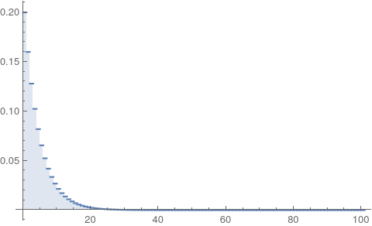

Slide 4
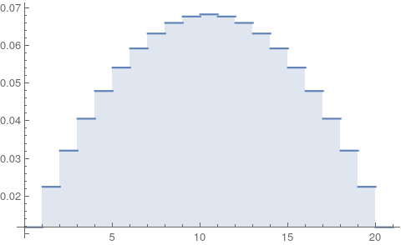

Slide 5
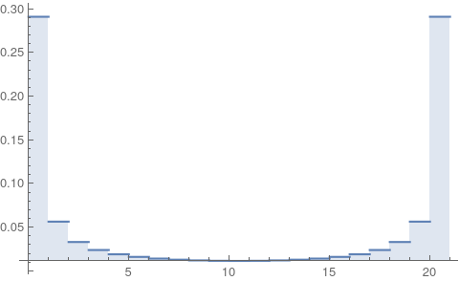
LOH

Slide 6
Wrong

Slide 8
00000000
00000010
00000010
00001010

Slide 9
00000000
00000010
00000010
00001010

Slide 10
00000000
00000010
00000010
00001010

Slide 11
11111111
00000000
11111111
00000010
11111111
00000010
11110111
00001010

Slide 12
11111111
00000000
11111111
00000010
11111111
00000010
11110111
00001010

Slide 13
11111111
00000000
11111111
00000010
11111111
00000010
11110111
00001010

Slide 14
11111111
00000000
11111111
00000010
11111111
00000010
11110111
00001010

Slide 15
11111111
00000000
11111111
00000010
11111111
00000010
11110111
00001010

Slide 16
Improve Clonealign by modifying the likelihood based on the multiplicity
Infer the effectiveness caused by a subset of mutations

