Slide 1
Prepoznavanje objekata pomoću dubokih neuronskih mreža

Slide 2
VGG16
AlexNet
ImageNet
3-layer CNN

Slide 3
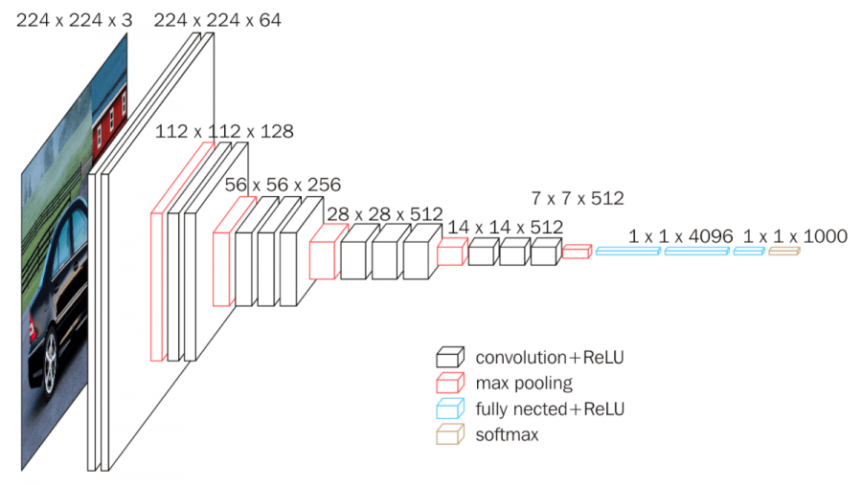

Slide 4
ResNet
NN with residual blocks
CIFAR-10 and ImageNet
Vanishing gradient problem - solved

Slide 5
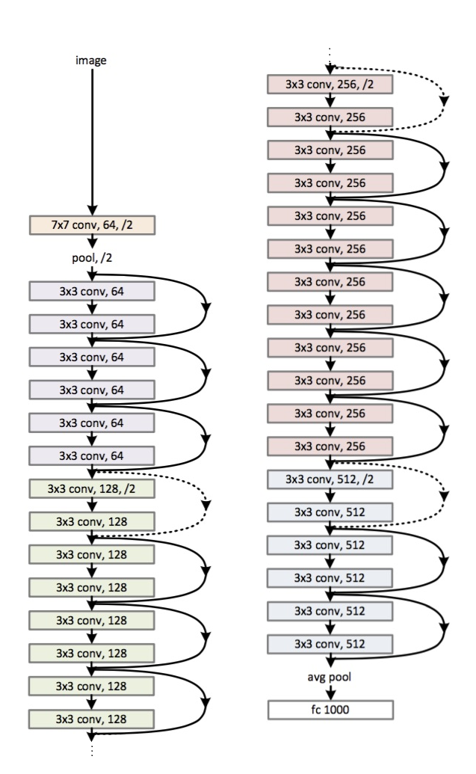

Slide 6
INCEPTION V3
Google, 3rd gen
ImageNet
Inception layers

Slide 7
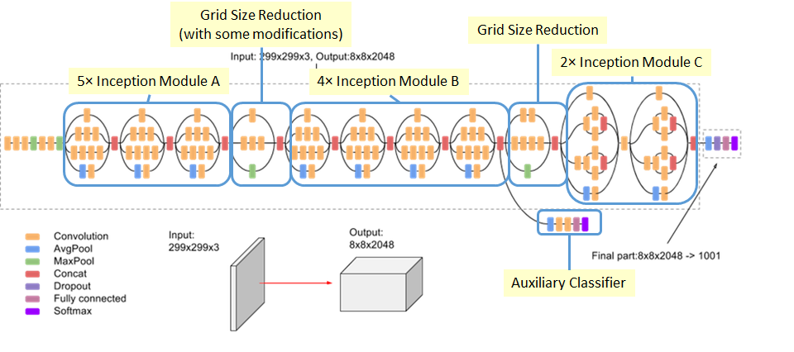

Slide 8
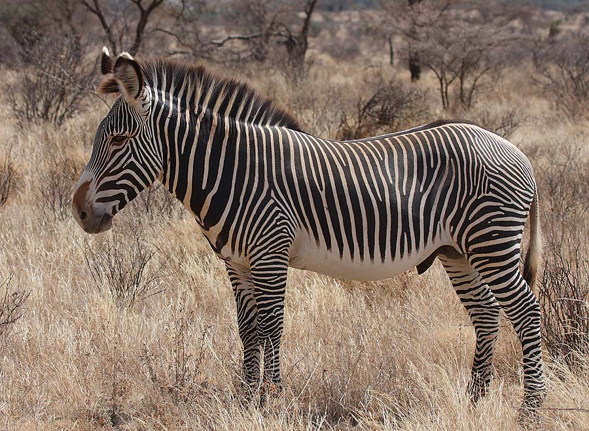
Examples
VGG16 – zebra (98.59%)
ResNet50 – zebra (99.81%)
InceptionV3 – zebra (96.47%)

Slide 9
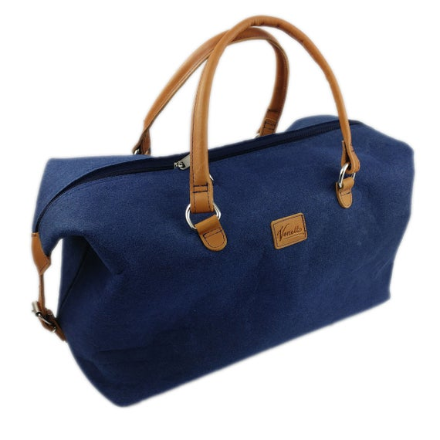
VGG16 – mailbag (40.21%)
ResNet50 – mailbag (76.83%)
InceptionV3 – purse (47.50%)

Slide 10
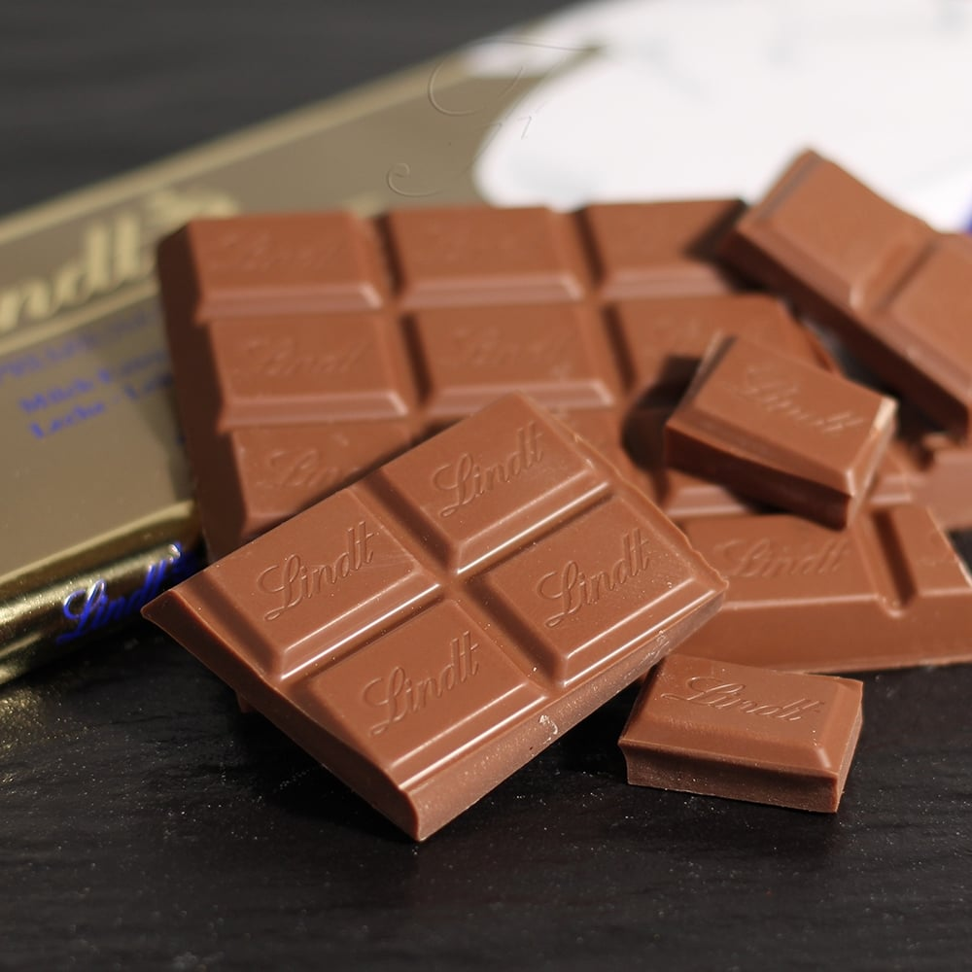
VGG16 – wool (21.18%)
ResNet50 – packet (29.36%)
InceptionV3 – butternut_squash (10.65%)

