Slide 1
Java 8 features

Slide 2
Agenda
Java 8 new features
Changes in Interfaces:
  Default methods
  Static methods
  Functional interfaces
Lambda expressions
Streams

Slide 3
Interfaces in Java 7
An Interface is like a Class, with no bodies in the methods. It may define constants (public static final) but no runtime variables.
Usually, an Interface is public.
An interface provides a standard way to access a class which could be implemented in many different ways.
The Java Tutorials:
“There are a number of situations in software engineering when it is important for disparate groups of programmers to agree to a ‘contract’ that spells out how their software interacts.”
“Each group should be able to write their code without any knowledge of how the other group's code is written.”
“Generally speaking, interfaces are such contracts.”

Slide 4
Implementations as contracts
A class which realizes an interface must provide an implementation of every method defined within the interface
A class may implement some additional methods (but these extra methods aren’t accessible through this interface)
Beware: adding another method to an existing Interface will “break” every current implementation of this Interface!
A class can implement many interfaces.
An Interface can extend other Interfaces.
Extension is the preferred way to add new methods to an Interface.
(Do you understand why?)
In Java, classes are less extendible than interfaces, because a Class can extend at most one other Class (“single inheritance”).
class MountainBike extends Bicycle { … }

Slide 5
Interfaces in Java 8
In Java 8, an interface may contain
default implementations of instance methods, and
implementations of static methods.
In any OO language, an interface
cannot be instantiated, and
defines a “contract” which any realization of the interface must fulfil.
Java is a strongly-typed language.
Java compilers can enforce contracts, by refusing to compile classes whose implementations might “partially realize” an interface.
Java is a tightly-specified language.
If a compiler allows instantiations of incompletely-implemented interfaces, then it is not a Java compiler.

Slide 6
Default Methods
Default methods are methods which are implemented in interface
Reasons to introduce default methods:
  To have backward compatibility with existing published interfaces and
  To add functionality to existing Collection interfaces
  To support lambda expressions with
Difference between interfaces with default methods and abstract classes:
  Abstract class can hold state of object. Abstract class can have constructors and member variables.
  Interfaces with default method cannot maintain state.

Slide 7
Java 8 Interfaces

Slide 8
Static Methods in Interfaces
Java 7 and earlier prohibited static methods in interfaces. Java 8 now allows this
Motivation
  Seems natural to put operations related to the general type in the interface
  Does not violate the "spirit" of interfaces
  Shape.sumAreas(arrayOfShapes);
Notes
  You must use interface name in the method call, even from code within a class that
implements the interface
Shape.sumAreas, not sumAreas
  The static methods cannot manipulate static variables
  Java 8 interfaces continue to prohibit mutable fields

Slide 9
Example from OOP Section
Goal
Want to be able to make mixed collections of Circle, Square, etc.
Standard solution
  Define Shape interface and have Circle, Square, etc. implement it
Goal
  Want to be able to sum up the areas of an array of mixed Shapes
Standard solution
  Put abstract getArea method in the interface, define it in the classes
  Make static method that takes a Shape[] and sums the areas
Java 8 twist
  Put static method directly in Shape instead of in a utility class as would have been done in Java 7

Slide 10
Functional Interfaces
Design decision: Java 8 lambdas are assigned to functional interfaces.
A functional interface is a Java interface with exactly one non-default method. E.g.,
public interface Consumer<T> {
void accept(T t);
}
The package java.util.function defines many new useful functional interfaces.
Notes:
Functional interfaces are a common idiom in Java code.
Examples of existing JDK functional interfaces: Runnable, Comparable<T>, Callable<V>.
Design decision: Java 8 lambdas should work with existing Java code without requiring recompilation.

Slide 11
4 categories of Functional Interfaces
Functional Interface archetypes | Example used in
Consumer | forEach(Consumer), peek(Consumer)
Predicate | filter(Predicate)
Function | map(Function)
Supplier | reduce(Supplier) collect(Supplier)

Slide 12
Location of Functional Interfaces
You may define your own “Functional Interfaces”
Java8 defines many in: java.util.function.*
43 interfaces in 4 categories, such as Function, Supplier, Consumer, Predicate.

Slide 13
Lambdas

Slide 14
Imperative versus Declarative
Imperative: is a style of programming where you program the algorithm with control flow and explicit steps. Think pseudocode algorithm with branching and looping logic.
  Object-oriented programming is a Imperative programming paradigm based on the concept of "objects", which may contain data, in fields or attributes; and code, in the form of procedures or methods.
Declarative: is a style of programming where you declare what needs be done without concern for the control flow.
  Functional programming: is a declarative programming paradigm that treats computation as a series of functions and avoids state and mutable data to facilitate concurrency an in particular parallelism.

Slide 15
Behavior Parameterization
What is the problem with a “STRICTLY” object-oriented programming language?
Everything is either a primitive or an object.
What's good about the OO paradigm?
OO is extremely powerful. It affords inheritence, polymorphism, and reflection….however...
Strict OO forces you to think in terms of Objects living on the heap and your code is highly imperative (branching and explicit looping).
OO was a great leap forward from procedural programming.
OO is not going to be replaced any time soon. It's way too powerful. Rather it will live alongside functional programming.

Slide 16
What is Functional Programming?
A style of programming that treats computation as the evaluation of mathematical functions
Eliminates side effects
Treats data as being immutable
Expressions have referential transparency – this reference will do this and this only.
Functions can take functions as arguments and return functions as results
Prefers recursion over explicit for-loops

Slide 17
Why do Functional Programming?
Allows us to write easier-to-understand, more declarative, more concise programs than imperative programming
Allows us to focus on the problem rather than the code
Facilitates parallelism

Slide 18
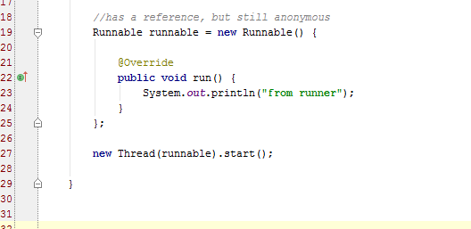
Anon (inner) classes
The way Java deal with “functional” programming prior to Java8.

Slide 19
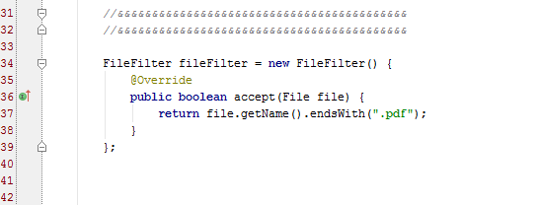
Another example of anon class

Slide 20
Lambda expressions
A more brief and clearly expressive way to implement functional interfaces
The lambda calculus was introduced in the 1930s by Alonzo Church as a mathematical system for defining computable functions.
The lambda calculus serves as the computational model underlying functional programming languages such as Prolog, Lisp, Haskell, Scheme, Ocaml, etc.
Features from the lambda calculus such as lambda expressions have been incorporated into many widely used programming languages like C++ and now very recently Java 8.
Functions are now first-class citizens
Store a method in a Lambda for deferred execution.
Lambdas are not objects (reflection and “this” do not work

Slide 21
Syntax of Java 8 Lambdas
A Java 8 lambda is basically a method in Java without a declaration usually written as (parameters) -> { body }. Examples,
(int x, int y) -> { return x + y; }
x -> x * x
( ) -> x
A lambda can have zero or more parameters separated by commas and their type can be explicitly declared or inferred from the context.
Parenthesis are not needed around a single parameter.
( ) is used to denote zero parameters.
The body can contain zero or more statements.
Braces are not needed around a single-statement body.

Slide 22
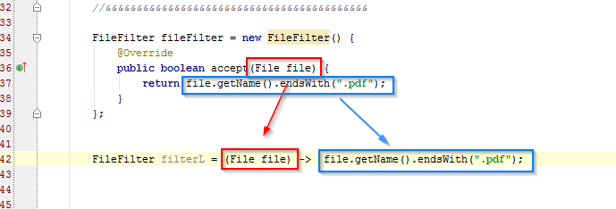
Lambda expression example

Slide 23
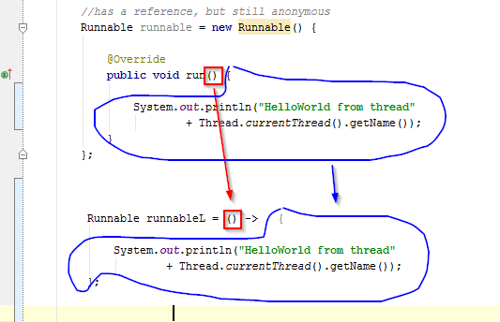
Another Lambda example

Slide 24
The “Type” of Lambda Expression
The java ‘Type’ of a lamba expression is a “Functional Interface”
Functional Interface is an interface with exactly ONE non-default, non-overriding method.
A Lambda can NOT use reflection as it is NOT an object.
A lambda can not use the “this” keyword as it is NOT an object.
Much like instance methods, a lambda does not live on the heap.

Slide 25
Lambda Expression
The concept of “Functional Interface” is new, but many of the interfaces in Java7 and before are “functional interfaces” such as Runnable, Comparable, etc.
Older (Java7 and earlier) interfaces have been decorated with default methods to preserve backwards compatibility

Slide 26
Can I store a Lamba Expression in a variable in Java?
Yes!
Wherever a method requires an anonymous inner class (with one method), you may put a lamba expression.
For example: Collections.sort(list, compL);
You may also use lambda expressions with Streams

Slide 27
Is a Lambda expression an Object?
Not really. It is an ‘object without identity’.
It does not inherit from Object and so you can’t call the .equals(), .hashcode(), etc.
There is no ‘new’ keyword in lamba, so there is far less overhead both at compile- and run-time.
You can't use 'this' keyword to identify it using reflection.

Slide 28
The java.util.function.* library
Functional Interfaces:
Examine the SDK java.util.function
Consumers
Predicates
Suppliers
Functions
Numeric Performance Functional Interfaces
Operators
Notes:
Functional interfaces are a common idiom in Java code.
Examples of existing JDK functional interfaces: Runnable, Comparable<T>, Callable<V>.
Design decision: Java 8 lambdas should work with existing Java code without requiring recompilation.

Slide 29
Implementation of Java 8 Lambdas
The Java 8 compiler first converts a lambda expression into a function
It then calls the generated function
For example, x -> System.out.println(x) could be converted into a generated static function
public static void genName(Integer x) {
System.out.println(x);
}
Notes:
What type should be generated for this function? How should it be called?
What class should the translated lambda expression function be placed it?
Should the generated method be a static or an instance method?
The Java 8 designers spent a lot of time thinking about how to implement lambdas!

Slide 30
Method References
Method references can be used to pass an existing function in places where a lambda is expected
The signature of the referenced method needs to match the signature of the functional interface method

Slide 31
Summary of Method References
Method Reference Type | Syntax | Example
static | ClassName::StaticMethodName | String::valueOf
constructor | ClassName::new | ArrayList::new
specific object instance | objectReference::MethodName | x::toString
arbitrary object of a given type | ClassName::InstanceMethodName | Object::toString

Slide 32
Streams

Slide 33
What is a Stream
java.util.stream.Stream is sequence of elements supporting sequential and parallel aggregate operations.
It is a limitless iterator that allows you to process collections.
Streams are created on-demand and they are infinite.
You can chain operations. This chain is called a pipeline.
You must have at least one terminal operation and zero or more intermediary operations.
The pipeline usually takes the form of map-reduce pattern.
Any stream operation that returns a Stream<T> is an intermediate operation, and any object that returns void is terminal.
May be parallelized and optimized across cores.

Slide 34
Sequence of Elements
Sequence of elements— Like a collection, a stream provides an interface to a sequenced set of values of a specific element type. Because collections are data structures, they’re mostly about storing and accessing elements, but streams are also about expressing computations such as filter, sorted, and map.

Slide 35
What is NOT Stream
java.util.stream.Stream is NOT:
  java.io.InputStream — this abstract class is the superclass of all classes representing an input stream of bytes.
  java.io.OutputStream — this abstract class is the superclass of all classes representing an output stream of bytes

Slide 36
Data processing
Data processing — Streams support database-like operations and common operations
from functional programming languages to manipulate data, such as filter, map, reduce, find, match, sort, and so on.
Stream operations can be executed either sequentially or in parallel.

Slide 37
Pipelining
Pipelining— Many stream operations return a stream themselves, allowing operations to be chained and form a larger pipeline. This enables certain optimizations such as laziness and short-circuiting. A pipeline of operations can be viewed as a database-like query on the data source.

Slide 38
A Stream Pipeline
A stream pipeline has three components:
  A source such as a Collection, an array, a generator function, or an IO channel;
  Zero or more intermediate operations; and
  A terminal operation

Slide 39
Source
Source— Streams consume from a data-providing source such as collections, arrays, or I/O resources.
Note that generating a stream from an ordered collection preserves the ordering. The elements of a stream coming from a list will have the same order as the list.

Slide 40

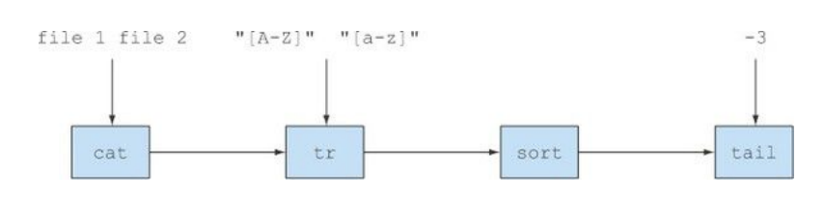
Streams are like Unix pipes
$ cat a.txt b.txt | tr "[a-z]" "[A-Z]" | sort | tail -3

Slide 41
Stream Operations
An intermediate operation keeps a stream open for further operations. Intermediate operations are lazy.
A terminal operation must be the final operation on a stream. Once a terminal operation is invoked, the stream is consumed and is no longer usable.

Slide 42
Intermediary operation
Intermediary operation: A method that takes a Stream and returns a Stream.
They are lazily loaded and will only be executed if you include a terminal operation at the end.
  peek returns a stream consisting of the elements of this stream, allowing to do action on each element and consume it.
  filter excludes all elements that don’t match a Predicate.
  map performs a one-to-one transformation of elements using a Function.

Slide 43
Terminal operation
Terminal operation: A method that takes a Stream<T> and returns void.
They are eagerly loaded and will cause the entire pipeline to be executed.
A terminal operation will “spend” the stream.
  forEach performs an action for each element of this stream.
  count returns the count of elements in this stream.
  max returns the maximum element of this stream according to the provided Comparator
  collect performs a mutable reduction operation on the elements of this stream using a Collector
  reduce performs a reduction on the elements of this stream, using an associative accumulation function, and returns an Optional describing the reduced value, if any.

Slide 44
Iteration
Internal iteration— In contrast to collections, which are iterated explicitly using an iterator,
stream operations do the iteration behind the scenes for you.
Streams are consumed. You can iterate over them only once.
You can get a new stream from the initial data source to traverse it again just like for an iterator (assuming it’s a repeatable source like a collection;
  if it’s an I/O channel, you’re out of luck.

Slide 45
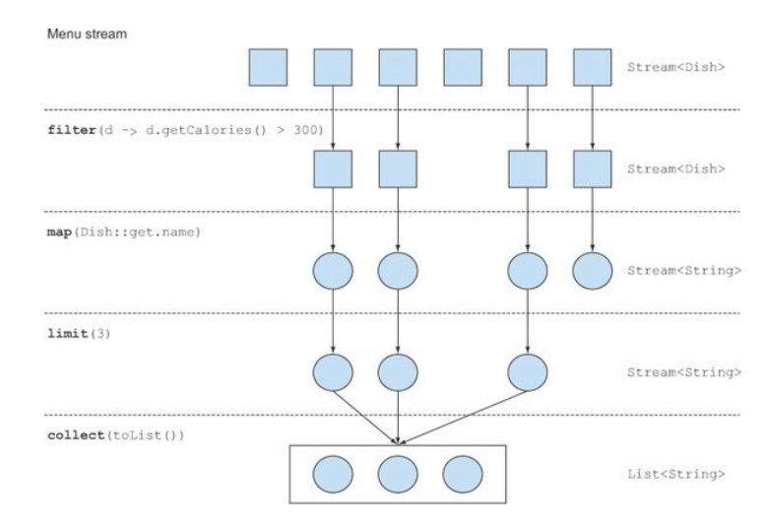
Typical operations

Slide 46
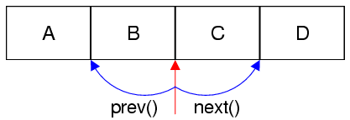
Iterator

Slide 47
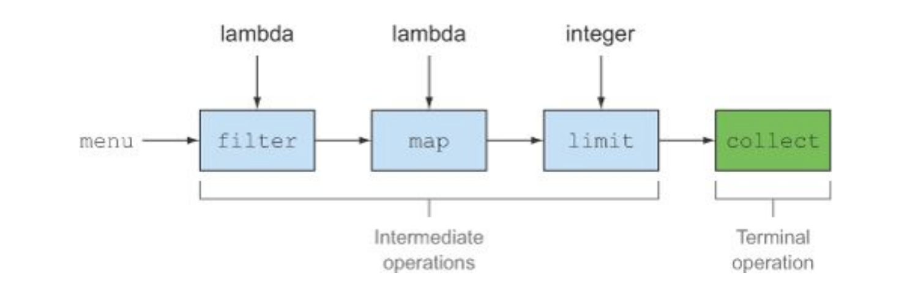
Intermediate versus Terminal ops
Only the terminal operation can consume the stream which is done in a lazy manner – or on-demand.

Slide 48
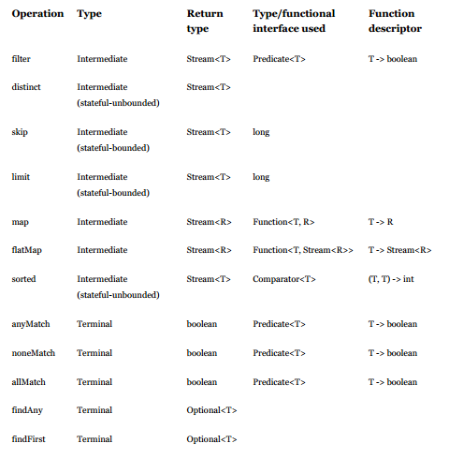
Table of ops

Slide 49
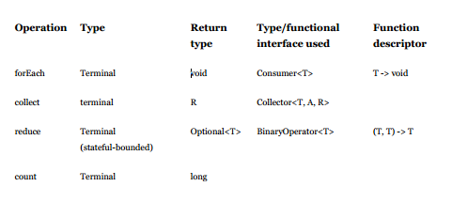
Table of ops (cont)

Slide 50
Stream Example
int sum = widgets.stream()
.filter(w -> w.getColor() == RED)
.mapToInt(w -> w.getWeight())
.sum();
Here, widgets is a Collection<Widget>. We create a stream of Widget objects via Collection.stream(), filter it to produce a stream containing only the red widgets, and then transform it into a stream of int values representing the weight of each red widget. Then this stream is summed to produce a total weight.

Slide 51
Map-Reduce example
List<Integer> list = Arrays.asList(1,2,3);
int sum = list.stream().map(x -> x*x).reduce((x,y) -> x + y).get();
System.out.println(sum);
Here map(x -> x*x) squares each element and then reduce((x,y) -> x + y) reduces all elements into a single number

Slide 52
References
The Java Tutorial
  http://docs.oracle.com/javase/tutorial/java/index.html
Lambda Expressions
  http://docs.oracle.com/javase/tutorial/java/javaOO/lambdaexpressions.html
Stream API
  http://download.java.net/jdk8/docs/api/java/util/stream/Stream.html
Java 8 Explained: Applying Lambdas to Java Collections
  http://zeroturnaround.com/rebellabs/java-8-explained-applying-lambdas-to-java-collections/
Java 8 first steps with Lambdas and Streams
  https://blog.codecentric.de/en/2013/10/java-8-first-steps-lambdas-streams/
Java 8Tutorial: Lambda Expressions, Streams, and More
  http://www.coreservlets.com/java-8-tutorial/

