Slide 1
ONENIAGA
One business.
One dashboard.
Every platform.
SHOPEE
TIKTOK SHOP
OneNiaga gives Malaysian multi-platform sellers one clear place to manage what matters today.
LAZADA
ONE VIEW
Tan Qian Hui · Cheong Jiahui · Laila Suhaila
AI for Tech Venture · Investor Demo Day
Notes:
Open with the operational promise. The three marketplace blocks converge into one view—this is the product idea before any feature explanation.
[Sources]
User-provided OneNiaga pitch deck and design reference.
[/Sources]

Slide 2
OPPORTUNITY & VALUE
02
One product becomes three sources of truth
01
02
03
04
ONE PRODUCT
3 SELLER CENTRES
MANUAL UPDATES
NUMBERS DRIFT
Same item
Shopee · Lazada · TikTok
Stock · orders · listings
Stockouts · missed orders
Sellers spend their time reconciling—buyers experience the mistake.
THE OPPORTUNITY
5/9
thought identical listings
looked like different products
9/9
would hesitate or
abandon the purchase
Replace four manual steps
with one trusted number.
OneNiaga · SAIA2183 Investor Demo Day
2
Notes:
Walk left to right. The problem is not that sellers lack tools; it is that every platform holds a separate version of the same product. The buyer experiment is directional evidence only (n=9), not a market-wide claim.
[Sources]
Buyer experiment results supplied in the user-provided OneNiaga pitch deck (n=9 general shoppers).
[/Sources]

Slide 3
SOLUTION & TECHNOLOGY
03
One workflow turns scattered data into a next action
01
02
03
04
CONNECT
AUTOMATE
ANALYZE
ADVISE
Link every sales channel once.
Update listings with seller confirmation.
See sales, stock and orders together.
Act on the highest-priority issue first.
TODAY'S RANKED ACTION
Restock Matcha Clay Mask within 2 days.
ACT NOW
MVP scope: seller-confirmed publishing today · full API sync after platform access
OneNiaga · SAIA2183 Investor Demo Day
3
Notes:
The technology story is deliberately simple: connectivity is the foundation, automation reduces repetitive work, analysis creates one business view, and advice ranks the next action. Be explicit that MVP publishing remains seller-confirmed because marketplace write access is restricted. Full API sync is Phase 2.
[Sources]
Product workflow and technical scope supplied in the user-provided OneNiaga pitch deck; seller interview insight attributed there to Jessie, ERP operator.
[/Sources]

Slide 4
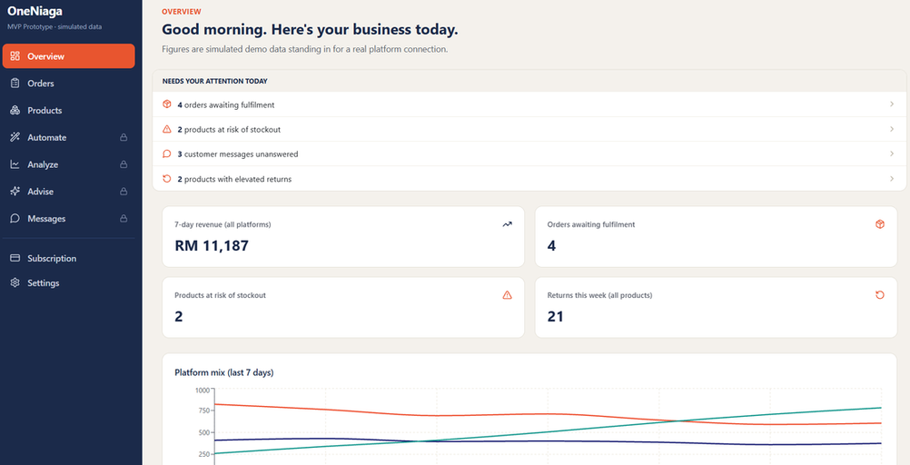
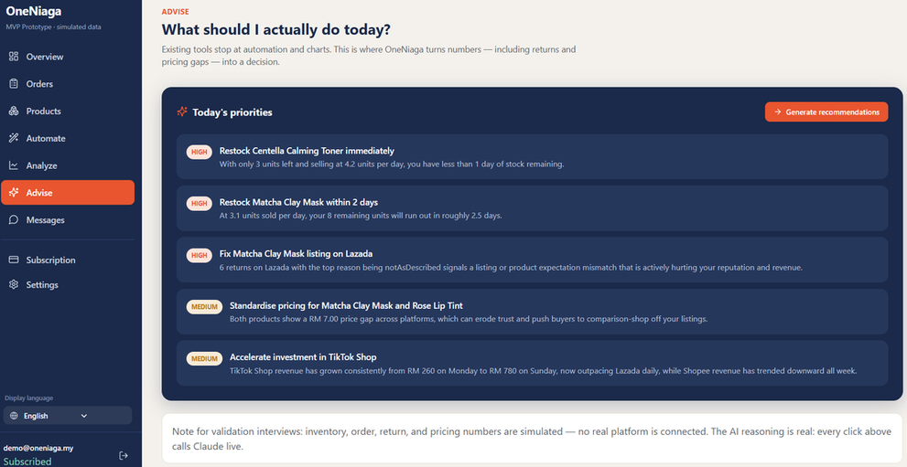
PRODUCT
04
The prototype makes the morning decision obvious
OVERVIEW
ADVISE
What needs attention today
What the seller should do next
CONNECT ONCE
SEE ONE BUSINESS
ACT WITH CONFIDENCE
LIVE PROTOTYPE
OneNiaga · SAIA2183 Investor Demo Day
4
Notes:
Demonstrate only two screens. Start with Overview: the seller sees urgent work without opening three seller centres. Then move to Advise: OneNiaga turns the same data into a ranked recommendation. Connections and business data are simulated; AI responses are generated live, not scripted.
[Sources]
Prototype screenshots extracted from the user-provided OneNiaga pitch deck.
[/Sources]

