Slide 1
MU Housing
Process of Database Design
BY:
Daniel Y. Patrick
Lauren Vaughn

Slide 2
Conceptual Database
Database Analysis
Business Rules
Response Time
Conceptual Data Model (ER)
Identification of Relations

Slide 3
Business Rules
organizational policy, calculations, regulations, and other constraints
Example:
1. A student is assigned to exactly one adviser.
2. An adviser is assigned to at least one student.

Slide 4

Response Time
“Time is Money”
Information is readily accessible.
No more than 10 seconds to query requests

Slide 5

Conceptual Data Model (ER)
Identify entity types (i.e. StudentInfo, NOK, etc..)
ER Model using Visual Paradigm

Slide 6
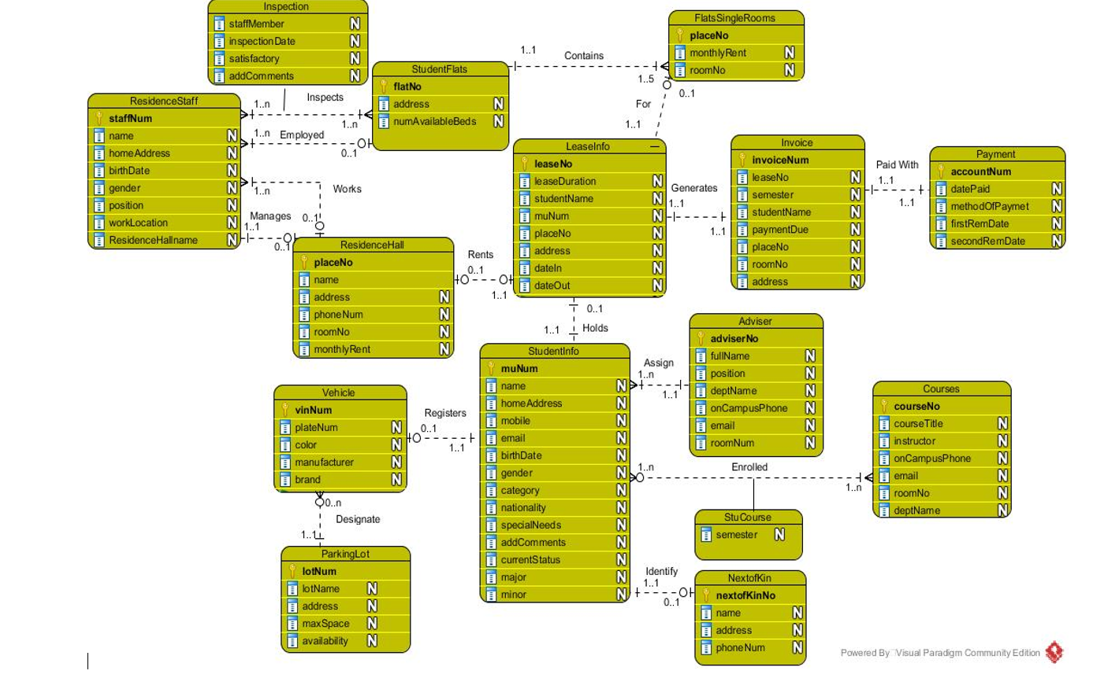
Logical Database
ER Model
Identify Entities
Identify attributes

Slide 7
Attributes
Identify Attributes
Define datatype
Define purpose
Identify primary key
Identify foreign key(s)

Slide 8
Validation of Relations
Given a Query, Output Result
Example:
Query: Present a report listing the Manager’s name and telephone number for each hall of residence.
Given: Residence Hall(s), retrieve the name and telephone number for each manager
Relations: Hall (hallNO, staffNo, hallName, phoneNumber)
Staff (staffNo, position)

Slide 9
Physical Database
Determine data types for all attributes.
INT, CHAR, VARCHAR
Determine index attributes.
“when to index?”
40% disk-space
Calculate overall database size.
34MB (million bytes).

Slide 10

Connecting MySQL with Java
Created database in Command Line Client
Connect Eclipse to MySQL Server
Created menu method to execute queries
Execute MU Housing Program

