Slide 1

ELEV8TIDE
ADVANCED WELLNESS & PERFORMANCE
The Growth
System.
How a luxury wellness brand becomes an
automated client-acquisition machine.

Slide 2

THE OPPORTUNITY
You built
the brand.
Now let's build
the machine.
02

Slide 3
THE BUILD
Five phases. One engine.
1
2
3
4
5
The Funnel
Email + SMS
Paid Ads
AI Agents
Automation
A luxury page that captures every lead.
Automated nurture that warms leads to buyers.
Targeted traffic from affluent buyers.
A 24/7 concierge that answers & books.
The whole engine, running itself.
03

Slide 4

01
PHASE ONE · LIVE NOW
The luxury
front door.
A high-end landing page that captures every visitor's
name, email & phone. Already built — sample is live.
VIEW THE LIVE SAMPLE
04

Slide 5

02
PHASE TWO
Follow up,
automatically.
Welcome series + SMS that nurture every lead the
moment they join. 98% of texts get opened.
EMAIL + SMS
05

Slide 6

03
PHASE THREE
Fuel the
fire.
Targeted Meta & Google ads that put ELEV8TIDE
in front of the exact luxury buyer — at scale.
PAID ADS
06

Slide 7
04
PHASE FOUR
A concierge
that never sleeps.
An AI team in the ELEV8TIDE voice — answering DMs,
qualifying leads and booking calls 24/7.
AI AGENTS
07

Slide 8
PHASE FIVE
The complete engine.
Every piece connected — running itself.
Ads
→
Funnel
→
Nurture
→
Book
→
Follow-up
One dashboard. Full visibility. A business that grows without adding hours.
08

Slide 9
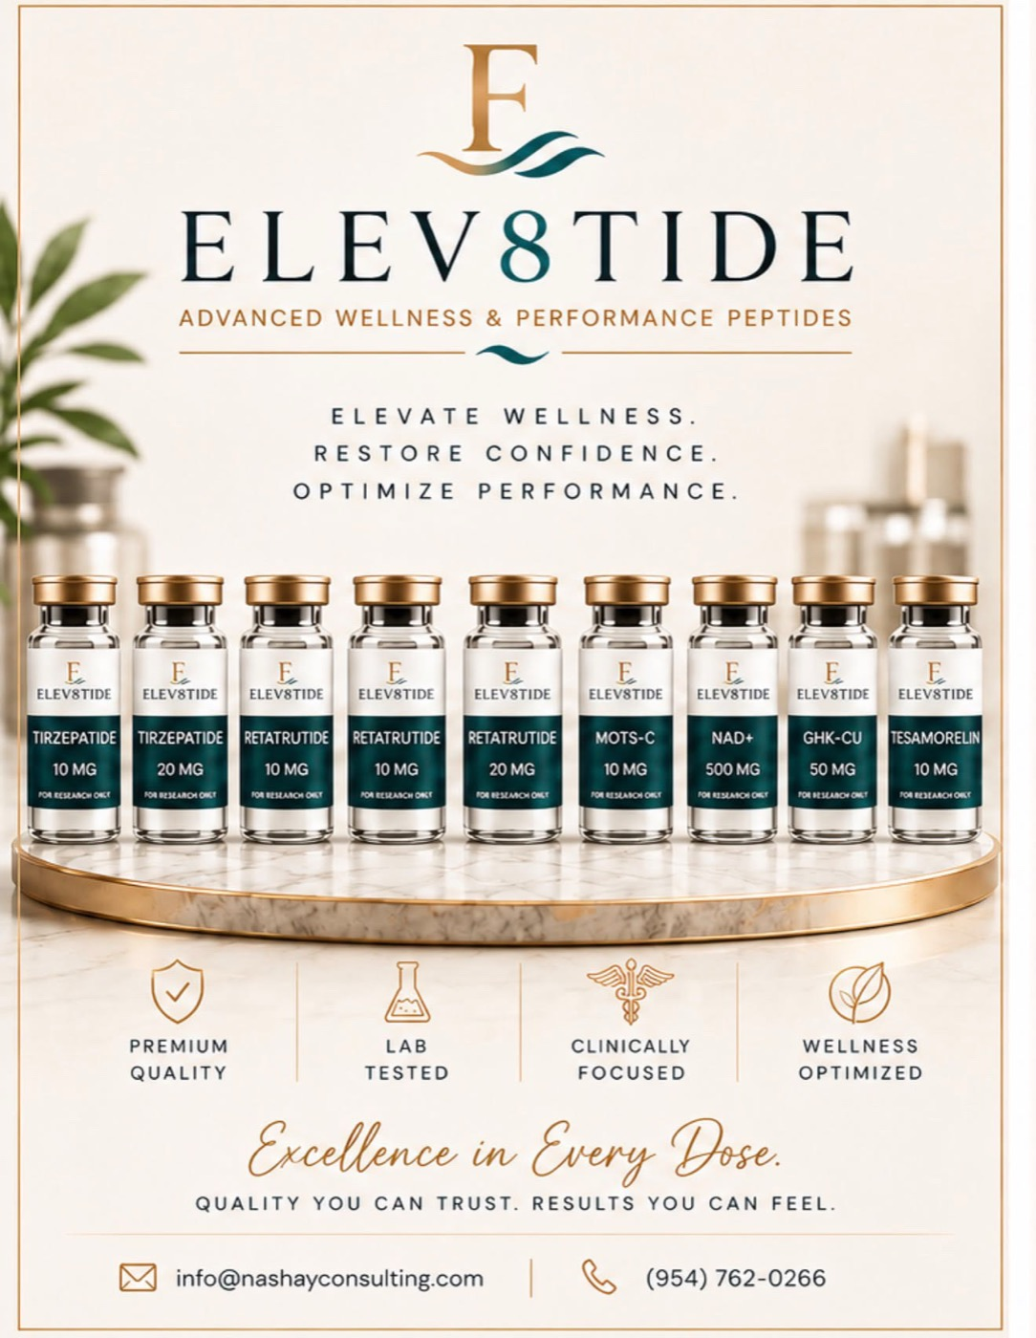
THE POSSIBILITY
Your product line,
elevated.
The same system can showcase the full
ELEV8TIDE catalog — premium, lab-tested,
clinically focused — and turn interest
into orders automatically.
09

Slide 10

THE STANDARD
A brand that feels
like a private club.
Discretion, design and care in every touchpoint —
online exactly as it feels in person.
10

Slide 11
INVESTMENT
Choose your tide.
Start where it makes sense. Each tier unlocks — and pays for — the next.
MOST POPULAR
LAUNCH
GROWTH
ELITE
The Front Door
The Engine
Full Autopilot
Funnel + lead capture
Funnel + email/SMS + ads
Everything + AI agents
✦ Luxury 1-page funnel
✦ Everything in Launch
✦ Everything in Growth
✦ Name / email / phone capture
✦ Email & SMS nurture
✦ 24/7 AI concierge
✦ Leads to your inbox
✦ Meta + Google ads
✦ End-to-end automation
✦ Mobile-optimized & live
✦ Monthly optimization
✦ Dedicated growth partner
Exact pricing scoped to ELEV8TIDE's goals — final numbers in the proposal.

Slide 12
ELEV8TIDE
YOUR NEXT CHAPTER STARTS HERE
Elevate. Restore.
Optimize.
Let's start with the front door — then scale from there.

