Slide 1
Visualization Tools For Webcam Scenes
A Masters Project by David Ross
Friday, May 24, 2009
With slides by Nathan Jacobs and Robert Pless

Slide 2
Overview

Slide 3
Introduction

Slide 4
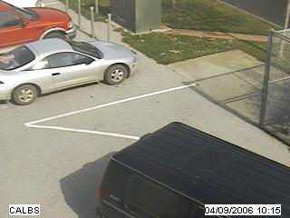
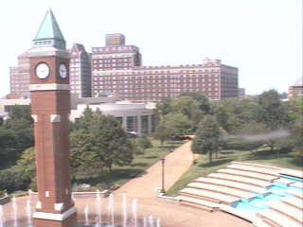
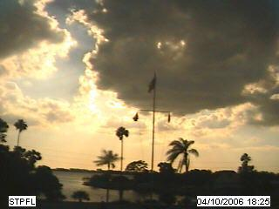
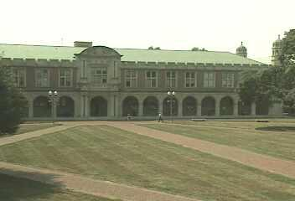
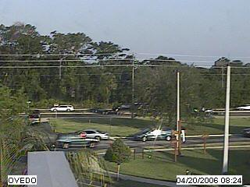
AMOS Dataset
The Archive of Many Outdoor Scenes (AMOS)
Images from ~1000 static webcams,
Every 30 minutes since March 2006.
http://amos.cse.wustl.edu
Capture variations from fixed cameras
Due to lighting (time of day), and
Seasonal and weather variations (over a year).
From cameras mostly in the USA (a few elsewhere).

Slide 5
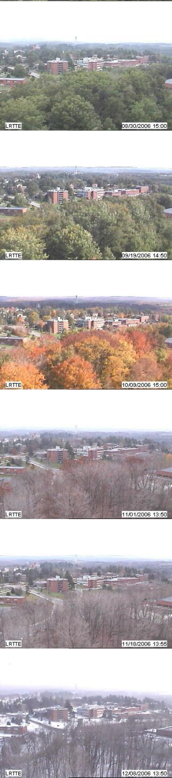
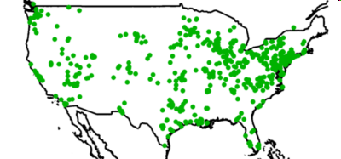
AMOS Dataset
3000 webcams
x 1 years
35 million images
Variations
over a year and over a day

Slide 6
The Project
Have many webcams, want interesting variants
Too many to go through manually
PCA learns consistent variation
PCA error => interesting variation… (interesting == inconsistent?)

Slide 7
Principal Component Analysis
M = U S V^{T}

Slide 8
PCA Math
Principle component analysis.
Images are in a 3D matrix I(x,y,t).
Change that matrix into a data matrix D(p,t), listing the pixel values in each frame.
Do the “SVD” decomposition:
D = U S V
Frame 2 coefficients.
Frame 1 coefficients.
D
U
S
V
coefficients
=
Images
Basis Images
Notes:
Key points: describe pca. Show the coefficients. Show how to compute the residual.

Slide 9
D
U
S
V
=
S is a diagonal matrix, so it only has diagonal elements, called singular values.
These numbers are the relative importance of each of the principle components.
If we want we can make the principle components be the columns of U * S, and have the columns of V be the coefficients.
Alternatively, we can keep the columns of U, and make the coefficients be S * the columns of V. This is more common.

Slide 10
D
U
S
V
coefficients.
=
Images
Basis Images
Special properties:
U,V are both orthonormal matrices.
This is cool:
Given a new image W, to get its coefficients v_{w}, you can use:
v_{w}=U^{T}W
Then U v_{w} approximately reconstructs W. Why?
U v_{w}
= U (U^{T}W)
= (U U^{T})W
= I W
= W.

Slide 11
D
U
S
V
coefficients
=
Basis Images
These coefficients define the appearance of the image.
The U matrix defines the space of possible images within this video.
Given a new set of coefficients ( a new column of V ), we can make a new image.
New image = U v
(this will give us a column vector of the pixel values…
you have to rearrange it into the shape of the image).
Given a new image W we can find its coefficients
v = U>W

Slide 12
PCA Math – Going back to slide 1
Principle component analysis.
Images are in a 3D matrix I(x,y,t).
Change that matrix into a data matrix D(p,t), listing the pixel values in each frame.
Do the “SVD” decomposition:
D = U S V
Frame 2 coefficients.
Frame 1 coefficients.
D
U
S
V
coefficients
=
Images
Basis Images

Slide 13
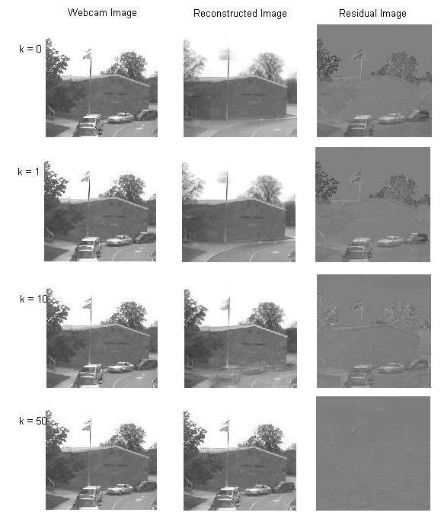
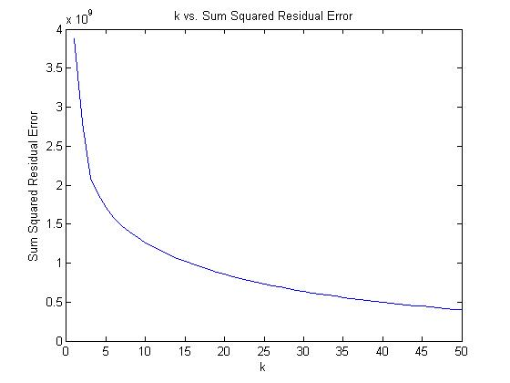
PCA – dependence on k (189 images)
Notes:
Projected should read “reconstructed”.
Why does error go up?!
(incremental PCA does not guarantee orthogonal bases). (check if you recompute v matrix).

Slide 14
Incremental PCA
Too many images to fit into memory at once
At each step,

Slide 15
But what do we take PCA of?
Daytime images
Sky Mask
Gradient Magnitude Images

Slide 16
Daytime Images
Could take PCA of the entire set of images from one camera

Slide 17
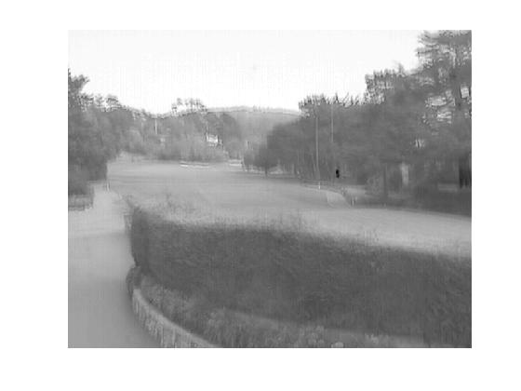
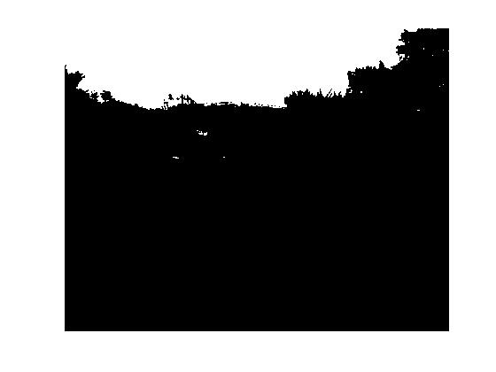
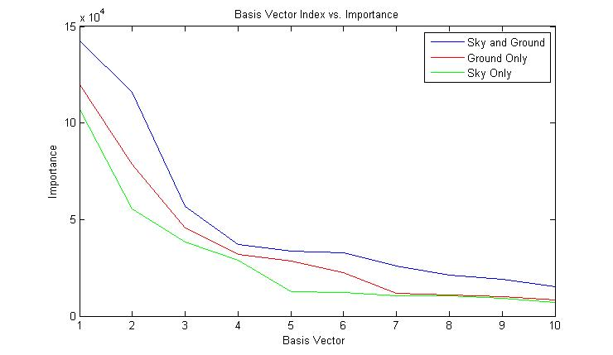
Sky Mask

Slide 18
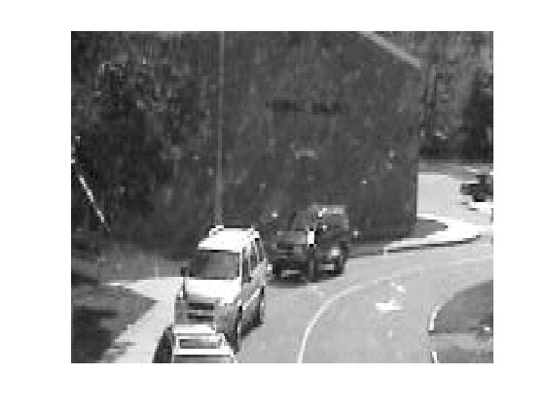
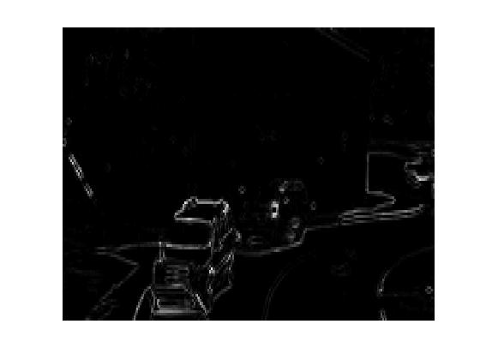
Gradient Magnitude Images

Slide 19
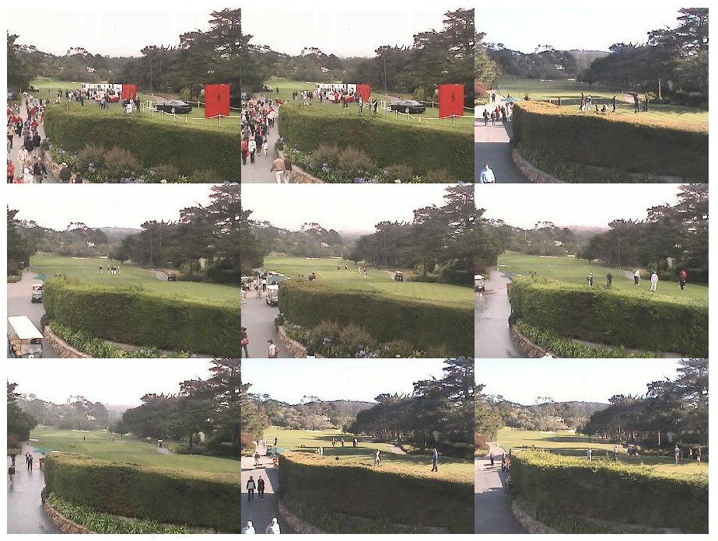
How do we display results?
Image montage (image here)
Well-Separated Set Montage
2D GUI

Slide 20
Well-Separated Set

Slide 21
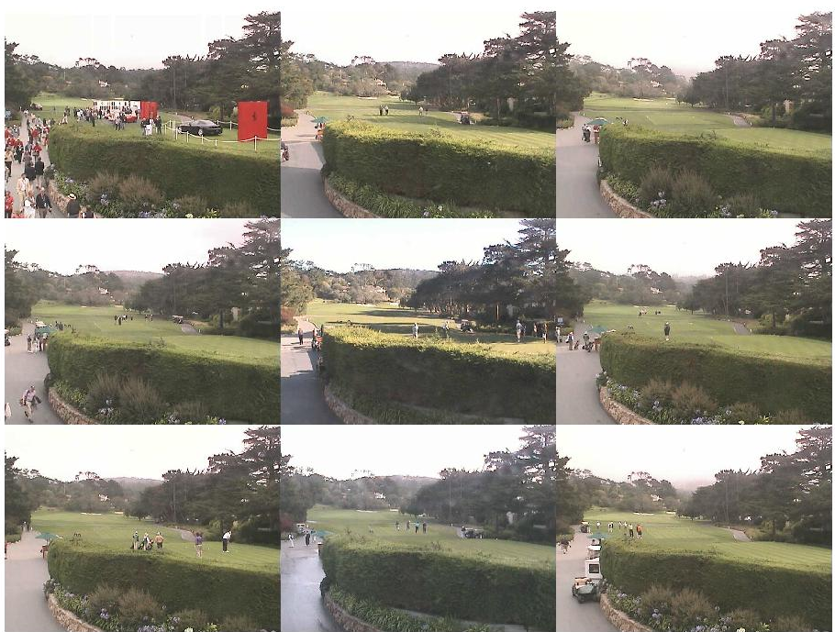

Slide 22
How do we evaluate images?
Coefficient Vector Magnitude
Reconstruction Error
Variance Model
Statistics
Notes:
Here, need to talk to the desire to understand images by their relationship to the PCA basis.

Slide 23
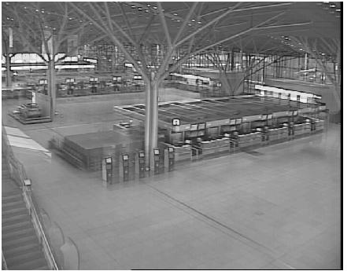
PCA Coefficient Vector Magnitude
D (:,x) ~= U S V(x,:)
S * V(x,:) is a vector of dimension k corresponding to the linear combination of U columns that best approximates D(:,x)
D is mean subtracted so
||SV(x,:)|| gives a measure of how far from the mean image is each image

Slide 24
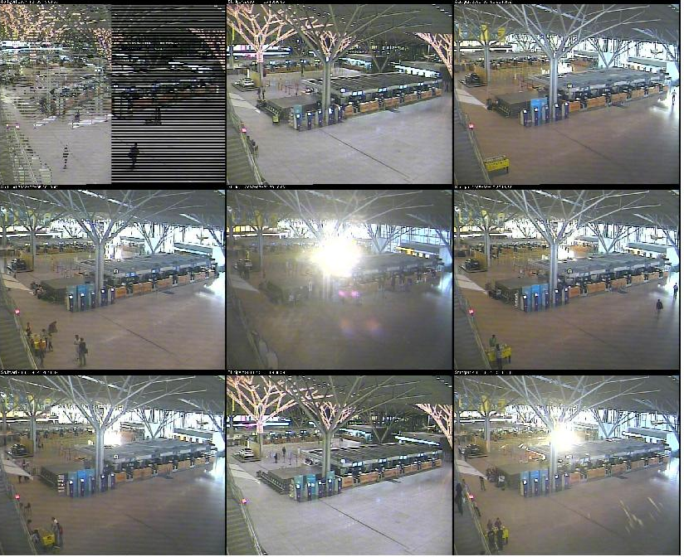

Slide 25
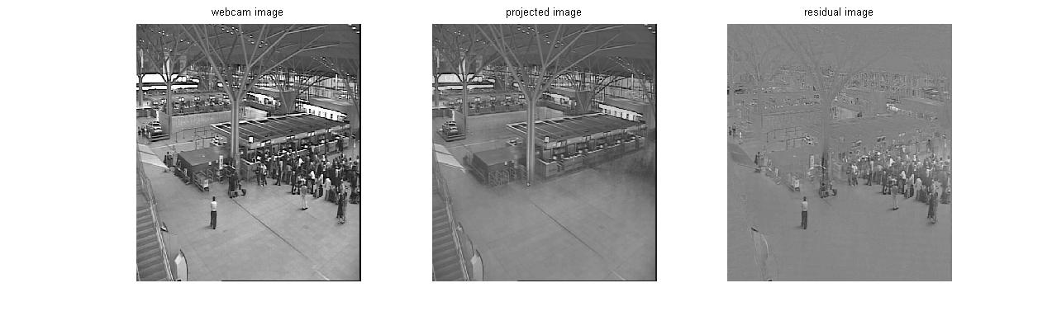
Residual Error

Slide 26
Variance Model
Can estimate the variance image of a scene by summing …

Slide 27
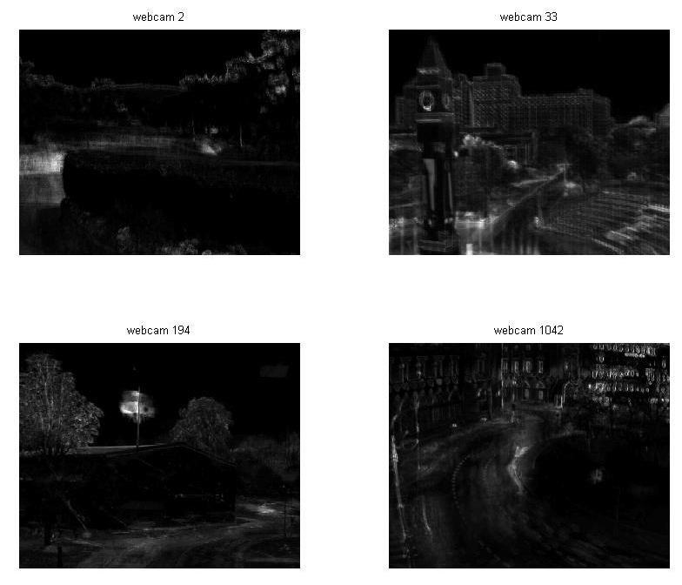

Slide 28
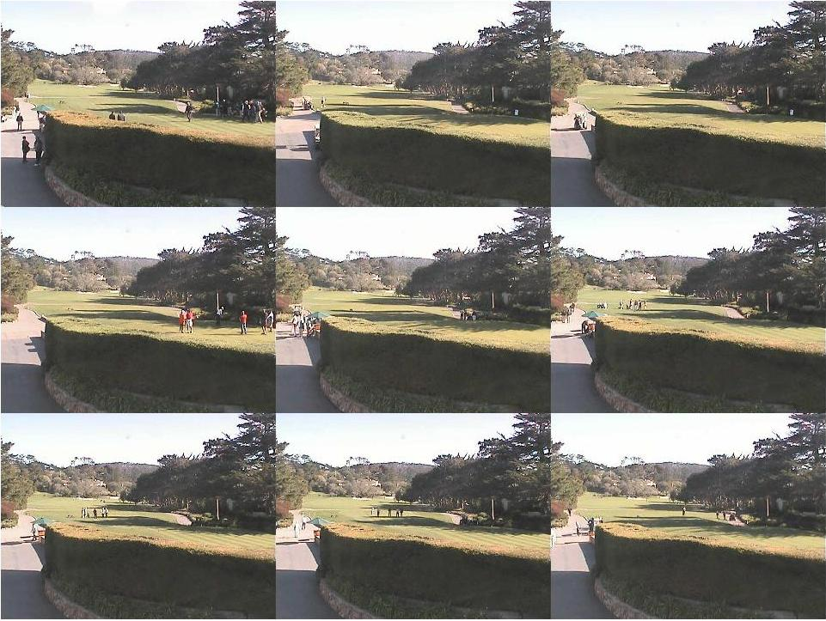
Z-score Image

Slide 29
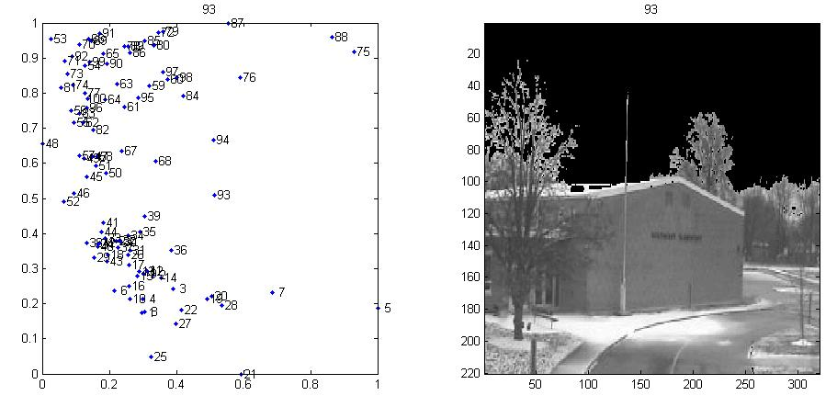
2D GUI

Slide 30
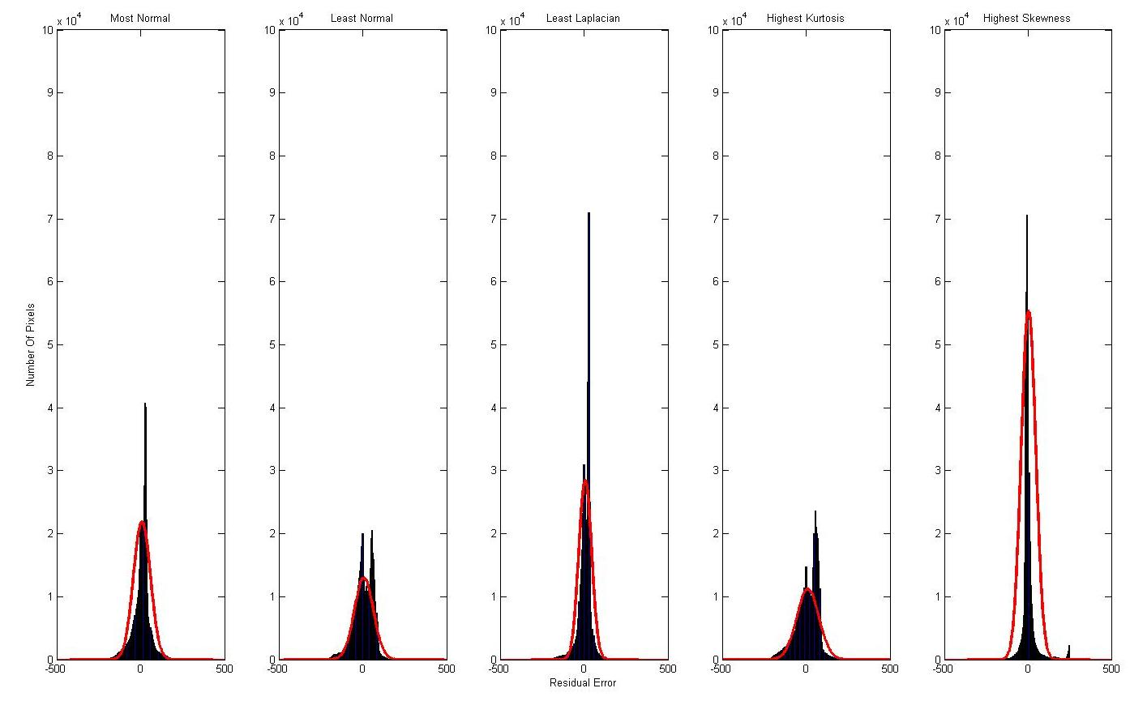
Statistical Distribution of Residual Images
Notes:
Where are those Gaussians?!
Scale by # pixels -> better results
-show the pictures + residuals (scaled so you can see errors (maybe show log(1+abs(resid))))

Slide 31
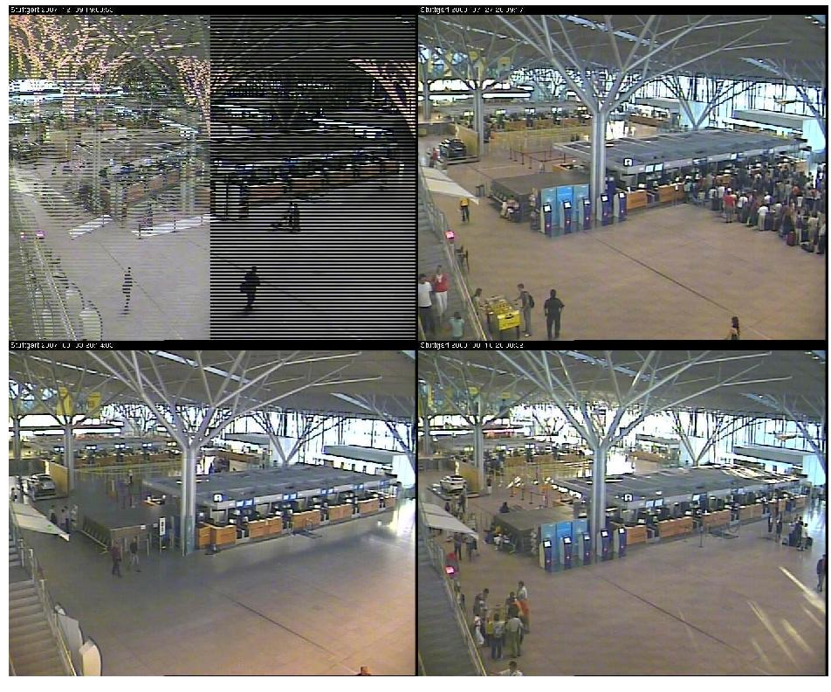
Normal Distribution

Slide 32
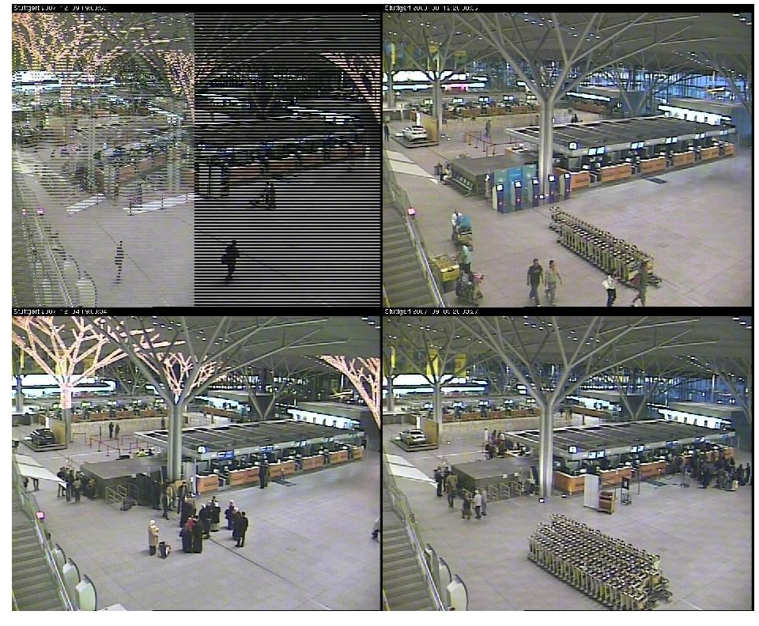
Laplacian Distribution

Slide 33
Bonus – Kurtosis and Skewness
Notes:
Show pictures sorted by both and say how it didn’t work
The effect of small objects is dominated by the noise in the (larger) rest of the image.

Slide 34
Future Work

Slide 35
Questions?

