Slide 1
Visualization Tools For
Webcam Scenes
A Masters Project by David Ross
Friday, May 24, 2009
With slides by Nathan Jacobs and Robert Pless

Slide 2
Acknowledgement
Advisor:
  Professor Robert Pless
Committee:
  Professor Tao Ju
  Professor Bill Smart
M&M Lab:
  Nathan Jacobs
  Michael Dixon
  and others

Slide 3
Overview
Introduction
  Webcams and the AMOS Dataset
  Problem Motivation
Principal Component Analysis (PCA)
Visualization Tools
  PCA Input
  Visualization
  Evaluations
Conclusion
Future Work

Slide 4
Introduction
Given a static webcam scene, how can we make it easier to understand the variation in the scene?
  Automatic visualization tools to quickly show interesting variation
Why? Help to maintain and understand massive AMOS Dataset
Use PCA to learn less interesting variation, analyze PCA error to find more interesting variation

Slide 5
“Interesting” Variation
Outdoor scenes vary naturally and predictably
  Day/night
  Weather
  Seasonal
Unnatural variation less predictable
  People, cars, other objects
  Camera/image variation
  Scene changes
To understand a scene is to understand the latter

Slide 6
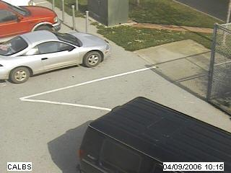
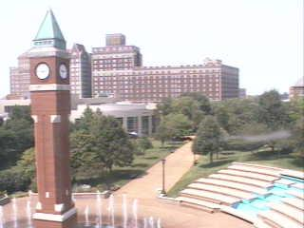
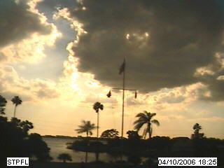
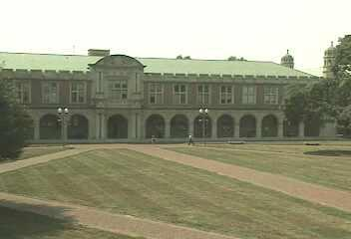
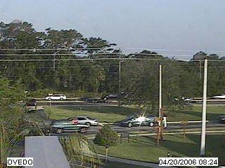
AMOS Dataset
The Archive of Many Outdoor Scenes (AMOS)
  Images from ~1000 static webcams,
  Every 30 minutes since March 2006.
  http://amos.cse.wustl.edu
Capture variations from fixed cameras
  Due to lighting (time of day), and
  Seasonal and weather variations (over a year).
  From cameras mostly in the USA (a few elsewhere).

Slide 7
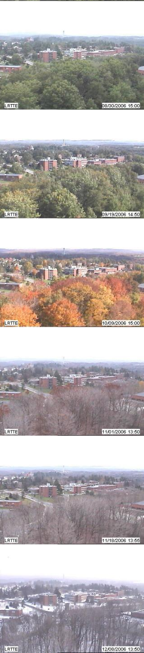
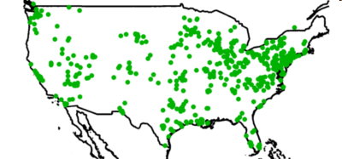
AMOS Dataset
3000 webcams
x 1 years
35 million images
Variations
over a year and over a day

Slide 8
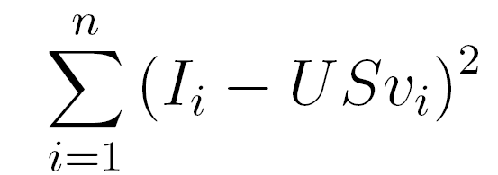
Principal Component Analysis (PCA)
PCA is a method used to extract the most significant features from given dataset
Given a set of images I and a number k>0, finds the k most important features in the set of images
[U S V] = PCA(I,k)
  U contains the k feature, or basis, images, all of which are orthogonal to each other
  S is a diagonal matrix which contains the weights of each feature vector
  V contains the coefficients of each basis image for each actual image
Will extract the most significant features to minimize
Notes:
Another correlation technique used is PCA…
Decomposes images into U,S,V
Can represent each image by a few numbers

Slide 9
PCA
D
U
S
V
coefficients
=
Images
Basis Images
We can reconstruct image x as a linear combination of the basis images: i_{x}=USv_{x}
Reconstructed images will not exactly match the original images
  Similarity increases as we increase the number of coefficients k
Given a new image W we can find its coefficients
  v = U^{T}W
Residual Image or reconstruction error
  I_{residual} = (I – I_{mean} ) – I_{recontsructed}
Notes:
Further explanation

Slide 10
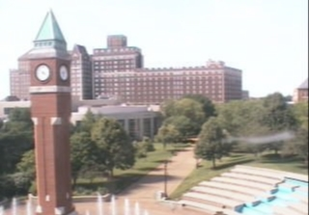
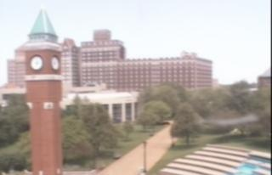
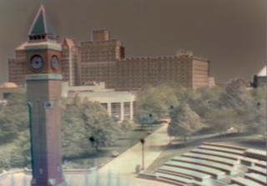
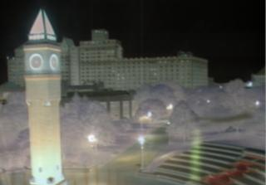
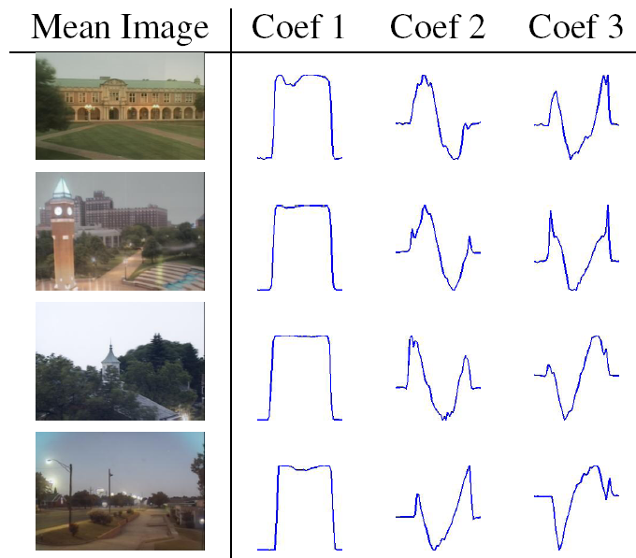
= + f₁(t) + f₂(t) + ...
mean Image
component 1
component 2
Camera 1
Camera 2
Camera 3
Camera 4
Notes:
Visual example. See day/night, dawn/dusk. Keep?? Shows why we cannot use images from entire day, localize to certain range of hours

Slide 11
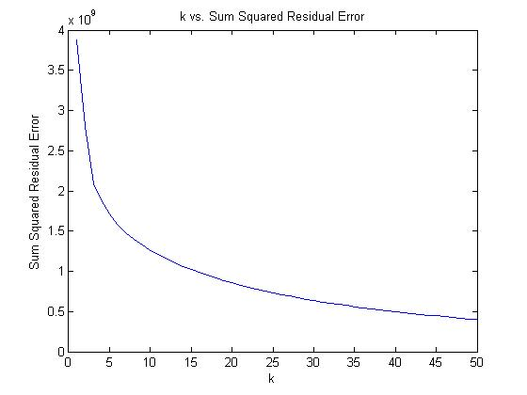
PCA – dependence on k
Image reconstruction is sensitive to k parameter
As k approaches the number of images, error decreases
  189 images, k = 0-50
Notes:
Projected should read “reconstructed”.
Why does error go up?!
(incremental PCA does not guarantee orthogonal bases). (check if you recompute v matrix).

Slide 12
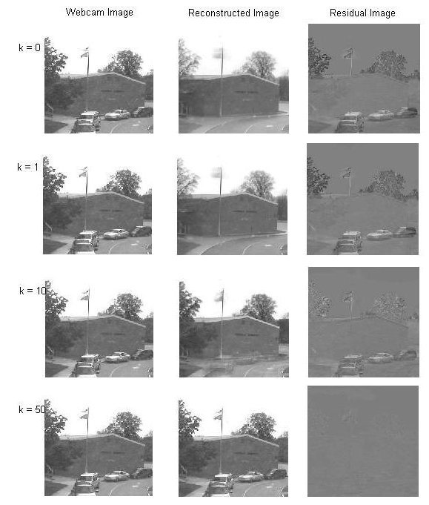

Slide 13
Incremental PCA
Too many images to fit into memory at once
Can iteratively update our U, S, and V matrices for new images
  Good estimate for U and S
  V coefficient for early images not updated well for later changes to U and S
    Can fix S and V on a second pass
    (S * V_{x})_{fixed}= (I_{x} – I_{mean}) * U

Slide 14
But what do we take PCA of?
Daytime images
Sky Mask
Gradient Magnitude Images

Slide 15
Daytime Images
Could take PCA of the entire set of images from one camera
  Not interested in how image varies from day to night
  Camera noise in low light
Choose only daytime images
  Input images have least natural variation

Slide 16
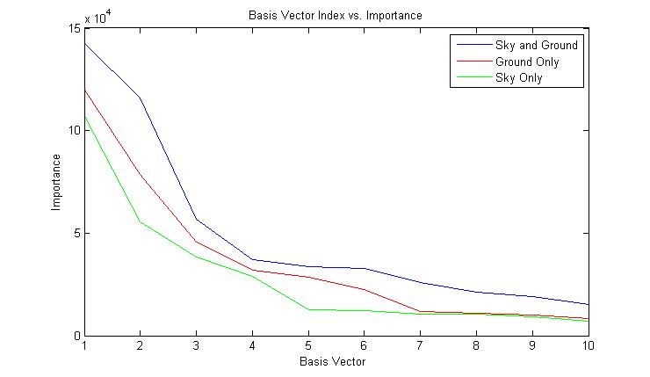
Sky Mask
Sky is another source of unnatural variation
  Sun, clouds, hard to model
  Not what we are interested in, so why waste effort?

Slide 17
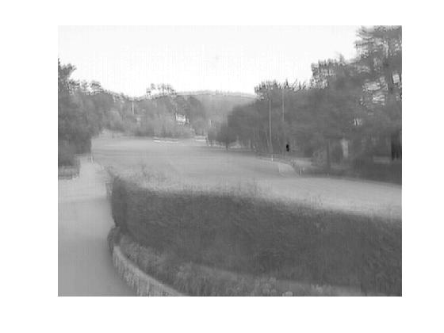
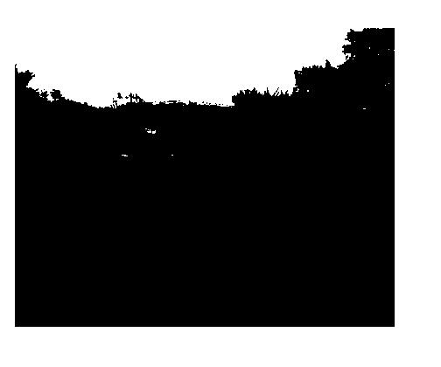
Sky Mask - algorithm
Luckily, we can mask it away
  1st PCA Component of most natural scenes (all times of day) is the sky
  Simple thresholding can accurately segment the scene

Slide 18
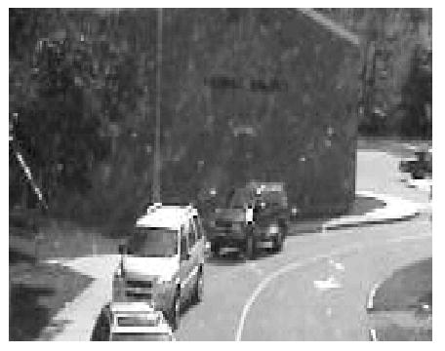
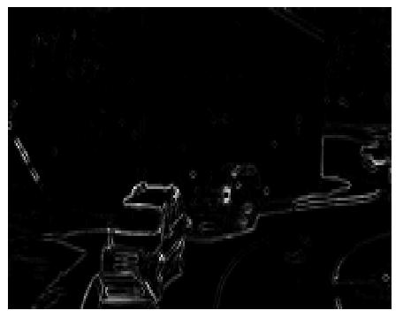
Gradient Magnitude Images
Can take the gradient magnitude of images
  Ignores changes in overall image intensity while retaining the scene structure
Not that useful

Slide 19
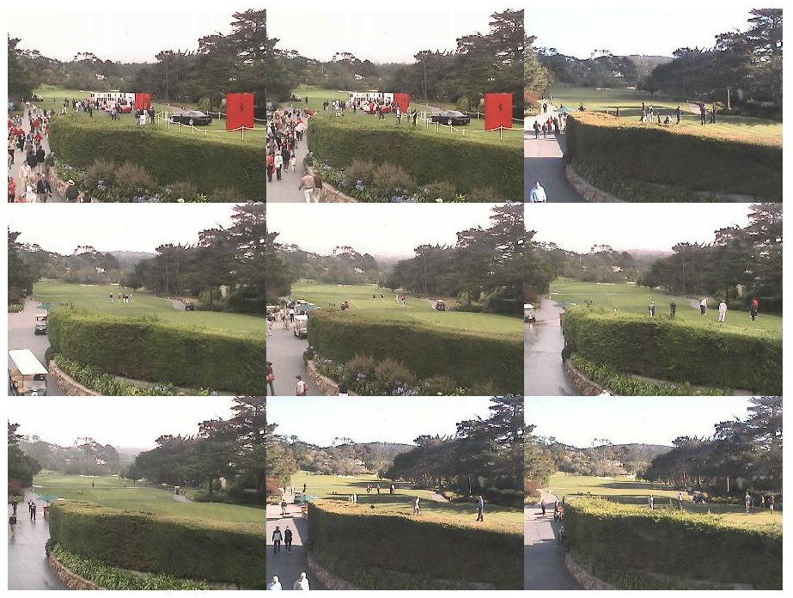
How do we display results?
Image montage – show most interesting images
  Highest value of some score
Well-Separated Set Montage
2D GUI

Slide 20

Well-Separated Set
Image montages often have similar images
  same parked cars, same crazy golf course scene
Want to show the n most interesting and unique images
Algorithm:
  Pick N > n interseting images to set S
  Seed with S = {most interesting image}
  Iterate
    Create by-pixel difference Matrix D
    Choose image i that has highest distance to set S
    S = {S i}
Used for all montage visualizations

Slide 21
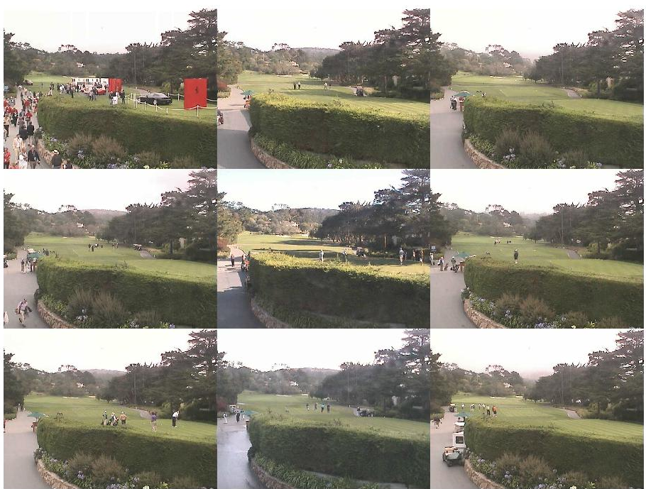


Slide 22
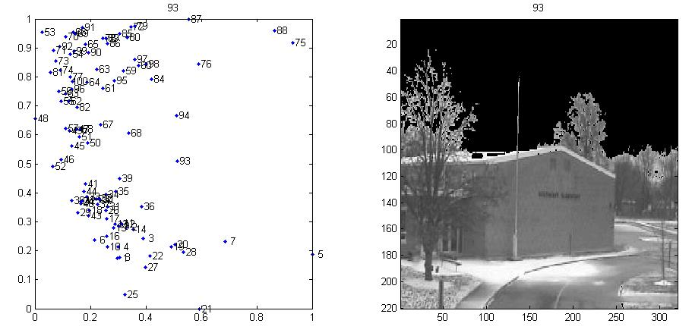
2D GUI
Explore two dimensions at once (example later)

Slide 23
How do we evaluate images?
PCA will capture the uninteresting variation, need to analyze the error to find interesting variation
  Coefficient Vector Magnitude
  Reconstruction Error
  Variance Model
  Distribution of Residuals
Notes:
Here, need to talk to the desire to understand images by their relationship to the PCA basis.

Slide 24
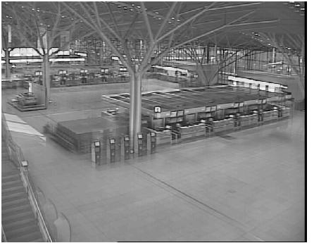
PCA Coefficient Vector Magnitude
D (:,x) ~= U S V(x,:)
S * V(x,:) is a vector of dimension k corresponding to the linear combination of U columns that best approximates D(:,x)
D is mean subtracted so
||SV(x,:)|| gives a measure of how far from the mean image is each image

Slide 25
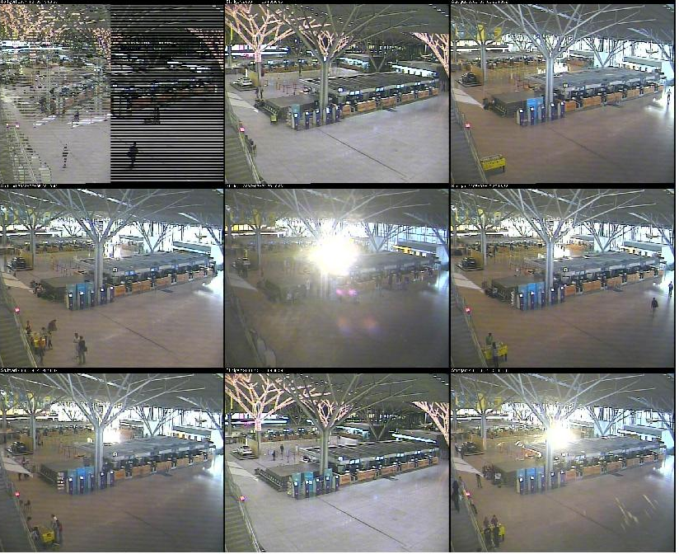

Slide 26
Residual Error
PCA gives a reconstructed image
I_{residual} = (I – I_{mean} ) – I_{recontsructed}
Sum of the squared residual values gives a good measure for “how much variation did we not capture”

Slide 27
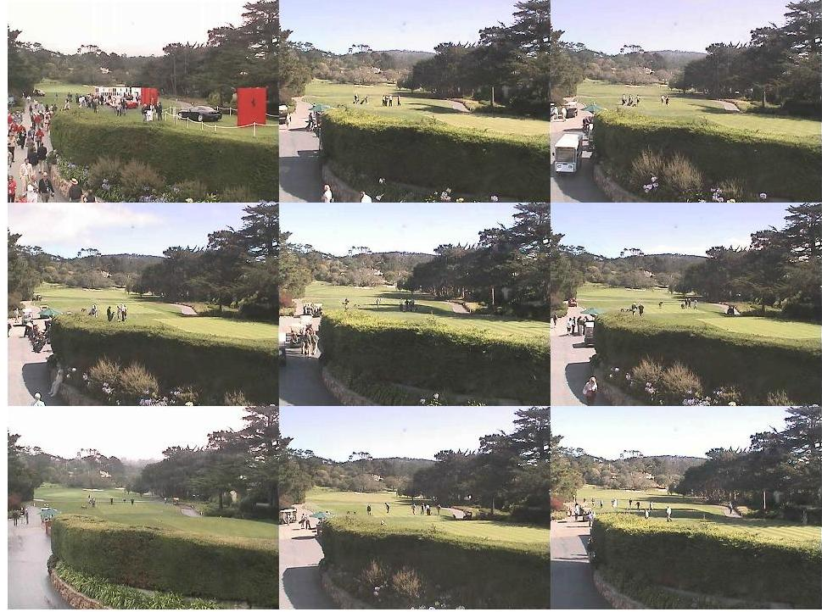

Slide 28
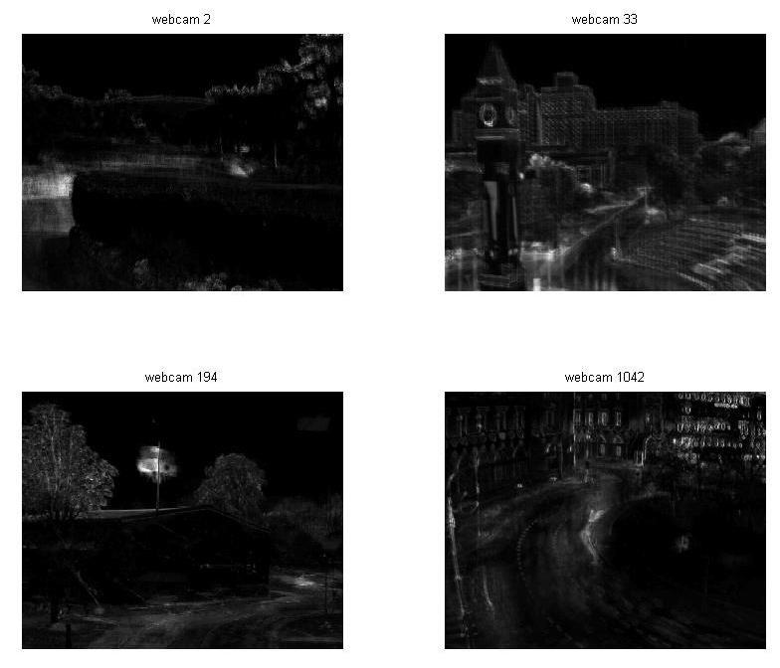
Variance Model
Can estimate the variance image of a scene by averaging sum squared residual at each pixel across all images

Slide 29
Z-score Image
To find which variation is most unusual, can calculate the z-score at each pixel
Z-score(x,y) = Residual(x,y) / Variance(x,y)
Now we have a more context-based system for evaluating how interesting variation is
Most marketable contribution
  security

Slide 30
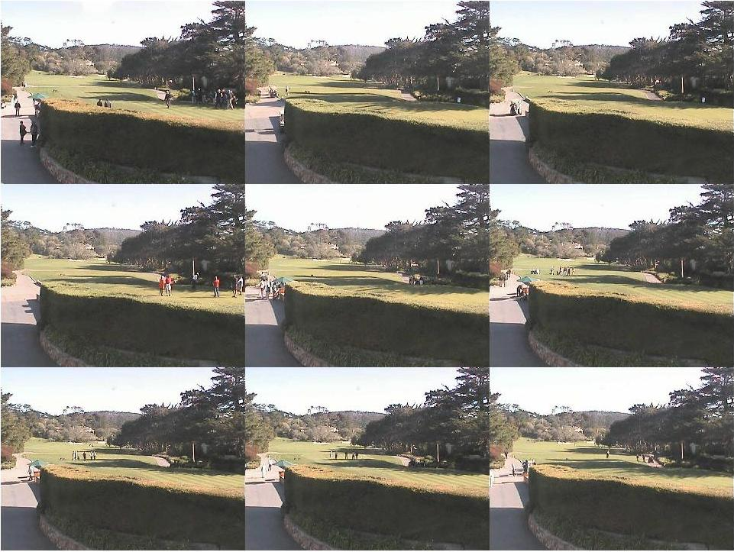

Slide 31
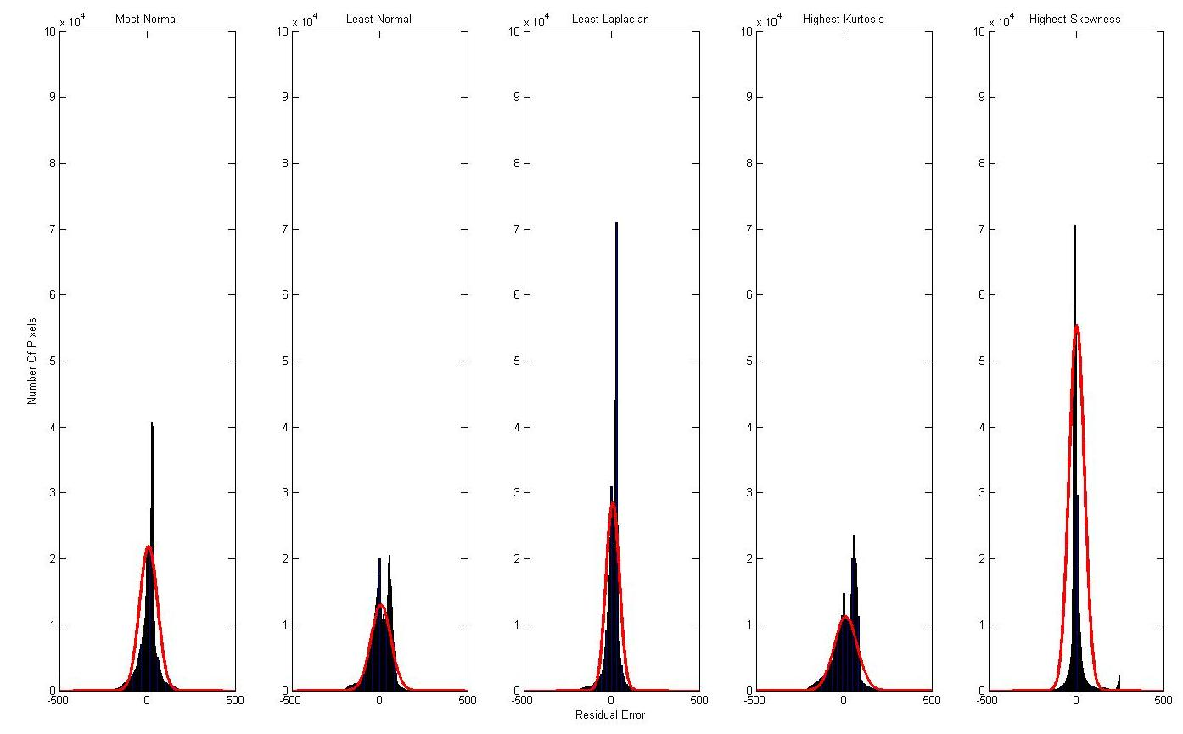
Statistical Distribution of Residual Images
Can treat R(x,y) as a sample from an underlying PDF
  Expect noise to be Gaussian, objects to be non-Gaussian
Notes:
Where are those Gaussians?!
Scale by # pixels -> better results
-show the pictures + residuals (scaled so you can see errors (maybe show log(1+abs(resid))))

Slide 32
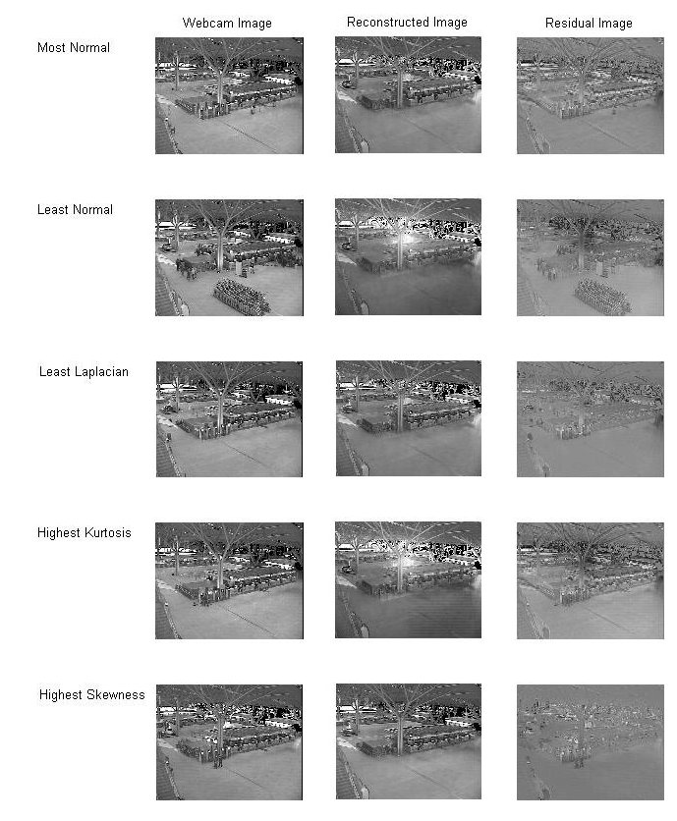

Slide 33

Normal Distribution
If we expect R(x,y) to sample from a normal distribution, we can easy estimate that and then evaluate each value using

Slide 34
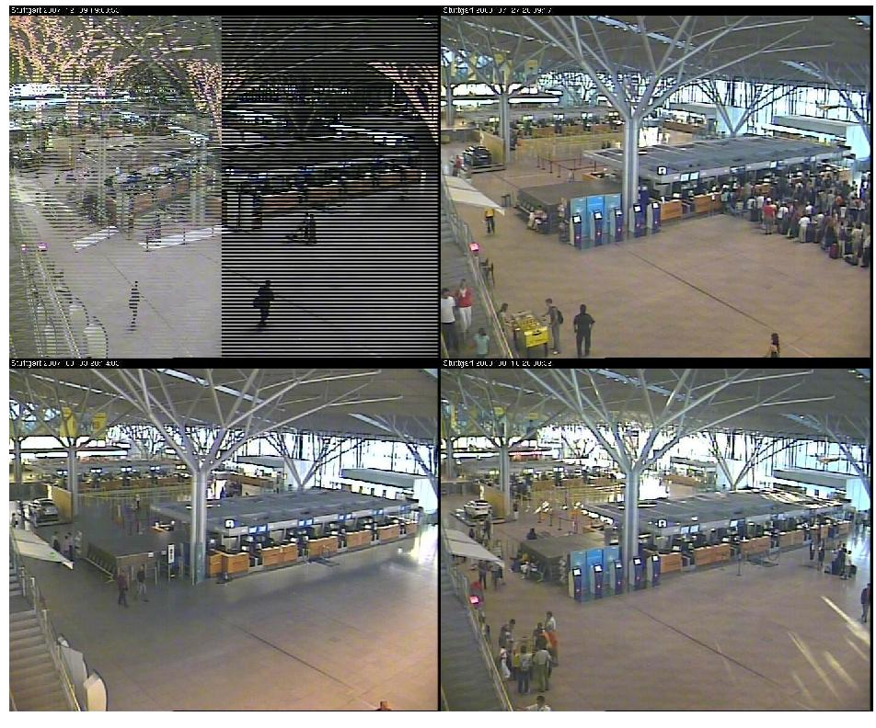

Slide 35

Laplacian Distribution
Many histograms look more like Laplacian Distributions, so we can do the same algorithm but for the Laplacian distribution

Slide 36
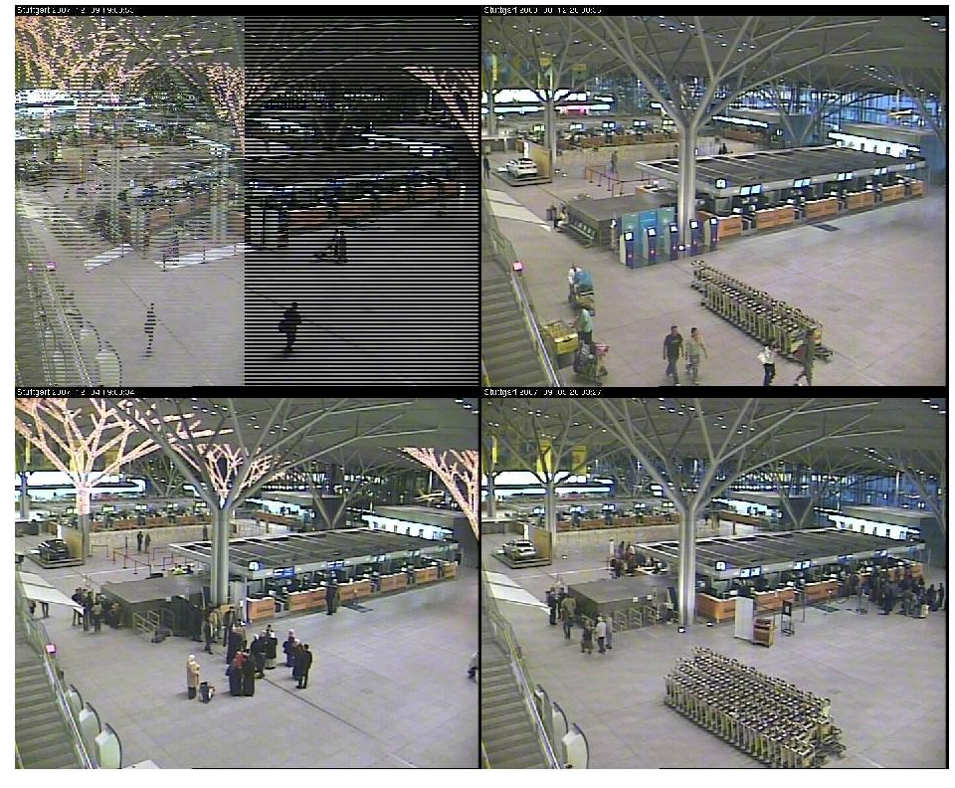

Slide 37



Bonus – Kurtosis and Skewness
Statistics for “non-Guassiannesss”
Skewness measures asymmetry
  No good results
Kurtosis measures unlikely deviation
  Tends to mirror the residual sum squared error scores
The effect of small objects is dominated by the noise over the rest of the image
Notes:
Show pictures sorted by both and say how it didn’t work
The effect of small objects is dominated by the noise in the (larger) rest of the image.

Slide 38
Conclusion
AMOS Dataset too big to keep track of interesting variation in each scene
Developed automatic visualization tools to help
  Use PCA to learn less interesting variation
    Daytime images, sky mask -> useful
    Gradient images -> not useful
  Interesting images from evaluating PCA error
    Reconstruction error and Variance Models -> useful
    Statistical models -> mixed results

Slide 39
Future Work
Interface with AMOS site
Object Extraction
User customizability

Slide 40
Questions?

