Slide 1
Visualization Tools For Webcam Scenes
A Masters Project by David Ross
Friday, May 24, 2009
With slides by Nathan Jacobs and Robert Pless

Slide 2
Introduction

Slide 3
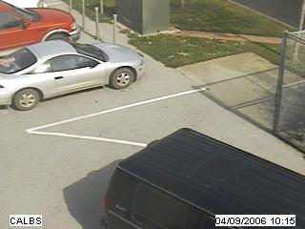
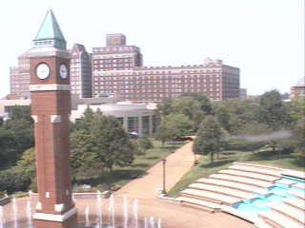
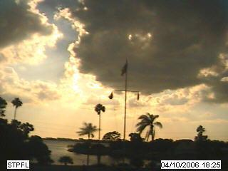
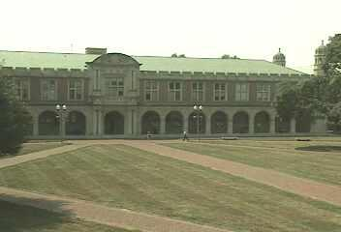
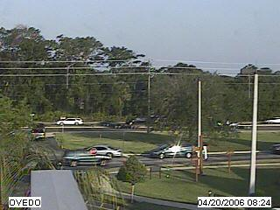
AMOS Dataset
The Archive of Many Outdoor Scenes (AMOS)
Images from ~3000 static webcams,
Every 30 minutes since March 2006.
http://amos.cse.wustl.edu
Capture variations from fixed cameras
Due to lighting (time of day), and
Seasonal and weather variations (over a year).
From cameras mostly in the USA (a few elsewhere).

Slide 4
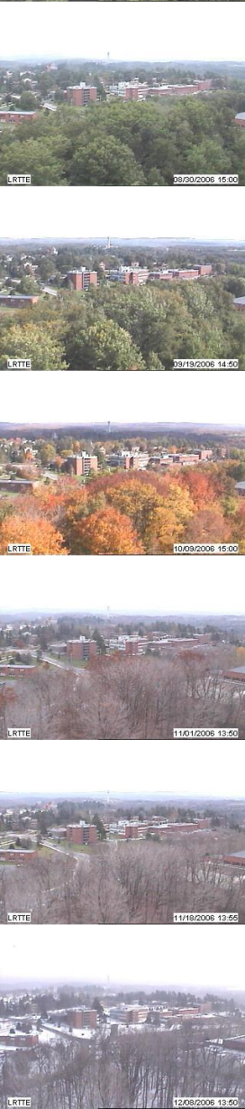
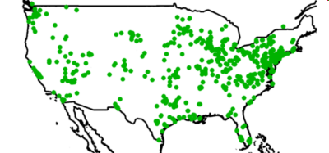
AMOS Dataset
3000 webcams
x 3 years
35 million images
Variations
over a year and over a day

Slide 5
The Project
Have many webcams, want interesting variants
Too many to go through manually
PCA learns consistent variation
PCA error => interesting variation

Slide 6
Principal Component Analysis
M = U S V^{T}

Slide 7
PCA Math
Principle component analysis.
Images are in a 3D matrix I(x,y,t).
Change that matrix into a data matrix D(p,t), listing the pixel values in each frame.
Do the “SVD” decomposition:
D = U S V
Frame 2 coefficients.
Frame 1 coefficients.
D
U
S
V
coefficients
=
Images
Basis Images

Slide 8
D
U
S
V
=
S is a diagonal matrix, so it only has diagonal elements, called singular values.
These numbers are the relative importance of each of the principle components.
If we want we can make the principle components be the columns of U * S, and have the columns of V be the coefficients.
Alternatively, we can keep the columns of U, and make the coefficients be S * the columns of V. This is more common.

Slide 9
D
U
S
V
coefficients.
=
Images
Basis Images
Special properties:
U,V are both orthonormal matrices.
This is cool:
Given a new image W, to get its coefficients v_{w}, you can use:
v_{w}=U^{T}W
Then U v_{w} approximately reconstructs W. Why?
U v_{w}
= U (U^{T}W)
= (U U^{T})W
= I W
= W.

Slide 10
D
U
S
V
coefficients
=
Basis Images
These coefficients define the appearance of the image.
The U matrix defines the space of possible images within this video.
Given a new set of coefficients ( a new column of V ), we can make a new image.
New image = U v
(this will give us a column vector of the pixel values…
you have to rearrange it into the shape of the image).
Given a new image W we can find its coefficients
v = U>W

Slide 11
PCA Math – Going back to slide 1
Principle component analysis.
Images are in a 3D matrix I(x,y,t).
Change that matrix into a data matrix D(p,t), listing the pixel values in each frame.
Do the “SVD” decomposition:
D = U S V
Frame 2 coefficients.
Frame 1 coefficients.
D
U
S
V
coefficients
=
Images
Basis Images

Slide 12
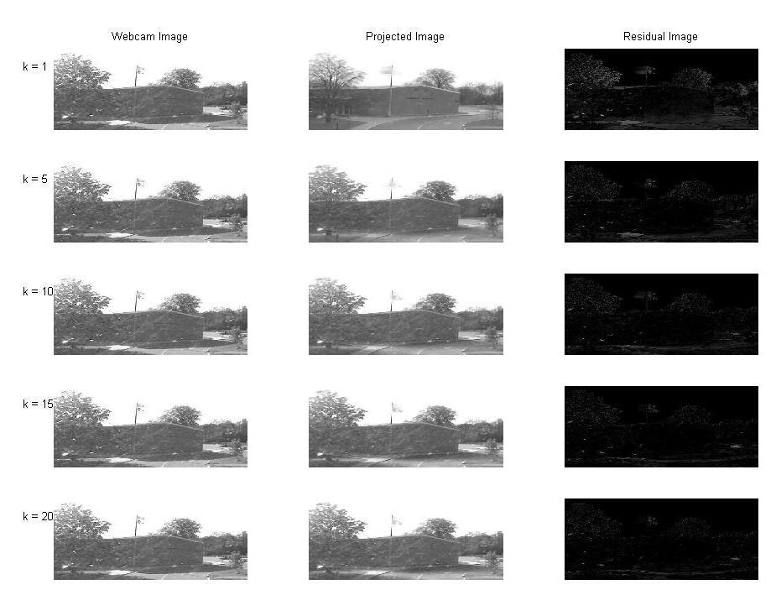
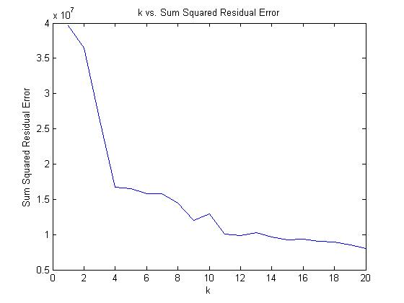
PCA – dependence on k

Slide 13
Incremental PCA
Too many images to fit into memory at once
At each step,

Slide 14
But what do we take PCA of?
Daytime images
Sky Mask
Gradient Magnitude Images

Slide 15
Daytime Images
Could take PCA of the entire set of images from one camera

Slide 16
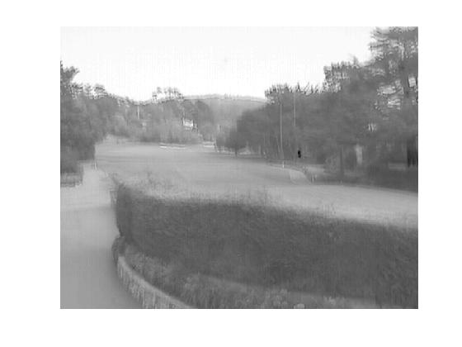
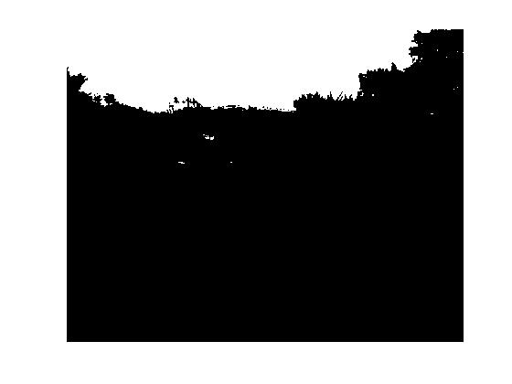
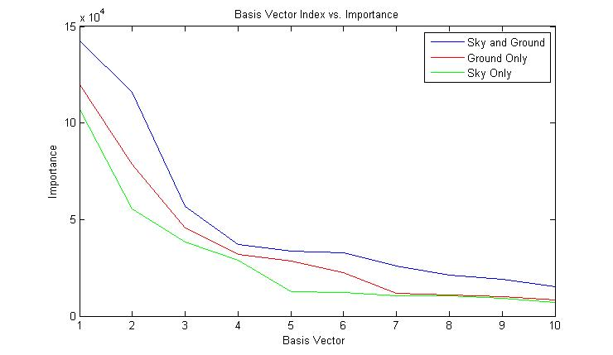
Sky Mask

Slide 17
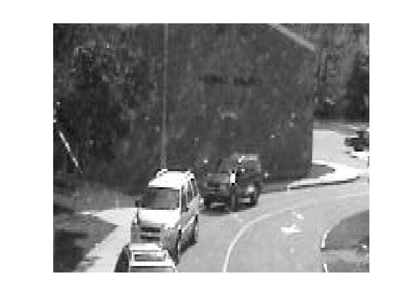
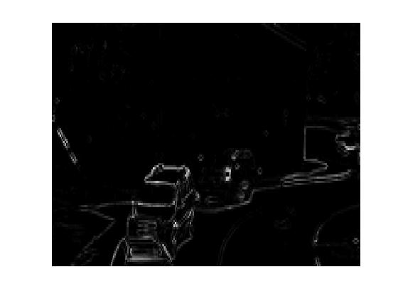
Gradient Magnitude Images

Slide 18
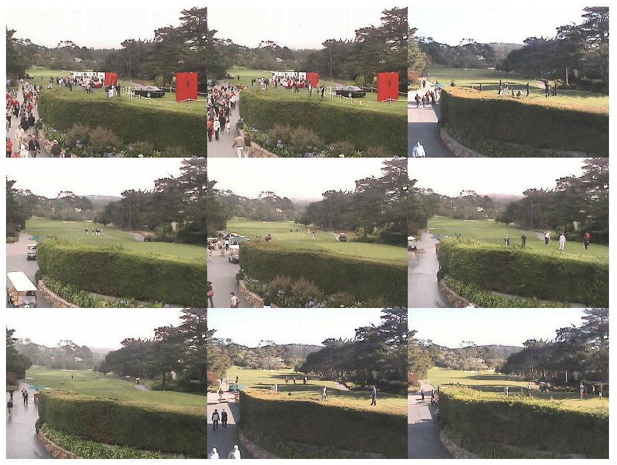
How do we display results?
Image montage (image here)
Well-Separated Set Montage
2D GUI

Slide 19
Well-Separated Set

Slide 20
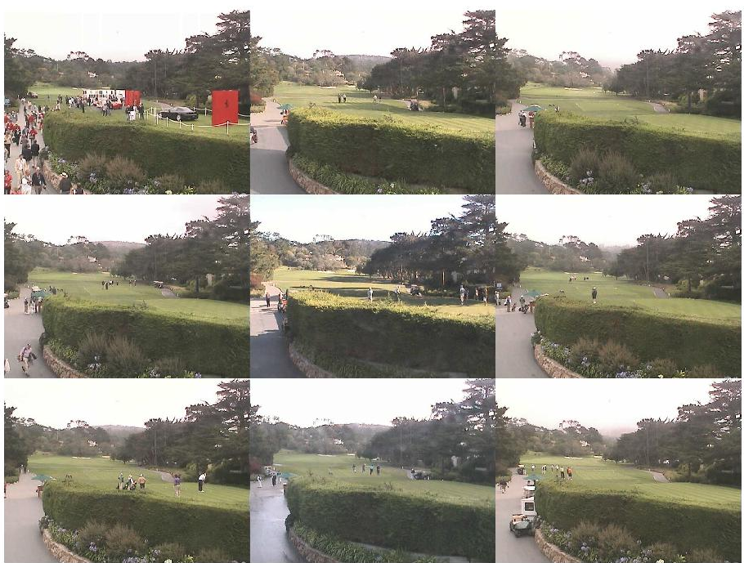

Slide 21
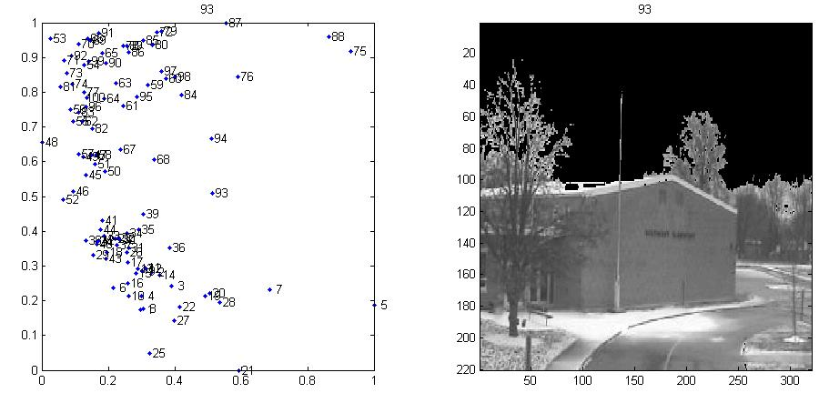
2D GUI

Slide 22
How do we evaluate images?
Vector Magnitude
Reconstruction Error
Variance Model
Statistics

Slide 23
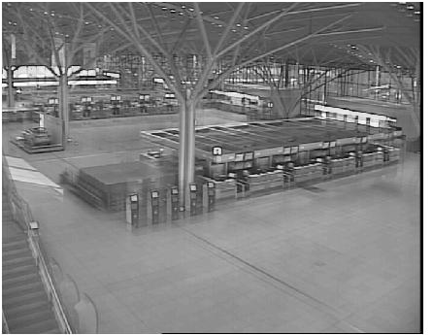
PCA Coefficient Vector Magnitude
D (:,x) ~= U S V(x,:)
S * V(x,:) is a vector of dimension k corresponding to the linear combination of U columns that best approximates D(:,x)
D is mean subtracted so
||SV(x,:)|| gives a measure of how far from the mean image is each image

Slide 24
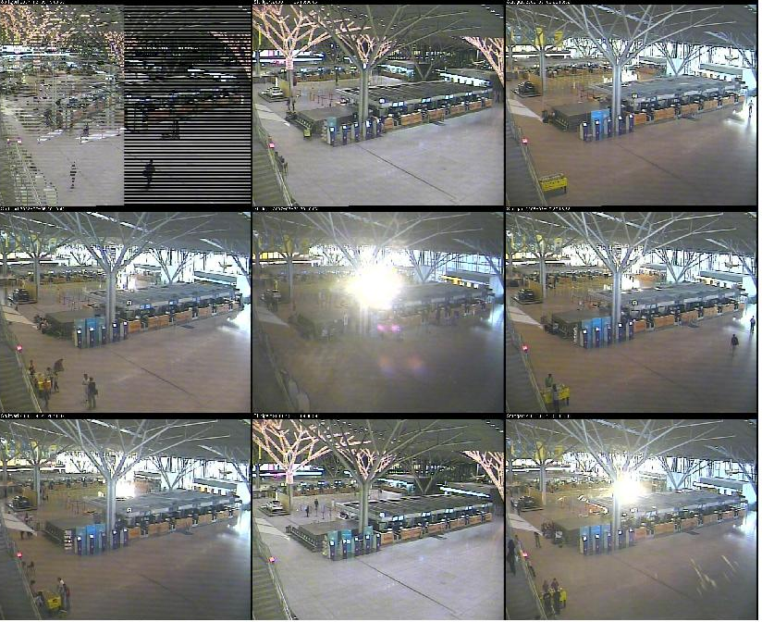

Slide 25
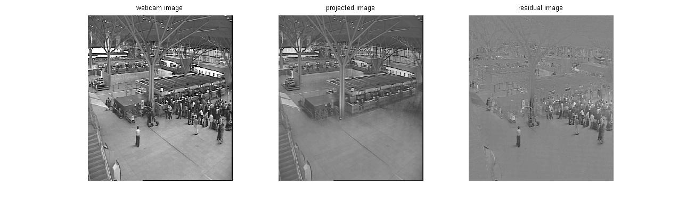
Residual Error

Slide 26
Variance Model
Can estimate the variance image of a scene by summing …

Slide 27
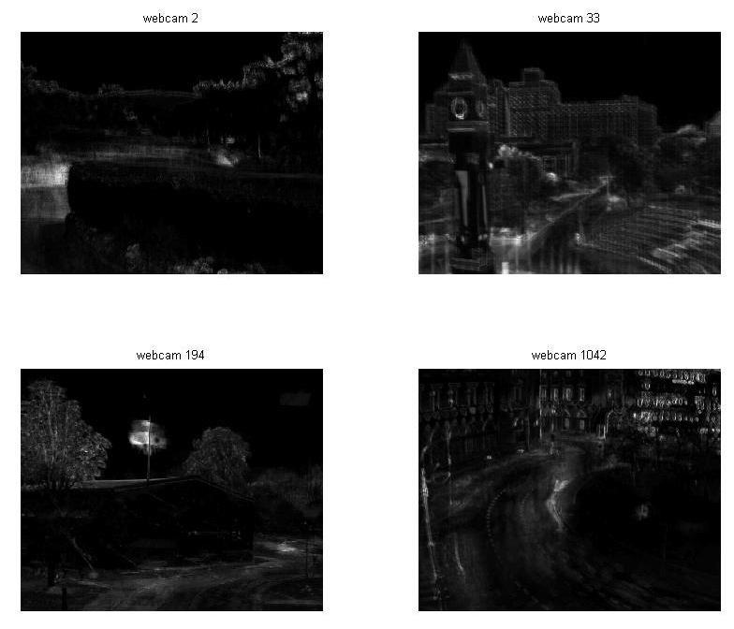

Slide 28
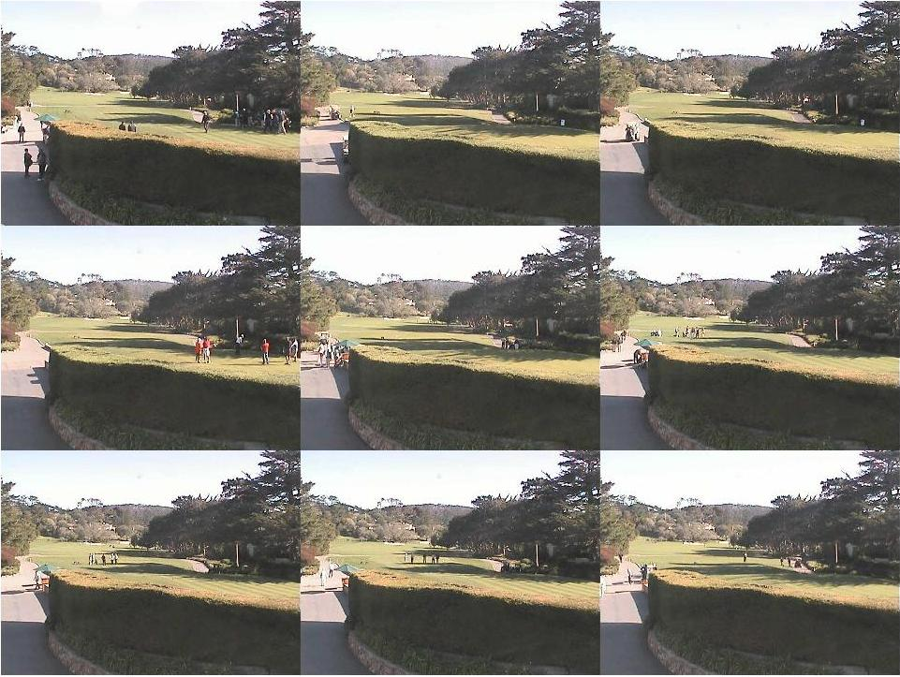
Z-score Image

Slide 29
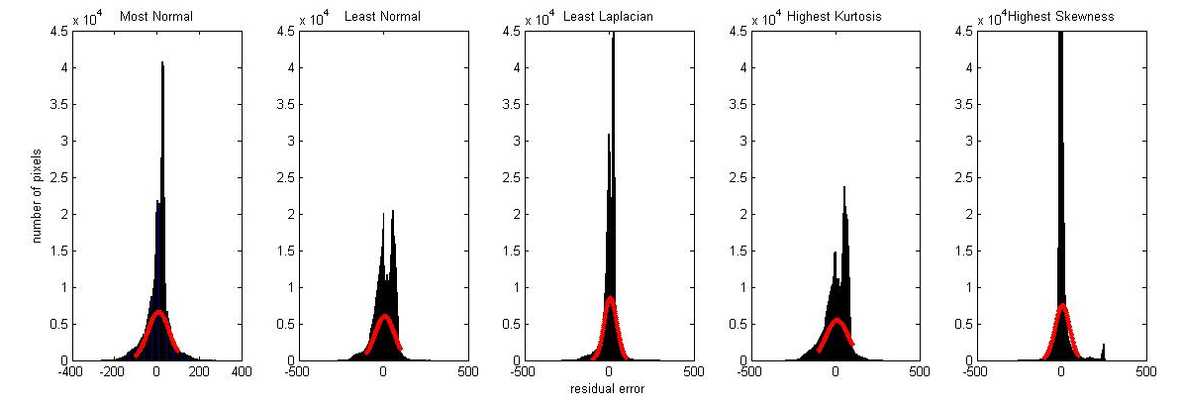
Statistical Distribution of Residual Images

Slide 30
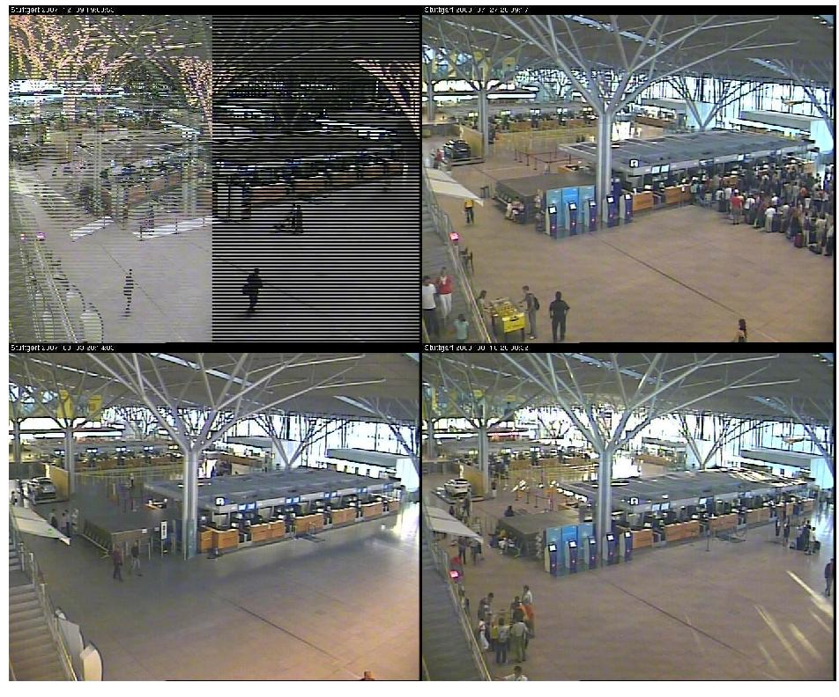
Normal Distribution

Slide 31
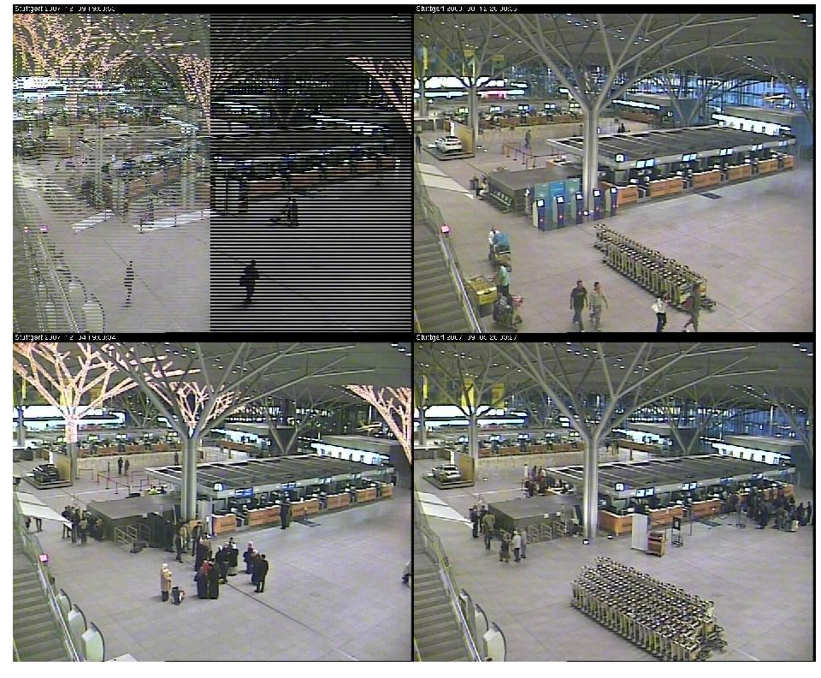
Laplacian Distribution

Slide 32
Bonus – Kurtosis and Skewness

Slide 33
Future Work

Slide 34
Questions?

