Slide 1
Visualization Tools For Webcam Scenes
A Masters Project by David Ross
Friday, May 24, 2009
With slides by Nathan Jacobs and Robert Pless

Slide 2
Acknowledgement
Advisor:
Professor Robert Pless
Committee:
Professor Tao Ju
Professor Bill Smart
M&M Lab:
Nathan Jacobs
Michael Dixon
others

Slide 3
Overview
Introduction
Webcams and the AMOS Dataset
Problem Motivation
Principal Component Analysis (PCA)
Visualization Tools
PCA Input
Visualization
Evaluations
Conclusion
Future Work

Slide 4
Introduction
Given a static webcam scene, how can we make it easier to understand the variation in the scene?
Automatic visualization tools to quickly show interesting variation
Why? Help to maintain and understand massive AMOS Dataset
Use PCA to learn less interesting variation, analyze PCA error to find more interesting variation

Slide 5
“Interesting” Variation
Outdoor scenes vary naturally and predictably
Day/night
Weather
Seasonal
Unnatural variation less predictable
People, cars, other objects
Camera/image variation
Scene changes
To understand a scene is to understand the latter

Slide 6
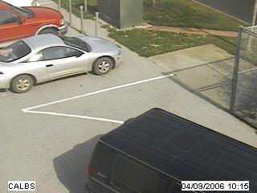
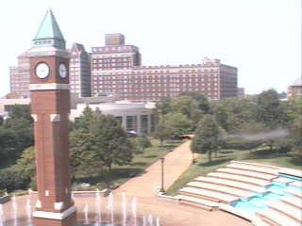
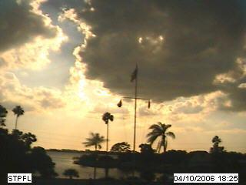
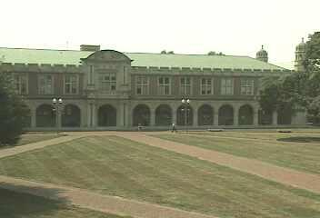
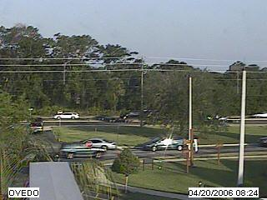
AMOS Dataset
The Archive of Many Outdoor Scenes (AMOS)
Images from ~1000 static webcams,
Every 30 minutes since March 2006.
http://amos.cse.wustl.edu
Capture variations from fixed cameras
Due to lighting (time of day), and
Seasonal and weather variations (over a year).
From cameras mostly in the USA (a few elsewhere).

Slide 7
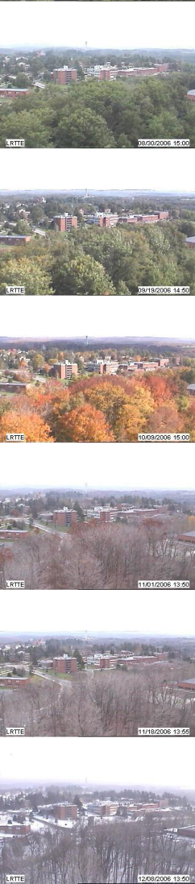
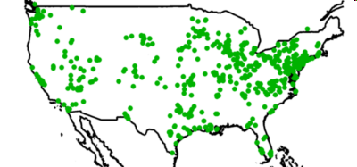
AMOS Dataset
3000 webcams
x 1 years
35 million images
Variations
over a year and over a day

Slide 8
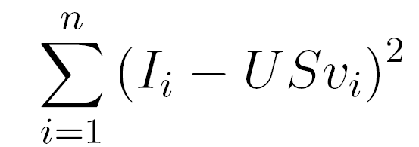
Principal Component Analysis (PCA)
PCA is a method used to extract the most significant features from given dataset
Given a set of images I and a number k>0, finds the k most important features in the set of images
[U S V] = PCA(I,k)
U contains the k feature, or basis, images, all of which are orthogonal to each other
S is a diagonal matrix which contains the weights of each feature vector
V contains the coefficients of each basis image for each actual image
Will extract the most significant features to minimize
Notes:
Another correlation technique used is PCA…
Decomposes images into U,S,V
Can represent each image by a few numbers

Slide 9
PCA
D
U
S
V
coefficients
=
Images
Basis Images
We can reconstruct image x as a linear combination of the basis images: i_{x}=USv_{x}
Reconstructed images will not exactly match the original images
Similarity increases as we increase the number of coefficients k
Given a new image W we can find its coefficients
v = U^{T}W
Residual Image or reconstruction error
I_{residual} = (I – I_{mean} ) – I_{recontsructed}
Notes:
Further explanation

Slide 10
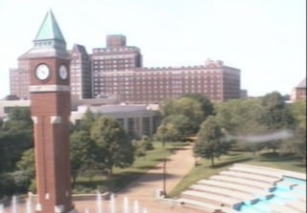
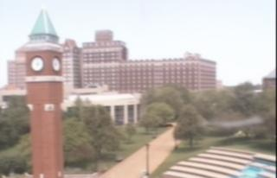
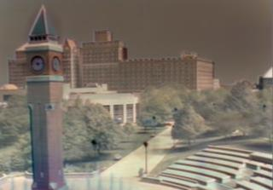
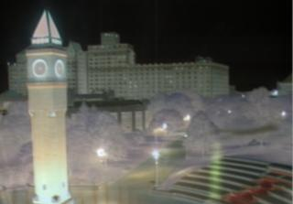
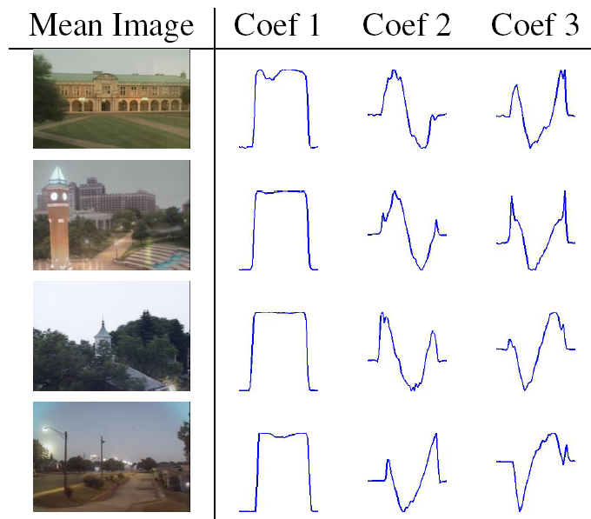
= + f₁(t) + f₂(t) + ...
mean Image
component 1
component 2
Camera 1
Camera 2
Camera 3
Camera 4
Notes:
Visual example. See day/night, dawn/dusk. Keep?? Shows why we cannot use images from entire day, localize to certain range of hours

Slide 11
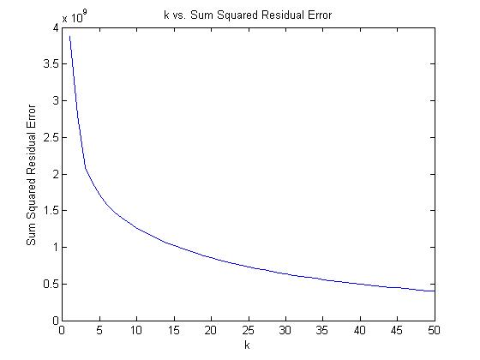
PCA – dependence on k
Image reconstruction is sensitive to k parameter
As k approaches the number of images, error decreases
189 images, k = 0-50
Notes:
Projected should read “reconstructed”.
Why does error go up?!
(incremental PCA does not guarantee orthogonal bases). (check if you recompute v matrix).

Slide 12
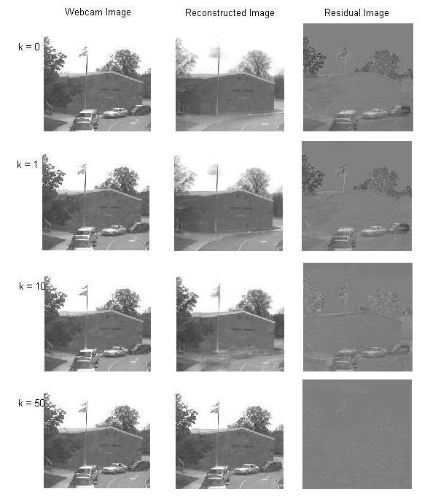

Slide 13
Incremental PCA
Too many images to fit into memory at once
Can iteratively update our U, S, and V matrices for new images
Good estimate for U and S
V coefficient for early images not updated well for later changes to U and S
Can fix S and V on a second pass
(S * V_{x})_{fixed}= (I_{x} – I_{mean}) * U

Slide 14
What do we take PCA of?
Daytime images
Sky Mask
Gradient Magnitude Images

Slide 15
Daytime Images
Could take PCA of the entire set of images from one camera
Not interested in how image varies from day to night
Camera noise in low light
Choose only daytime images
Input images have least natural variation

Slide 16
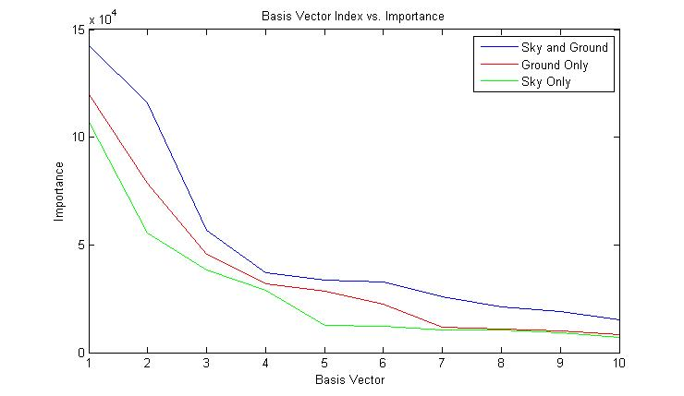
Sky Mask
Sky is another source of unnatural variation
Sun, clouds, hard to model
Not what we are interested in, so why waste effort?

Slide 17
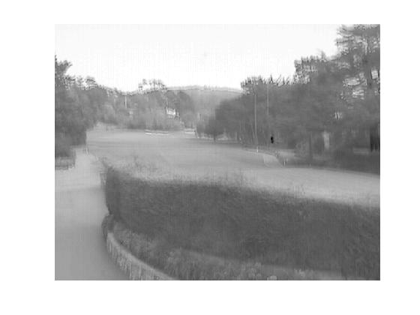
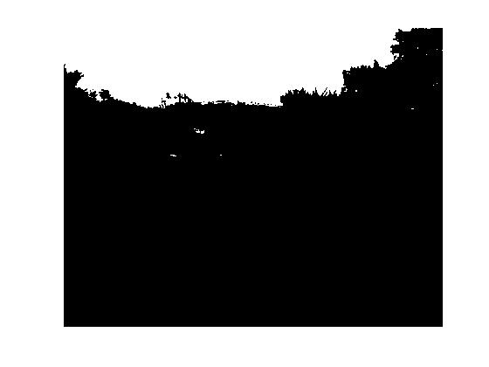
Sky Mask - algorithm
Luckily, we can mask it away
1st PCA Component of most natural scenes (all times of day) is the sky
Simple thresholding can accurately segment the scene

Slide 18
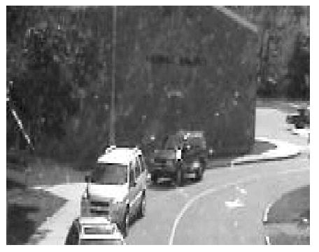
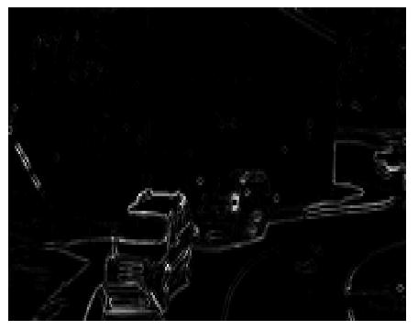
Gradient Magnitude Images
Can take the gradient magnitude of images
Ignores changes in overall image intensity while retaining the scene structure
Not that useful

Slide 19
What do we take PCA of?
Daytime images - yes
Sky Mask - yes
Gradient Magnitude Images - no

Slide 20
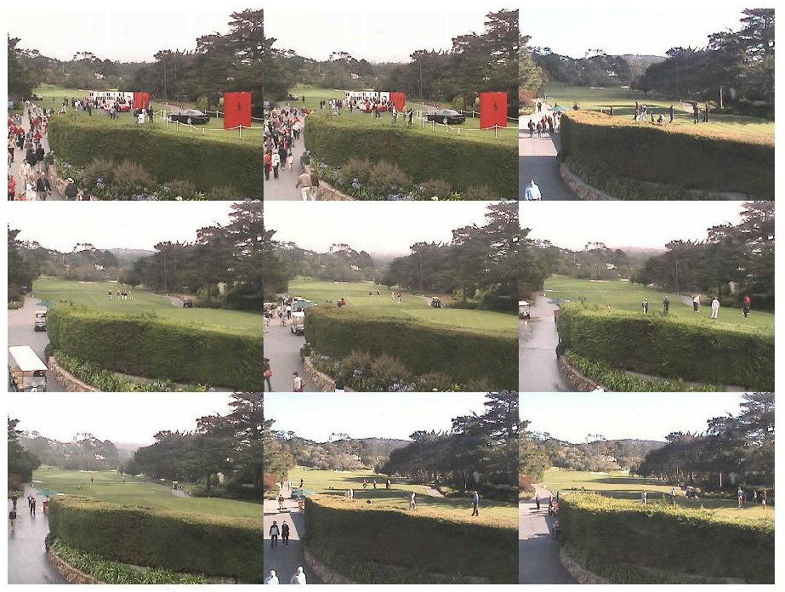
How do we display results?
Image montage – show most interesting images
Highest value of some score
Well-Separated Set Montage
2D GUI

Slide 21

Well-Separated Set
Image montages often have similar images
same parked cars, same crazy golf course scene
Want to show the n most interesting and unique images
Algorithm:
Pick N > n interseting images to set S
Seed with S = {most interesting image}
Iterate
Create by-pixel difference Matrix D
Choose image i that has highest distance to set S
S = {S i}
Used for all montage visualizations

Slide 22
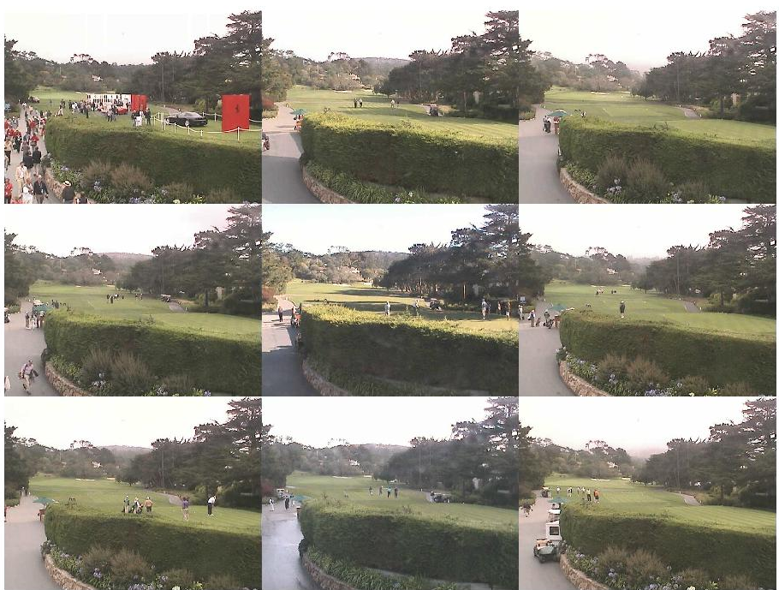

Slide 23
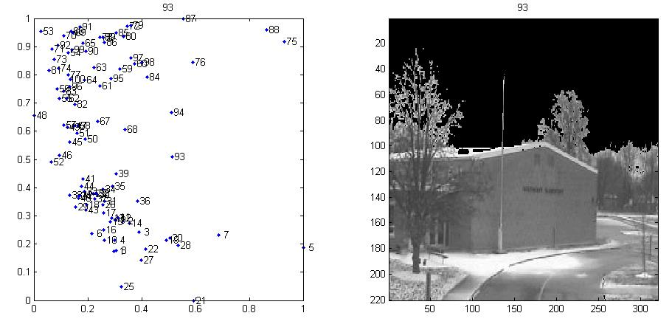
2D GUI
Explore two dimensions at once (example later)

Slide 24
How do we display results?
Image montage – good
Well-Separated Set Montage - better
2D GUI - best

Slide 25
How do we evaluate images?
PCA will capture the uninteresting variation, need to analyze the error to find interesting variation
PCA Basis Coefficient Vector Magnitude
Reconstruction Error
Variance Model
Distribution of Residual Values
Notes:
Here, need to talk to the desire to understand images by their relationship to the PCA basis.

Slide 26
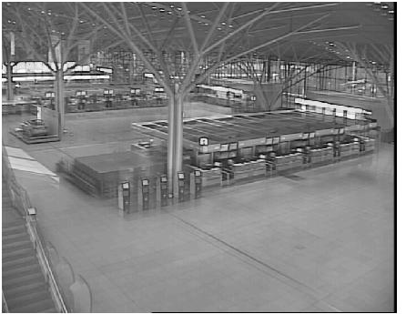
PCA Coefficient Vector Magnitude
D (:,x) ~= U S V(x,:)
S * V(x,:) is a vector of dimension k corresponding to the linear combination of U columns that best approximates D(:,x)
D is mean subtracted so
||SV(x,:)|| gives a measure of how far from the mean image is each image

Slide 27
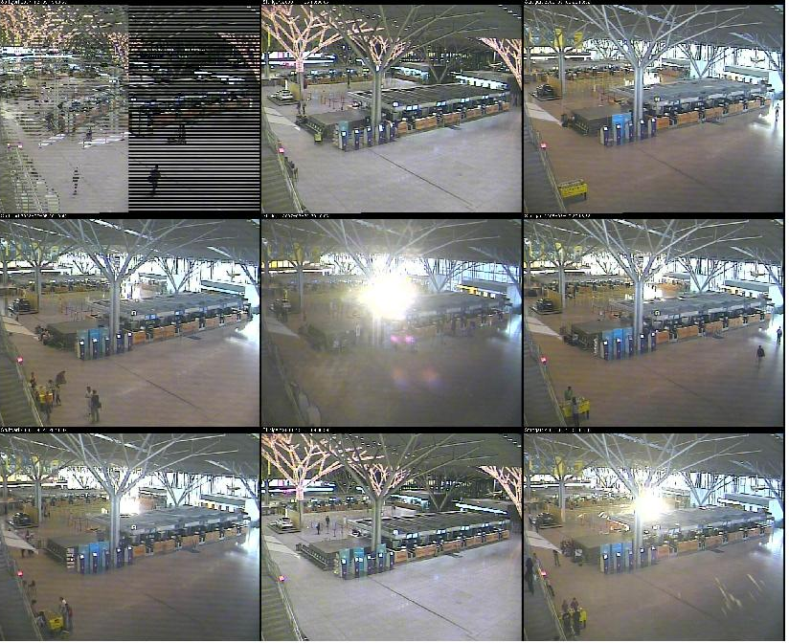

Slide 28
Residual Error
PCA gives a reconstructed image
I_{residual} = (I – I_{mean} ) – I_{recontsructed}
Sum of the squared residual values gives a good measure for “how much variation did we not capture”

Slide 29
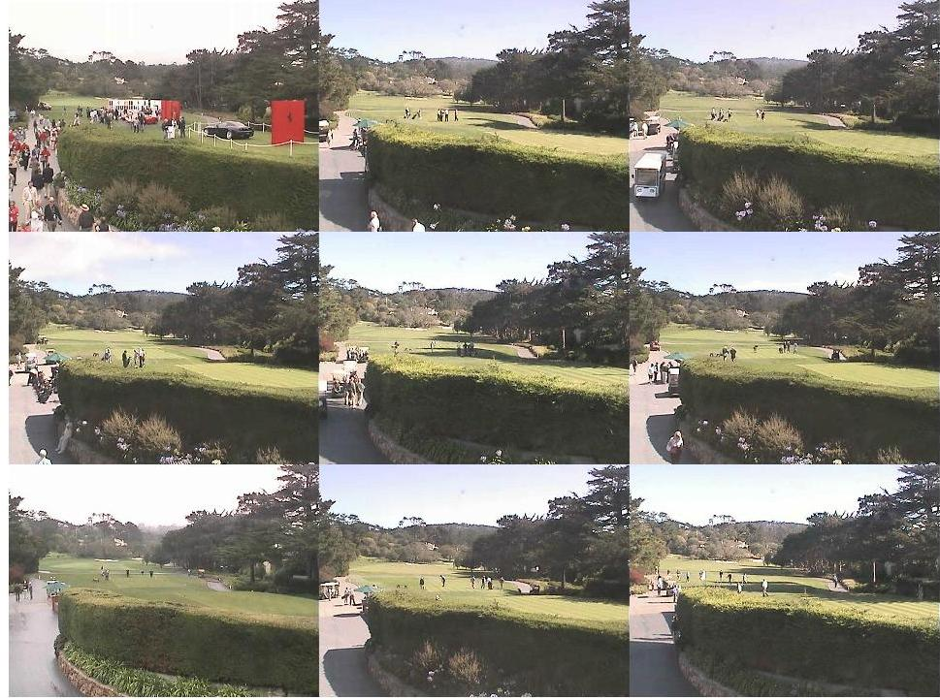

Slide 30
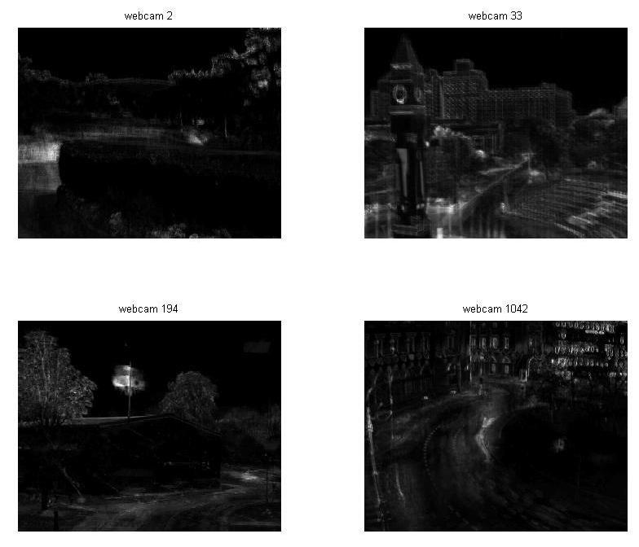
Variance Model
Can estimate the variance image of a scene by averaging sum squared residual at each pixel across all images

Slide 31
Z-score Image
To find which variation is most unusual, can calculate the z-score at each pixel
Z-score(x,y) = Residual(x,y) / Variance(x,y)
Now we have a more context-based system for evaluating how interesting variation is
Most marketable contribution
Security systems

Slide 32
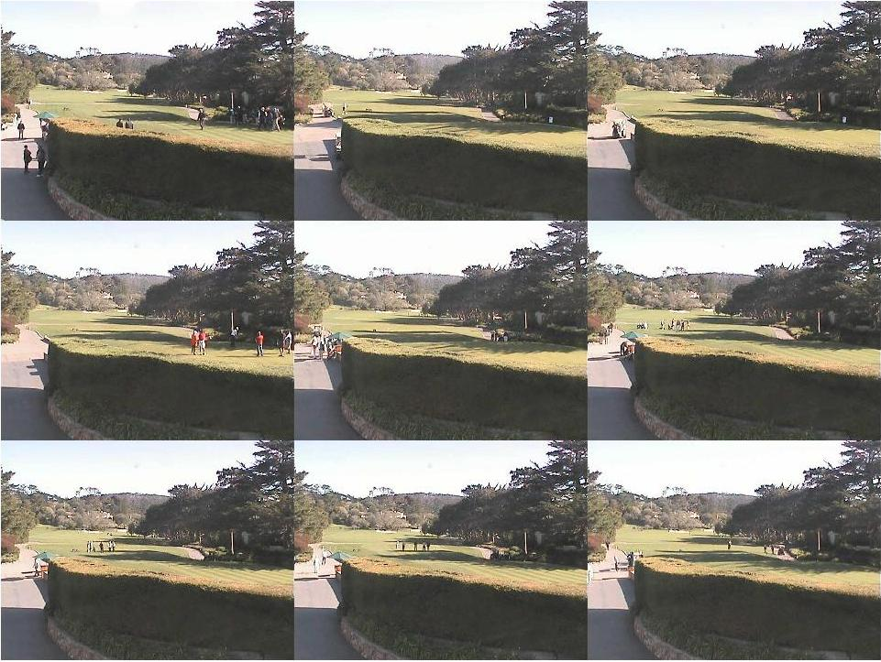

Slide 33
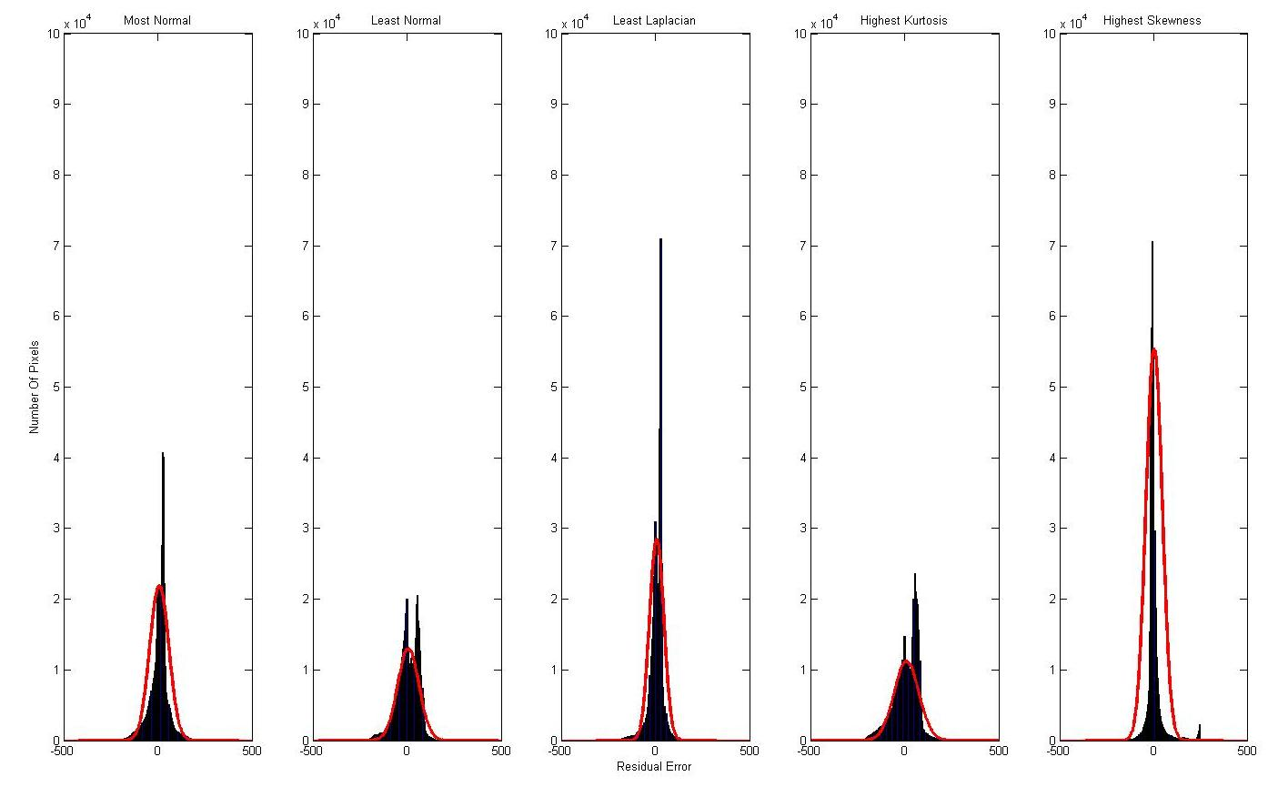
Statistical Distribution of Residual Images
Can treat R(x,y) as a sample from an underlying PDF
Expect noise to be Gaussian, objects to be non-Gaussian
Notes:
Where are those Gaussians?!
Scale by # pixels -> better results
-show the pictures + residuals (scaled so you can see errors (maybe show log(1+abs(resid))))

Slide 34
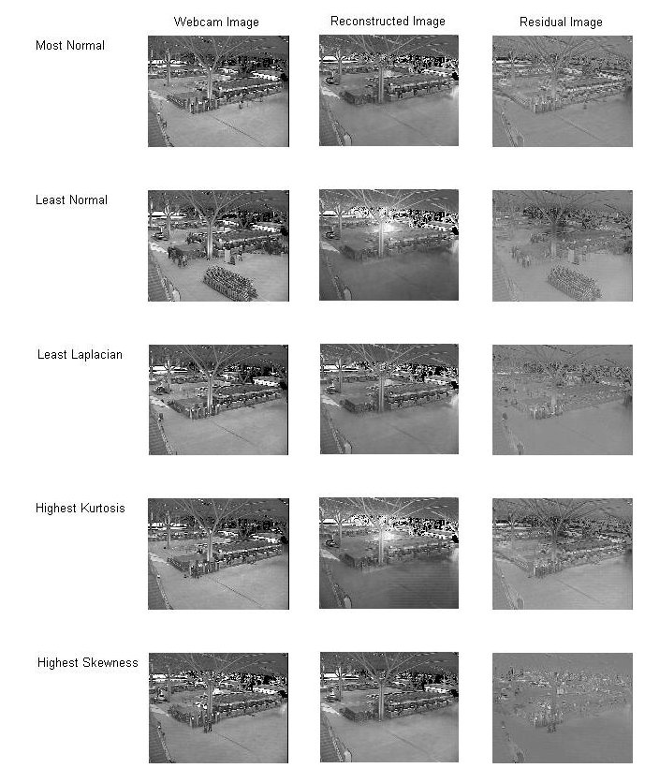

Slide 35

Normal Distribution
If we expect R(x,y) to sample from a normal distribution, we can easy estimate that and then evaluate each value using

Slide 36
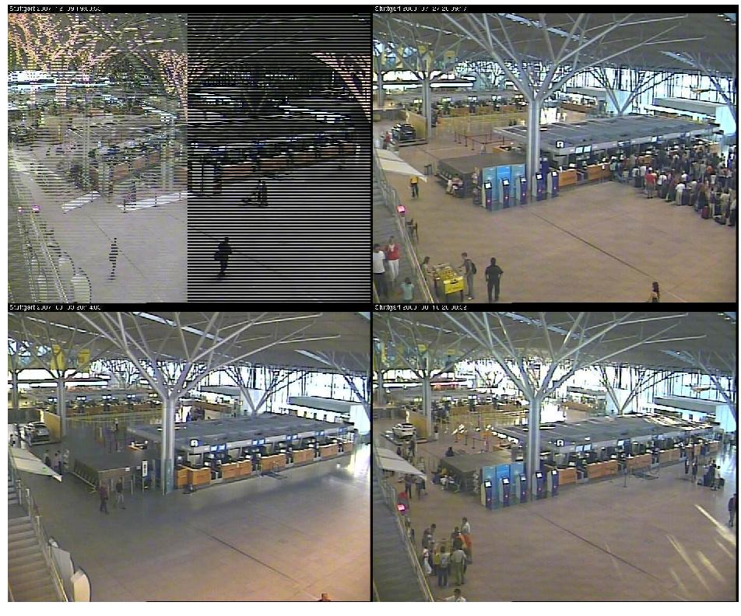

Slide 37

Laplacian Distribution
Many histograms look more like Laplacian Distributions, so we can do the same algorithm but for the Laplacian distribution

Slide 38
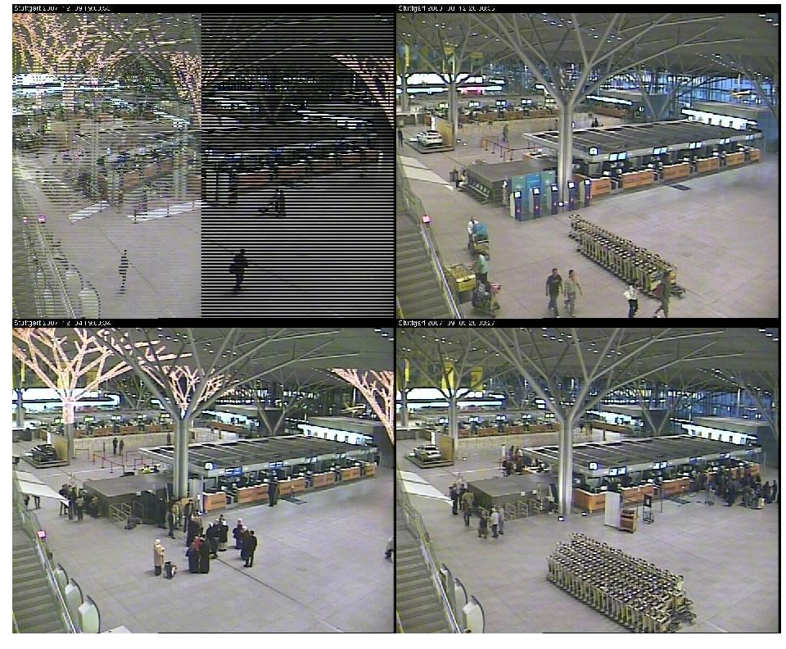

Slide 39



Bonus – Skewness and Kurtosis
Statistics for “non-Guassiannesss”
Skewness measures asymmetry
No good results
Kurtosis measures unlikely deviation
Tends to mirror the residual sum squared error scores
The effect of small objects is dominated by the noise over the rest of the image
Notes:
Show pictures sorted by both and say how it didn’t work
The effect of small objects is dominated by the noise in the (larger) rest of the image.

Slide 40
How do we evaluate images?
PCA Basis Coefficient Vector Magnitude
distance from mean
Reconstruction Error
Interesting variation
Variance Model
Least common interesting variation
Distribution of Residual Values
Laplacian Likelihood works best, but not better than variance model
Notes:
Here, need to talk to the desire to understand images by their relationship to the PCA basis.

Slide 41
Conclusion
AMOS Dataset too big to keep track of interesting variation in each scene
Developed automatic visualization tools to help
Use PCA to learn less interesting variation
Daytime images, sky mask -> useful
Gradient images -> not useful
Interesting images from evaluating PCA error
Reconstruction error and Variance Models -> useful
Statistical models -> mixed results

Slide 42
Future Work
Interface with AMOS site
Object Extraction
User customizability

Slide 43
Questions?

