Slide 1
EAG GLOBAL BUILDATHON 2026
VitaPod
Privacy-Preserving Clinical Trial Eligibility
Track: Local AI, Private AI & User-Owned Data
Notes:
LIVE SCRIPT — read aloud (~10s):
“Hi — we're VitaPod. We built a way for patients to prove they qualify for a clinical trial without handing over a single biomarker.”
────────────────────────────────────────
CONTEXT
EAG Global Buildathon 2026, Florianópolis. Track: Local AI, Private AI & User-Owned Data — the track explicitly calls out privacy-first AI, user-owned datasets, private credentials, and selective disclosure. Format is a short showcase plus Q&A, which is why every slide's live line is deliberately short.
One-sentence definition if the audience needs it: a zero-knowledge proof lets you mathematically prove a true/false statement about private data without showing the data itself. VitaPod applies that to clinical-trial eligibility rules (age, HbA1c, eGFR thresholds).
SOURCES
• EAG Global Buildathon event page — https://luma.com/5fbmh4p9
IF ASKED
Q: What does EAG stand for?
A: Effective Altruism Global — this buildathon's track is Local AI, Private AI & User-Owned Data.
Q: Is this a real build or just a slide deck?
A: It's a running prototype — CLI proof pipeline, Solidity registry, and a browser demo, all in the public repo (github.com/dyrtyData/VitaPod). We're about to show it live.

Slide 2
TEAM
Team
Diana Chang
Mehdi-Loup Nasom
Mariana Uchoa
AI Engineer, Project Lead
Blockchain/Web3 Developer
Scientific Advisor
PharmD, MS Health IT
ENSC Ingénieur en Cognitique
PhD Neuroscience, former clinical trial lead
Notes:
LIVE SCRIPT — read aloud (~6s):
“Three of us: pharmacy and health IT, blockchain engineering, and neuroscience with trial operations experience.”
────────────────────────────────────────
BACKGROUND
• Diana Chang — AI Engineer & Project Lead. PharmD + MS Health IT: the pharmacy background gives clinical/regulatory literacy; built the end-to-end architecture and this pitch.
• Mehdi-Loup Nasom — Blockchain/Web3 Developer. ENSC Ingénieur en Cognitique (French engineering degree, cognitive-science/engineering focus). Built the smart contracts and wallet integration, and recorded the technical walkthrough.
• Mariana Uchoa — Scientific Advisor. PhD Neuroscience (USC); background running clinical trials is where the SME framing on where recruitment/screening breaks comes from.
PRESENTER NOTE
Keep bios to what's on the slide and in the public docs. If Mariana is asked for more specific trial-operations detail, let her answer live from her own experience rather than assert unverified specifics — a background check on public sources confirmed her USC neuroscience PhD and biotech-industry affiliations but couldn't fully verify a formal principal-investigator record, so 'former clinical trial lead' (as used consistently across every pitch document) is the safe, accurate framing.
IF ASKED
Q: Who actually wrote the code?
A: Diana and Mehdi. Mariana is the clinical subject-matter expert on this project, not an engineer on the build.

Slide 3
THE PROBLEM
What Patients Hand Over Just to Screen
Complete medical history
All current and past medications
Full physical examination
Blood samples (16mL) and urine
ECG and echocardiogram
CT, PET, or MRI imaging
Tumor tissue from biopsies
All this happens BEFORE you know if you qualify. Up to 80% of screened patients fail.
Notes:
LIVE SCRIPT — read aloud (~6s):
“Before a patient knows whether they even qualify, this is the list they hand over.”
────────────────────────────────────────
BACKGROUND
This list is transcribed from a real trial consent form (Emory University IRB) — shown in full on the next slide as proof it isn't exaggerated or a composite.
Screen-failure is the real payoff for all that disclosure: rates range from 20-30% (genitourinary cancer) up to 58-80% (Alzheimer's-type trials) depending on indication. 'Up to four out of every five individuals screened may never enroll.'
The 80% figure on the slide is deliberately the high end of that range — used because it's the most vivid proof of wasted burden, not because it's the typical case.
SOURCES
• Advarra, 'Screen Failure in Clinical Trials' — https://www.advarra.com/resource-library/screen-failure-in-clinical-trials/
IF ASKED
Q: Is 80% typical?
A: No — it's indication-dependent, roughly 20% to 80%. We show the high end because it's the most dramatic illustration, but even the low end means a fifth to a third of this entire workup is thrown away.

Slide 4
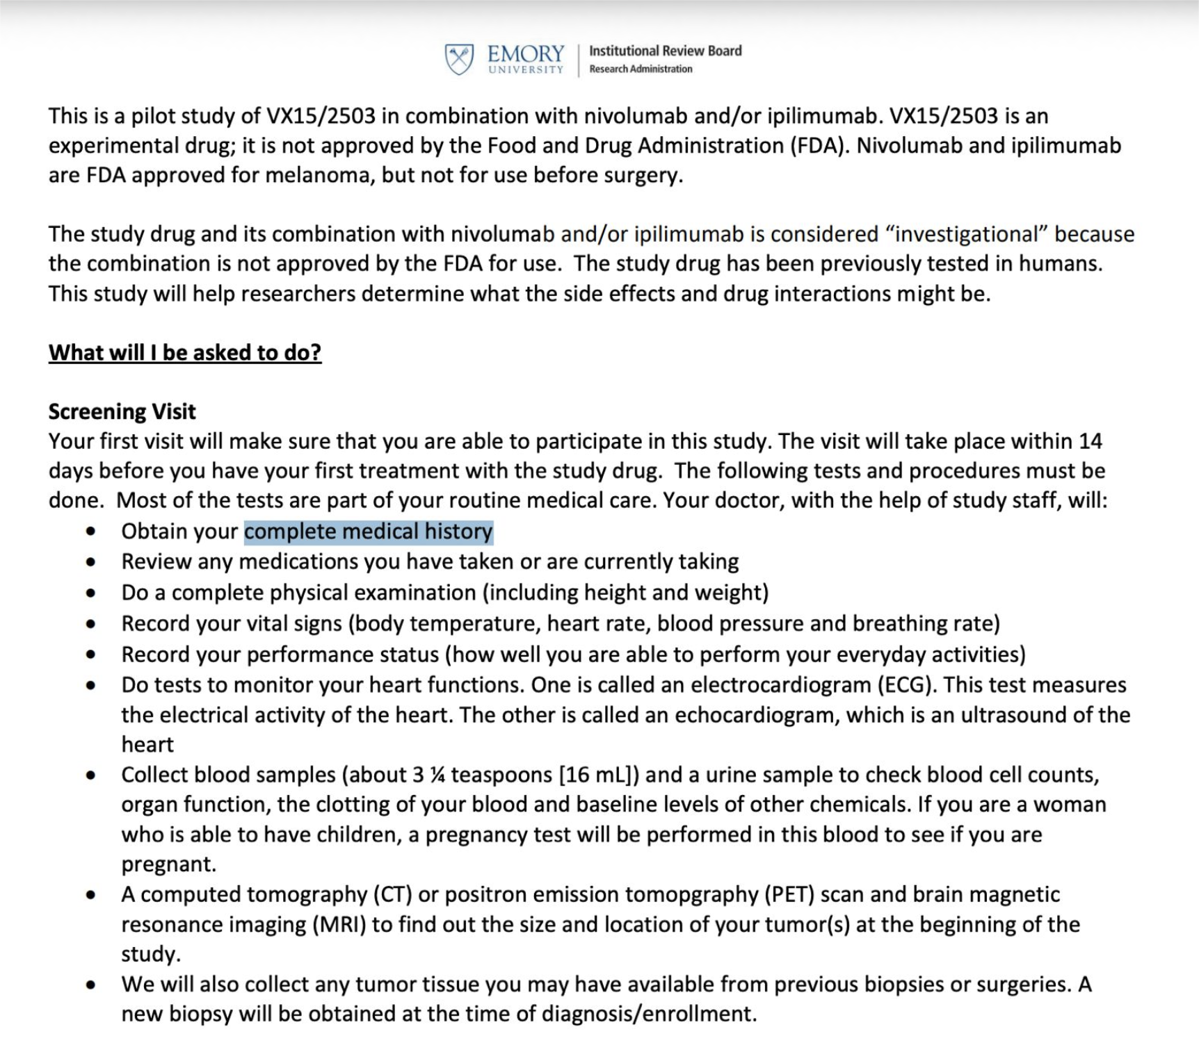
THE PROBLEM
Notes:
LIVE SCRIPT — read aloud (~6s):
“Here's the real thing — an actual Emory University consent form, word for word.”
────────────────────────────────────────
BACKGROUND
This is a genuine, publicly available Emory University IRB consent form for a real pilot study (VX15/2503, an experimental drug, combined with nivolumab/ipilimumab in melanoma). Nothing on this slide is a mock-up or a paraphrase.
It's the exact source the slide-3 bullet list was distilled from: complete medical history, medication review, full physical exam, vitals, ECG/echocardiogram, ~16 mL blood plus urine (including a pregnancy test where applicable), CT/PET/MRI imaging, and tumor tissue from biopsies — all before eligibility is even known.
Let it sit on screen for a beat in near-silence; the wall of text is the point. No need to narrate every bullet.
IF ASKED
Q: Did you get permission to show this / is this someone's real data?
A: It's the blank consent-form template itself, which is what Emory's IRB process produces and what a real patient would have signed — not a completed form with anyone's actual answers or identifying information.

Slide 5
THE PROBLEM
Patients Don't Trust Pharma With Their Data
18%
65%
31%
37%
trust pharma 'a lot'
say 'pharma only wants money'
concerned about data theft
worried sharing discourages others
Notes:
LIVE SCRIPT — read aloud (~5s):
“And patients know it. Trust in pharma with personal data is very low.”
────────────────────────────────────────
BACKGROUND
CISCRP 2023 Perceptions & Insights Study (n=12,017): only 18% trust pharma 'a lot'; 65% say 'pharma only wants to make money.'
NEJM / Mello et al. 2018 (n=771) surveyed people who had already enrolled in a trial, not just the general public: 31% were concerned about their data being stolen; 37% worried that data sharing discourages other people from enrolling.
Backup stat, not on the slide: a Dutch/German broad-consent study found only 16.6% would allow industry (pharma) access to their data under broad consent, versus 92% who accept broad consent for academic research generally. People trust research — they don't trust the sponsor.
SOURCES
• CISCRP 2023 — https://www.ciscrp.org/services/research-services/perceptions-insights-studies/
• Mello et al., NEJM 2018 — https://www.nejm.org/doi/full/10.1056/NEJMsa1713258
• Dutch/German broad-consent study — https://pubmed.ncbi.nlm.nih.gov/30890543/
IF ASKED
Q: Isn't 18%/65% just general public opinion, not actual participants?
A: The 31%/37% figures are from people who already enrolled (Mello, NEJM) — so the concern holds even among patients who already said yes once.

Slide 6
THE PROBLEM
Clinical Trial Data Breaches
NOVO NORDISK (June 2026)
~11,500 trial participants
DM CLINICAL RESEARCH (2024)
1.67M records — unprotected server
CENCORA (2024)
1.4M individuals — Novartis, Bayer, AbbVie
23andMe (2023)
6.9M users — data targeted ethnic groups
There's no way to reset health data the way you can a password.
Notes:
LIVE SCRIPT — read aloud (~6s):
“Their concern is well founded — here are four breaches from the last three years.”
────────────────────────────────────────
BACKGROUND
• Novo Nordisk (disclosed June 2026): ~11,500 trial participants; biomarkers, health data, and lifestyle factors exposed; hackers claimed 700K+ files / 1.3 TB.
• DM Clinical Research (2024): 1.67 million recruitment records — names, medications, pregnancy status — sitting on an unprotected database with no password.
• Cencora (2024): 1.4 million individuals; names, diagnoses, medications; sponsors affected include Novartis, Bayer, AbbVie, Regeneron.
• 23andMe (2023): 6.9 million users; the stolen data was specifically marketed by attackers to target Ashkenazi Jewish and Asian users, during a period of rising hate crimes — a targeted exposure, not a random one.
SOURCES
• HIPAA Journal (Novo Nordisk, DM Clinical) — https://www.hipaajournal.com/
• Drug Discovery Trends (Cencora, 2024)
• Security.org (23andMe) — https://www.security.org/identity-theft/breach/23andme/
IF ASKED
Q: Doesn't HIPAA cover this?
A: Nuanced, deliberately not on the slide because it reads as a legal technicality: pharma sponsors are almost never HIPAA 'covered entities' — that status is limited to health plans, clearinghouses, and providers. Research sites are covered; sponsors receive data under the patient's signed authorization, which is contract law, not HIPAA statute. HHS/OCR has stated research is not a 'covered function,' so sponsors usually aren't business associates either. A sponsor-side breach is pursued through state law and contract claims, not OCR/federal HIPAA penalties. (Wiggin & Dana — https://www.wiggin.com/publication/hipaa-considerations-for-pharmaceutical-industry-sponsored-research/; HHS.gov Business Associates FAQ.)
Q: Isn't a 'HIPAA-compliant' vendor system enough protection?
A: Not necessarily — that usually means the vendor is a business associate to its healthcare customers, not that the pharma sponsor using the system is itself bound by HIPAA.

Slide 7
THE PROBLEM
When Health Data Is Breached, It's Permanent
- Life, disability, long-term care insurers CAN legally use it
- GINA only covers health insurance and employers (15+)
- 550+ documented denials due to genetic predisposition
- Pre-employment screening flags, termination after disclosure
- 23andMe data marketed to target ethnic groups
You can reset a password. You cannot reset your genome.
Notes:
LIVE SCRIPT — read aloud (~6s):
“A breach of health data is not a temporary inconvenience — the consequences are lifelong.”
────────────────────────────────────────
BACKGROUND
GINA (Genetic Information Nondiscrimination Act) only covers health insurance and employers with 15+ employees. Life, disability, and long-term-care insurers are NOT covered — they can legally use genetic/health data in underwriting decisions.
550+ people have been documented by the EEOC as denied insurance or employment based on genetic predisposition alone.
Ties back to slide 6: the 23andMe data marketed to target ethnic groups is the concrete example of 'permanent and weaponizable' — targeted harassment, not just GINA-style insurance discrimination.
SOURCES
• Genome.gov — https://www.genome.gov/about-genomics/policy-issues/Genetic-Discrimination
• EEOC — https://www.eeoc.gov/genetic-information-discrimination
IF ASKED
Q: What exactly is GINA?
A: A 2008 federal law barring health insurers and employers (15+) from using genetic information in coverage or hiring decisions. Its gaps are real and by design: life, disability, and long-term-care insurance are excluded.

Slide 8
THE PROBLEM
The Enrollment Crisis
~40%
<2%
Up to 80%
25-32%
of NCI trials fail accrual
of cancer patients enroll
rare disease trials terminated
screen failure rate
Notes:
LIVE SCRIPT — read aloud (~6s):
“The privacy problem is also an enrollment problem — trials are starved of participants.”
────────────────────────────────────────
BACKGROUND
~40% of NCI (National Cancer Institute) network trials fail to complete accrual; fewer than 2% of adult cancer patients enroll in any trial at all (Craddock Lee et al., JCO 2019).
Screen-failure rate has risen to 36.3%, at an estimated $800-$2,500 cost per failed screen.
25-32% of rare-disease trials are terminated specifically for low accrual — not because the science failed, but because the logistics and trust failed.
SOURCES
• Craddock Lee et al., JCO 2019;37:1993-1996 — https://ascopubs.org/doi/10.1200/JCO.19.00101
IF ASKED
Q: Why do rare-disease trials get hit hardest?
A: Smaller eligible population to start with, so the same travel/trust barriers that cause any one patient to drop out have an outsized effect on whether the trial can recruit enough people at all.

Slide 9
THE SOLUTION
Two Barriers, One Solution: Privacy
BEFORE VITAPOD
WITH VITAPOD
✗ Share biomarkers to screen
✗ Data flows to pharma
✗ Data gets breached
✗ Breach is permanent
✓ Data never leaves device
✓ Sponsor sees: 'eligible'
✓ Nothing to breach
✓ Trust the math
Notes:
LIVE SCRIPT — read aloud (~3s):
“Both barriers have the same fix. First, privacy.”
────────────────────────────────────────
BACKGROUND
Core mechanism: instead of sending biomarker values to the sponsor, the patient generates a zero-knowledge proof locally stating 'this record satisfies the eligibility policy' — true or false — without transmitting the values that made it true.
This is a real, working zk-SNARK (EZKL compiling an ONNX policy graph to a Halo2 circuit), not a mockup: measured at ~2.05s to generate a proof and 27ms to verify it locally.
Why this beats other privacy approaches: tokenization (e.g. Datavant) still needs a trusted third party holding linkage keys; federated learning needs a trusted aggregator; homomorphic encryption produces an encrypted output someone must still decrypt. A ZK proof produces a public, verifiable result with no decryption step and no intermediary at all.
IF ASKED
Q: Isn't this just encryption?
A: No — encrypted data can still be decrypted by whoever holds the key. A ZK proof reveals nothing to decrypt; the sponsor never possesses anything the biomarkers could be recovered from.

Slide 10
THE SOLUTION
Two Barriers, One Solution: Logistics
BEFORE VITAPOD
WITH VITAPOD
✗ Travel 67+ miles to screen
✗ 2-4 hour screening visit
✗ Wait days/weeks for results
✗ Up to 80% fail anyway
✓ Know eligibility BEFORE travel
✓ 2-second local proof
✓ Instant verification
✓ Only qualified travel
Notes:
LIVE SCRIPT — read aloud (~4s):
“Second, logistics — the travel and time cost of screening disappears.”
────────────────────────────────────────
BACKGROUND
Current burden: 67 miles average one-way travel (135 for rare disease), a 2-4 hour screening visit (often across multiple visits in a 2-4 week window), days to weeks waiting for lab results — and still up to 80% fail after all of it.
With remote/decentralized verification: 89% completion vs. 60% for traditional trials; sites randomize 58% faster (0.79 vs. 0.50 participants/site/month); 63% of patients say they're more likely to join if telehealth is offered.
SOURCES
• CISCRP (travel distance) · ACRP (visit duration) — https://acrpnet.org/
• PMC10643920 (decentralized trial outcomes) — https://www.ncbi.nlm.nih.gov/pmc/articles/PMC10643920/
IF ASKED
Q: Does VitaPod replace the in-person visit entirely?
A: No — it front-loads the eligibility check so only patients who already qualify make the trip. Final confirmation, consent, and sample collection at the site are unchanged; we remove the wasted trips, not the trial itself.

Slide 11
MARKET
Market Opportunity
$1.9B
270+
2,000+
89%
AI patient matching by 2030
trials using tokenization
hospitals using Datavant
completion (decentralized trials)
Notes:
LIVE SCRIPT — read aloud (~4s):
“The market for privacy-preserving patient matching is already forming.”
────────────────────────────────────────
BACKGROUND
AI-based patient matching: $641.6M -> $1.9B by 2030 (25% CAGR). The broader clinical-trial recruitment market is $11.8B (2025), heading to $26.2B by 2035.
Datavant's tokenization is already deployed across 270+ trials and 2,000+ hospitals, including the top 30 pharma brands — proof sponsors already pay for privacy infrastructure.
The catch: tokenization still requires a trusted intermediary to hold linkage keys. A zero-knowledge proof needs nobody to hold anything — no intermediary at all.
SOURCES
• Grand View Research (AI patient matching market)
• Roots Analysis, 2025 (clinical trial recruitment market)
• Datavant — https://www.datavant.com/
IF ASKED
Q: So VitaPod competes with Datavant?
A: Not directly — different layer. Datavant tokenizes identity for linking records; VitaPod proves an eligibility computation without any intermediary at all. The two could coexist.

Slide 12
MARKET
Who Buys This
CROs (IQVIA, Medpace)
reduce screen failure costs
Patient matching (Trialbee, Deep 6 AI)
privacy as differentiator
Decentralized trials (Medable, Science 37)
trust-building
Rare disease (RARE-X, Global Genes)
reach privacy-sensitive
DeSci (VitaDAO, Molecule)
proof-of-contribution
Notes:
LIVE SCRIPT — read aloud (~4s):
“Five buyer segments, each with a different reason to care.”
────────────────────────────────────────
BACKGROUND
• CROs (IQVIA, Medpace) — reduce screen-failure costs directly.
• Patient-matching platforms (Trialbee, Deep 6 AI, Antidote) — privacy as a competitive differentiator.
• Decentralized-trial vendors (Medable — $2.1B valuation, Science 37, Curebase) — trust-building for remote enrollment, which is their whole business model.
• Rare-disease programs (RARE-X, Global Genes) — reach patients who otherwise won't share data at all.
• DeSci organizations (VitaDAO, Molecule) — need a privacy-preserving proof-of-contribution substrate for IP-NFT / funding mechanisms.
IF ASKED
Q: Do you have a signed pilot or customer?
A: No — this is a buildathon prototype. These are the logical buyers because they already purchase adjacent privacy infrastructure (e.g. Datavant); no LOI or pilot exists yet.

Slide 13
MODEL
Proof-of-Contribution Benefits
Drug access discounts for verified contributors
Priority trial access based on past participation
Travel/time compensation triggered by proofs
Personal health insights (aggregated)
Patient advisory board roles
Proof-of-contribution provides the substrate. Sponsors choose rewards.
Notes:
LIVE SCRIPT — read aloud (~2s):
“Proofs also give patients something back.”
────────────────────────────────────────
BACKGROUND
Once a patient can prove eligibility or participation without exposing data, that verified proof becomes a portable credential a sponsor can reward: drug-access discounts, priority access to future trials, travel/time compensation, aggregated personal health insights, patient advisory-board seats.
Important boundary — don't overclaim: a proof does not by itself grant IP rights, equity, or royalties. Molecule/VitaDAO already provide the legal IP-NFT wrapper for research contributions; what's been missing is a privacy-preserving way to prove a contribution happened at all. VitaPod is the verifiable substrate, not the reward mechanism — sponsors and DAOs choose what to layer on top.
IF ASKED
Q: Do proofs give participants IP rights?
A: Not directly — that requires separate legal frameworks: consent, contracts, IP assignment, regulatory review. What a proof gives you is cryptographic evidence that you participated. Sponsors or DAOs can attach any reward structure to that evidence.

Slide 14
HOW IT WORKS
How VitaPod Works
1
2
3
Patient loads lab results in browser (data stays local)
Local policy evaluation shows eligibility preview
EZKL compiles policy to zk-SNARK circuit
4
5
6
Proof generated locally in ~2 seconds
Blockchain records only wallet + proof hash
Sponsor sees ONE BIT: eligible or not
No age. No HbA1c. No eGFR. No data to steal.
Notes:
LIVE SCRIPT — read aloud (~5s):
“Six steps, all but one of them on the patient's own machine.”
────────────────────────────────────────
BACKGROUND
Three-stage architecture. (1) Browser: the React app parses the JSON record with a Zod schema — the single source of truth — and evaluates the same policy logic locally, in memory only, with no network calls. (2) Local proof pipeline: inside a pinned Docker container, the identical policy is encoded as an ONNX graph (age >= 18, HbA1c between 5.7 and 8.5, eGFR >= 60, all normalized to fixed-point integers), and EZKL compiles and proves it as a Halo2 zk-SNARK. (3) Blockchain: the registry contract verifies the proof and emits an event.
Pinned toolchain for reproducibility: EZKL 23.0.5, ONNX 1.19.1, Python 3.11.2, native aarch64 — versions and artifact hashes recorded in a manifest.
'No upload' is tested, not just claimed: an automated guard test scans the intake component's source for fetch / axios / XMLHttpRequest / sendBeacon / localStorage / IndexedDB and fails the build if any appear.
This 4-biomarker threshold is deliberately the simplest possible demonstration, not the ceiling: the same EZKL/ONNX pipeline compiles arbitrarily complex models the same way — EZKL itself has demonstrated proofs over 18-million-parameter networks. Swapping in a richer clinical model is a model-export change, not an architecture change.
IF ASKED
Q: What if EZKL changes its output format later?
A: Every dependency is version-pinned and recorded in a manifest (model hash, settings hash, EZKL/ONNX/Python versions) specifically so the proof pipeline stays reproducible on another machine.
Q: Is this actually zero-knowledge, or just hashing?
A: It's a real zk-SNARK (Halo2 via EZKL) over an ONNX computational graph — cryptographic proof of correct computation, not a hash comparison.

Slide 15
HOW IT WORKS
What the Blockchain Sees
PROOFACCEPTED EVENT
submitter: 0x742d...3a1f
WHAT IT NEVER SEES
wallet address
policyDigest: 0x8c29...4e7b
Age, HbA1c, eGFR, or any biomarker values
policy hash
proofDigest: 0x1a3f...9c2d
proof hash
Notes:
LIVE SCRIPT — read aloud (~4s):
“This is the entire on-chain footprint. Three hashes, no biology.”
────────────────────────────────────────
BACKGROUND
ProofAccepted event fields: submitter (wallet address), policyDigest (keccak256 of the policy identifier), proofDigest (keccak256 of the proof bytes). Nothing else is stored in the registry.
Never present anywhere in the proof, calldata, event logs, or storage: age, HbA1c, eGFR, or any biomarker value — checked by an automated privacy-scan test on the bundle, not just an assertion.
Replay protection: the registry maps policyDigest -> wallet -> boolean; a second submission from the same wallet for the same policy reverts with 'Wallet already accepted.'
IF ASKED
Q: Could someone reverse the hashes to recover the biomarker values?
A: No — keccak256 and the zk-SNARK proof are one-way; there is no computationally feasible way to recover inputs from a hash or from proof bytes.
Q: What if I lose access to my wallet?
A: No recovery mechanism exists yet — a known limitation tied to the identity-binding gap (a proof is bound to a wallet, not a verified person). See the roadmap slide.

Slide 16
BUILD
Technical Stack
Frontend
React + Vite + Tailwind (local-only)
Proof
EZKL v23.0.5 + ONNX (zk-SNARK)
System
Halo2 zk-SNARK
Contracts
Hardhat + generated verifier
Registry
TrialProofRegistry.sol
Deploy
Docker Compose (arm64)
LIVE DEPLOYMENT
0x22ec…255ab (verifier) · 0xe4a8…fefd9 (registry) — source-verified on HashKey Chain Testnet
PERFORMANCE
setup 5.7s · prove 2.0s · verify 0.027s
Notes:
LIVE SCRIPT — read aloud (~5s):
“Everything here is running today, with these numbers measured on a laptop.”
────────────────────────────────────────
BACKGROUND
Full stack: React + Vite + Tailwind (frontend, local-only); viem + wagmi (wallet); Zod (schema); EZKL v23.0.5 + ONNX (proof pipeline); Halo2 (proof system); Hardhat + generated verifier (contracts); TrialProofRegistry.sol (registry); Docker Compose, arm64 (deployment).
Measured performance, native linux/arm64 inside the pinned container: setup 5.665s (one-time — model export, calibration, circuit compile, key generation), prove (eligible) 2.050s, prove (ineligible) 1.907s, verify (local) 0.027s.
IF ASKED
Q: Does this run on a phone, or at production scale?
A: Demonstrated today on laptop-class arm64 hardware inside Docker. Browser-native (WASM) proving is future work, not yet built — we say that explicitly rather than imply it exists.
Q: Is the code open source?
A: Yes — github.com/dyrtyData/VitaPod, MIT license; synthetic fixtures only, no real health data anywhere in the repo.
Q: Is this deployed anywhere beyond Docker/local?
A: Yes — HashKey Chain Testnet (chain 133). Halo2Verifier at 0x22ec2ee3c88632f5a9c03afc74cb4027a54255ab, TrialProofRegistry at 0xe4a8412d544cf515eb869164855f24bc4d4fefd9 — both fully source-verified on the Blockscout explorer (testnet-explorer.hskchain.net), not just bytecode-deployed. Confirmed via raw RPC/API, not just tool output: bytecode matches, registry-to-verifier wiring is correct, a real committed proof was simulated against submit() and came back accepted at 648,593 gas, and the verified explorer source re-hashes to exactly match the committed source files. Mainnet (chain 177) was deliberately not touched.

Slide 17
ROADMAP
Future Roadmap
PHASE 1 — TODAY
PHASE 2
PHASE 3
PHASE 4
Prove eligibility for threshold policy
Authenticated inputs — signed labs, zkTLS
Scientific bounties — auto-claim on proof
Proof-of-contribution — continuous benefits
Notes:
LIVE SCRIPT — read aloud (~6s):
“Phase one is built and demoed today; two through four are the path from here.”
────────────────────────────────────────
BACKGROUND
Phase 2 — Authenticated inputs: today's proof shows the computation ran correctly, not that the input came from a real lab. Phase 2 adds provenance (signed lab results, FHIR provenance, or zkTLS) to close that gap.
Phase 3 — Scientific bounties: a sponsor posts eligibility criteria on-chain with a reward; a patient's proof auto-claims it when it verifies.
Phase 4 — Proof-of-contribution: proofs generated across enrollment, milestones, and completion accumulate into a track record that can unlock benefits (see the proof-of-contribution slide).
Be candid about today's two biggest limitations: (1) Data provenance — nothing today stops someone from proving over a fabricated record; (2) Identity binding — the registry binds a proof to a wallet, not a verified unique person (one person could use multiple wallets; a credential layer like World ID or zkPassport would be needed to close this).
IF ASKED
Q: What stops someone from faking their input data today?
A: Nothing yet, and we say so directly — the proof guarantees the computation ran correctly, not that the input is authentic. That's exactly what Phase 2 is for.
Q: Couldn't one person submit from ten different wallets?
A: Yes, today — the proof binds to a wallet, not a person. Identity-binding (e.g. World ID, zkPassport) is a deliberately separate, unsolved problem we've scoped for later, not silently assumed away.

Slide 18
SWITCHING TO THE APP
Live Demo
Load labs locally
Generate proof in ~2s
Verify on chain
Notes:
LIVE SCRIPT — read aloud (~7s):
“Switching to the live app now — load labs, see the preview, generate the proof, verify on chain.”
────────────────────────────────────────
DEMO BEAT SHEET
• 1. Load eligible.json — point at the age/HbA1c/eGFR fields and the 'Eligible' result. Say: evaluated entirely in-browser, no upload.
• 2. Import the CLI-generated proof bundle — point at the policy digest / model hash in the middle column. Say explicitly what's absent: no age, no HbA1c, no eGFR.
• 3. Connect wallet, submit — approve in the wallet, point at the emitted ProofAccepted(wallet, policyDigest, proofDigest) event.
• 4. The 'aha' beat — submit the same proof again, show the 'wallet already accepted' revert: one person, one verified contribution, no double-claiming.
IF THE DEMO BREAKS
Recovery line: 'The container's having a moment — let me walk you through what you'd see,' then narrate the three-column flow from memory (browser -> local proof artifact -> chain).
IF ASKED (mid-demo)
Q: Why isn't the raw lab file shown anywhere on-chain?
A: Point back at the 'what the blockchain sees' slide — literally nothing but the wallet address and two hashes ever leaves the local machine.
Q: Could you show this on the public testnet instead of localhost?
A: The same contracts are already live and source-verified on HashKey Chain Testnet (chain 133) — Halo2Verifier 0x22ec2ee3c88632f5a9c03afc74cb4027a54255ab, TrialProofRegistry 0xe4a8412d544cf515eb869164855f24bc4d4fefd9 — and a real proof simulates as accepted there too. We're running the live click-through on local Hardhat for reliability during the timed demo; happy to pull up the testnet explorer right after.

Slide 19
VitaPod
The privacy primitive for trustless clinical trials.
Same architecture, any model — the privacy primitive Decentralized Science needs.
github.com/dyrtyData/VitaPod
Questions?
Notes:
LIVE SCRIPT — read aloud (~7s):
“VitaPod is the privacy primitive for trustless clinical trials. Repo is public — happy to take questions.”
────────────────────────────────────────
MASTER Q&A INDEX — for the open Q&A period
Q: Doesn't this already exist?
A: No runnable open-source example combining EZKL + ONNX + a generated Solidity verifier + an on-chain registry for clinical eligibility was found. Academic proposals exist as papers without shipped code (TeleZK-L2, TeleZK-FL, zkFL-Health, CoSMeTIC). Solve.Care's Care.Trials (2023) uses ZK for identity, not zkML over biomarkers. EZKL's own docs have no healthcare example. VitaPod is the first runnable reference implementation of this specific combination — not a new idea, the first proof the idea works.
Q: Doesn't HIPAA already cover this?
A: Pharma sponsors are almost never HIPAA covered entities; data reaching them is bound by contract/authorization, not federal statute (see the breaches slide). VitaPod sidesteps the question entirely — it never transmits PHI, so there's nothing for HIPAA to cover.
Q: Do proofs give participants IP rights?
A: No, not directly (see the proof-of-contribution slide) — that requires separate legal frameworks. VitaPod is the verifiable substrate, not the reward mechanism.
Q: How do you know the input data is real?
A: We don't, yet (see the roadmap slide) — explicitly out of scope for this prototype; Phase 2 (zkTLS / signed labs) is the next step.
Q: How fast is this, really?
A: 5.7s one-time setup, ~2s to prove, 27ms to verify (see the technical-stack slide).
Q: What's the business model?
A: Not fully designed yet. Likely buyers: CROs, patient-matching platforms, DCT vendors, rare-disease programs, DeSci orgs (see the 'who buys this' slide) — sponsors already pay for privacy infrastructure like Datavant.
Q: Can I see the code, or a written report?
A: Code: github.com/dyrtyData/VitaPod (MIT license). A citation-backed write-up also exists in the repo at docs/report/vitapod-zkml-eligibility.md (and as a PDF) if anyone wants the full methods/results/references.
Q: Is this live on a real chain, or just local?
A: Both. Reproducible local Hardhat drives the timed demo; independently, it's also deployed and fully source-verified on HashKey Chain Testnet (chain 133) — Halo2Verifier 0x22ec2ee3c88632f5a9c03afc74cb4027a54255ab, TrialProofRegistry 0xe4a8412d544cf515eb869164855f24bc4d4fefd9, testnet-explorer.hskchain.net. A real proof simulates as accepted on-chain there (648,593 gas), and the verified explorer source hashes exactly match the committed source files. Mainnet was not touched.
Q: Why does 'Decentralized Science' show up on the closing slide — is this just a clinical-trial tool?
A: The architecture is deliberately generic: the same EZKL/ONNX pipeline that proves a 4-biomarker threshold today proves any deterministic computation over private data, and swapping in a complex ML model doesn't touch the registry or verifier contracts. That's the actual pitch for DeSci — a privacy-preserving proof-of-computation primitive that any decentralized science project needing 'prove this happened, without revealing the private input' can build on, not a clinical-trials-only tool.

Slide 20
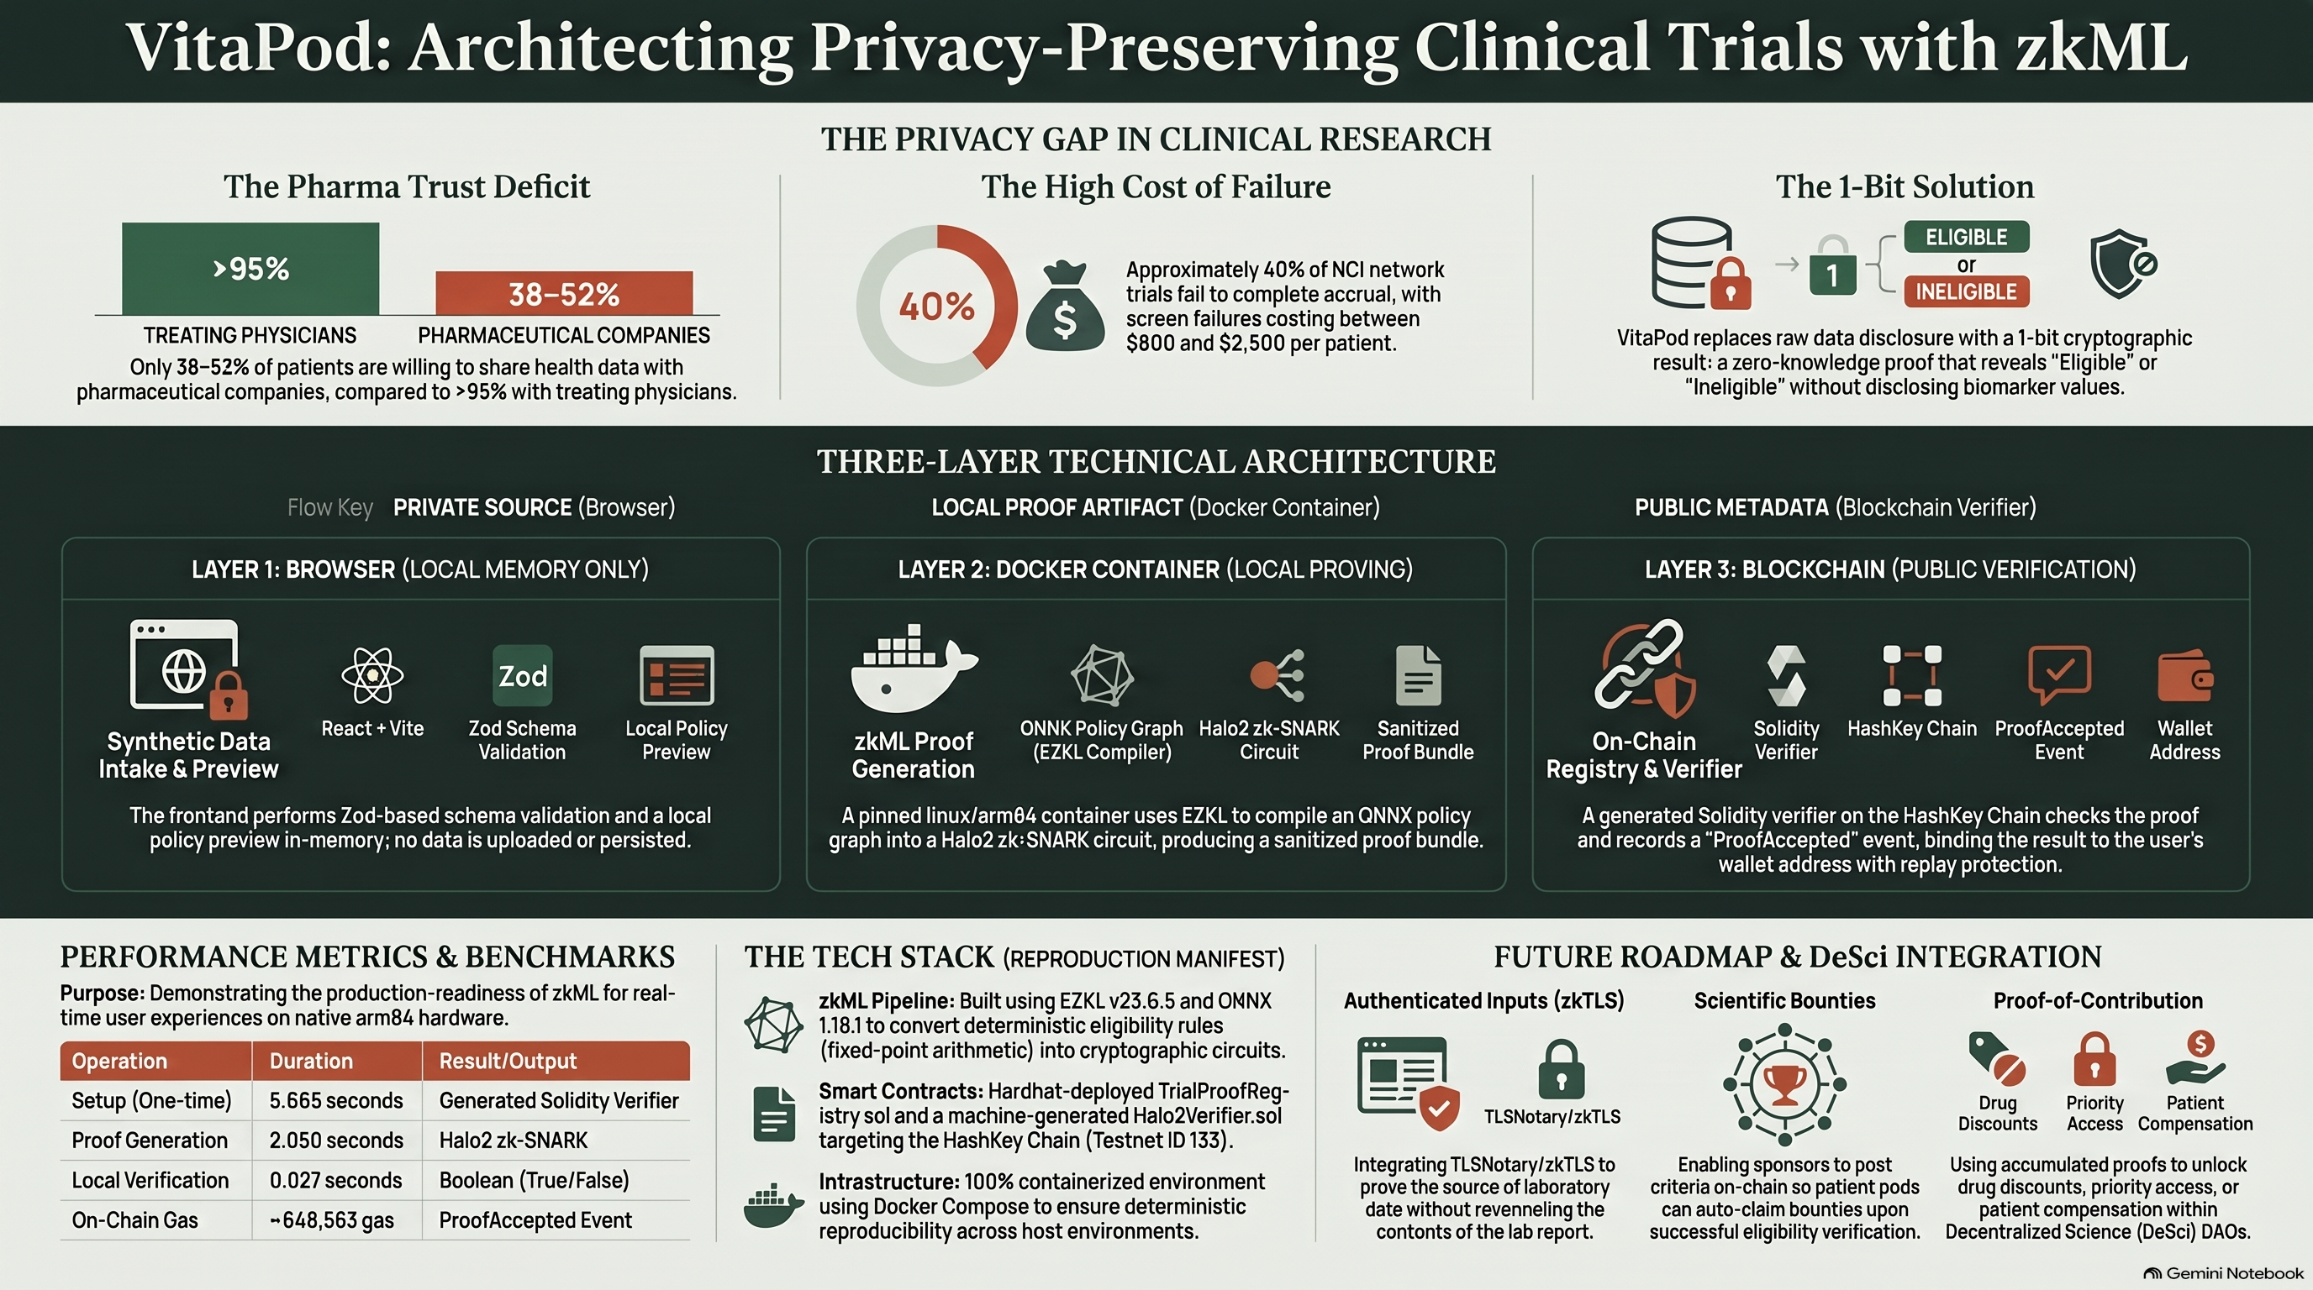
Notes:
Appendix — architecture reference infographic (supplementary, not part of the timed pitch).

