Slide 1
Multitouch Interfaces
Will Holcomb
CS-395: Multimedia Systems
Fall 2008
http://odin.himinbi.org/classes/cs395/
Notes:
Good afternoon, my name is Will and I am going to be telling you a bit about multitouch systems today.
I've been interested in these interfaces for a while and I think there are some really interesting potential applications with them and figured I'd take this class as an opportunity to learn about them and build one.

Slide 2
Presentation Overview
Introduction
History
Projector/Camera Based Construction
Applications
Notes:
This presentation will cover the design motivations and basic construction of multitouch systems.
After some history of the field, I am going to focus on construction methods used for creating large (four foot and larger) systems.
I'll wrap things up with an overview of how the interfaces are being used in some places today.
Sprinkled throughout the presentation are little videos. Multitouch has some demos that are certainly at least as interesting as me talking.
My slides are mostly diagrams that I will be explaining. So, if I say something that isn't clear and you would like more information on, feel free to stop me and ask.

Slide 3
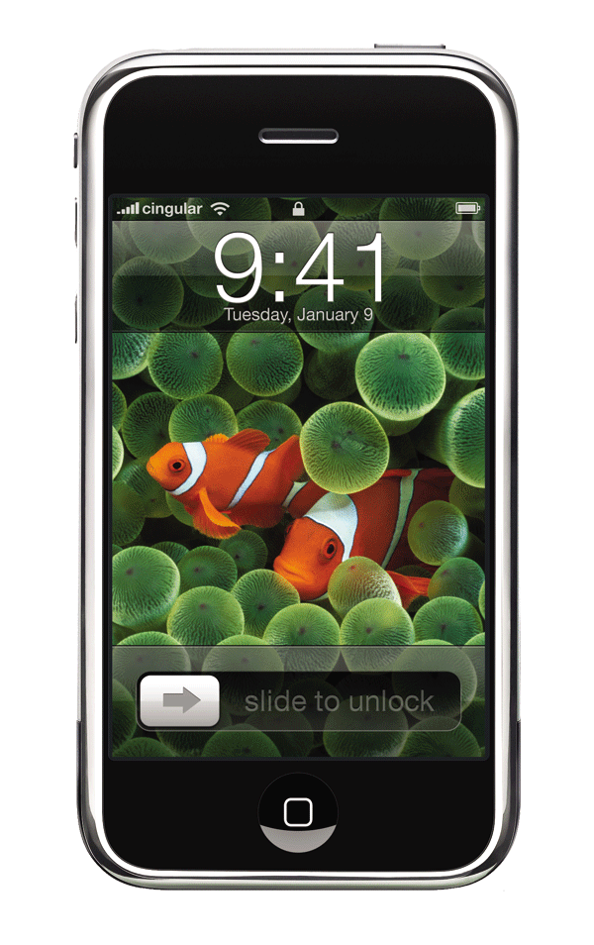
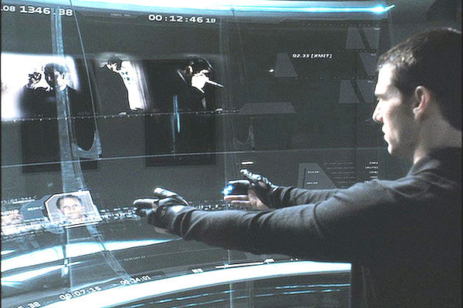
What Is Multitouch?
Multiple simultaneous passive styluses
Minority Report
iPhone
Notes:
So, what is multitouch exactly?
Everyone here is familiar with the technology, if not the name. Multitouch simply means a touch interface where multiple contact points are made simultaneously.
Perhaps the first time that multitouch really made it into the public view on a large scale was in the movie Minority Report.
Show Video
Multitouch isn't just big though, there's probably at least one person in this room with a small multitouch display in their pocket.
Apple's iPhone is the largest deployment of multitouch interfaces in the market currently.
Show Video

Slide 4
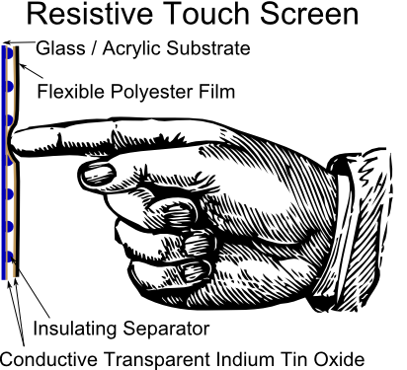
Resistive Touchscreen
Invented in 1971
Still in use today
Labor intensive production
Material fatigues over time
Difficult to scale
Notes:
Multitouch, as a technology, grew out of single touch interfaces.
Dr. Sam Hurst at the University of Kentucky designed the first touch sensor in 1971. The design uses two separated sheets of metal and the resistance between them to determine the location of the touch.
A few years later, Hurst changed the conductive surface to a transparent metal oxide layered on glass and created a screen that could be mounted in front of a television.
Thus the touch screen was born.
The problem with resistive touch screens is that it requires physically flexing a panel in order to make a contact.
Over time and extended use this panel will fatigue and begin to deteriorate.

Slide 5
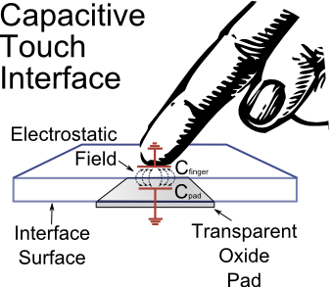
Capacitive Touchscreen
Entirely electrical operation
Multitouch possible using patterned etching
Still not scalable to large interfaces
Notes:
A different approach to the problem is to use the fact that the human body is a big conductor that holds a charge.
As you probably remember, when two charge carriers are held apart from each other there is an magnetic field between them.
Capacitive touch interfaces use this change in capacitance to detect and localize a touch.
Multiple touch interfaces can either be created with different patterns of etching of conductors on the glass or with multiple layers of conductors.
Capacitive interface have the advantage of being completely electrical, and so more robust than resistive interface, but they still don't scale up to large sizes well.

Slide 6
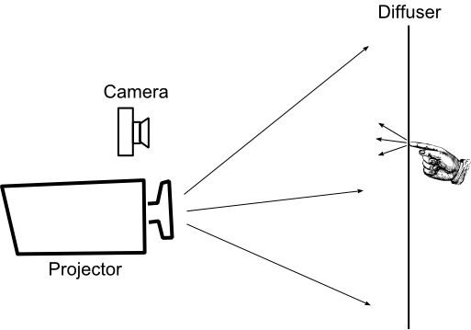
Camera / Projector Multitouch
Notes:
There are a few other types of touch-based systems, including ones using strain gauges and the absorption of ultrasonic waves. Practically though, pretty much all large installations operate using a camera / projector pair.
This is the basic setup: a projector and camera are both pointed at the back of a screen. The user then stands at the front of the screen and when he touches the screen the camera takes a picture of the touch which is then processed and the location of the touch is translated into a cursor movement in the interface.
One obvious issue with this setup is the clarity of the image. Since the light coming from the projector is necessarily changing in intensity (since the interface is changing in appearance), how does one get a consistent clear image of the touches?
The camera is generally operating in infrared.

Slide 7
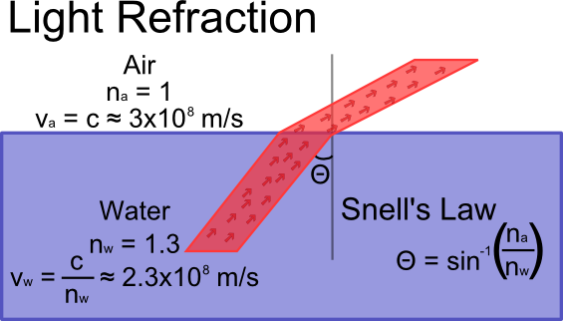
Light Refraction
Light travels at different speeds through different media
Photons arriving at different times causes a “bending” of the light beam
Notes:
Before discussing the first method of creating a display, I'm going to do a brief physics review.
You may recall from basic relativity that the speed of light, c, is constant in all frames of reference.
That is not entirely true. C denotes the speed of light in a vacuum. The speed of light in any given medium is constant for all frames of reference, that speed is not always 3x10^8 m/s however.
The index of refraction for a material gives the ratio of the speed of light in a vacuum to the speed in that material.
Even a beam of light like a laser is billions of photons wide. This means that the photons at the top of the beam hit the border between the two media sooner than those at the bottom.
The difference in timing for the change of speed causes a “bend” in the beam (which we refer to as refraction).

Slide 8
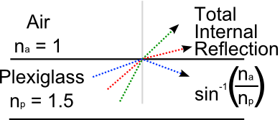
Total Internal Reflection
There exists a critical angle where the beam doesn't escape from one media into the other
The beam of light is reflected back into the original medium
Notes:
Air has an index of refraction that is nearly the same as a vacuum. This means that when light is entering the air from another material it tends to be bent back toward the original material.
If the angle of incidence is high enough, the ray of light won't enter the air at all. It will, instead, be reflected back.
This is called “total internal reflection,” and it is the property that fiber optic cables use to transmit light. At the fair they sell little fiber optic toys with a bunch of little fiber optic cables mounted on a flashlight. If you take those cables and bend them you can change the angle of incidence within the cable and the light will escape.
Also it is noteworthy that if the material where the beam was reflected is flat on both sides, the angle of incidence when the beam hits the opposite side will also be internally reflected.

Slide 9
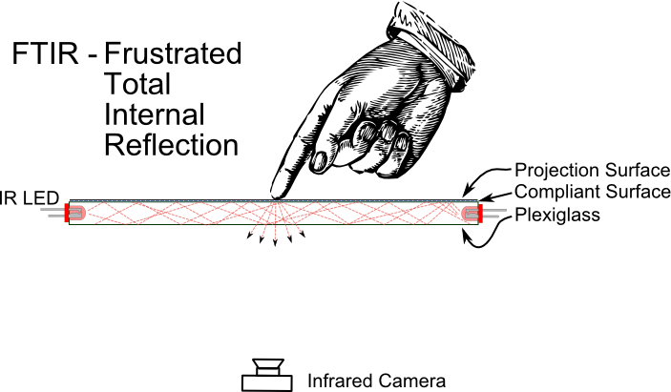
Frustrated Total Internal Reflection
Notes:
The first method of infrared illumination that was used in multitouch displays relied on total internal reflection.
A row of infrared leds is mounted along the side of a piece of plexiglass and rays of light are sent bouncing back and forth within the surface.
Because of total internal reflection, none of the rays escape from the surface and there is no outward illumination.
When someone presses something against the surface, however, that object will scatter the beams within the surface and become visible to an infrared camera.

Slide 10
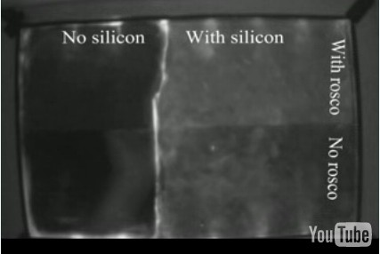
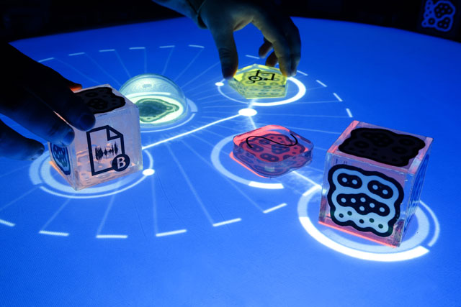
Compliant Surface
Surface Test
Reactable
Notes:
One of the issues with ftir is that the amount of illumination is a function of the quantity and pressure of the contact with the surface.
This is a positive characteristic in that it makes it possible to have pressure sensitive displays, but negative in that if too much pressure is required it will unnecessarily fatigue the user.
To mitigate this issue, the surface of the plexiglass is frequently covered with a more pliant material, generally clear silicone. This preserves the pressue sensitivity while reducing the amount of pressure needed.
Show Video - Mention rosco is a commercial projection surface.
Another issue with fitr is it is purely touch-based, there is no illumination of the object on the screen. This makes it impossible to see fiducials, for an example of an interesting application of fiducials, lets look at the reactable project. Show Video

Slide 11
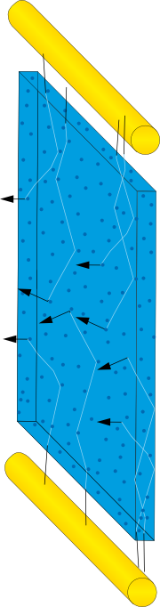
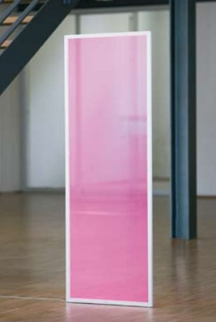
Plexiglass EndLighten
Light transmitted through surface using total internal reflection
Particles within the surface diffuse light
Even illumination across the material
Notes:
One potential solution to the issue is to use a material made by plexiglass called EndLighten.
EndLighten is much like the normal acrylite that plexiglass is generally made of, but the material also contains small particulate matter that diffuses light.
This uniform diffusion will disrupt total internal reflection and cause the surface of the material to glow.
The original intent was to simply provide a large uniform light source for illuminating signs. A printed translucent plastic sign is mounted in front of the EndLighten and the material will light it uniformly.
This also offers an opportunity for another type of multitouch display however.

Slide 12
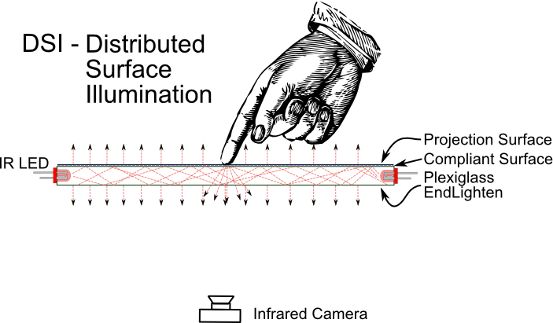
Distributed Surface Illumination
Notes:
Distributed surface illumination is the same basic setup as frustrated total internal reflection, but now touch will both disrupt internal reflection and the object will also be illuminated by the surface.
This allows for applications that involve detecting markers through the surface.
There is some degradation of image quality since previously the only infrared light was from the ftir and with dsi there is a uniform infrared glow everywhere.
This reduces the contrast of images, but the software can still adequately detect blobs.
The issue with EndLighten is cost. It is not as readily available as normal plexiglass. In Nashville, for example, it is only possible to order it from the distributer at $450 per sheet with a 20 sheet minimum. That's a bit much for a prototype.

Slide 13
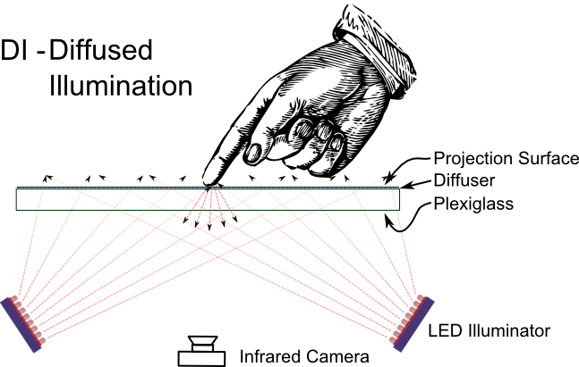
Diffused Illumination
Notes:
An alternative is to do away with the internal reflection altogether and simply point arrays of infrared leds at the back of the screen.
The light will then shine through and illuminate whatever is on the other side for the camera.
The biggest disadvantage to this method is that is is very difficult to get uniform illumination across the surface. Without uniform illumination, it is difficult for the software to determine whether a change in luminosity was the result of the user moving farther away or simply a change in the light intensity.

Slide 14
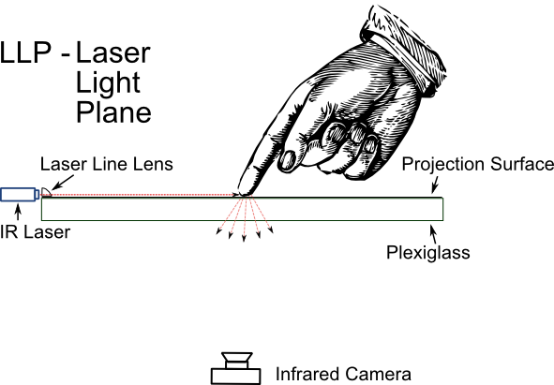
Laser Light Plane
Notes:
A final method that I want to mention is the laser light plane.
In this method, a set infrared lasers are mounted at the sides of the surface and filtered through a lens that flattens their beam into a line.
These flattened beams are aligned just above the surface of the table so that when any object touching the surface is illuminated.
FITR has an issue where fast movements across the surface can reduce the intensity of the blobs, making it more difficult to track. LLP was designed to give a faster response time.
The main issues with LLP are the orientation and calibration of the lasers. They require very precise positioning to create a light plane just above the surface and there must be enough of them in the design that an object in one place doesn't block another.
Also, this method can't read markers.

Slide 15
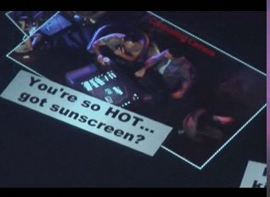
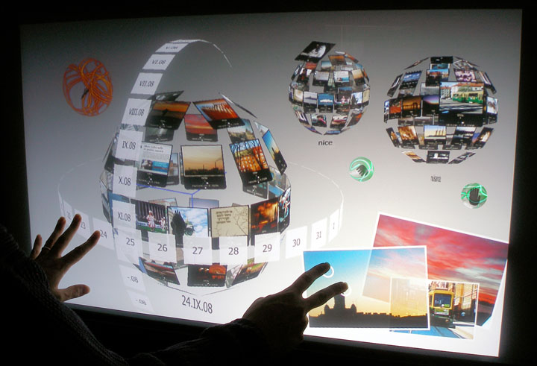
Commercial Applications
Microsoft Surface
CityWall
Notes:
Probably the biggest player in the commercial multitouch market at this point is Microsoft with their Surface product.
Show Video
This video shows an installation at the Rio Hotel in Las Vegas called iBar.
Note that there are several different interaction modalities being exploited for person, within group and intragroup interactions as well as commercialization.
Another large scale installation is CityWall in Helsikni, Finland.
Show Video
This interface is interesting not only because it is publicly accessible and draws its media from public sources like Flikr, but it is also an attempt to use a three dimensional interface, an idea that has largely failed on the desktop, but which might work for multitouch.

Slide 16
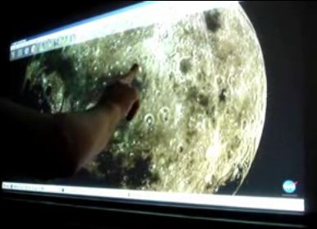
Touchlib
Touchlib
Notes:
Touchlib is an open source C++ software library for interfacing with multitouch displays. This video demonstrates several of the capabilities including fluid dynamics simulations and image manipulation.
The library also has the ability to interface with Flash applications.
Show Video
Touchlib is maintained by the NUI Group.

Slide 17




Further Reading
Instructables
Perceptive Pixel
Ubiquitous Interaction
NUI Group
Notes:
Instructables, an outgrowth of Make magazine, has several in-depth tutorials on creating multitouch displays.
NUI Group is likely the most active internet forum for the discussion of constructing multitouch displays, particularly for hobbyists. They are also the creators of the touchlib demo that I showed in the last slide.
Perceptive Pixel is a company founded by Jeff Han who was one of the early innovators in the multitouch field.
Ubiquitous Interaction is the research group at the University of Helsinki that did the CityWall and has several more rigorous interface use studies available.

