Slide 1

Department of Happiness
The DoH
Choose the Future
10 November 2009
Will Holcomb
http://dhappy.org
Notes:
Hello, my name is Will Holcomb and the Department of Happiness is an idea that I have been working on for the last year.
This presentation is both to keep the security organizations abreast of what I am planning and also offer the possiblity of involvement.

Slide 2

The Department of Happiness
Notes:
Last November, I started writing a near term science fiction story called Technoanarchist Revolution about a group of nerds who take over the country by creating a software company which privatizes the utility markets by out competing the government.
I am planning to tell the story in a collaboratively scripted videoblog and attempt to use the medium to organize people to actually make it happen.

Slide 3

The Five Year Plan
Notes:
The show as a whole is working toward making 1/1/2015 a day when no one pays for food.
The intervening five years are about introducing and popularizing the technologies that will make that possible.
The first two years are about creating infrastructure, both technological and social.
The third year introduces the idea of planet-wide celebrations and works at throwing the largest party possible for the end of the Myan calendar.
The fourth year takes the media attention from the previous years and starts turning it outward by focusing on travel.
The fifth year introduces the idea of starting each year with a day where everyone eats and then tries to make it happen.

Slide 4
Digital Contracts

Slide 5

Cornucopia
Notes:
The first is creating the software to organize a worldwide party for the end of the world, the new moon at the end of the Myan Calendar.
The second is organizing a day where all the food on the planet is served without cost on New Years 2015.

Slide 6
Swap

Slide 8
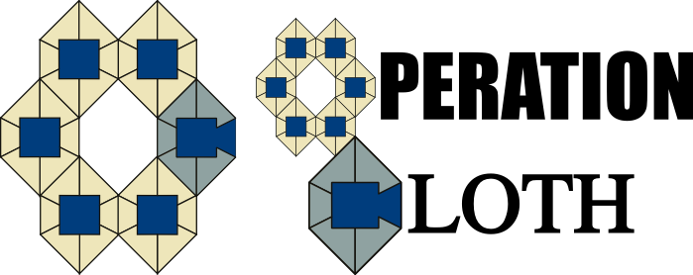
What Is Cloth?
Notes:
The way that I am going to structure this presentation is as a military briefing. One of my basic ideas is that there should be some method for civilians to submit operational plans to the military for potential execution.
So, this is a proposed operational timeline. It explains the actors and their roles including a potential role for the government.
The name for the propososed project as a whole is Operation Cloth for reasons that will be explained as the presentation progresses.

Slide 9
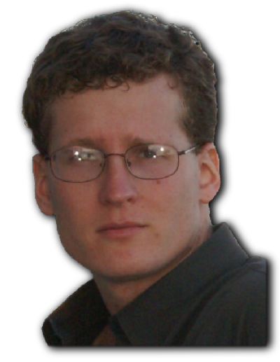
⋱ Who Is Will Holcomb?
Agent: Will Holcomb
Codename: Will
Role: Year One: CEO
Notes:
First, I'll introduce myself. My name is Will Holcomb.

Slide 10
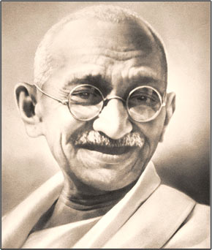
ⓐ Technoanarchy
"If national life becomes so perfect as to become self-regulated, representation becomes unnecessary. There is then a state of enlightened anarchy. In such a state everyone is his own ruler. He rules himself in such a manner that he is never a hindrance to his neighbor. In the ideal state, therefore, there is no political power because there is no state. Hence the classical statement of Thoreau that 'the government is best which governs least.'"
— Mahatma Gandhi
Notes:
I needed a name for the system running this utopia. It's a direct democracy, but there and changes to the systems of how resources are distributed as well.
So far as the isms of the world would probably be classified as Democratic Socialism or Mutualism. It's not really a philosophical ideal though. I don't really worry about what is fair as much as what is likely to happen.
The basic story is the scientists and humanitarians finally get fed up and use technology to out compete the corporations. So, I combined ”technology” + government that tries not to interfere (i.e. ”anarchy”) for Technoanarchy.
I don't plan to use the term when discussing the project though because, unfortuately, militants have tarnished the word ”anarchy” to the point it only conjures to mind instability and violence.

Slide 11
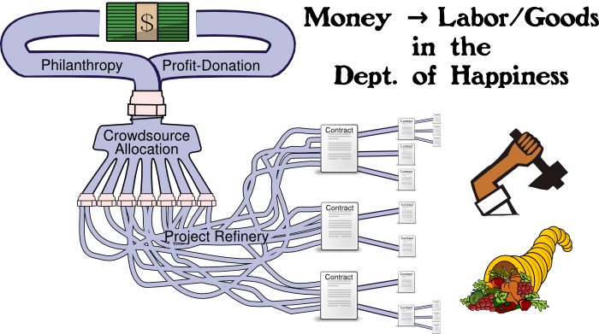
$ Follow the Money

Slide 12
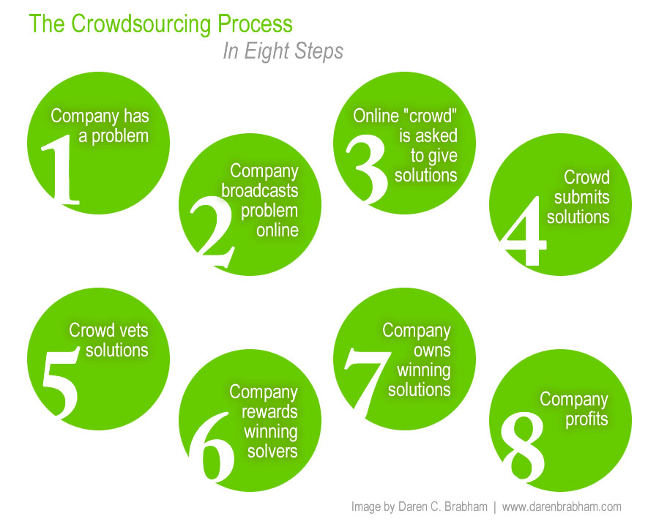
⧜ Crowdsourcing

Slide 13
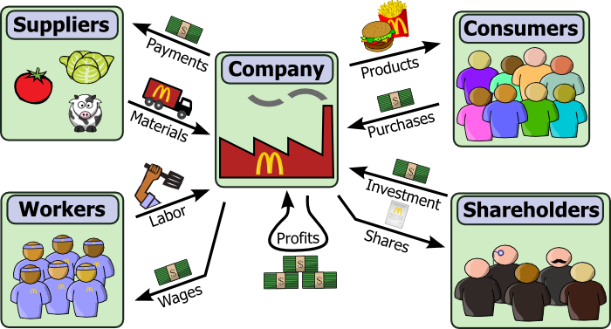
Traditional Corporation

Slide 14
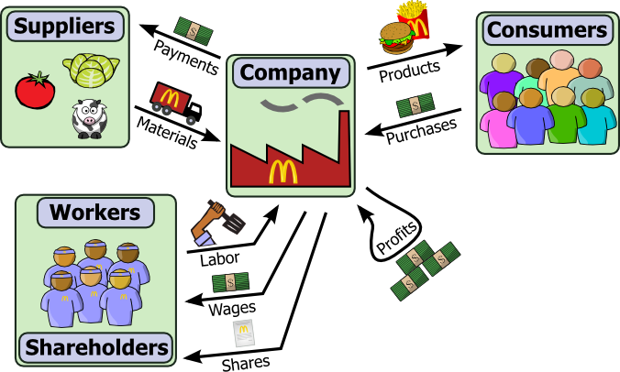
Worker-Owner Cooperative

Slide 15
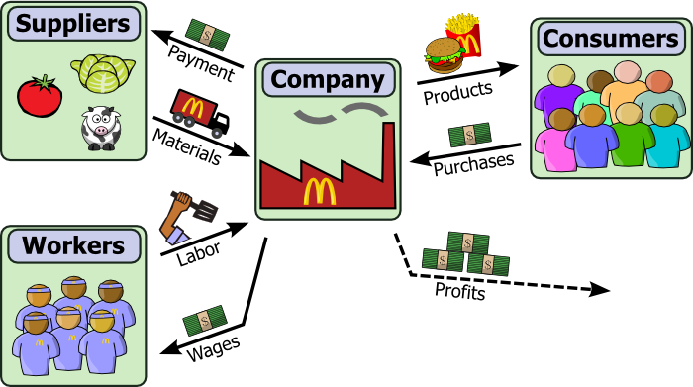
足 Profit-Donation Capitalism

Slide 16
$ Follow the Money

Slide 17
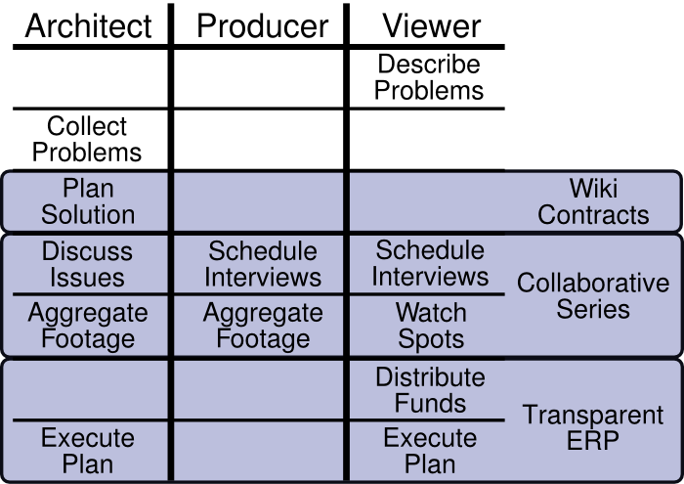
Project Refinery

Slide 18
Wiki Contracts
Resource requirement — goods or labor
Negotiation through editing
Any edit clears signatures

Slide 19
Collaborative Series
Custom content channels
Channels are series of spots developed by producers
Spots composited from footage vault

Slide 20
Transparent Resource Planning
The division between companies is traditionally the distribution of profits
Profits are used for reprovisioning, growth and innovation
Profit-donation creates self limiting businesses
The DoH functions as a innovation incubator

Slide 21
$ Follow the Money

Slide 22
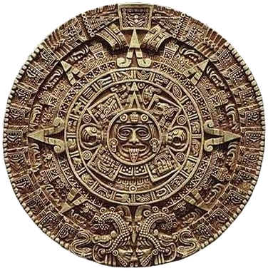
▶ The End of the World
21/12/2012
Notes:
If you follow the latest in Internet trivia, you may have heard that the winter solstice in 2012 marks the end of the 12th baktun in the Mayan calendar. This is the end of the Mayan calendar which began over 5,000 years ago.
There are lots of theories as to what this might mean which fall roughly into either the mystical or the apocalyptic. On both sides though there's this sense that something big will happen from outside to change humanity.
What I thought would be interesting is if this date was somehow significant for a social movement. The question was then when, where, how and why such a thing might come about.

