Slide 1

Quest - Participant Briefing Event
December, 2017
This presentation is solely for the use of client personnel. No part of it may be circulated,
quoted or reproduced for distribution outside of the client organization without prior
written approval of ZS Associates.
Evanston | +1 847 492 3600

Slide 2
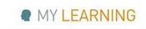
The third innings of QUEST is here…
Close to 20 teams each in New Delhi and Pune consisting of 7 to 10 members each: 342 participants in total (163 from Delhi & 179 from Pune)
50 students are joining us from top e-schools
Quest is happening at the same time in Delhi and Pune
We had an amazing Quest Innovation Challenge last year and we are looking to make it even bigger and better this time!
Focused on collaborative learning and building solutions to new age problems…Focused on ‘serious’ innovation while having fun on the way!
Every team has an equal opportunity to Make an Impact
A Big Thank you for giving up part of your Saturday

Slide 3




Share your moments from Quest on Social Media using the hashtag: #ZSQuest2017
Participate in our Twitter contest using #ZSQuest2017
CONTEST RULES:
LIKE and FOLLOW the ZS India pages
(Click on the icons below to LIKE/Follow)
Post a tweet with an interesting caption and photo
Use the hashtag #ZSQuest2017
ZS in India
ZS in India
@ZSIndia_CEC
ZS in India

Slide 4
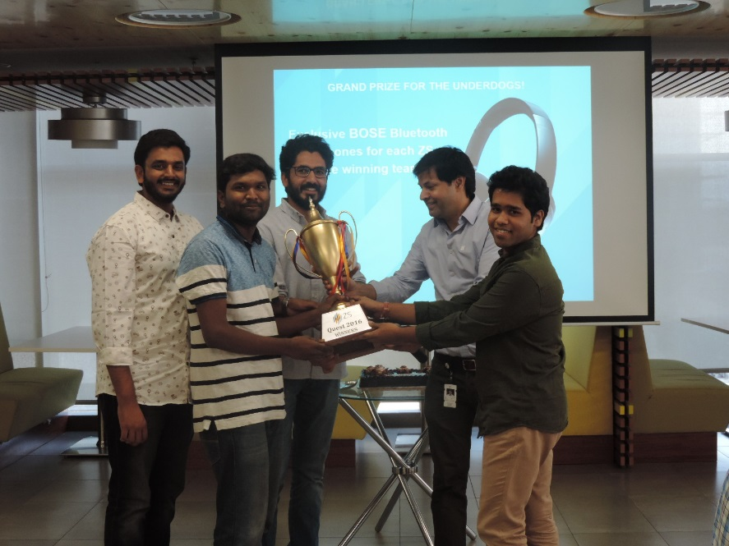
Winners will be announced in the coming months
Winning tools, PoC’s and prototypes will be used on projects
Extensive coverage and “bragging rights” at ZS
Underdogs – Pune Winning Team from Quest 2016

Slide 5


Slide 6
Overview of QUEST – Venue & Areas
15th -16th December
11th Floor in ND office & 2nd Floor in Pune office
We will begin the day at 8:00 AM and end at 7:30 PM on Sat
The Hub | The Café | Time Out
This area is the main area where QUEST will be conducted. 33-hour marathon challenge | This room is where the participants and others would be served refreshments and they can take a break. | This is the sleeping zone. Separate zones for males and females. Participants could take a nap here.
 | Tech Room | Logistics Room
 | Tech support services are controlled out of here. These include audio, video, social media, etc. | This space is reserved for Logistics managers to control the end- to- end delivery of QUEST.

Slide 7
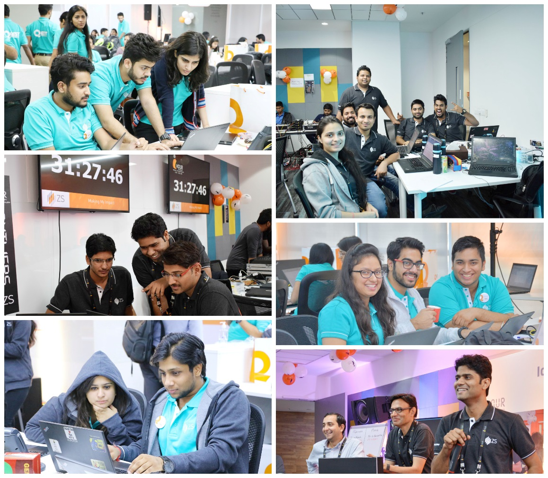
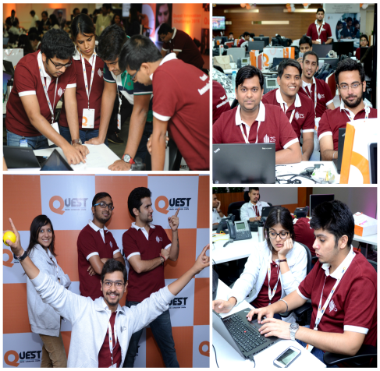
Moments from 2015 and 2016!

Slide 8
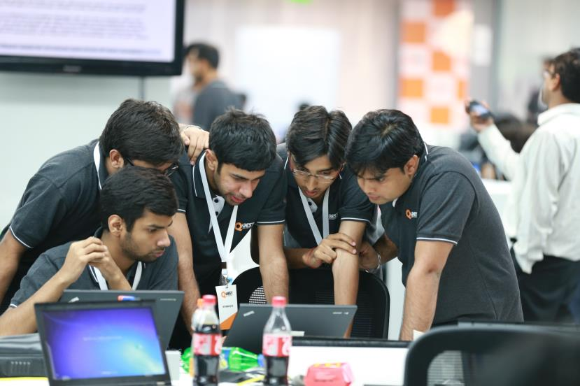
At ZS Quest, its not about your idea or my idea but our idea

Slide 9
Rules of Engagement
Once a team is formed, the composition cannot be changed.
Please arrive at QUEST Hackathon with your complete team for registration and breakfast at 8 a.m. Teams need to be photographed in front of a branded panel before inauguration.
The Hackathon will go on for up to 33 continuous hours. Teams should submit their respective solutions within the allotted time. If teams complete their solutions within 24 hours (10:30 a.m.), 27 hours (1:30 p.m.) and 30 hours (1:30 p.m.), they can choose to submit and leave. Cabs will be allotted only after 24 hours and after 33 hours.
Teams will be allowed to carry their ZS laptops, and access to sources on the web is permitted. For any software-related queries on the Quest day, reach out to Ganesh Shinde in Pune.
Submitted solutions will be judged by the panel and their decisions will be considered final.
Enter your time spent in Quest using this project code 9100ZS0003
Diversity in your team can significantly improve your chances of winning

Slide 10
Rules of Engagement
The submitted solutions will be judged by the panel and their decisions will be considered final.
In case a team member has to drop out because of genuine reasons such as illness, the organizing team will review and provide the team with a new replacement.
Each of you will need to sign a standard Indemnity Form during registration
Any questions should be directed to Abhishek Trigunait, Nirupam Tiwary, Roshni Khanna, Anisha Pullokkaran, Rameshwari Sakhalkar or Mayura Joshi.
Use #ZSQuest2017 on Twitter to talk about moments from Quest!

Slide 11
Schedule for 15th and 16th Dec

Slide 12
Schedule of Day 1 – Friday, December 15
Agenda | Start Time | End Time | Location
Breakfast: First floor cafeteria | 8:00 AM | 8:50 AM | First floor
Team registration @ second floor (Quest zone) | 8:00 AM | 8:50 AM | Second floor
Participants settle down and sit with their teams in hackathon after registration | 8:50 AM | 9:00 AM | Second floor
Quest opening ceremony on second floor Opening note by Sanjay (VC) – 10 minutes Keynote address by Aseem Sood (VC) – 20 minutes Message from Tarun – 5 minutes Introduction to IdeaBox by Pankaj – 5 minutes Note from Chris and Jaideep – 2 minutes Diya ceremony by Tarun and Abhishek – 10 min | 9:00 AM | 10:00 AM | Second floor
Teams to settle in hackathon zone (second floor) in their assigned spaces and photograph | 10:00 AM | 10:30 AM | Second floor
Tarun/Abhishek to start the countdown clock and Quest is declared open. Teams start working on their respective topics. | 10:30 AM |  | Second floor
Morning snacks | 11:30 AM | 12:00 PM | Second floor (same for Day 2)
Lunch | 1:30 PM | 3:00 PM | First floor (same for Day 2)
Evening snacks | 4:30 PM | 5:30 PM | Second floor (same for Day 2)
Dinner | 8:30 PM | 10:30 PM | First floor (same for Day 2)
Late-night snacks | 11:30 PM |  | Second floor

Slide 13
Schedule of Day 2 – Saturday, December 16
Agenda | Start Time | End Time
Early morning snacks | 5.00 AM | 5.30 AM
Breakfast | 8:00 AM | 9:30 AM
Teams continue with their topics | … | 10:30AM
Submission option 1: 24 hours Teams who have completed the solutions can submit their prototype/tool/MVP | 10:30 AM
Cabs depart from office for teams who have completed the submission
Mid-morning snacks | 11:30 AM | 12:00 PM
Submission option 2: 27 hours Teams who have completed the solutions can submit their prototype/tool/MVP | 1:30 PM
Working lunch | 1:30 PM | 3:00 PM
Submission option 3: 30 hours Teams who have completed the solutions can submit their prototype/tool/MVP | 4:30 PM
Evening snacks | 4:30 PM | 5:30 PM
Teams to continue with their topics | … | 7:30 PM
Time up: 33 hours Submission of prototype/ tool/ MVP for all the remaining teams. Closing note | 7:30 PM
Cabs depart from office

