Slide 1
Multi-Step Forms with CTools
Capital Camp and Gov Days 2014

Slide 2
Who Are We?
Jeremy Gottwig
@jgottwig
Senior Developer
RepEquity
Miro Scarfiotti
@smiro2000
Senior Developer
RepEquity
www.RepEquity.com | @RepEquity

Slide 3
Downloads
Handout Available at:
http://goo.gl/5ozQfi
Example Module available at:
https://github.com/jgottwig/ctools-wizard-example

Slide 4
The Goal
Create multi-page forms
In Drupal (not using a 3rd party service)
Without using Webform
That maintains data between pages
And allows us to process each page as it’s submitted using data from current and previous pages

Slide 5
The Elephant in the Room
Why not just use Webform?
Webform is great for data collection forms
Creates multi-step forms out of the box
Supports many field types and has many contrib modules to extend it
Webform is not build for advanced user driven data processing
Geolocation api calls to process zip codes
SOLR queries to compare user input to indexed content and return an appropriate response
Generate PDF’s, zip them and email them to user

Slide 6
Our Toolkit
Form API in all its glory
Ctools
Multistep Wizard (This is just what ctools calls its multi step form processor)
Object Cache (This is where ctools stores form data between steps. It’s still up to the developer to pass information to the object cache in the form callbacks.)
Additional project-specific tools (more on how these fit in later)
Solr
Batch API
PDF generation tools
Zip file builders

Slide 7
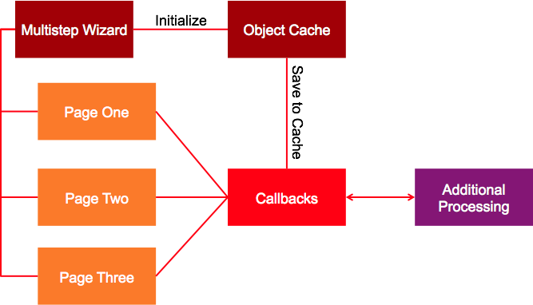
Understanding the Pieces

Slide 8
Understanding the Wizard
The heart of your form:
ctools_wizard_multistep_form($form_info, $step, $form_state);
Three arguments:
$form_info - This defines our workflow, options, and callbacks
If we click the ‘Next’ button, what happens?
What are our page steps and how are they ordered?
$step - Where we are in the flow
$form_state - Stores the object cache along with the object ID, and passes it to each individual page’s $form_state
This ensures that previous page submission data is always available

Slide 9
The Setup
We’re working with two CTools includes
We will also want to define our object ID for cache
Note that may be easier to do this as a constant
We will need it throughout the module
function example_form_builder($step = NULL) {
ctools_include(‘wizard’);
ctools_include(‘object-cache’);
$object_id = 1;
Notes:
Here we talk about how to initialize the ctools tools we’ll be using

Slide 10
ctools_wizard_multistep_form($form_info, $step, $form_state);
$form_info contains all information the CTools wizard needs to understand and process the form
Here are some basic options (there are more)
$form_info = array(
‘id’ => ‘example_form’,
‘path’ => ‘example/%step’,
‘show cancel’ => FALSE,
‘next callback’ => ‘example_builder_next’,
‘finish callback’ => ‘example_builder_finish’,
‘next text’ => t(‘Next Step’),
);
Notes:
Here we talk about setting up the basic structure, including the buttons we want included. Also available are: ‘next text’, ‘back text’, ‘show trail’, ‘show return’, ‘show back’

Slide 11
ctools_wizard_multistep_form($form_info, $step, $form_state);
The keys of this array dual but related purposes
Your steps (as seen in $step)
Your page as seen by the user ‘path’ => ‘example/%step’,
$form_info[‘order’] => array(
‘step-1’ => t(‘Step One’),
‘step-2’ => t(‘Step Two’),
‘step-3’ => t(‘Step Three’),
// and so on...
);
Notes:
Here we talk about managing basic flow

Slide 12
ctools_wizard_multistep_form($form_info, $step, $form_state);
Details for all forms using your $form_info[‘order’] keys
You don’t need to use includes (but they do make things easier)
Each form is standard Form API using all available callbacks
$form_info[‘forms’] = array(
‘step-1’ => array(
‘form id’ => ‘example_step_one_form’,
‘include’ => ‘path_to_form_include’,
),
// Rinse and repeat for each additional step
Notes:
Here we talk about managing basic flow

Slide 13
ctools_wizard_multistep_form($form_info, $step, $form_state);
Remember this?
function example_form_builder($step = NULL)
We need a behavior in case $step does, in fact, equal NULL
if (empty($step)) {
$step = 'step-1';
}
// Not much to see here

Slide 14
ctools_wizard_multistep_form($form_info, $step, $form_state);
CTools Wizard will add this to the $form_state of all form steps
Includes our storage $object
And our Object-Cache ID ($object_id)
$object = _example_get_obj_cache($object_id);
$form_state = array(
‘object_id’ => $object_id,
‘object’ => &$object,
);
Notes:
more on $object and $object_id later

Slide 15
ctools_wizard_multistep_form($form_info, $step, $form_state);
$object_id instructs CTools how to find the storage object in the cache table
It prevents collisions in tools with lots of possible storage objects
E.g., Views and Panels
$object = _example_get_obj_cache($object_id);
$form_state = array(
‘object_id’ => $object_id,
‘object’ => &$object,
);

Slide 16
All Done!
ctools_wizard_multistep_form($form_info, $step, $form_state);
Hopefully $form_info makes sense at this point
Ditto for $step
But $form_state?
We should get deeper into the whole $object piece
$object = _example_get_obj_cache($object_id);
$form_state = array(
‘object_id’ => $object_id,
‘object’ => &$object,
);

Slide 17
Introducing CTools Object-Cache
Injecting $object into $form_state gives us a place to store form content across forms
The wizard will see to it that all our forms get this
ctools_object_cache_get stores data in memory
You can pass an option to skip memory cache
$object = _example_get_obj_cache($object_id);
function _example_get_obj_cache($object_id) {
ctools_include(‘object-cache’);
if (!$cache = ctools_object_cache_get(‘example’, $object_id)) {
$cache = new stdClass();
$cache->locked = ctools_object_cache_test(‘example’, $object_id);
}
}
Notes:
Note that ctools_object_cache_get can also take an extra user ID argument. It will otherwise just use session_id()

Slide 18
Updating the Object Cache
Remember this from our $form_info?
‘next callback’ => ‘_example_builder_next’,
function _example_builder_next(&$form_state) {
_example_update_obj_cache(OBJECT_ID, $form_state[‘object’]);
}
function _example_update_obj_cache($id, $content) {
ctools_include(‘object-cache’);
$cache = ctools_object_cache_set(‘example’, $id, $content);
}

Slide 19
Shutting Things Down
Remember this from our $form_info?
‘finish callback’ => ‘_example_builder_finish’,
function _example_builder_finish() {
_example_clear_obj_cache(OBJECT_ID);
// Anything else? Want to redirect to a thank you page?
}
function _example_clear_obj_cache($id) {
ctools_include(‘object-cache’);
ctools_object_cache_clear(‘example, $id);
}

Slide 20
Caveats and Special Cases from our Implementation
In our application, we had to fire _example_builder_finish from outside of $form_info
A Batch API at the end of our process derailed things and dropped us out of the ctools wizard
We called the _example_builder_finish from Batch API’s own finish function
You might find that other tools can derail things as well
Maybe something about Ajax and our Select Meds here?
This might be a no-duh for some, but additional functions in our various form .inc files are not available to other form pages
Maybe place these in your .module
For example, we had Solr calls that we sometimes needed one one step, sometimes a later step

Slide 21
Special Thanks to...
Abby Milberg, designer extraordinaire
@AbbyMilberg

Slide 22

Thank You
www.RepEquity.com
@RepEquity

