Slide 1
The Outer Hadron Calorimeter (HO)

Slide 2

Need of Outer Hadron Calorimeter
The design of HCAL is strongly influenced by the solenoid coil.
Interaction length of HB at $\left|η\right|=0$ is just $5.8 λ_{I}$.
Solenoid
Not enough to contain the whole hadronic shower
1.18 m
EB
Tracker

Slide 3
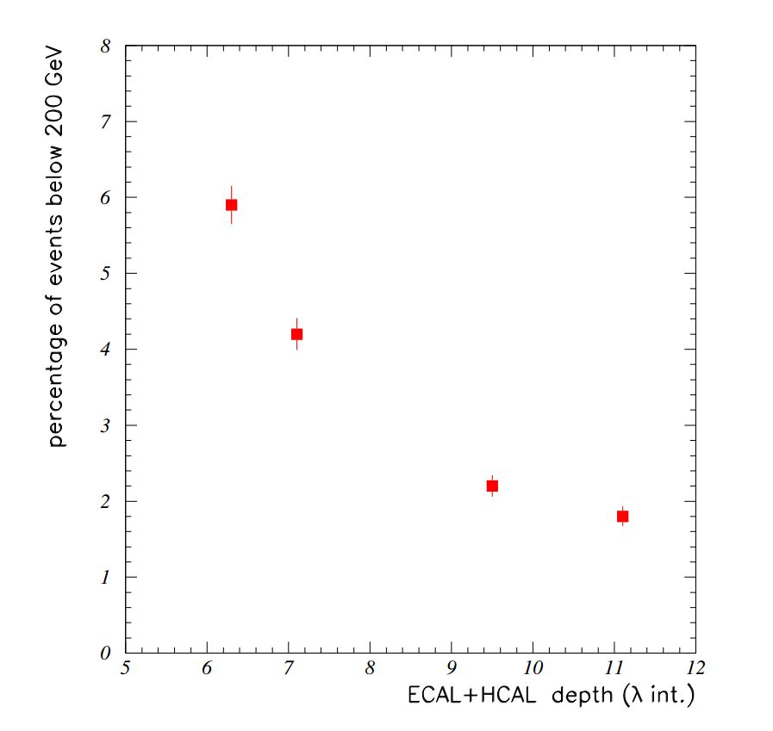
Studies showed that without HO, nearly 3% of events having a 300 GeV pion will give rise to missing energy corresponding to 100 GeV.
Figure: 1996 test beam data at 3 Tesla magnetic field
Source: CMS NOTE 2006/127

Slide 4
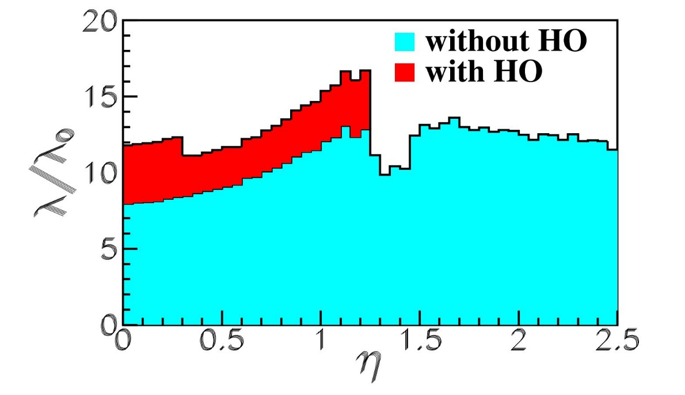
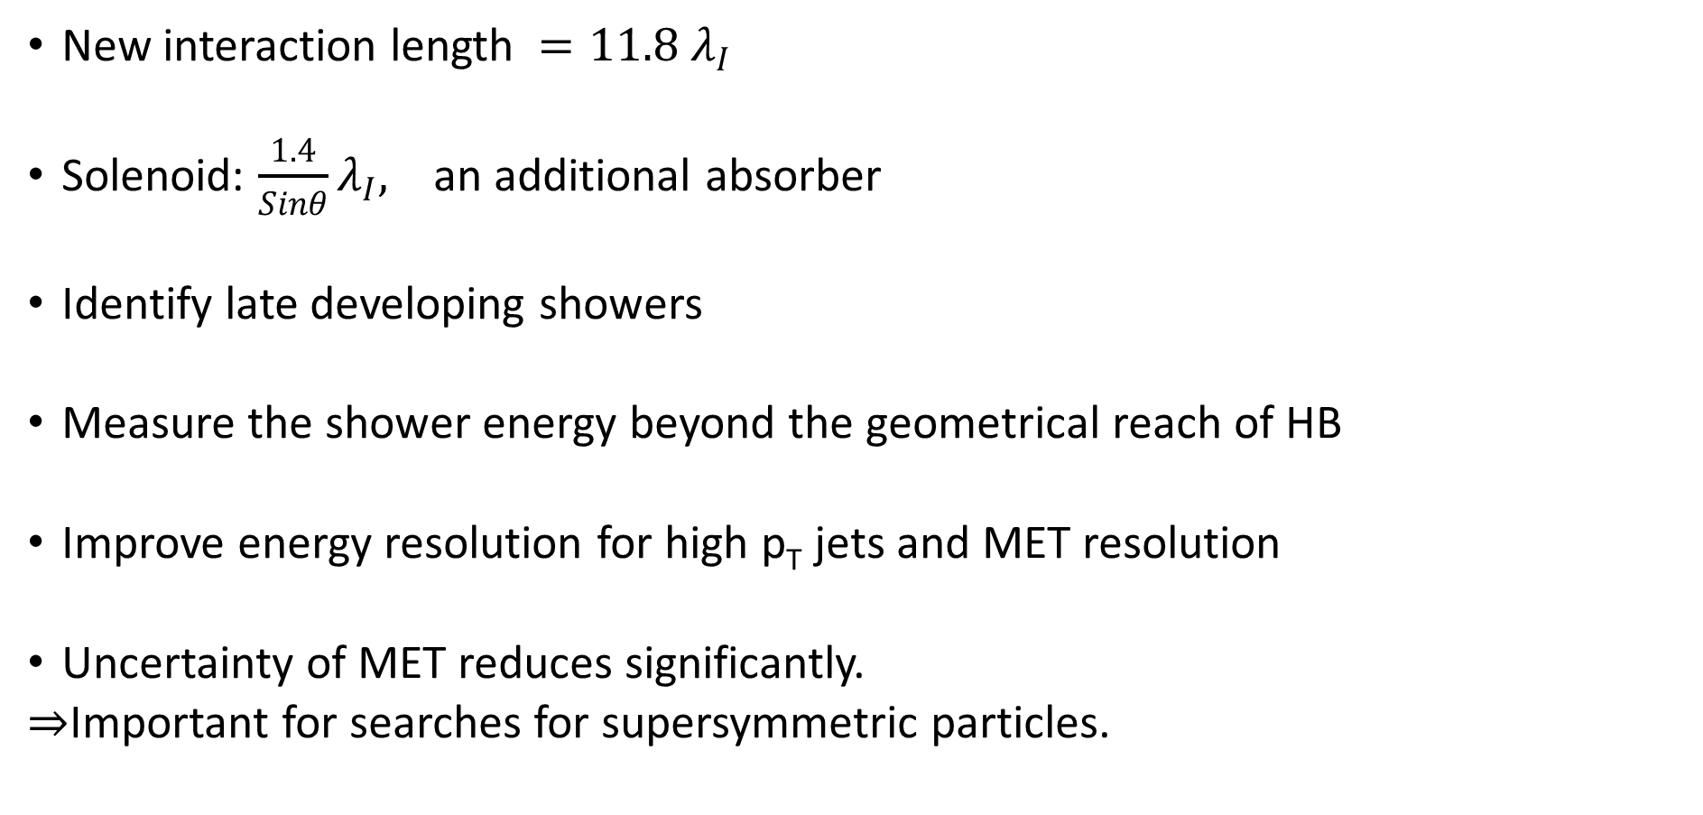
Improvements
New interaction length ${=11.8 λ}_{I}$
Solenoid: $\frac{1.4}{Sinθ}λ_{I},$ an additional absorber
Identify late developing showers
Measure the shower energy beyond the geometrical reach of HB
Improve energy resolution for high p_{T} jets and MET resolution
Uncertainty of MET reduces significantly.
$⇒$Important for searches for supersymmetric particles.

Slide 5
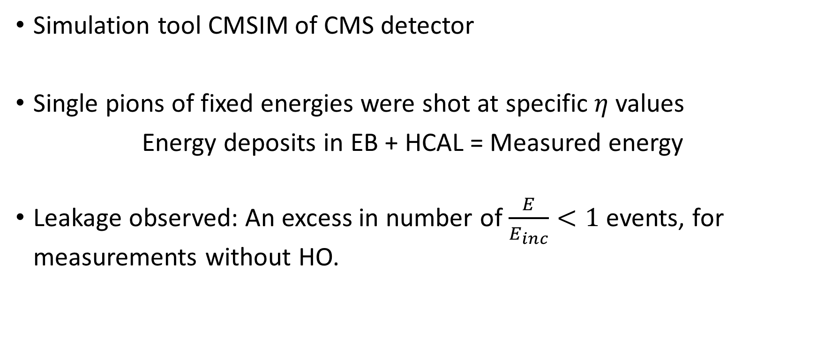
Quantitative Improvement
Simulation tool CMSIM of CMS detector
Single pions of fixed energies were shot at specific$η$ values
Energy deposits in EB + HCAL = Measured energy
Leakage observed: An excess in number of $\frac{E}{E_{inc}}<1$ events, for measurements without HO.

Slide 6
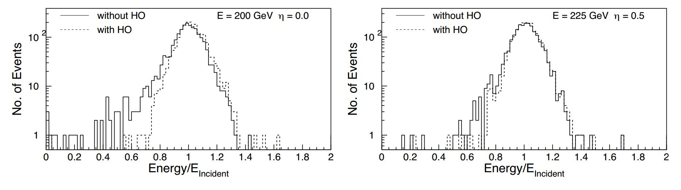
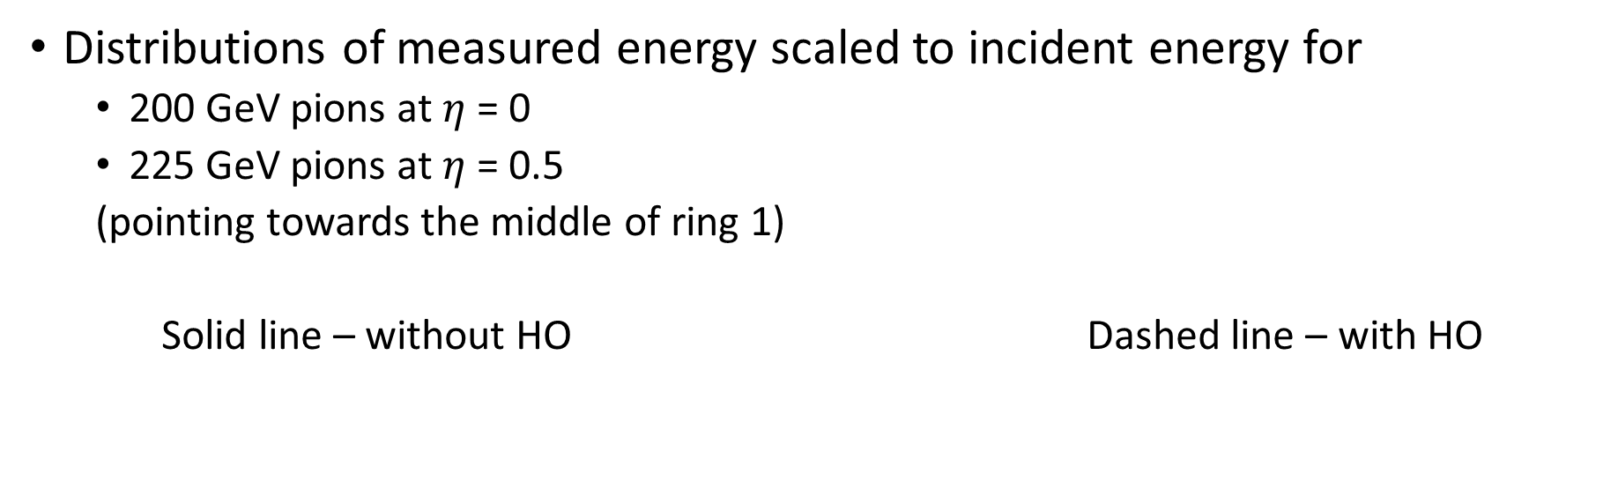
Distributions of measured energy scaled to incident energy for
200 GeV pions at $η$ = 0
225 GeV pions at $η$ = 0.5
(pointing towards the middle of ring 1)
Solid line – without HO Dashed line – with HO

Slide 7
Mean fraction of energy in HO increases from 0.38% for 10 GeV pions to 4.3% for 300 GeV pions.
RMS of the fractional energy increases from 0.034 to 0.10.
Some evidence of leakage without HO in ring 1 but with reduced intensity.
Negligible amount of leakage in ring 2.

Slide 8
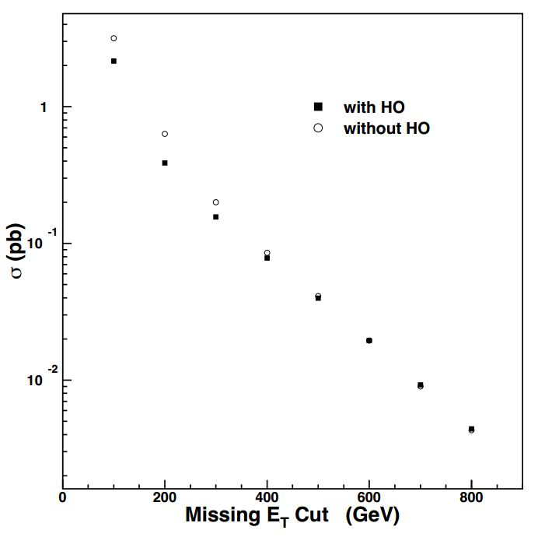
Direct consequence of shower leakage on E_{T}
The inclusion of HO reduces the background cross section by a factor of 1.5 or more for moderate E_{T} values.
This E_{T} region is important for searches of
supersymmetric particles.
Figure: Integrated background cross
section above
threshold as a function of missing
E_{T} with or without HO.

Slide 9
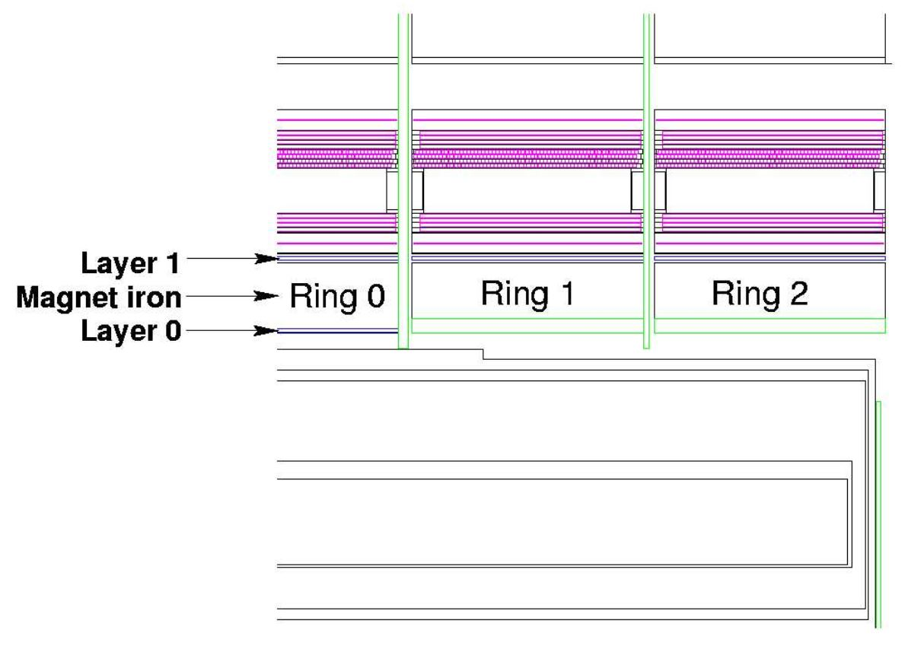
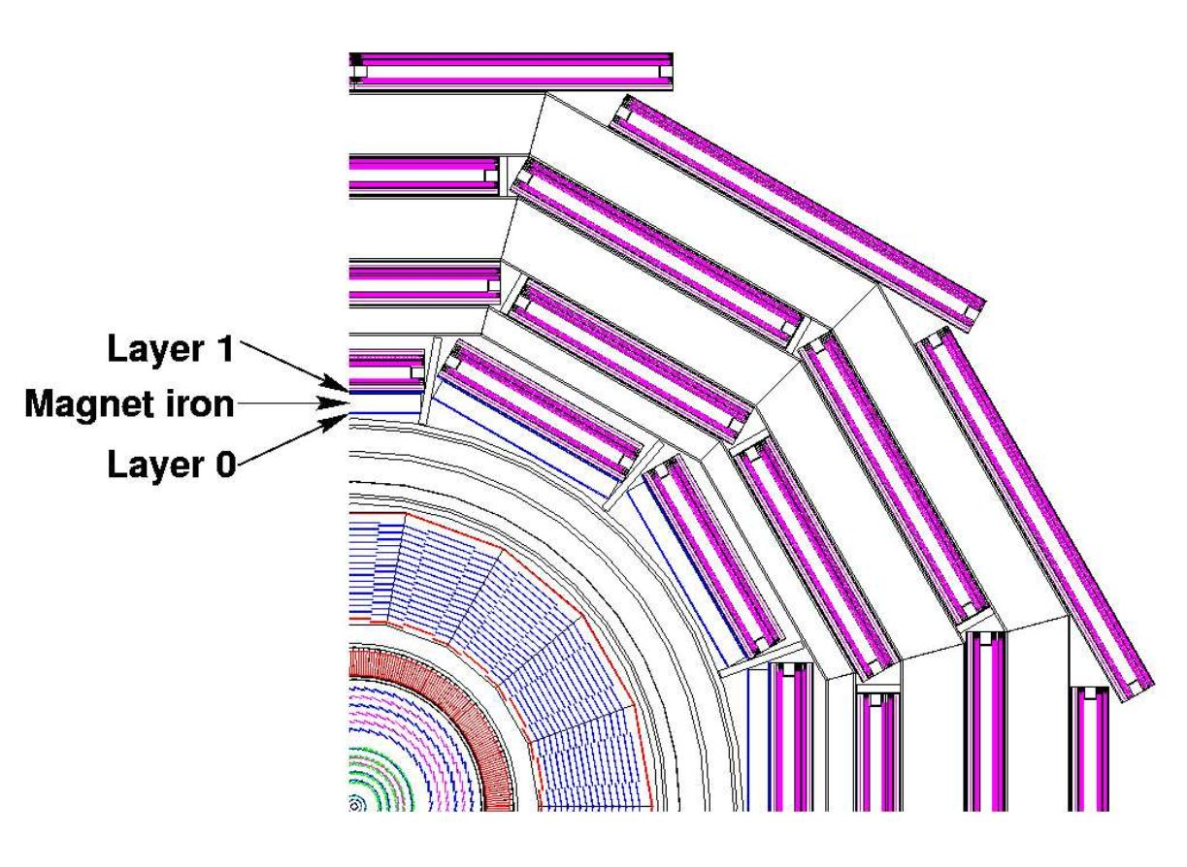
Design
Two layers
+2.686 m
+5.342 m
4070 mm
3820 mm
Beam
19.5 mm thick

Slide 10
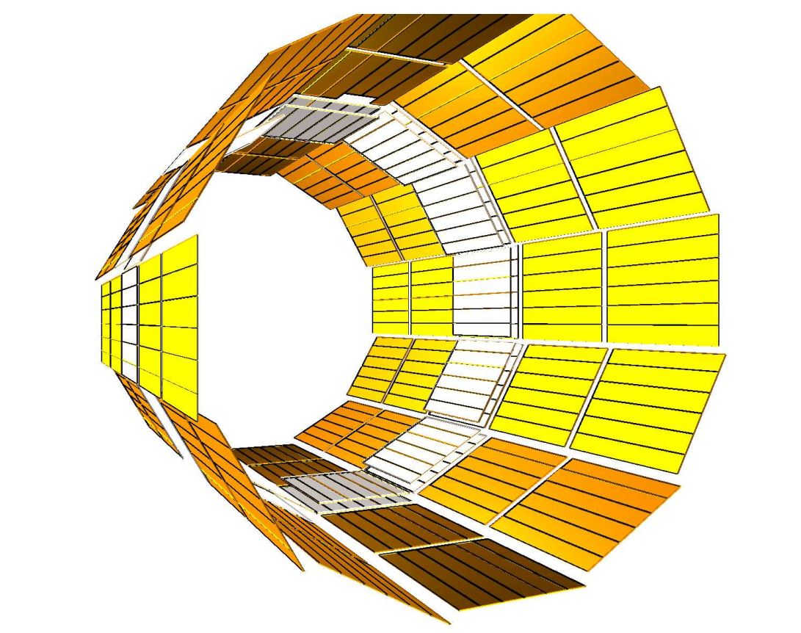
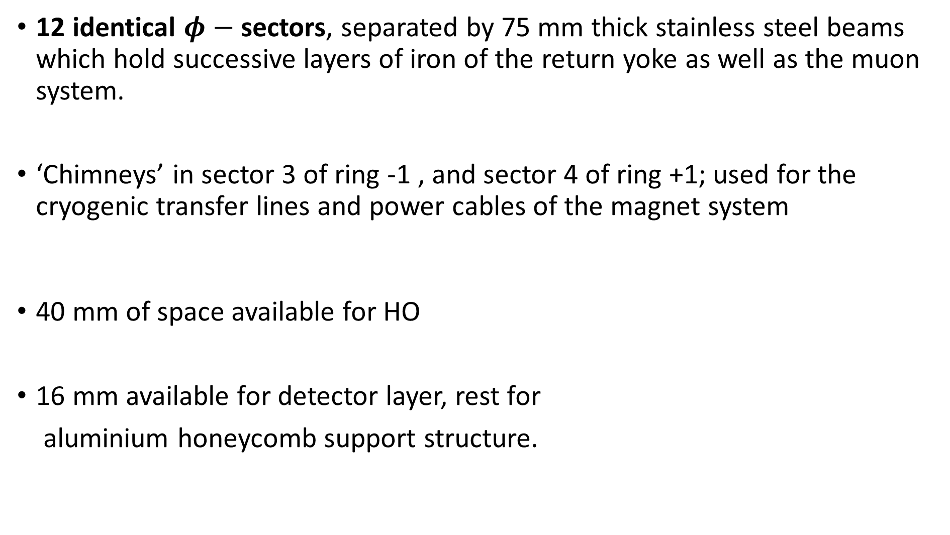
12 identical $φ−$sectors, separated by 75 mm thick stainless steel beams which hold successive layers of iron of the return yoke as well as the muon system.
‘Chimneys’ in sector 3 of ring -1 , and sector 4 of ring +1; used for the cryogenic transfer lines and power cables of the magnet system
40 mm of space available for HO
16 mm available for detector layer, rest for
aluminium honeycomb support structure.

Slide 11

The sizes and positions of the tiles in HO, roughly map the layers of HB to make towers of granularity 0.087 x 0.087 in $η$ and $φ$.
Multi-clad Y11 Kuraray wave length shifting (WLS) fibres, of diameter 0.94 mm.
Scintillator tile
WLS
Photo
Detector
Multi-clad Y11 Kuraray
Diameter = 0.94 mm
+
Spliced multi-clad clear
fiber (Dia. = 0.94 mm)
located on the structure of the return yoke

Slide 12
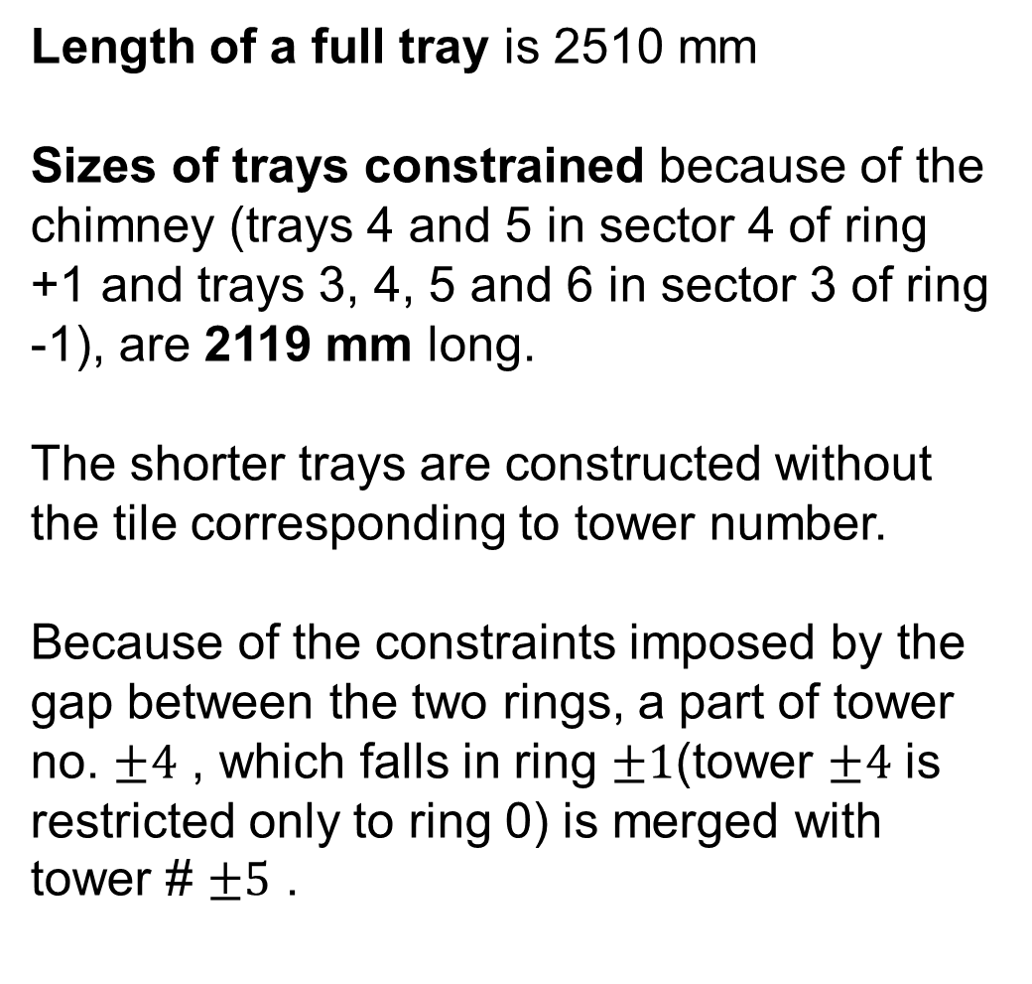
The final layout of all the HO trays in the overall CMS detector.
Length of a full tray is 2510 mm
Sizes of trays constrained because of the chimney (trays 4 and 5 in sector 4 of ring +1 and trays 3, 4, 5 and 6 in sector 3 of ring -1), are 2119 mm long.
The shorter trays are constructed without the tile corresponding to tower number.
Because of the constraints imposed by the gap between the two rings, a part of tower no. $±4$ , which falls in ring $±1$(tower $±4$ is restricted only to ring 0) is merged with tower # $±5$ .

Slide 13
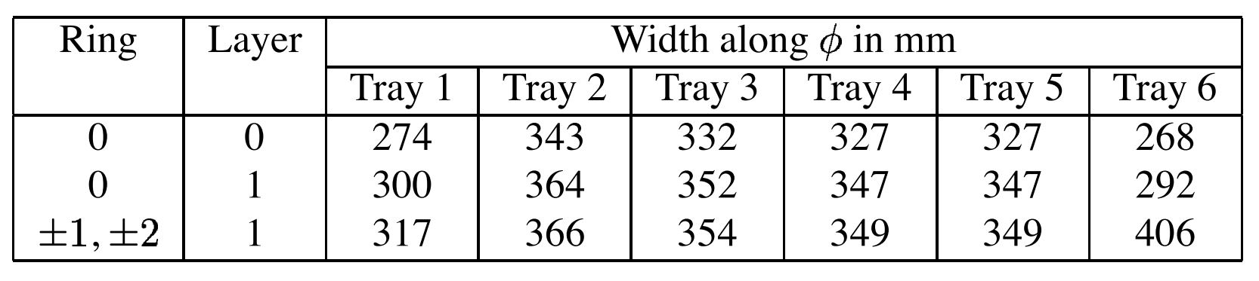


Both layers of ring 0 have 8 $η$-divisions (8 tiles in a tray: -4 to 4)
Ring 1 has 6 divisions: (5 to 10)
Ring 2 has 5 divisions: 11 to 15
Ring -1 and ring +1 have the same number of divisions as rings 1 and 2 but with -ve indices.
The $η$-dimensions of any tile with -ve tower number is the same as the one with +ve number.
Dimensions of tiles along $φ$ for different trays

Slide 14
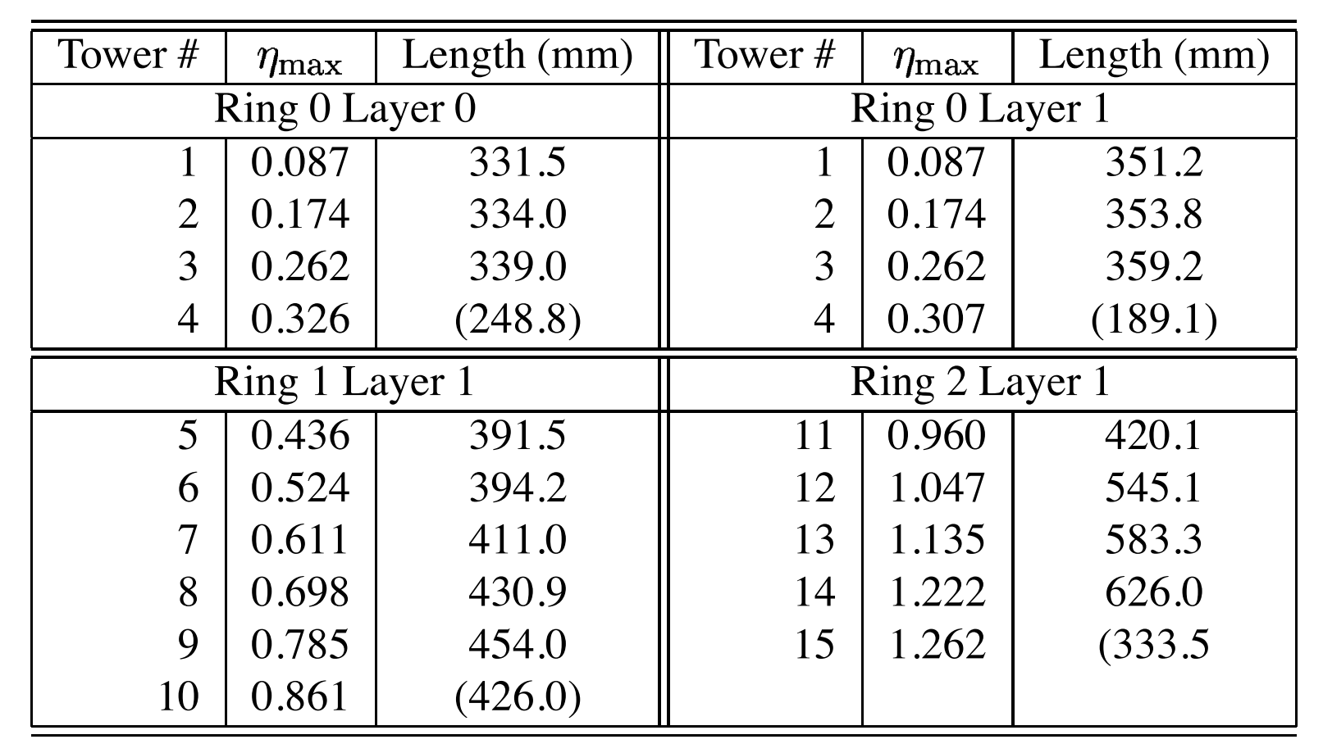

Dimensions of rings along $η$ for the towers:

Slide 15
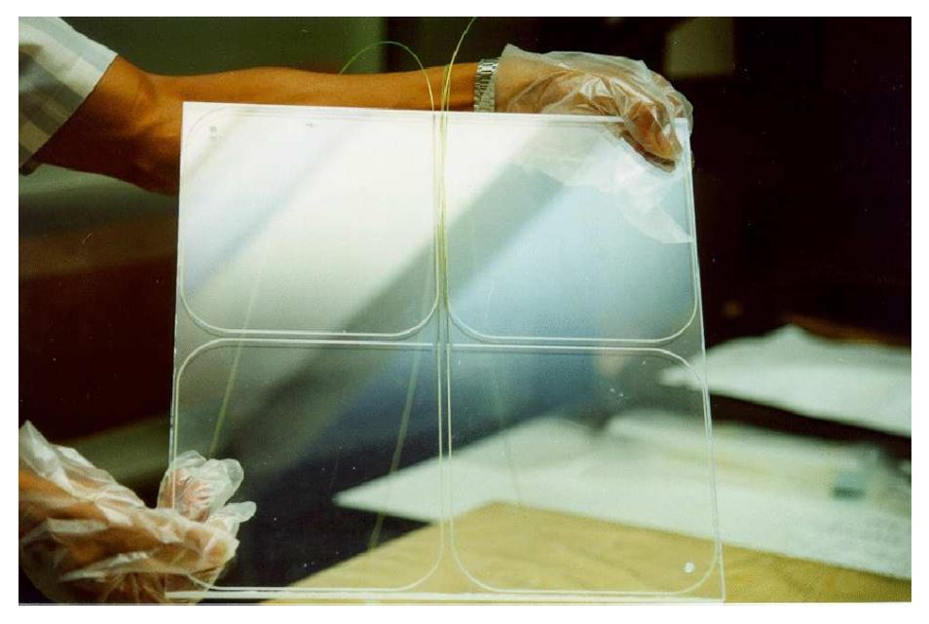
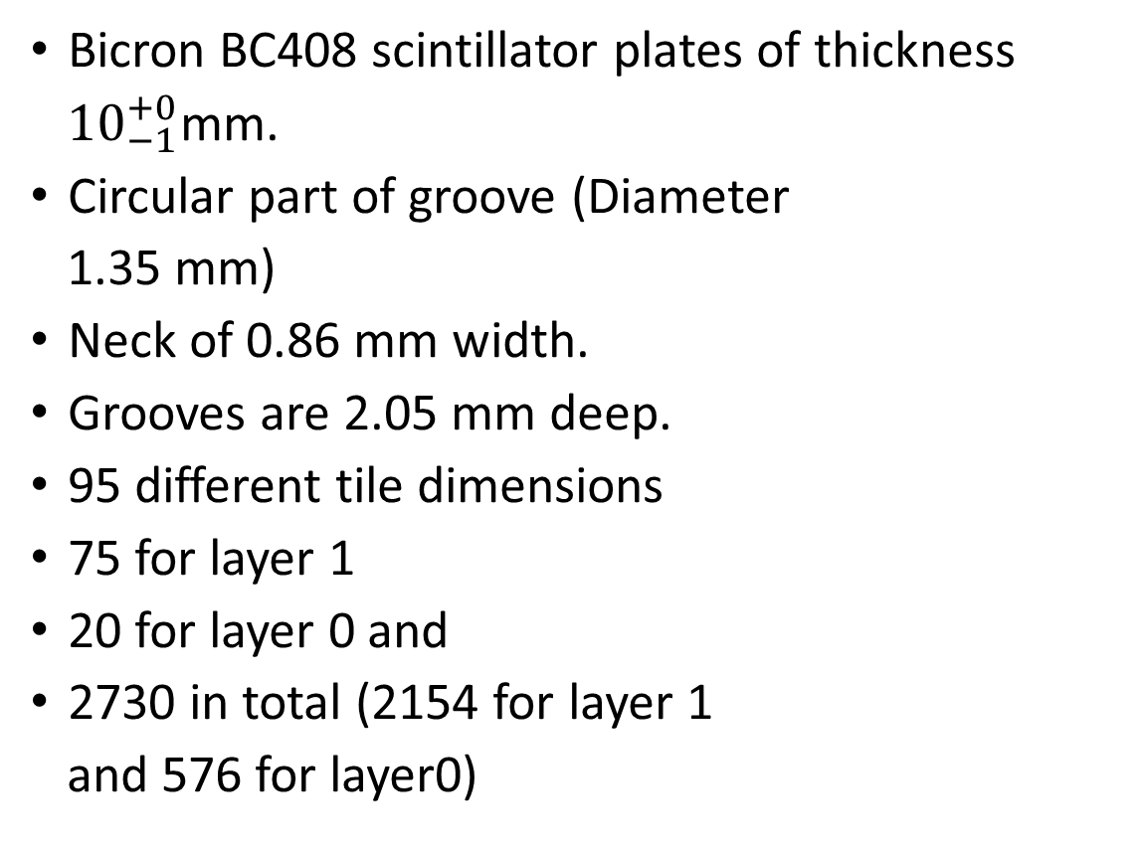
Tiles
Bicron BC408 scintillator plates of thickness
${10}_{−1}^{+0}$mm.
Circular part of groove (Diameter
1.35 mm)
Neck of 0.86 mm width.
Grooves are 2.05 mm deep.
95 different tile dimensions
75 for layer 1
20 for layer 0 and
2730 in total (2154 for layer 1
and 576 for layer0)

Slide 16
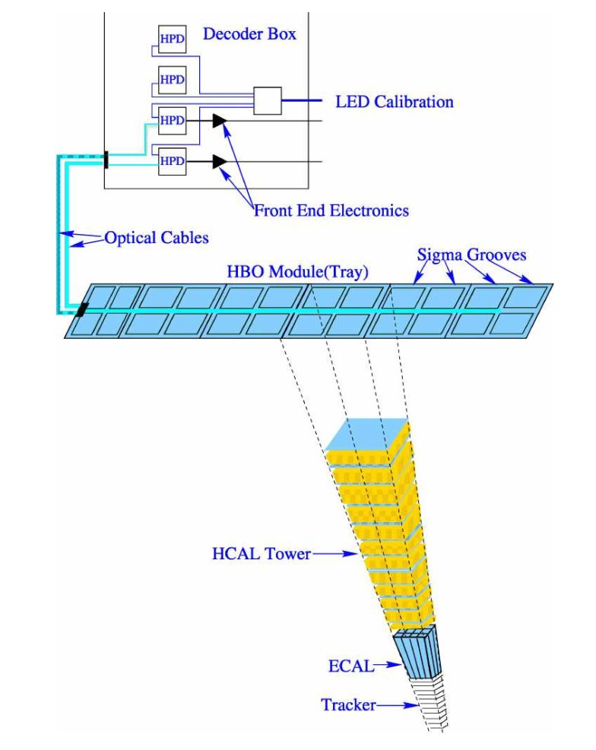

Tray
Each tray corresponds to one
slice (5 wide in $φ$).
Along the z ($η$) direction, a tray
covers the entire span of a muon ring.
Each tray contains:
5 tiles in ring $±2$
6 tiles in ring $±1$
8 tiles in ring 0

Slide 17
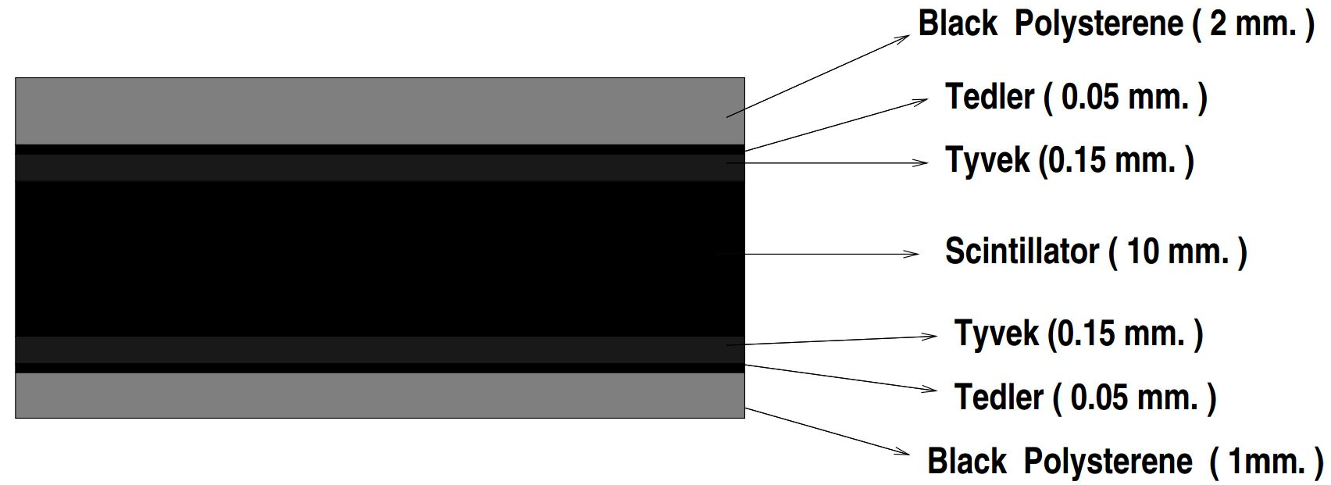
Bicron reflecting white paint on the tile edges
Better light collection
Isolation of the tile
Further isolation: Black tedlar strip between adjacent tiles
1.6 mm deep channels grooved on the top plate
1.5 mm deep straight groove along the edge of the top cover to house the S.S. tube
Fibres
Grooves
Optical connector

Slide 18
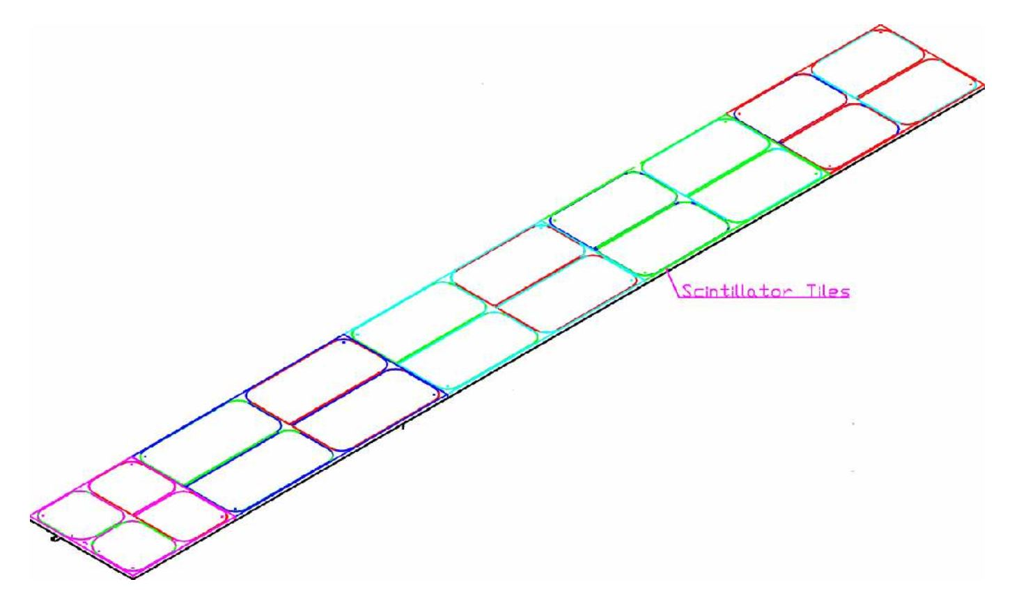
Optical Connector

Slide 19
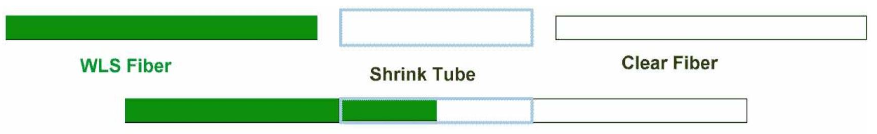


Pigtails
Photodetectors are located on muon rings.
Comes out of the tile
Attenuation length $\sim 1.8m$
Attenuation length $\sim 8.0 m$
Polished aluminized and protected using polymer coating

Slide 20
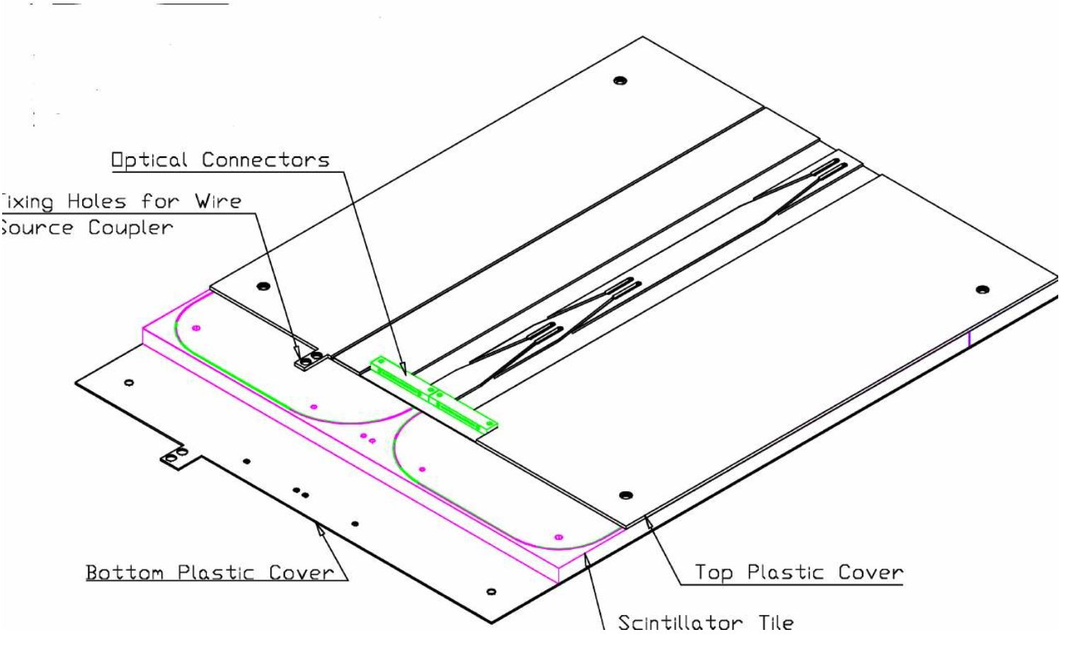
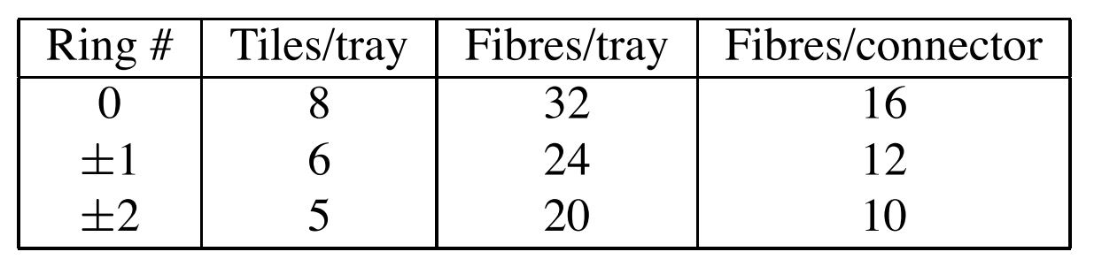
In a tray, the grooves of the tiles form two rows along.
The fibres from all grooves on one row terminate on one connector
Tray specifications for different rings of HO

Slide 21
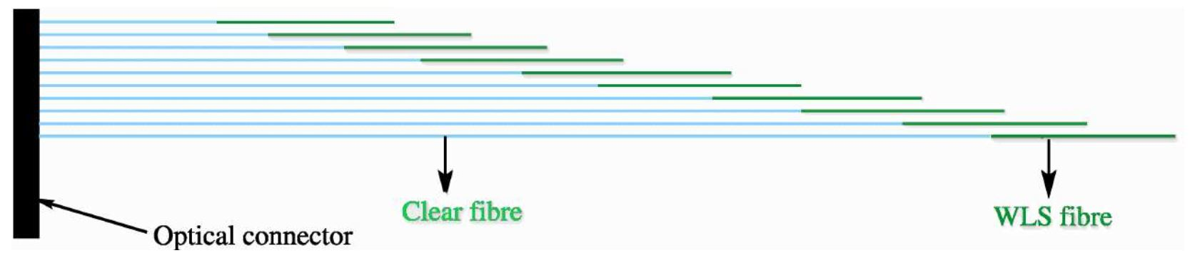
Each tray has 2 pigtails and there are 864 pigtails in total: 720 for layer 1 and 144 for layer 0.
Fabrication:
WLS fiber: cut, polish both ends, aluminize one end and coat with thin polymer layer
Clear fiber: cut and polish one end
Splice non aluminized end of WLS fiber and non-polished end of clear fiber
Correctly insert the spliced fibers in the connector and fix using optical hardener
Polish the connector end with a high speed diamond cutter

Slide 23
Certification of Pigtails
Setup:
a computer controlled mechanical stage which houses an UV lamp.
At specific points, the shutter is opened, fibres absorb UV photons and the light in each fibre is carried to the end to a set of photo diodes.
Digitised and stored the signals.
The combined transmission loss(spliced junctions, connector interface and attenuation offered) are estimated by analysing the data.
Measurements were made for all the pigtails belonging to a given layer and ring and if a pigtail was within 10% of the average in term of transmission properties, the pigtail was accepted.

Slide 27
The HO is physically located inside the barrel return yokes (YB) in front of first layer of muon system.
five rings of return iron
The HO is constrained by the geometry of the muon system.
divided into five rings R0, R±1 and R±2 in η
nominal central z positions of five rings are respectively -5.432m, -2.686m, 0, +2.686m and +5.342m.
minimal absorber depth at η = 0, two layers of HO scintillators on either side of 19.5 cm thick piece of iron at the radial distance of 3.82 m and 4.07 m, respectively.
All outer rings have a single HO layer at a radial distance of 4.07 m.
Each ring has 12 identical φ –sectors, separated by 75-mm-thick stainless steel beams

Slide 28
The space occupied by these stainless steel beams in the φ direction, space between successive muon rings in η direction and the space occupied by the cryogenic “chimneys” (used for the cryogenic transfer lines and power cables of the magnet) in sector 3 of R-1, sector 4 of R+1 is not available for HO
In the radial direction, each HO layer has been allocated a total of 40 mm, of which only 16 mm is available for the detector layer, the rest being used for the aluminum honeycomb support structures. The mechanical structures further constrain the shape and segmentation of the HO

Slide 29
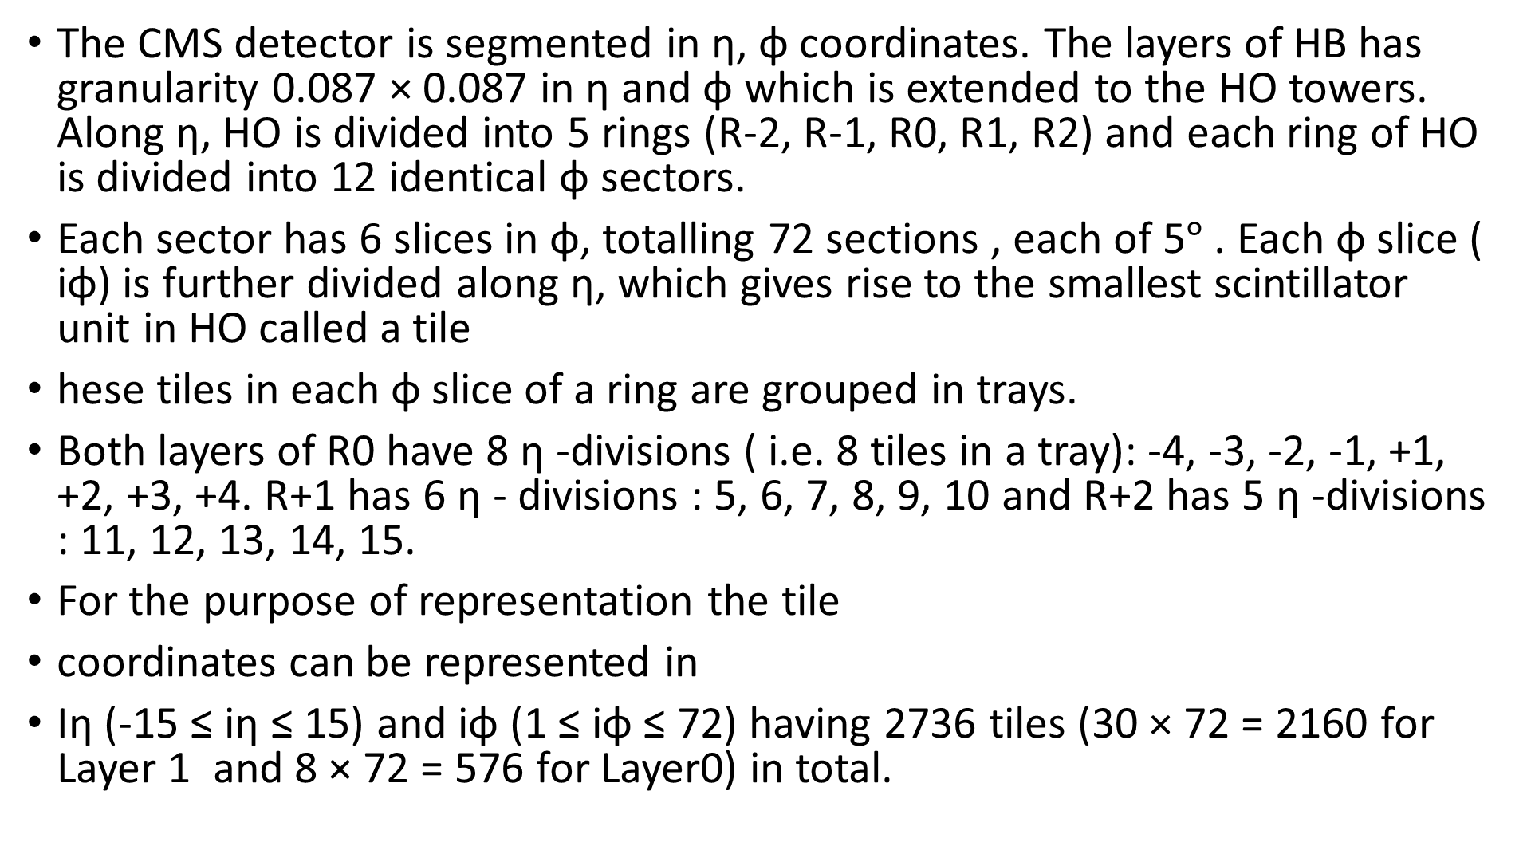
The CMS detector is segmented in η, φ coordinates. The layers of HB has granularity 0.087 × 0.087 in η and φ which is extended to the HO towers. Along η, HO is divided into 5 rings (R-2, R-1, R0, R1, R2) and each ring of HO is divided into 12 identical φ sectors.
Each sector has 6 slices in φ, totalling 72 sections , each of 5$°$ . Each φ slice ( iφ) is further divided along η, which gives rise to the smallest scintillator unit in HO called a tile
hese tiles in each φ slice of a ring are grouped in trays.
Both layers of R0 have 8 η -divisions ( i.e. 8 tiles in a tray): -4, -3, -2, -1, +1, +2, +3, +4. R+1 has 6 η - divisions : 5, 6, 7, 8, 9, 10 and R+2 has 5 η -divisions : 11, 12, 13, 14, 15.
For the purpose of representation the tile
coordinates can be represented in
Iη (-15 ≤ iη ≤ 15) and iφ (1 ≤ iφ ≤ 72) having 2736 tiles (30 × 72 = 2160 for Layer 1 and 8 × 72 = 576 for Layer0) in total.

Slide 30
Each η − φ position is read out by a separate channel.
In addition, some readout channels are not connected to any scintillator and are used for noise measurement and calibration. The total number of electronics channels is 2376.
Figure 6.2
The length of full tray is 2510 mm, but due to the constraint of chimneys, there are shorter trays of 2119 mm located in tray 4 and 5 in sector 4 of R1 and trays 3, 4, 5 and 6 in sector 3 of R-1 [103].
Table 6.1
TABLE 6.2

Slide 31
These tiles are made from Bicron BC408 scintillator plates of thickness 10 +0 − 1 mm.
The Wavelength Shifting fibres (WLS) made from multi-clad Y11 Kuraray of diameter 0.94 mm are held inside the tile in grooves with a key hole cross-section
WLS fibre absorbs a fraction of light emitted by the tile, re-
emits the light shifted to a longer wavelength. This light is needed to be transported to the photo-detectors (Hybrid Photo-Diode (till 2013) and Silicon Photo-Multiplier (from
2015)) located far away on the muon detector.
To reduce the loss of light during transportation, WLS is spliced to clear fibre to transport light to Optical Decoder Unit (ODU), final interface between scintillation light and photo-readout element.

Slide 32
The optical signal obtained from the scintillator tile is converted to electrical signal using the photo-readout with a very high gain.
The optical signal obtained from the scintillator tile is converted to electrical sig-
nal using the photo-readout with a very high gain. Then this analogue signal is converted
to digital signal by a charge-integrating ADC ASIC called the QIE (Charge-Integrator
and decoder) [107]. The QIE internally contains four capacitors which are connected in
turn to the input, one during each 25 ns period. Each electronic channel collects and
processes the signal from each cell (or tile). The signal from the front-end electronics
cannot be sampled instantaneously, rather the electric current from the photo-detector is
integrated over each clock period and then sampled using the pulse shape. In general 68%
of the pulse is contained with in 25 ns leaving 32% of the pulse to out-of-time-pileup.

