Slide 2
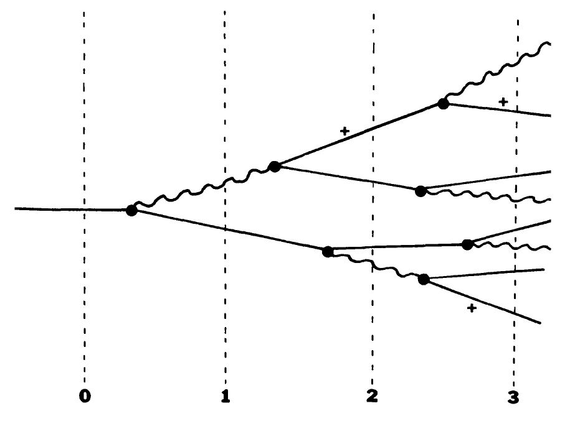
Electromagnetic Shower

Slide 3
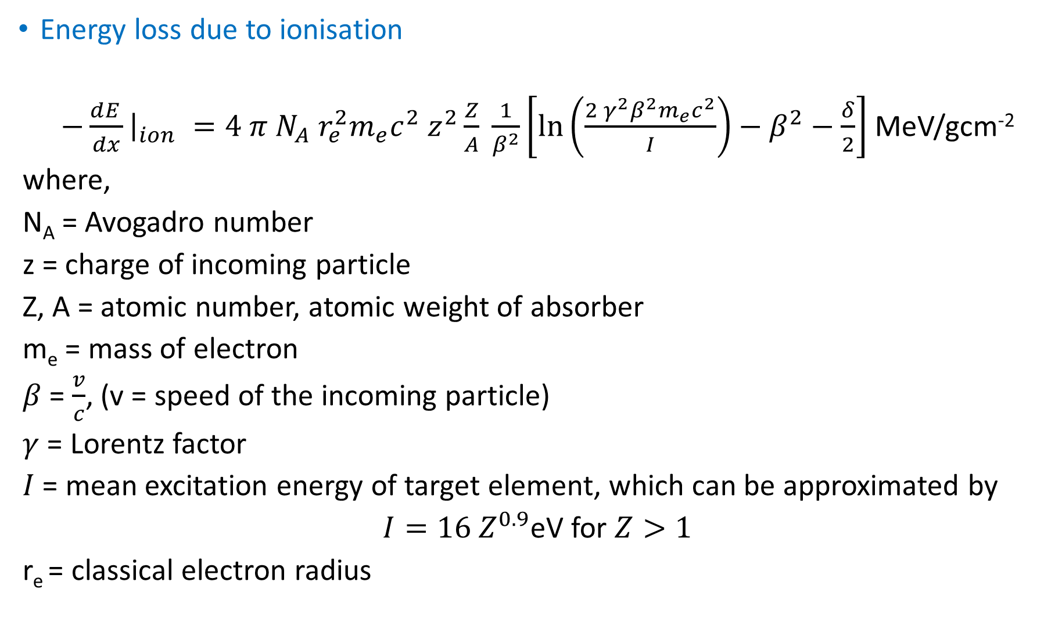

Energy loss due to ionisation
$−\frac{dE_{ }}{dx}{\left.​\right|}_{ion} =4 π N_{A} r_{e}^{2}m_{e}c^{2} z^{2}\frac{Z}{A} \frac{1}{β^{2}}\left[\ln\left(\frac{2{ γ}^{2}β^{2}m_{e}c^{2}}{I}\right)−β^{2}−\frac{δ}{2}\right]$ MeV/gcm⁻²
where,
N_{A} = Avogadro number
z = charge of incoming particle
Z, A = atomic number, atomic weight of absorber
m_{e} = mass of electron
$β$ = $\frac{v}{c}$, (v = speed of the incoming particle)
$γ$ = Lorentz factor
$I$ = mean excitation energy of target element, which can be approximated by
$I=16 Z^{0.9}$eV for $Z>1$
r_{e} = classical electron radius
Function of :
Speed of the incident particle:
At low energies $\left(γβ<1\right)→\frac{1}{β^{2}}$
At high energies, slow variation
due to $\ln\left(γ\right)$
Mean Excitation energy $ℏ〈ω〉$
Notes:
Soft collisons: Kinetic energy (T) of the atomic collision after collision is less than the T_{max}. Reverse for Hard collisions

Slide 4
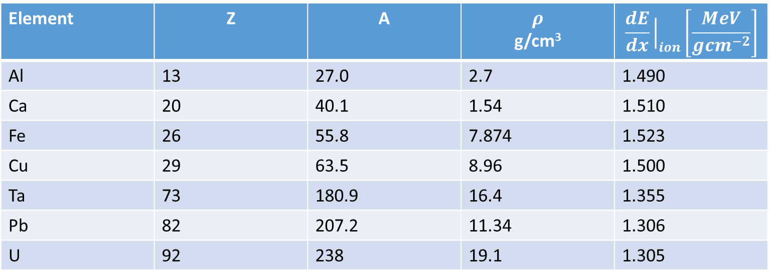

$δ−$ screening parameter
$4 π N_{A} r_{e}^{2}m_{e}c^{2}=0.3071$ MeV/gcm⁻²
At very high energies,
$\frac{δ}{2}=ln\frac{{28.8\sqrt{ρ〈\frac{Z}{A}〉}} }{I} +\ln{βγ} −\frac{1}{2}$
Average energy loss by 225 GeV muon in various materials
Element | Z | A | $$ρ$$ g/cm³ | $$\frac{dE}{dx}{\left.​\right|}_{ion}\left[\frac{MeV}{gcm^{−2}}\right]$$
Al | 13 | 27.0 | 2.7 | 1.490
Ca | 20 | 40.1 | 1.54 | 1.510
Fe | 26 | 55.8 | 7.874 | 1.523
Cu | 29 | 63.5 | 8.96 | 1.500
Ta | 73 | 180.9 | 16.4 | 1.355
Pb | 82 | 207.2 | 11.34 | 1.306
U | 92 | 238 | 19.1 | 1.305

Slide 5
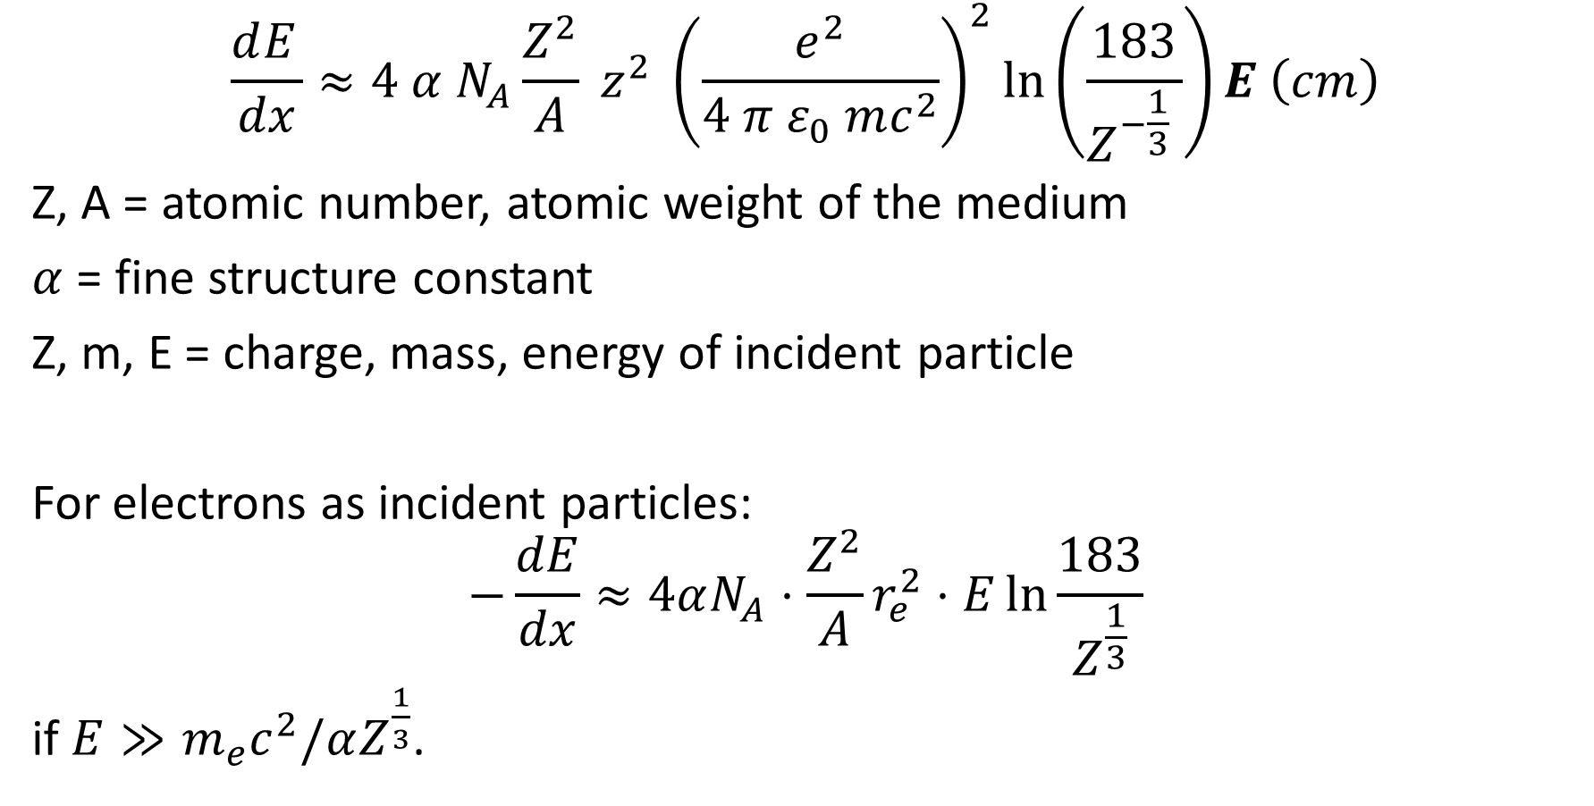
Radiation loss (Bremsstrahlung)
$$\frac{dE_{ }}{dx}≈4 α N_{A}\frac{Z^{2}}{A} z^{2} {\left(\frac{e^{2}}{4 π ε_{0} mc^{2}}\right)}^{2}\ln\left(\frac{183}{Z^{−\frac{1}{3}} }\right)E \left(cm\right)$$
Z, A = atomic number, atomic weight of the medium
$α$ = fine structure constant
Z, m, E = charge, mass, energy of incident particle
For electrons as incident particles:
$$−\frac{dE}{dx}≈4αN_{A}⋅\frac{Z^{2}}{A}r_{e}^{2}⋅E\ln{\frac{183}{Z^{\frac{1}{3}}}}$$
if $E≫m_{e}c^{2}/αZ^{\frac{1}{3}}$.

Slide 6
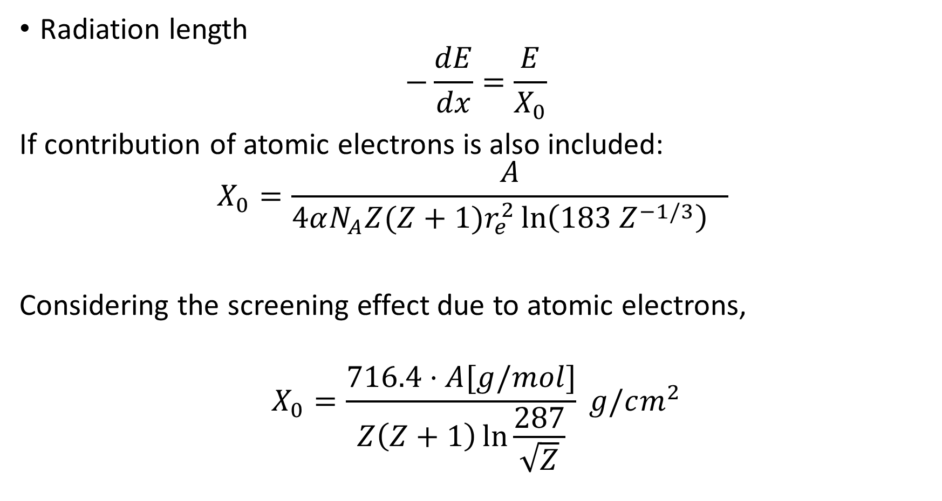
Radiation length
$$−\frac{dE}{dx}=\frac{E}{X_{0}}$$
If contribution of atomic electrons is also included:
$$X_{0}=\frac{A}{4αN_{A}Z(Z+1)r_{e}^{2}\ln\left(183 Z^{−1/3}\right) }$$
Considering the screening effect due to atomic electrons,
$$X_{0}=\frac{716.4⋅A[g/mol]}{Z\left(Z+1\right)\ln{\frac{287}{\sqrt{Z}}}} g/cm^{2}$$

Slide 7
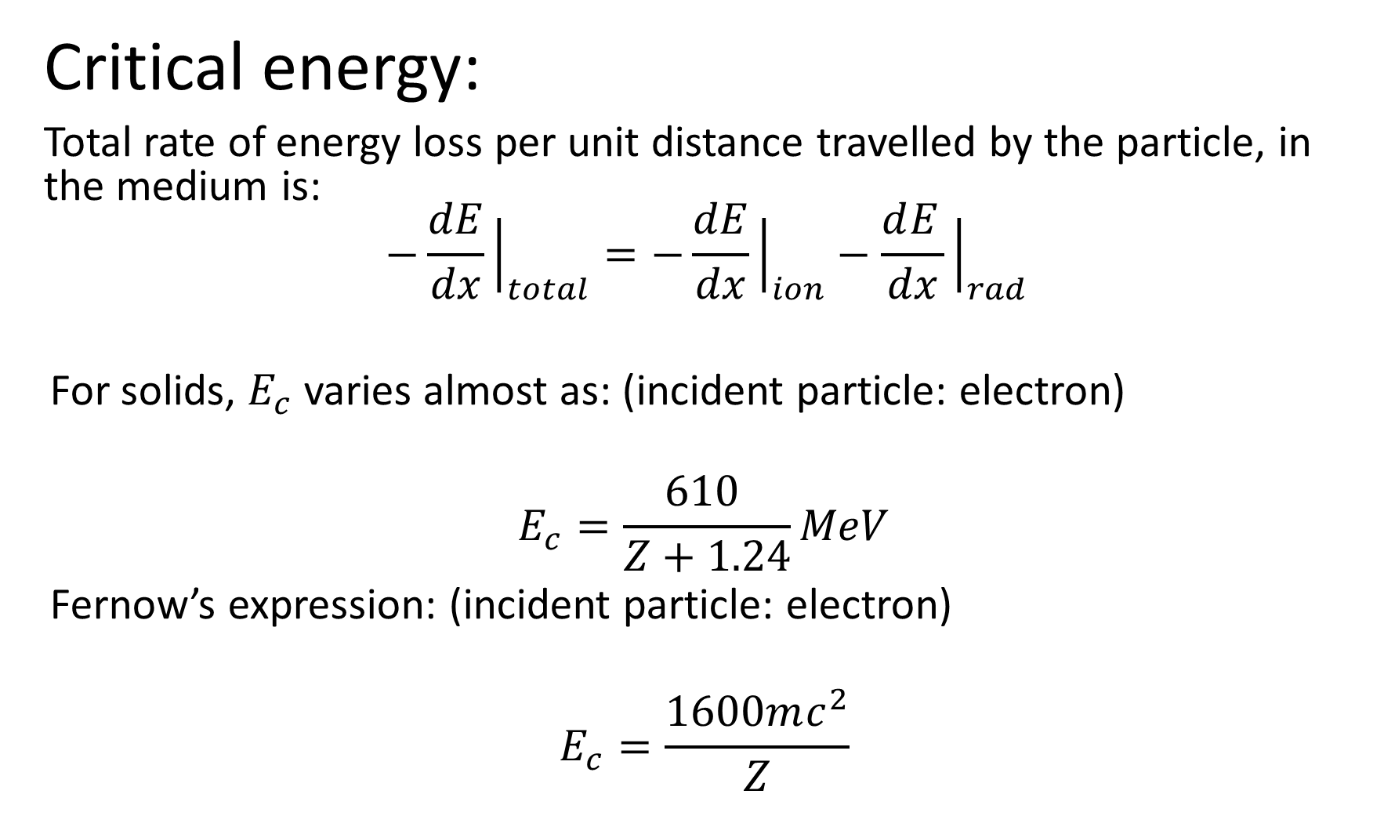
Critical energy:
Total rate of energy loss per unit distance travelled by the particle, in the medium is: $$−\frac{dE}{dx}{\left.​\right|}_{total}=−\frac{dE}{dx}{\left.​\right|}_{ion}−\frac{dE_{ }}{dx}{\left.​\right|}_{rad}$$
For solids, $E_{c}$ varies almost as: (incident particle: electron)
$$E_{c}=\frac{610 }{Z+1.24}MeV$$
Fernow’s expression: (incident particle: electron)
$$E_{c}=\frac{1600mc^{2}}{Z}$$

Slide 8

E_{c} of electron and muon
Shower parameters:
Number of particles in the shower after ‘t’ radiation lengths:
$$N\left(t\right)= 2^{t}= e^{t\ln{2}}$$
Energy of each particle after ‘t’ radiation lengths:
$E\left(t\right)= E_{0}/2^{t}$­
Maximum number of particles in the shower
$N_{max}=e^{t_{max}\ln{2}}$ =${{ E}_{0}}/{E_{c}}$
Element | Z | E_{c} Electron MeV/c² | E_{c} Muon MeV/c²
Si | 14 | 40.0262 | 1.7101
Pb | 82 | 7.3282 | 0.3131
Al | 13 | 42.8371 | 1.8302
Fe | 26 | 22.3935 | 0.9568
Cu | 29 | 20.1719 | 0.8618
W | 74 | 8.1074 | 0.3464

Slide 9
Moleir radius

Slide 10
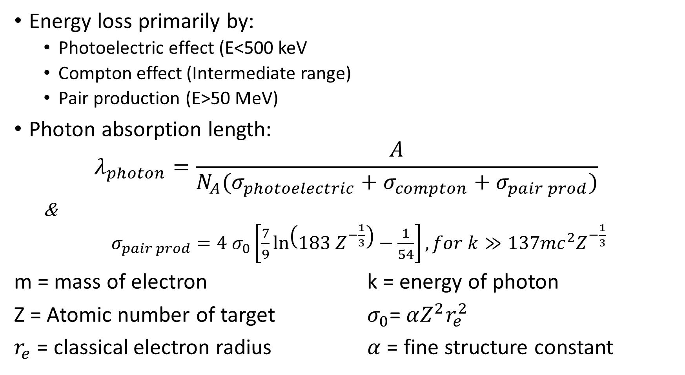
Interaction of photons
Energy loss primarily by:
Photoelectric effect (E<500 keV
Compton effect (Intermediate range)
Pair production (E>50 MeV)
Photon absorption length:
$$λ_{photon}=\frac{A}{N_{A}(σ_{photoelectric}+σ_{compton}+σ_{pair prod})}$$
&
$σ_{pair prod}=4 σ_{0}\left[\frac{7}{9}\ln\left(183 Z^{−\frac{1}{3}}\right)−\frac{1}{54}\right], for k≫137mc^{2}Z^{−\frac{1}{3}}$
m = mass of electron k = energy of photon
Z = Atomic number of target $σ_{0}$= $αZ^{2}r_{e}^{2}$
$r_{e}$ = classical electron radius $α$ = fine structure constant

Slide 11
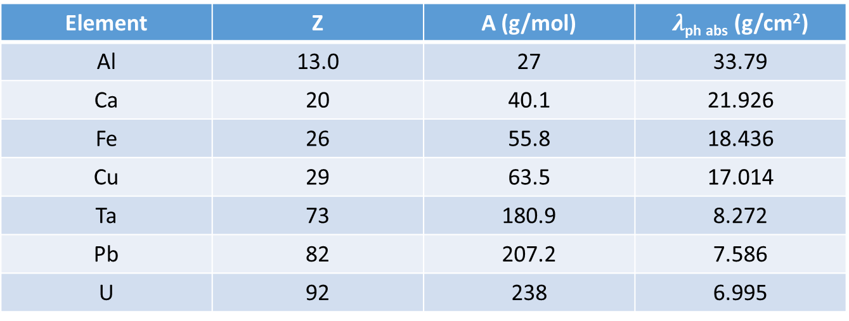
Photon absorption length for some elements:
At high energies where pair production is dominant
Element | Z | A (g/mol) | $λ$_{ph abs} (g/cm²)
Al | 13.0 | 27 | 33.79
Ca | 20 | 40.1 | 21.926
Fe | 26 | 55.8 | 18.436
Cu | 29 | 63.5 | 17.014
Ta | 73 | 180.9 | 8.272
Pb | 82 | 207.2 | 7.586
U | 92 | 238 | 6.995

Slide 12
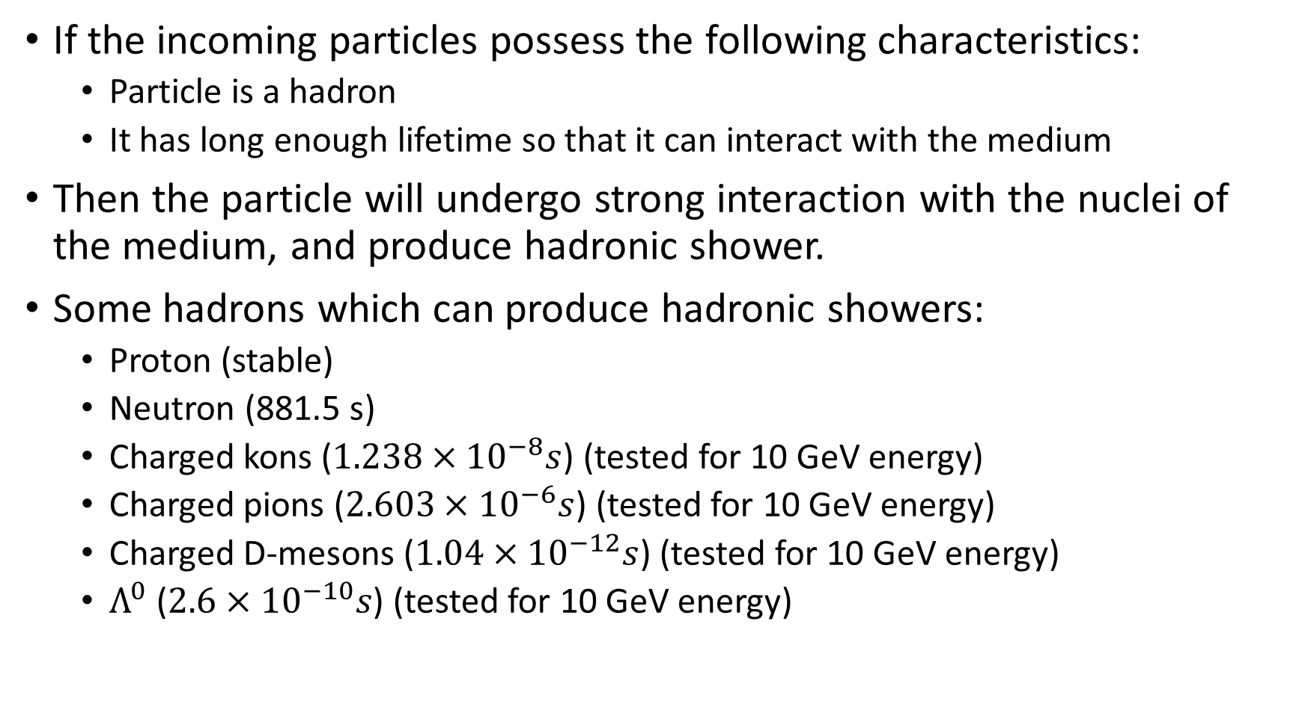
Hadronic Showers
If the incoming particles possess the following characteristics:
Particle is a hadron
It has long enough lifetime so that it can interact with the medium
Then the particle will undergo strong interaction with the nuclei of the medium, and produce hadronic shower.
Some hadrons which can produce hadronic showers:
Proton (stable)
Neutron (881.5 s)
Charged kons ($1.238×{10}^{−8}s$) (tested for 10 GeV energy)
Charged pions ($2.603×{10}^{−6}s$) (tested for 10 GeV energy)
Charged D-mesons ($1.04×{10}^{−12}s$) (tested for 10 GeV energy)
$Λ^{0}$ ($2.6×{10}^{−10}s$) (tested for 10 GeV energy)

Slide 13
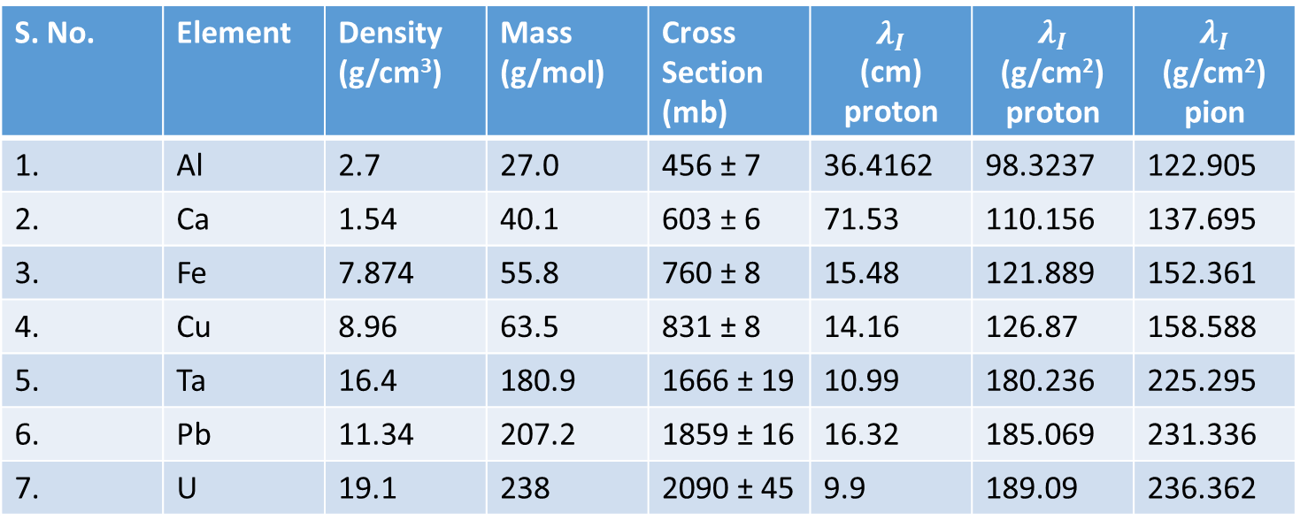
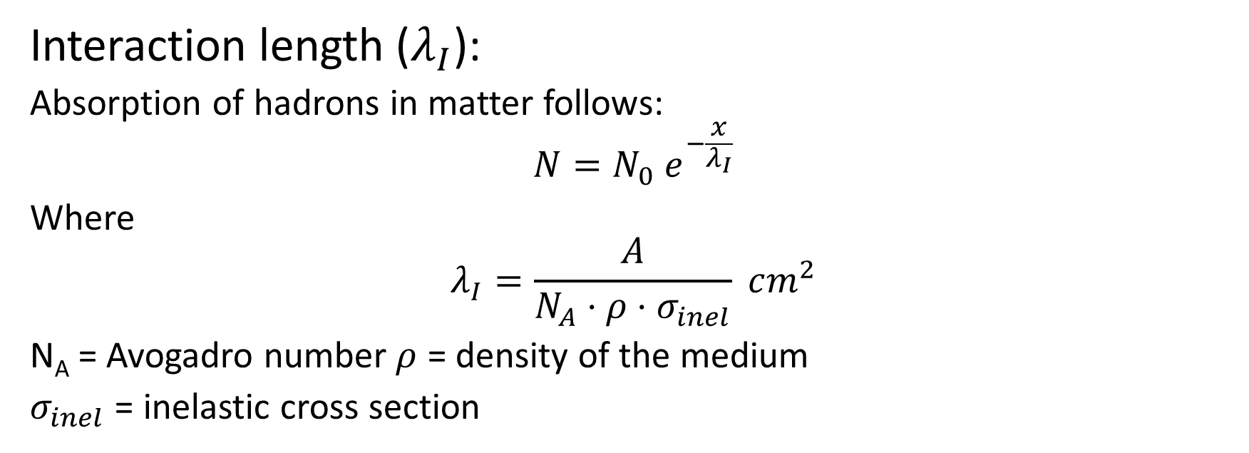
Interaction length ($λ_{I}$):
Absorption of hadrons in matter follows:
$$N=N_{0} e^{−\frac{x}{λ_{I}}}$$
Where
$$λ_{I}=\frac{A}{N_{A}⋅ρ⋅σ_{inel}} cm^{2}$$
N_{A} = Avogadro number$ρ$ = density of the medium
$σ_{inel}$ = inelastic cross section

Slide 14
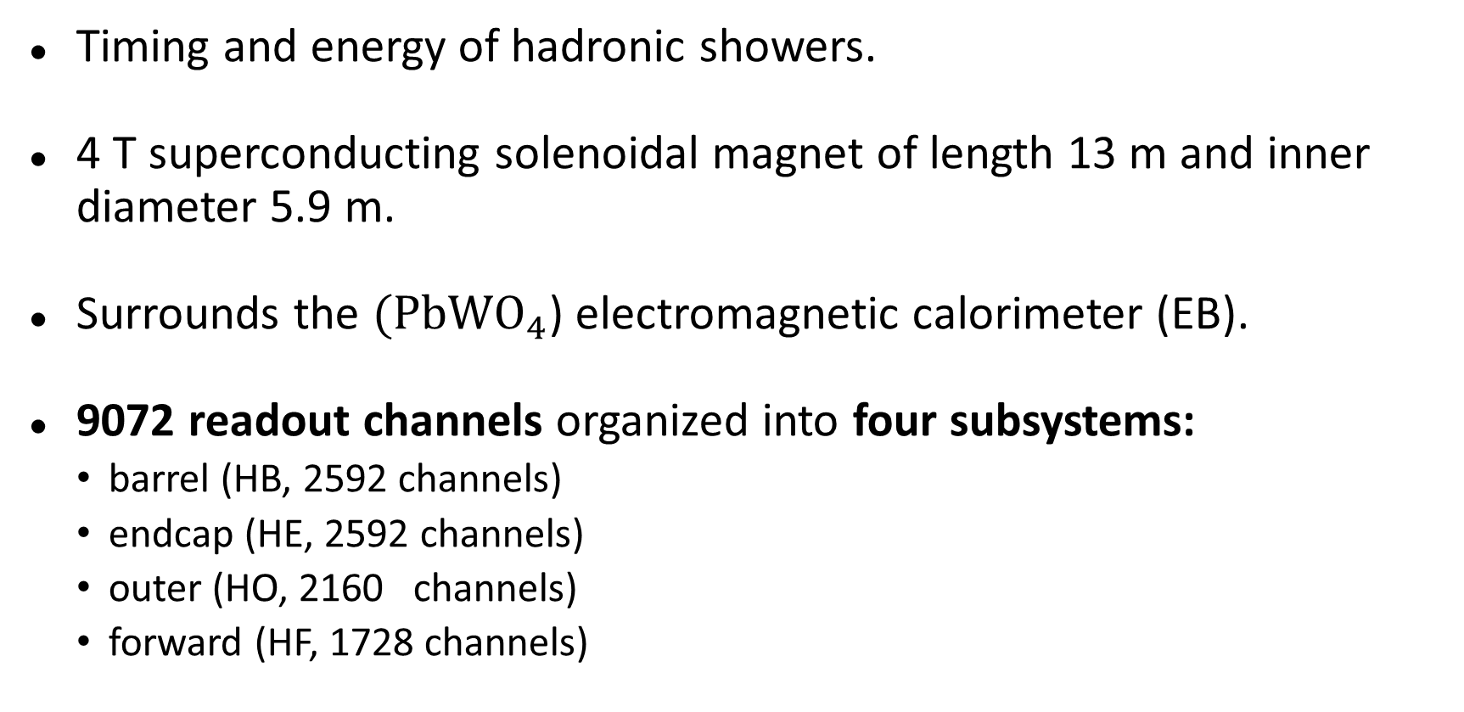
HCAL
Timing and energy of hadronic showers.
4 T superconducting solenoidal magnet of length 13 m and inner diameter 5.9 m.
Surrounds the $(PbWO_{4}$) electromagnetic calorimeter (EB).
9072 readout channels organized into four subsystems:
barrel (HB, 2592 channels)
endcap (HE, 2592 channels)
outer (HO, 2160 channels)
forward (HF, 1728 channels)

Slide 15
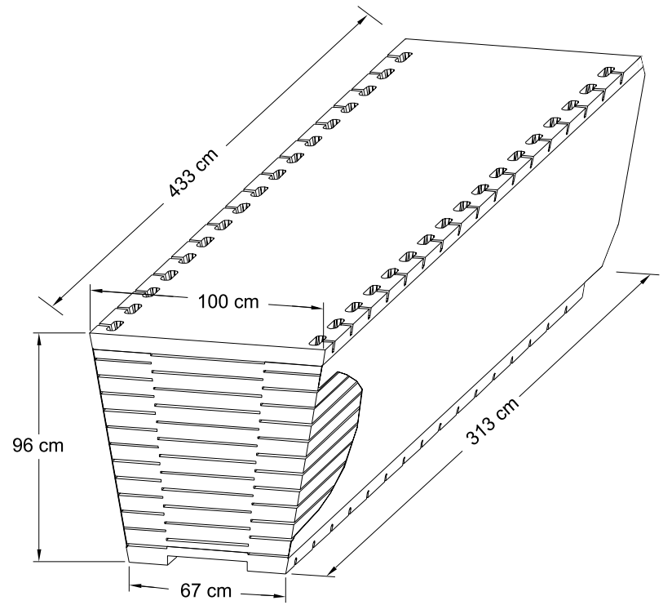
Pseudorapidity range −1.3 < η < 1.3.
Two half-barrels (HB+ and HB–), 36 identical azimuthal wedges (∆φ = 20◦)
Four azimuthal (∆φ = 5◦) sectors.
The scintillator is divided into 16 η sectors, resulting in a segmentation of (∆η, ∆φ) = (0.087, 0.087).
Design

Slide 16
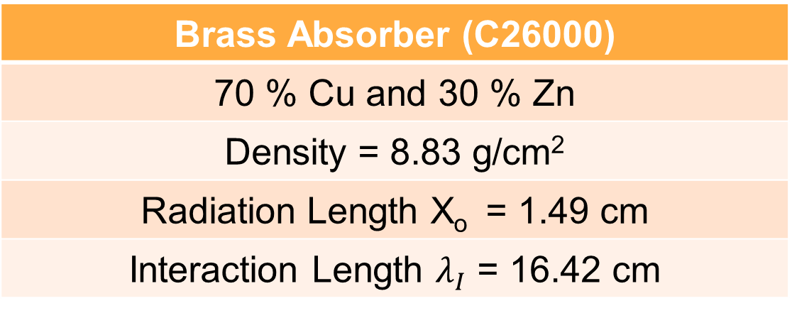

Absorber Geometry
The HB effective thickness
increases with polar angle;
10.6 $λI$ at |η| = 1.3.
EB adds $∼1.1λI$.
Back Steel Plate (75 mm)
6 Brass plates (56.5 mm)
8 Brass plates (50.5 mm)
Front Steel Plate (40 mm)
Beam Direction
Brass Absorber (C26000)
70 % Cu and 30 % Zn
Density = 8.83 g/cm²
Radiation Length X_{o} = 1.49 cm
Interaction Length $λ_{I}$ = 16.42 cm

Slide 17
2.2 Scintillator
CMS HCAL active elements consist of about 70,000 scintillator tiles.
Tray
HB Scintillator
A 3.7-mm thick Kuraray SCSN81 plate was used
Long term stability and acceptable radiation hardness
First layer (Layer-0) is made of 9-mm thick Bicron BC408.
Last layer (Layer-16) is 9-mm thick Kuraray SCSN81.
Used to oversample early and late developing showers

Slide 18
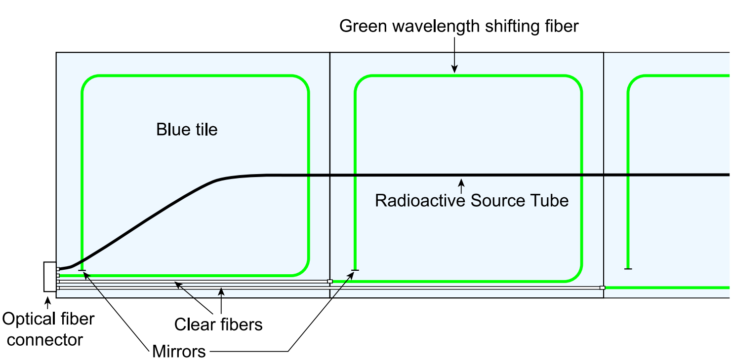
Fig: Schematic of a partial scintillator tray
Source: CMS NOTE 2006/138
Wavelength shifting fiber (Kuraray Y11)
Green double clad, 0.94 – mm diameter
Mirrorred at the tip; average reflectivity ∼ 83% with a spread of about 6.5%
Spliced to clear fibers; transmission efficiency: 92.6%, rms :1.8%

Slide 19
Scintillator plates
WLS
Clear Fibers
Optical connector
Optical unit
Hybrid photodiode
(HPD)
Source tube
1-mm diameter stainless steel tube, for calibration purposes
Guides a 137Cs (or 60Co) source welded on the tip of a thin stainless steel wire across the center of each tile in a tray
Used during the assembly stage, to guide the wire source.
RMS of $\frac{\text{Light} \text{yield} \text{by} \text{collimated} \text{source}}{\text{Light} \text{yield} \text{by} \text{wire} \text{source}}$=1.3%.
Wire sources can be used to calibrate individual tiles to better than 2%
Arranges the fibers into readout towers
Testing of the tray
Collimated ¹³⁷Cs source, illuminated a 4-cm diameter spot on the tray
Determined the relative yield of each tile and uniformity of each tray.
RMS of response and transverse uniformity of each tile = 4.6%, spread of 4.5%
Results imply - tile uniformity contributes negligibly to the fractional energy resolution of the HCAL.

Slide 20
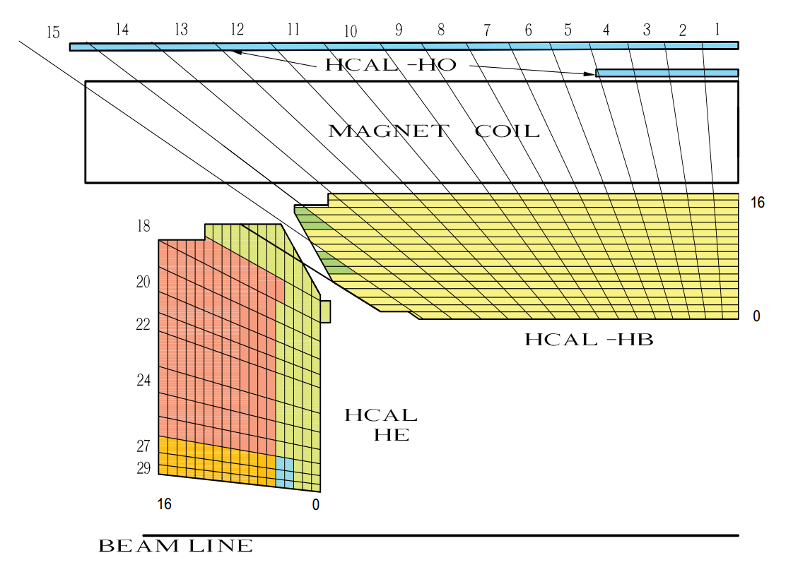
2.3 Longitudinal Segmentation
Tower number
Scintillator layer number
Figure 4: The HCAL tower segmentation for one-fourth of the HB, HO, and HE detectors.The shading
represents independent longitudinal readouts in the HB/HE overlap and the small angle regions.

Slide 21
Towers 1 through 14, all have a single longitudinal readout
Towers 15 and 16 are segmented in depth.
Front segment of Tower 15 contains either 12 or 13 scintillator layers.
Rear segment of Tower 15 has three scintillator layers.
Tower 16 has five layers in the front segment and three in the rear.
Tower 16 does not have a Layer-0 scintillator.

Slide 22
3. Electronics and Data Acquisition

Slide 23
Each wedge contains 72 channels of front-end electronics mounted on the detector periphery near Tower 14 in an enclosure referred to as a readout box (RBX).
A single RM contains an 19-channel HPD which registers signals from an independent (∆η, ∆φ) = (0.0875, 0.0875) tower.
RBX
Each RBX is divided into
Readout
four readout modules
Modules

Slide 24
Photoelectrons are accelerated to ∼ 8 kV kinetic energy and strike the diode causing ionization.
Collection of the liberated holes leads to a high gain of about 1600.
The diode consists of 19 electrically independent
readouts.
The HPD signals are measured and encoded into
a non-linear digital scale by the charge integrator
IC (QIE).

Slide 25
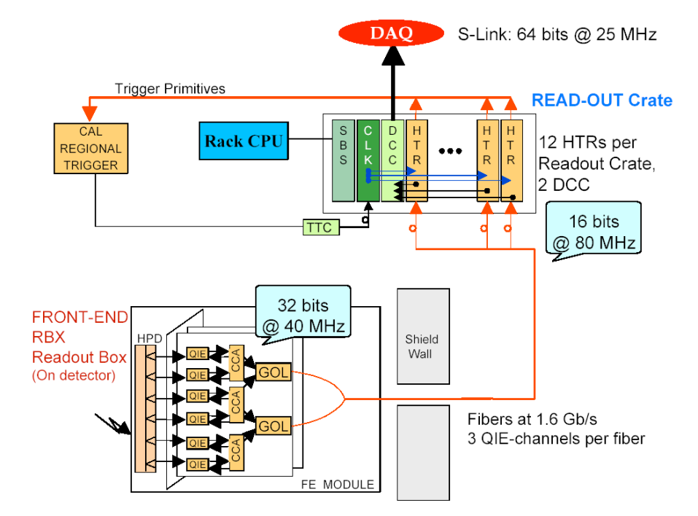
Figure 5: Overview of the HCAL data acquisition electronics. Source: CMS NOTE 2006/138

Slide 26
3.1 Trigger and Readout Modules
Data from Detector to HCAL trigger and readout modules (HTR) via gigabit optical links (GOL).
The HTR is equipped with
optical receivers,
timing and trigger (TTC) signal circuitry,
serial low voltage digital signal outputs (LVDS-Channel Link) to the data concentrator card (DCC), and FPGA for trigger outputs.

Slide 27
The HTR includes two data pipe-lines:
The trigger pipe-line assigns the front-end data to a particular LHC bunch crossing and sends them to the CMS trigger.
The data acquisition pipe-line stacks the frontend data and sends it to the DCC which performs the data acquisition task.
The raw input data stream is deserialized and synchronized to the local clock.
A programmable delay of up to a few clock cycles is used to align data from different input fibers.

Slide 28
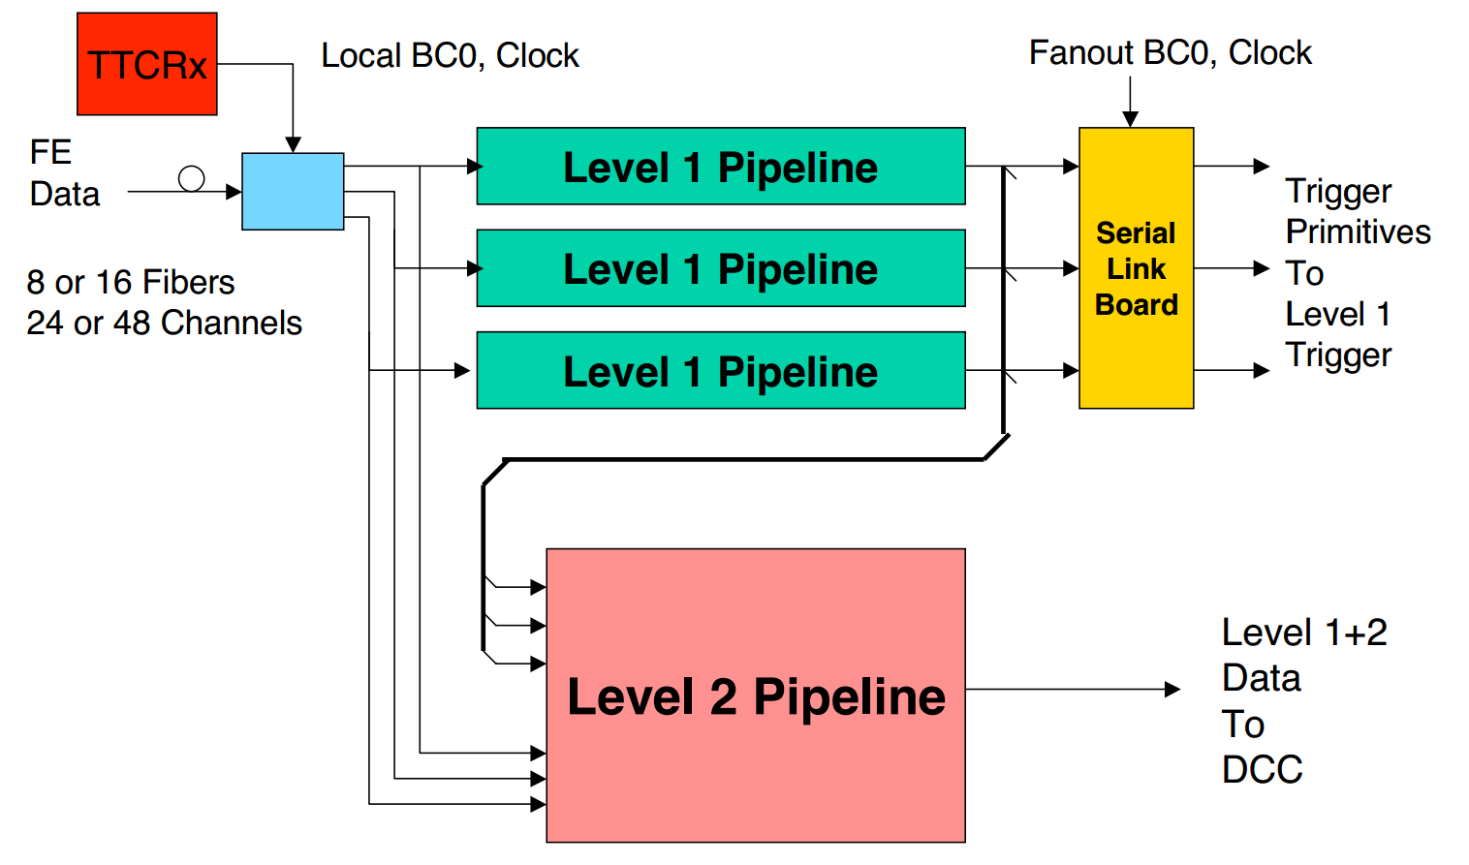
Figure 6: Block diagram of the HTR electronics. The data from the detector drives two pipelines; one
to the CMS trigger and a second to the CMS data acquisition via DCC.
Source: CMS NOTE 2006/138

Slide 29
3.2 Data Concentrator Card
The LVDS link receiver boards contain three independent link receivers which can operate at 20–66 MHz (16-bit words). Event building, protocol checking, event number checking and bit error correction are performed independently for each link.
The DCC logic is designed to operate continuously at the full speed of the two input PCI busses, namely (33 MHz)×(32 bits)×(2).
The event builder and output logic must thus run at an average rate of at least
66 MHz (32-bit words) or 264 MBytes/sec.
The event builder output is sent in parallel to several destinations.

Slide 30
The outputs of event builder are:
The data acquisition (DAQ) output: Every event is sent to the CMS DAQ.
The trigger data output: The trigger information sent to the CMS Level-1 trigger is also sent to a special trigger DAQ system for monitoring of the trigger performance.
The spy output: A selected subset of events is sent to a VME-accessible memory for monitoring and diagnostics.

Slide 31
4. Test Beam Setup
The data were recorded during 2002 at the CERN H2 test beam.
Prototype electromagnetic crystal calorimeter which was inserted in front of the HB for some of the measurements.
The two-dimensional movement of the platform in φ and η directions allowed the beam to be directed onto any tower of the calorimeter.
Four scintillation counters were located approximately three meters upstream of the calorimeters and a coincidence between a subset of these counters was used for the trigger.

Slide 32
4.1 ECAL Module
The electromagnetic calorimeter module consisted of 49 lead tungstate crystals arranged in a 7 × 7 array.
The crystals were consistent with the CMS electromagnetic calorimeter design.
Each crystal was coupled to a single photo-multiplier tube through a plastic light guide located at the front of the crystal.
The PMT signals were digitized by CAEN V792 charge-to-digital converters (QDC).

Slide 33
4.2 Data Sets
Electron (GeV/c) | Pion (GeV/c) | Muon (GeV/c)
20 | 20 | 225
30 | 30
50 | 50
100 | 100
 | 300
Beams - directed into the centers of all towers
limited to the bottom two 5◦ sectors of the top wedge for mechanical
reasons
The scan covered the entire η range (16 sectors).
These data were taken without the electromagnetic calorimeter module

Slide 34
4.2 Data Sets
Several special runs :
taken with the moving radioactive wire source and with a LED pulser which illuminated the HPD.
The measurements included a complete radioactive sourcing of all scintillator tiles (2092 tiles for each pair of wedges)
Layer-0 of the HB
used to sample early hadronic showers.
is thicker and brighter than those in other layers in the HB.
Its sampling weight is controlled by an optical filter in the readout chain.
4.3 Determination of Layer-0 Weight

Slide 35
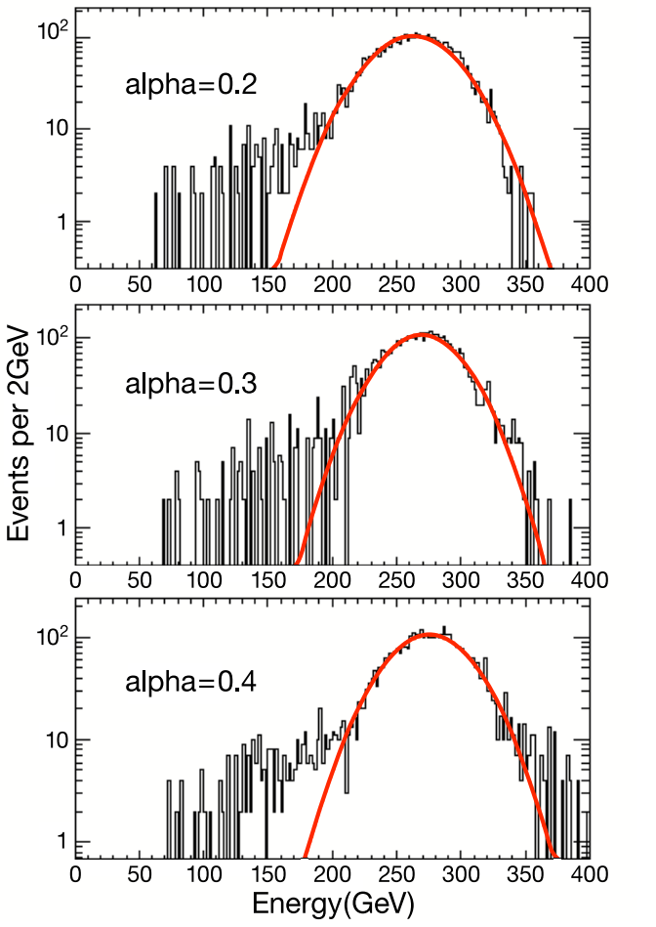
The best energy resolution was obtained with a Layer-0 weight of α = 0.3.
At α = 0.4, a tail at large energy, starts becoming evident.
The α = 0.2 spectrum has a larger rms than that for α = 0.3.
Figure 8: Single Gaussian fit to the signal distribution for 300 GeV/c pion beam
Source: CMS NOTE 2006/138

Slide 36
4.4 Noise Performance
The front-end electronics was operated at 33.79 MHz for all measurements.
The least count corresponds to 2080 electrons. The observed noise spread in the pedestal is less than 5000 electrons.
As will be seen from the beam measurements, this corresponds to an energy of ∼ 0.5 GeV
Notes:
How to determine the energy loss by a pion.
Consider the case of muon. Muon loses its energy by ionization, and it’s a landau distribution. The peak is called landau peak and we call it minimum ionization potential. We find this peak for all the towers (8 x 16 = 128), and …

Slide 37
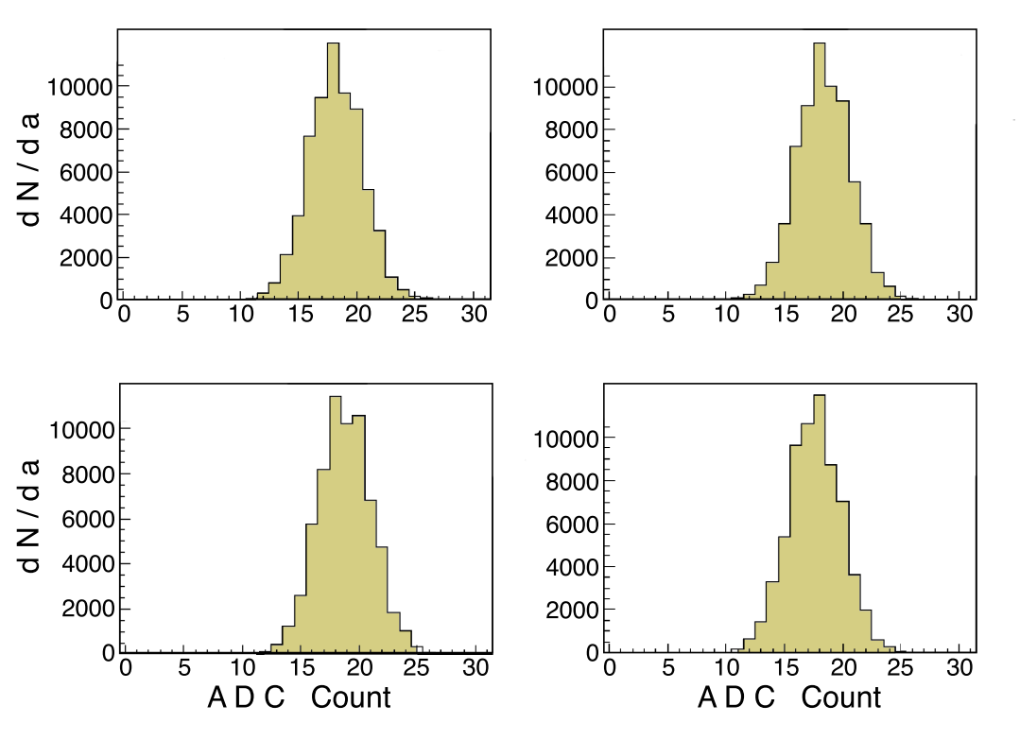
4.4 Noise Performance
The noise distribution at the highest gain setting of the multi-range ADC, for a single QIE channel.
Figure 9:
Measured pedestal distributions (dN/da) in units of raw ADC counts in the most sensitive
QIE range for 4 capacitor banks of the QIE. The rms is 2.3 ADC counts, independent of which capacitor bank stores the charge.
Source: CMS NOTE 2006/138

Slide 38
4.5 Time Structure
The time structure of the HB pulse is dominated by the scintillator decay times.
Two different measurements of the time structure of the pulse of deposited energy were made.
First, with a photomultiplier and commercial electronics;
Second, with HPD and QIE electronics.

Slide 39
4.5.1 Measurements with a Photomultiplier Tube
A single 10-stage, 2-inch photo-multiplier tube (RCA 6342A) was used and the output was fed into a digital oscilloscope which recorded voltage in 0.4 ns bins.
Recorded 300 GeV/c and 20 GeV/c pion and 100 GeV/c electron showers, as well as signals from high energy muons.
In the case of muons, fluctuations in the number of photoelectrons lead to large event by event fluctuations.

Slide 40
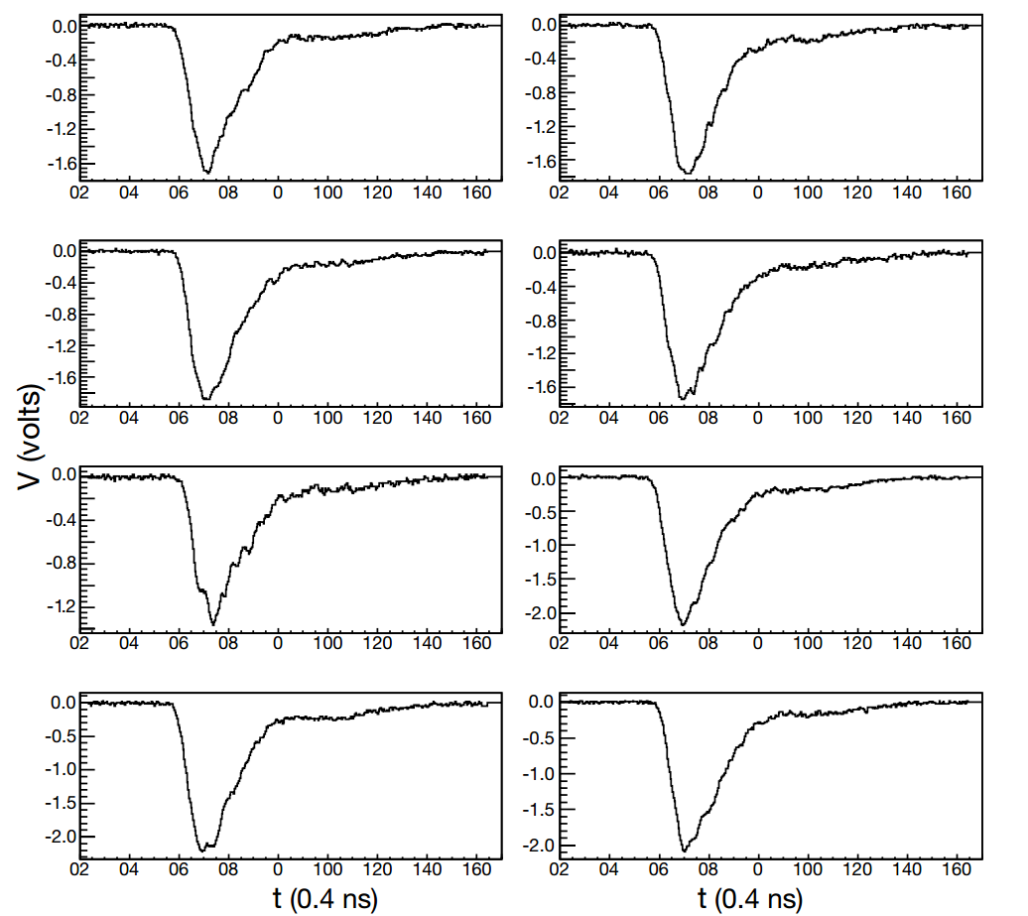
Figure 10: Calorimeter pulses for eight individual events, voltage vs time, observed with a photomultiplier for 300 GeV pion showers. The time scale is 0.4 ns per bin.

Slide 41
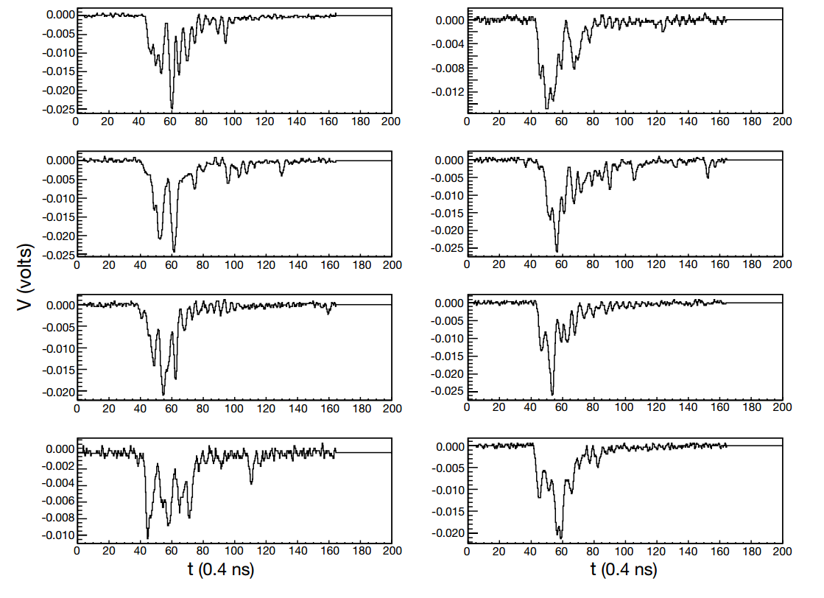
Figure 11:
Calorimeter pulses for eight individual events, voltage vs time, observed with a photomultiplier
for 225 GeV/c incident muons. The time scale is 0.4 ns per bin.
Source: CMS NOTE 2006/138

Slide 42
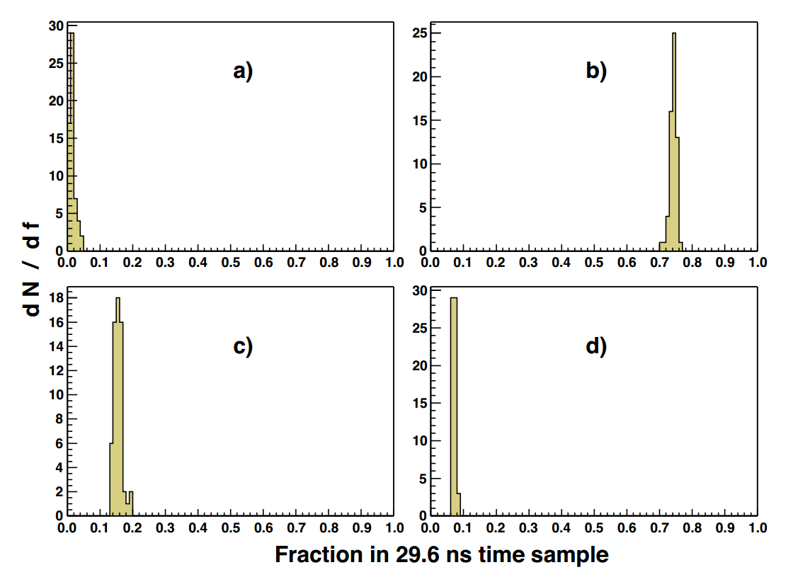
Figure 12:
Fraction of energy (f) observed in 29.6 ns time samples for 200 GeV/c pion showers.
a) first time sample,
b) second time sample, c) third time sample, and d) fourth time sample.
Source:
CMS NOTE 2006/138

Slide 43
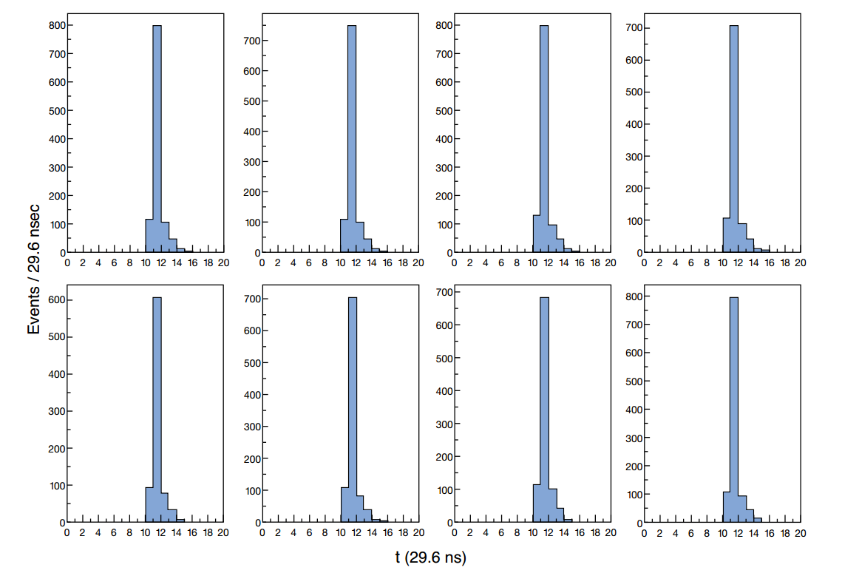
4.5.2 HPD/QIE Measurements
Twenty time samples were recorded for each QIE channel.
At a frequency of 33.79 MHz, each time sample corresponds to 29.6 ns
Figure 13:
Time structure for eight events with 300 GeV/c incident pions in which the phase is selected
by demanding that 10-12% of the observed energy is in time sample number 10.
Source: CMS NOTE 2006/138

Slide 44
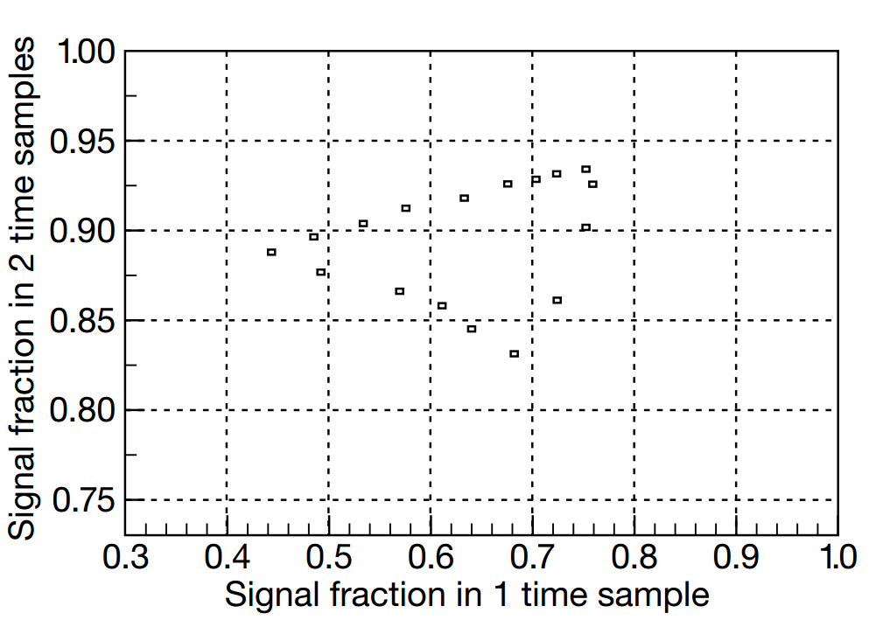
Most of the signal is collected in two time samples.
.
Figure 14:
Fraction of signal observed in two time sample vs that observed in a single time sample. The zero point is suppressed for each axis.
Source: CMS NOTE 2006/138

Slide 45
5. The HB Response to Pions and Muons

Slide 46
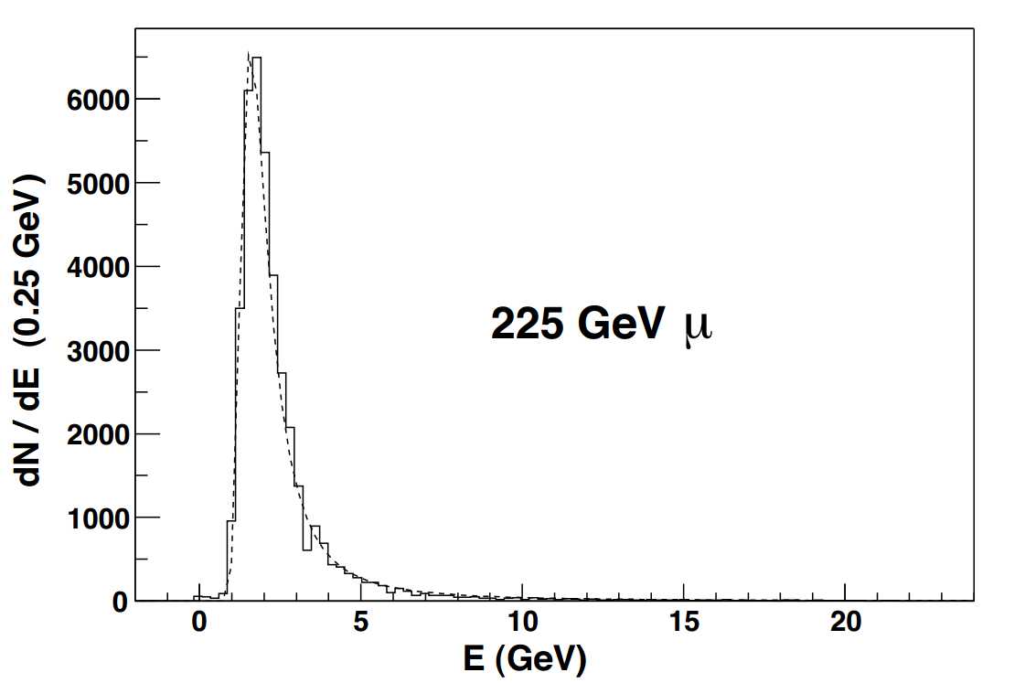
Muons
Important to understand HB response to muons for particle identification purposes
A feature bit will be reported for use in higher level triggers, when a muon is identified by the HB.
A Landau fit to this distribution results in 1.64 GeV for the most probable and 2.5 GeV for the mean value.
Source: CMS NOTE 2006/138

Slide 47
How to measure the energy of pion?
Steps involved:
Calibrate the detector using muons of known energy
Take the data using pions; use the calibration; find out the energy of pions
Calibration:
We consider 25 towers of the calorimeter
Select a tower, say (1,1) element of the 5x5 matrix
Incident a muon beam (of energy 225 GeV) in the center of the tower
In the beam, there will be 10,000 pulses i.e., 10,000 events. Each pulse consists of one muon

Slide 48
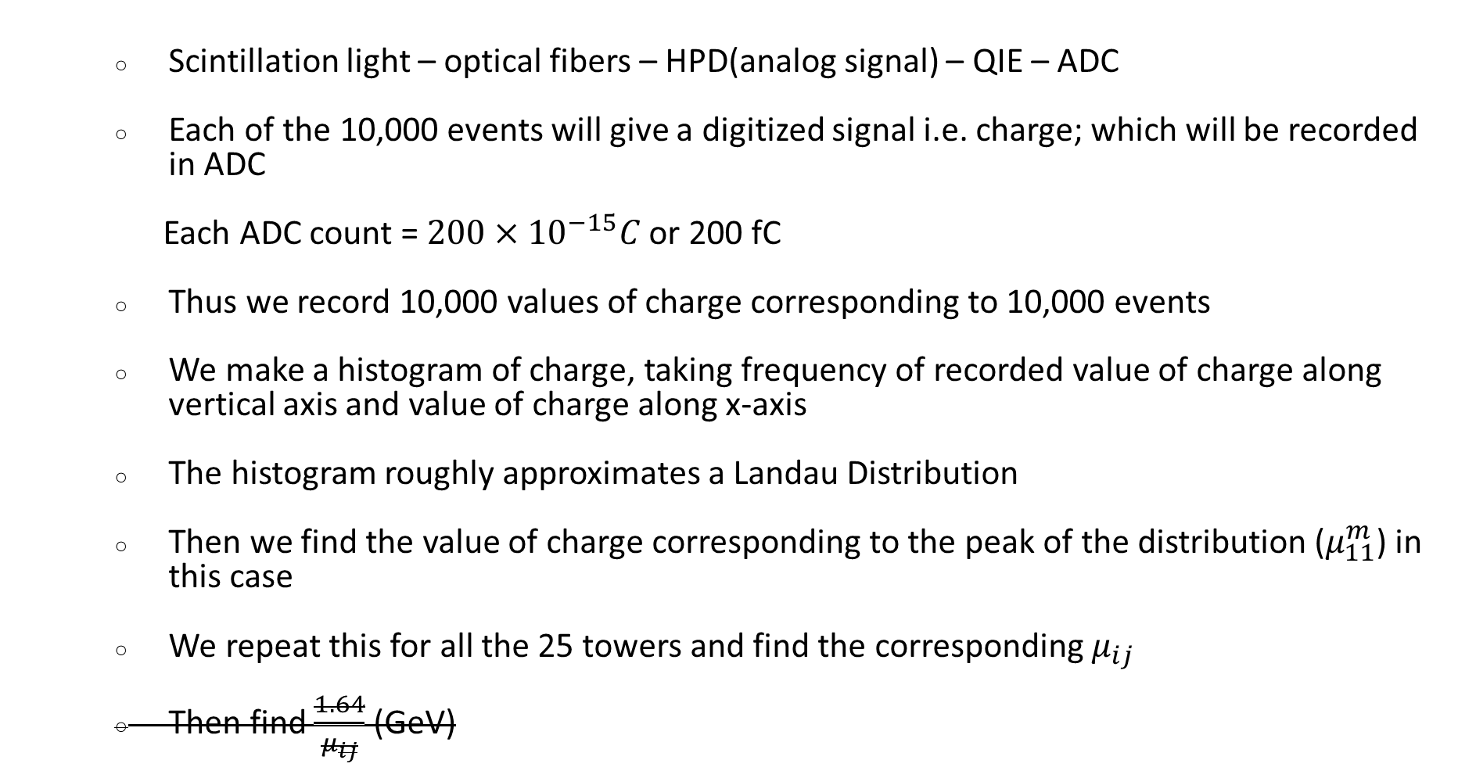
Scintillation light – optical fibers – HPD(analog signal) – QIE – ADC
Each of the 10,000 events will give a digitized signal i.e. charge; which will be recorded in ADC
Each ADC count = $200×{10}^{−15}C$ or 200 fC
Thus we record 10,000 values of charge corresponding to 10,000 events
We make a histogram of charge, taking frequency of recorded value of charge along vertical axis and value of charge along x-axis
The histogram roughly approximates a Landau Distribution
Then we find the value of charge corresponding to the peak of the distribution ($μ_{11}^{m}$) in this case
We repeat this for all the 25 towers and find the corresponding $μ_{ij}$
Then find $\frac{1.64}{μ_{ij}}$ (GeV)

Slide 49

Determination of pion energy
Repeat the steps and finding $μ_{ij}^{p}$ for pions
Calibrate the ADC counts scale to make it energy scale: $\frac{μ_{ij}^{p}}{μ_{ij}^{m}}×1.64 \left(GeV\right)$
Fit the distribution of pion histogram and find the energy value (horizontal axis) corresponding to the peak

Slide 50
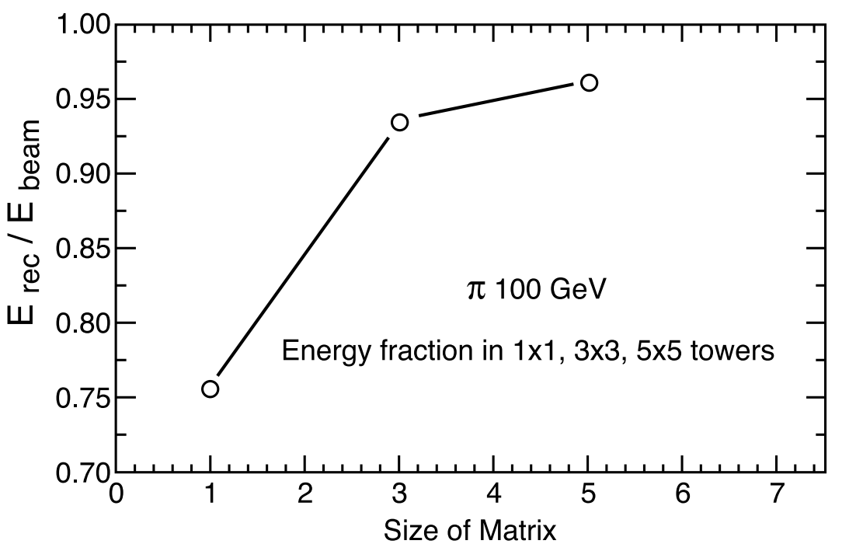
Pions
With the 100 GeV/c pion beam centered on a tower, the fraction of energy observed in the single tower is on average 75%.
If the energy in the neighboring eight towers is added, forming a 3×3 array, 93% of the pion energy is observed.
The energy in a 5 × 5 array is 96%.
Source: CMS NOTE 2006/138

Slide 51
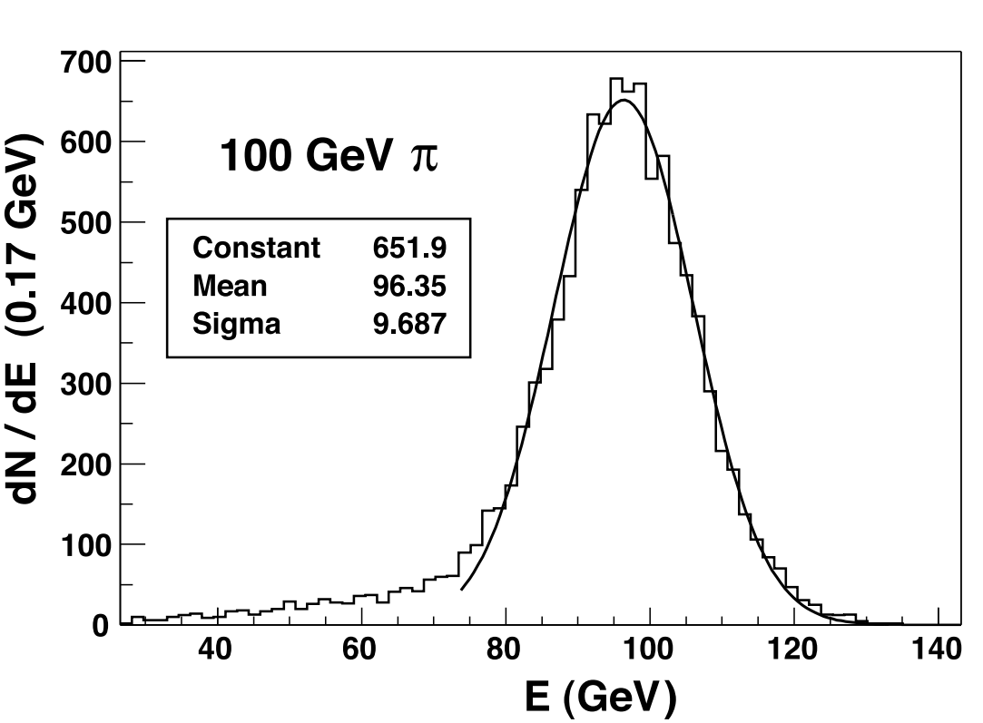
The energy response for 100 GeV pions in a 5 × 5 array is shown in figure.
A Gaussian fit suggests that the energy resolution at this energy is about 10%.
Source: CMS NOTE 2006/138

Slide 52
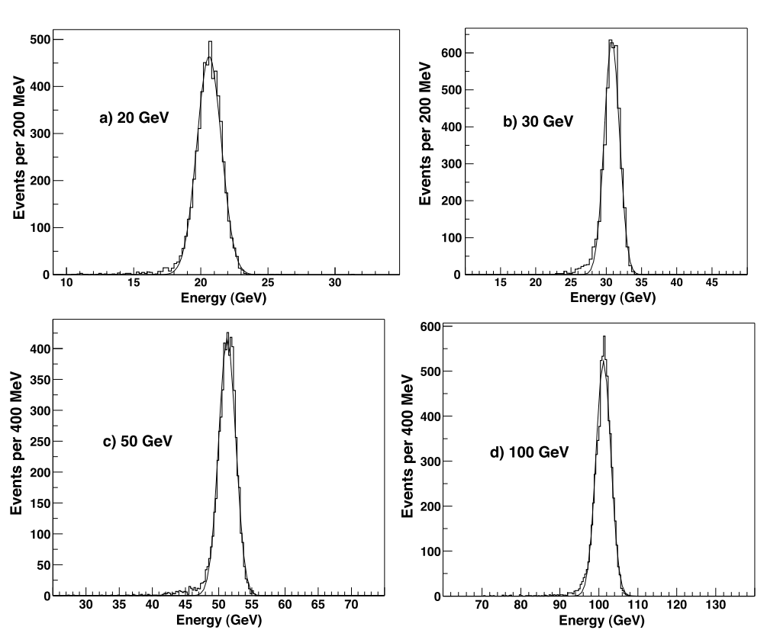
6. The EB Response to Electrons
All 49 electromagnetic calorimeter crystals were calibrated with 100 GeV/c electrons.
The linearity of response of the EB module was studied at electron beam energies of 20, 30, 50 and 100 GeV/c.
The single crystal EB response to incident electrons of energy. The smooth curves represent single gaussian fits to the histogram data.
Source: CMS NOTE 2006/138

Slide 53
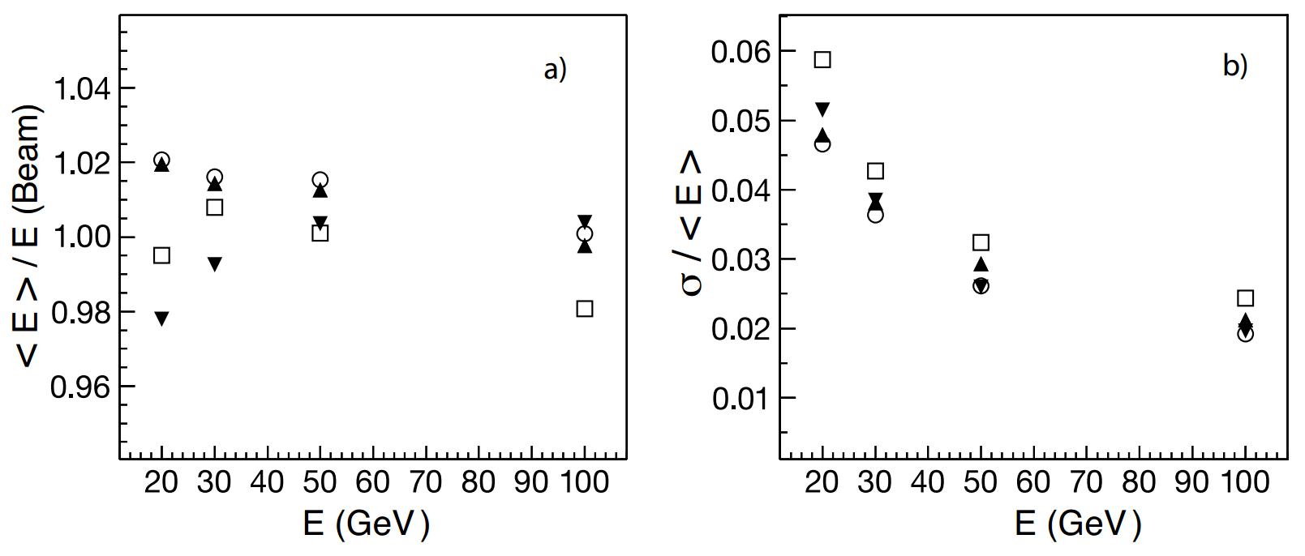
The linearity of energy response as a function of beam energy derived from the Gaussian fits.
Figure 19:
a) Mean energy divided by the beam energy vs the beam energy.
b) The fitted Gaussian energy resolution vs the beam energy.
Source: CMS NOTE 2006/138

Slide 54
7. Performance of the combimed calorimeters: EB+HB

Slide 55
7.1 Energy Resolution and Response
The performance characteristics of the HB and the EB module were studied with pion beams of varying momenta contaminated with muons and electrons.
The absolute energy scale of the HB was defined using a beam of 50 GeV/c pions directed at the combined calorimeter systems.
Only those pions which deposited less than 2 GeV in the EB were selected for the HB calibration.
The calibration factor was extracted as the ratio between the pion beam momentum and the mean of the distribution of summed HB energy deposited in a 5 × 5 tower array centered on the beam position

Slide 56
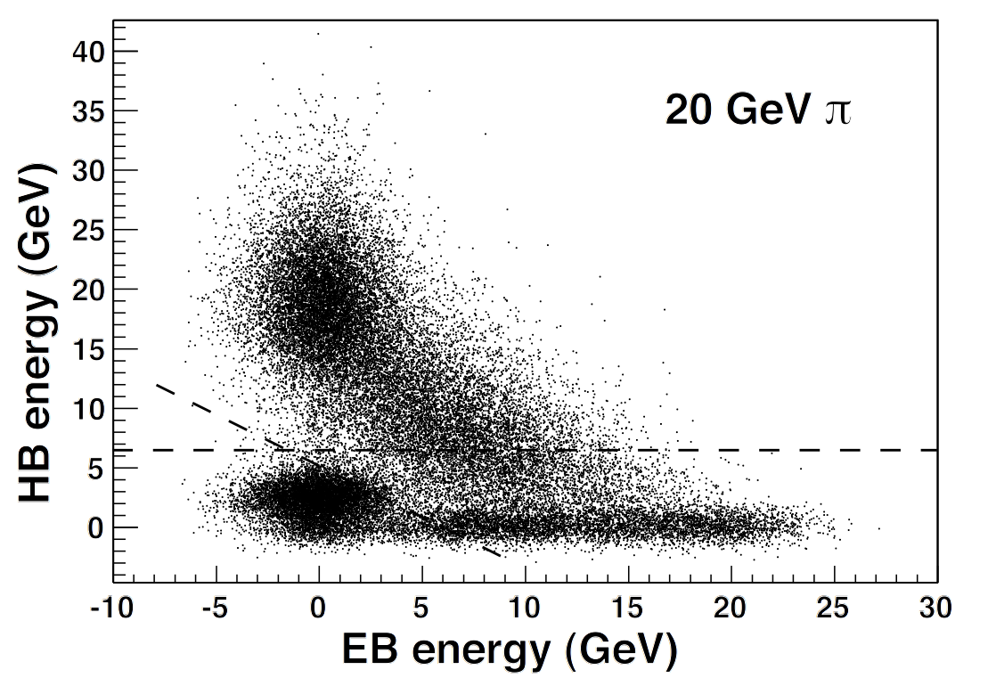
Figure 20:
Energy observed in the HB vs the EB module for 20 GeV/c pions. The dashed lines show the cut limits which were imposed to remove muon and electron contamination in the beam.
Source: CMS NOTE 2006/138

Slide 57
A series of cuts were developed to select pions in contaminated beams.
A cut EHB > 6.5 GeV, where EHB is the HB energy, was applied in order to eliminate the events with abnormally small HB energy and also to remove electron contamination.
An additional cut of EHB > −0.83E_{EB} + 5.2 GeV, where E_{EB} is the energy measured by the EB, was made to reduce the muon background.
These energy response and energy resolution measurements were corrected for the effect of the beam cuts, using a Monte Carlo simulation based on GEANT4.

Slide 58
Beams of pions were generated and showered in the EB and the HB, and the resulting distributions were scaled up to match the measured mean energy.
The quality cuts for background rejection were then applied and the correction factors were derived.
The correction factors to the energy response and the resolution for 20 GeV/c (30 GeV/c) pions are 0.931 (0.987) and 1.056 (1.018), respectively. The corrections factors at higher energies are negligible.

Slide 59
There are three contributions to the quoted HB calibration error.
One comes from the 2 GeV cut to the EB energy deposition by 50 GeV/c pions, The second contribution comes from the background subtraction method applied to the 50 GeV/c calibration sample.
The third component comes from the statistical error on the mean of the 50 GeV/c distribution.
Added in quadrature, the total calibration uncertainty is ±1.3%.
This error on the pion energy was propagated to the mean and width of the distributions by recalculating the total energy with the nominal, high, and low calibration factors.

Slide 60
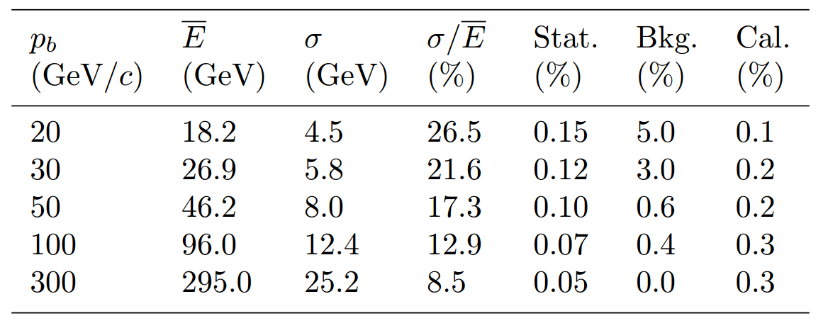
Table 2: The energy resolutions and the associated errors ascribed to statistics, background and the
calibration uncertainties for pions at five different beam momenta.
Source: CMS NOTE 2006/138
The fits are applied to the raw data and no correction is made for the large e/h value of the electromagnetic calorimeter. Results are in agreement with GEANT4 within the systematic errors and the available beam momentum range.

Slide 61
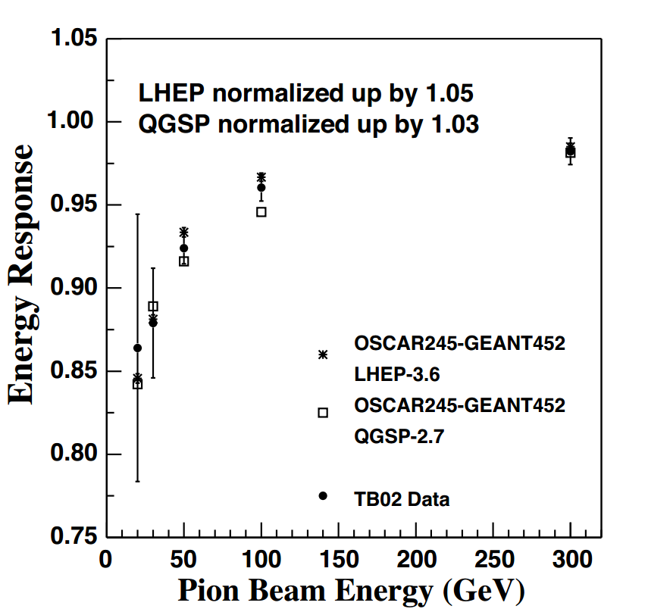
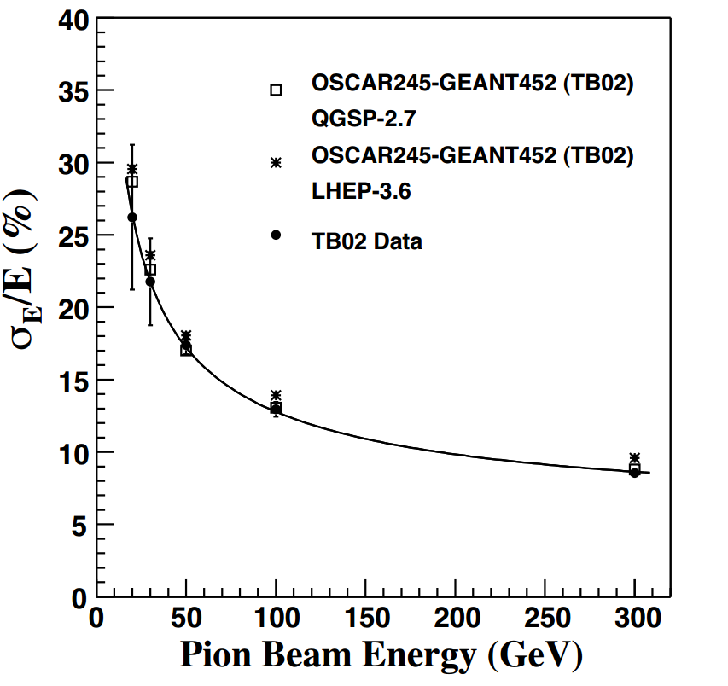
Figure 21: The measured energy resolution(solid circles) with fit (solid line) (σ/E) = 115 √.E 3% ⊕ 5.5% compared to two different tunes of GEANT4 (open squares and stars). The symbol ⊕ implies that two terms are added in quadrature.
Figure 22: The measured energy response (solid circles) linearity compared to the GEANT4 simulations with different physics lists. The error bars indicate the statistical and systematic uncertainties added in quadrature.
Source: CMS NOTE 2006/138

Slide 62
8. Comparison with GEANT4

Slide 63
The CMS Collaboration developed the Object oriented Simulation for CMS Analysis and Reconstruction (OSCAR) framework, based on the GEANT4 tool kit, to describe the detector geometry and the passage of particles through the detector material.
GEANT4 uses either parametric (LHEP) or microscopic (QGSP) physics models to simulate the particle showers arising from the interaction of particles with matter.
For the studies presented in this paper, the software package OSCAR 2.4.5 is used, based on GEANT 4.5.2, with LHEP 3.6 and QGSP 2.7 physics lists or models.

Slide 64
A detailed comparison using GEANT4 was made for one tower location. The electronic noise was taken to be 520 MeV. The secondary particle cuts were set to 1 mm for both electrons and positrons, and 10 mm for photons, except in the electromagnetic calorimeter where the photon cut was set to 1 mm.
The energy calibration of the EB and HB followed closely the same procedure used in the beam measurements.
For 100 GeV/c electrons in the electromagnetic calorimeter, the two GEANT4 physics lists, LHEP-3.6 and QGSP-2.7, give energy resolutions in excellent agreement with each other.
For the EB, an additional scaling term was introduced so that the electron energy resolution simulated in the range 20-100 GeV/c agreed with the experimental values.

Slide 65
The relative degradation in the energy resolution for pions when incorporating the extra smearing into the energy observed by the EB is 3% (1% absolute) at 20 GeV/c, and 0.6% (0.06% absolute) at 300 GeV/c.
The measurements are in good agreement with the simulation for the two physics lists tested.
The LHEP-3.6 gives an energy resolution a few percent larger than the QGSP-2.7.
The experimental data and the Monte Carlo predictions are more straightforward to compare in ratio:

Slide 66
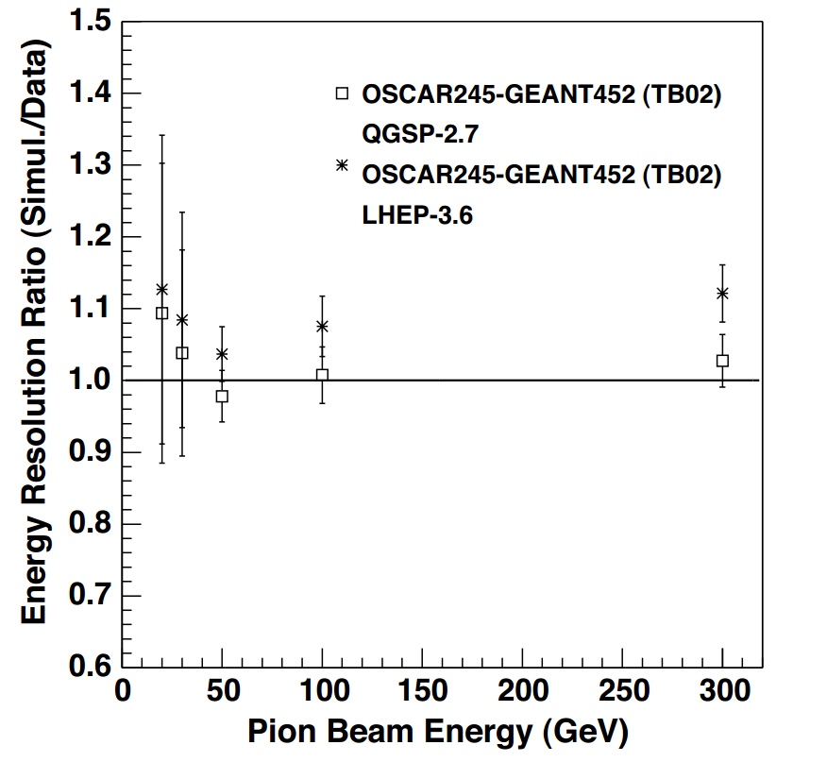
The importance of the electronic noise contribution increases as the pion beam energy decreases.
At 20 GeV/c, the resolution degrades by more 15 than 30% when a realistic electronic noise model is incorporated into the simulation.
LHEP-3.6 predicts a slightly faster growing response with energy compared to that measured, the one derived from the QGSP-2.7 increases more slowly.
The electronic noise does not affect this measurement significantly.
Figure 23: The energy resolution ratio of the different tunes of GEANT4 (open squares and asterisks) to the test beam data as a function of the pion beam energy. The solid line represents perfect energy independent agreement.

Slide 67
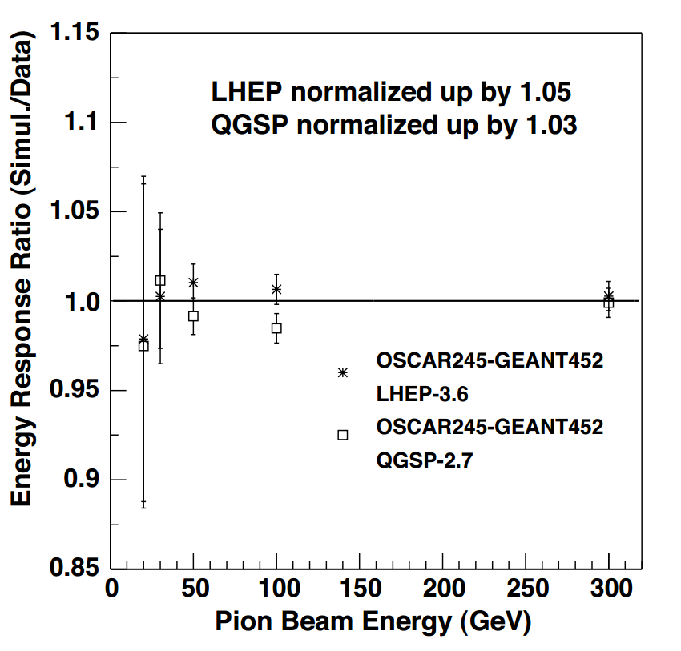
Figure 24: The energy linearity ratio of the different tunes of GEANT4 (open squares and asterisks) to
the test beam data as a function of the pion beam energy. The solid line represents perfect energy
independent agreement.
Source: CMS NOTE 2006/138

Slide 68
9. Radioactive Source Calibration

Slide 69
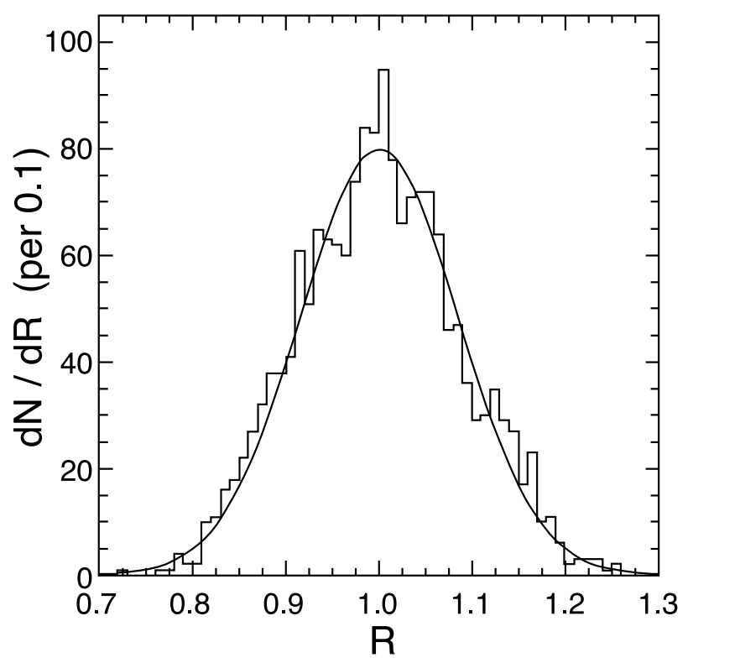
The radioactive source calibration is performed for every scintillator tile.
The ratio of the radioactive source signal to the energy response to the pions in the beam for each tower provides the initial calibration.
This ratio depends on the type and activity of the source.
The signals from 1745 tiles, corrected for the different fiber attenuation, are shown in figure.
The width of the distribution is 8% and it is consistent with the measurements of tile uniformity made during tray reconstruction.
Figure 25: Distribution of scintillating tile response (R) to the source calibration normalized to the mean of the distribution. The line represents a single Gaussian fit to the data.

Slide 70
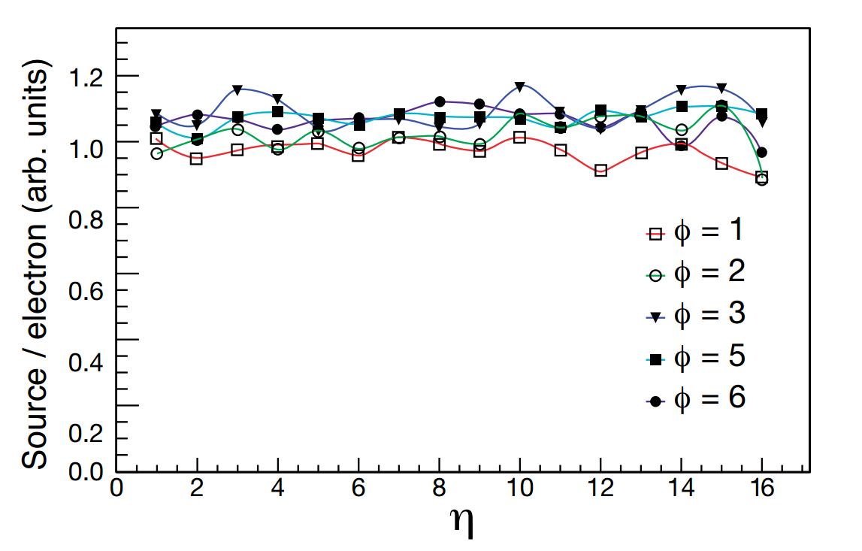
Dependence of the ratio of radioactive signal to the electron signal on the tower number.
Figure 26: Ratio of the radioactive source signal (fit to peak value) to the 100 GeV/c incident electron
signal in the HB vs η number of the tower for five different φ numbers (80 towers total).

Slide 71
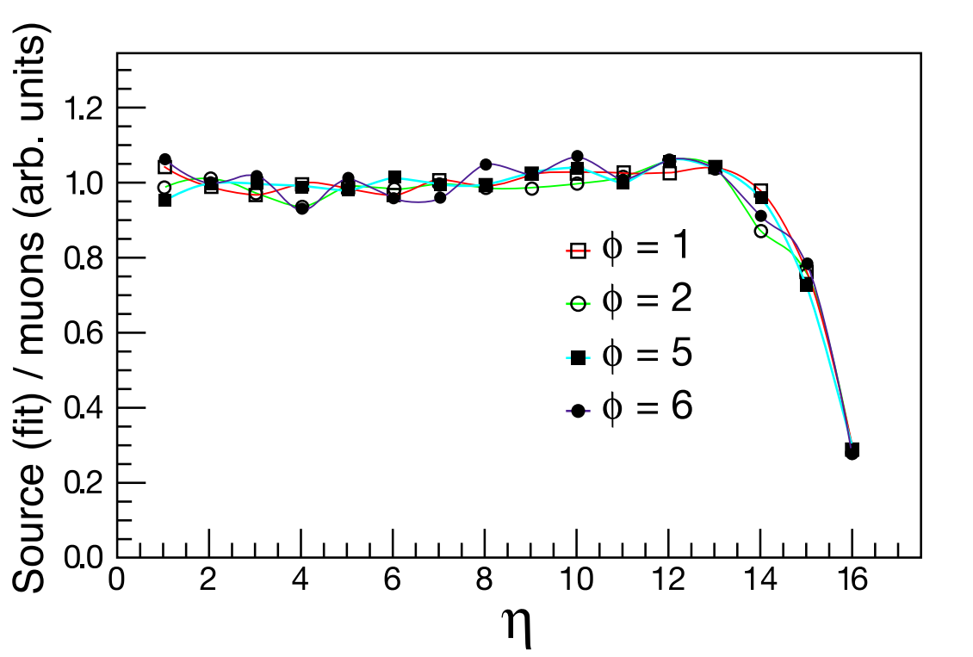
Dependence of the ratio of radioactive signal to the muon signal on the tower number.
Figure 27: Ratio of the radioactive source signal to the HB signal due to a 225 GeV/c beam of incident muons vs η number for four different φ numbers (64 towers total). Towers with the number 15 and 16 have longitudinal segmentation which is not corrected for in this plot

Slide 72
The electron response agrees with the radioactive source measurements to an rmsof 5%, while the muon data agrees to 3%.
The greater spread in the electron data is attributed to the fact that the electron shower is concentrated in the first few scintillator layers, while the source measurement is averaged over all layers with equal weight as is the muon signal.
The muon data are therefore better suited to establish the HB tower-to-tower relative calibration. The electron data, however, establish the absolute energy scale. Therefore, we have a cross check of the calibration initially established by pions.

Slide 73
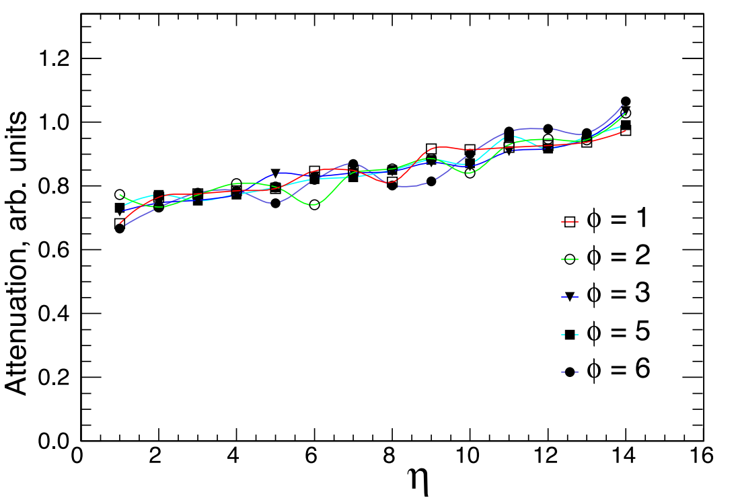
The length of the optical fibers between the scintillators and the HPDs varies with η. Figure shows the relative response to the radioactive source as a function of η. These data show that the light level at the HPD is about 30% lower for η = 1 towers when compared to η = 14 towers. The η = 15 and 16
Figure 28: Measurement of the attenuation vs η number for five different φ numbers (80 towers total)..

