Slide 1
The Outer Hadron Calorimeter (HO)

Slide 2
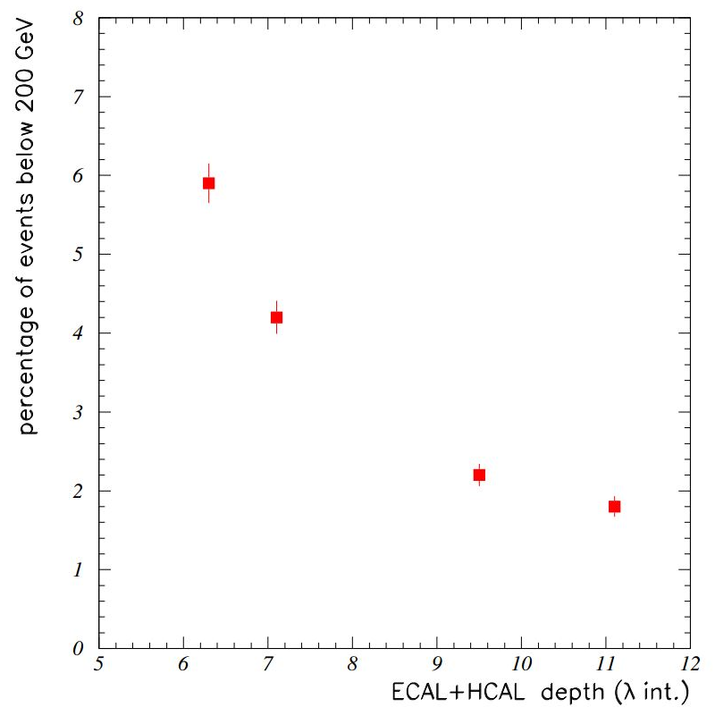

Need of Outer Hadron Calorimeter
The design of HCAL is strongly influenced by the solenoid coil.
Interaction length of HB at $\left|η\right|=0$ is just $5.8 λ_{I}$.
Solenoid
Not enough to contain the whole hadronic shower
1.18 m
EB
Tracker
Without HO, nearly 3% of events having a 300 GeV pion will give rise to missing energy corresponding to 100 GeV.

Slide 3
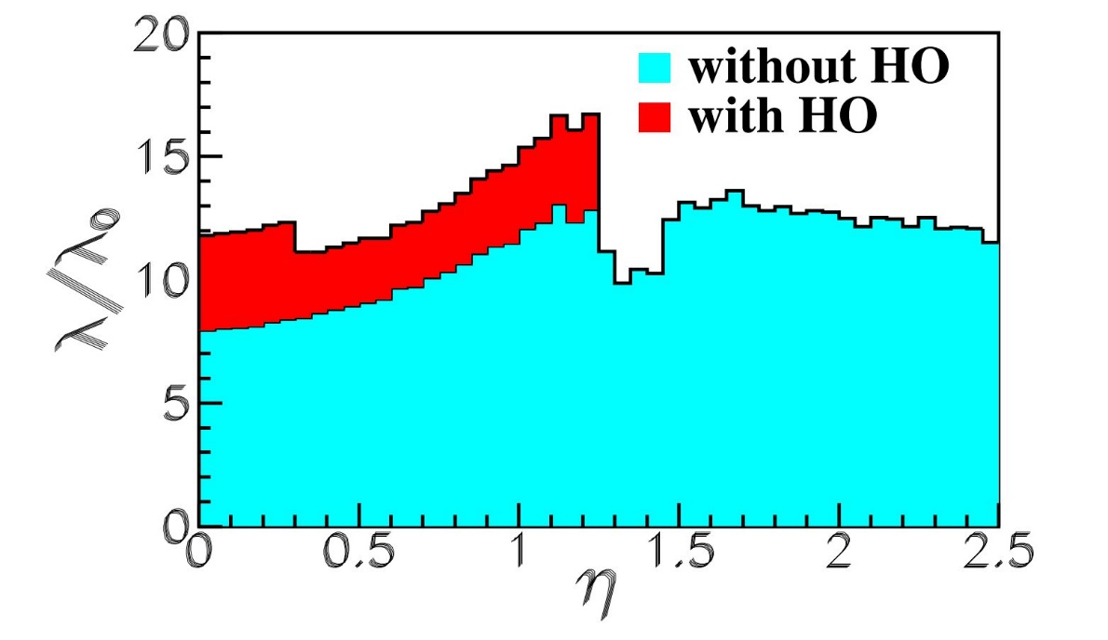
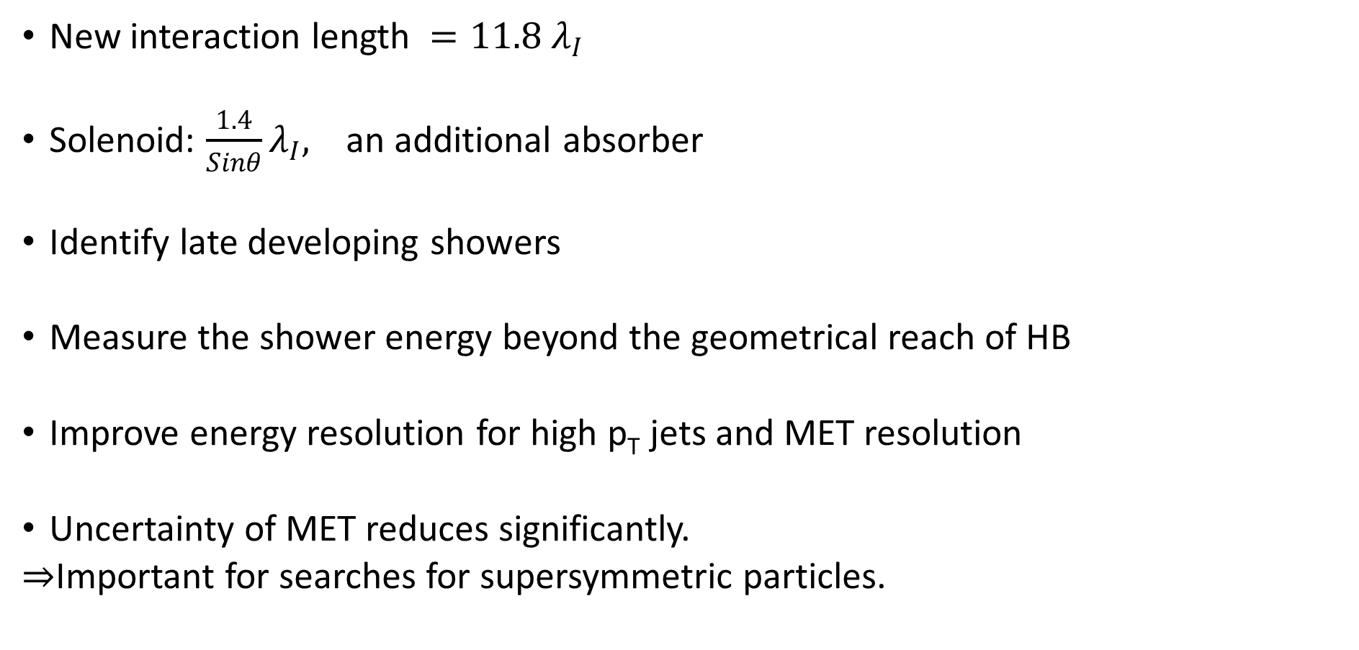
Improvements
New interaction length ${=11.8 λ}_{I}$
Solenoid: $\frac{1.4}{Sinθ}λ_{I},$ an additional absorber
Identify late developing showers
Measure the shower energy beyond the geometrical reach of HB
Improve energy resolution for high p_{T} jets and MET resolution
Uncertainty of MET reduces significantly.
$⇒$Important for searches for supersymmetric particles.

Slide 4
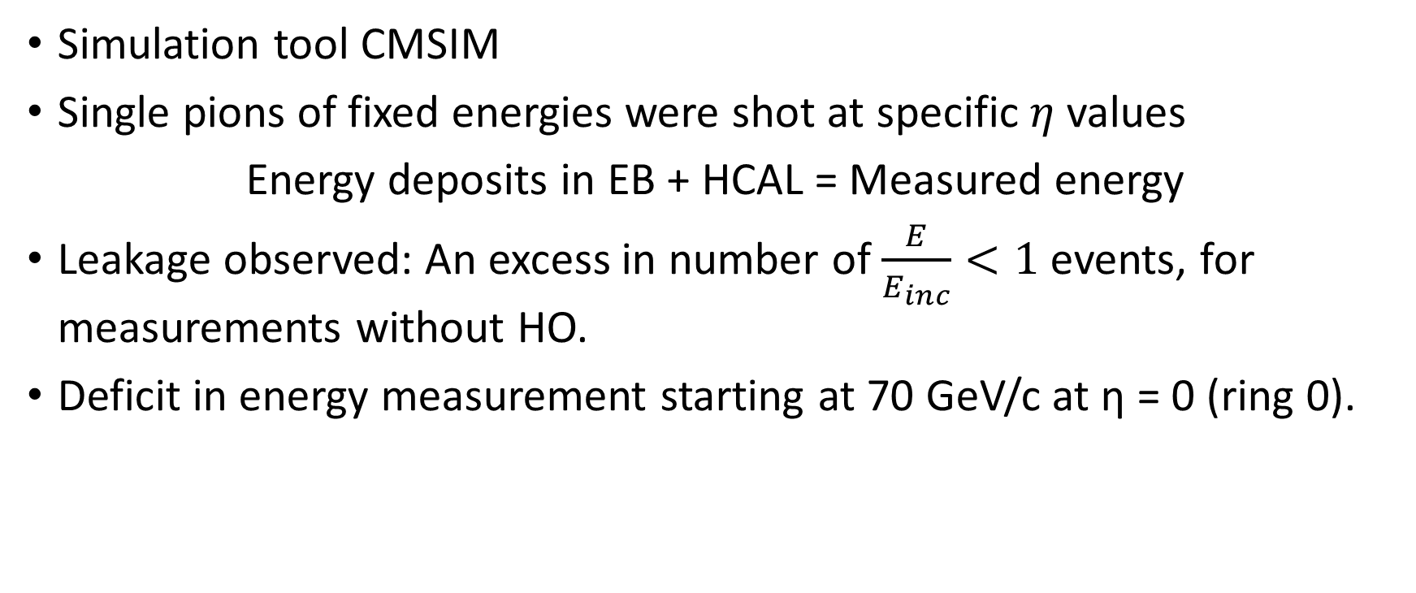
Quantitative Improvement
Simulation tool CMSIM
Single pions of fixed energies were shot at specific$η$ values
Energy deposits in EB + HCAL = Measured energy
Leakage observed: An excess in number of $\frac{E}{E_{inc}}<1$ events, for measurements without HO.
Deficit in energy measurement starting at 70 GeV/c at η = 0 (ring 0).

Slide 5
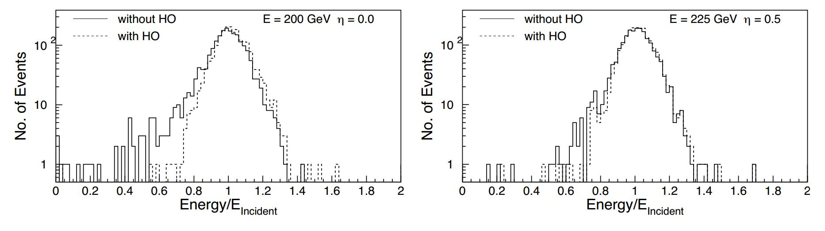

Distributions of measured energy scaled to incident energy for
200 GeV pions at $η$ = 0
225 GeV pions at $η$ = 0.5
(pointing towards the middle of ring 1)
Solid line – without HO Dashed line – with HO
Some evidence of leakage without HO in ring 1 but with reduced intensity. Negligible amount of leakage in ring 2.

Slide 6
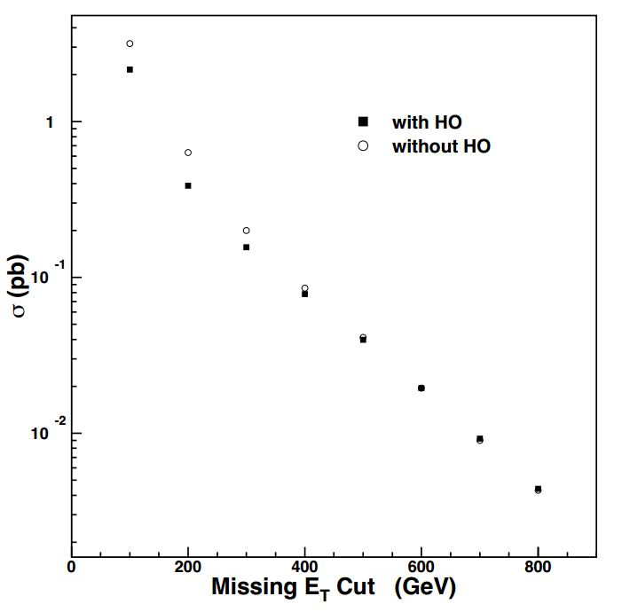
Direct consequence of shower leakage on E_{T}
The inclusion of HO reduces the background cross section by a factor of 1.5 or more for moderate E_{T} values.
This E_{T} region is important for searches of
supersymmetric particles.
Figure: Integrated background cross
section above threshold as a
function of missing
E_{T} with or without HO.

Slide 7
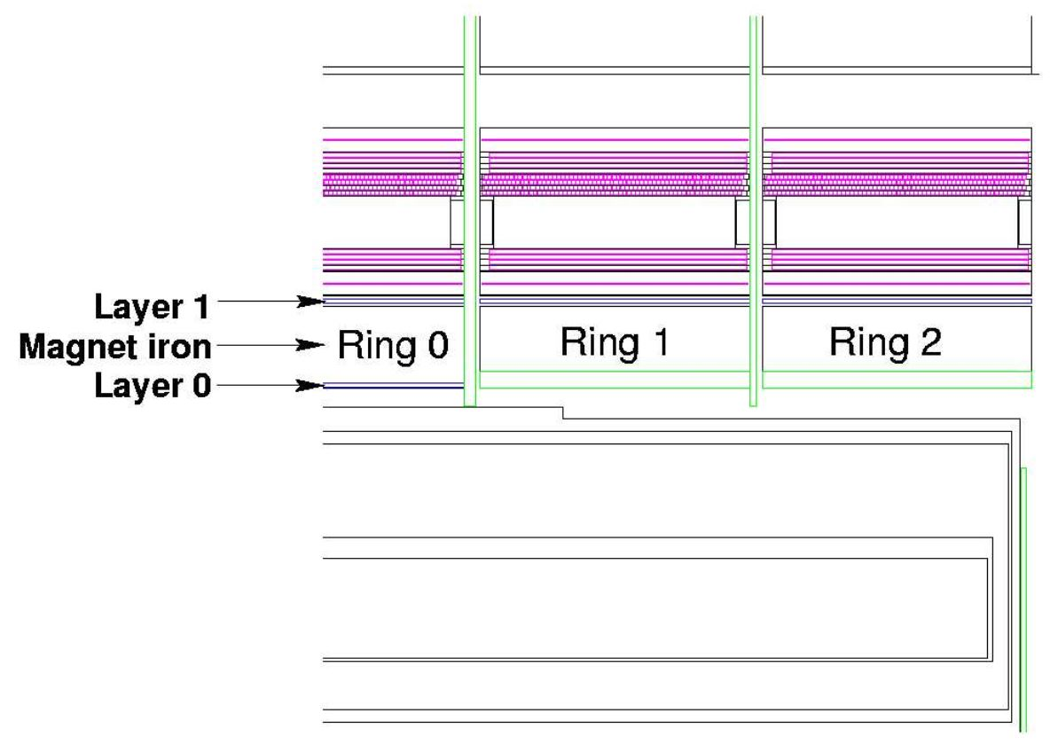
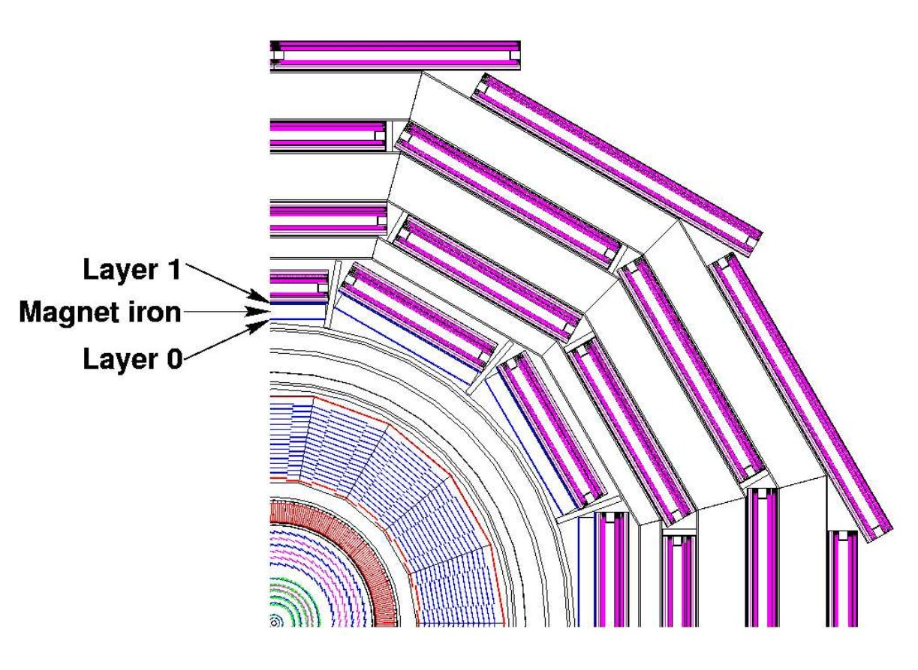
Design
Two layers
+2.686 m
+5.342 m
4070 mm
3820 mm
Beam
19.5 mm thick

Slide 8
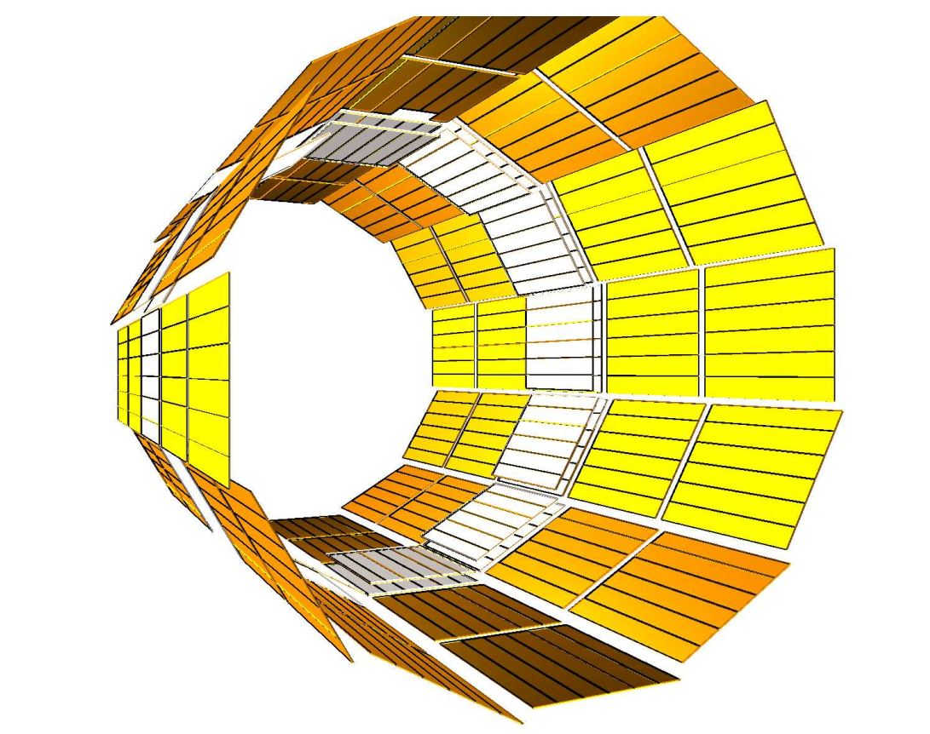

12 identical $φ−$sectors, separated by 75 mm thick stainless steel beams
Numbered 1 to 12 counting clockwise starting from
9 o’clock position
40 mm of space available for HO
16 mm available for detector layer, rest for
aluminium honeycomb support structure.
The sizes and positions of the tiles in HO, roughly map the layers of HB to make towers of granularity 0.087 x 0.087 in $η$ and $φ$.
Scintillator tile
WLS
Photo
Detector
Multi-clad Y11 Kuraray
Diameter = 0.94 mm
+
Spliced multi-clad clear
fiber (Dia. = 0.94 mm)
located on the structure of the return yoke

Slide 9
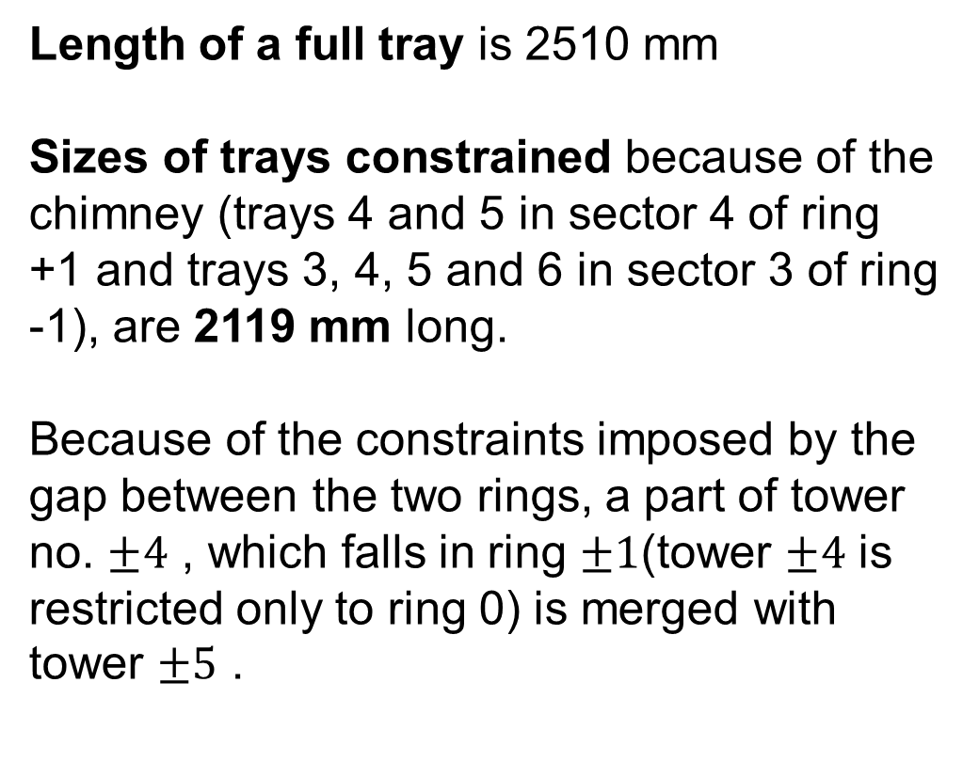
The final layout of all the HO trays in the overall CMS detector.
Length of a full tray is 2510 mm
Sizes of trays constrained because of the chimney (trays 4 and 5 in sector 4 of ring +1 and trays 3, 4, 5 and 6 in sector 3 of ring -1), are 2119 mm long.
Because of the constraints imposed by the gap between the two rings, a part of tower no. $±4$ , which falls in ring $±1$(tower $±4$ is restricted only to ring 0) is merged with tower $±5$ .

Slide 10
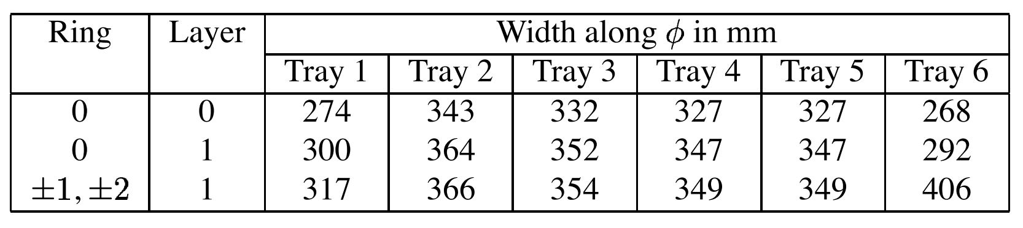


Both layers of ring 0 have 8 $η$-divisions (8 tiles in a tray: -4 to 4)
Ring 1 has 6 divisions: (5 to 10)
Ring 2 has 5 divisions: 11 to 15
Ring -1 and ring +1 have the same number of divisions as rings 1 and 2 but with -ve indices.
The $η$-dimensions of any tile with -ve tower number is the same as the one with +ve number.
Dimensions of tiles along $φ$ for different trays

Slide 11
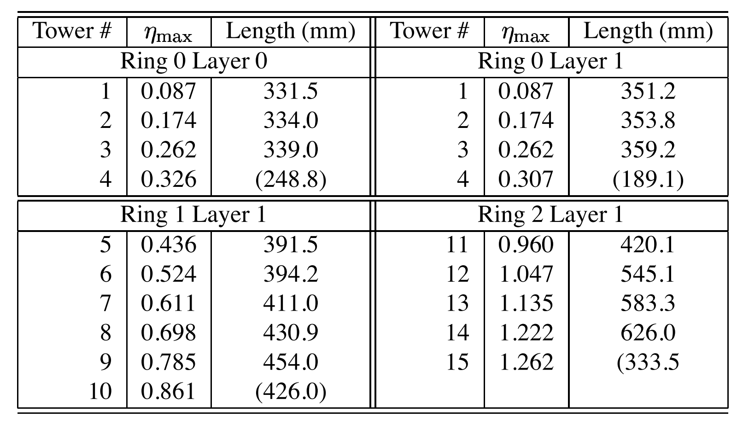

Dimensions of rings along $η$ for the towers:

Slide 12
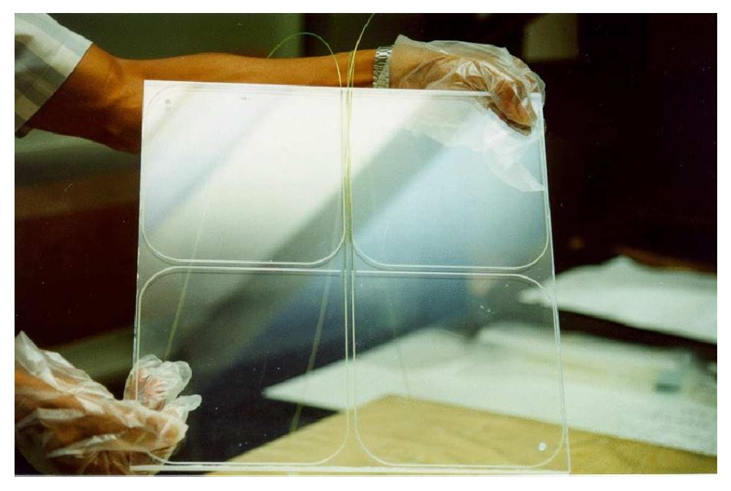
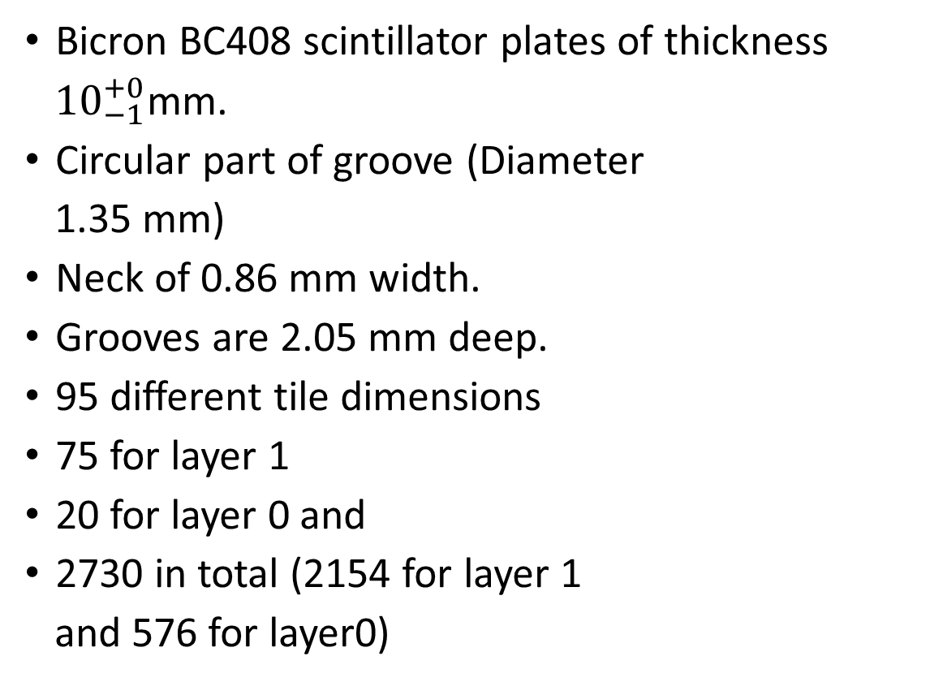
Tiles
Bicron BC408 scintillator plates of thickness
${10}_{−1}^{+0}$mm.
Circular part of groove (Diameter
1.35 mm)
Neck of 0.86 mm width.
Grooves are 2.05 mm deep.
95 different tile dimensions
75 for layer 1
20 for layer 0 and
2730 in total (2154 for layer 1
and 576 for layer0)

Slide 13
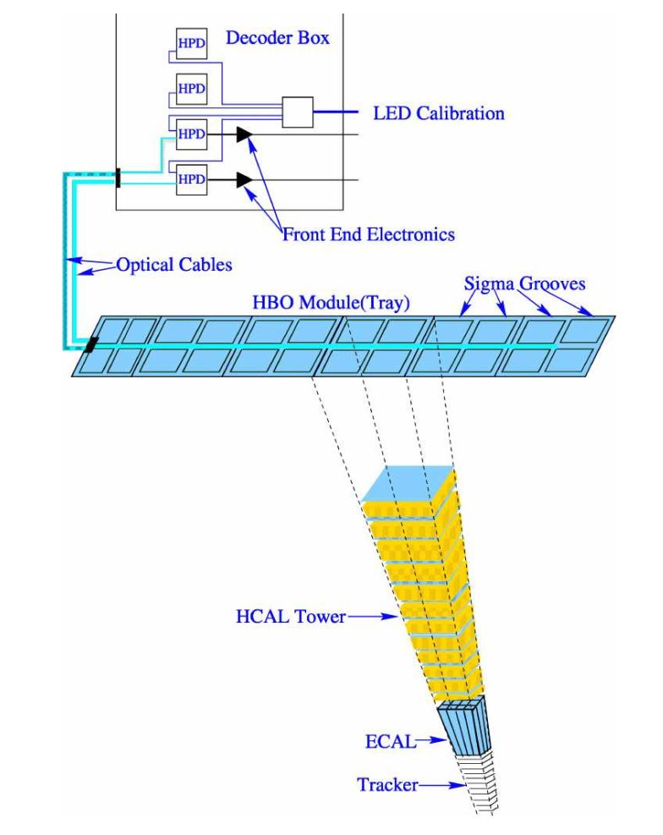

Tray
Each tray corresponds to one
slice (5 wide in $φ$).
Along the z ($η$) direction, a tray
covers the entire span of a muon ring.
Each tray contains:
5 tiles in ring $±2$
6 tiles in ring $±1$
8 tiles in ring 0

Slide 14
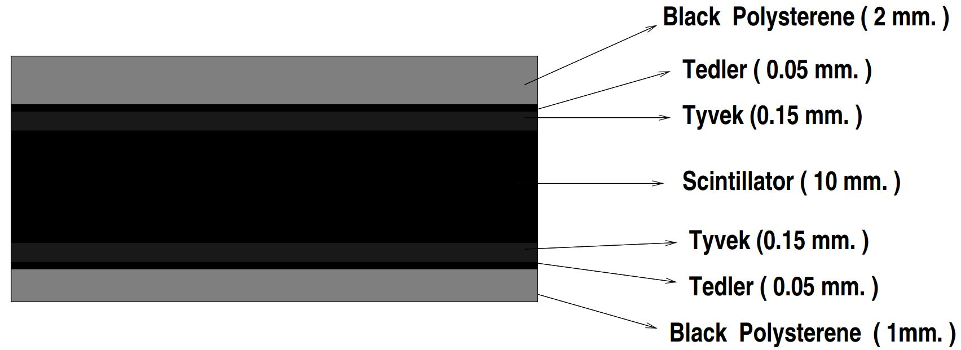
Bicron reflecting white paint on the tile edges
Better light collection
Isolation of the tile
Further isolation: Black tedlar strip between adjacent tiles
1.6 mm deep channels grooved on the top plate
1.5 mm deep straight groove along the edge of the top cover to house the S.S. tube
Fibres
Grooves
Optical connector

Slide 15
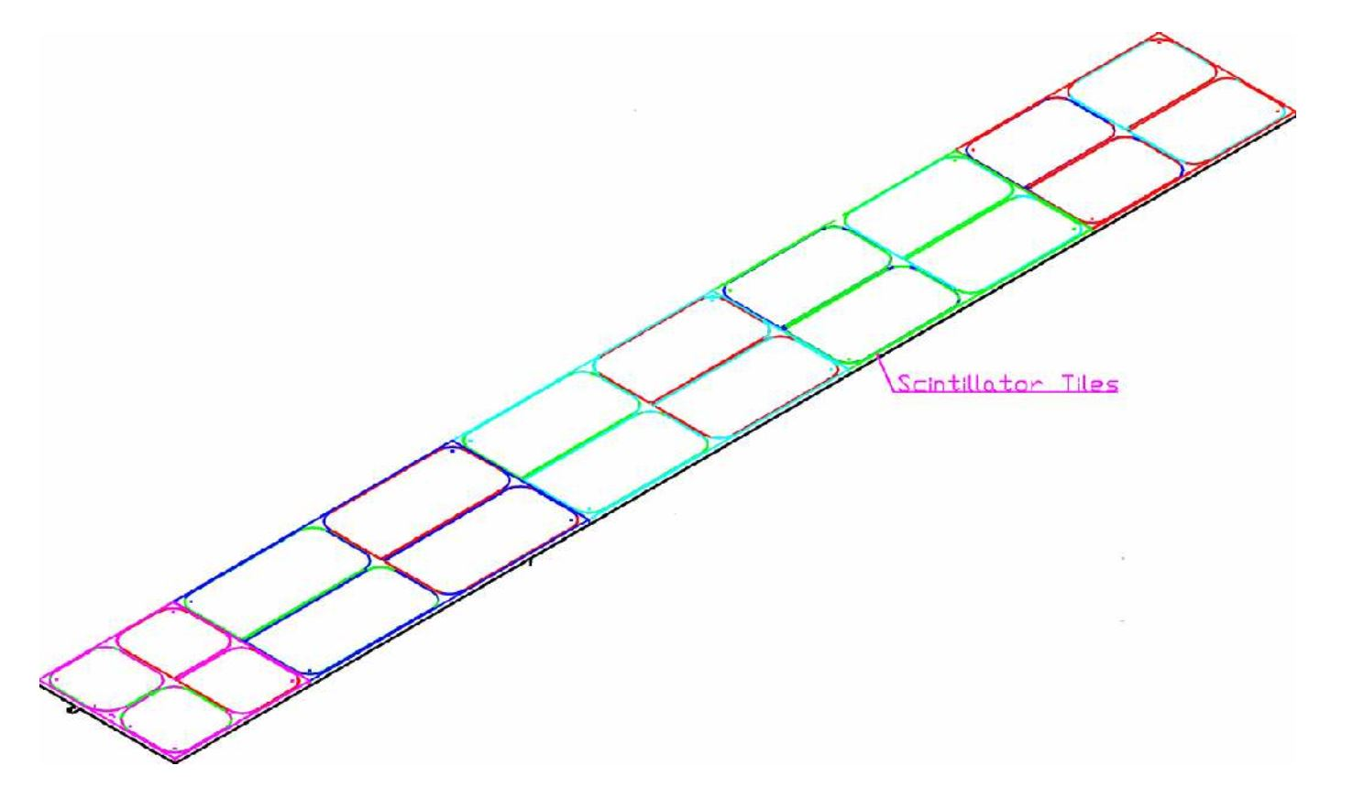
Optical Connector

Slide 16
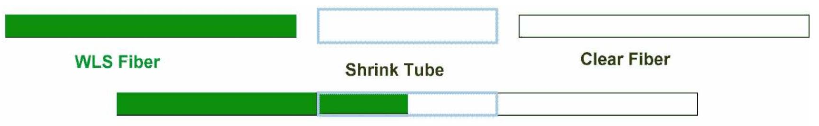


Pigtails
Photodetectors are located on muon rings.
Comes out of the tile
Attenuation length $\sim 1.8m$
Attenuation length $\sim 8.0 m$
Polished aluminized and protected using polymer coating

Slide 17
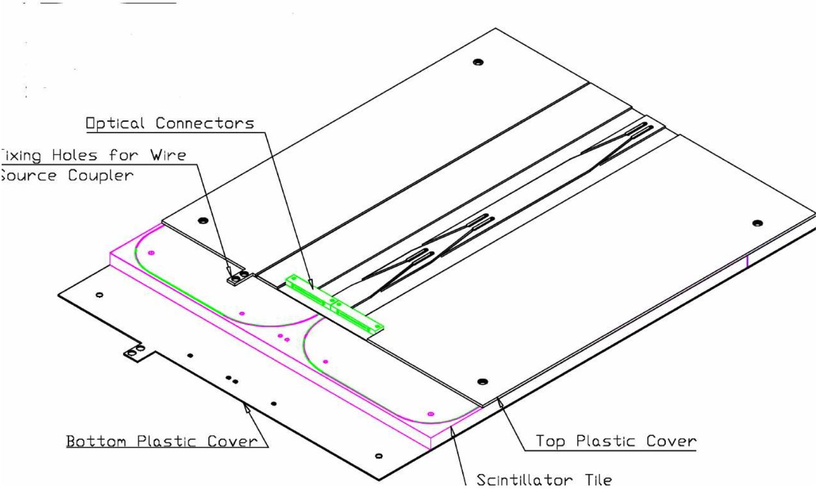
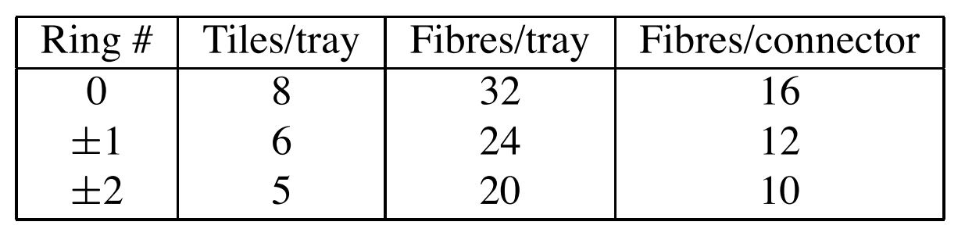
In a tray, the grooves of the tiles form two rows along.
The fibers from all grooves on one row terminate on one connector
Tray specifications for different rings of HO

Slide 18
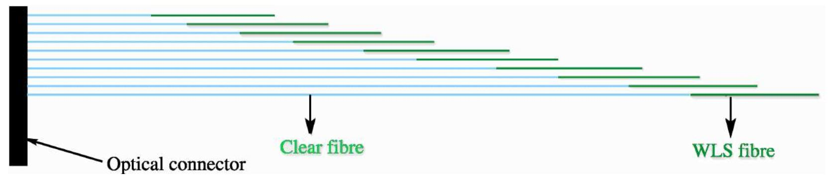
Each tray has 2 pigtails and there are 864 pigtails in total: 720 for layer 1 and 144 for layer 0.
Fabrication:
WLS fiber: cut, polish both ends, aluminize one end and coat with thin polymer layer
Clear fiber: cut and polish one end
Splice non aluminized end of WLS fiber and non-polished end of clear fiber
Correctly insert the spliced fibers in the connector and fix using optical hardener
Polish the connector end with a high speed diamond cutter

Slide 19
Testing and Quality assurance
Three independent quality control tests were performed:
The radioactive wire-source test
Radioactive XY Scan
Cosmic muon test

Slide 20
Certification of Pigtails
Setup:
a computer controlled mechanical stage which houses an UV lamp.
At specific points, the shutter is opened, fibres absorb UV photons and the light in each fibre is carried to the end to a set of photo diodes.
Digitized and stored the signals.
The combined transmission loss(spliced junctions, connector interface and attenuation offered) are estimated by analysing the data.
Measurements were made for all the pigtails belonging to a given layer and ring and if a pigtail was within 10% of the average in term of transmission properties, the pigtail was accepted.

Slide 21
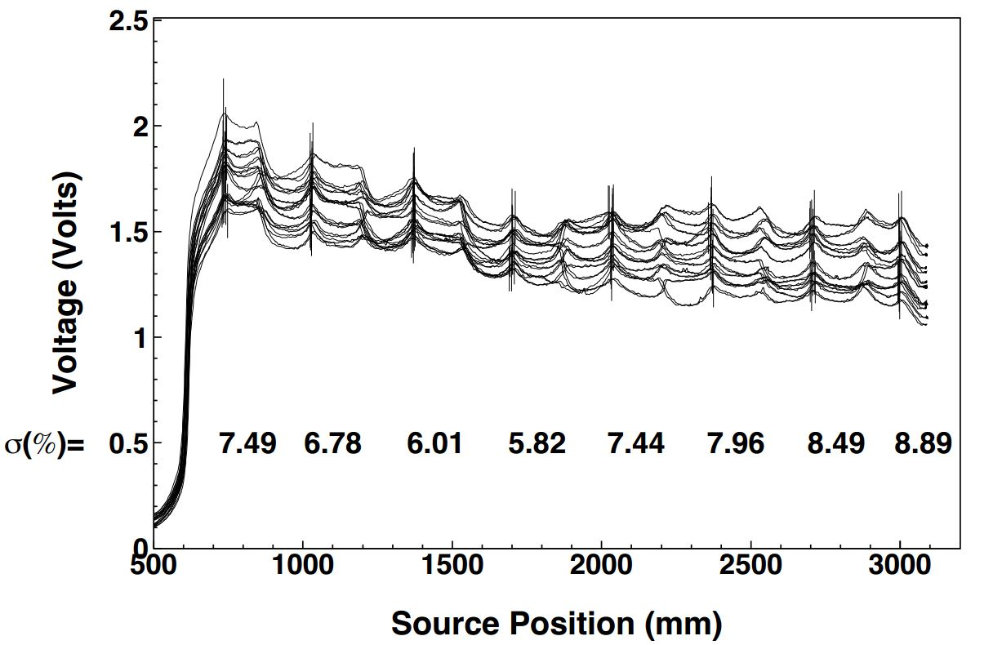
Radioactive wire source
In-situ relative tile calibration procedure
A quick quality control test of a completely assembled HO tray.
Stainless steel wire with a point-like radioactive source of strength of 3 millicurie
Wire Source scan of a set of 12 fully assembled scintillator trays (of the 12 sectors) belonging to ring 0 & layer 0
tray position 3.
Peak positions corresponding to the center of the tile
Measured dispersion of those points

Slide 22
Signals were sampled in histogram mode.
The mean of such a histogram represents the response of tile at the given reel position.
The reel position is used to find out the correspondence between tile number and readout channel.
The height of the signal is largest near the connector end
There are several spikes which correspond to source positions where WLS fibre(s) directly see the effect of the source.
Dispersion is well below 10% which is used as the acceptance criterion.

Slide 23
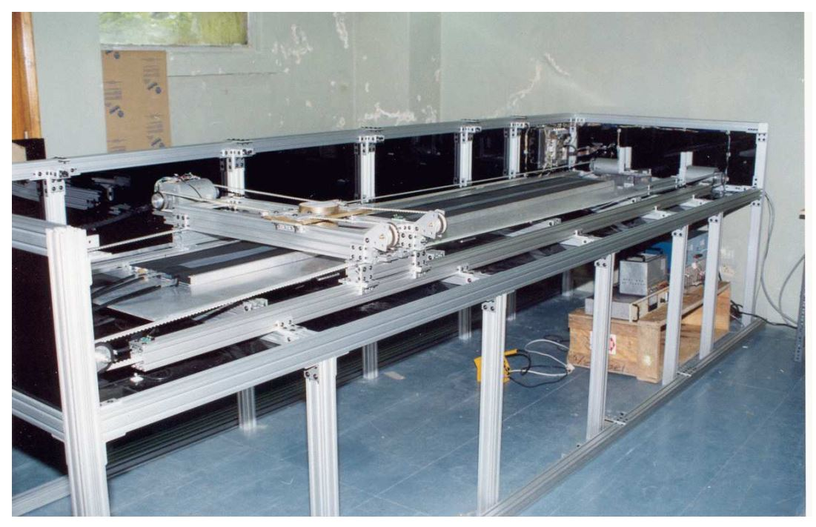
Radioactive XY Scan

Slide 24
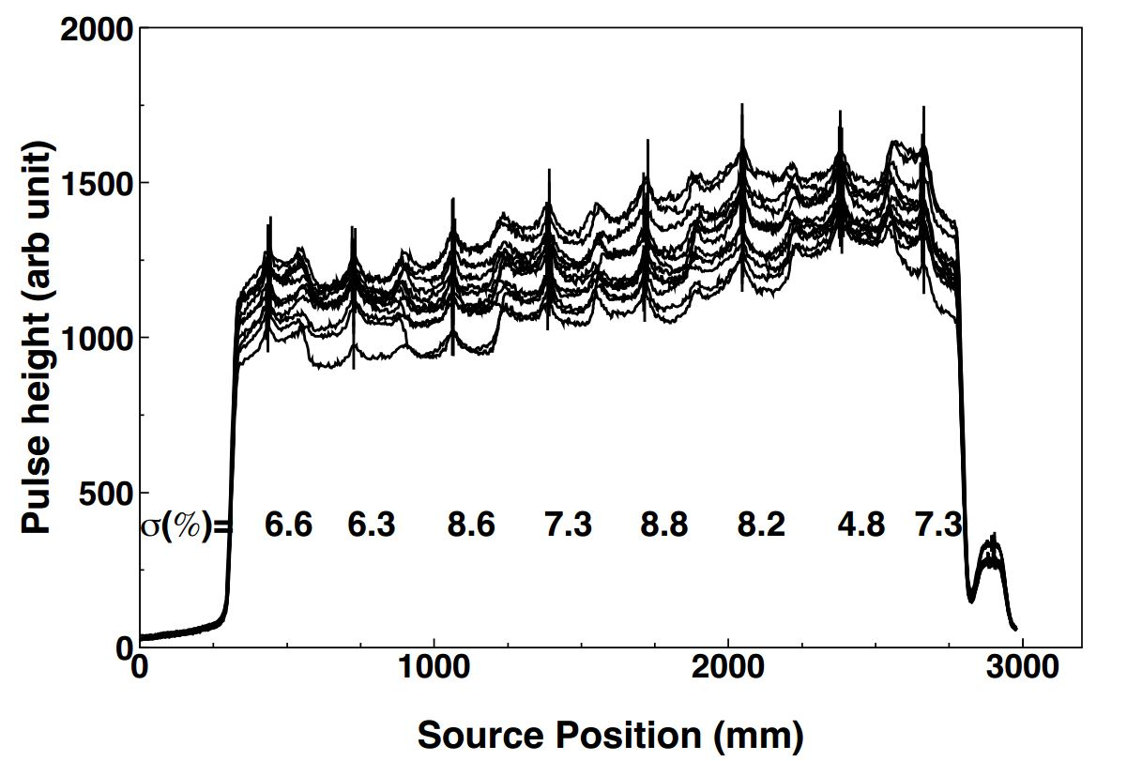
The HO trays are expected to supply at least 10 photo electrons for a MIP if PMTs were used in the read out.
A collimated Cs¹³⁷ (10 mCi)
radioactive source
The positioning accuracy is
about 1 mm over a span of
about 3000 mm x 500 mm.
ADC output at several x and
y points over the surfaces of
twelve trays of tray type 3
belonging to ring 0 and layer 0
Peak from permanently fixed tile

Slide 25
The fluctuations among the trays are at a level much below 10%.
A scintillator tile is permanently fixed on one end of the scanning table.
Fixed tile is used to cancel out day to day gain variations in the readout system. Also used for obtaining the response uniformity scan of the entire tray

Slide 26
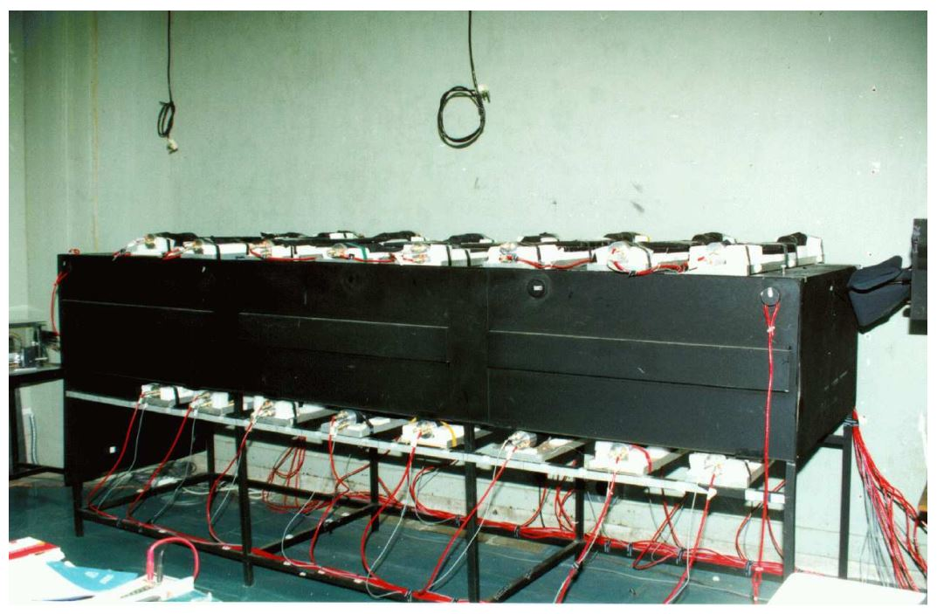
Cosmic muon test

Slide 27
Setup:
The tray is placed in a black box equipped with a set of 8 telescopes.
Each telescope has 4 scintillators with photo multiplier read out.
Vertical muons are selected using 4-fold coincidence trigger logic.
These telescopes are positioned roughly at the centre of each of the tiles in the tray.
If any of the telescopes registers a coincidence, data from the tray are read out together with the information of the telescope causing the trigger

Slide 28
Signal from the tiles are grouped into two bunches (alternate tiles)
The two bunches are then led to two fully calibrated green extended photo multiplier tube.
The electronic signal is sent to a charge-sensitive ADC for converting it into a digital one.
Online data are acquired in a PC.
These PMT’s are calibrated using a precisely controlled LED source to get the factor for ADC count per photo electron.

Slide 29
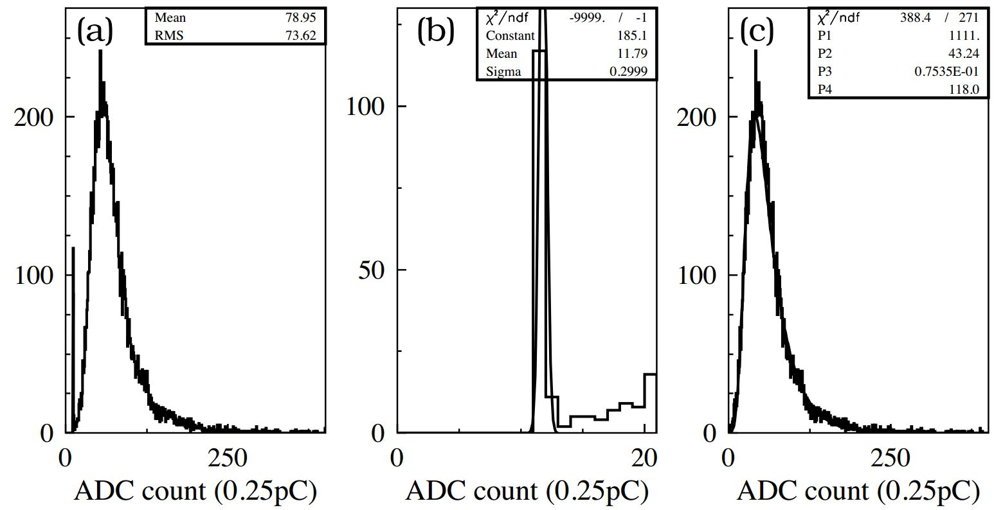
(a) Raw ADC spectrum for tile # 8 for one of the trays for ring 0 layer 0 tray position 3;
(b) a fit to the pedestal part to a Gaussian distribution;
(c) pedestal subtracted distribution fitted to a Gaussian convoluted Landau distribution.

Slide 30
A calibration tile equipped with fibre readout which is placed separately and is always read out to monitor PMT gains.
The pedestal subtracted pulse height is fitted to a Landau distribution and the position of the mean value of the spectrum together with the calibration factor provides the number of photoelectrons yielded in a given tile.

Slide 31
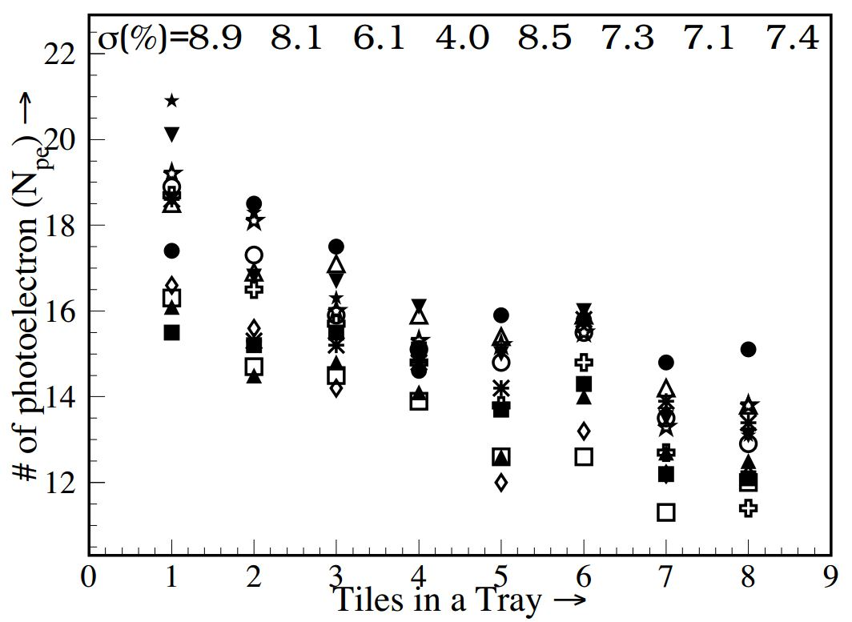
A plot of average number of photo electrons obtained using cosmic muons as a function of the tile number in a set of 12 trays belonging to ring 0 layer 0 tray position 3.
The number of photo electrons is always above 10. They are as high as 20 for some of the tiles close to the connector. The RMS spread in the number of photo electrons is less than 10% which is the acceptance criterion for the trays

Slide 32
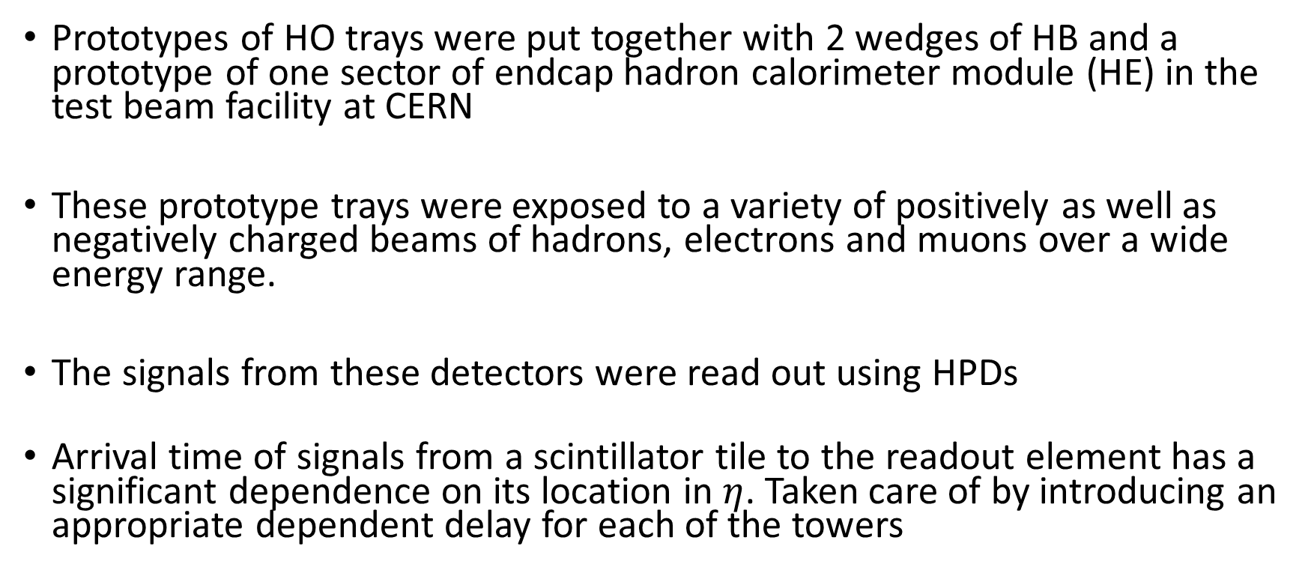
Test Beam Studies
Prototypes of HO trays were put together with 2 wedges of HB and a prototype of one sector of endcap hadron calorimeter module (HE) in the test beam facility at CERN
These prototype trays were exposed to a variety of positively as well as negatively charged beams of hadrons, electrons and muons over a wide energy range.
The signals from these detectors were read out using HPDs
Arrival time of signals from a scintillator tile to the readout element has a significant dependence on its location in $η$. Taken care of by introducing an appropriate dependent delay for each of the towers

Slide 33
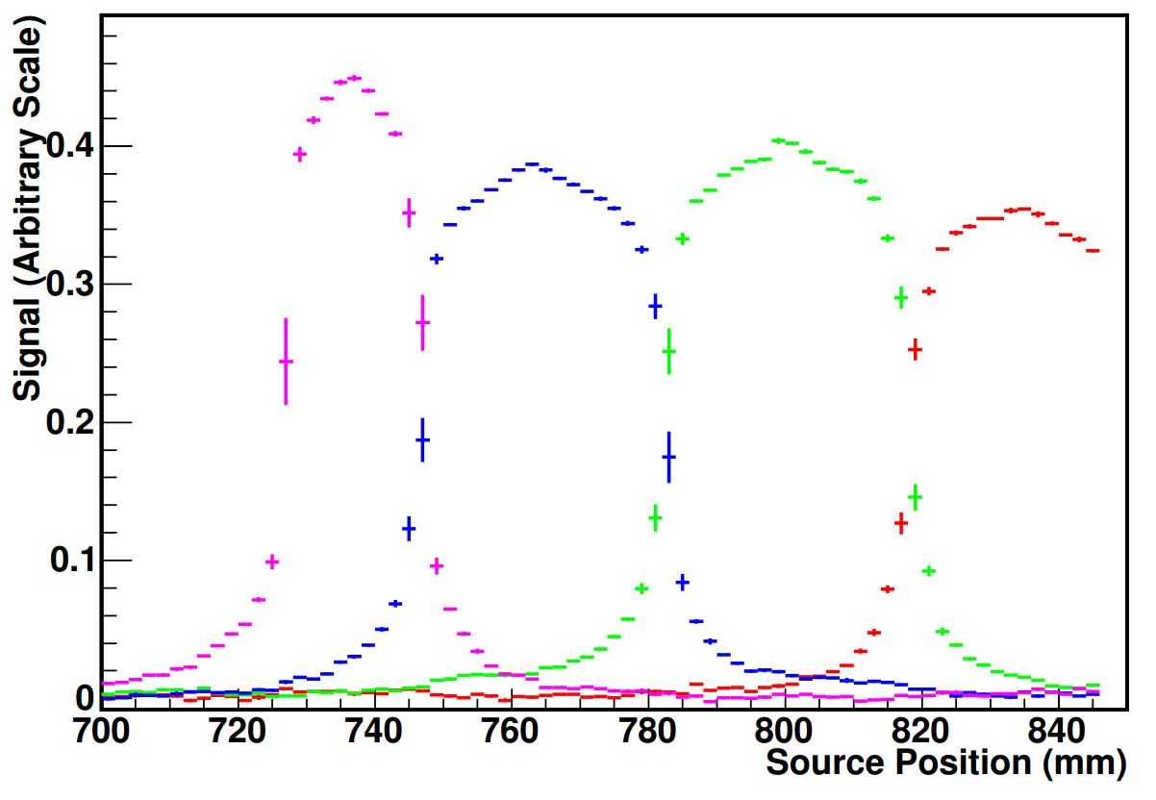
Calibration
The HO trays were calibrated using the radioactive wire-source test as well as by exposing them to a beam of muons.
Figure shows a plot of ADC counts from ring 0, layer 0 tiles as the radioactive source passes along them.
Pedestal: Fitting a straight line with zero slope to the part of the signal when radioactive source is far away from the tile under consideration.

Slide 34
Evident leakage of the signal to the neighbouring tiles when the source is at the edge of the tile.
So the pedestal subtracted signals from the neighbouring tiles are added with proper weight to get the total signal. The signal from a tile and that from its two adjacent ones are then fitted using an iterative procedure to extract the calibration constants.
The HPD for HO readout was operated at voltages 8 kV and 10 kV and separate datasets were collected for the two settings.
Calibration constants obtained with these two sets of data show the expected consistency being different by a factor of 1.415.

Slide 35
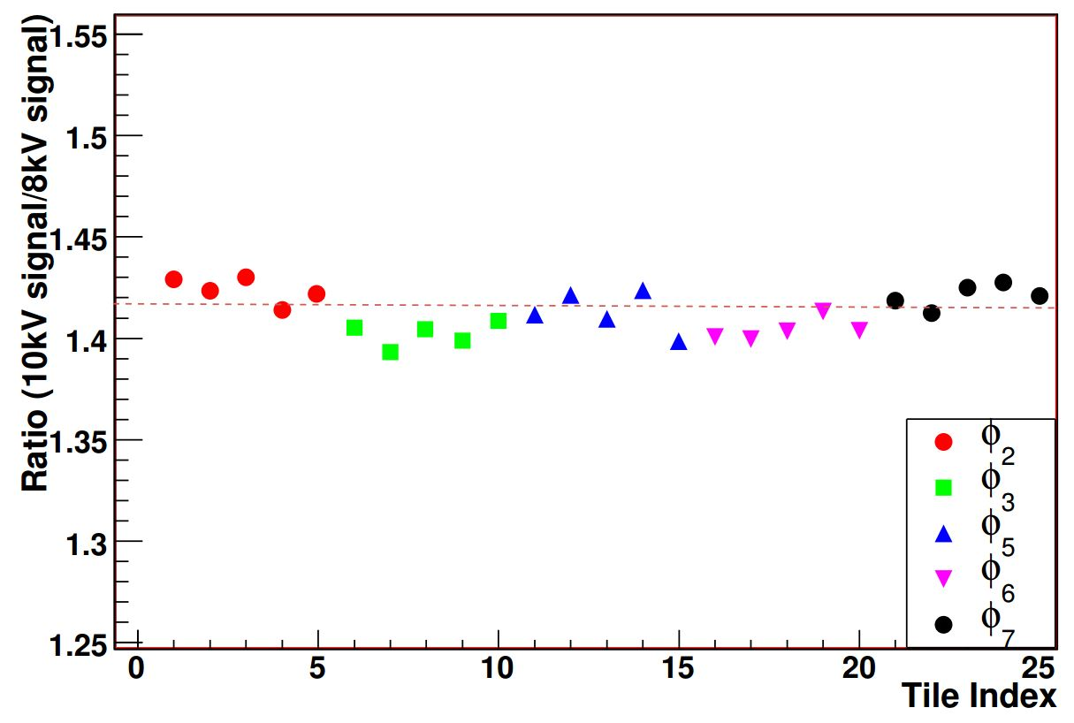
Ratio of calibration constant for ring 1 HO tiles in the test beam set up with the HPD’s being operated at 10 kV and at 8 kV.

Slide 36
For the muon runs:
The HPD was operating at 10 kV.
Muons of energy 150 GeV were pointed at the centre of each HO tile and muon calibration constant was determined.
To minimize noise, the sum of 4 time slices with the maximum amount of energy deposit is taken as the signal.
The sum of four time slices away from the signal region is taken as the pedestal.
The pedestal value is taken as the fitted mean obtained by fitting the pedestal distribution with a Gaussian curve.
Pedestal subtracted muon signal is then fitted with a Gaussian convoluted Landau distribution to find the muon calibration constant for the tile.

Slide 37
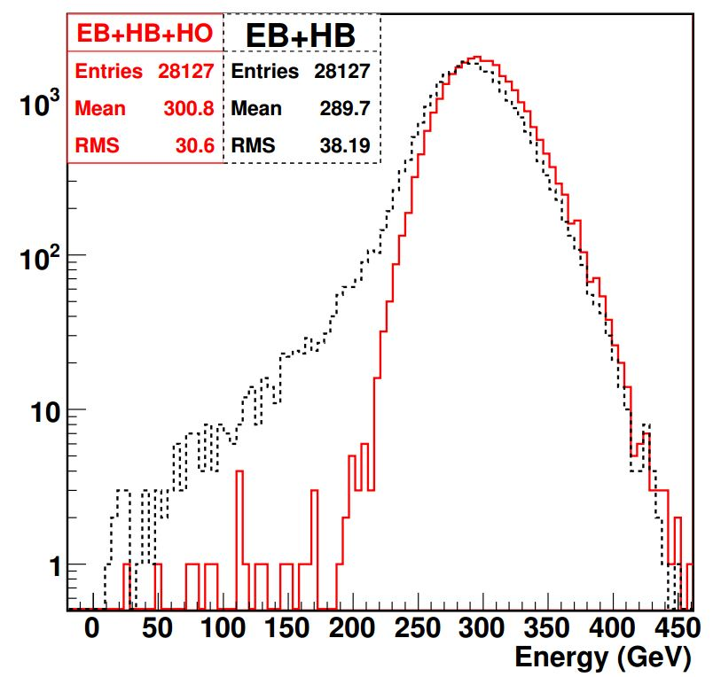
Figure shows energy distributions for a 300 GeV pion beam with only EB + HB in the beam and with EB + HB + HO in the beam.
The measured distributions for hadron beams of energy above 100 GeV are more symmetric and have smaller widths after adding HO to the energy calculation.

