Slide 2
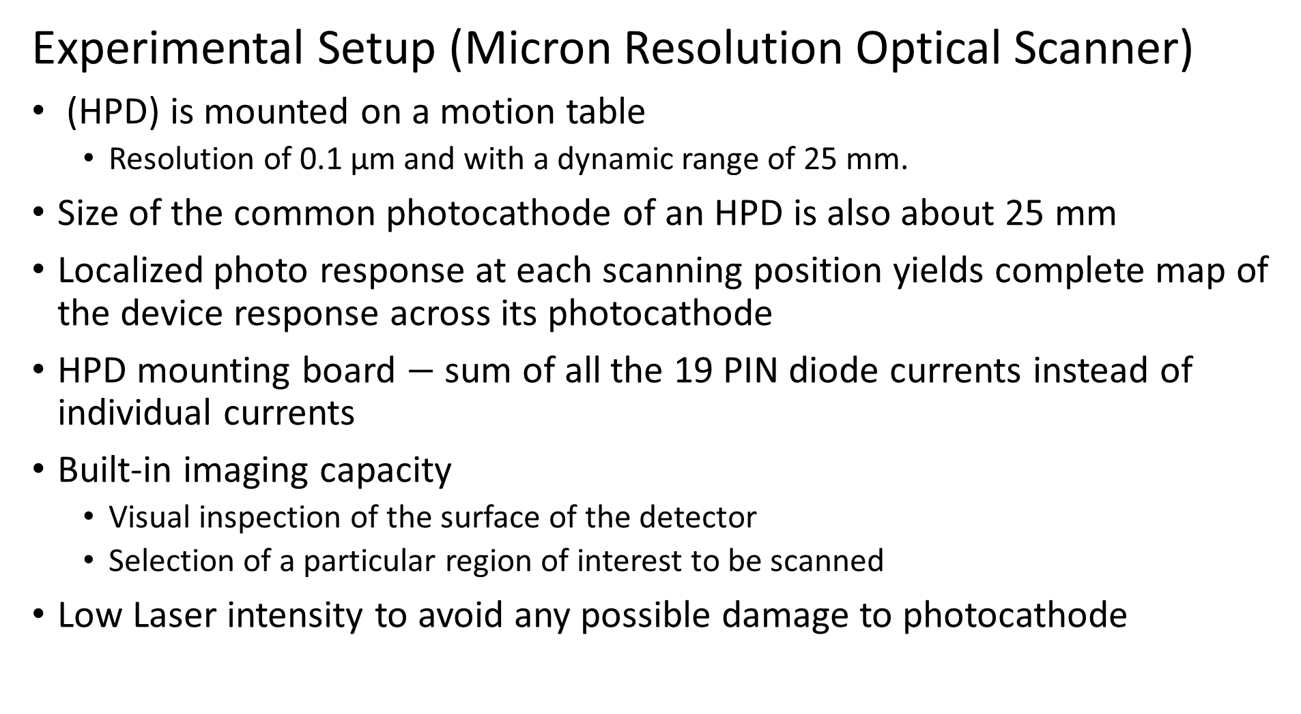
Experimental Setup (Micron Resolution Optical Scanner)
(HPD) is mounted on a motion table
Resolution of 0.1 µm and with a dynamic range of 25 mm.
Size of the common photocathode of an HPD is also about 25 mm
Localized photo response at each scanning position yields complete map of the device response across its photocathode
HPD mounting board $−$ sum of all the 19 PIN diode currents instead of individual currents
Built-in imaging capacity
Visual inspection of the surface of the detector
Selection of a particular region of interest to be scanned
Low Laser intensity to avoid any possible damage to photocathode

Slide 3
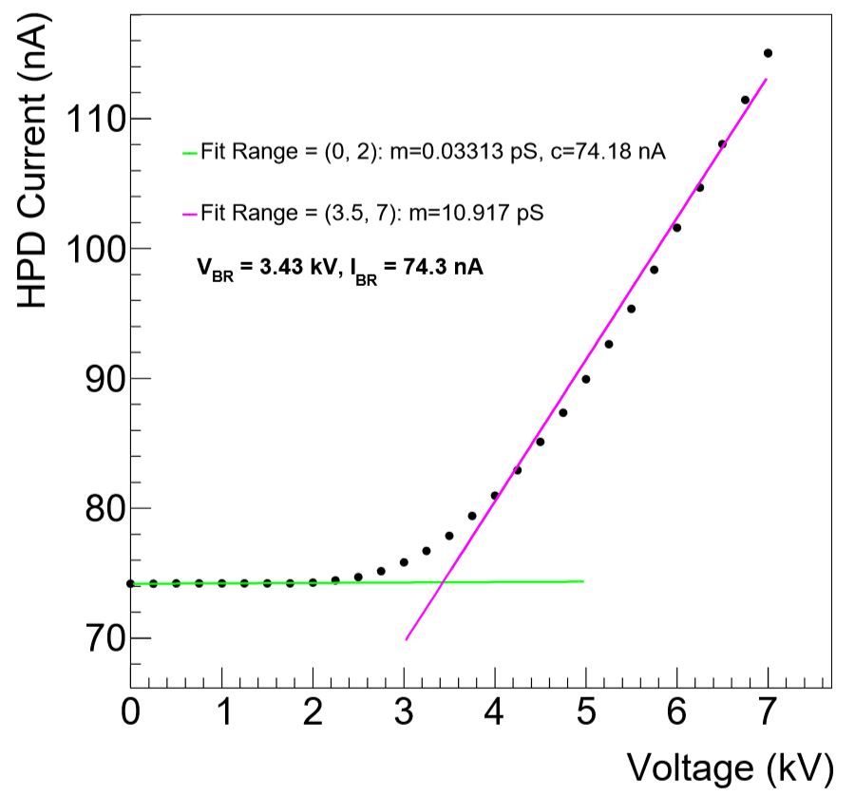
HPD requires two power supplies for its operation
A high voltage (negative) bias is applied to the photocathode
All the photo-diodes are reverse biased (80V)
The high energy electrons impinging on the photo-diode give rise to a large number of carriers
Large gain of about 2000 with low noise
Breakdown voltage of the HPD
The high cathode voltage at which the energy of
the accelerated electrons become sufﬁcient to
generate detectable current inside photo-diode

Slide 4
Imaging and focal axis determination
Before microscopic scanning, a built-in CMOS camera surveys the surface of the device and access the scan area.
Imaging also helps in roughly determining the focal plane.
modiﬁed knife-edge method to accurately determine the position of the focal plane and to establish the laser beam proﬁle on the photocathode with the ﬁber optic window
Imaging and focal axis determination

