Slide 1
Microscopic Characterization of Hybrid Photo Diode
Departmental Project – 1
Presented By – Mohit Saharan
Supervisor – Prof. Shashi Dugad

Slide 2
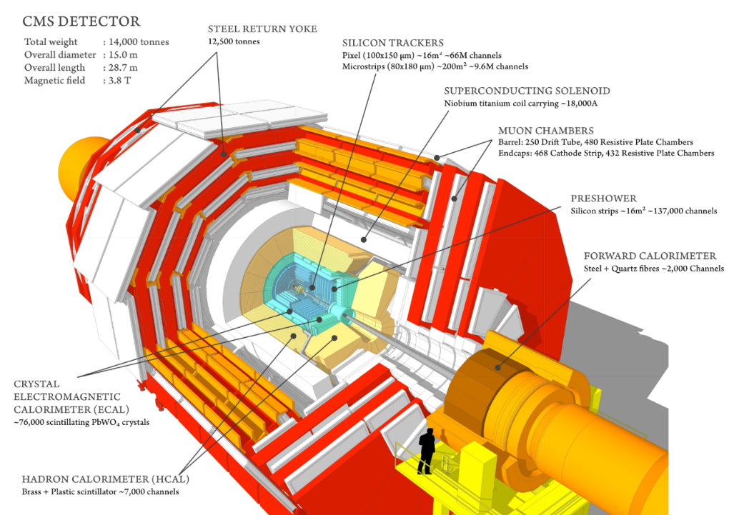
CMS Detector
The CMS detector is designed to study pp collisions at the LHC.
Hadron Barrel calorimeter and Hadron End-Cap calorimeter are made up of alternating layers of absorber and scintillator.
Collected scintillation light is transported to photodetectors (HPD in the past, now SIPM)
Signal loss in HE data was observed over years.
Decoupling of signal loss due to degradation of HPD and scintillator
http://cms.web.cern.ch/news/cms-detector-design

Slide 3
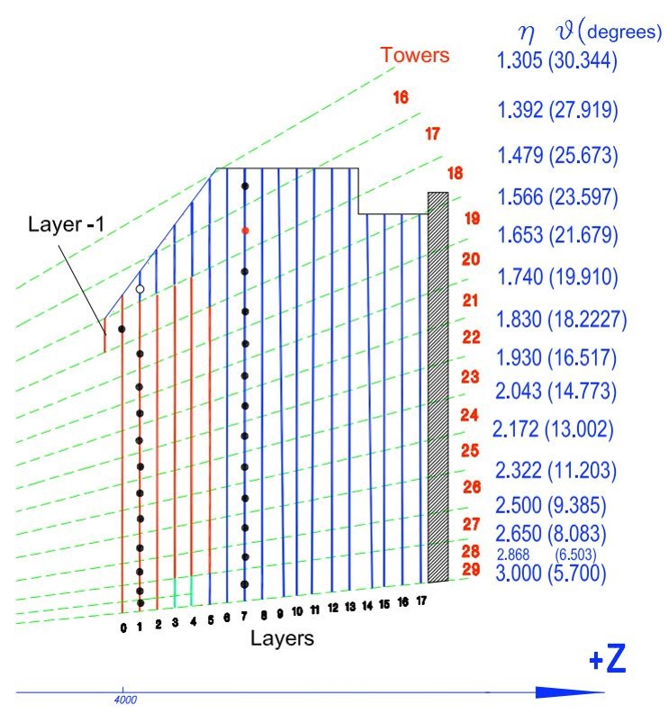
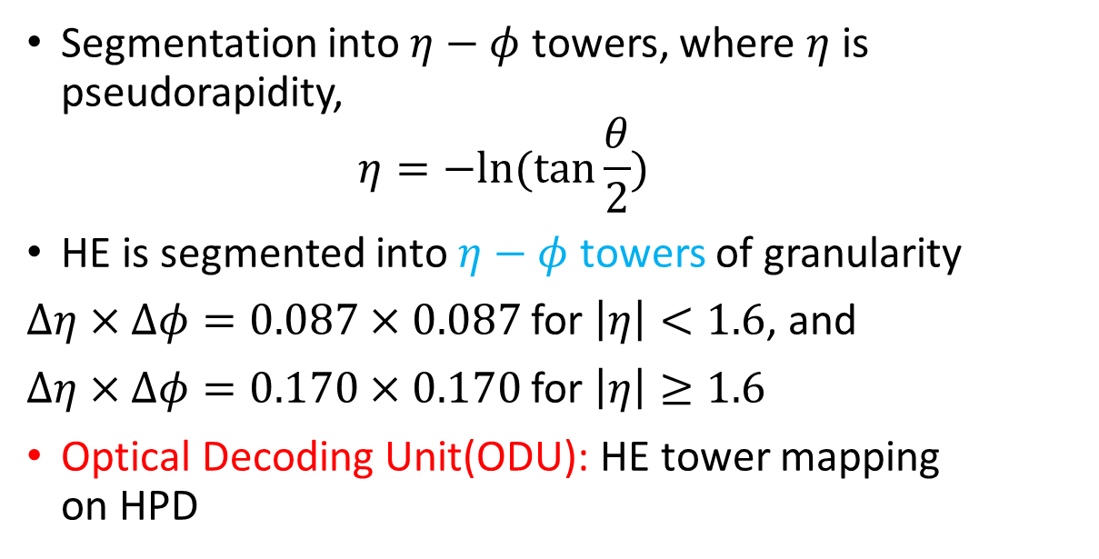

Signal Collection In HE
Scintillator
WLS
Clear Fibers
$$⋯$$
Optical Decoding Unit
Hybrid photodiode
(HPD)
Segmentation into $η−φ$ towers, where $η$ is pseudorapidity,
$$η=−ln⁡(tan⁡\frac{θ}{2})$$
HE is segmented into $η−φ$ towers of granularity
$Δη×Δφ=0.087×0.087$ for $\left|η\right|<1.6$, and
$Δη×Δφ=0.170×0.170$ for $\left|η\right|≥1.6$
Optical Decoding Unit(ODU): HE tower mapping on HPD
Forward
Middle
Rear
arXiv:1806.09887 [physics.ins-det]

Slide 4
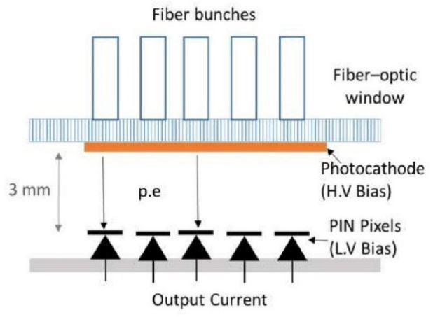
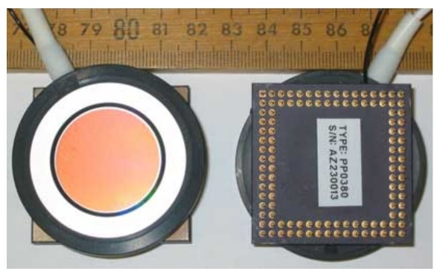
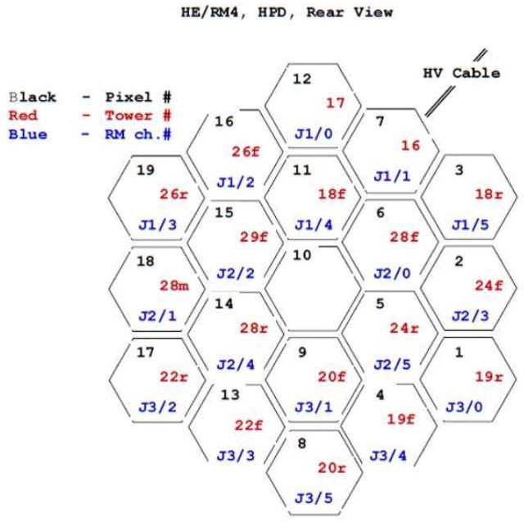
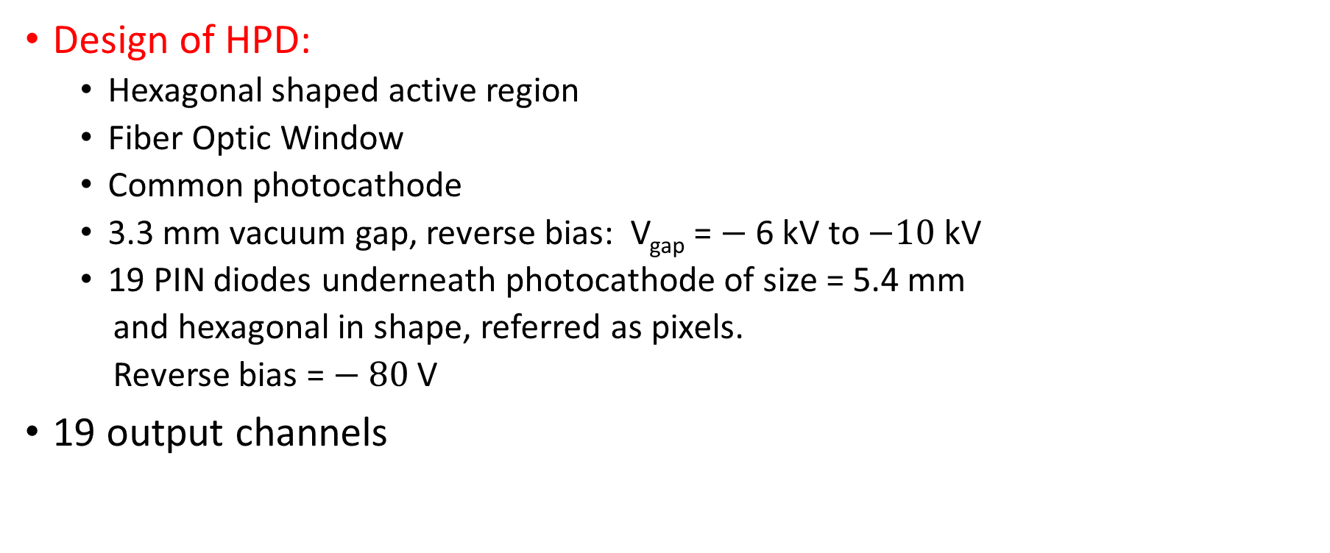
Hybrid Photo Diode (HPD)
3.3 mm
Design of HPD:
Hexagonal shaped active region
Fiber Optic Window
Common photocathode
3.3 mm vacuum gap, reverse bias: V_{gap} = $−$ 6 kV to $−10$ kV
19 PIN diodes underneath photocathode of size = 5.4 mm
and hexagonal in shape, referred as pixels.
Reverse bias = $− 80$ V
19 output channels
Nucl.Instrum.Meth. A587 (2008) 250-258 CERN-CMS-NOTE-2008-011
arXiv:1806.09887 [physics.ins-det]
arXiv:1806.09887 [physics.ins-det]

Slide 5
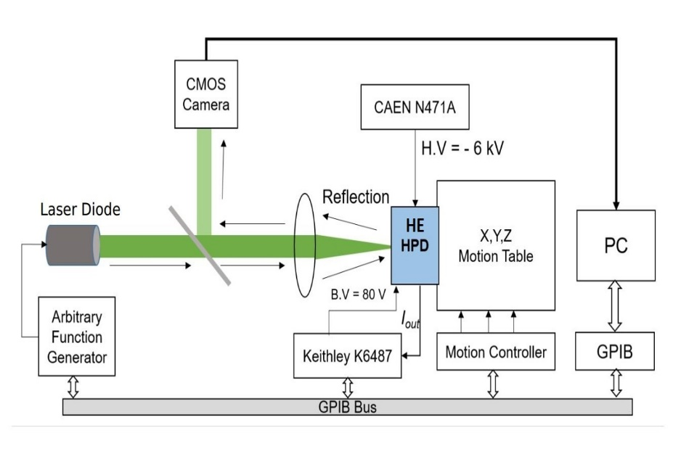
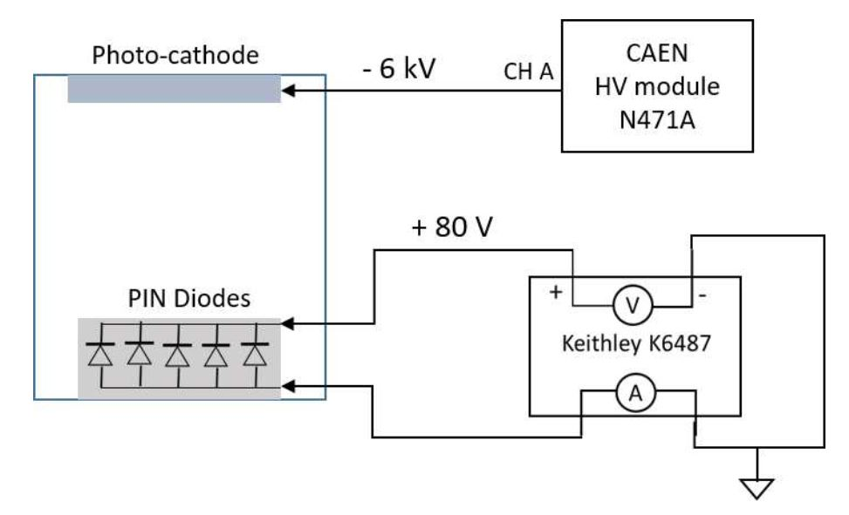
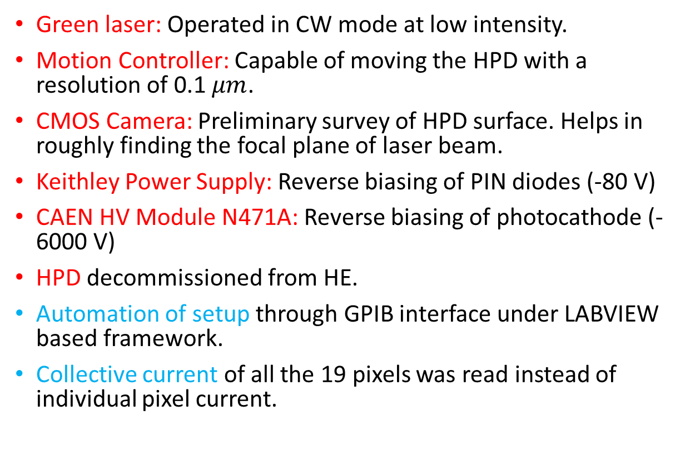
Experimental Setup (MROS)
Green laser: Operated in CW mode at low intensity.
Motion Controller: Capable of moving the HPD with a resolution of 0.1 $μm$.
CMOS Camera: Preliminary survey of HPD surface. Helps in roughly finding the focal plane of laser beam.
Keithley Power Supply: Reverse biasing of PIN diodes (-80 V)
CAEN HV Module N471A: Reverse biasing of photocathode (-6000 V)
HPD decommissioned from HE.
Automation of setup through GPIB interface under LABVIEW based framework.
Collective current of all the 19 pixels was read instead of individual pixel current.
arXiv:1806.09887 [physics.ins-det]

Slide 6
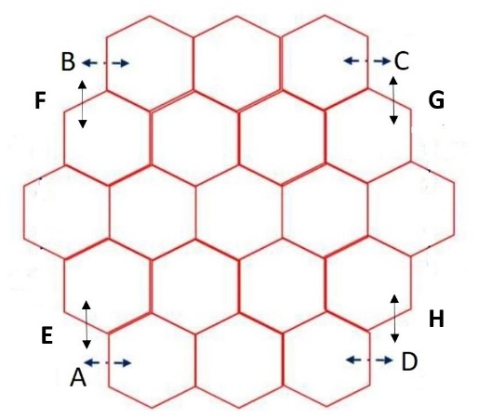
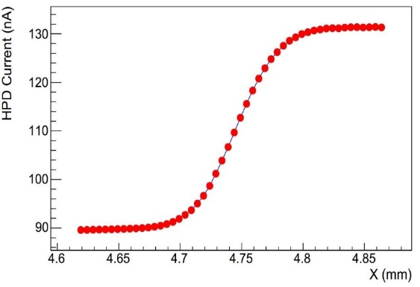
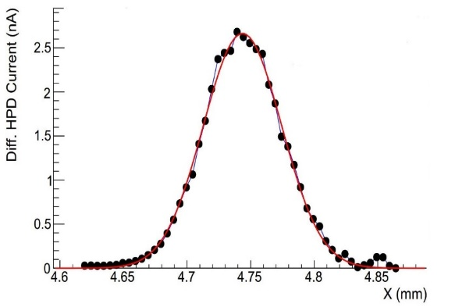
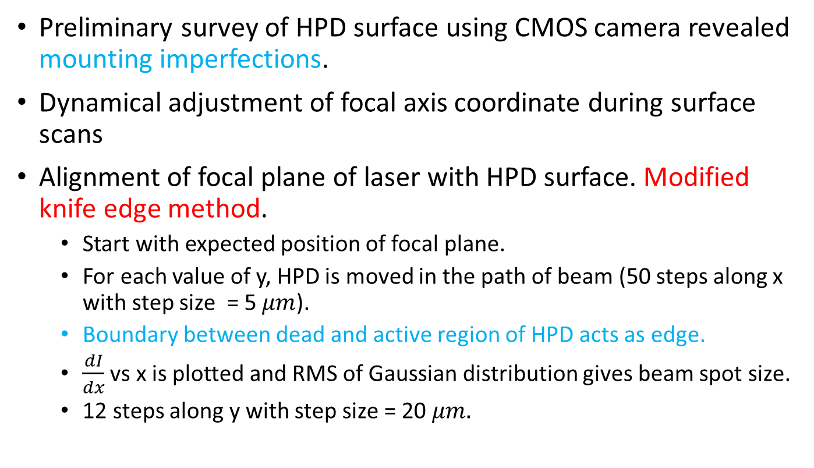



Focal Plane Determination
Preliminary survey of HPD surface using CMOS camera revealed mounting imperfections.
Dynamical adjustment of focal axis coordinate during surface scans
Alignment of focal plane of laser with HPD surface. Modified knife edge method.
Start with expected position of focal plane.
For each value of y, HPD is moved in the path of beam (50 steps along x with step size = 5 $μm$).
Boundary between dead and active region of HPD acts as edge.
$\frac{dI}{dx}$ vs x is plotted and RMS of Gaussian distribution gives beam spot size.
12 steps along y with step size = 20 $μm.$
$$z$$
$$y$$
$$x$$
arXiv:1806.09887 [physics.ins-det]

Slide 7
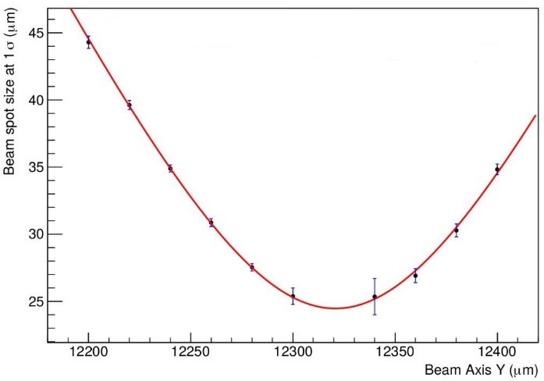
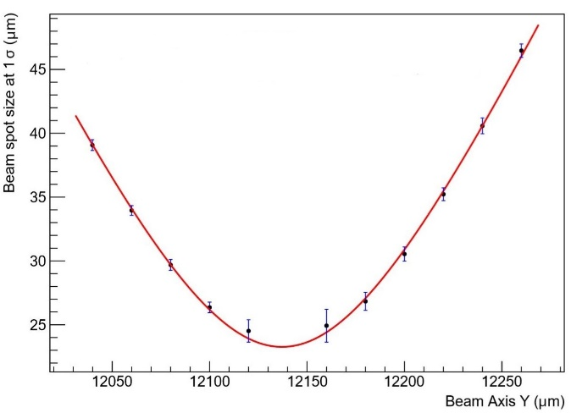
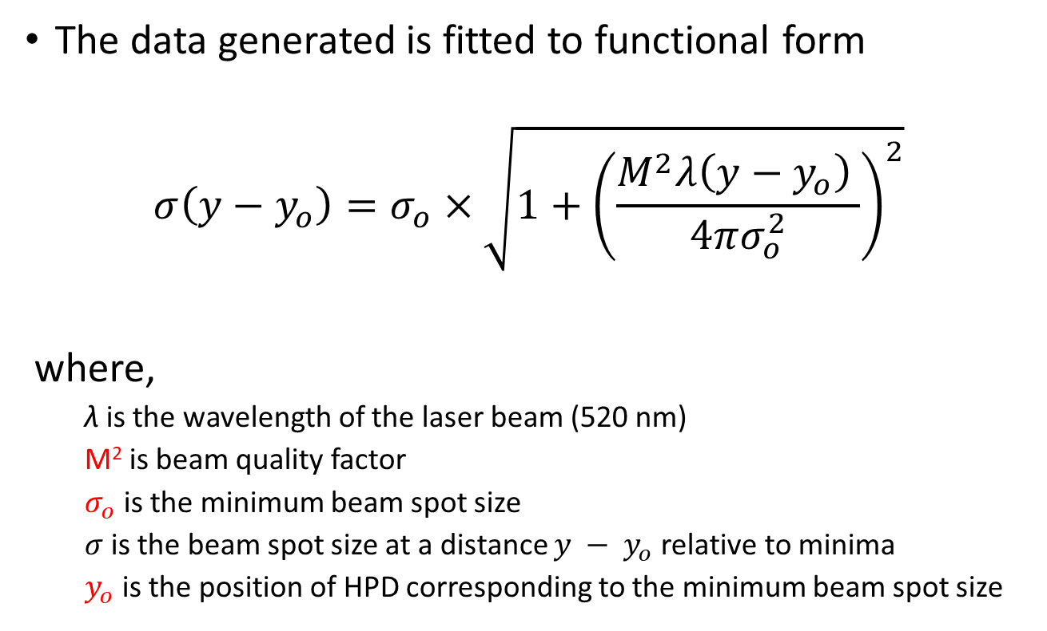
Focal Plane Determination
Position A
The data generated is fitted to functional form
$$σ\left(y−y_{o}\right)=σ_{o}×\sqrt{1+{\left(\frac{M^{2}λ{\left(y−y_{o}\right)}^{ }}{4πσ_{o}^{2}}\right)}^{2}}$$
where,
λ is the wavelength of the laser beam (520 nm)
M² is beam quality factor
$σ_{o}$ is the minimum beam spot size
$σ$ is the beam spot size at a distance $y − y_{o}$relative to minima
$y_{o}$ is the position of HPD corresponding to the minimum beam spot size
Position C

Slide 8
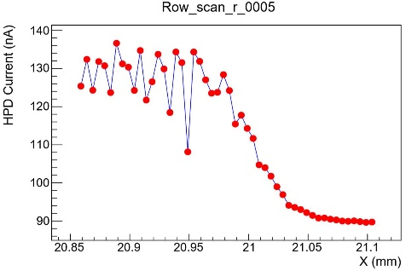
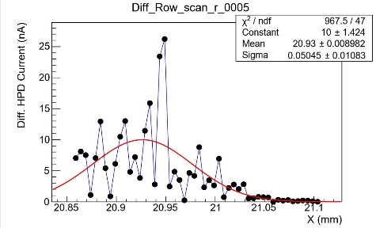
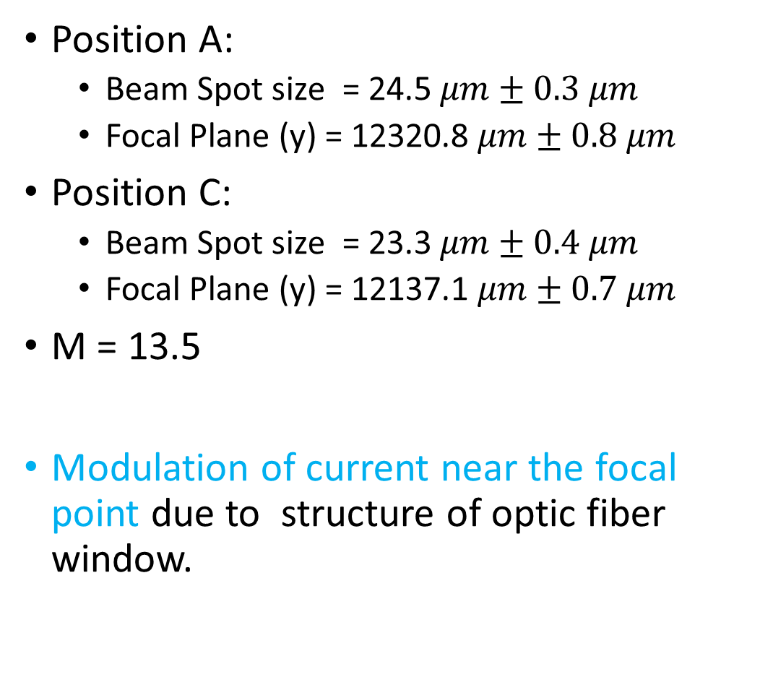
Focal Plane Determination
Position | Focal Plane (y, mm)
A | 12.32
B | 12.26
C | 12.14
D | 12.22
E | 12.32
F | 12.26
G | 12.14
H | 12.18
Position A:
Beam Spot size = 24.5 $μm±0.3 μm$
Focal Plane (y) = 12320.8 $μm±0.8 μm$
Position C:
Beam Spot size = 23.3 $μm±0.4 μm$
Focal Plane (y) = 12137.1 $μm±0.7 μm$
M = 13.5
Modulation of current near the focal point due to structure of optic fiber window.
Focal point for other positions, Ref: arXiv:1806.09887 [physics.ins-det]

Slide 9
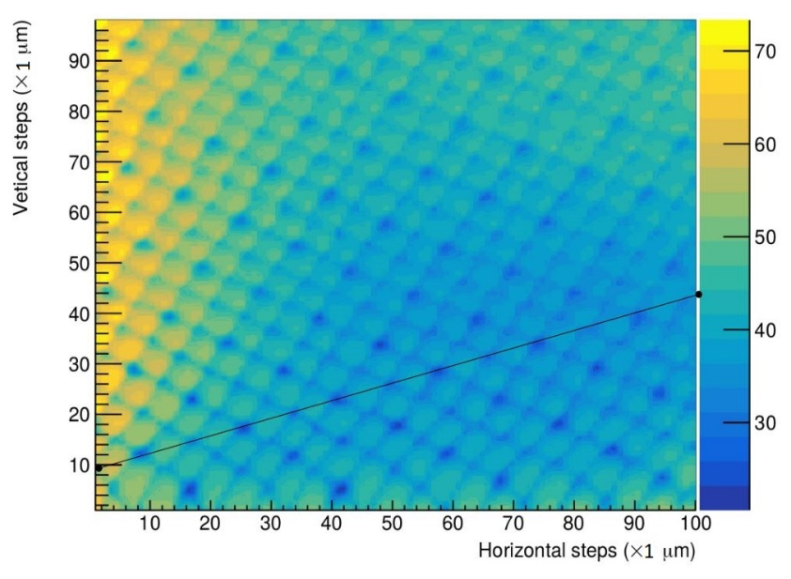
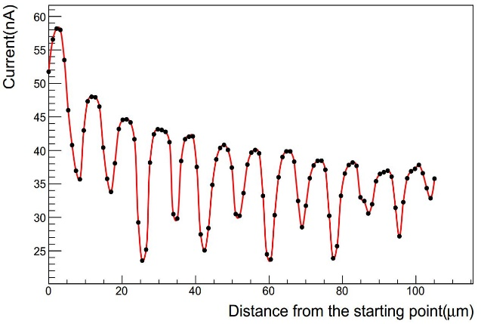
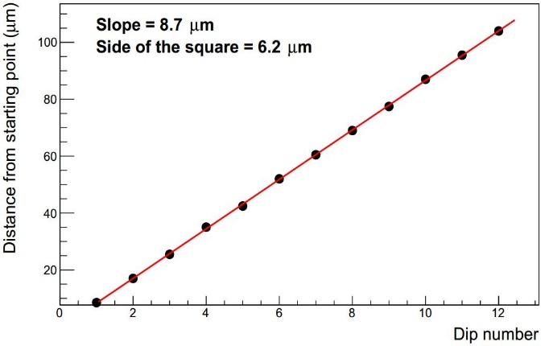
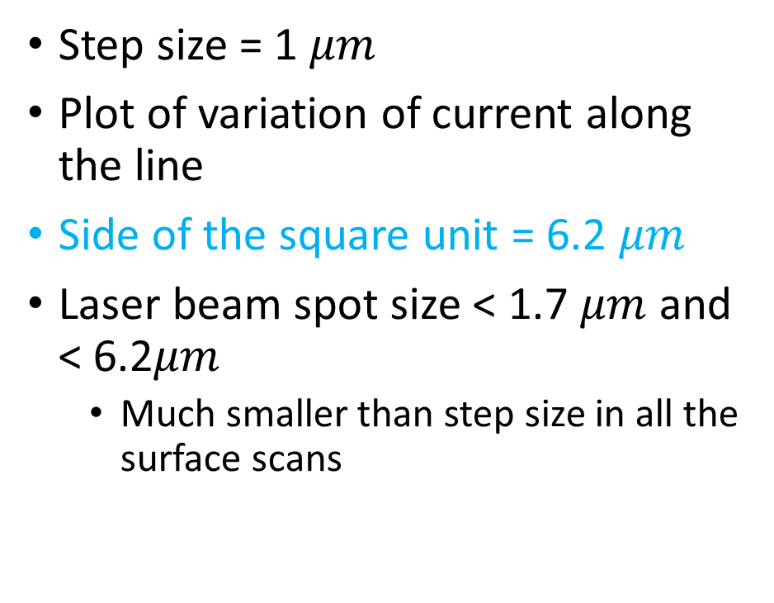
Ultra-Fine Scan
Step size = 1 $μm$
Plot of variation of current along the line
Side of the square unit = 6.2 $μm$
Laser beam spot size < 1.7 $μm$ and < 6.2$μm$
Much smaller than step size in all the surface scans
Y
X

Slide 10
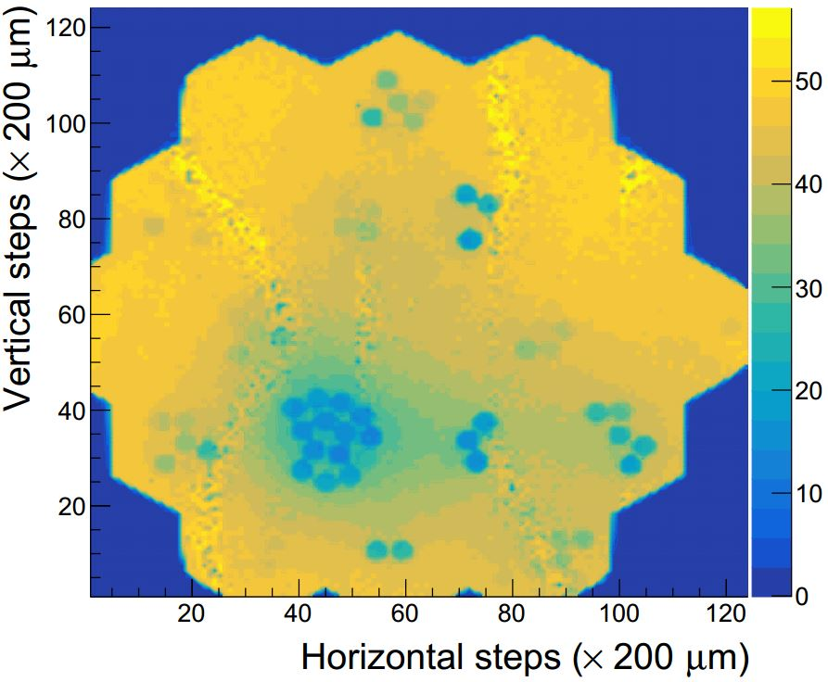
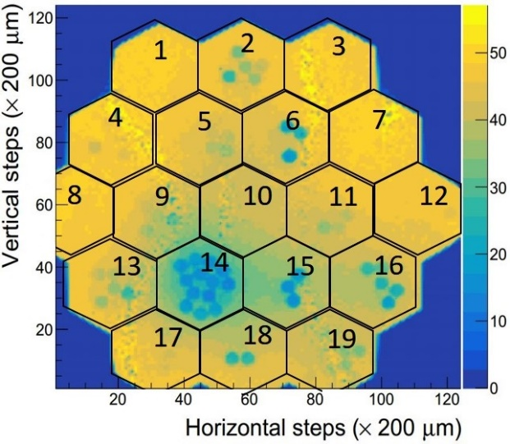
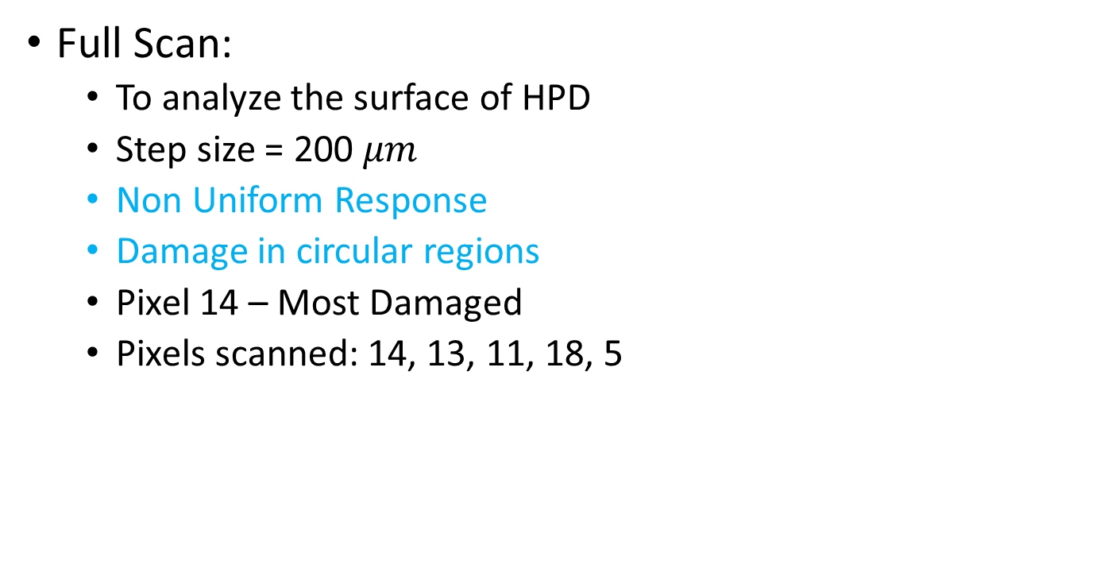
Surface scans of HPD and Position Dependent Response
Full Scan:
To analyze the surface of HPD
Step size = 200 $μm$
Non Uniform Response
Damage in circular regions
Pixel 14 – Most Damaged
Pixels scanned: 14, 13, 11, 18, 5
arXiv:1806.09887 [physics.ins-det]

Slide 11
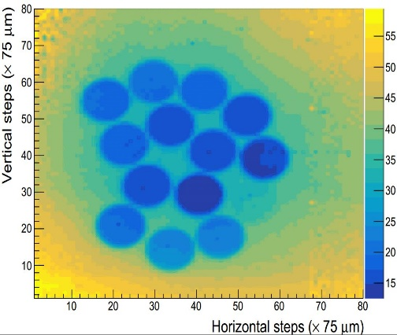
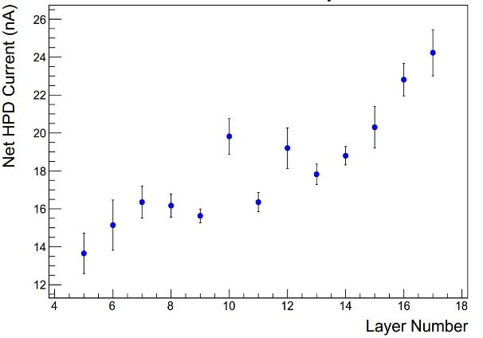

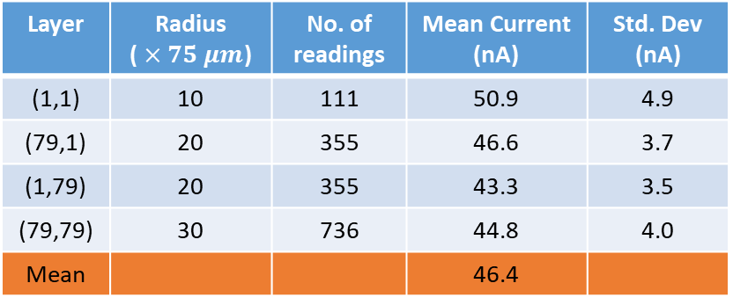
Localized Scans
Pixel 14
12
15
14
11
7
13
8
6
Step size = 75 $μm$, much greater than beam spot size
Percentage signal loss in each pixel
Mean current in fiber imprint
Mean current in undamaged region of pixel
9
5
10
17
16
Layer | Mean Current (nA) | Std. Dev. (nA) | % Signal Loss
5 | 13.7 | 1.1 | 70.6
6 | 15.1 | 1.3 | 67.4
7 | 16.4 | 0.8 | 64.8
8 | 16.2 | 0.6 | 65.1
9 | 15.6 | 0.4 | 66.3
10 | 19.8 | 0.9 | 57.3
11 | 16.4 | 0.5 | 64.8
12 | 19.2 | 1.1 | 58.6
13 | 17.8 | 0.5 | 61.6
14 | 18.8 | 0.5 | 59.5
15 | 20.3 | 1.1 | 56.2
16 | 22.8 | 0.9 | 50.8
17 | 24.2 | 1.2 | 47.8
Mean |  |  | 60.8
Layer | Radius ( $×75 μm$) | No. of readings | Mean Current (nA) | Std. Dev (nA)
(1,1) | 10 | 111 | 50.9 | 4.9
(79,1) | 20 | 355 | 46.6 | 3.7
(1,79) | 20 | 355 | 43.3 | 3.5
(79,79) | 30 | 736 | 44.8 | 4.0
Mean |  |  | 46.4

Slide 12
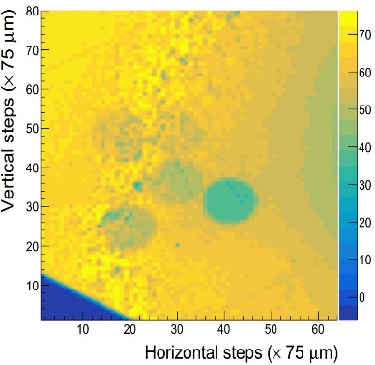
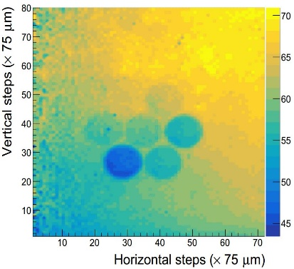
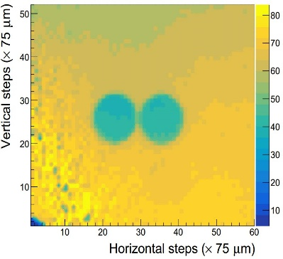
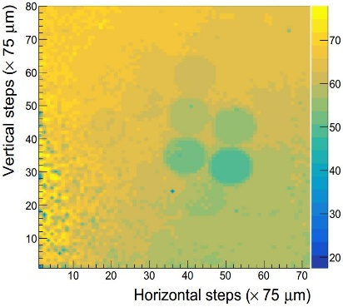
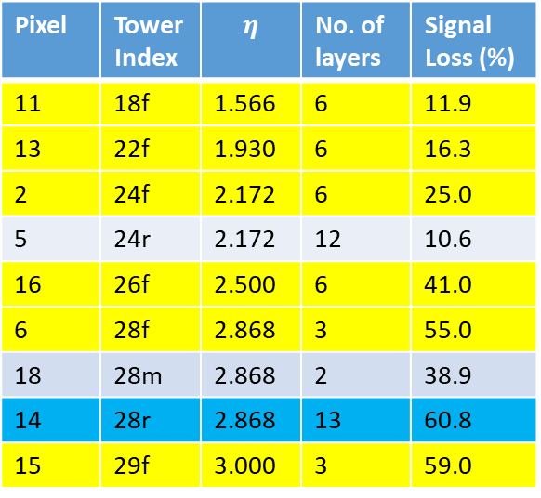
Localized Scans
Pixel 13
Pixel 11
D
C
F
E
A
D
E
B
B
A
C
Pixel 18
Pixel 5
Damage increases with pseudorapidity.
Damage in forward region > Middle region
Damage in Pixel 14 (tower 28r) > Pixel 6 (tower 28f) and Pixel 18 (tower 28m).
13 fibers coming from very high pseudorapidity region
Significant spread damage to neighboring regions
F
E
A
B
G
D
B
H
A
C
Pixel | Tower Index | $$η$$ | No. of layers | Signal Loss (%)
11 | 18f | 1.566 | 6 | 11.9
13 | 22f | 1.930 | 6 | 16.3
2 | 24f | 2.172 | 6 | 25.0
5 | 24r | 2.172 | 12 | 10.6
16 | 26f | 2.500 | 6 | 41.0
6 | 28f | 2.868 | 3 | 55.0
18 | 28m | 2.868 | 2 | 38.9
14 | 28r | 2.868 | 13 | 60.8
15 | 29f | 3.000 | 3 | 59.0
Signal loss in pixel 2, 6, 15, 16 Ref: arXiv:1806.09887 [physics.ins-det]

Slide 13
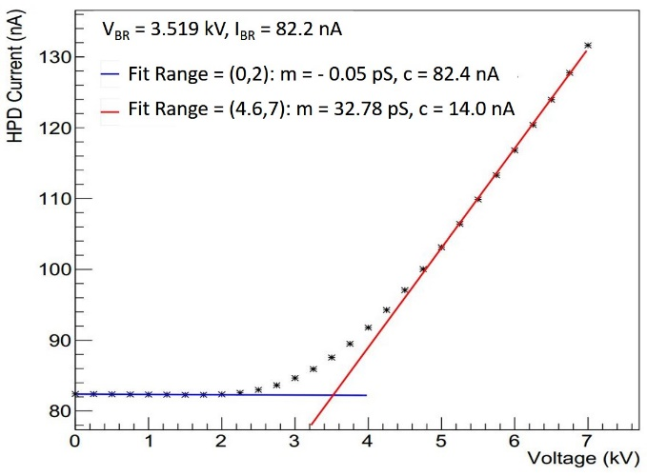
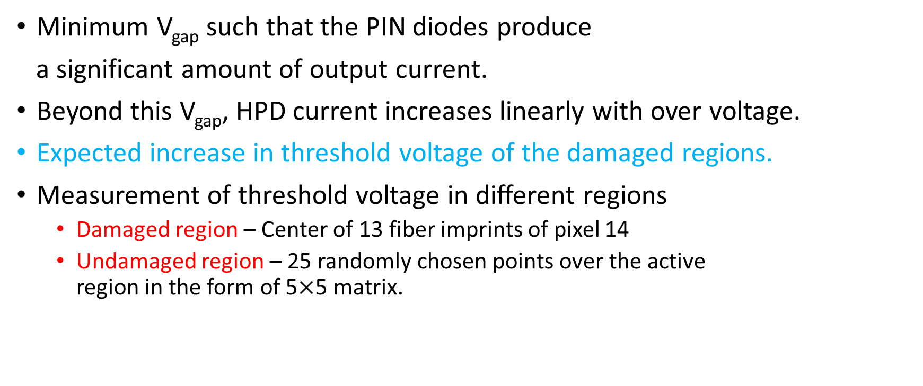
Threshold voltage analysis
Minimum V_{gap} such that the PIN diodes produce
a significant amount of output current.
Beyond this V_{gap}, HPD current increases linearly with over voltage.
Expected increase in threshold voltage of the damaged regions.
Measurement of threshold voltage in different regions
Damaged region – Center of 13 fiber imprints of pixel 14
Undamaged region – 25 randomly chosen points over the active region in the form of 5$×$5 matrix.

Slide 14
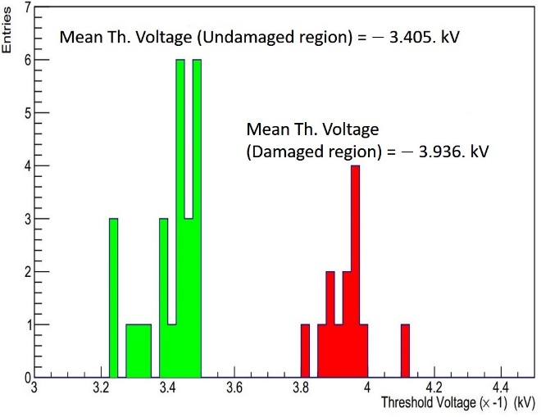
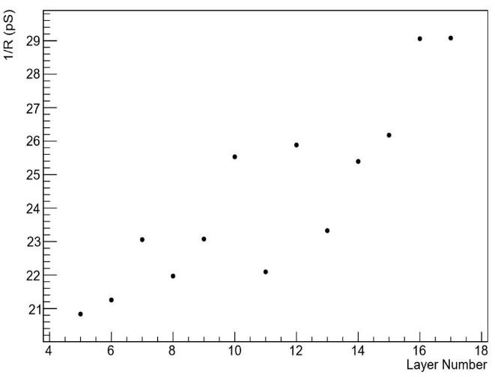
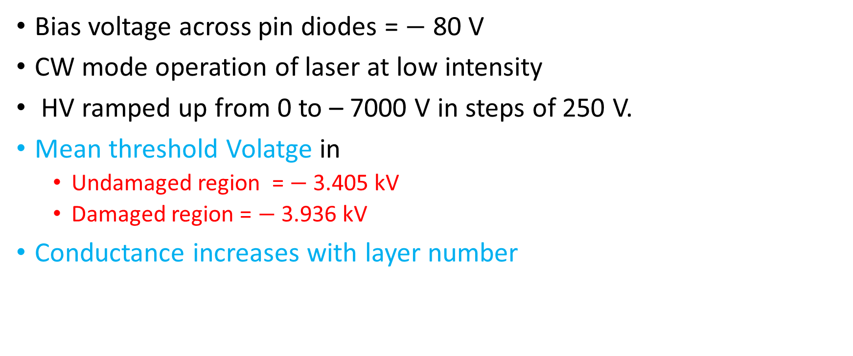
Threshold Voltage Analysis
Bias voltage across pin diodes = $−$ 80 V
CW mode operation of laser at low intensity
HV ramped up from 0 to – 7000 V in steps of 250 V.
Mean threshold Volatge in
Undamaged region = $−$ 3.405 kV
Damaged region = $−$ 3.936 kV
Conductance increases with layer number

Slide 15
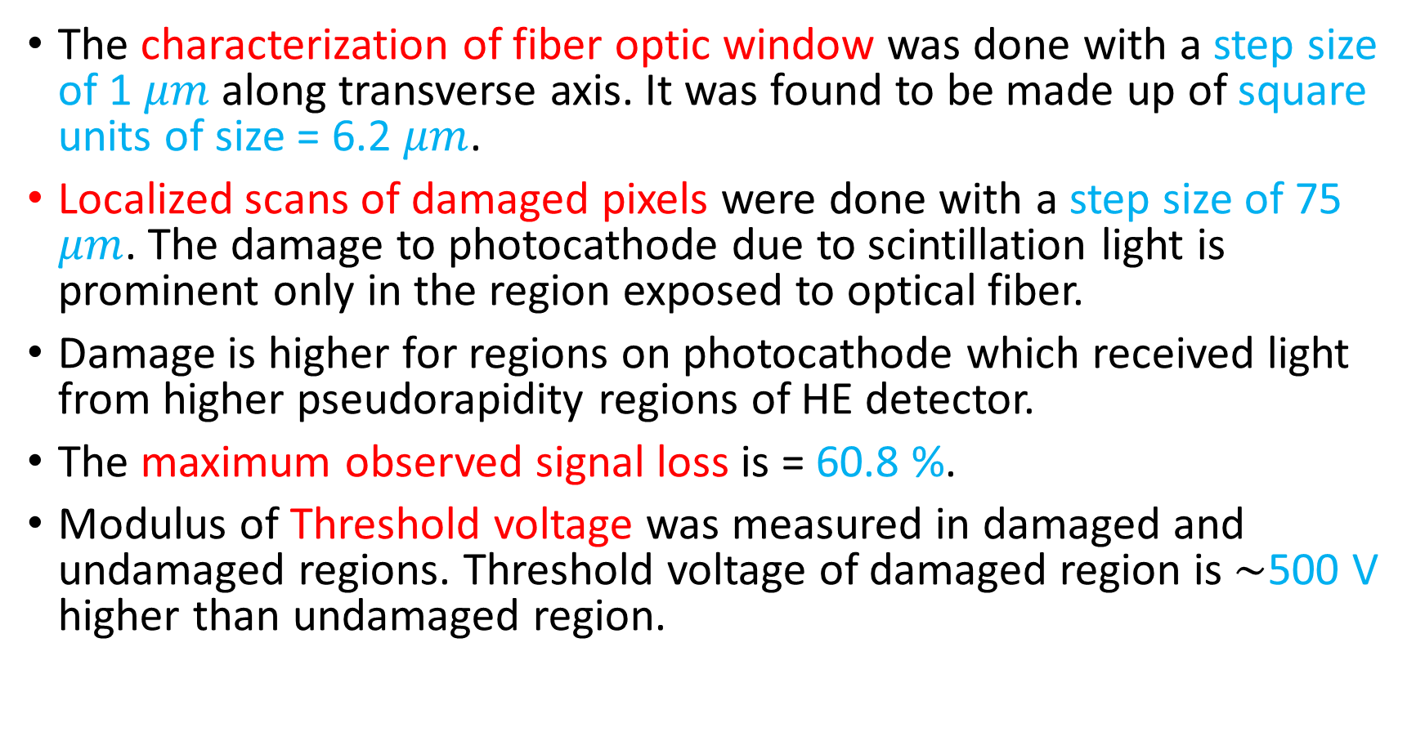
Summary
The characterization of fiber optic window was done with a step size of 1 $μm$ along transverse axis. It was found to be made up of square units of size = 6.2 $μm$.
Localized scans of damaged pixels were done with a step size of 75 $μm$. The damage to photocathode due to scintillation light is prominent only in the region exposed to optical fiber.
Damage is higher for regions on photocathode which received light from higher pseudorapidity regions of HE detector.
The maximum observed signal loss is = 60.8 %.
Modulus of Threshold voltage was measured in damaged and undamaged regions. Threshold voltage of damaged region is $\sim$500 V higher than undamaged region.

Slide 16
References
R A Shukla, V G Achanta, P D Barbaro, S R Dugad, A Heering, S K Gupta, I Mirza, S S Prabhu, P Rumerio, "Microscopic Characterisation of Photo Detectors from CMS Hadron Calorimeter". arXiv:1806.09887 [physics.ins-det].
Abdullin, S., Abramov, V., Acharya, B. et al. Eur. Phys. J. C (2008) 55: 159. https://doi.org/10.1140/epjc/s10052-008-0573-y.
Baiatian G. et al.(CMS HCAL Collaboration), "Design, performance, and calibration of CMS hadron endcap calorimeters", CERN-CMS-NOTE-2008-010.
P. Cushman and B. Sherwood, "Lifetime Studies of the 19-channel Hybrid Photodiode for the CMS Hadronic Calorimeter", Tech. Rep. CMS-NOTE-2008-011 (CERN, Geneva, 2007).
R. Shukla, S. Dugad, C. Garde, A. Gopal, S. Gupta, and S. Prabhu, Review of Scientific Instruments 85, 023301(2014)

