Slide 1
Plagiarism Detekor

Slide 2
Project presentation
Aim: develop and evaluate software for analyzing and detecting plagiarized documents. Providing Interface for manual checking

Slide 3
Plan
1 - Algorithmic approach to problem
2 - Implementation and performances
3 - Closing

Slide 4
Algorithmic approach

Slide 5
Program’s steps
Ranking
Finding matches to queries in database
Fingerprinting
Produces a compact description, or fingerprint, for each document in the collection
Visualising
Visual support for manually checking relevance of results
Identity measures

Slide 6
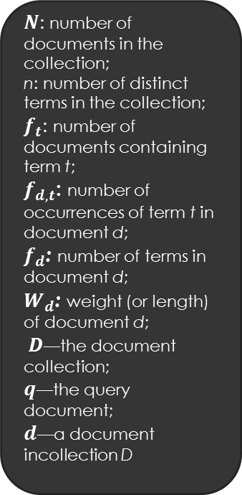
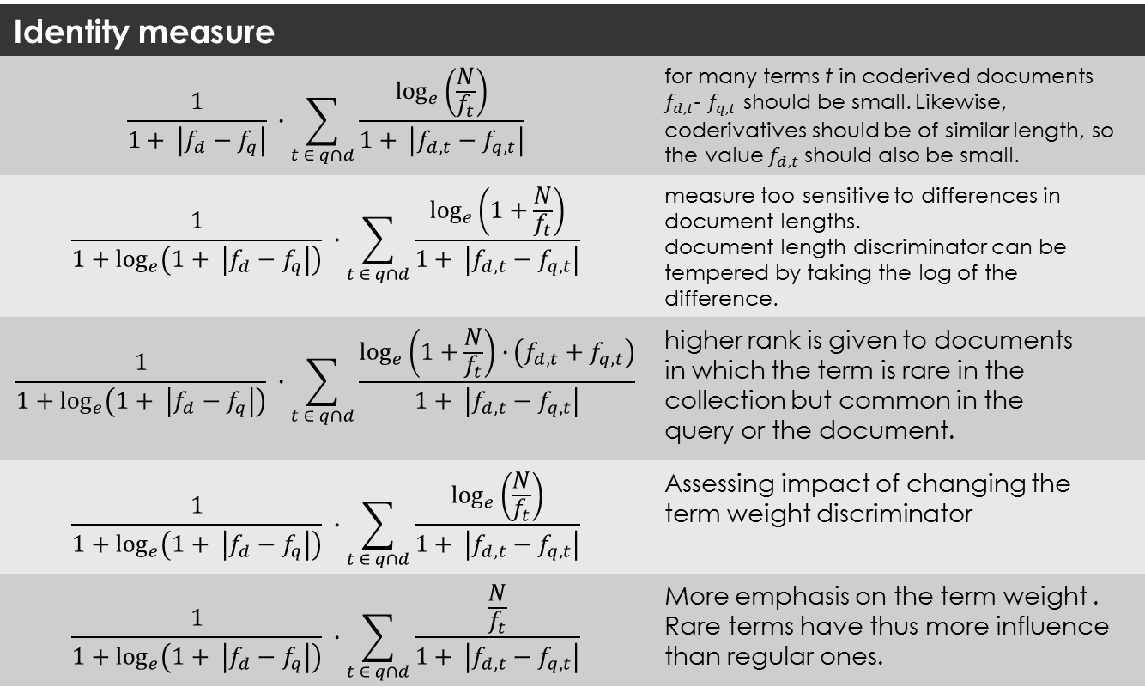
Ranking
Identity measure
$$\frac{1}{1+ \left|f_{d}−f_{q}\right|} ∙\sum_{t ∈ q∩d}{\frac{\log_{e}\left(\frac{N}{f_{t}}\right)}{1+ \left|f_{d,t}−f_{q,t}\right|}}$$ | for many terms t in coderived documents $f_{d,t}$- $f_{q,t}$ should be small. Likewise, coderivatives should be of similar length, so the value $f_{d,t}$ should also be small.
$$\frac{1}{1+\log_{e}\left(1+ \left|f_{d}−f_{q}\right|\right)} ∙\sum_{t ∈ q∩d}{\frac{\log_{e}\left(1+\frac{N}{f_{t}}\right)}{1+ \left|f_{d,t}−f_{q,t}\right|}}$$ | measure too sensitive to differences in document lengths. document length discriminator can be tempered by taking the log of the difference.
$$\frac{1}{1+\log_{e}\left(1+ \left|f_{d}−f_{q}\right|\right)} ∙\sum_{t ∈ q∩d}{\frac{\log_{e}\left(1+\frac{N}{f_{t}}\right)∙\left(f_{d,t}+f_{q,t}\right)}{1+ \left|f_{d,t}−f_{q,t}\right|}}$$ | higher rank is given to documents in which the term is rare in the collection but common in the query or the document.
$$\frac{1}{1+\log_{e}\left(1+ \left|f_{d}−f_{q}\right|\right)} ∙\sum_{t ∈ q∩d}{\frac{\log_{e}\left(\frac{N}{f_{t}}\right)}{1+ \left|f_{d,t}−f_{q,t}\right|}}$$ | Assessing impact of changing the term weight discriminator
$$\frac{1}{1+\log_{e}\left(1+ \left|f_{d}−f_{q}\right|\right)} ∙\sum_{t ∈ q∩d}{\frac{\frac{N}{f_{t}}}{1+ \left|f_{d,t}−f_{q,t}\right|}}$$ | More emphasis on the term weight . Rare terms have thus more influence than regular ones.
$N:$number of documents in the collection;
n: number of distinct terms in the collection;
$f_{t}:$number of documents containing term t;
$f_{d,t}$: number of occurrences of term t in document d;
$f_{d}$: number of terms in document d;
$W_{d}$: weight (or length) of document d;
$D$—the document collection;
$q$—the query document;
$d$—a document incollection D
Calculating and sorting documents according to Identity measure
Different ways of proceeding:

Slide 7
Fingerprinting
Document’s fingeprints are a series of integer representing key content of the document.
Each document has its fingerprint representing its content
Comparing such fingerprints enables detection of coderivation
Generation of fingerprints is normally made by selecting defined substrings and applying a function to it.
When comparing queried document’s index with DB documents, number of matching minutiae will define the score for coderivation.
4 design decisions are to be made : function used for generating minutiae, size of substrings, number of minutiae and strategy for picking substrings.

Slide 8
.1 Fingerprints generation
Converting a string to an integer.
Number of minutiae is bounded
Has to be :
Reproducible
Uniformely dispatched
Fast
Simple hashing functions do not satisfy the 3 criterons at once

Slide 9
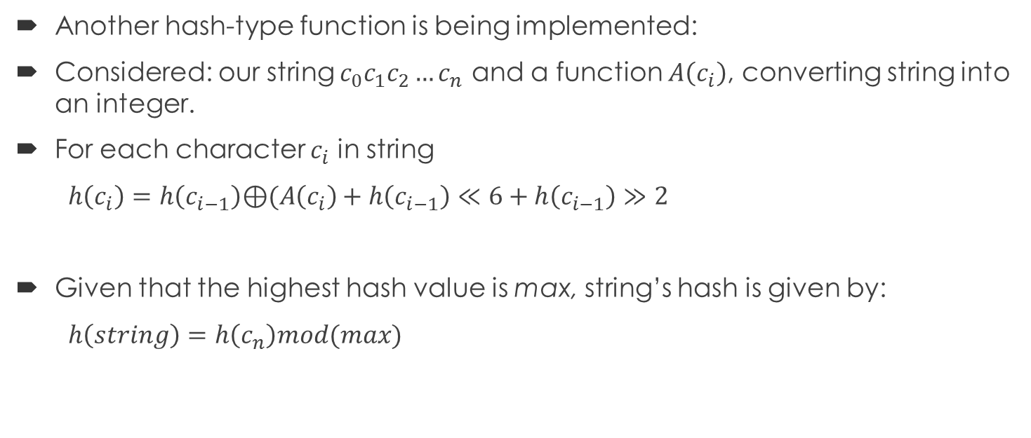
.1 Fingerprint generation
Another hash-type function is being implemented:
Considered: our string ${c_{0}c_{1}c_{2}…c}_{n}$ and a function $A\left(c_{i}\right)$, converting string into an integer.
For each character $c_{i}$ in string
$h\left(c_{i}\right)=h\left(c_{i−1}\right)\text{⊕}(A\left(c_{i}\right)+h\left(c_{i−1}\right)≪6+h\left(c_{i−1}\right)≫2$
Given that the highest hash value is max, string’s hash is given by:
$h\left(string\right)=h\left(c_{n}\right)mod(max)$

Slide 10
.2 Fingerprints granularity
Significant impact on algorithm efficiency
Different way of defining it:
Number of characters
Number of sentences
Number of words – most commonly adopted
The higher the granularity, the lower the chance that 2 documents sharing a same minutiae share the same sentence is low
Vice versa, low granularity might generate matches by chance

Slide 11
.4 Substring selection strategy
If n number of minutiae have to be selected, n different substrings have to be hashed.
4 main selection strategies :
Full fingerprinting: every substring of size g is selected.
Positional Selection: random, all substrings, first-r, first-r-sliding
Frequency based strategies: rarest in document, rarest in collection, rarest prefix
Structure based strategies: using anchors (K-th in sentence, K-th sentence…)
Full fingerprinting was implemented, supposely best-case effectiveness

Slide 12
Implementation & Performance

Slide 13
Design decisions
Input: Query document, document for 1-1 comparison, options for computation
Output: Visualisation of relevant datas after computation in HTML file, visual comparison of the two documents with underlined coderivative data.
Language: C++

Slide 14
Design decisions
Ranking:
All variations have been implemented. One selects the version to apply through the USI
Text queries and documents are previously standardised through erasing of stopwords and passing uppercase to lowercase characters
Construction of inverted indexes for providing expected frequencies
Fingerprinting:
Full fingerprinting implemented

Slide 15
Testing and analysis

