Slide 1

A Framework for Simulating Artificial Life
on Distributed Systems

Slide 2
Artificial Life
“Life as it is” VS “Life as it could be”

Slide 3
Problems
High Computational Costs
Reprogram the simulation into a distributed application and also the configuration overhead of the underlying distributed system.

Slide 4
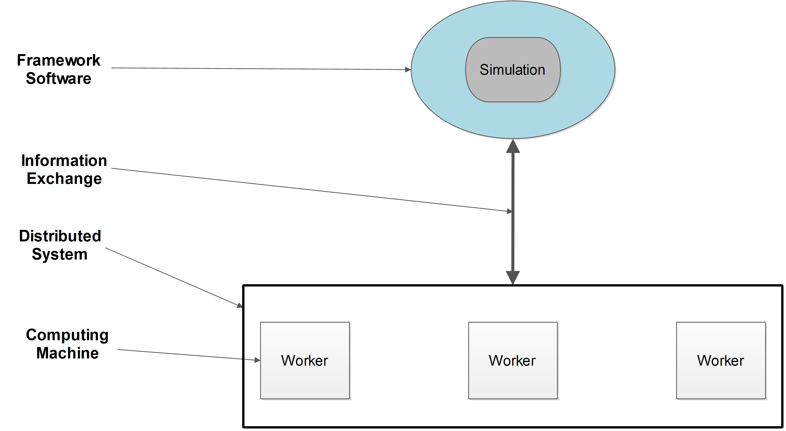
Solution

Slide 5
Revisit ALife
Most Alife simulations use a GA as their main algorithm.

Slide 6
Genetic Algorithm
Adaptive search algorithms inspired by natural selection theory.
Used in optimization problems and Alife simulations.

Slide 7
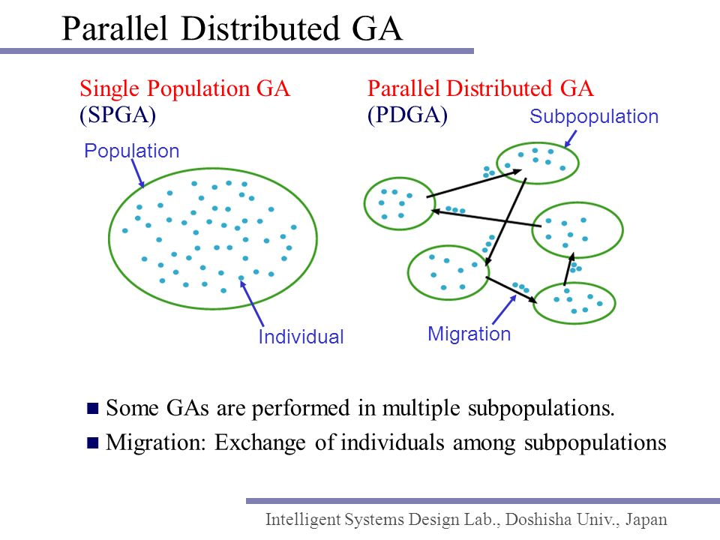

Slide 8
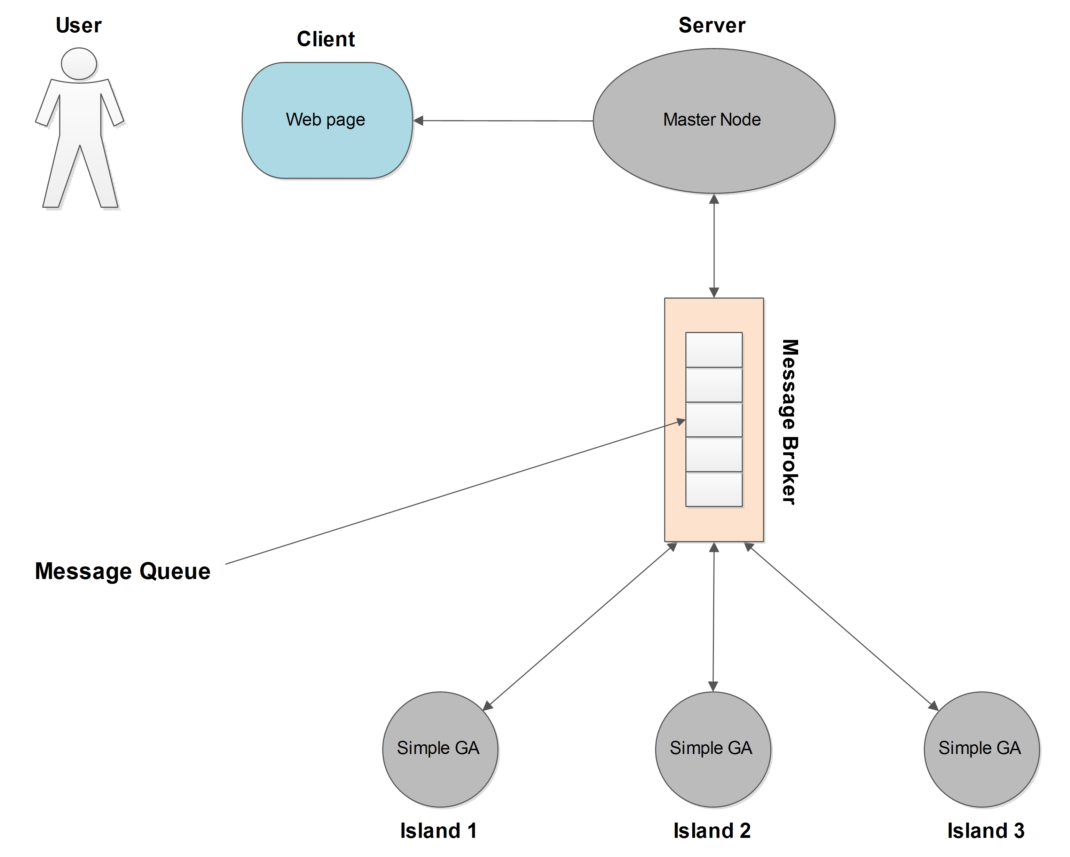
Theoretical Model

Slide 9
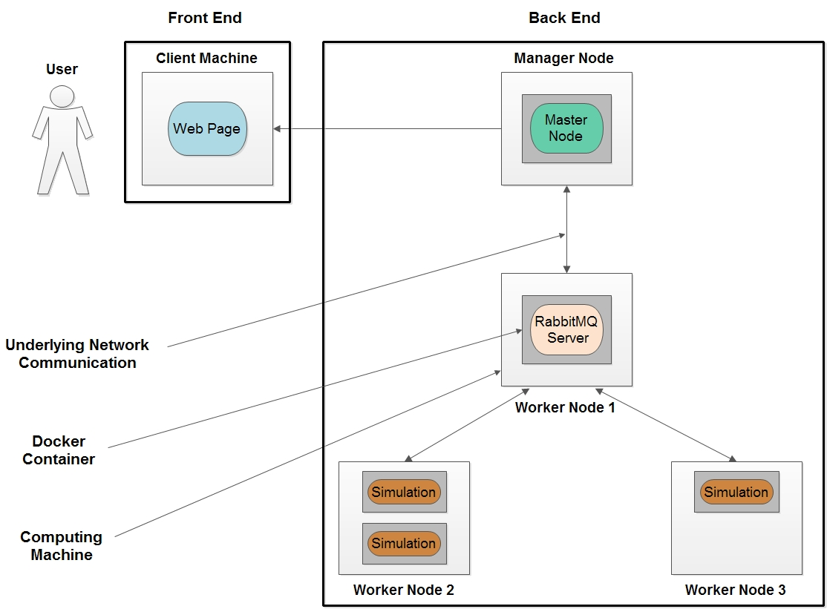
Software Architecture

