Slide 1
An introduction to React

Slide 2
What to expect
A 6-8 hour interactive workshop
Learning about React while building something with it
Using modern React (functional components)
Code examples and try-it-yourself challenges
Feel free to ask questions

Slide 3
What not to expect
Full coverage of every React feature (time)
Server-side or react-native code (mobile)
In-depth look at frameworks and libraries

Slide 4
Questions?

Slide 5
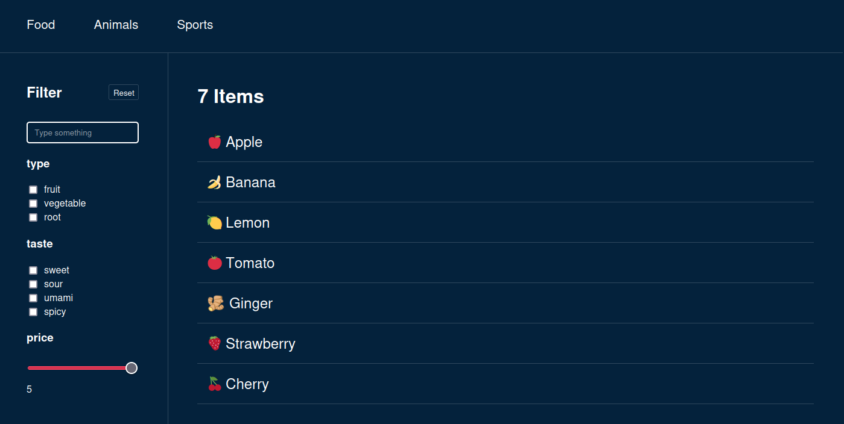
Let’s build a filter-app together!
Example: Final product (end goal)

Slide 6
Why React?
An industry standard
Well documented, matured library
Many 3rd party packages & tools
Reusable components
State management

Slide 7

Quick setup with Vite
1.
2.
3.
npm create vite@latest
Need to install the following packages:
create-vite@4.4.1
Ok to proceed? (y) y
✔ Project name: … vite-project
? Select a framework: › - Use arrow-keys. Return to submit.
Vanilla
Vue
❯ React
Preact
Lit
Svelte
Solid
Qwik
Others
npm install
npm run dev
? Select a variant: › - Use arrow-keys. Return to submit.
TypeScript
❯ TypeScript + SWC
JavaScript
JavaScript + SWC

Slide 8
Where to start?
Start with a single component
Make it return basic & static HTML
Future steps:
  Make it dynamic (components & properties)
  Make it interactive (state & event-handlers)

Slide 9
HTML structure within .jsx
Conditionals
Iterations
Fragments

Slide 10
Conditionals
<div>
{isLoading && <p>Loading...</p>}
</div>
<div>
{isLoading ? <p>Loading...</p> : <Filter />}
</div>
JavaScript expressions can be put inside JSX by placing it between {}
There are many strategies for conditional JSX

Slide 11
Iterations
{options.map((option) => (
<li key={option.id}>
{option.id}
</li>
))}
Arrays can be iterated over and each return more JSX

Slide 12
Fragments
<>
<h1>Hello</h1>
<p>World</p>
</>
<Fragment>
<h1>Hello</h1>
<p>World</p>
</Fragment>
<div>
<h1>Hello</h1>
<p>World</p>
</div>
✅
✅
❌
React requires single top-level elements
Fragments group items without affecting the DOM (<div> could affect CSS & JS selectors)

Slide 13
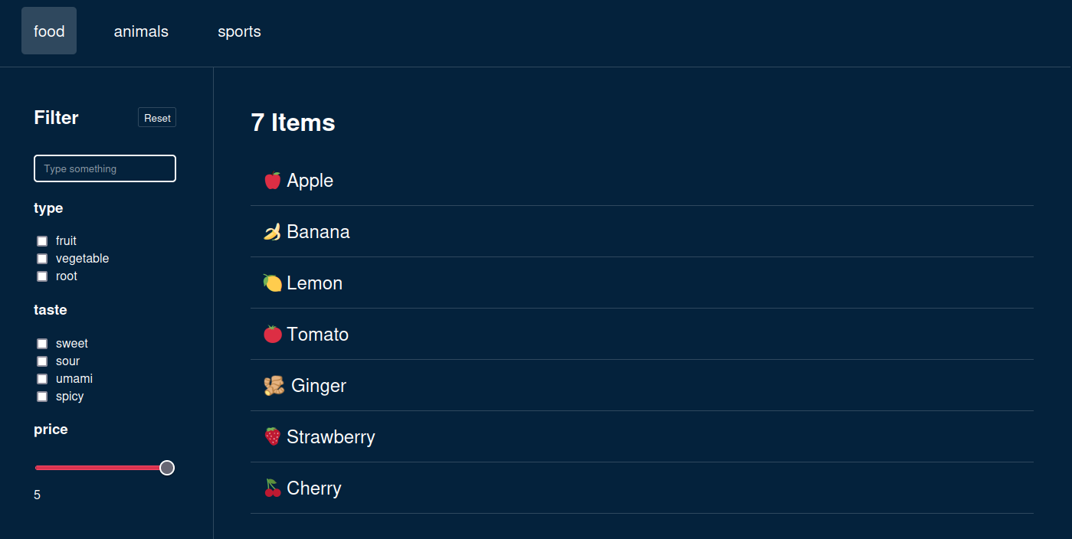
Example: Building static HTML

Slide 14
Split code into components
Reusable
Configurable
Testable
Readable

Slide 15
Tabs
Filter
FilterSettings
FilterResults
Textsearch
Checkboxgroup
Checkboxgroup
RangeSlider
Example: Splitting into components

Slide 16
Dynamic components
Example: Splitting into components
Checkboxgroup
Checkboxgroup

Slide 17
Component properties
Make components re-usable
Hands over state to parent components

Slide 18
Component properties
<Checkboxgroup
label="taste"
options={["sweet", "sour", "umami"]}
/>
export function Checkboxgroup({ label, options }) {
return (
<>
<h3>{label}</h3>
<ul>
{options.map((option) => (
<li key={option}>
<label>
<input
name={`${label}_checkboxgroup`}
type="checkbox"
value={option}
/>
{option}
</label>
</li>
))}
</ul>
</>
);
}
<Checkboxgroup
label="type"
options={["fruit", "vegetables"]}
/>
Example: Component configuration
components/FilterSettings.tsx
Example: Component configuration
components/Checkboxgroup.tsx

Slide 19
👉Interactivity

Slide 20
User input 🖱⌨️📱🕹
Visually our app looks finished, but it lacks interactivity
For now let’s focus on direct user events
Examples: click, scroll, focus, input,..

Slide 21
Event-handling
document.querySelector('#search').addEventListener('change', (e) => {
updateFilterResults(e.target.value);
});
❌
This is problematic because:
React’s virtual DOM frequently recreates nodes
Every render would create additional event-handlers

Slide 22
React event-handling
<input
type="search"
value={value}
onChange={(event) => {/* do something */}}
/>
<button onClick={(event) => /* do something */}>
Reset
</button>
Attach events directly inside .jsx
Event-handlers change state, which is defined outside of .jsx

Slide 23
📃 Interactivity checklist:
◻️Create a variable to hold state
◻️Use the state in our component (JSX & JS)
◻️Update state on user-input (event)
◻️Re-render the app after state updates

Slide 24
State

Slide 25
🪝useState()
const [activeTab, setActiveTab] = useState(0);
const [search, setSearch] = useState("");
<input type="search"
value={search}
onChange={e => setSearch(e.target.value)}
/>
Returns a state variable and a set function
State is saved between renders
React will re-render when state changes

Slide 26
Interactivity checklist
✅ Create a variable to hold state
✅ Use the state in our component (JSX & JS)
✅ Update state on user-input (event)
✅ Re-render the app after state updates
const [search, setSearch] = useState("");
<input type="search" value={search} onChange={e => setSearch(e.target.value)} />
<input type="search" value={search} onChange={e => setSearch(e.target.value)} />
// React re-renders automatically after state mutates!

Slide 27
Interactive <Tabs>
Example: Interactive <Tabs>
Tabs

Slide 28
Interactive <Tabs>
import { useState } from "react";
import { Tabs } from "./components/Tabs";
export function ExampleInteractiveTabs() {
const options = ["food", "animals", "sports"];
const [activeFilter, setActiveFilter] = useState(options[0]);
return (
<>
<Tabs
options={options}
active={activeFilter}
onUpdate={setActiveFilter}
/>
<pre>Checked tab: {activeFilter}</pre>
</>
);
}
export function Tabs({ options, active, onUpdate }) {
return (
<div className="filter-navigation" role="tablist">
{options.map((option) => (
<button
key={option}
role="tab"
aria-selected={active === option}
className={`filter-navigation__button${
active === option ? " active" : ""
}`}
onClick={() => onUpdate(option)}
>
{option}
</button>
))}
</div>
);
}
Example: Interactive <Tabs>
InteractiveTabs.tsx
Example: Interactive <Tabs>
components/Tabs.tsx

Slide 29
let, const, var
const search = “”
<input type="search"
value={search}
onChange={e => { search = e.target.value }}
/>
❌
Wouldn’t work because:
The variable gets recreated on every render
Updating the variable won’t tell react to re-render

Slide 30
let, const, var
const [search, setSearch] = useState("");
const searchLowerCase = search.toLowerCase();
Not everything needs to be defined with useState()
For example: derived variables
  They won’t need to be changed directly
  Their origin will already cause a re-render on change

Slide 31
Lifting state up
In React data always flows from the top to the bottom
If state needs to be shared between adjacent components, move it to a parent and pass it down with properties
Pass setState to a child so it can change the state of a parent, from where the updated state will flow down afterwards

Slide 32
Interactive <TextSearch>
Example: Interactive <TextSearch>
Textsearch

Slide 33
Interactive <TextSearch>
import { useState } from "react";
import { Tabs } from "./components/Tabs";
export function ExampleTabs() {
const options = ["food", "animals", "sports"];
const [activeFilter, setActiveFilter] = useState(options[0]);
return (
<>
<Tabs
options={options}
active={activeFilter}
onUpdate={setActiveFilter}
/>
<pre>Checked tab: {activeFilter}</pre>
</>
);
}
export function Tabs({ options, active, onUpdate }) {
return (
<div className="filter-navigation" role="tablist">
{options.map((option) => (
<button
key={option}
role="tab"
aria-selected={active === option}
className={`filter-navigation__button${
active === option ? " active" : ""
}`}
onClick={() => onUpdate(option)}
>
{option}
</button>
))}
</div>
);
}
Work in progress

Slide 34
Interactive <Checkboxgroup>
Example: Interactive <Checkboxgroup>
Checkboxgroup
Checkboxgroup

Slide 35
Interactive <Checkboxgroup>
import { useState } from "react";
import { Tabs } from "./components/Tabs";
export function ExampleTabs() {
const options = ["food", "animals", "sports"];
const [activeFilter, setActiveFilter] = useState(options[0]);
return (
<>
<Tabs
options={options}
active={activeFilter}
onUpdate={setActiveFilter}
/>
<pre>Checked tab: {activeFilter}</pre>
</>
);
}
export function Tabs({ options, active, onUpdate }) {
return (
<div className="filter-navigation" role="tablist">
{options.map((option) => (
<button
key={option}
role="tab"
aria-selected={active === option}
className={`filter-navigation__button${
active === option ? " active" : ""
}`}
onClick={() => onUpdate(option)}
>
{option}
</button>
))}
</div>
);
}
Work in progress

Slide 36
Recap

Slide 37
QUIZ
useState

Slide 38
🪝Hooks
useState
useRef
useSyncExternalStore
useCallback
useTransition
useEffect
useInsertionEffect
useContext
useReducer
useImperativeHandle
useLayoutEffect
useDeferredValue
use
useId
useDebugValue
useMemo

Slide 39
🪝Hooks
Hook are functions that let you “hook” into React’s state
They need to run
  inside a functional component
  in the same order every render
  unconditionally

Slide 40
Pure Functions inside React
Always produce same output with same input
Have no side-effects

Slide 41
Functional Components
React can easily abort incomplete renders
Results can be cached more easily
Components can be rendered on the server

Slide 42
Mutating state
Inside event handlers
Inside useEffect()

Slide 43
Detecting state changes
We want to fetch our data when the app initializes and when the category is changed

Slide 44
🪝useEffect()
Run after the component has rendered
Has a dependency array that needs to match the effects dependencies
If dependencies are empty it only runs once
The returned function runs when component unmounts

Slide 45
🪝useEffect()
Its purpose is to synchronize with external systems
Send analytics events
Connect to a native (video) or external API (image gallery)

Slide 46
🪝useEffect()
Can easily be misused and introduce unnecessary complexity and performance costs.

Slide 47
How to avoid prop drilling?
Filter.tsx
FilterSettings.tsx
<div className="filter">
<FilterSettings
filters={filters}
updateCategory={updateCategory}
updateRange={updateRange}
updateSearch={updateSearch}
reset={reset}
/>
<FilterResults
items={filterResults}
search={filters.search.value}
reset={reset}
/>
</div>
<div className="filter__settings">
<FilterSettingsToolbar reset={reset} />
<TextSearch
value={filters.search.value}
onUpdate={(e) => updateSearch(e.target.value)}
/>
...
</div>

Slide 48
🪝useContext()
Provides a shared state to all children who subscribe with the useContext hook
Other components in between don’t have to know the data exists
Can lead to unintended re-renders

Slide 49
🪝useContext()
FilterSettings.tsx & FilterResults.tsx
Filter.tsx
export const FilterContext = createContext(null);
import { FilterContext } from './Filter.tsx'
<FilterContext.Provider items={items} >
<FilterSettings />
<FilterResults />
</FilterContext.Provider>
items = useContext(FilterContext)

Slide 50
Will it re-render?

Slide 51
🪝useRef()
Changing ref.current doesn’t cause a rerender!

Slide 52
Component updates
React tries to only update parts of DOM which need to be updated
React has it’s own virtual DOM
Sometimes we want to explicitly update components

Slide 53
key attribute
Whenever the key attribute changes, React will treat it like a different element and cause a rerender.

Slide 54
How to handle complex state
The filtersettings are increasing in complexity and we want a better way than useState to handle it in a unified way.

Slide 55
🪝useReducer()
UseReducer() is similar to useState() but it can provide multiple functions to update the state it holds

Slide 56
JS mutations
 | copy | mutating
add | .concat(), [...arr] | .push(), .unshift()
remove | .filter(), slice() | .pop(), .shift(), .splice()
replace | .map() | .splice(), arr[i] =
sort | [...arr] => arr.sort() | .reverse(), .sort()
Source: https://react.dev/learn/updating-arrays-in-state

Slide 57
Copying deeply nested state
Copying nested state can become very tedious and hard to read:
case "SET_RANGE":
return {
...state,
ranges: {
...state.ranges,
[action.payload.id]: {
...state.ranges[action.payload.id],
value: action.payload.value,
},
},
};
useFilter.tsx:41

Slide 58
Immer (Framework)
Immer allows state to be mutated directly
  Replace useState() with useImmer()
  Replace useReducer() with immerReducer()
case "SET_RANGE":
return {
...state,
ranges: {
...state.ranges,
[action.payload.id]: {
...state.ranges[action.payload.id],
value: action.payload.value,
},
},
};
case "SET_RANGE":
state.ranges[action.payload.id].value = action.payload.value;
break;

Slide 59
🪝Custom hooks
Need to start with use
Only are considered hooks if they wrap around React hooks, otherwise they’re just functions
Are essentially just wrappers like functions

Slide 60
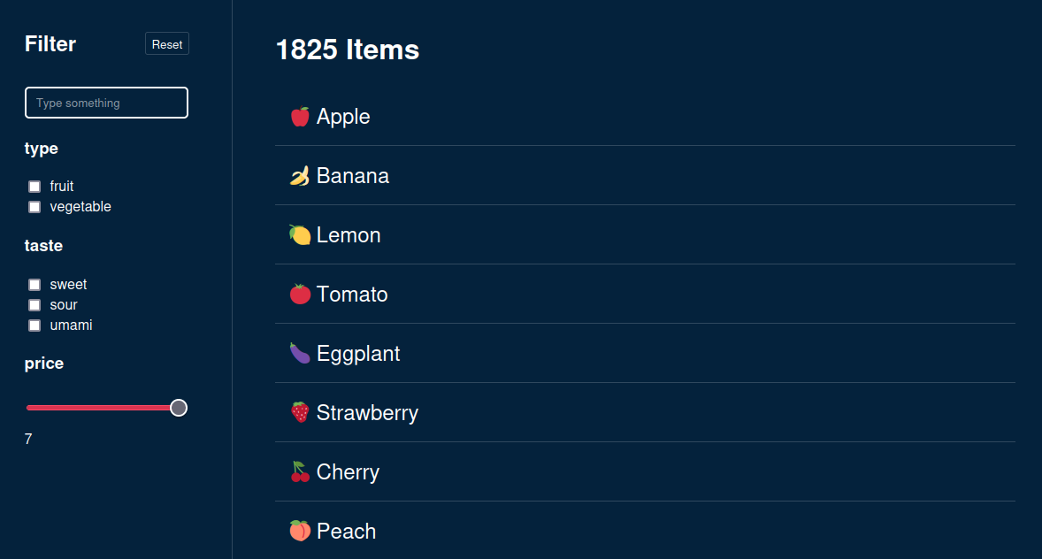
⚠️ Performance issues
If we had complex filters with thousands of items, slower devices might run into performance issues

Slide 61
🪝useMemo()
const filterResults = useMemo(() => {
// costly filter operation
return filtereditems;
}, [filters, items]);
useFilterContext.tsx:30
Cache the result of a heavy computation
Not needed for simple calculations
Only updates when dependency array changes

Slide 62
🪝useCallback()
Like useMemo() but it returns a function instead of a value
Referential equality

Slide 63

Typescript

Slide 64
State Management
SWR
React Query
Redux & Redux Toolkit
Zustand
Jotai

Slide 65
Routing
React-Router
NextJS

Slide 66
Next steps & Ideas
Add routing for detailviews
Save the filter-state in url for deep linking
Extract Filter types into separate modules

Slide 67
Recommendations
Official React.dev - Learn & Documentation
https://react.dev/learn
Jack Herrington - Typescript & React
https://www.youtube.com/watch?v=j8AVXNozac8
Web Dev Simplified – React Hooks Explained
https://www.youtube.com/watch?v=O6P86uwfdR0

Slide 68
Thank you!

