Slide 1
An introduction to React

Slide 2
What to expect
A 6-8 hour interactive workshop
Learning about React while building something with it
Using modern React (functional components)
Code examples and try-it-yourself challenges
Feel free to ask questions

Slide 3
What not to expect
Full coverage of every React feature (time)
Server-side or react-native code (mobile)
In-depth look at frameworks and libraries

Slide 4
Questions?

Slide 5
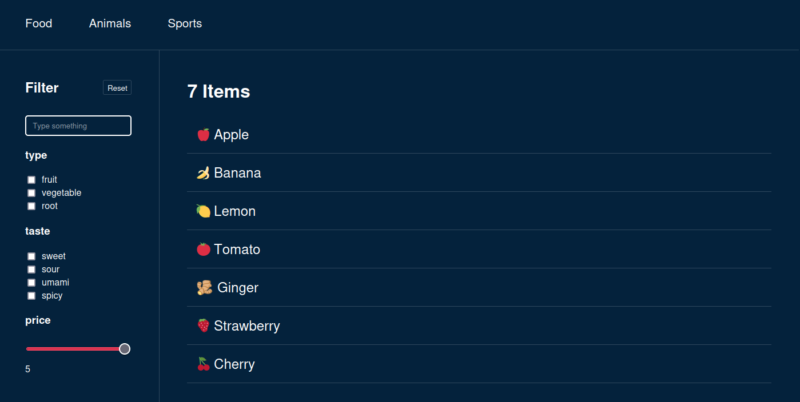
Let’s build a filter-app together!
Example: Final product (end goal)

Slide 6
Why React?
An industry standard
Well documented, matured library
Many 3rd party packages & tools
Reusable components
State management

Slide 7

Quick setup with Vite
1.
2.
3.
npm create vite@latest
Need to install the following packages:
create-vite@4.4.1
Ok to proceed? (y) y
✔ Project name: … vite-project
? Select a framework: › - Use arrow-keys. Return to submit.
Vanilla
Vue
❯ React
Preact
Lit
Svelte
Solid
Qwik
Others
npm install
npm run dev
? Select a variant: › - Use arrow-keys. Return to submit.
TypeScript
❯ TypeScript + SWC
JavaScript
JavaScript + SWC

Slide 8
Where to start?
Start with a single component
Make it return basic & static HTML
Future steps:
  Make it dynamic (components & properties)
  Make it interactive (state & event-handlers)

Slide 9
HTML structure within .jsx
Conditionals
Iterations
Fragments

Slide 10
Conditionals
<div>
{isLoading && <p>Loading...</p>}
</div>
<div>
{isLoading ? <p>Loading...</p> : <Filter />}
</div>
JavaScript expressions can be put inside JSX by placing it between {}
There are many strategies for conditional JSX

Slide 11
Iterations
{options.map((option) => (
<li key={option.id}>
{option.id}
</li>
))}
Arrays can be iterated over and each return more JSX

Slide 12
Fragments
<>
<h1>Hello</h1>
<p>World</p>
</>
<Fragment>
<h1>Hello</h1>
<p>World</p>
</Fragment>
<div>
<h1>Hello</h1>
<p>World</p>
</div>
✅
✅
❌
React requires single top-level elements
Fragments group items without affecting the DOM (<div> could affect CSS & JS selectors)

Slide 13
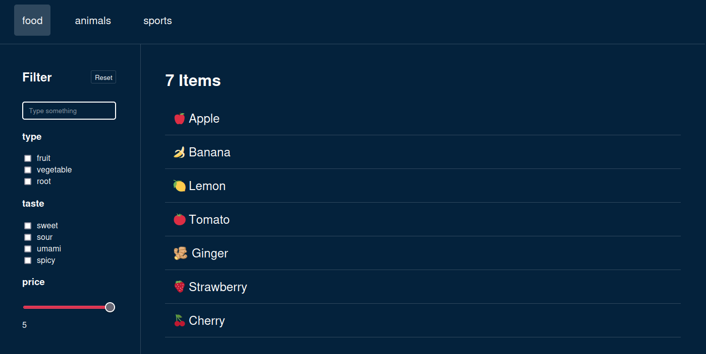
Example: Building static HTML

Slide 14
Split code into components
Reusable
Configurable
Testable
Readable

Slide 15
Tabs
Filter
FilterSettings
FilterResults
Textsearch
Checkboxgroup
Checkboxgroup
RangeSlider
Example: Splitting into components

Slide 16
Dynamic components
Example: Splitting into components
Checkboxgroup
Checkboxgroup

Slide 17
Component properties
Make components re-usable
Hands over state to parent components

Slide 18
Component properties
<Checkboxgroup
label="taste"
options={["sweet", "sour", "umami"]}
/>
export function Checkboxgroup({ label, options }) {
return (
<>
<h3>{label}</h3>
<ul>
{options.map((option) => (
<li key={option}>
<label>
<input
name={`${label}_checkboxgroup`}
type="checkbox"
value={option}
/>
{option}
</label>
</li>
))}
</ul>
</>
);
}
<Checkboxgroup
label="type"
options={["fruit", "vegetables"]}
/>
Example: Component configuration
components/FilterSettings.tsx
Example: Component configuration
components/Checkboxgroup.tsx

Slide 19
Recap
Built static HTML with .jsx
  Used iteration and conditionals for HTML generation
Separated it into reusable React components
Made components dynamic with properties
Visually our app looks complete, but of course it is missing…

Slide 20
👉 Interactivity one of React’s strengths

Slide 21
User input 🖱⌨️📱🕹
For now let’s focus on events which get triggered by direct user-input
Examples: click, focus, input, scroll,..

Slide 22
Event-handling
document.querySelector('#search').addEventListener('change', (e) => {
updateFilterResults(e.target.value);
});
❌
The JS addEventListener doesn’t work well:
React’s virtual DOM frequently recreates nodes
Every render creates additional event-handlers
(need to be cleaned up)

Slide 23
React event-handling
<input
type="search"
value={value}
onChange={(event) => {/* do something */}}
/>
<button onClick={(event) => /* do something */}>
Reset
</button>
Example: Final Product
components/FilterReset.tsx
Example: Final Product
components/TextSearch.tsx
Attach events directly inside .jsx
Event-handlers change state, which is defined outside of .jsx

Slide 24
📃 Interactivity checklist
◻️Create a variable to hold state
◻️Use the state in our component (JSX & JS)
◻️Update state on user-input (event)
◻️Re-render the app after state updates

Slide 25
🎛 State management one more of React’s strengths

Slide 26
🪝useState()
const [activeTab, setActiveTab] = useState(0);
const [search, setSearch] = useState("");
<input type="search"
value={search}
onChange={e => setSearch(e.target.value)}
/>
Returns a state variable and a setter function
State is saved between renders
React will re-render when state changes

Slide 27
📃 Interactivity checklist
✅ Create a variable to hold state
✅ Use the state in our component (JSX & JS)
✅ Update state on user-input (event)
✅ Re-render the app after state updates
const [search, setSearch] = useState("");
<input type="search" value={search} onChange={e => setSearch(e.target.value)} />
<input type="search" value={search} onChange={e => setSearch(e.target.value)} />
// React re-renders automatically after state mutates!

Slide 28
Interactive <Tabs>
Example: Interactive <Tabs>
Tabs

Slide 29
Interactive <Tabs>
import { useState } from "react";
import { Tabs } from "./components/Tabs";
const options = ["food", "animals", "sports"];
export function ExampleInteractiveTabs() {
const [activeFilter, setActiveFilter] = useState(options[0]);
return (
<>
<Tabs
options={options}
active={activeFilter}
onUpdate={setActiveFilter}
/>
<pre>Checked tab: {activeFilter}</pre>
</>
);
}
export function Tabs({ options, active, onUpdate }) {
return (
<div className="filter-navigation" role="tablist">
{options.map((option) => (
<button
key={option}
role="tab"
aria-selected={active === option}
className={`filter-navigation__button${
active === option ? " active" : ""
}`}
onClick={() => onUpdate(option)}
>
{option}
</button>
))}
</div>
);
}
Example: Interactive <Tabs>
InteractiveTabs.tsx
Example: Interactive <Tabs>
components/Tabs.tsx

Slide 30
let, const, var
const search = “”
<input type="search"
value={search}
onChange={e => { search = e.target.value }}
/>
❌
Wouldn’t work because:
The variable gets recreated on every render
Updating the variable won’t tell react to re-render

Slide 31
let, const, var
const [search, setSearch] = useState("");
const searchLowerCase = search.toLowerCase();
Not everything needs to be defined with useState()
For example: derived variables
  They won’t need to be changed directly
  Their origin will already cause a re-render on change

Slide 32
Lifting state up
In React data always flows from the top to the bottom
If state needs to be shared between adjacent components, move it to a parent and pass it down with properties
Pass setState to a child so it can change the state of a parent, from where the updated state will flow down afterwards

Slide 33
Interactive <TextSearch>
Example: Interactive <TextSearch>
Textsearch

Slide 34
Interactive <TextSearch>
import { useState } from "react";
import { Tabs } from "./components/Tabs";
export function ExampleTabs() {
const options = ["food", "animals", "sports"];
const [activeFilter, setActiveFilter] = useState(options[0]);
return (
<>
<Tabs
options={options}
active={activeFilter}
onUpdate={setActiveFilter}
/>
<pre>Checked tab: {activeFilter}</pre>
</>
);
}
export function Tabs({ options, active, onUpdate }) {
return (
<div className="filter-navigation" role="tablist">
{options.map((option) => (
<button
key={option}
role="tab"
aria-selected={active === option}
className={`filter-navigation__button${
active === option ? " active" : ""
}`}
onClick={() => onUpdate(option)}
>
{option}
</button>
))}
</div>
);
}
Work in progress

Slide 35
Interactive <Checkboxgroup>
Example: Interactive <Checkboxgroup>
Checkboxgroup
Checkboxgroup

Slide 36
Interactive <Checkboxgroup>
import { useState } from "react";
import { Tabs } from "./components/Tabs";
export function ExampleTabs() {
const options = ["food", "animals", "sports"];
const [activeFilter, setActiveFilter] = useState(options[0]);
return (
<>
<Tabs
options={options}
active={activeFilter}
onUpdate={setActiveFilter}
/>
<pre>Checked tab: {activeFilter}</pre>
</>
);
}
export function Tabs({ options, active, onUpdate }) {
return (
<div className="filter-navigation" role="tablist">
{options.map((option) => (
<button
key={option}
role="tab"
aria-selected={active === option}
className={`filter-navigation__button${
active === option ? " active" : ""
}`}
onClick={() => onUpdate(option)}
>
{option}
</button>
))}
</div>
);
}
Work in progress

Slide 37
Recap
Work in progress

Slide 38
QUIZ
useState

Slide 39
🪝Hooks
useState
useRef
useSyncExternalStore
useCallback
useTransition
useEffect
useInsertionEffect
useContext
useReducer
useImperativeHandle
useLayoutEffect
useDeferredValue
use
useId
useDebugValue
useMemo

Slide 40
🪝Hooks
Hook are functions that let you “hook” into React’s state
They need to run:
  inside a functional component
  in the same order every render
  unconditionally

Slide 41
Pure Functions
Work in progress
Always produce same output with same input
Have no side-effects
Can itself have impure functions within it’s own boundaries

Slide 42
Functional Components
Work in progress
React can easily abort incomplete renders
Results can be cached
Components can be rendered on the server

Slide 43
Mutating state
Work in progress
Where to mutate state?
Inside event handlers
Inside useEffect()

Slide 44
Detecting state changes
Work in progress
We want to fetch our data when the app initializes and when the category is changed
This should happen without user-input

Slide 45
🪝useEffect()
Work in progress
Run after the component has rendered
Has a dependency array that needs to match the effects dependencies
If dependencies are empty it only runs once
The returned function runs when component unmounts

Slide 46
🪝useEffect()
Work in progress
Its purpose is to synchronize with external systems
Examples:
  Send analytics events
  Synchronize with native APIs like window resize
  Synchronize with an external API like a chatrooms

Slide 47
🪝useEffect()
Work in progress
Can easily be misused and introduce unnecessary complexity and performance costs.

Slide 48
How to avoid prop drilling?
<div className="filter">
<FilterSettings
filters={filters}
updateCategory={updateCategory}
updateRange={updateRange}
updateSearch={updateSearch}
reset={reset}
/>
<FilterResults
items={filterResults}
search={filters.search.value}
reset={reset}
/>
</div>
<div className="filter__settings">
<FilterSettingsToolbar reset={reset} />
<TextSearch
value={filters.search.value}
onUpdate={(e) => updateSearch(e.target.value)}
/>
...
</div>
Example: Final Product
FilterSettings.tsx
Example: Final Product
Filter.tsx

Slide 49
🪝useContext()
export const FilterContext = createContext(null);
import { FilterContext } from './Filter.tsx'
<FilterContext.Provider items={items} >
<FilterSettings />
<FilterResults />
</FilterContext.Provider>
items = useContext(FilterContext)
Example: Final Product
components/FilterSettings.tsx
& components/FilterResults.tsx
Example: Final Product
components/Filter.tsx
Provides a shared state to all child components which subscribe with the useContext hook

Slide 50
🪝useContext()
Work in progress
Components which don’t subscribe don’t have to know the data even exists
Can lead to unintended re-renders

Slide 51
Will it re-render?

Slide 52
🪝useRef()
Work in progress
Changing ref.current doesn’t cause a rerender!

Slide 53
Component updates
Work in progress
React tries to only update parts of DOM which need to be updated
React has it’s own virtual DOM
Sometimes we want to explicitly update components

Slide 54
key attribute
Work in progress
Whenever the key attribute changes, React will treat it like a different element and cause a rerender.

Slide 55
How to handle complex state
Work in progress
There are multiple states all describing the state of the filter settings.
=> It would be good to unify them

Slide 56
🪝useReducer()
Work in progress
UseReducer()
Similar to useState() but it can have multiple functions to update the state it holds

Slide 57
JS mutations
 | copy | mutating
add | .concat(), [...arr] | .push(), .unshift()
remove | .filter(), slice() | .pop(), .shift(), .splice()
replace | .map() | .splice(), arr[i] =
sort | [...arr] => arr.sort() | .reverse(), .sort()
Source: https://react.dev/learn/updating-arrays-in-state

Slide 58
Copying deeply nested state
Copying nested state can become very tedious and hard to read:
case "SET_RANGE":
return {
...state,
ranges: {
...state.ranges,
[action.payload.id]: {
...state.ranges[action.payload.id],
value: action.payload.value,
},
},
};
useFilter.tsx

Slide 59
Immer (Framework)
Immer allows state to be mutated directly
  Replace useState() with useImmer()
  Replace useReducer() with immerReducer()
case "SET_RANGE":
return {
...state,
ranges: {
...state.ranges,
[action.payload.id]: {
...state.ranges[action.payload.id],
value: action.payload.value,
},
},
};
case "SET_RANGE":
state.ranges[action.payload.id].value = action.payload.value;
break;

Slide 60
🪝Custom hooks
Work in progress
Need to start with use
Only are considered hooks if they wrap around React hooks, otherwise they’re just functions
Are essentially just wrappers like functions

Slide 61
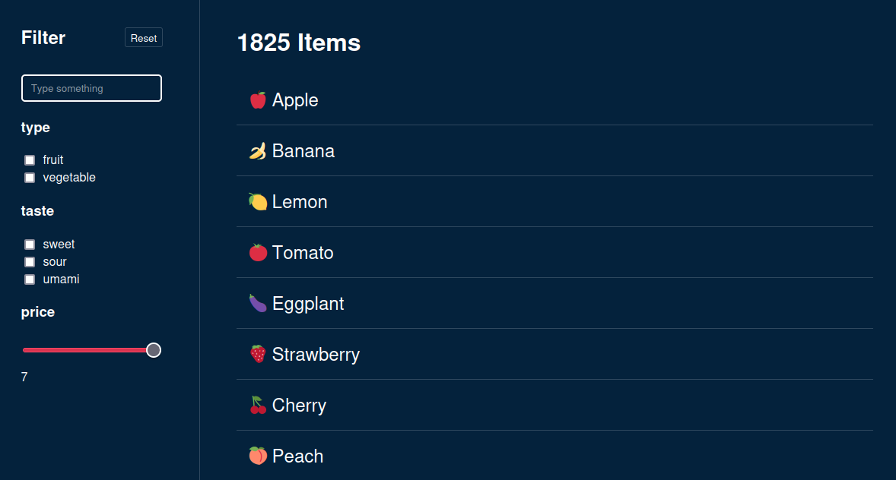
⚠️ Performance issues
If we had complex filters with thousands of items, slower devices might run into performance issues

Slide 62
Performance optimizations
Work in progress
React has hooks to optimize performance e.g.:
useMemo()
useCallback()
useTransition()
useDeferredValue()

Slide 63
🪝useMemo()
Work in progress
const filterResults = useMemo(() => {
// costly filter operation
return filtereditems;
}, [filters, items]);
Cache the result of a heavy computation
Not needed for simple calculations
Only updates when dependency array changes

Slide 64
🪝useCallback()
Work in progress
Like useMemo() but it returns a function instead of a value
Referential equality

Slide 65

Typescript
Work in progress

Slide 66
State Management
Work in progress
SWR
React Query
Redux & Redux Toolkit
Zustand
Jotai

Slide 67
Routing
Work in progress
React-Router
NextJS

Slide 68
Next steps & Ideas
Work in progress
Add routing (detail views)
Save the filter-state inside url query params for deep linking capabilities
Extract Filter types into separate modules and make it extendible

Slide 69
Recommendations
Work in progress
Official React.dev - Learn & Documentation
https://react.dev/learn
Jack Herrington - Typescript & React
https://www.youtube.com/watch?v=j8AVXNozac8
Web Dev Simplified – React Hooks Explained
https://www.youtube.com/watch?v=O6P86uwfdR0

Slide 70
Thank you!

