Slide 1
An introduction to React

Slide 2
What to expect
A 6-8 hour interactive workshop
Learning about React while building something with it
Using modern React (functional components)
Code examples and try-it-yourself challenges
Feel free to ask questions

Slide 3
What not to expect
Full coverage of every React feature (time)
Server-side or react-native code (mobile)
In-depth look at frameworks and libraries

Slide 4
Questions?

Slide 5
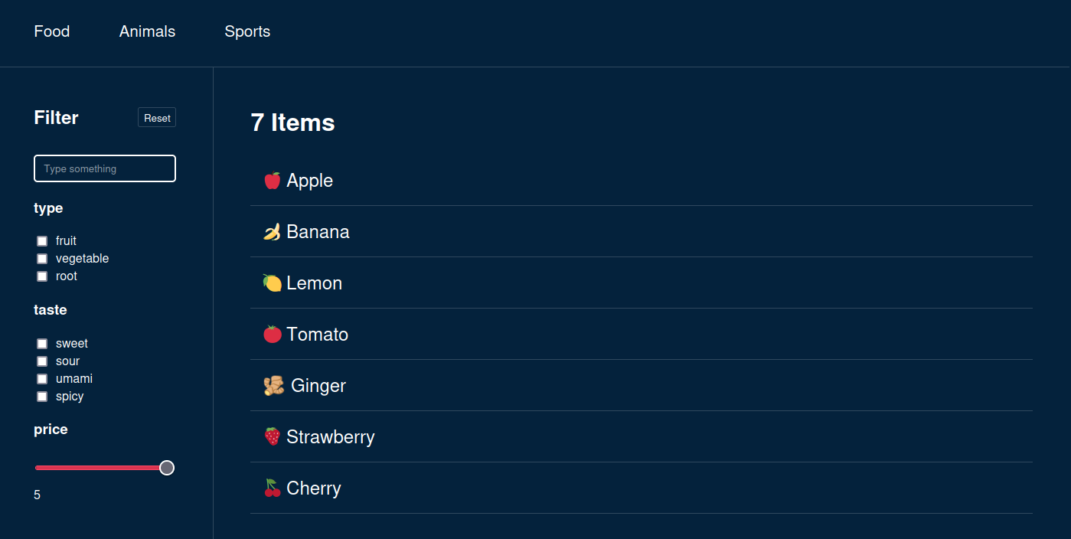
Let’s build a filter-app together!
Example: Final product (end goal)

Slide 6
Why React?
An industry standard
Well documented, matured library
Many 3rd party packages & tools
Reusable components
State management

Slide 7

Quick setup with Vite
1.
2.
3.
npm create vite@latest
Need to install the following packages:
create-vite@4.4.1
Ok to proceed? (y) y
✔ Project name: … vite-project
? Select a framework: › - Use arrow-keys. Return to submit.
Vanilla
Vue
❯ React
Preact
Lit
Svelte
Solid
Qwik
Others
npm install
npm run dev
? Select a variant: › - Use arrow-keys. Return to submit.
TypeScript
❯ TypeScript + SWC
JavaScript
JavaScript + SWC

Slide 8
Where to start?
Start with a single component
Make it return basic & static HTML

Slide 9
HTML structure within .jsx
Conditionals
Iterations
Fragments

Slide 10
Conditionals
<div>
{isLoading && <p>Loading...</p>}
</div>
<div>
{isLoading ? <p>Loading...</p> : <Filter />}
</div>
JavaScript expressions can be put inside JSX by placing it between {}
There are many strategies for conditional JSX

Slide 11
Iterations
{options.map((option) => (
<li key={option.id}>
{option.id}
</li>
))}
Arrays can be iterated over and each return more JSX

Slide 12
Fragments
<>
<h1>Hello</h1>
<p>World</p>
</>
<Fragment>
<h1>Hello</h1>
<p>World</p>
</Fragment>
<div>
<h1>Hello</h1>
<p>World</p>
</div>
✅
✅
❌
React requires single top-level elements
Fragments group items without affecting the DOM (<div> could affect CSS & JS selectors)

Slide 13
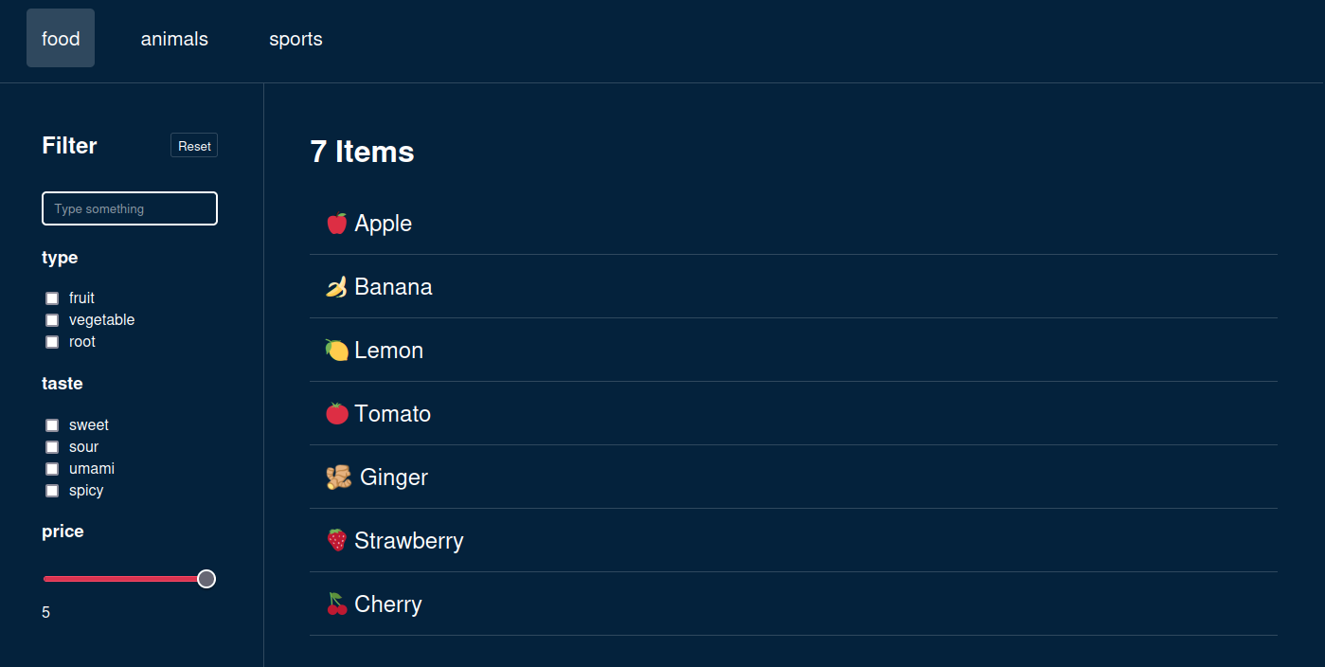

Slide 14
Split code into components
Reusable
Configurable
Testable
Readable

Slide 15
Tabs
Filter
FilterSettings
FilterResults
Textsearch
Checkboxgroup
Checkboxgroup
RangeSlider
Chapter: Building the static HTML

Slide 16
Textsearch
Chapter: Building the TextSearch element

Slide 17
Tabs
Chapter: Building the Tabs element

Slide 18
Checkboxgroup
Checkboxgroup
Chapter: Building the CheckboxGroup element

Slide 19
Component properties
Ideally this component can be used anywhere
We can build new base-level components like
datepickers, or a simple input[type=”password”] and reuse them throughout our app

Slide 20
👉Interactivity
Before we can build our reusable components, we need to know how to make them interactive.

Slide 21
👉Interactivity
document.querySelector('#search').addEventListener('change', (e) => {
updateFilterResults(e.target.value);
});
❌
This is problematic because:
React’s virtual DOM frequently recreates nodes
Every render would create additional event-handlers

Slide 22
📃 Interactivity checklist:
◻️Create a variable
◻️Use the variable in our component (JSX & JS)
◻️Update the variable on user-input
◻️Re-render the app after a variable updates

Slide 23
🪝useState()
const [activeTab, setActiveTab] = useState(0);
const [search, setSearch] = useState("");
<input type="search"
value={search}
onChange={e => setSearch(e.target.value)}
/>
Allows to save state between renders
Tells React to re-render when state changes

Slide 24
Interactivity checklist
✅Create a variable
✅Use the variable in our component (JSX & JS)
✅Update the variable on user-input
✅Re-render the app after a variable updates
const [search, setSearch] = useState("");
<input type="search" value={search} onChange={e => setSearch(e.target.value)} />
<input type="search" value={search} onChange={e => setSearch(e.target.value)} />
// React re-renders automatically after state mutates!

Slide 25
Let’s use our new tools
Textsearch

Slide 26
let, const, var
const search = “”
<input type="search"
value={search}
onChange={e => { search = e.target.value }}
/>
❌
Wouldn’t work because:
The variable gets recreated on every render
Updating the variable won’t tell react to re-render

Slide 27
let, const, var
const [search, setSearch] = useState("");
const searchLowerCase = search.toLowerCase();
Not everything needs to be defined with useState()
For example: derived variables
  They won’t need to be changed directly
  Their origin will already cause a re-render on change

Slide 28
Lifting state up
In React data always flows from the top to the bottom
If state needs to be shared between adjacent components, move it to a parent and pass it down with properties
Pass setState to a child so it can change the state of a parent, from where the updated state will flow down afterwards

Slide 29
QUIZ
useState

Slide 30
🪝Hooks
useState
useRef
useSyncExternalStore
useCallback
useTransition
useEffect
useInsertionEffect
useContext
useReducer
useImperativeHandle
useLayoutEffect
useDeferredValue
use
useId
useDebugValue
useMemo

Slide 31
🪝Hooks
Hook are functions that let you “hook” into React’s state
They need to run
  inside a functional component
  in the same order every render
  unconditionally

Slide 32
Pure Functions inside React
Always produce same output with same input
Have no side-effects

Slide 33
Functional Components
React can easily abort incomplete renders
Results can be cached more easily
Components can be rendered on the server

Slide 34
Mutating state
Inside event handlers
Inside useEffect()

Slide 35
Detecting state changes
We want to fetch our data when the app initializes and when the category is changed

Slide 36
🪝useEffect()
Run after the component has rendered
Has a dependency array that needs to match the effects dependencies
If dependencies are empty it only runs once
The returned function runs when component unmounts

Slide 37
🪝useEffect()
Its purpose is to synchronize with external systems
Send analytics events
Connect to a native (video) or external API (image gallery)

Slide 38
🪝useEffect()
Can easily be misused and introduce unnecessary complexity and performance costs.

Slide 39
How to avoid prop drilling?
Filter.tsx
FilterSettings.tsx
<div className="filter">
<FilterSettings
filters={filters}
updateCategory={updateCategory}
updateRange={updateRange}
updateSearch={updateSearch}
reset={reset}
/>
<FilterResults
items={filterResults}
search={filters.search.value}
reset={reset}
/>
</div>
<div className="filter__settings">
<FilterSettingsToolbar reset={reset} />
<TextSearch
value={filters.search.value}
onUpdate={(e) => updateSearch(e.target.value)}
/>
...
</div>

Slide 40
🪝useContext()
Provides a shared state to all children who subscribe with the useContext hook
Other components in between don’t have to know the data exists
Can lead to unintended re-renders

Slide 41
🪝useContext()
FilterSettings.tsx & FilterResults.tsx
Filter.tsx
export const FilterContext = createContext(null);
import { FilterContext } from './Filter.tsx'
<FilterContext.Provider items={items} >
<FilterSettings />
<FilterResults />
</FilterContext.Provider>
items = useContext(FilterContext)

Slide 42
🪝useContext()
<div className="filter">
<FilterSettings
filters={filters}
updateCategory={updateCategory}
updateRange={updateRange}
updateSearch={updateSearch}
reset={reset}
/>
<FilterResults
items={filterResults}
search={filters.search.value}
reset={reset}
/>
</div>
<div className="filter">
<FilterContextProvider items={items}>
<FilterSettings />
<FilterResults />
</FilterContextProvider>
</div>
Filter.tsx:8

Slide 43
Will it re-render?

Slide 44
🪝useRef()
Changing ref.current doesn’t cause a rerender!

Slide 45
Bug report
We’re updating the items, but the Filter still shows the old data.

Slide 46
key attribute
Whenever the key attribute changes, React will treat it like a different element and cause a rerender.

Slide 47
How to handle complex state
The filtersettings are increasing in complexity and we want a better way than useState to handle it in a unified way.

Slide 48
🪝useReducer()
UseReducer() is similar to useState() but it can provide multiple functions to update the state it holds

Slide 49
JS mutations
 | copy | mutating
add | .concat(), [...arr] | .push(), .unshift()
remove | .filter(), slice() | .pop(), .shift(), .splice()
replace | .map() | .splice(), arr[i] =
sort | [...arr] => arr.sort() | .reverse(), .sort()
Source: https://react.dev/learn/updating-arrays-in-state

Slide 50
Copying deeply nested state
Copying nested state can become very tedious and hard to read:
case "SET_RANGE":
return {
...state,
ranges: {
...state.ranges,
[action.payload.id]: {
...state.ranges[action.payload.id],
value: action.payload.value,
},
},
};
useFilter.tsx:41

Slide 51
Immer (Framework)
Immer allows state to be mutated directly
  Replace useState() with useImmer()
  Replace useReducer() with immerReducer()
case "SET_RANGE":
return {
...state,
ranges: {
...state.ranges,
[action.payload.id]: {
...state.ranges[action.payload.id],
value: action.payload.value,
},
},
};
case "SET_RANGE":
state.ranges[action.payload.id].value = action.payload.value;
break;

Slide 52
🪝Custom hooks
Need to start with use
Only are considered hooks if they wrap around React hooks, otherwise they’re just functions
Are essentially just wrappers like functions

Slide 53
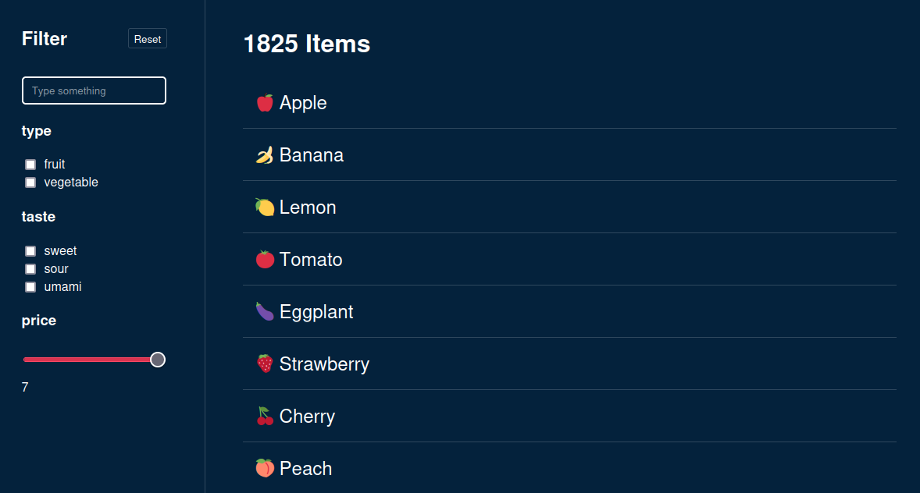
⚠️ Performance issues
If we had complex filters with thousands of items, slower devices might run into performance issues

Slide 54
🪝useMemo()
const filterResults = useMemo(() => {
// costly filter operation
return filtereditems;
}, [filters, items]);
useFilterContext.tsx:30
Cache the result of a heavy computation
Not needed for simple calculations
Only updates when dependency array changes

Slide 55
🪝useCallback()
Like useMemo() but it returns a function instead of a value
Referential equality

Slide 56

Typescript

Slide 57
State Management
SWR
React Query
Redux & Redux Toolkit
Zustand
Jotai

Slide 58
Routing
React-Router
NextJS

Slide 59
Next steps & Ideas
Add routing for detailviews
Save the filter-state in url for deep linking
Extract Filter types into separate modules

Slide 60
Recommendations
Official React.dev - Learn & Documentation
https://react.dev/learn
Jack Herrington - Typescript & React
https://www.youtube.com/watch?v=j8AVXNozac8
Web Dev Simplified – React Hooks Explained
https://www.youtube.com/watch?v=O6P86uwfdR0

Slide 61
Thank you!

