Slide 1
Session State

Slide 2
Session State

Slide 3
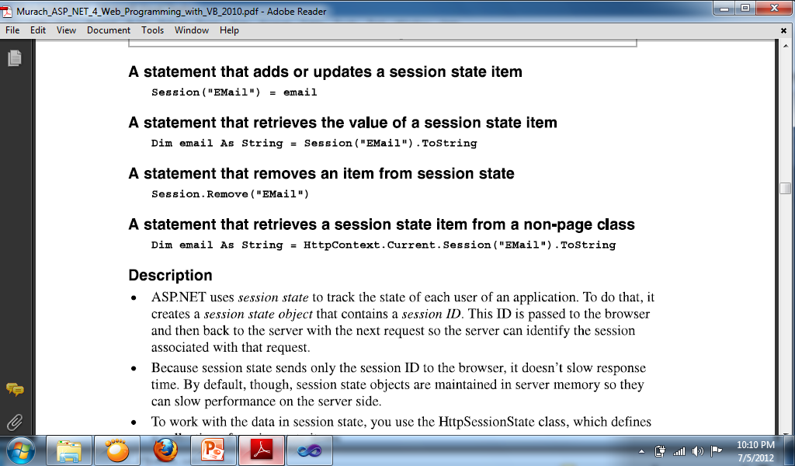
How to use Session State
ASP.NET uses session state to track the state of each user of an application. To do that, it creates a session state object that contains a session ID. This ID is passed to the browser and then back to the server with the next request so the server can identify the session associated with that request.
Because session states sends only the session ID to the browser, it doesn’t slow response time. By default, though, session state objects are maintained in server memory so they can slow performance on the server side.

Slide 4
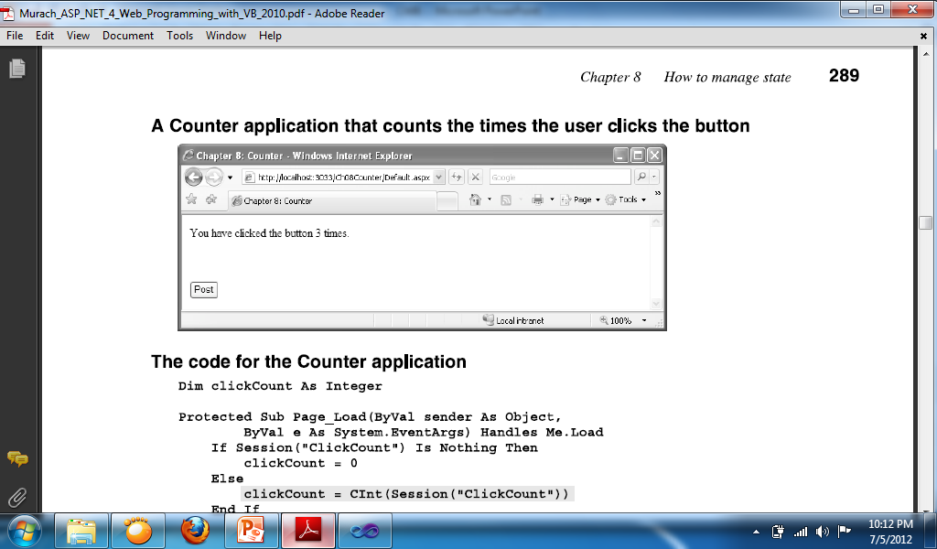
Sample program using the Session state
Dim clickcount As Integer
Button Code:
clickcount += 1
Label1.Text = "You clicked the button " & clickcount & " times."
Session("SaveClickCount") = clickcount
Page_Load Code:
If Session("SaveClickCount") Is Nothing Then
clickcount = 0
Else
clickcount = Session("SaveClickCount").ToString
End If

Slide 5
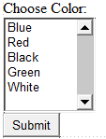
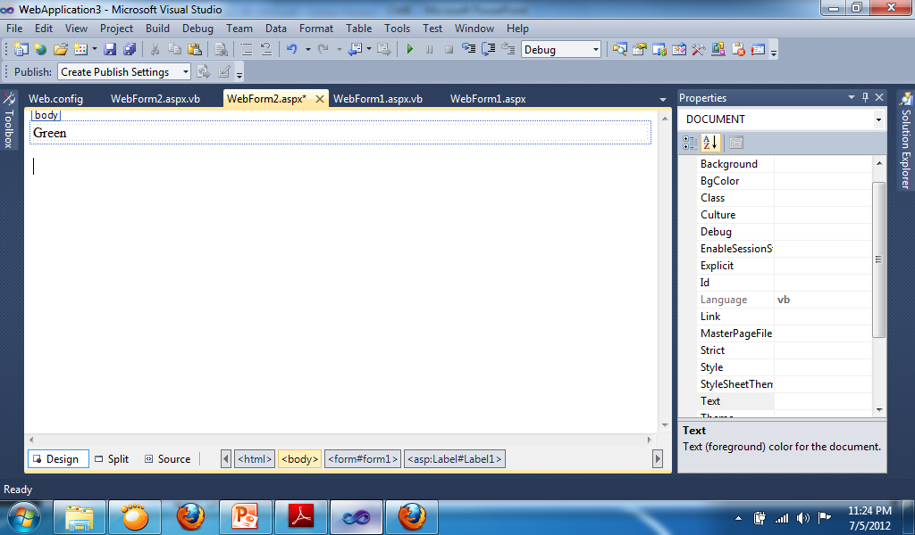
WebForm1 Button Code:
Session("Color") = ListBox1.SelectedValue
Response.Redirect("Webform2.aspx")
WebForm2 Page Load Code:
Label1.Text = Session("Color").ToString

Slide 6
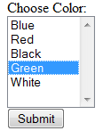
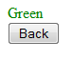
Changing color and text
Webform1 Button Code:
Session("Color") = ListBox1.SelectedValue
Response.Redirect("Webform2.aspx")
Webform2 Page Load Code:
Label1.Style.Add("color", Session("color").ToString)
Label1.Text = Session("color").ToString
Webform2 Button Code:
Response.Redirect("Webform1.aspx")

Slide 7
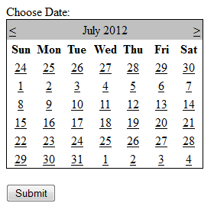
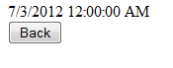
Selecting dates
Webform1 Button Code:
Session("DateSelect") = Calendar1.SelectedDate.Date
Response.Redirect("Webform2.aspx")
Webform2 Page Load Code:
Label1.Text = Session("DateSelect").ToString
Webform2 Button Code:
Response.Redirect("Webform1.aspx")

Slide 8
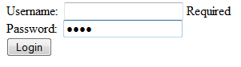
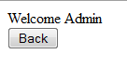
Sample for transferring username to other webform
Webform1 Button Code:
If IsValid Then
Session("username") = TextBox1.Text
Response.Redirect("Webform2.aspx")
End If
Webform2 Page Load Code:
Label1.Text = "Welcome " + Session("username").ToString
Webform2 Button Code:
Response.Redirect("Webform1.aspx")

