Slide 1
Designing Websites with Master Pages

Slide 2
Master Page
A Master Page enables you to share the same content among multiple content pages in a website. You can use a Master Page to create a common page layout.
You also can use Master Pages to display common content in multiple pages. For example, if you want to display a standard header and footer in each page in your website, you can create the standard header and footer in a Master Page.

Slide 3
Creating Master Pages
You create a Master Page in Visual Web Developer by selecting the Website menu option, Add New Item, and the Master Page item.
You can see two special things about the Master Page. First, the file contains a <%@ Master %> directive instead of the normal <%@ Page %> directive. Second, the Master Page includes two ContentPlaceHolder controls.
When the Master Page merges with a particular content page, the content from the content page appears in the areas marked by ContentPlaceHolder controls. You can add as many ContentPlaceHolders to a Master Page as you need.

Slide 4
Create Content Pages
In Visual Web Developer, you create an ASP.NET page associated with a particular Master Page by selecting Website, Add New Item, and Web Form. Next, check the check box labeled Select Master Page. When you click Add, a dialog box appears that enables you to select a Master Page.

Slide 5
Content Page
The content page does not contain any of the standard opening and closing XHTML tags.
All these tags are contained in the Master Page. All the content contained in the content page must be added with Content controls.
You must place all the content contained in a content page within the Content controls. If you attempt to place any content outside these controls, you get an exception.
The Content control includes a ContentPlaceHolderID property. This property points to the ID of a ContentPlaceHolder control contained in the Master Page.
Within a Content control, you can place anything that you would normally add to an ASP.NET page, including XHTML tags and ASP.NET controls.

Slide 6
Modifying Master Page Content
Master Pages enable you to display the same content in multiple content pages. You quickly discover that you need to override the content displayed by a Master Page in the case of particular content pages.
For example, normally the Master Page contains the opening and closing HTML tags, including the <title> tag. This means that every content page displays the same title. Normally, you want each page to display a unique title.

Slide 7
Using the Title Attribute
If you need to modify only the title displayed in each content page, you can take advantage of the <%@ Page %> directive’s Title attribute. This attribute accepts any string value.
<%@ Page Title="Content Title" Language="C#" MasterPageFile="~/MasterPage.master" AutoEventWireup="true" CodeFile="Default.aspx.cs" Inherits="_Default" %>
There is one requirement for the Title attribute to work. The HTML <head> tag in the Master Page must be a server-side Head tag. In other words, the <head> tag must include the runat=”server” attribute. When you create a new Web Form or Master Page in Visual Web Developer, a server-side <head> tag is automatically created.

Slide 8
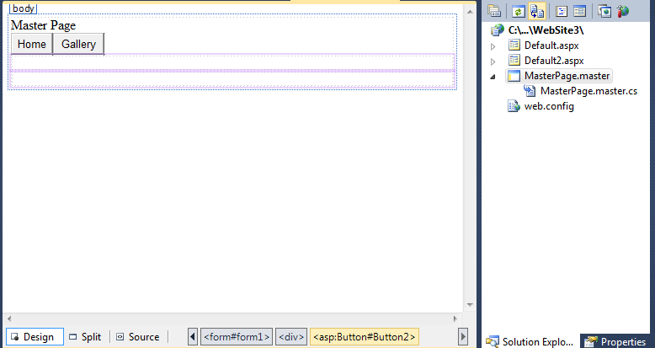
Sample Master Page

Slide 9
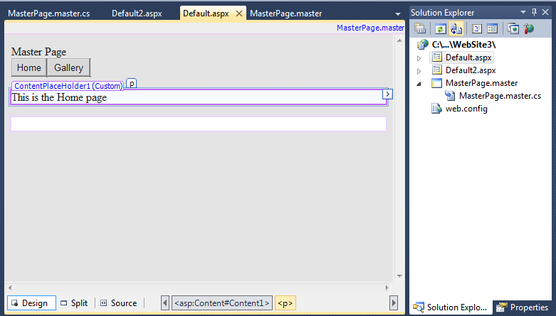
Default.aspx (Home)

Slide 10
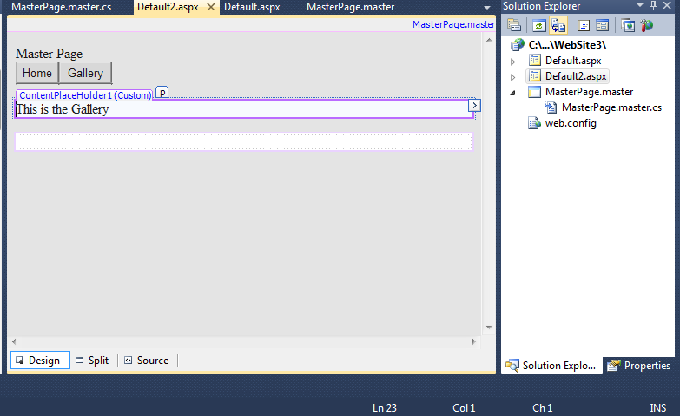
Default2.aspx (Gallery)

Slide 11
Codes for the buttons on Master Page
Codes for Home Button:
ContentPlaceHolder1.Page.Response.Redirect("Default.aspx")
Codes for Gallery Button:
ContentPlaceHolder1.Page.Response.Redirect("Default2.aspx")

