Slide 1
Designing Websites with Themes

Slide 2
Themes
An ASP.NET Theme enables you to apply a consistent style . Summary to the pages in your website. You can use a Theme to control the appearance of both the HTML elements and ASP.NET controls that appear in a page.
Themes are different than Master Pages. A Master Page enables you to share content across multiple pages in a website. A Theme, on the other hand, enables you to control the appearance of the content.

Slide 3
Creating Themes
When using Visual Web Developer, you can create a new Theme folder by right-clicking the name of your project in the Solution Explorer window and selecting Add Folder, Theme Folder.
A Theme folder can contain a variety of different types of files, including images and text files. You also can organize the contents of a Theme folder by adding multiple subfolders to a Theme folder.
Following are the most important types of files in a Theme folder:
. Skin Files
. Cascading Style Sheet Files
Be careful about how you name your Theme (the folder name). The contents of a Theme folder are automatically compiled in the background into a new class. Don’t name a Theme with a class name that conflicts with an existing class name in your project.

Slide 4
Adding Skins to Themes
A Theme can contain one or more Skin files. A Skin enables you to modify any of the properties of an ASP.NET control that have an effect on its appearance.
For example, imagine that you decide that you want every TextBox control in your web application to appear with a yellow background color and a dotted border.

Slide 5
You can name a Skin file anything you want. I recommend following a naming convention in which you name the Skin file after the name of the control that the Skin modifies.
A Theme folder can contain a single Skin file that contains Skins for hundreds of controls.
Alternatively, a Theme can contain hundreds of Skin files, each of which contains a single Skin. It doesn’t matter how you organize your Skins into files because everything in a Theme folder eventually gets compiled into one Theme class.
The Skin file in next example contains a declaration of a TextBox control. The TextBox control includes a BackColor property set to the value Yellow and a BorderStyle property set to the value Dotted.
The TextBox control includes a Runat=”Server” attribute, but it does not include an ID attribute. You must always include a Runat attribute, but you can never include the ID attribute when declaring a control in a Skin.

Slide 6
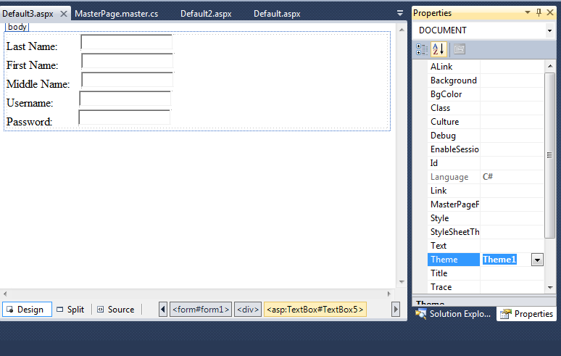
Example using Theme1
Use the theme you made.

Slide 7
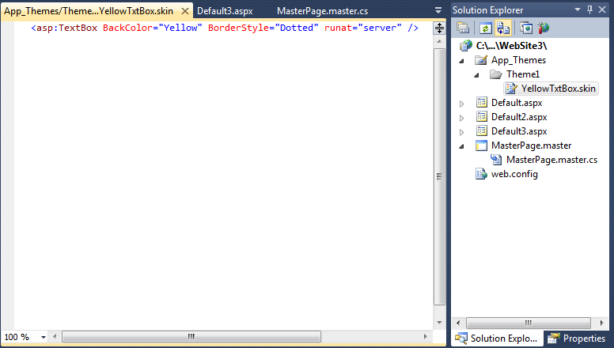
Theme1: YellowTxtBox.skin

Slide 8
Creating Named Skins
In the previous section, we created something called a Default Skin.
A Default Skin is applied to every instance of a control of a certain type.
For example, a Default Skin is applied to every instance of a TextBox control.
You also have the option of creating a Named Skin. When you create a Named Skin, you can decide when you want to apply the Skin.
For example, you might want required fields in a form to appear with a red border. In that case, you can create a Named Skin and apply the Skin to only particular TextBox controls.

Slide 9
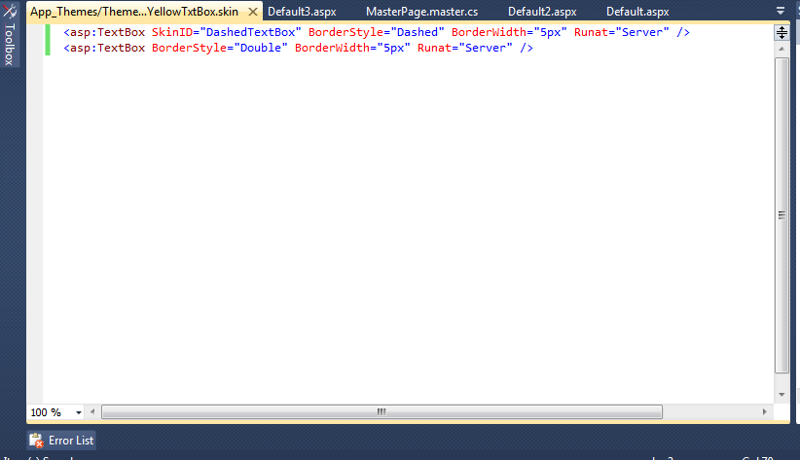
Example Skin2:

Slide 10
The first TextBox is an example of a Named Skin and includes a SkinID property.
The SkinID property represents the name of the Named Skin. You use the value of this property when applying the Skin in a page.
It also includes a Default Skin for a TextBox control. The Default Skin does not include a SkinID property. If a TextBox control in a page is not associated with a Named Skin, the Default Skin is applied to the TextBox.
A Theme can contain only one Default Skin for each type of control. However, a Theme can contain as many Named Skins as you want. Each Named Skin must have a unique name.
The page in the next example contains two TextBox controls. The first TextBox control includes a SkinID attribute. This attribute causes the Named Skin to be applied to the control. The second TextBox, on the other hand, does not include a SkinID property. The Default Skin is applied to the second TextBox control.

Slide 11
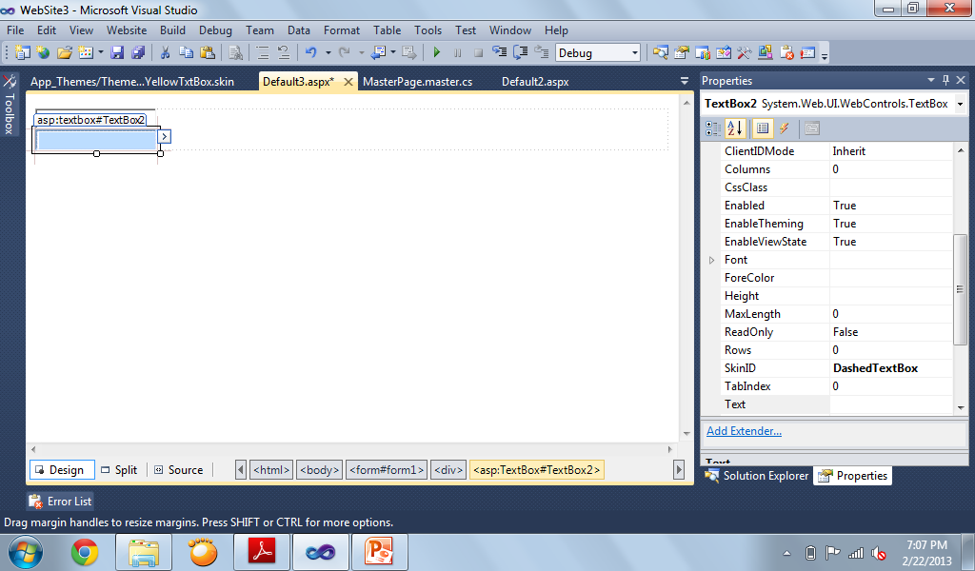
Example Skin2 Page
Select the name of the skin id you want to use

Slide 12
Themes Versus StyleSheetThemes
When you apply a Theme to a page, the Skins in the Theme override any existing properties of the controls in the page. In other words, properties in a Skin override properties in a page.
You can override any existing control properties that have an effect on the appearance of the control.
However, there are situations in which you might want to override Skin properties. For example, you might want to display every Label in your website with an orange background color except for one Label. In that case, it would be nice if there were a way to override the Skin property.
You can override Skin properties by applying a Theme to a page with the StyleSheetTheme attribute instead of the Theme attribute.

Slide 13
Disabling Themes
Every ASP.NET control includes an EnableTheming property. You can use the EnableTheming property to prevent a Skin from being applied to a particular control in a page.
You can disable a theme on a control by changing the EnableTheming property to False.

