Slide 1
ASP.NET AJAX

Slide 2
ASP.NET is a server-side technology for building web applications. Almost all the work happens on the web server and not the web browser. Whenever you perform an action in an ASP.NET page—such as clicking a button or sorting a GridView—the entire page must be posted back to the web server. Any significant action on a page results in a postback.
When you perform a postback in an ASP.NET page, the entire page must be transported across the Internet from browser to server. Next, the .NET class that corresponds to the page must re-render the entire page again from scratch. Finally, the finished page must be sent back across the Internet to the browser. This whole long, slow, agonizing process must occur even if you are updating a tiny section of the page.

Slide 3
AJAX (Asynchronous JavaScript and XML)
This enabled already-rendered web pages to make asynchronous calls and retrieve XML, which could then be used to modify the existing page.
These are the commonly used controls in ASP.Net AJAX:
UpdatePanel Control
Timer Control

Slide 4
Using the UpdatePanel Control
Microsoft’s server-side AJAX framework consists of one main control: UpdatePanel. The UpdatePanel control enables you to update a portion of a page without updating the entire page. In other words, it enables you to perform partial-page rendering.

Slide 5
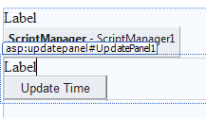
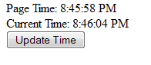
Sample using UpdatePanel control
Page_Load Code:
Label1.Text = "Page Time: " + TimeOfDay
Button Code:
Label2.Text = "Current Time: " + TimeOfDay

Slide 6
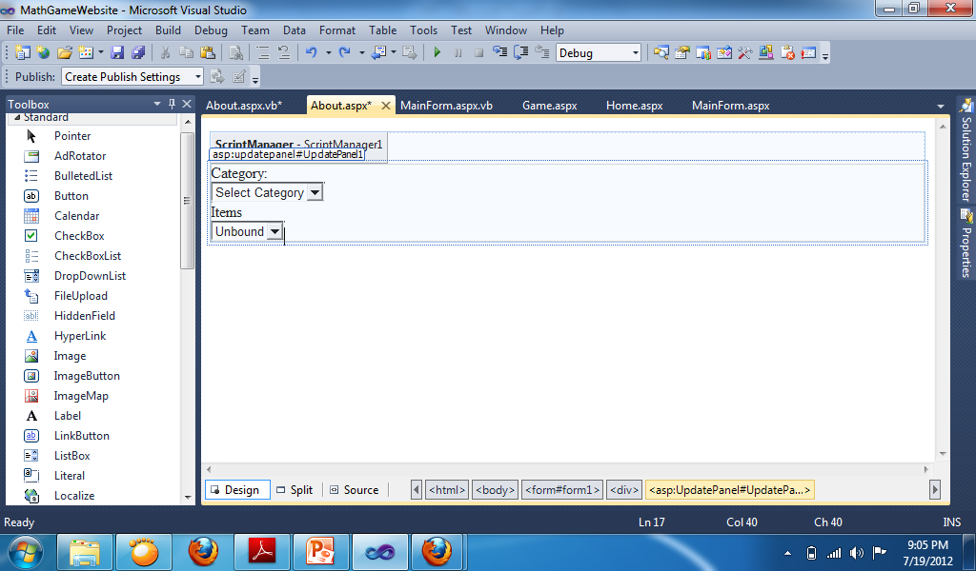
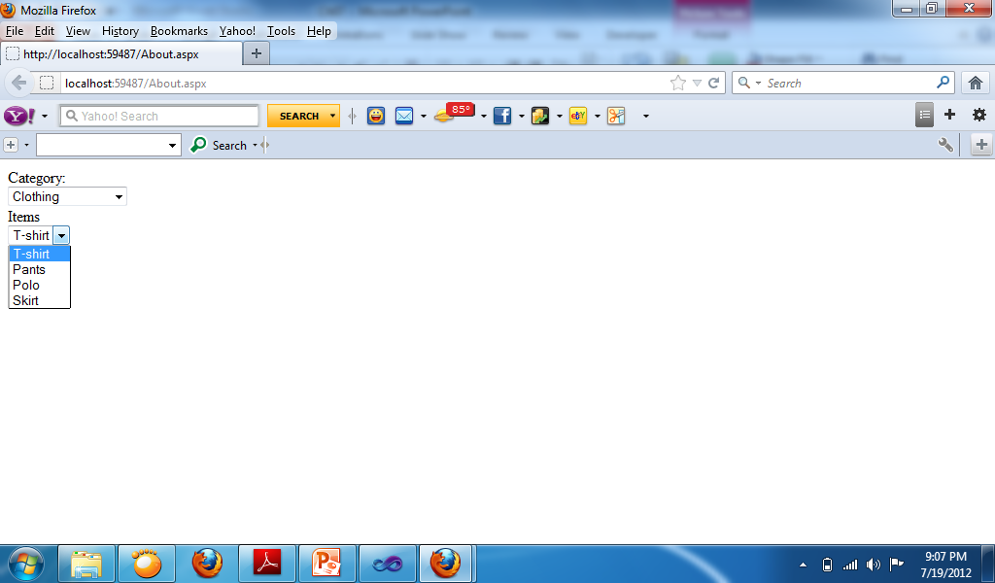

Sample using Panel Control
Change Property of Dropdownlist:
AutoPostBack: True
DropdownList 1 Code:
If DropDownList1.SelectedValue = "Clothing" Then
DropDownList2.Items.Clear()
DropDownList2.Items.Add("T-shirt")
DropDownList2.Items.Add("Pants")
DropDownList2.Items.Add("Polo")
DropDownList2.Items.Add("Skirt")
ElseIf DropDownList1.SelectedValue = "Shoes" Then
DropDownList2.Items.Clear()
DropDownList2.Items.Add("Nike")
DropDownList2.Items.Add("Converse")
DropDownList2.Items.Add("Vans")
Else
DropDownList2.Items.Clear()
End If

Slide 7
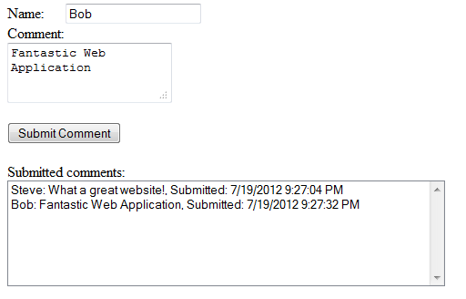
Button Code:
ListBox1.Items.Add(TextBox1.Text + ": " + TextBox2.Text + ", Submitted: " + Now)

Slide 8
AJAX Timer Control
The ASP.NET AJAX Timer control enables you to refresh an UpdatePanel (or the entire page) on a timed basis. The Timer control has one important property:
Interval—The amount of time, in milliseconds, between Tick events. The default value is 60,000 (1 minute).
The Timer control raises a Tick event every so many milliseconds, depending on the value of its Interval property.
If you don’t associate the Timer control with an UpdatePanel, the Timer posts the entire page back to the server performing a normal postback.

Slide 9
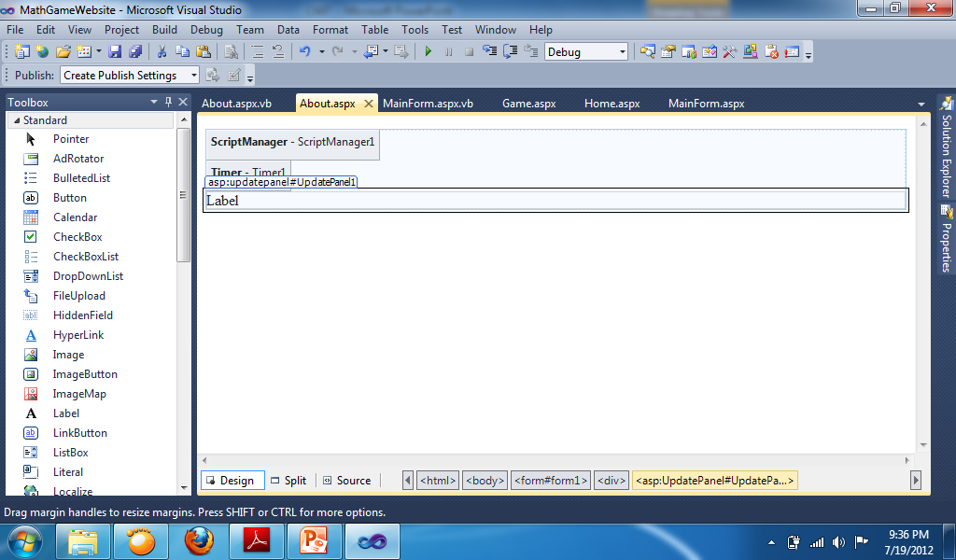
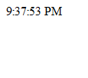
Using Timer Control
Change Property:
Timer:
Interval: 1000
UpdatePanel:
Triggers: AsyncPostBack, ControlID: Timer1, EventName: Tick
Timer Code:
Label1.Text = TimeOfDay

Slide 10
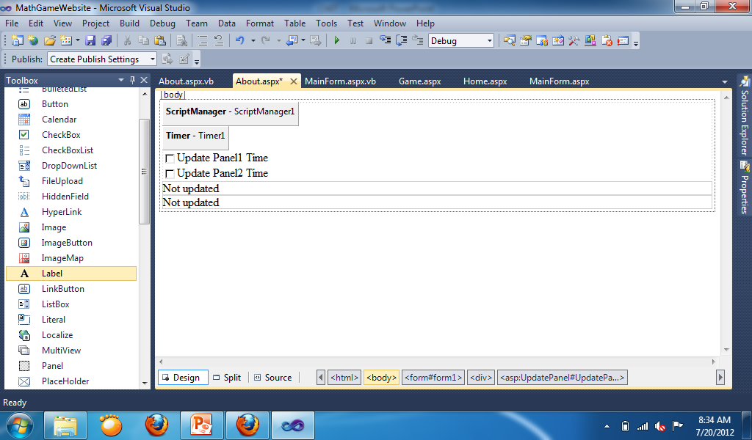
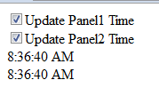
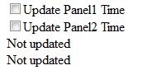
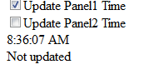
Conditional update in UpdatePanel
Change Property:
Update Panel 1:
Triggers: AsyncPostBack, ControlID: Timer1, EventName: Tick
Update Panel 2:
Triggers: AsyncPostBack, ControlID: Timer1, EventName: Tick
Code Timer1:
If CheckBox1.Checked = True Then
Label1.Text = TimeOfDay
End If
If CheckBox2.Checked = True Then
Label2.Text = TimeOfDay
End If

Slide 11
AJAX Control Toolkit

Slide 12
How to install AJAX Control Toolkit
To install the ASP.NET Ajax Control Toolkit manually into either Visual Studio 2010 or Visual Studio 2008 you will fist need to download the latest version of the toolkit.
Extract the files somewhere on your hard drive remembering the path to where you extracted the files.
Next you will need to add the toolkit to your toolbar within Visual Studio. To do so right click on an empty portion of your toolbar and click on “Add Tab”. This will add a new tab to your toobar. Next name the toolbar something like “ASP.NET AJAX Control Toolkit”.
Next right click on your newly created tab and click on “Choose Items..”. Make sure the “.NET Framework Components” tab is selected then click on “Browse…”. Browse to where you extracted the toolkit files to earlier and open the file named “AjaxControlToolkit.dll” then click “OK”. You should now have available to you the ASP.NET AJAX Control Toolkit controls within your Toolbox.

Slide 13
Accordion
The Accordion is a web control that allows you to provide multiple panes and display them one at a time. It is like having several CollapsiblePanels where only one can be expanded at a time. The Accordion is implemented as a web control that contains AccordionPane web controls. Each AccordionPane control has a template for its Header and its Content. We keep track of the selected pane so it stays visible across postbacks.

Slide 14
It also supports three AutoSize modes so it can fit in a variety of layouts.
None - The Accordion grows/shrinks without restriction. This can cause other elements on your page to move up and down with it.
Limit - The Accordion never grows larger than the value specified by its Height property. This will cause the content to scroll if it is too large to be displayed.
Fill - The Accordion always stays the exact same size as its Height property. This will cause the content to be expanded or shrunk if it isn't the right size.

Slide 15
Properties
SelectedIndex - The AccordionPane to be initially visible
HeaderCssClass - Name of the CSS class to use for the headers. This can be either applied to the Accordion as a default for all AccordionPanes, or an individual AccordionPane.
HeaderSelectedCssClass - Name of the CSS class to use for the selected header. This can be either applied to the Accordion as a default for all AccordionPanes, or an individual AccordionPane.
ContentCssClass - Name of the CSS class to use for the content. This can be either applied to the Accordion as a default for all AccordionPanes, or an individual AccordionPane.
FadeTransitions - True to use the fading transition effect, false for standard transitions.
TransitionDuration - Number of milliseconds to animate the transitions
FramesPerSecond - Number of frames per second used in the transition animations
AutoSize - Restrict the growth of the Accordion. The values of the AutoSize enumeration are described above.
RequireOpenedPane - Prevent closing the currently opened pane when its header is clicked (which ensures one pane is always open). The default value is true.
Panes - Collection of AccordionPane controls

Slide 16
AlwaysVisible
The AlwaysVisibleControl is a simple extender allowing you to pin controls to the page so that they appear to float over the background body content when it is scrolled or resized. It targets any ASP.NET control and always keeps the position a specified distance from the desired horizontal and vertical sides.
To avoid having the control flash and move when the page loads, it is recommended that you absolutely position the control in the desired location in addition to attaching the extender.

Slide 17
AlwaysVisible Properties
TargetControlID - ID of control for this extender to always make visible
HorizontalOffset - Distance to the HorizontalSide edge of the browser in pixels from the same side of the target control. The default is 0 pixels.
HorizontalSide - Horizontal edge of the browser (either Left, Center, or Right) used to anchor the target control. The default is Left.
VerticalOffset - Distance to the VerticalSide edge of the browser in pixels from the same side of the target control. The default is 0 pixels.
VerticalSide - Vertical edge of the browser (either Top, Middle, or Bottom) used to anchor the target control. The default is Top.
ScrollEffectDuration - Length in seconds of the scrolling effect to last when the target control is repositioned. The default is .1 second.

Slide 18
BalloonPopupExtender
The BalloonPopupExtender control displays a popup which can contain any content. For example, you can use the BalloonPopupExtender to display help information when you move focus to a TextBox control.
The BalloonPopupExtender supports three different styles: Balloon, Rectangle, and Custom. You can select among three different sizes for the popup: Small, Medium, and Large. If you set the BalloonPopup style to the value Custom then you can define a custom appearance for the BalloonPopup. In that case, you also need to set the CustomCssUrl property to point to a custom style sheet.
This control can be set to 5 positions - TopLeft, TopRight, BottomLeft, BottomRight and Auto. If you select the value Auto then the position of the BalloonPopup is determined automatically based on available space.
You can set the BalloonPopExtender to be triggered by the MouseOver, Focus or Click events. The control is hidden automatically when you click outside the Balloon Popup.

Slide 19
BalloonPopupExtender Properties
BalloonPopupControlID - The ID of the control to display.
Position - Optional setting specifying where the popup should be positioned relative to the target control. (TopRight, TopLeft, BottomRight, BottomLeft, Auto) Default value is Auto.
OffsetX/OffsetY - The number of pixels to offset the Popup from its default position, as specified by Position. Default value is 0.
BalloonStyle - Optional setting specifying the theme of balloon popup. (Cloud, Rectangle, Custom). Default value is Rectangle.
BalloonSize - Optional setting specifying the size of balloon popup. (Small, Medium and Large). Default value is Small.
CustomCssUrl - This is required if user choose BalloonStyle to Custom. This specifies the url of custom css which will display custom theme.
UseShadow - Optional setting specifying whether to display shadow of balloon popup or not.
ScrollBars - Optional setting specifying whether to display scrollbar if contents are overflowing. This property contains 5 options - None, Horizontal, Vertical, Both and Auto. Default value is Auto.
DisplayOnMouseOver - Optional setting specifying whether to display balloon popup on the client onMouseOver event. Default value is false.
DisplayOnFocus - Optional setting specifying whether to display balloon popup on the client onFocus event. Default value is false.
DisplayOnClick - Optional setting specifying whether to display balloon popup on the client onClick event. Default value is true.

Slide 20
CalendarExtender
Calendar is an ASP.NET AJAX extender that can be attached to any ASP.NET TextBox control. It provides client-side date-picking functionality with customizable date format and UI in a popup control. You can interact with the calendar by clicking on a day to set the date, or the "Today" link to set the current date.
In addition, the left and right arrows can be used to move forward or back a month. By clicking on the title of the calendar you can change the view from Days in the current month, to Months in the current year. Another click will switch to Years in the current Decade. This action allows you to easily jump to dates in the past or the future from within the calendar control.
The page uses the culture setting English (United States) which was specified by the browser. The page properties have Culture="auto" and UICulture="auto" set to enable the same.

Slide 21
CalendarExtender Properties
TargetControlID - The ID of the TextBox to extend with the calendar.
CssClass - Name of the CSS class used to style the calendar. See the Calendar Theming section for more information.
Format - Format string used to display the selected date.
PopupPosition - Indicates where the calendar popup should appear at the BottomLeft(default), BottomRight, TopLeft, TopRight, Left or Right of the TextBox.
SelectedDate - Indicates the date the Calendar extender is initialized with.
StartDate - Indicates start date for range that available for selection.
EndDate - Indicates end date for range that available for selection.

Slide 22
CollapsiblePanel
The CollapsiblePanel is a very flexible extender that allows you to easily add collapsible sections to your web page. This extender targets any ASP.NET Panel control. The page developer specifies which control(s) on the page should be the open/close controller for the panel, or the panel can be set to automatically expand and/or collapse when the mouse cursor moves in or out of it, respectively.
The page developer can specify whether the panel should scroll when it does not expand to the full size of its contents, and can also specify whether the panel expands in the height or width dimensions.

Slide 23
CollapsiblePanel Properties
CollapsedSize - The size of the target, in pixels, when it is in the collapsed state.
ExpandedSize - The size of the target, in pixels, when it is in the opened state.
Collapsed - Specifies that the object should initially be collapsed or expanded. Set this to match your initial size. In this case, we initially set the panel to a height of 0 to match the CollapsedSize property, so when the page first renders, we don't see the panel expanded.
AutoCollapse - True to automatically collapse when the mouse is moved off the panel.
ExpandControlID/CollapseControlID - The controls that will expand or collapse the panel on a click, respectively. If these values are the same, the panel will automatically toggle its state on each click.

Slide 24
ColorPicker
ColorPicker is an ASP.NET AJAX extender that can be attached to any ASP.NET TextBox control. It provides client-side color-picking functionality with UI in a popup control. You can interact with the color picker by clicking on a color to select the color. Optionally, a PopupButton control and a SampleControl can be provided which allows customizing ColorPicker's behavior.
In addition, if a custom color value is entered in a targeted TextBox then the sample control if it's used can demonstrate a custom color even if it's not in a color picker palette.

Slide 25
ColorPicker Properties
PopupButtonID - The ID of a control to show the ColorPicker popup when clicked. If this value is not set, the color picker will pop up when the textbox receives focus.
SampleControlID - The ID of a control to show the ColorPicker's selected color. If this value is set and the color picker popup is open the background color of the sample control will sample the hovered color. If this value is not set, the selected color is not shown.
PopupPosition - Indicates where the color picker popup should appear at the BottomLeft(default), BottomRight, TopLeft, TopRight, Left or Right of the TextBox.
SelectedColor - Indicates the color value the ColorPicker extender is initialized with.

Slide 26
ConfirmButton
ConfirmButton is a simple extender that catches clicks on a button (or any instance of a type derived from Button) and displays a message to the user. If the "OK" button is clicked, the button or link functions normally. If not, the click is trapped and the button will not perform its default submit behavior.

Slide 27
ConfirmButton Properties
ConfirmText - The text to show when you want to confirm the click. ConfirmOnFormSubmit - True if the confirm dialog should wait until just before the form submits to display. This is useful when ASP.NET validators are in use and the confirm should be shown only after all validators pass.

Slide 28
FilteredTextBox
FilteredTextBox is an extender which prevents a user from entering invalid characters into a text box. Note that since this effect can be avoided by deactivating JavaScript, you should use this extender as a convenience for your users, but you must never expect that the data being sent to the server consists of "valid" chars only.

Slide 29
FilteredTextBox Properties
FilterType - A the type of filter to apply, as a comma-separated combination ofNumbers, LowercaseLetters, UppercaseLetters, and Custom. If Custom is specified, the ValidChars field will be used in addition to other settings such as Numbers.
ValidChars - A string consisting of all characters considered valid for the text field, if "Custom" is specified as the filter type. Otherwise this parameter is ignored.
InvalidChars - A string consisting of all characters considered invalid for the text field, if "Custom" is specified as the filter type and "InvalidChars" as the filter mode. Otherwise this parameter is ignored.

Slide 30
HoverMenu
HoverMenu is an ASP.NET AJAX extender that can be attached to any ASP.NET WebControl, and will associate that control with a popup panel do display additional content. When the user moves the mouse cursor over the main control two things happen:
The popup panel is displayed at a position specified by the page developer (at the left, right, top, or bottom of the main control)
Optionally, a CSS style can be applied to the control

Slide 31
HoverMenu Properties
PopupControlID - The ID of the control to display when mouse is over the target control.
PopupPostion - Where the popup should be positioned relative to the target control. Can be Left (Default), Right, Top, Bottom, Center.
OffsetX/OffsetY - The number of pixels to offset the Popup from it's default position, as specified by PopupPosition. So if you want it to popup to the left of the target and have a 5px space between the popup and the target, the value should be "-5".
PopDelay - The time, in milliseconds, for the popup to remain visible after the mouse moves away from the target control. Default is 100.

Slide 32
ListSearchExtender
The ListSearchExtender lets you search for items in a ListBox or DropDownList by typing. The extender performs an incremental search within the ListBox based on what has been typed so far.

Slide 33
ListSearchExtender Properties
PromptText - Message to display when the ListBox or DropDownList is given focus. Default is 'Type to search'. The PromptText is replaced by the search text typed by the user.
PromptPosition - Indicates whether the message should appear at the Top or Bottom of the ListBox. The default is Top.
QueryPattern - Indicates how the typed characters should be used in the search query. The default pattern queries for results that start with the typed word.
IsSorted - Indicates if items added to the List are expected to be sorted. The default is false. If set to true it allows the code to perform a faster search instead of having to determine the same before performing the search.
QueryTimeout - Indicates whether the search query should be reset after the timeout if no match is found. The default is 0, meaning no auto reset behavior.

Slide 34
RoundedCorners
The RoundedCorners extender applies rounded corners to existing elements. To accomplish this it inserts elements before and after the element that is selected, so the overall height of the element will change slightly. You can choose the corners of the target panel that should be rounded by setting the Corners property on the extender to None, TopLeft, TopRight, BottomRight, BottomLeft, Top, Right, Bottom, Left, or All.

Slide 35
RoundedCorners Properties
Radius - The radius of the corners (and height of the added area). Default is 5.
Corners - The corners of the target panel that will be rounded (can be None, TopLeft, TopRight, BottomRight, BottomLeft, Top, Right, Bottom, Left, or All)

Slide 36
TextBoxWatermark
TextBoxWatermark is an ASP.NET AJAX extender that can be attached to an ASP.NET TextBox control to get "watermark" behavior. When a watermarked TextBox is empty, it displays a message to the user with a custom CSS style. Once the user has typed some text into the TextBox, the watermarked appearance goes away. The typical purpose of a watermark is to provide more information to the user about the TextBox itself without cluttering up the rest of the page.

Slide 37
TextBoxWatermark Properties
WatermarkText - The text to show when the control has no value
WatermarkCssClass - The CSS class to apply to the TextBox when it has no value (e.g. the watermark text is shown).

Slide 38
ToggleButton
ToggleButton is an ASP.NET AJAX extender that can be attached to an ASP.NET CheckBox control. ToggleButton enables the use of custom images to show the state of the CheckBox. The behavior of the CheckBox is unaffected.

Slide 39
ToggleButton Properties
ImageHeight\ImageWidth - The height and width of the image
CheckedImageUrl - the URL of the image to show when the toggle button is in the checked state.
UncheckedImageUrl - the URL of the image to show when the toggle button is in the unchecked state.
CheckedImageAlternateText - the alt text to show when the toggle button is in the checked state.
UncheckedImageAlternateText - the alt text to show when the toggle button is in the unchecked state.

