Slide 1
Introduction to ASP.net

Slide 2
Web Applications
A Web Application consists of web pages that are generated in response to user requests.
Some examples of web applications:
Search engines
Online stores
Auctions
News sites
Discussion groups
Games

Slide 3
Web Form
A web page that contains controls that let the user interact with the page, like textboxes and drop-down lists, are called web form.
An ASP.net application consists of one web form for each web application.

Slide 4
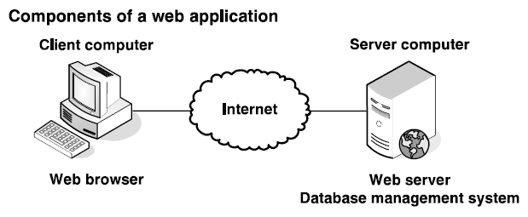
Hardware and Software components of web applications

Slide 5
Web applications are a type of client / server application.
In client / server application the function of the application are split between the client computer and server computer.
In a web application, the client and server computers are connected via internet or via intranet (a local area network).
In a web application, the user works with a web browser at the client computer.
The web browser provides the user interface for the application.
The most common web browser is Microsoft’s Internet Explorer, but other web browsers like Mozilla Firefox and Chrome may be used.

Slide 6
The application runs on the server computer under the control of web server software.
The web application itself is stored on the server computer. This computer runs web server software that enables it to send web pages to web browsers.
For ASP.net applications, the server typically runs Microsoft’s web server, called Internet Information Services, or IIS. Although Apache can also be used.
The server computer also runs a Database Management System or DBMS, such as Microsoft SQL’s Server.
The DBMS provides access to information stored in a database.
To improve performance on larger applications, the DBMS can be run on a separate server computer.

Slide 7
The user interface for a web application is implemented as a series of web pages that are displayed in the web browser.
Each web page is defined by a web form using HTML, or HyperText Mark-up Language, which is a collection of mark-up tags.
The web browser and web server exchange information using HTTP, or HyperText Transfer Protocol.

Slide 8
Static web pages and Dynamic web pages

Slide 9
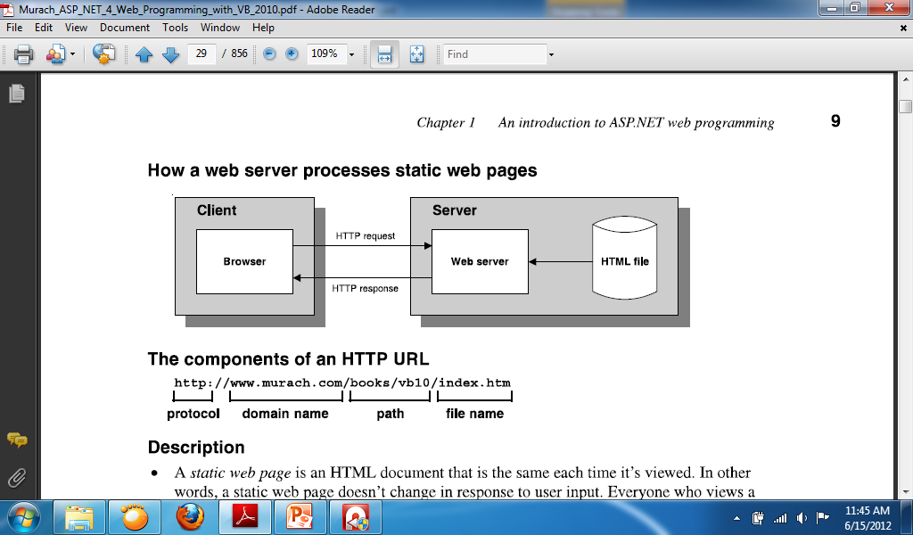
Static web page
A static web page is an HTML document that is the same each time it is viewed. In other words, a static web page doesn’t change in response to user input. Everyone who views a static web page sees exactly the same content.

Slide 10
Static web pages are usually simple HTML files that are stored in the web server. When a browser requests a static web page, the web server retrieves the file from disk and sends it back to the browser. Static web pages usually have a file extension of .htm or .html.
A web browser requests a page from a web server by sending the server an HTTP message known as an HTTP request. The HTTP request includes the name of the HTML file being requested and the Internet addresses of both the browser and the web server.

Slide 11
A user working with a browser can initiate an HTTP request in several ways.
One way is to type the address of a web page, called a URL (Uniform Resource Locator), into the browser’s address and then press the enter key.
Another way is to click a link that refers to a web page.
A web server replies to an HTTP request by sending a message known as an HTTP response back to the browser. The HTTP response contains the addresses of the browser and the server as well as the HTML document that’s being returned.

Slide 12
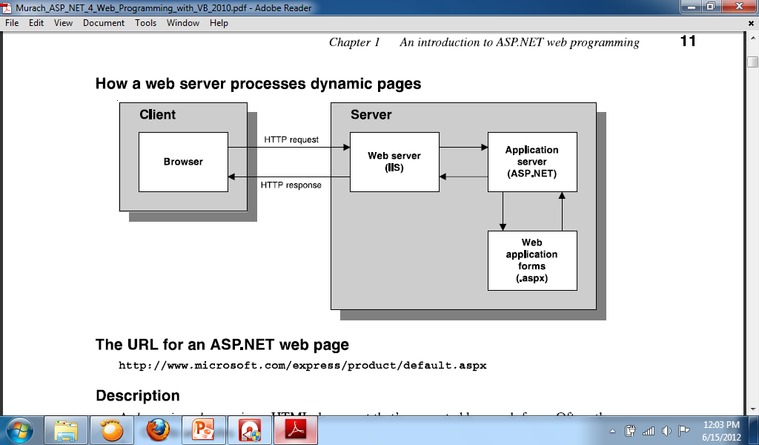
Dynamic web page
A dynamic web page is an HTML document that’s generated by a web form. Often, the web page changes according to information that’s sent to the web form by the browser.

Slide 13
When a web server receives a request for a dynamic web page, it looks up the extension of the requested file in a list of application mappings to find out which application server should process the request. If the file extension is aspx, the request is passed on to ASP.net for processing.
Application mappings indicate what program a file extension is associated with.
When the application server receives a request, it runs the specified web form. Then the web form generates an HTML document and returns it to the application server, which passes it back to the web server and from there to the browser.

Slide 14
The browser doesn’t know or care whether the HTML was retrieved from a static HTML file or generated dynamically by a web form. Either way, the browser simply displays the HTML that was returned as a result of the request.
After the page is displayed, the user can interact with it using its controls. Some of those controls let the user post the page back to the server, which is called a postback. Then, the page is processed again using the data the user entered.
The process that begins with the user requesting a web page and ends with the server sending a response back to the client is called a round trip.

Slide 15
What is state?
State refers to the current status of the properties, variables, and other data maintained by an application for a single user. The application must maintain a separate state for each user currently accessing the application.
HTTP is a statless protocol. That means that it doesn’t keep track of state between roundtrips. Once a browser makes a request and receives a response, the application terminates and its state is lost.

Slide 16
Four ASP.net features for maintaining state:
View state:
ASP.net uses view state to maintain the value of form control properties that the application changes between executions of the application. Since view state is implemented by default, no special coding is required.
Session state:
When a user starts a new session, ASP.net creates a session state object that contains a session ID. This ID is passed from the server to the browser and back to the server so the server can associate the browser with an existing session. To maintain session state, you can add program values to the session state object.

Slide 17
Application state:
When an application begins, ASP.net creates an application state object. To maintain application state, you can add program values to the application state object. These values are available to all users of the application until the application ends.
Profile:
You can use the profile feature to keep track of user data. Although a profile is similar to a session state object, it persists between user sessions because it is stored in a database. The profile feature is not commonly used.

Slide 18
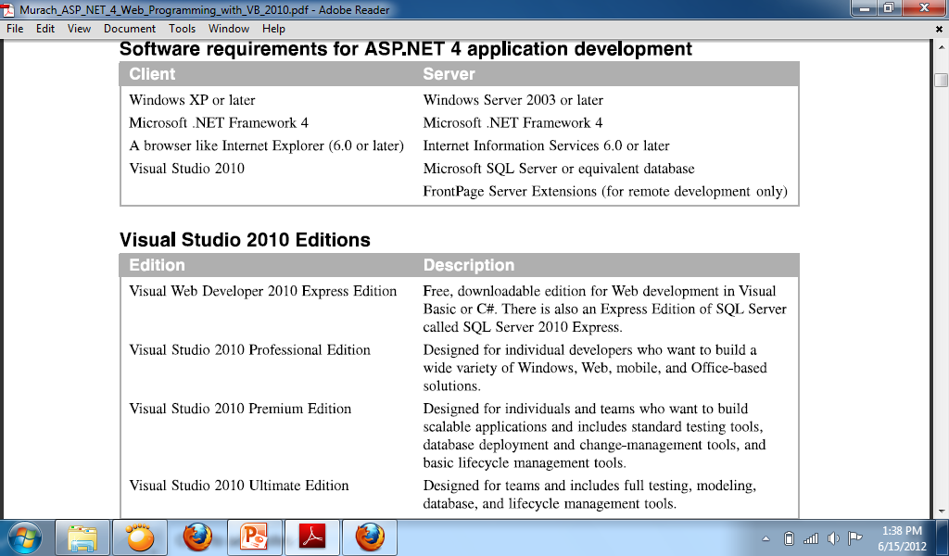

Slide 19
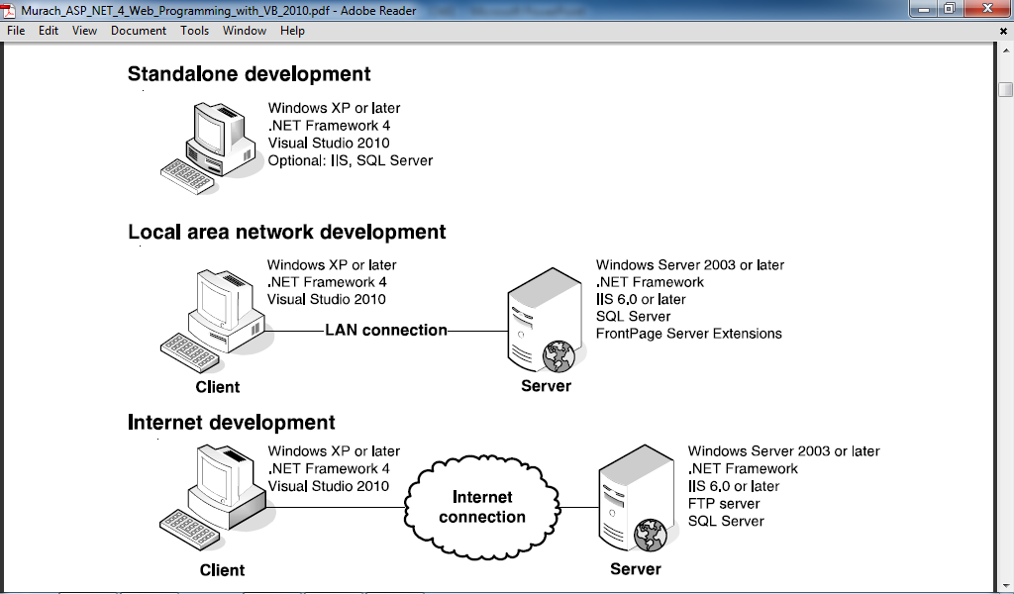
Three environments for developing ASP.net applications

Slide 20
Standalone development:
When you use standalone development, a single computer serves as both the client and the server.
Local area network development:
When you use a local area network (LAN), a client computer communicates with a server computer over the LAN. With this setup, two or more programmers at the same site can work on the same application.
Internet development:
When you use Internet development, a client computer communicates with a server computer over the internet. With this setup, programmers at different locations can work on the same application

Slide 21
More about ASP.net
For each web form in an application, ASP.net 4 keeps two files. The file with the aspx extension holds the HTML code and the ASP tags for the server controls. The file with the aspx.vb extension is the code-behind file that contains the Visual Basic code for the form.

Slide 22
Introduction to the VS 2010 IDE
The Visual Studio 2010 Integrated Development Environment (IDE) provides the interface for developing various kinds of applications. The IDE is a centralized location for developing these applications or components of applications as projects.

Slide 23
Basic windows of VS 2010 IDE
Start Page
Toolbars
Solution Explorer Window
Properties Window
Code Editor
Design View
Source View
IntelliSense

Slide 24
Start Page
The Start Page is the default page of Visual Studio 2010.
The Start Page displays the following panes:
Recent Projects: This pane displays a list of the most recent projects you opened with Visual Studio. You can open the projects by clicking on the hyperlink having the project’s name.
Getting Started: This pane contains links to various programming tasks in the product’s documentation.

Slide 25
Toolbars
The Toolbars in the .NET IDE provides developers with an easy access to the features of the IDE. The .NET IDE provides different toolbars for each category of tasks that are needed in the process of developing an application. The Standard Toolbar is the default visible toolbar.

Slide 26
Solution Explorer
The Solution Explorer window lists the solution name, the project name, and all the forms and modules that are used in the project.
The Solution Explorer window is viewed in either of the following ways:
From the main menu, select View > Solution Explorer
Press the key combination CTRL+ALT+L

Slide 27
Properties Window
The Visual Studio IDE makes the task of designing a user interface for Windows and Web applications very easy providing the Properties window.
The properties of Windows Forms or Web Forms and the controls on the forms can be set interactively at the application design time by using this window.
The buttons on the toolbar of the Properties window allow for sorting of properties in alphabetical order or category-wise navigation of properties and events.
The Properties window is viewed in either of the following ways:
From the main menu, select View > Properties Windows.
Press the F4 key.

Slide 28
Code Editor
The Visual Studio IDE provides with a built-in and very advanced editor for writing code for the .NET projects. This supports the keywords and identifiers of the Visual Studio environment. If Visual Basic is chosen as the programming language for a .NET project, then the Code Editor for this project only supports Visual Basic syntax and not those of any other .NET programming language.
The Code Editor recognizes keywords and identifiers of the programming language in use and applies proper color-coding schemes and layout indenting to them. It checks and warns the developer for the syntax errors, incorrect initialization of variables, invalid declarations, and unrecognized calling of procedures by appropriately highlighting them.

Slide 29
Design View
The Design View of Visual Studio 2010 allows a developer to design a user-friendly and a customized Web Form.
In the Design View, you can perfectly align the Web controls on a Web Form and set the graphical properties of these controls.
The Design View offers a lot of customization and formatting features for the Web Forms, some of which are as follows:
You can directly write text on the Web Form.
You can customize the layout of the Web Forms as absolute and relative using position option in the format menu.
You can apply various font styles, foreground. And background colors on the Web Form and the controls contained in it.

Slide 30
Source View
You can access the Source View of a Web page by clicking the source tab present at the bottom of the Visual Studio IDE.
This view contains the HTML definition of the Web Form and all the controls present to it.
If you drag and drop a control on the Web Form either in the Design view or in the Source view, you see that their equivalent HTML tags are induced into the Source View.
Also as you go on customizing a control’s appearance by setting different properties through the Properties window, these are reflected in the HTML tag for that control in the Design view.

Slide 31
IntelliSense
Visual Studio Code Editor supports the feature of IntelliSense, which helps you to write accurate code. As you start typing the code the methods, properties, and events of the .NET Framework Class Library are automatically offered as a sorted list with the help of IntelliSense feature. This list, which automatically opens in an IntelliSense, shows all the members that are valid for using the code.
When the Web developer selects an option from the IntelliSense, it is included in the line of code with accurate spelling and case.
While writing a code, if there is any error in the code, the IntelliSense underline the code or the keyword that signifies an induced error.

