Slide 1
Creating Websites in ASP.Net

Slide 2
Web site
In Visual Studio 2010, a web application is called a web site.
A web project is a project that is used for the development of a web site. Web sites are often referred to as web projects. However, ASP.Net web sites don’t use project files. Instead, they use web.config files to store project information.
To create a new ASP.Net web application, use the File > New Web Site command.
When you start a new web site, Visual Studio creates a solution file for the web site in the default location for solution files, which is normally My Documents \ Visual Studio 2010 \ Projects.

Slide 3
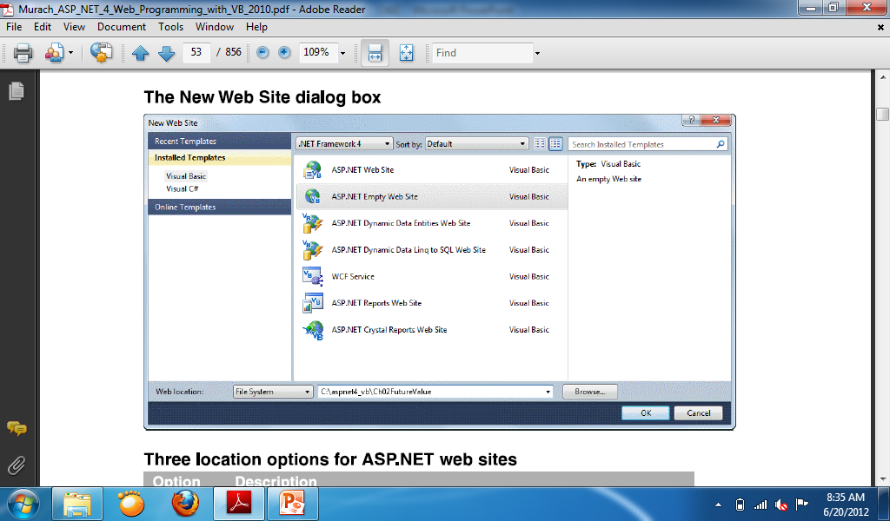
New web site dialog box

Slide 4
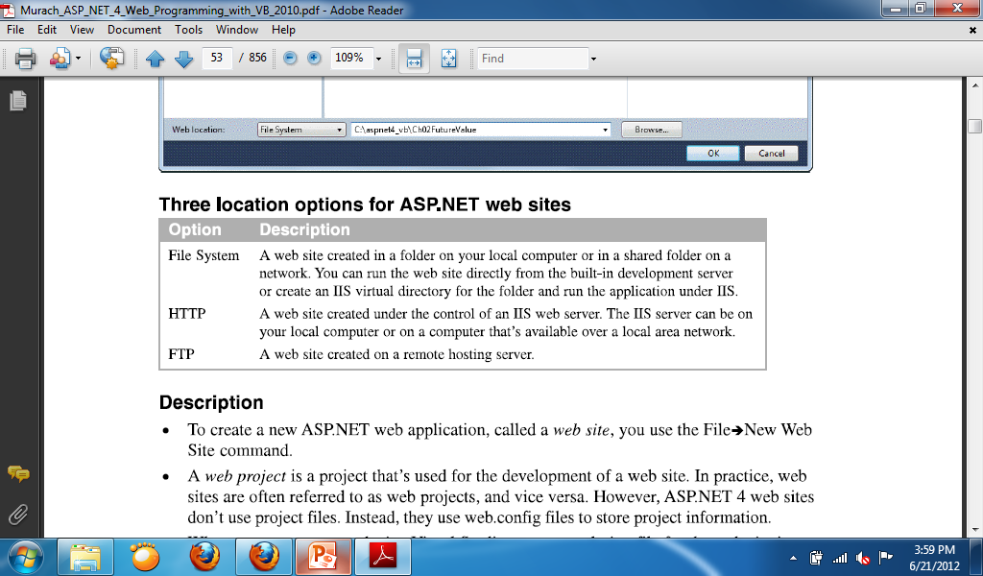
Three location options for ASP.NET web sites

Slide 5
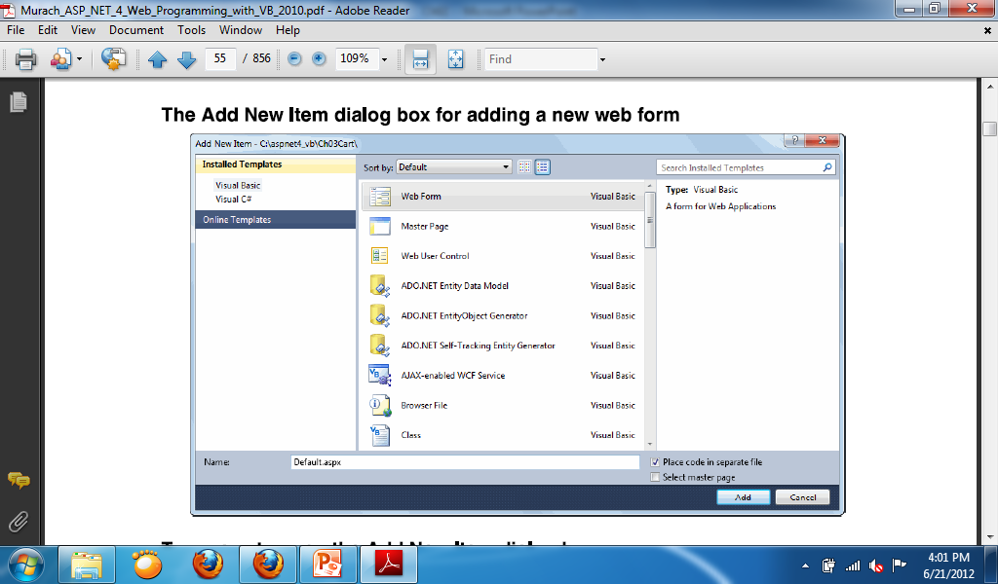

Slide 6
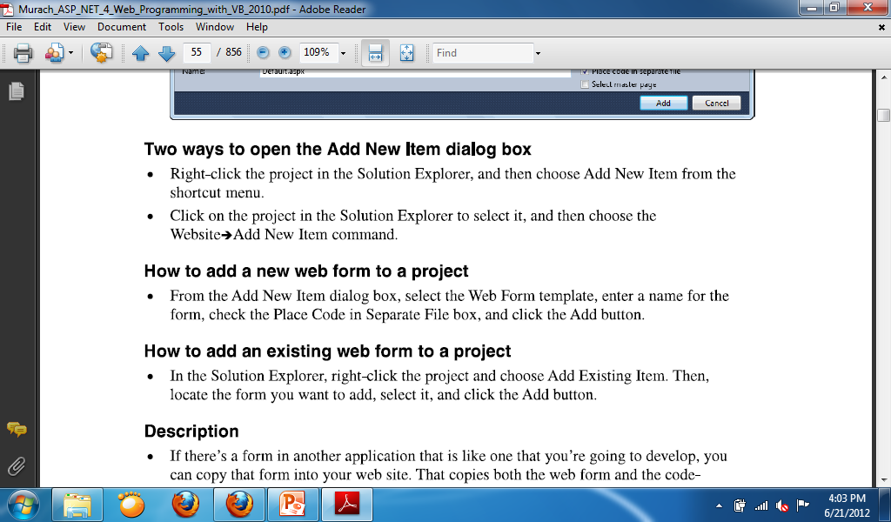

Slide 7
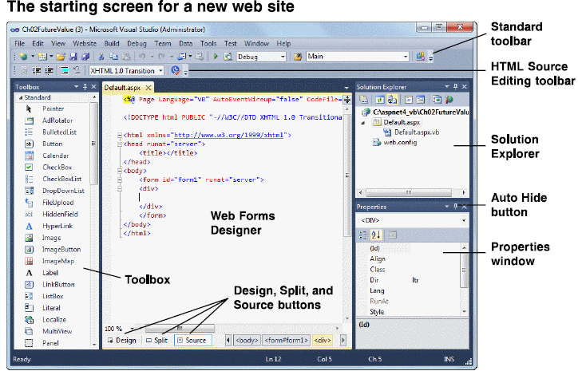

Slide 8
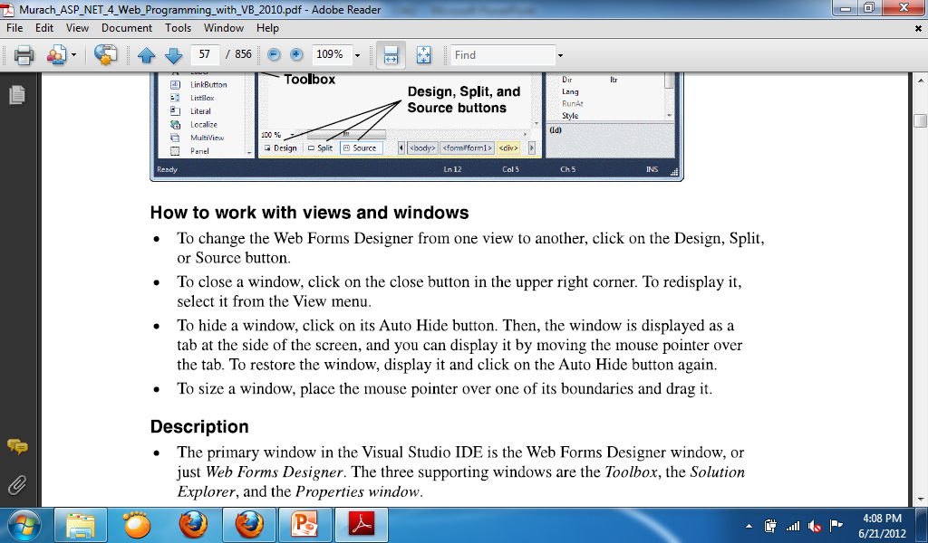

Slide 9
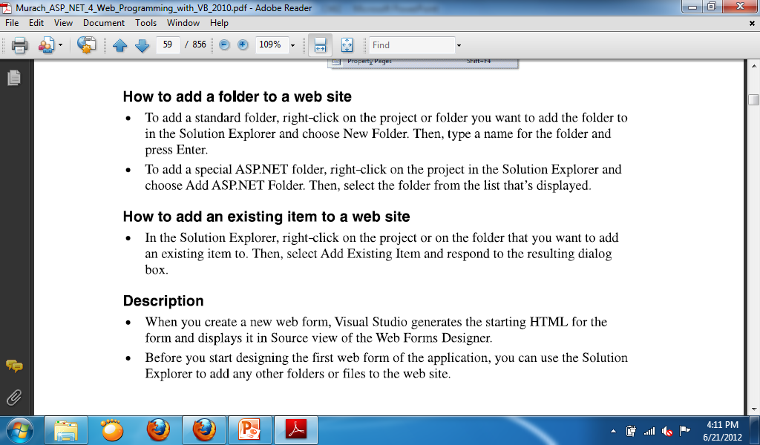

Slide 10
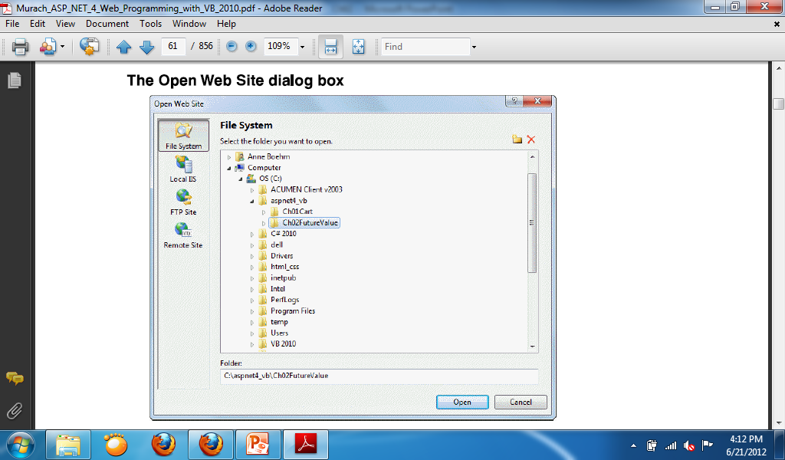

Slide 11
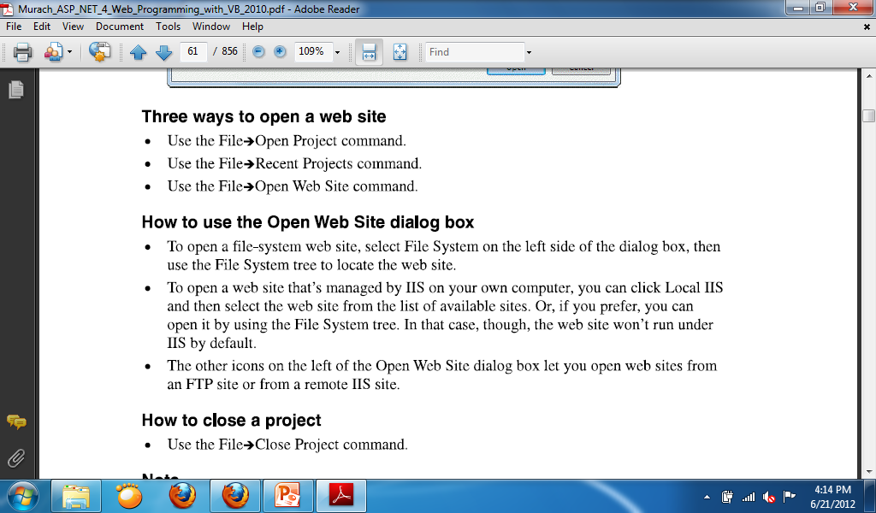

Slide 12
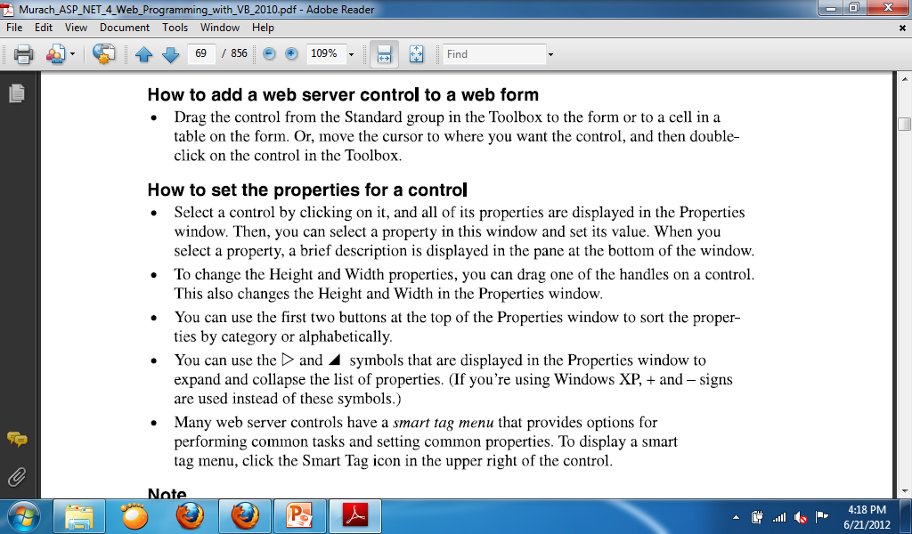

Slide 13
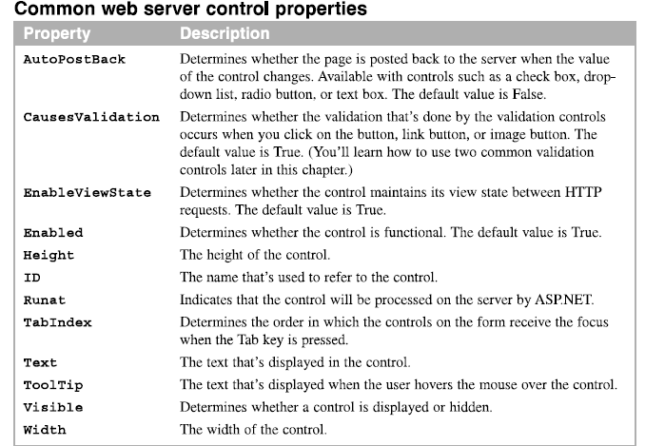

Slide 14
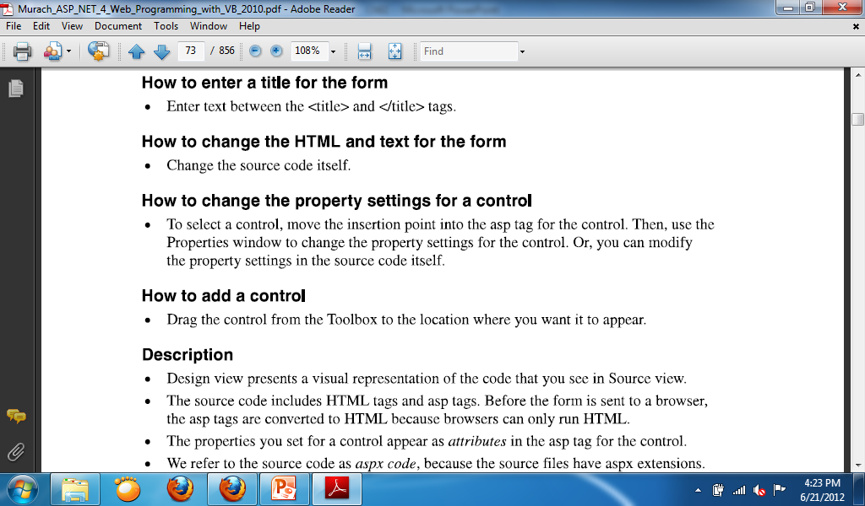
How to use Source View to modify the design

Slide 15
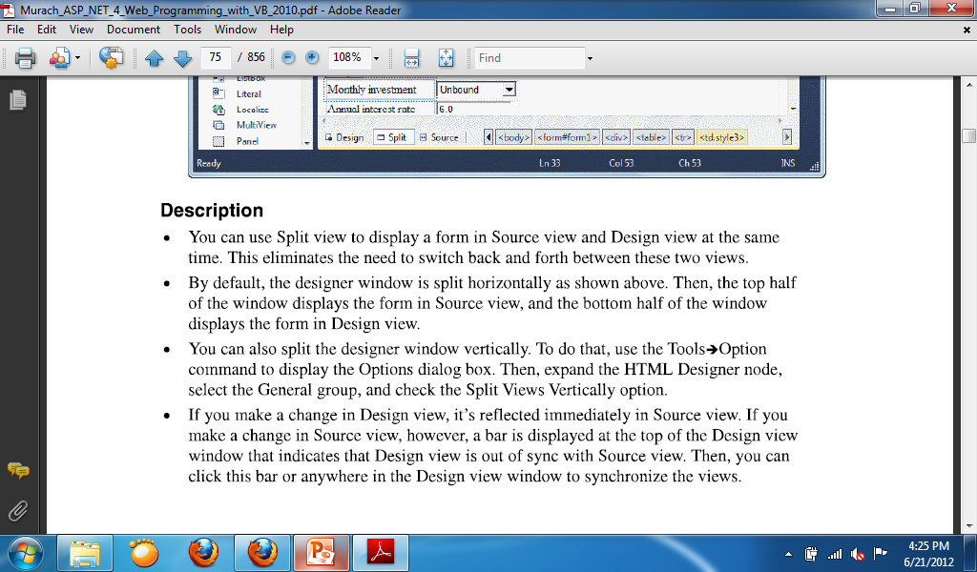
Modify the form design using Split View

Slide 16
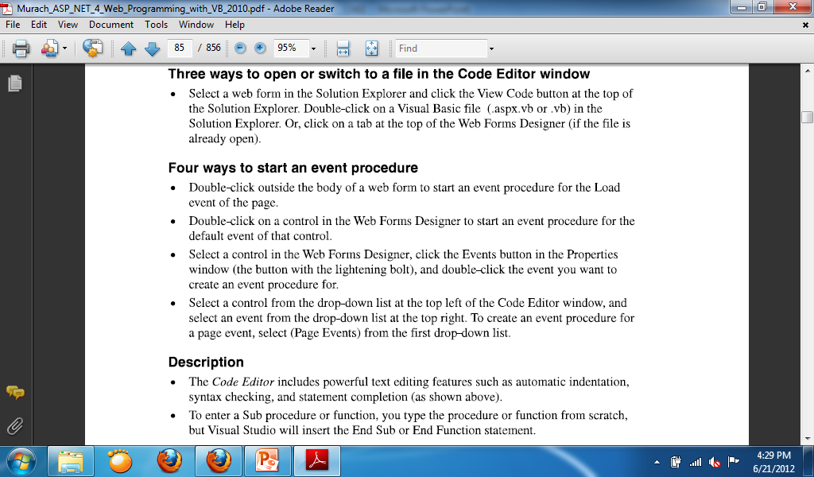

Slide 17
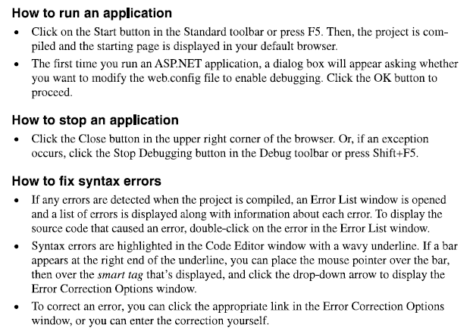

Slide 18
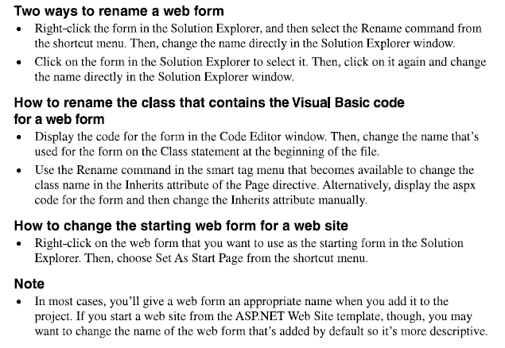

Slide 19
How to redirect or transfer to another page
Response.Redirect(“Cart.aspx”)

Slide 20
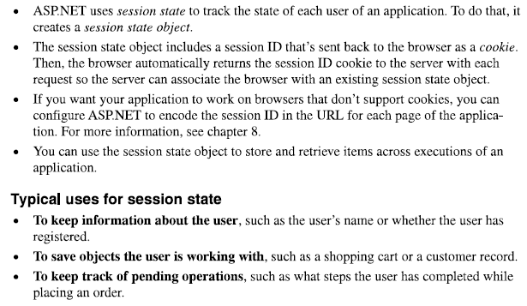
Session State

