Slide 1
ASP.Net Controls

Slide 2
Standard Controls

Slide 3
Using the Label Control
Whenever you need to modify the text displayed in a page dynamically, you can use the Label control.
Common Properties:
BackColor—Enables you to change the background color of the label.
BorderColor—Enables you to set the color of a border rendered around the label.
BorderStyle—Enables you to display a border around the label. Possible values are NotSet, None, Dotted, Dashed, Solid, Double, Groove, Ridge, Inset, and Outset.
BorderWidth—Enables you to set the size of a border rendered around the label.
CssClass—Enables you to associate a Cascading Style Sheet class with the label.
Font—Enables you to set the label’s font properties.
ForeColor—Enables you to set the color of the content rendered by the label.
Style—Enables you to assign style attributes to the label.
ToolTip—Enables you to set a label’s title attribute. (In Microsoft Internet Explorer, the title attribute displays as a floating tooltip.)

Slide 4
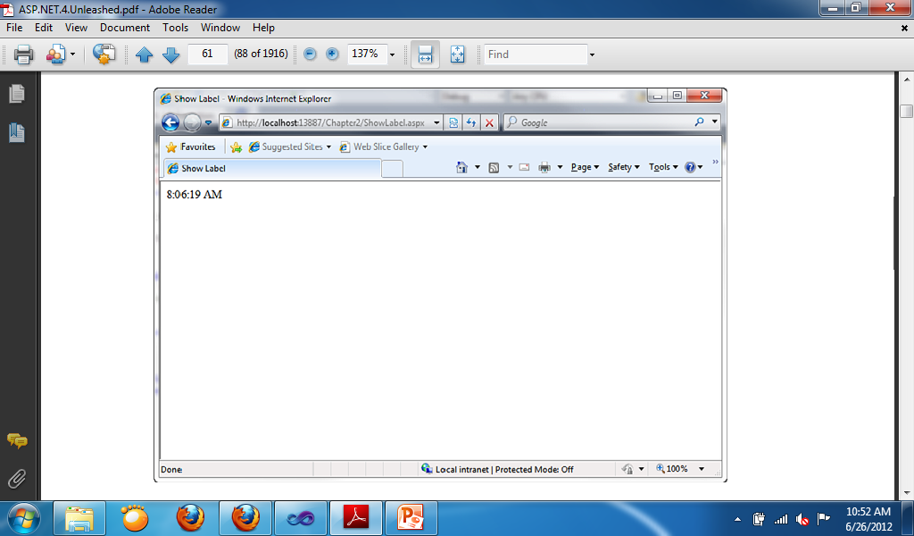
Showing time using Label Control
Protected Sub Page_Load(ByVal sender As Object, ByVal e As System.EventArgs) Handles Me.Load
Label1.Text = TimeOfDay
End Sub

Slide 5
Accepting User Input
The ASP.NET Framework includes several controls that you can use to gather user input. In this section, you learn how to use the TextBox, CheckBox, and RadioButton controls. These controls correspond to the standard types of HTML input tags.

Slide 6
Using the TextBox Control
You can use the TextBox control to display three different types of input fields depending on the value of its TextMode property.
The TextMode property accepts the following three values:
SingleLine—Displays a single-line input field.
MultiLine—Displays a multiline input field.
Password—Displays a single-line input field in which the text is hidden.

Slide 7
TextBox Properties, Methods and Events
Properties:
Enabled—Enables you to disable the text box.
MaxLength—Enables you to specify the maximum length of data that a user can enter in a text box. (This does not work when TextMode is set to Multiline.)
ReadOnly—Enables you to prevent users from changing the text in a text box.
Rows—Enables you to specify the number of rows to display.
TabIndex—Enables you to specify the tab order of the text box.
Wrap—Enables you to specify whether text word-wraps when the TextMode is set toMultiline.
Method:
Focus—Enables you to set the initial form focus to the text box.
Event:
TextChanged—Raised on the server when the contents of the text box are changed.

Slide 8
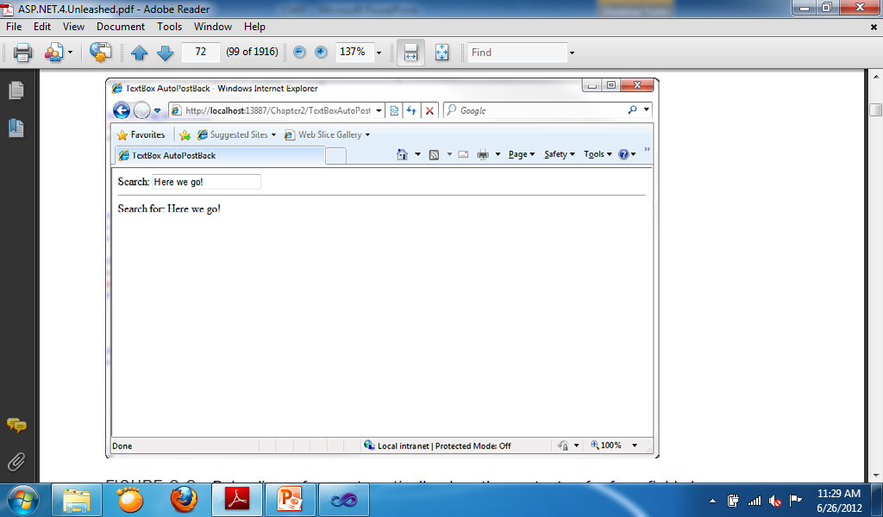
Sample for TextBox TextChanged event
Protected Sub TextBox1_TextChanged(ByVal sender As Object, ByVal e As System.EventArgs) Handles TextBox1.TextChanged
Label2.Text = "Search for: " + TextBox1.Text
End Sub

Slide 9
Using the CheckBox Control
The CheckBox control enables you to display a check box.
CheckBox enables you to select or deselect multiple options in a group of CheckBoxes.
When the CheckBox have a check mark, it means it is selected, when the CheckBox doesn’t have a check mark it is deselected.
You can check / select mulitple CheckBoxes at the same time.

Slide 10
CheckBox Properties, Methods and Events
Properties:
Checked—Enables you to get or set whether the CheckBox is checked.
Enabled—Enables you to disable the TextBox.
TabIndex—Enables you to specify the tab order of the check box.
Text—Enables you to provide a label for the check box.
TextAlign—Enables you to align the label for the check box. Possible values are Left and Right.
Methods:
Focus—Enables you to set the initial form focus to the check box.
Event:
CheckedChanged—Raised on the server when the check box is checked or unchecked.

Slide 11
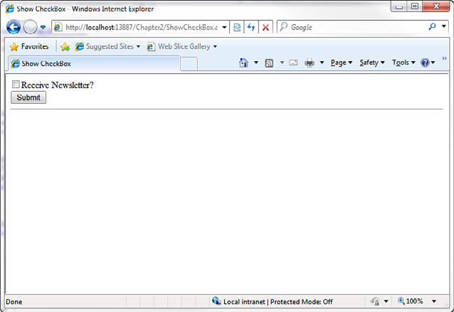
Displaying checkbox
Protected Sub Button1_Click(ByVal sender As Object, ByVal e As EventArgs) Handles Button1.Click
Label1.Text = CheckBox1.Checked.ToString
End Sub

Slide 12
Using the RadioButton Control
You always use the RadioButton control in a group. Only one radio button in a group of RadioButton controls can be checked at a time.

Slide 13
RadioButton Properties, Methods and Events
Properties:
Checked—Enables you to get or set whether th RadioButton control is checked.
Enabled—Enables you to disable the RadioButton.
GroupName—Enables you to group RadioButton controls.
TabIndex—Enables you to specify the tab order of the RadioButton control.
Text—Enables you to label the RadioButton control.
TextAlign—Enables you to align the RadioButton label. Possible values are Left and Right.
Methods:
Focus—Enables you to set the initial form focus to the RadioButton control.
Events:
CheckedChanged—Raised on the server when the RadioButton is checked or unchecked.

Slide 14
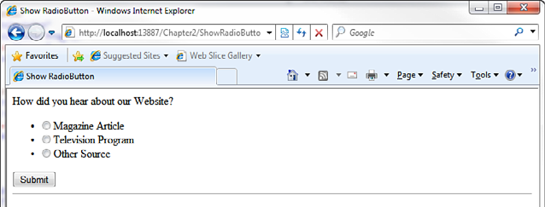
Change the GroupName property of the RadioButtons First
Protected Sub Button1_Click(ByVal sender As Object, ByVal e As EventArgs) Handles Button1.Click
If RadioButton1.Checked = True Then
Label1.Text = RadioButton1.Text
ElseIf RadioButton2.Checked = True Then
Label1.Text = RadioButton2.Text
ElseIf RadioButton3.Checked = True Then
Label1.Text = RadioButton3.Text
End If
End Sub

Slide 15
Submitting Form Data

Slide 16
Using the Button, LinkButton and ImageButton Control
The Button control renders a push button that you can use to submit a form to the server.
The Button control is often the location where you can find most of the codes.
The three buttons have the same function but the link button looks like a hyperlink and the image button is a picture.

Slide 17
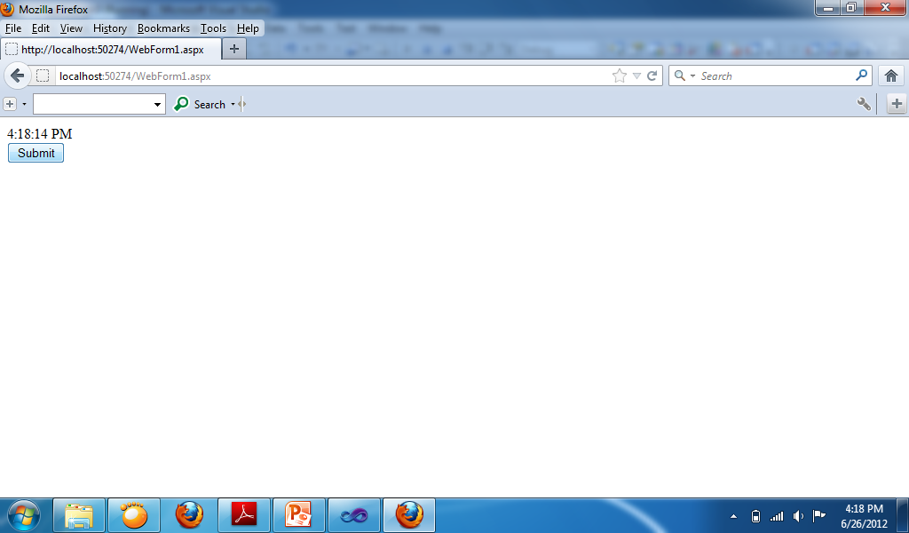
Protected Sub Button1_Click(ByVal sender As Object, ByVal e As EventArgs) Handles Button1.Click
Label1.Text = TimeOfDay
End Sub

Slide 18
Displaying Images

Slide 19
Using the Image Control
The control in ASP.Net used in displaying images.

Slide 20
Container Controls

Slide 21
Using the Panel Control
The Panel control enables you to work with a group of ASP.NET controls.
For example, you can use a Panel control to hide or show a group of ASP.NET controls.
Common Property for Panel is GroupingText—Enables you to render the Panel control as a fieldset with a particular legend.

Slide 22
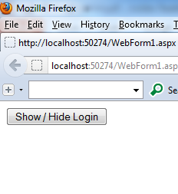
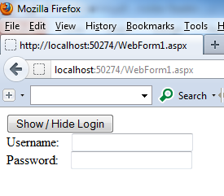
Change the Visible property of the Panel to False first.
Protected Sub Button1_Click(ByVal sender As Object, ByVal e As EventArgs) Handles Button1.Click
If Panel1.Visible = True Then
Panel1.Visible = False
Else
Panel1.Visible = True
End If
End Sub

