Slide 1
Validation Controls

Slide 2
Overview of Validation controls
Common Validation controls in ASP.Net:
RequiredFieldValidator—Enables you to require a user to enter a value in a form field.
RangeValidator—Enables you to check whether a value falls between a certain minimum and maximum value.
CompareValidator—Enables you to compare a value against another value or perform a data type check.
RegularExpressionValidator—Enables you to compare a value against a regular expression.
ValidationSummary—Enables you to display a summary of all validation errors in a page.
You can associate the validation controls with any form controls included in ASP.NET Framework. For example, if you want to require a user to enter a value into a TextBox control, you can associate a RequiredFieldValidator control with the TextBox control.

Slide 3
You should always check the Page.IsValid property when working with data submitted with a form that contains validation controls. Each of the validation controls includes an IsValid property that returns the value True when a validation error doesn’t exist. The Page.IsValid property returns the value True when the IsValid property for of the validation controls in a page returns the value True.
It is easy to forget to check the Page.IsValid property. When you use a browser that supports JavaScript with the validation controls, you are prevented from submitting a form back to the server when validation errors exist. However, if someone requests a page using a browser that does not support JavaScript, the page is submitted back to the server even when validation errors exist.

Slide 4
RequiredFieldValidator Control
The RequiredFieldValidator control enables you to require a user to enter a value into a form field before submitting the form.
You must set two important properties when using the RequiredFieldValidator control:
ControlToValidate—The ID of the form field validated.
ErrorMessage—The error message displayed when validation fails.
By default, the RequiredFieldValidator checks for a nonempty string (spaces don’t count). If you enter anything into the form field associated with the RequiredFieldValidator, the RequiredFieldValidator does not display its validation error message.

Slide 5
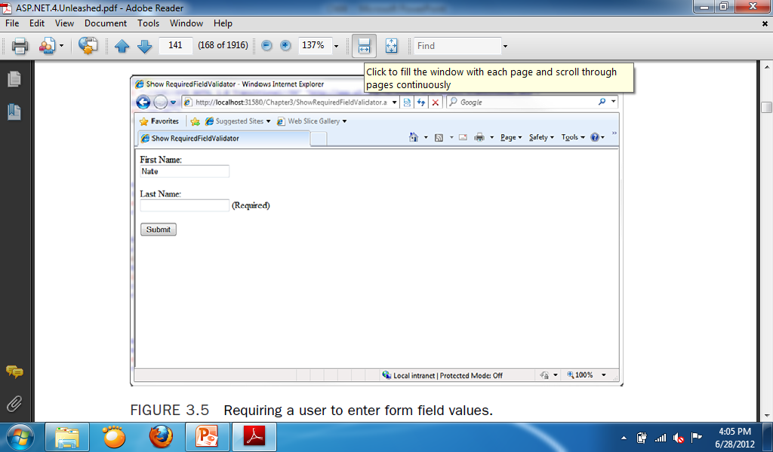
Sample for Required Field Validator Text property
Insert 2 RequiredFieldValidator on the web form.
Change the ControlToValidate property of the 2 RequiredFieldValidator to the 2 TextBoxes.
Change the ErrorMessage property of the 2 RequiredFieldValidator to (Required).
Code for button:
if (IsValid)
{
Response.Redirect("Webform2.aspx");
}

Slide 6
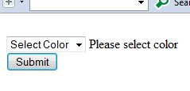
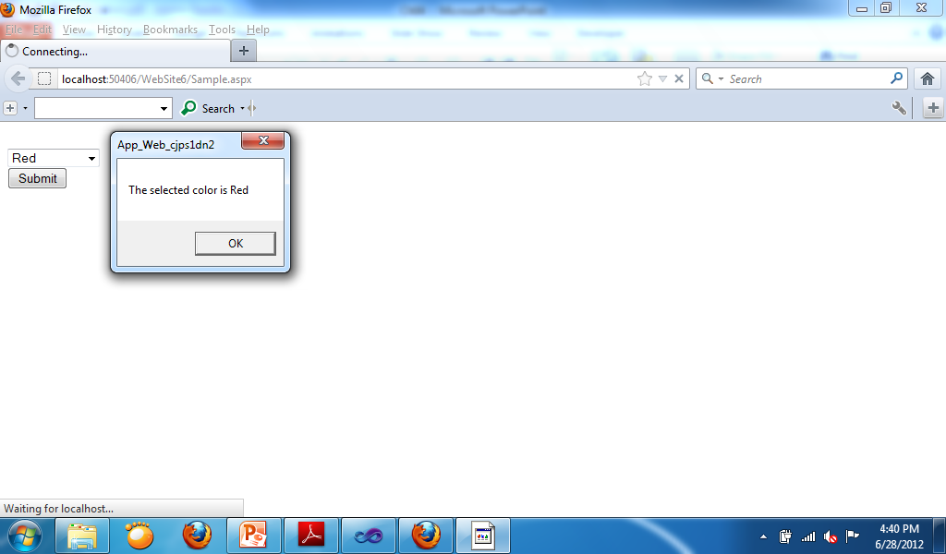
Sample for RequiredFieldValidator Initial Value Property
Insert a Drop-down List, a Button and a RequiredFieldValidator in the form.
In the Items property of the Drop-down list type “Select Color, Red, Blue, Green”
In the RequiredFieldValidator change the ControlToValidate property into Drop-down List and change the InitialValue into “Select Color” and change the ErrorMessage property into “Please select color”.
Codes for the button:
If IsValid Then
MsgBox("The selected color is " & DropDownList1.Text)
End If

Slide 7
RangeValidator Control
The RangeValidator control enables you to check whether the value of a form field falls between a certain minimum and maximum value. You must set five properties when using this control:
ControlToValidate—The ID of the form field validated.
ErrorMessage—The error message displayed when validation fails.
MinimumValue—The minimum value of the validation range.
MaximumValue—The maximum value of the validation range.
Type—The type of comparison to perform. Possible values are String, Integer, Double, Date, and Currency.

Slide 8
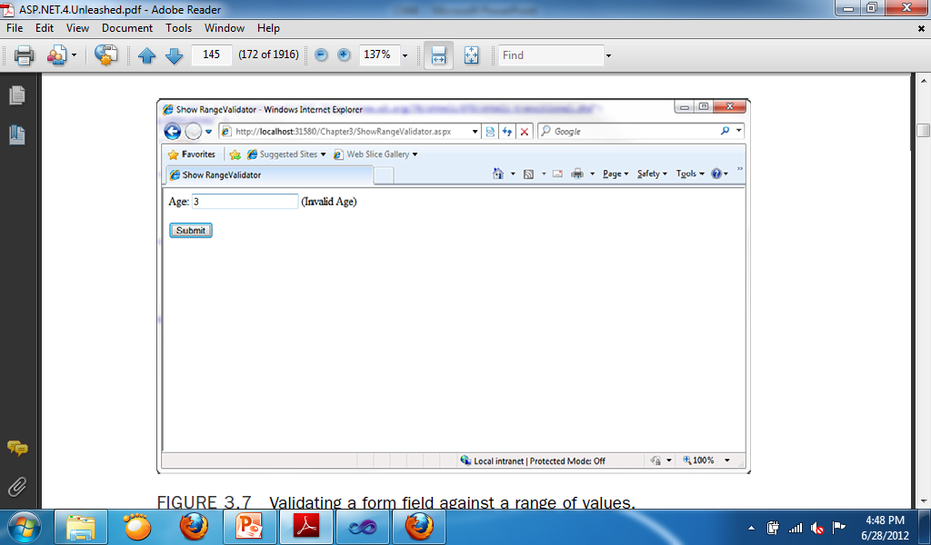
Sample Program for RangeValidator
This program checks the age if it is between 5 to 100.
Add: TextBox, Label, RangeValidator, Button.
Change:
RangeValidator
ControlToValidate:Textbox1
ErrorMesssage: (Invalid Age)
MinimumValue: 5
MaximumValue: 100
Type: Integer

Slide 9
CompareValidator Control
The CompareValidator control enables you to perform three different types of validation tasks. You can use the CompareValidator to perform a data type check. In other words, you can use the control to determine whether a user has entered the proper type of value into a form field, such as a date in a birth date field.
You also can use the CompareValidator to compare the value entered into a form field against a fixed value. For example, if you build an auction website, you can use the CompareValidator to check whether a new minimum bid is greater than the previous
minimum bid.
Finally, you can use the CompareValidator to compare the value of one form field against another. For example, you use the CompareValidator to check whether the value entered into the meeting start date is less than the value entered into the meeting end date.

Slide 10
The CompareValidator has six important properties:
ControlToValidate—The ID of the form field validated.
ErrorMessage—The error message displayed when validation fails.
Type—The type of value compared. Possible values are String, Integer, Double, Date, and Currency.
Operator—The type of comparison to perform. Possible values are DataTypeCheck, Equal, GreaterThan, GreaterThanEqual, LessThan, LessThanEqual, and NotEqual.
ValueToCompare—The fixed value against which to compare.
ControlToCompare—The ID of a control against which to compare.

Slide 11
An important limitation of the CompareValidator concerns how it performs a data type check. You cannot enter a long date(for example, December 25, 1966). You must enter a short date (for example, 12/25/1966). When validating currency amounts, you cannot enter the currency symbol. If these limitations concern you, you can use either the RegularExpression or CustomValidator controls to perform a more flexible data type check.

Slide 12
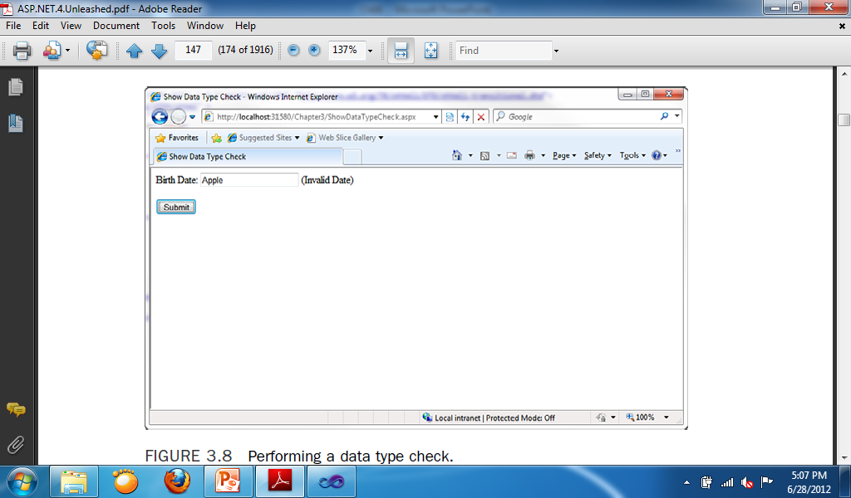
Sample for CompareValidator Date Check
Add: Label, TextBox, CompareValidator, Button
Change:
CompareValidator
ErrorMessage: “Invalid Date”
ControlToValidate: textbox1
Type: Date
Operator: DateTypeCheck

Slide 13
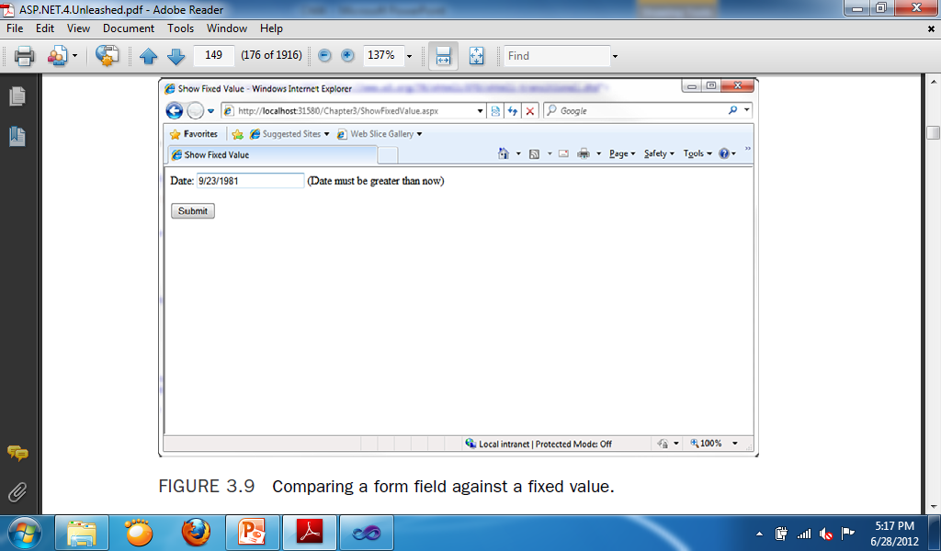
Sample for CompareValidator ValueToCompare
Add: Label, TextBox, CompareValidator, Button
Change:
CompareValidator:
ErrorMessage: “Date must be greater than now”
ControlToValidate: TextBox1
Type: Date
Operator: Greater Than
Code for Form:
CompareValidator1.ValueToCompare = Today

Slide 14
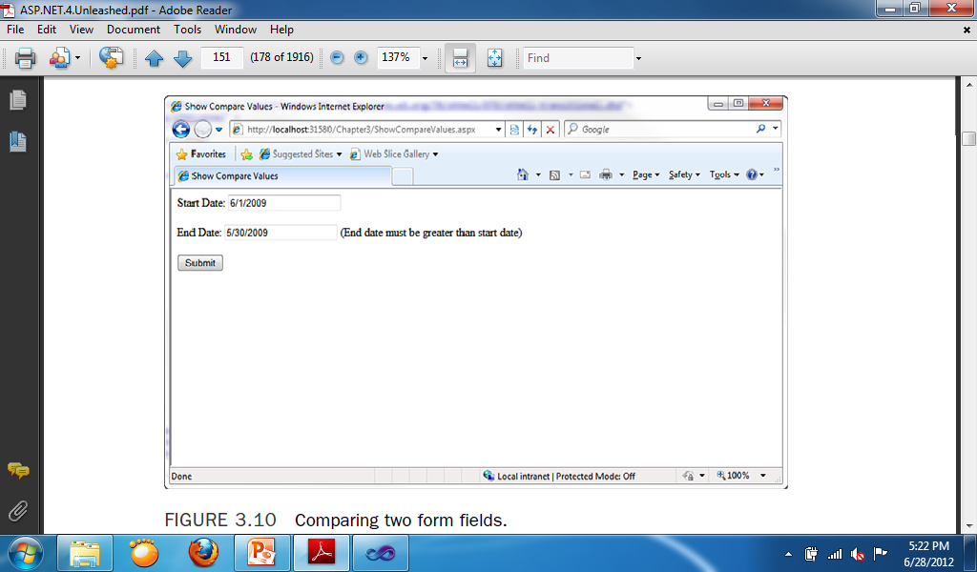
Sample for CompareValidator ControlsToCompare
Add: 2 Labels, 2 TextBox, CompareValidator, Button
Change:
CompareValidator:
ErrorMessage: “End date must be greater than start date”.
ControlToValidate: TextBox2
ControlsToCompare: TextBox1
Type: Date
Operator: Greater than

Slide 15
RegularExpressionValidator Control
The RegularExpressionValidator control enables you to compare the value of a form field against a regular expression. You can use a regular expression to represent string patterns such as email addresses, Social Security numbers, phone numbers, dates, currency amounts, and product codes.

Slide 16
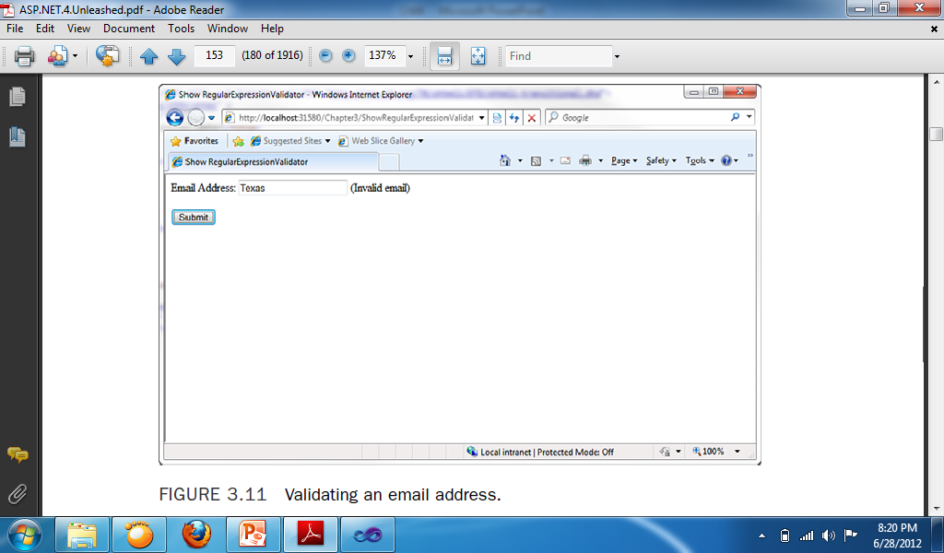
Sample for RegularExpressionValidator Email
Add: Label, TextBox, RegularExpressionValidator, Button
Change:
RegularExpressionValidator:
ControlToValidate: TextBox1
ErrorMessage: “Invalid email”
ValidationExpression: Email

Slide 17
ValidationSummary Control
The ValidationSummary control enables you to display a list of all the validation errors in a page in one location. This control is particularly useful when working with large forms. If a user enters the wrong value for a form field located toward the end of the page, the user might never see the error message. If you use the ValidationSummary control, however, you can always display a list of errors at the top of the form.
Each of the validation controls includes an ErrorMessage property. We have not been using the ErrorMessage property to represent the validation error message. Instead, we have used the Text property. The distinction between the ErrorMessage and Text property is that any message that you assign to the ErrorMessage property appears in the ValidationSummary control, and any message that you assign to the Text property appears in the body of the page. Normally, you want to keep the error message for the Text property short (for example, ”Required!”). The message assigned to the ErrorMessage property, on the other hand, should identify the form field that has the error (for example, ”First name is required!”).

Slide 18
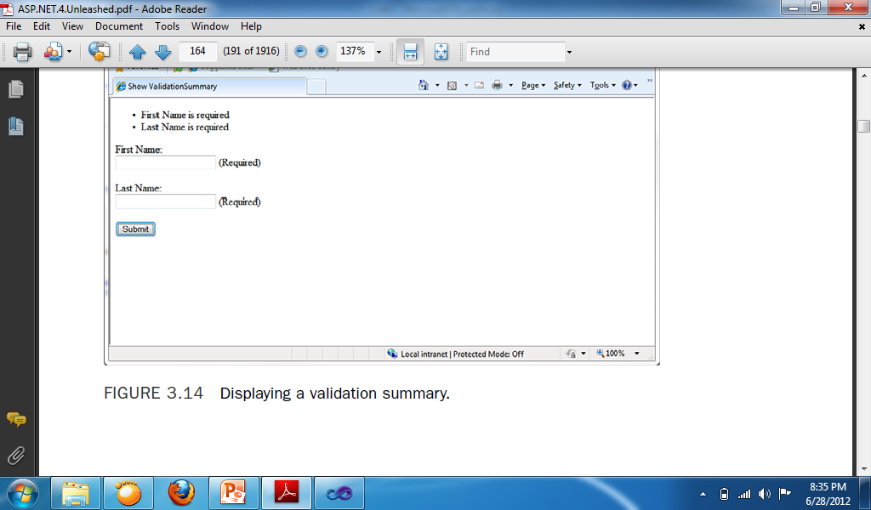
Sample for ValidationSummary
Add: 2 Labels, 2 TextBoxes, 2 RequiredFieldValidator, ValidationSummary, Button
Change:
RequiredFieldValidator1:
ControlToValidate: TextBox1
ErrorMessage: First Name is required
RequiredFieldValidator2:
ControlToValidate: TextBox2
ErrorMessage: Last Name is required

