Slide 1
Chapter 5 Other Controls

Slide 2
List Controls

Slide 3
RadioButtonList
A RadioButtonList control that contains ListItem controls that correspond to the radio buttons. All the List controls use the ListItem control to represent individual list items.
The ListItem control supports the following five properties:
Attributes—Enables you to add HTML attributes to a list item.
Enabled—Enables you to disable a list item.
Selected—Enables you to mark a list item as selected.
Text—Enables you to specify the text displayed by the List Item.
Value—Enables you to specify a hidden value associated with the List Item.

Slide 4
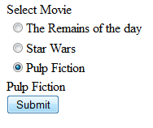
Add: 2 Labels, RadioButtonListBox, Button
Change:
RadioButtonListBox
Items:
“The Remains of the day”
“Star Wars”
“Pulp Fiction”
Code for Button:
Label2.Text = RadioButtonList1.SelectedItem.Text

Slide 5
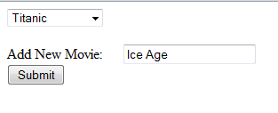
DropDownList
Add: DropDownListBox, Label, TextBox, Button
Code for Button:
DropDownList1.Items.Add(TextBox1.Text)

Slide 6
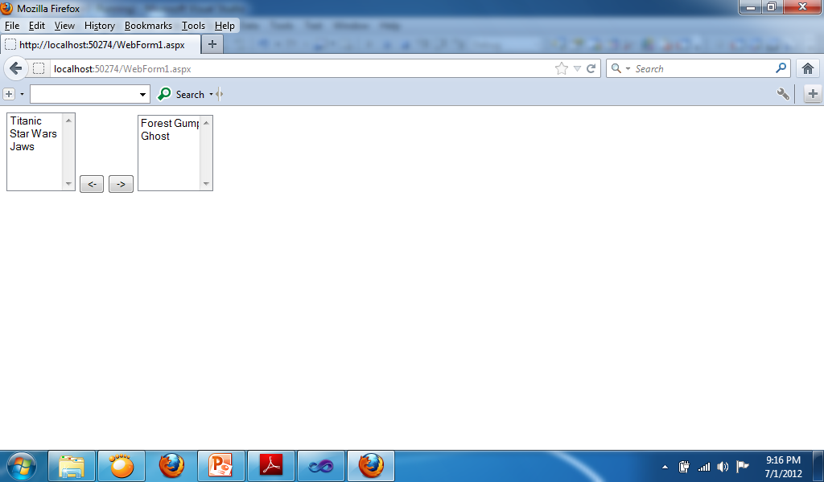
Sample for Moving ListBox Items
Add: 2 ListBox, 2 Buttons
Change:
ListBox1 Items:
Titanic
Star Wars
Jaws
Forest Gump
Ghost
Code for “<-” Button:
If ListBox2.Items.Count <> 0 And ListBox2.SelectedIndex <> -1 Then
ListBox1.Items.Add(ListBox2.SelectedValue)
ListBox2.Items.Remove(ListBox2.SelectedValue)
End If
Code for “->” Button:
If ListBox1.Items.Count <> 0 And ListBox1.SelectedIndex <> -1 Then
ListBox2.Items.Add(ListBox1.SelectedValue)
ListBox1.Items.Remove(ListBox1.SelectedValue)
End If

Slide 7
Displaying a Calendar
The Calendar control enables you to display a calendar. You can use the calendar as a date picker or to display a list of upcoming events.
The SelectionMode property enables you to change the behavior of the calendar so that you can not only select days, but also select weeks or months.

Slide 8
Calendar Properties
DayNameFormat—Enables you to specify the appearance of the days of the week. Possible values are FirstLetter, FirstTwoLetters, Full, Short, and Shortest.
NextMonthText—Enables you to specify the text that appears for the next month link.
NextPrevFormat—Enables you to specify the format of the next month and previous month link. Possible values are CustomText, FullMonth, and ShortMonth.
PrevMonthText—Enables you to specify the text that appears for the previous month link.
SelectedDate—Enables you to get or set the selected date.
SelectedDates—Enables you to get or set a collection of selected dates.
SelectionMode—Enables you to specify how dates are selected. Possible values are Day, DayWeek, DayWeekMonth, and None.
SelectMonthText—Enables you to specify the text that appears for selecting a month.
SelectWeekText—Enables you to specify the text that appears for selecting a week.
ShowDayHeader—Enables you to hide or display the day names at the top of the Calendar control.
ShowNextPrevMonth—Enables you to hide or display the links for the next and previous months.
ShowTitle—Enables you to hide or display the title bar displayed at the top of the calendar.
TitleFormat—Enables you to format the title bar. Possible values are Month and MonthYear.
TodaysDate—Enables you to specify the current date. This property defaults to the current date on the server.
VisibleDate—Enables you to specify the month displayed by the Calendar control.vThis property defaults to displaying the month that contains the date specified byvTodaysDate.

Slide 9
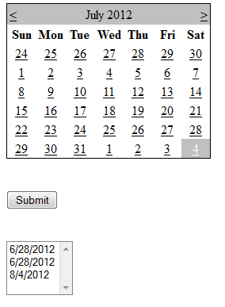
Add: Calendar, ListBox, Button
Code:
Button:
ListBox1.Items.Add(Calendar1.SelectedDate)

Slide 10
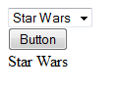
Sample for DropDown List
Add: DropDownList, Button, Label
Change:
DropDownList Items:
“Jaws”
“Ghost”
“Star Wars”
Code for button:
Label1.Text = DropDownList1.Text

Slide 11
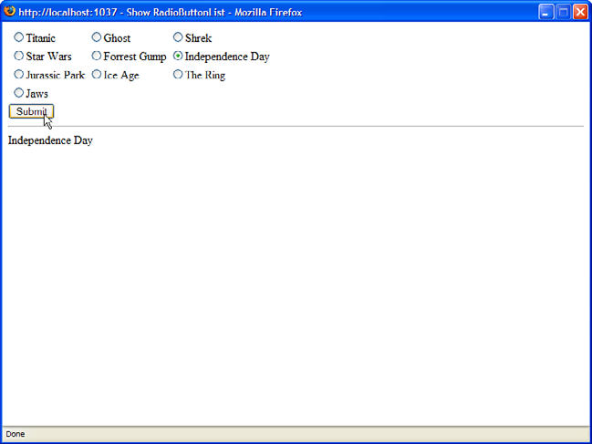
Sample for RadioButtonList
Add: RadioButtonList, Button, Label
Change
RadioButtonList Items
Code for Button:
Label1.Text = RadioButtonList1.SelectedValue

Slide 12
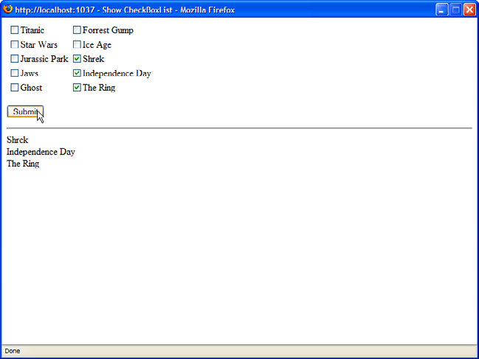
Sample for CheckBoxList
Add: CheckBoxList, Button, Label
Change:
CheckBoxList Items
Code for Button:
Dim item As ListItem
Label1.Text = ""
For Each item In CheckBoxList1.Items
If (item.Selected) Then
Label1.Text += "<li>" + item.Text
End If
Next

