Slide 1
Chapter 6 HTML in ASP.Net, Session State and Selection Statements

Slide 2
Introduction to HTML
Elements and tags:
An HTML document includes HTML elements that specify the content and structure of the page.
Most HTML elements have three parts: a start tag, content, and an end tag. Each tag is coded within a set of brackets(<>).
An element’s start tag include the name of the element. The end tag includes the element name preceded by a slash. And the content includes everything that appears between the start and end tags.
Some HTML elements have no content or end tag. For example, the <br /> element, which forces a line break, consists of just one tag. This type of tag is called a self-closing tag.
You should use lowercase letters for all your tags.

Slide 3
Attributes:
Attributes can appear within a start tag to supply optional values. For example, you can use the id attribute to specify a ID for any element.
All attribute values should be enclosed on quotation marks.
Use spaces to separate attribute from one another.
Comments and white space:
A comment is text that appears between the <!-and-> characters. Web browsers ignore comments, so you can use them to document sections of your HTML code that might otherwise be confusing.
White space, such as tabs, line returns, and consecutive spaces, is ignored by browsers. As a result, you can use space to indent lines of code and line breaks to separate elements from one another. Used properly, white space can make your HTML code easier to read.
To force the browser to display two or more consecutive spaces, use the character entity &nbsp; for each space.

Slide 4
How to work with HTML using Visual Studio
To edit the HTML for a web page in Visual Studio, display the page in Source view by clicking on the Source button at the bottom of the Web Forms Designer window.
Visual Studio uses distinctive colors to identify various items in Source view. In addition, it highlights syntax errors with a red wavy underline so they’re easy to locate.
When you enter the opening bracket (<) for a start tag, Visual Studio displays a list of the available elements. To select an element, type one or more letters of the element or scroll to the element, and then press the Tab or Enter key.

Slide 5
When you enter the name of an HTML element followed by a space, Visual Studio displays a list of the attributes you can use with that element. To select an attribute, type one or more letters of the attribute or scroll to the attribute, and then press Tab or Enter key.
When you enter the closing bracket (>) for a start tag, Visual Studio automatically adds the end tag.
You can also add or modify element attributes using the Properties window. To do that, move the insertion point into tag for the element to display its attributes in the Properties window and then change the attribute values as appropriate.

Slide 6
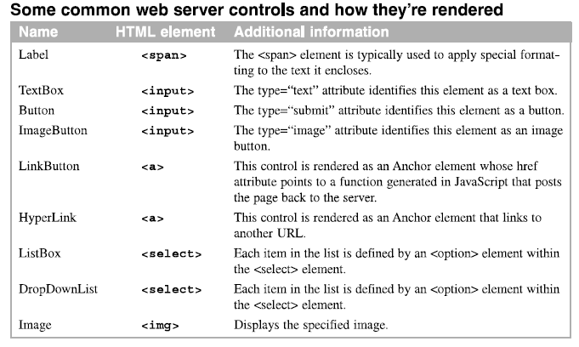
How web server controls are rendered

Slide 7
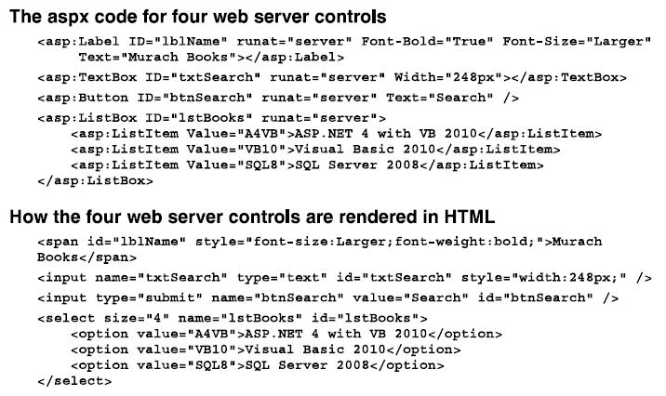
Difference between ASP.NET control tags and HTML Tags

Slide 8
Session State

Slide 9
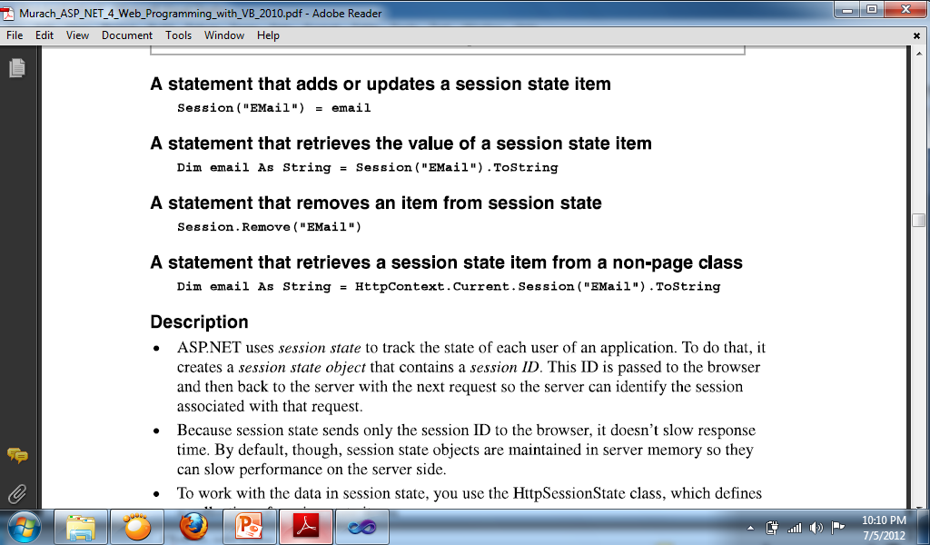
How to use Session State
ASP.NET uses session state to track the state of each user of an application. To do that, it creates a session state object that contains a session ID. This ID is passed to the browser and then back to the server with the next request so the server can identify the session associated with that request.
Because session states sends only the session ID to the browser, it doesn’t slow response time. By default, though, session state objects are maintained in server memory so they can slow performance on the server side.

Slide 10
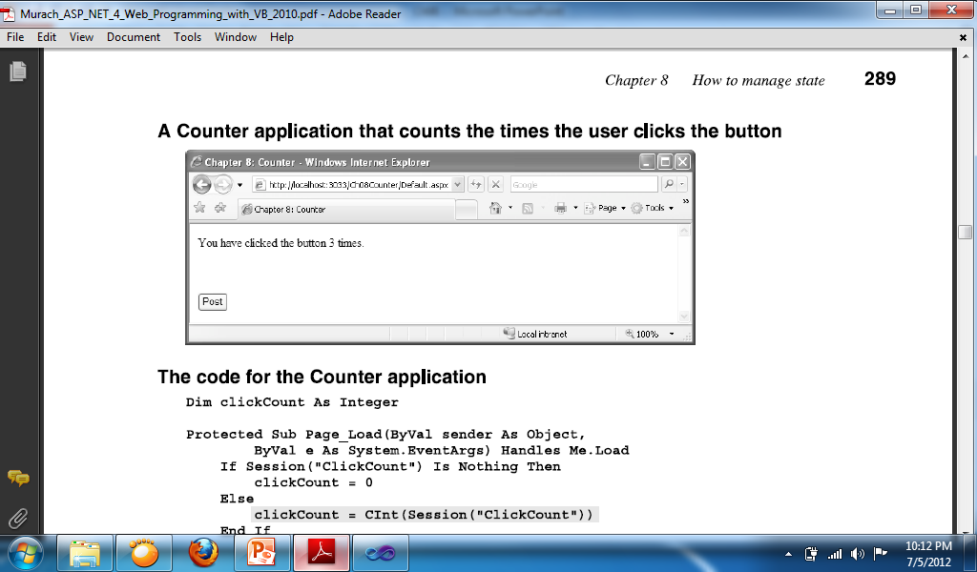
Sample program using the Session state
Dim clickcount As Integer
Button Code:
clickcount += 1
Label1.Text = "You clicked the button " & clickcount & " times."
Session("SaveClickCount") = clickcount
Page_Load Code:
If Session("SaveClickCount") Is Nothing Then
clickcount = 0
Else
clickcount = Session("SaveClickCount").ToString
End If

Slide 11
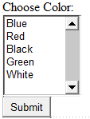
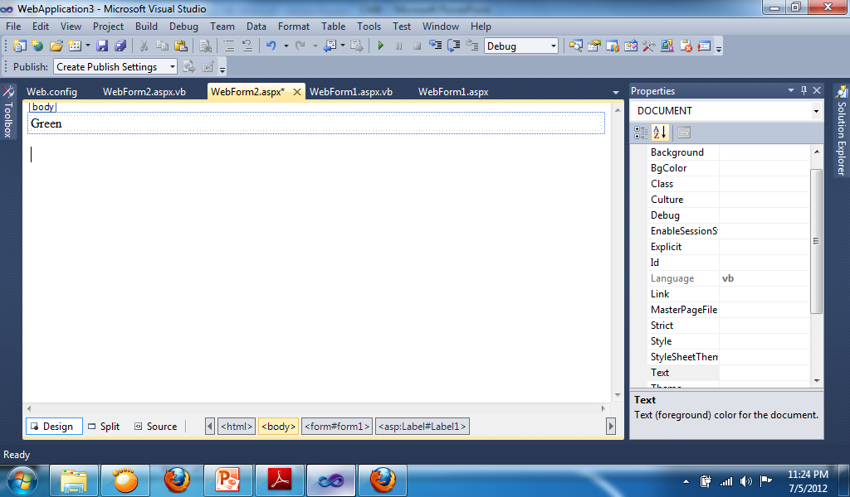
WebForm1 Button Code:
Session("Color") = ListBox1.SelectedValue
Response.Redirect("Webform2.aspx")
WebForm2 Page Load Code:
Label1.Text = Session("Color").ToString

Slide 12
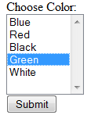
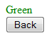
Changing color and text
Webform1 Button Code:
Session("Color") = ListBox1.SelectedValue
Response.Redirect("Webform2.aspx")
Webform2 Page Load Code:
Label1.Style.Add("color", Session("color").ToString)
Label1.Text = Session("color").ToString
Webform2 Button Code:
Response.Redirect("Webform1.aspx")

Slide 13
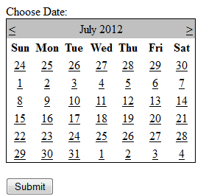
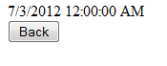
Selecting dates
Webform1 Button Code:
Session("DateSelect") = Calendar1.SelectedDate.Date
Response.Redirect("Webform2.aspx")
Webform2 Page Load Code:
Label1.Text = Session("DateSelect").ToString
Webform2 Button Code:
Response.Redirect("Webform1.aspx")

Slide 14
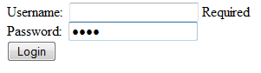
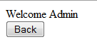
Sample for transferring username to other webform
Webform1 Button Code:
If IsValid Then
Session("username") = TextBox1.Text
Response.Redirect("Webform2.aspx")
End If
Webform2 Page Load Code:
Label1.Text = "Welcome " + Session("username").ToString
Webform2 Button Code:
Response.Redirect("Webform1.aspx")

Slide 15
Selection Statements

Slide 16
Making Decisions in a Program
The selection structure indicates that a decision (based on some condition) needs to be made, followed by an appropriate action derived from that decision. There are three types of selection structures: single-alternative, dual-alternative, and multiple-alternative.
The single-alternative selection structure requires a specific set of tasks to be performed only when the condition is true.
The dual-alternative selection structure contains one set of tasks to perform when the condition is true, but a different set of tasks to perform when the condition is false.

Slide 17
If . . . Then . . . Else statement
Syntax
If condition Then
statement block to be processed when the condition is true
[Else
statement block to be processed when the condition is false]
End If

Slide 18
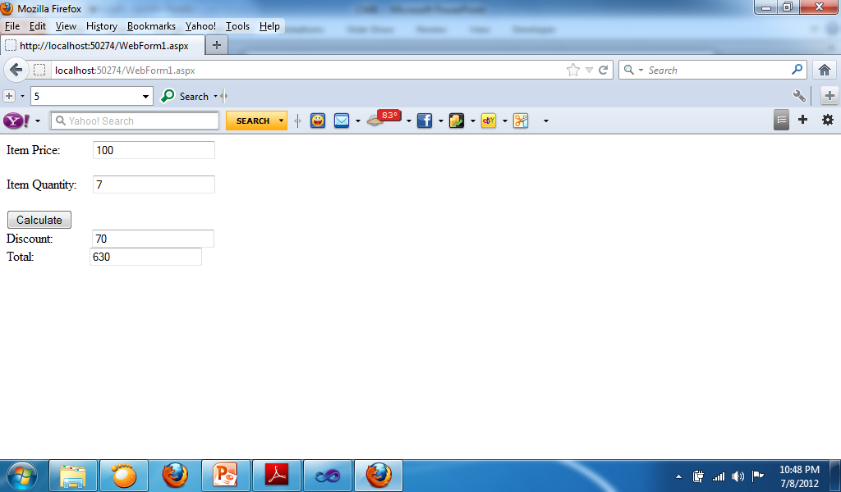
Sample for IF…THEN…ELSE Statement
Code for Button:
Dim Total, Discount As Double
Total = Val(TextBox1.Text) * Val(TextBox2.Text)
If Val(TextBox2.Text) > 5 Then
Discount = Total * 0.1
Else
Discount = 0
End If
Total = Total - Discount
TextBox3.Text = Discount
TextBox4.Text = Total

Slide 19
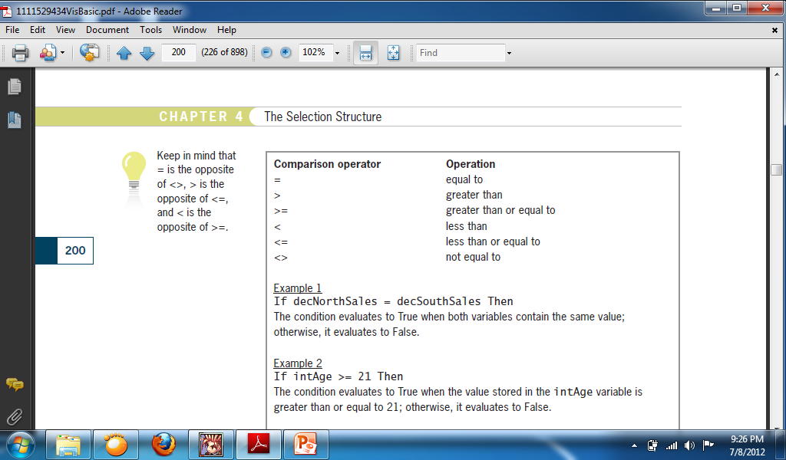
Comparison Operators
The condition in an If . . . Then . . . Else statement can contain comparison operators. The operators are called comparison operators because they are used to compare two values. The comparison always results in a Boolean value.

Slide 20
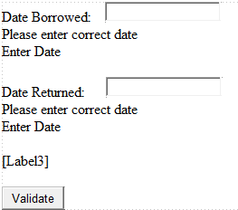
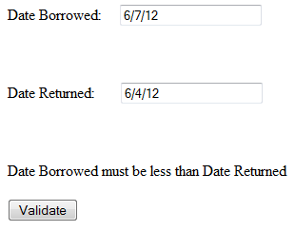
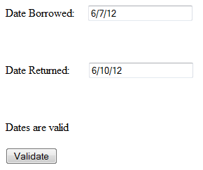
Sample for Comparison Operators
Code for Button:
If IsValid Then
Dim DateBorrowed As Date
Dim DateReturned As Date
DateBorrowed = TextBox1.Text
DateReturned = TextBox2.Text
If DateBorrowed > DateReturned Then
Label3.Text = "Date Borrowed must be less than Date Returned"
Else
Label3.Text = "Dates are valid"
End If
End If

Slide 21
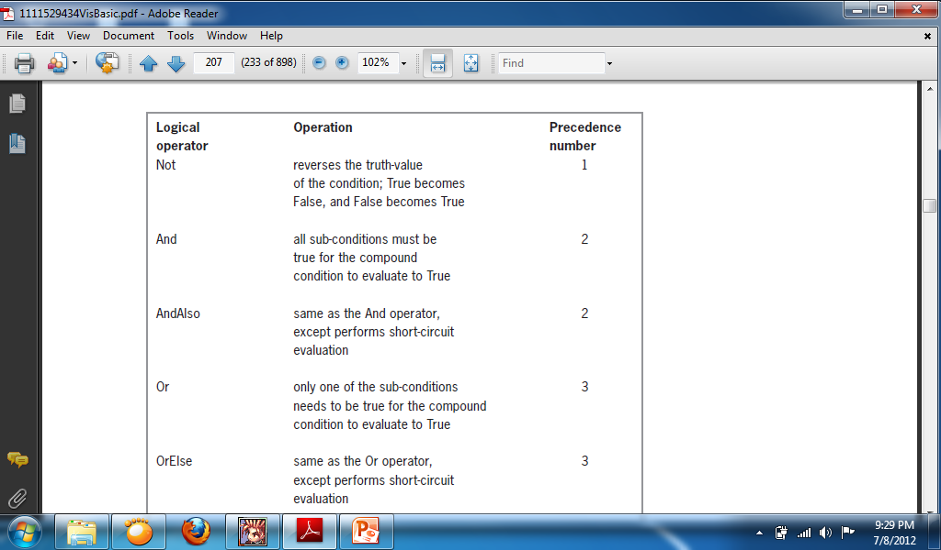
Logical Operators
An If . . . Then . . . Else statement’s condition also can contain logical operators, often referred to as Boolean operators.

Slide 22
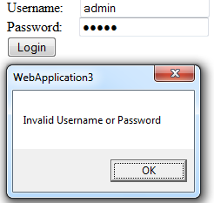
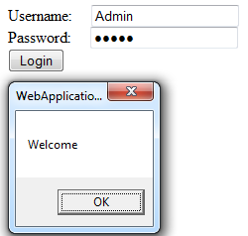
Sample for Logical Operators
Code for Button:
If TextBox1.Text = "Admin" And TextBox2.Text = "Admin" Then
MsgBox("Welcome")
Else
MsgBox("Invalid Username or Password")
End If

