Slide 1
Chapter 7 ASP.Net AJAX

Slide 2
ASP.NET is a server-side technology for building web applications. Almost all the work happens on the web server and not the web browser. Whenever you perform an action in an ASP.NET page—such as clicking a button or sorting a GridView—the entire page must be posted back to the web server. Any significant action on a page results in a postback.
When you perform a postback in an ASP.NET page, the entire page must be transported across the Internet from browser to server. Next, the .NET class that corresponds to the page must re-render the entire page again from scratch. Finally, the finished page must be sent back across the Internet to the browser. This whole long, slow, agonizing process must occur even if you are updating a tiny section of the page.

Slide 3
AJAX (Asynchronous JavaScript and XML)
This enabled already-rendered web pages to make asynchronous calls and retrieve XML, which could then be used to modify the existing page.
These are the commonly used controls in ASP.Net AJAX:
UpdatePanel Control
Timer Control

Slide 4
Using the UpdatePanel Control
Microsoft’s server-side AJAX framework consists of one main control: UpdatePanel. The UpdatePanel control enables you to update a portion of a page without updating the entire page. In other words, it enables you to perform partial-page rendering.

Slide 5
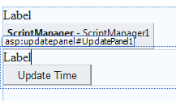
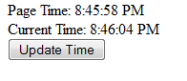
Sample using UpdatePanel control
Page_Load Code:
Label1.Text = "Page Time: " + TimeOfDay
Button Code:
Label2.Text = "Current Time: " + TimeOfDay

Slide 6
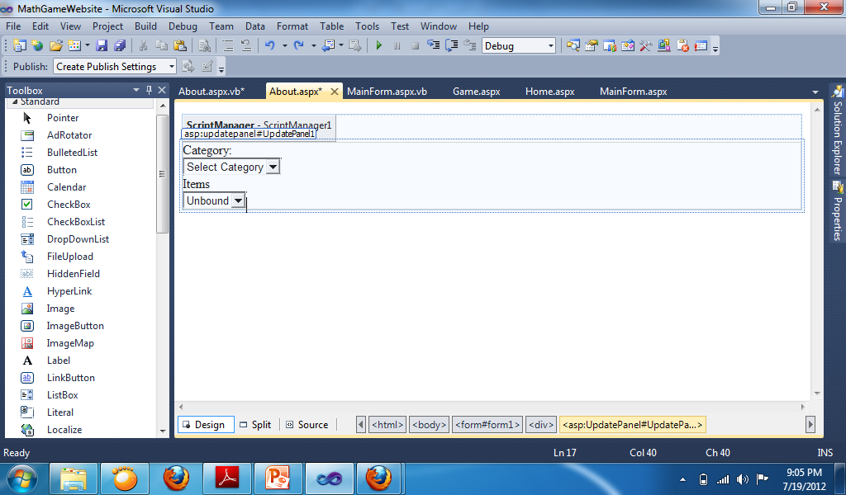
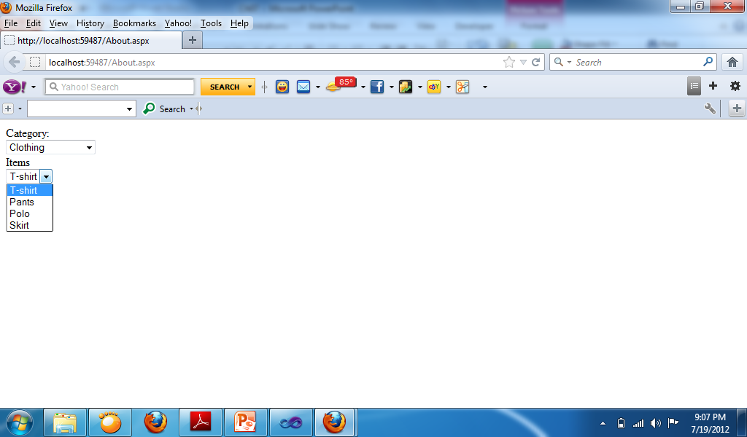

Sample using Panel Control
Change Property of Dropdownlist:
AutoPostBack: True
DropdownList 1 Code:
If DropDownList1.SelectedValue = "Clothing" Then
DropDownList2.Items.Clear()
DropDownList2.Items.Add("T-shirt")
DropDownList2.Items.Add("Pants")
DropDownList2.Items.Add("Polo")
DropDownList2.Items.Add("Skirt")
ElseIf DropDownList1.SelectedValue = "Shoes" Then
DropDownList2.Items.Clear()
DropDownList2.Items.Add("Nike")
DropDownList2.Items.Add("Converse")
DropDownList2.Items.Add("Vans")
Else
DropDownList2.Items.Clear()
End If

Slide 7
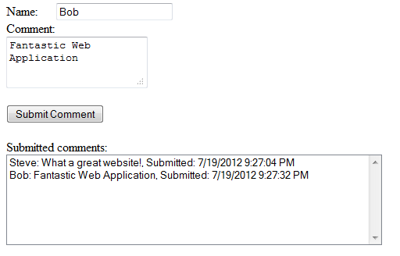
Button Code:
ListBox1.Items.Add(TextBox1.Text + ": " + TextBox2.Text + ", Submitted: " + Now)

Slide 8
AJAX Timer Control
The ASP.NET AJAX Timer control enables you to refresh an UpdatePanel (or the entire page) on a timed basis. The Timer control has one important property:
Interval—The amount of time, in milliseconds, between Tick events. The default value is 60,000 (1 minute).
The Timer control raises a Tick event every so many milliseconds, depending on the value of its Interval property.
If you don’t associate the Timer control with an UpdatePanel, the Timer posts the entire page back to the server performing a normal postback.

Slide 9
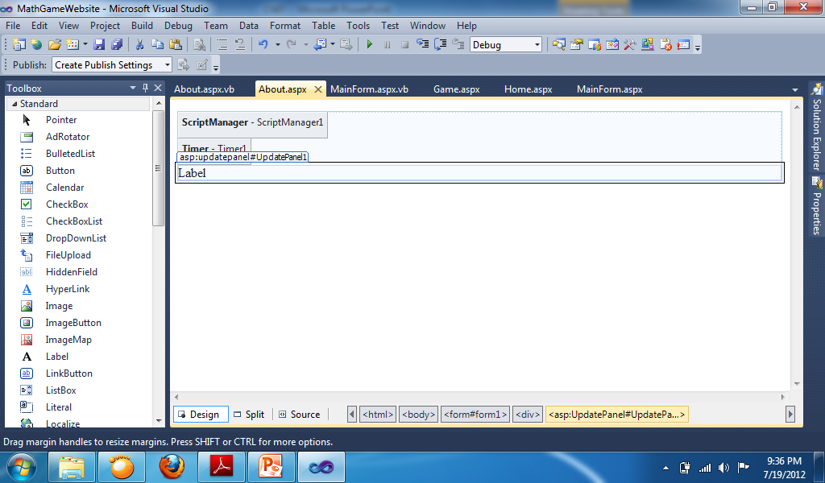
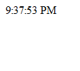
Using Timer Control
Change Property:
Timer:
Interval: 1000
UpdatePanel:
Triggers: AsyncPostBack, ControlID: Timer1, EventName: Tick
Timer Code:
Label1.Text = TimeOfDay

Slide 10
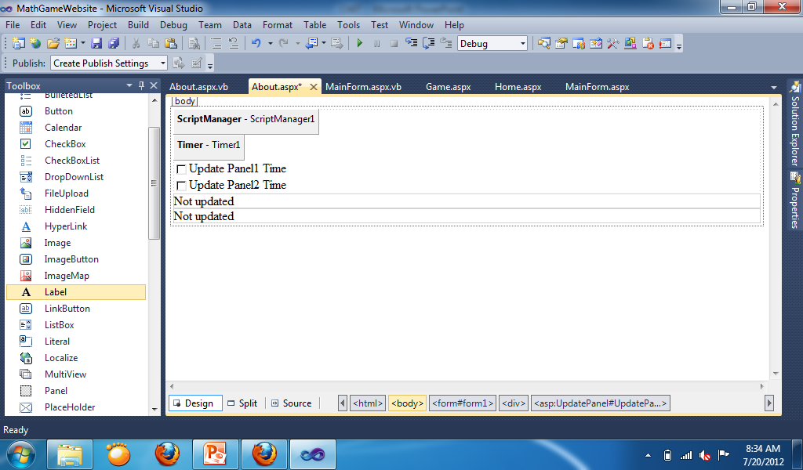
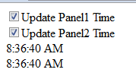
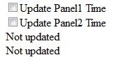
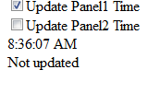
Conditional update in UpdatePanel
Change Property:
Update Panel 1:
Triggers: AsyncPostBack, ControlID: Timer1, EventName: Tick
Update Panel 2:
Triggers: AsyncPostBack, ControlID: Timer1, EventName: Tick
Code Timer1:
If CheckBox1.Checked = True Then
Label1.Text = TimeOfDay
End If
If CheckBox2.Checked = True Then
Label2.Text = TimeOfDay
End If

