Slide 1
Introduction to ARMv8 Aarch64
2014
issue.hsu@gmail.com

Slide 2
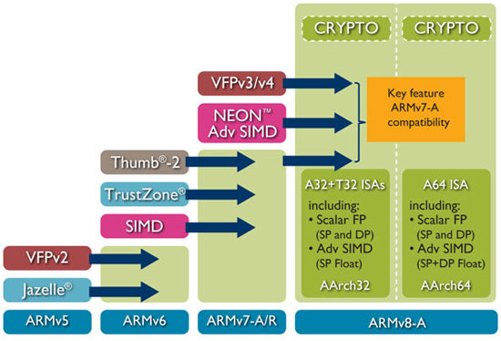
What is Aarch64?
64 Bit Instruction set introduced in ARMv8

Slide 3
Overview
64-Bit pointer and registers
Fixed length (32bit) instructions
Load/store architecture
Little endian (big endian possible)
31 general purpose registers and zero register
Unaligned access ok
Except of exclusive and ordered accesses

Slide 4
Traditional ARM features gone
No conditional execution of most instructions
No equivalent of T32 IT instruction
No “free shifts" in arithmetic instructions
Immediate shifts only
No RRX shift, no ROR shift for ADD/SUB
No open access to PC register
No co-processor concept
Now provide system instructions
No load/store multiple instructions
LDM, STM, PUSH, POP

Slide 5
Traditional ARM features still here
Floating point support is now mandatory
VFP -mostly same
AdvSIMD is based on NEON but with major changes
Weakly ordered memory
Basic arithmetic instructions usually same

Slide 6
New features
Load-acquire and store-release atomics
Crypto (AES and SHA) instructions
AdvSIMD usable for general purpose float math
Larger PC-relative addressing and branching
Literal pool access and most conditional branches are extended to ± 1MB, unconditional branches and calls to ±128MB
Non-temporal (cache skipping) load/store
Load/store of a non-contiguous pair of registers

Slide 7
New Features details

Slide 8
Advanced SIMD
Not covered in this slide

Slide 9
Registers
64 Bit integer registers:
X0 ~ X29, X30/LR, SP/ZERO
Only register with special semantics is 31, which acts as both stack pointer and a zero register
Zero register
When used as a source register, and discards the result when used as destination register
Stack pointer
When used as a load/store base register
Some arithmetic instructions
X30/LR for procedure call link register is unbanked, exception save restart PC to the target exception level’s ELR system register

Slide 10
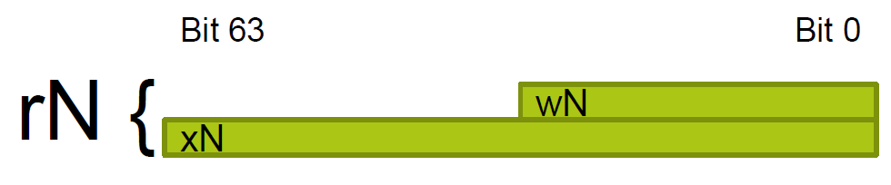
Registers (cont)
Bottom 32 bits of the registers are referred as W0 .. W30
Benefits
Easier to do 64-bit arithmetic!
Less need to spill to the stack
Spare registers to keep more temporaries

Slide 11
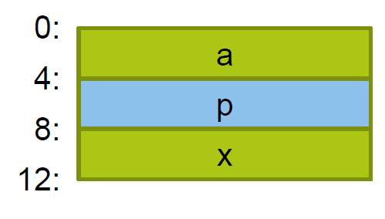
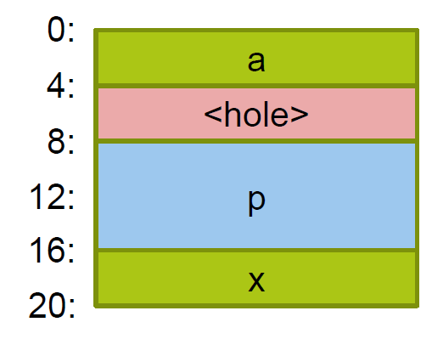
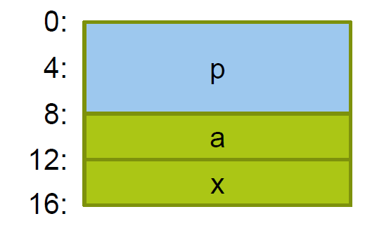
Structure Layout
struct foo {
int32_t a;
void* p;
int32_t x;
};
struct foo {
void* p;
int32_t a;
int32_t x;
};
32-bit
64-bit
64-bit

Slide 12
Data models
ARM targeted two data models for the 64-bit mode, to address the key OS partners
The first is LP64, where integers are 32-bit, and long integers are 64-bit, which is used by Linux, most UNIXes and OS X
The other is LLP64, where integers and long integers are 32-bit, while long long integers are 64-bit, and favored by Microsoft Windows
-mabi=name
Generate code for the specified data model.
Permissible values are ‘ilp32’ for SysV-like data model where int, long int and pointer are 32-bit, and ‘lp64’ for SysV-like data model where int is 32-bit, but long int and pointer are 64-bit.
The default depends on the specific target configuration. Note that the LP64 and ILP32 ABIs are not link-compatible; you must compile your entire program with the same ABI, and link with a compatible set of libraries.
Reference
http://www.unix.org/version2/whatsnew/lp64_wp.html
http://www.realworldtech.com/arm64/2/
http://gcc.gnu.org/onlinedocs/gcc/AArch64-Options.html

Slide 13
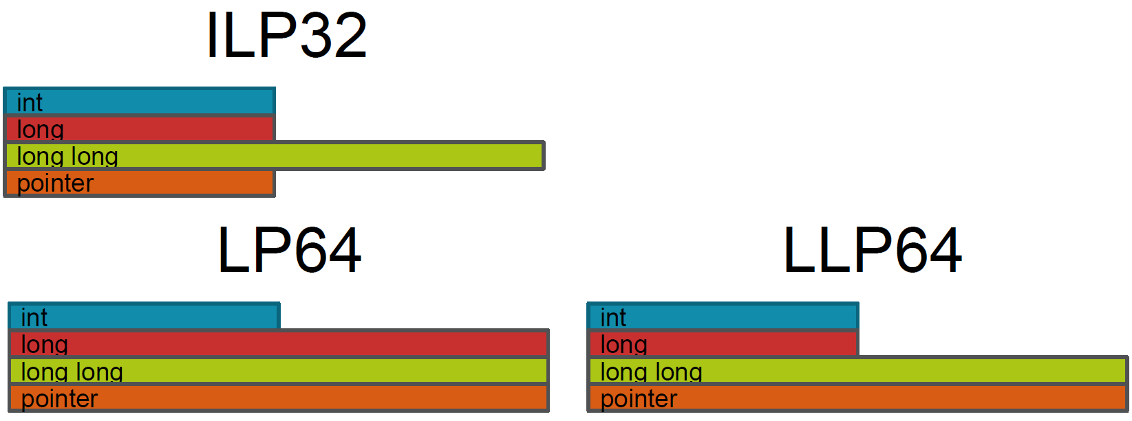
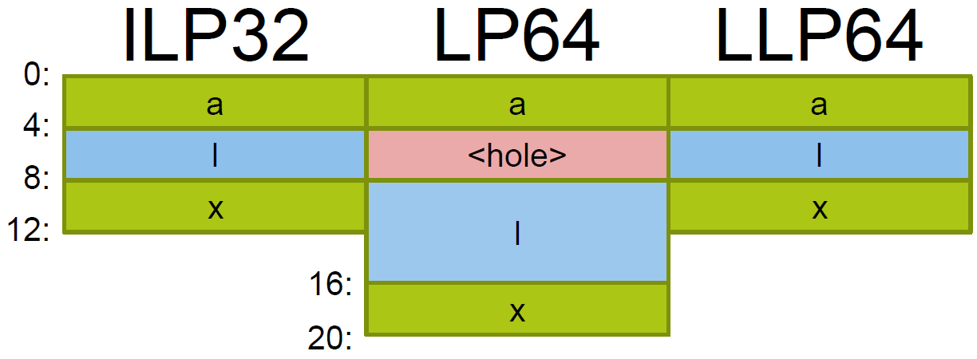
Data models (cont)
struct foo {
int a;
long l;
int x;
};
Reference
http://www.linaro.org/assets/common/campus-party-presentation-Sept_2013.pdf

Slide 14
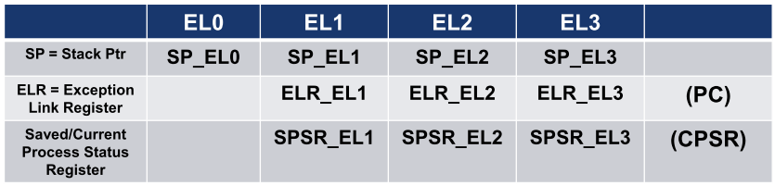
Banked registers
AArch64 Banked registers are banked by exception level
Used for exception return information and stack pointer
EL0 Stack Pointer can be used by higher exception levels after exception taken

Slide 15
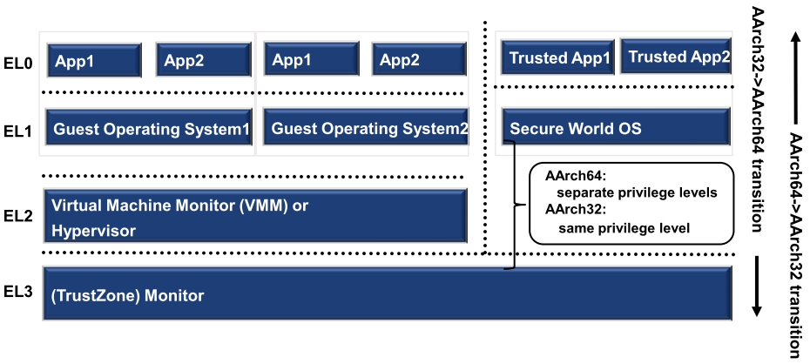
Exception model
4 exception levels: EL3-EL0
Forms a privilege hierarchy, EL0 the least privileged
Exceptions can be taken to the same or a higher exception level

Slide 16
Conditional instructions
Instructions are unconditionally executed but use the condition flags as an extra input to the instruction
Conditional branch
CBZ, B.cond
Add/subtract with carry
ADC, SBC
Conditional compare
CCMP
Conditional select/set with increment, negate or invert
Benchmarking reveals these to be the highest frequency used of single conditional instructions
CSEL, CSET

Slide 17

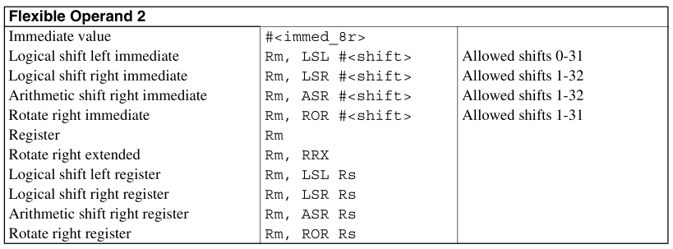
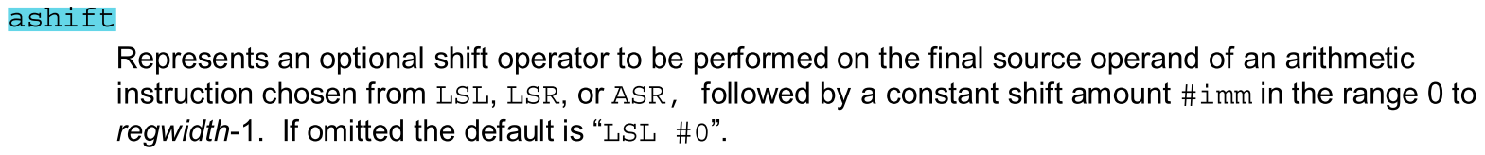
Immediate shifts for ADD/SUB
In ARMv7
In ARMv8

Slide 18
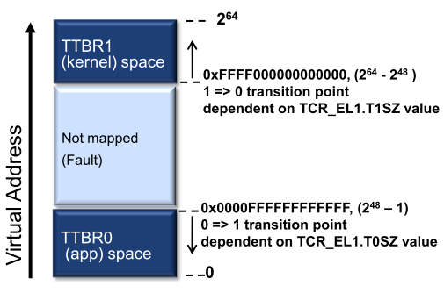
Addressing features
VA address space has a maximum address width of 48 bits, gives a maximum VA space of 256TB, with VA range of 0x0000_0000_0000_0000 to 0x0000_FFFF_FFFF_FFFF
For the EL1&0 translation stage the VA range is split into two subranges, one at the bottom of the full 64-bit address range of the PC, and one at the top, as follows:
The bottom VA range runs up from address 0x0000_0000_0000_0000. With the maximum address width of 48 bits this gives a VA range of 0x0000_0000_0000_0000 to 0x0000_FFFF_FFFF_FFFF
The top VA subrange runs up to address 0xFFFF_FFFF_FFFF_FFFF. With the maximum address width of 48 bits this gives a VA range of 0xFFFF_0000_0000_0000 to 0xFFFF_FFFF_FFFF_FFFF

Slide 19
Addressing features (cont)
Register indexed addressing
Allowing a 64-bit index register to be added to 64-bit base register
Providing sign or zero extension of 32-bit value within an index register
PC relative addressing
PC-relative literal loads have an offset range of ±1MB. This permits fewer literal pools, and more sharing of literal data between functions – reducing I-cache and TLB pollution
Most conditional branches have a range of ±1MiB, expected to be sufficient for the majority of conditional branches which take place within a single function
Unconditional branches, including branch and link, have a range of ±128MiB. Expected to be sufficient to span the static code segment of most executable load modules and shared objects, without needing linker-inserted trampolines or “veneers”
PC-relative load/store and address generation with a range of ±4GiB may be performed inline using only two instructions, i.e. without the need to load an offset from a literal pool

Slide 20
An example for global variable access
extern int gVar;
int main(void)
{
return gVar;
}
.arch armv5te
.text
.align 2
.global main
.type main, %function
main:
ldr r3, .L3
ldr r0, [r3]
bx lr
.L4:
.align 2
.L3:
.word gVar
.arch armv7-a
.text
.align 2
.global main
.type main, %function
main:
movw r3, #:lower16:gVar
movt r3, #:upper16:gVar
ldr r0, [r3, #0]
bx lr
.arch armv8-a+fp+simd
.section .text.startup
.align 2
.global main
.type main, %function
main:
adrp x0, gVar
ldr w0, [x0,#:lo12:gVar]
ret
arm-marvell-eabi-gcc -S -O2 -march=armv5te global.c
arm-marvell-eabi-gcc -S -O2 -march=armv7-a global.c
aarch64-marvell-elf-gcc -S -O2 -march=armv8-a global.c

Slide 21
Address Generation
ADRP Xd, label
Address of Page
Sign extends a 21-bit offset, shifts it left by 12 and adds it to the value of the PC with its bottom 12 bits cleared, writing the result to register Xd
This computes the base address of the 4KB aligned memory region containing label, and is designed to be used in conjunction with a load, store or ADD instruction which supplies the bottom 12 bits of the label’s address
This permits position-independent addressing of any location within ±4GB of the PC using two instructions, providing that dynamic relocation is done with a minimum granularity of 4KB
The term “page” is short-hand for the 4KB relocation granule, and is not necessarily related to the virtual memory page size

Slide 22
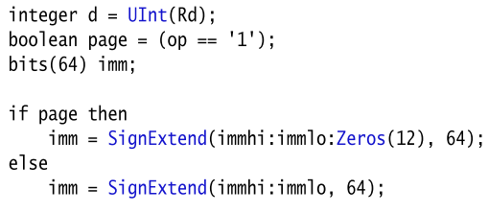
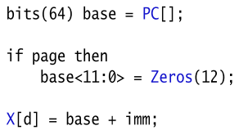
Address Generation (cont)
ADR Xd, label
Address
Adds a 21-bit signed byte offset to the program counter, writing the result to register Xd
Used to compute the effective address of any location within ±1MiB of the PC

Slide 23
The program counter (PC)
Cannot be used in arithmetic and load/store instructions
Instructions that implicitly read PC
PC relative address compute instructions
ADR, ADRP, literal load, direct branch
Its value is the address of the instruction, there is no implied offset of 4 or 8 bytes
Branch-and-link instructions
BL, BLR, will store PC to link register
Instructions to implicitly modify PC
Explicit control flow instructions
[Un]conditional branch, exception generation, exception return instructions

Slide 24
Memory Load-Store
Bulk transfers
LDM, STM, PUSH, POP do not exist in Aarch64
LDP, STP that load and store a pair of independent registers from consecutive memory locations, which support unaligned addresses when accessing normal memory
LDNP, STNP provide a streaming or non-temporal hint that data does not need to be retained in caches
A special exception to the normal memory ordering rules, where an address dependency exists between two memory reads and the second read was generated by a LDNP then, in the absence of any other barrier mechanism to achieve order, those memory accesses can be observed in any order by other observers within the shareability domain of the memory addresses being accessed.
Notes:
Address dependency
An address dependency exists when the value returned by a read access is used to compute the address of a subsequent read or write access. The address dependency exists even if the value read by the first read access does not change the address of the second read or write access.

Slide 25
Memory Load-Store (cont)
Exclusive accesses
LDXR, LDXP, STXR, STXP
Exclusive access to a pair of double words permit atomic updates of a pair of pointers
Must be naturally aligned, exclusive pair access must be aligned to twice the data size
Load-acquire, store-release
LDAR, STLR, LDAXR, STLXR
Explicitly synchronizing load and store instructions (release-consistency memory model)
Reducing the need for explicit memory barriers
Require natural address alignment

Slide 26
Memory Load-Store (cont)
Prefetch Memory
Support following addressing modes:
Base plus a scaled 12-bit unsigned immediate offset or base plus an unscaled 9-bit signed immediate offset
Base plus a 64-bit register offset. This can be optionally scaled by 8-bits, for example LSL#3.
Base plus a 32-bit extended register offset. This can be optionally scaled by 8-bits.
PC-relative literal.
PRFM <prfop>, addr | label
<prfop> is defined as <type><target><policy>
<type>: PLD (prefetch for load), PST (prefetch for store), PLI (preload instructions)
<target>: L1 (level 1 cache), L2 (level 2 cache), L3 (level 3 cache)
<policy>
KEEP: Retained or temporal prefetch, allocated in the cache normally
STRM: Streaming or non-temporal prefetch, for data that is used only once
PLDL1KEEP, PSTL2STRM, PLIL3KEEP

Slide 27
Floating Point
There is no “soft-float” variant of the AARCH64 Procedure Calling Standard
The deprecated small vector feature of VFP is removed
Load/store addressing modes are identical to integer load/store
FCSEL/FCCMP equivalent to integer CSEL/CCMP instructions
Set integer condition flags directly, not modify FPSR
All floating-point multiply-add and multiply-sub instructions are “fused”

Slide 28
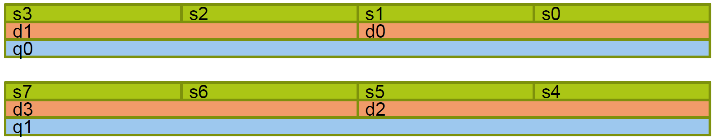
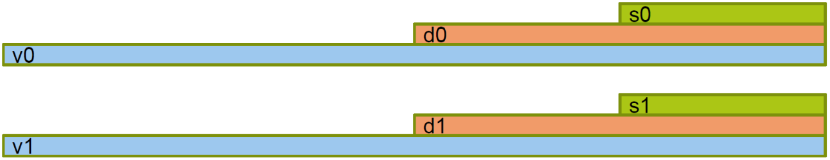
Scalar/SIMD Registers
SIMD and Scalar share register bank
32 bit float registers: S0 ... S31
64 bit double registers: D0 ... D31
128 bit SIMD registers: V0 ... V31
S0 is bottom 32 bits of D0 which is the bottom 64 bits of V0

Slide 29
System instructions
Exception generating instructions
SVC, HVC, SMC, ERET
BRK, HLT, DCPSn, CRPS
System register access
No access to CPSR as a single register, but with system instruction
MRS, MSR
System management
Cache and TLB maintenance, address translation
Architectural hints
NOP, WFE, WFI, SEV
Barriers and CLREX
DMB, DSB, ISB, CLREX
Notes:
SVC: gen exception target at EL1
HVC: gen exception target at EL2
SMC: gen exception target at EL3
DCPSn: debug change processor state to ELn
CRPS:debug restore processor state
WFE: wait for event
WFI: wait for interrupt
SEV: send event

Slide 30
Weakly ordered memory model
With ARM MP systems, the thread using programmer will also have to deal with weak memory model
Unlike on X86, but like Aarch32 and PowerPC, order of writes to memory isn't guaranteed. Deal with it:
use mutexes!
barrier instructions DMB, DSB, ISB
ARMv8: Load-Acquire/Store-Release instructions: LDRA, STRL

Slide 31
GNU/Linux porting issues

Slide 32
Good News
Most typical C/C++ OSS software compiles just fine - except:
when code assumes endianness or struct sizes
or calls kernel system call directly
or has assembler code or a JIT
or uses autoconf ^_^

Slide 33
Most common porting problem
checking build system type... x86_64-pc-linux-gnu
checking host system type... Invalid configuration `aarch64-oe-linux': machine `aarch64-oe' not recognized
configure: error: /bin/sh config.sub aarch64-oe-linux failed
Please run autoreconf against autotools-dev 20120210.1 or later, and make a release of your software.

Slide 34
Available defines
aarch64-oe-linux-cpp -dM -E - < /dev/null|sort
...
#define __aarch64__ 1
#define __BYTE_ORDER__ __ORDER_LITTLE_ENDIAN__
#define __CHAR_UNSIGNED__ 1
#define __SIZEOF_POINTER__ 8
... but this is gcc specific!

Slide 35
Test features, not platform
Works but not portable
#if defined (__alpha__) || defined(__aarch64__)
// assume 64-bit pointers
#elif ...
Instead
#if __SIZEOF_POINTER__ == 8
// assume 64-bit pointers
#elif ...

Slide 36
Aarch64 call convention
Arguments and return values in registers
X0 - X7 arguments and return value
X8 indirect result (struct) location
X9 - X15 temporary registers
X16 - X17 intra-call-use registers (PLT, linker)
X18 platform specific use (TLS)
X19 - X28 callee-saved registers
X29 frame pointer
X30 link register
SP stack pointer (XZR)
Reference
IHI0055B_aapcs64.pdf

Slide 37
Aarch64 call convention floats
VFP/SIMD mandatory - no soft float ABI
V0 - V7 arguments and return value
D8 - D15 callee saved registers
V16 - V31 temporary registers
Bits 64:128 not saved on V8-V15
Reference
IHI0055B_aapcs64.pdf

Slide 38
System calls
Since the architectures are new, some legacy support has been removed
linux-3.10.18/include/uapi/asm-generic/unistd.h

Slide 39
System calls
Deprecated system calls are not available:
alarm -> ualarm
epoll_wait -> epoll_pwait
futimesat -> utimensat
getpgrp -> getpgid
pause -> ?
recv -> recvfrom
send -> sendto
time -> ?
ustat -> statfs
bdflush -> gone!
fork -> clone
getdents -> getdents64
oldumount -> umount
poll -> ppoll
select -> pselect6
sysctl -> use /proc/sys
uselib -> gone!
utime -> utimes

Slide 40
System calls
Pre-at system calls are not available:
open -> openat
unlink -> unlinkat
chmod -> chmodat
mkdir -> mkdirat
lchown -> lchownat
rename -> renameat
symlink -> symlinkat
link -> linkat
mknod -> mknodat
chown -> chownat
rmdir -> rmdirat
access -> accessat
readlink -> readlinkat
utimes -> utimensat

Slide 41
System calls
System calls without flags parameter:
pipe -> pipe2
dup2 -> dup3
epoll_create -> epoll_create1
inotify_init -> inotify_init1
eventfd -> eventfd2
signalfd -> signalfd4

Slide 42
Reference
64-bit ARM - introduction to porting
ARMv8 Instruction Set Overview
ARM Architecture Reference Manual - ARMv8, for ARMv8-A architecture profile
ARMv8 Technology Preview

