Slide 1
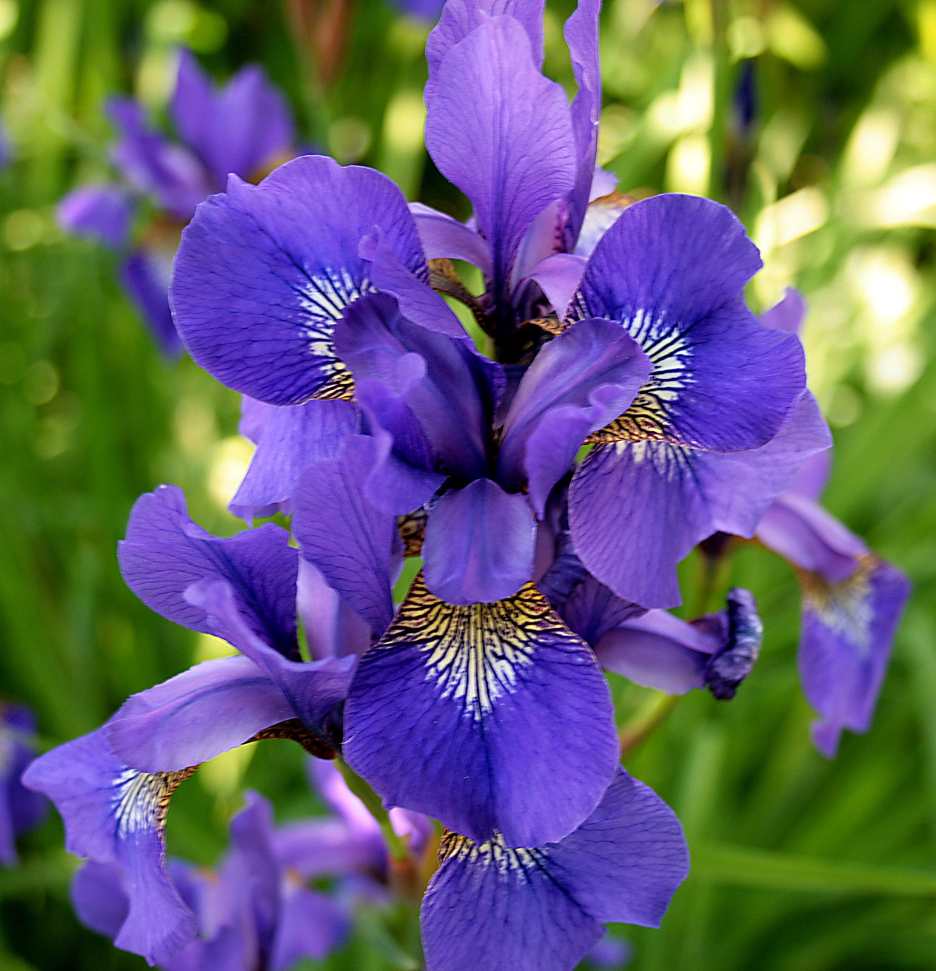
Iris
Classification

Slide 2



Problem
The Iris dataset stands as a classic benchmark for testing classification algorithms. But how can we push the boundaries of accuracy and reliability in classifying iris species?

Slide 3

Process
1
Data Handling
Exploratory Data Analysis
2
3
Training and Testing the data
Applying Logistic Regression as a classification model
4
5
Model Evaluation Metrics

Slide 4

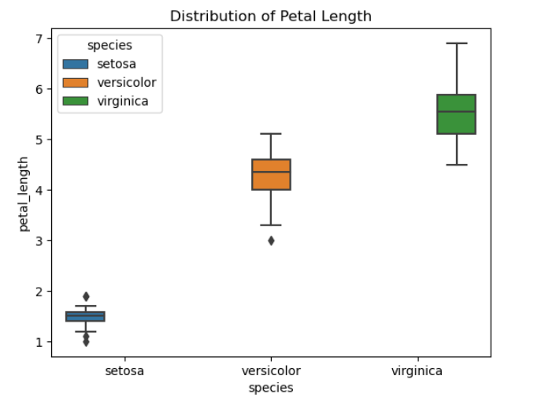
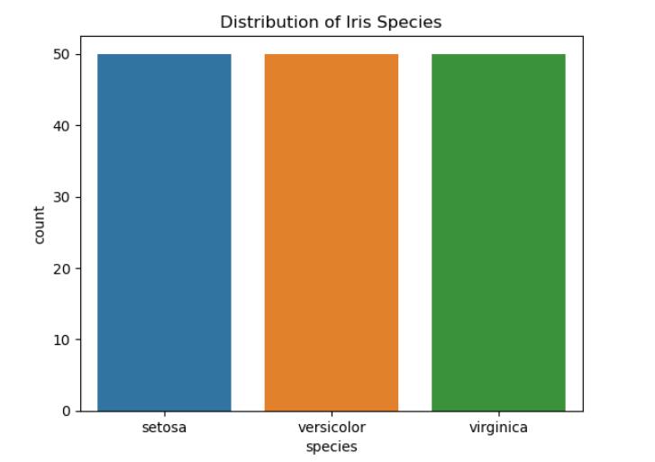
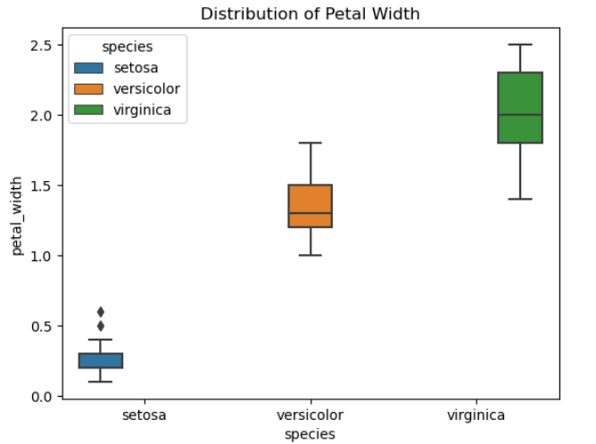
Iris flower has 3 types of species
Setosa has the smallest petal lengths and Petal width with the least variability.
Versicolor shows moderate petal lengths and petal width with moderate variability.
Virginica has the longest petal lengths and petal width, also with some variability but no extreme outliers.

Slide 5
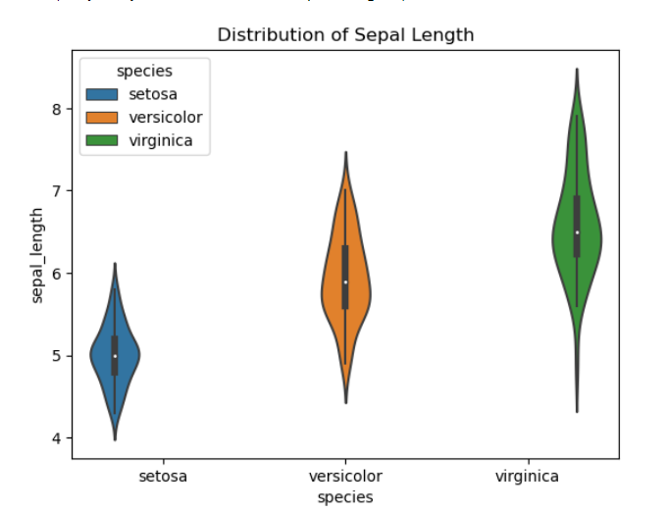
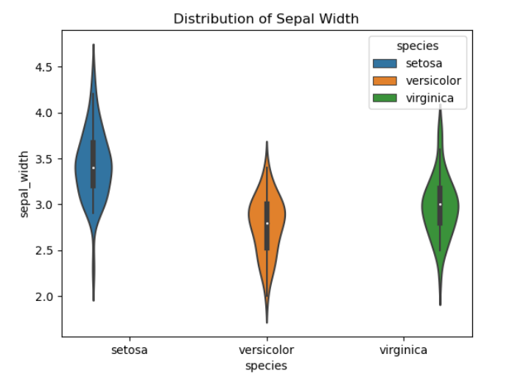
Setosa shows a narrow distribution indicating less variability in terms of sepal length.
Versicolor shows a wider distribution, suggesting more variability in sepal length.
Virginica also has a wider distribution like versicolor, but with a slightly higher median sepal length.
Setosa shows the most variation in sepal width. This suggests that setosa flowers have more diversity in sepal width compared to the other species.
Versicolor has the most symmetric distribution of sepal width, which indicates that its sepal widths are more consistently centered around the median value.
Virginica has a higher median sepal width than versicolor but less spread compared to setosa.

Slide 6
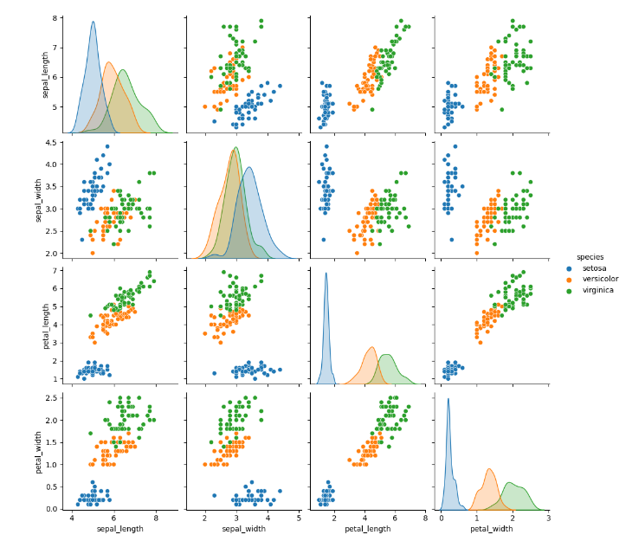
Pair Plot
The Pair plot here shows displays pairwise relationships in a dataset
Scatter Plots:
Sepal Length vs. Sepal Width: Setosa tends to have shorter sepal lengths and wider sepal widths compared to versicolor and virginica.
Petal Length vs. Petal Width: There’s a clear separation between the species, with setosa having the smallest petal dimensions, followed by versicolor and then virginica.
Histograms:
Sepal Length: Setosa shows a distinct peak at a shorter sepal length, while versicolor and virginica have more spread-out distributions.
Petal Length: Setosa has a narrow distribution with smaller petal lengths, whereas versicolor and virginica show more variation and larger petal lengths.

Slide 7
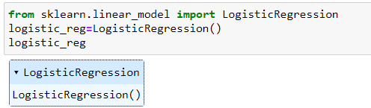
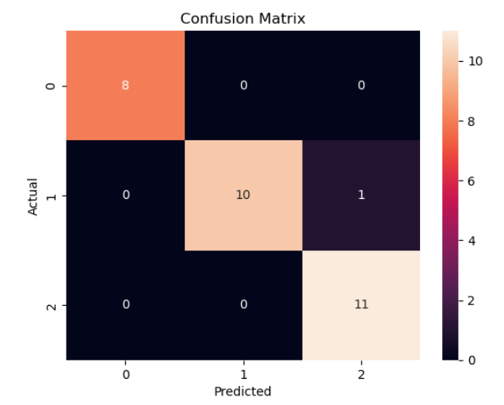


Logistic Regression has been used as a classification model
A confusion matrix is a table used to evaluate the performance of a classification model.
The model evaluation metrics like Precision , Recall, F1 score are given below
Best parameter for the model is mentioned below:
We can see that the model is having good level of accuracy.

Slide 8
Thank you

