Slide 1


Netflix Data:
Cleaning, Analysis and Visualization
By- Dyuti Dewanjee

Slide 2



Today's agenda
Problem
Process
Insights
Business Implications

Slide 3


Problem
Netflix, a global streaming giant, offers a vast library of movies and TV shows. But what are its Top contents, popular genres? Who are the top directors ! __ and more..

Slide 4

Process
1
Understanding The Data
2
Data Cleaning
3
Data Modelling
4
Data Analysis and Data Visualization
5
Uncover Insights

Slide 5
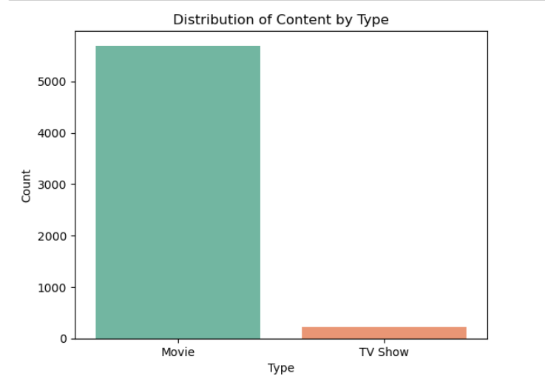
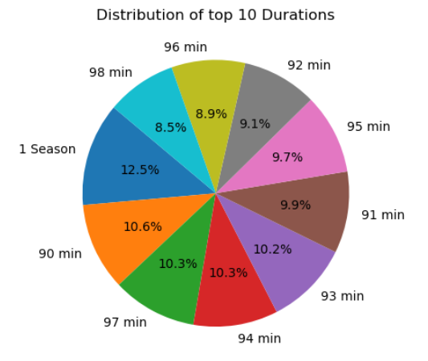
There are 5696 movies and 219 Tv shows present in the Netflix data. Count of movies present in the dataset is much higher than that of TV shows.
Incase of movies we can see most of the movies have a duration ranging in between 90 mins to 98 mins
Whereas majority of the TV Shows present in Netflix has only 1 season.

Slide 6
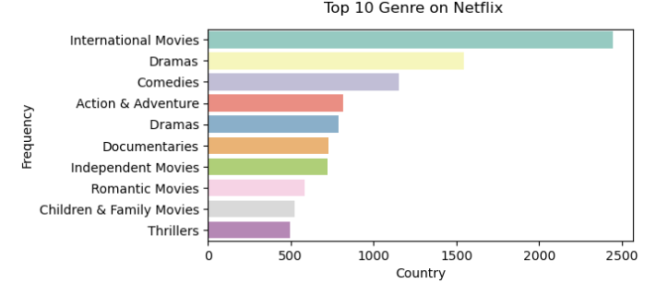
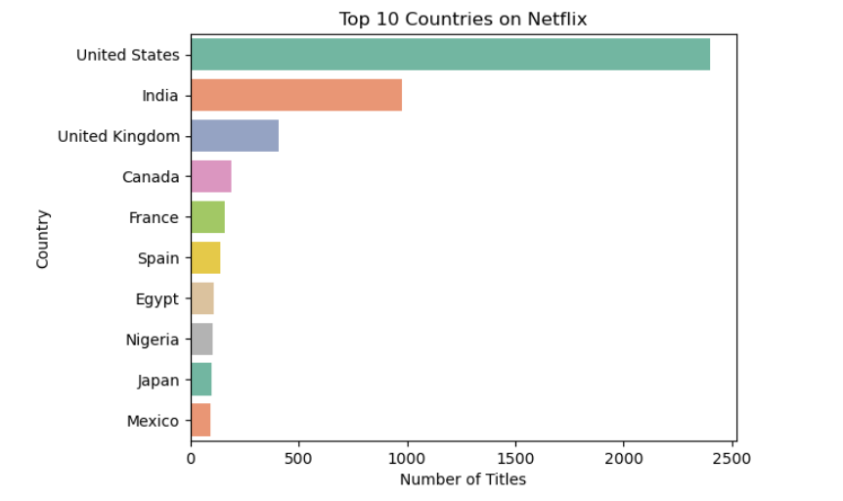
Among the Top 10 Genre on Netflix
International Movies ( 2445) ,Dramas (1543),Comedies (1154) are the top 3 genres having a count more than 1000
United States (2401) and India (975) are the countries with highest frequency present in the dataset.

Slide 7
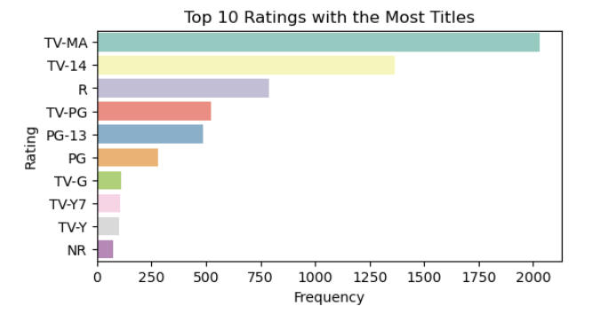
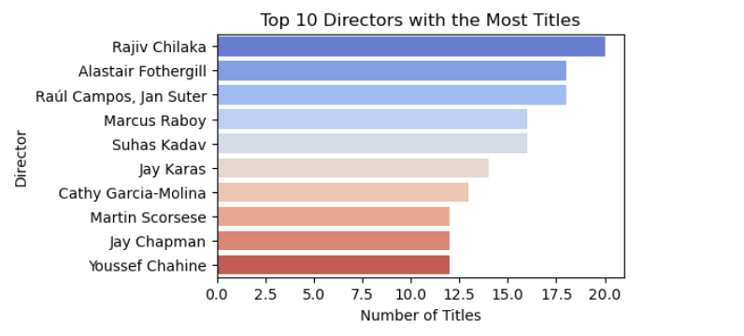
Top 2 Ratings of TV Shows present in Netflix are
TV-MA ( 2029)
TV-14 ( 1368)
Top 2 Ratings of Movies present in Netflix are
R ( 787)
PG-13 (486)
Rajiv Chilaka , Alastair Fothergill , Raúl Campos, Jan Suter
are the directors having major contribution in Netflix Movies and TV shows

Slide 8
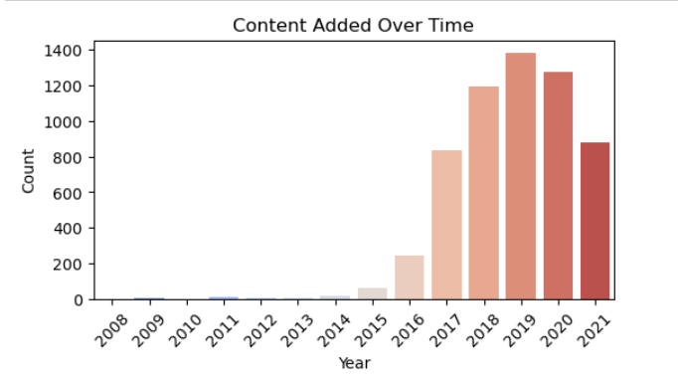
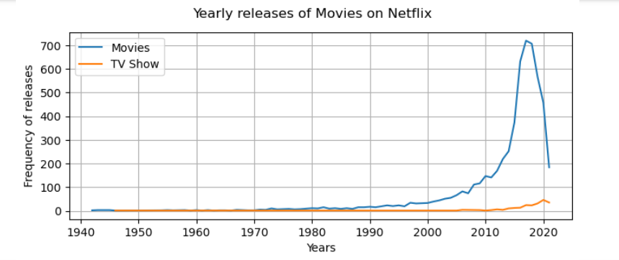
From the Bar diagram it is seen that most of the content was added on Netflix after 2015 and it peaked during the year 2019.
Even though Netflix was launched during the late 90’s ,
It actually gained its momentum after 2010 and is currently a streaming giant.
From line graph we can see most of the movies and Tv shows had it yearly release on Netflix some what between 2010 to 2016-17, but the rate of yearly release gradually declined afterwards

Slide 9

The size of each word indicates its frequency or importance within the dataset..
It is seen that most of the movie titles are on “Love” , “ Christmas”, “Man”, “Life”, ”Girl”, “Secret” etc.

Slide 10

Insights
Movies are the most common content types on Netflix
Most of the movies range from 90 to 98 mins.
Whereas only a few TV shows are present and most of them are having only 1 seasons.
Most of the movies present are rated R or PG-13And The TV shows are mostly rated TV-MA and TV-14
International Movies , Dramas , Comedies are the trending genres
Top 2 countries with the most content on Netflix are United States and India.
Rajiv Chilaka , Alastair Fothergill , Raúl Campos, Jan Suter are the directors having major contribution in Netflix Movies and TV shows
Most of the movies and Tv shows had it yearly release on Netflix some what between 2010 to 2016-17, but the rate of yearly release gradually declined afterwards
Majority of the movie titles are on “Love” , “ Christmas”, “Man”, “Life”, ”Girl”, “Secret” etc.

Slide 11
Business Implications
Apart from the movies Netflix should put a lot of emphasis on adding good TV Shows and launch more seasons of Top pre existing TV Shows to increase viewers engagement.
It should also include more movies from different countries to expand it horizon and be relevant to people from different countries.
It is also seen that the rate of yearly releases of movies have decreased after 2018. So movies based on the popular genres should be added into it’s list.

Slide 12
Thank you!

