Slide 1
Point Cloud Course Project
PointNet vs DGCNN | ModelNet40 & ModelNet10

Slide 2
Project Overview
Two-stage workflow: Colab training + report & presentation
Models: PointNet baseline, data augmentation, SE-attention, DGCNN comparison
Datasets: ModelNet40 main task and ModelNet10 cross-dataset test
Outputs: loss/accuracy curves, comparison figures, and best checkpoints

Slide 3
Training & Experiment Flow
Baseline: PointNet on ModelNet40 with standard HDF5 pipeline
Advanced: data augmentation + SE-block attention
Cross-dataset: evaluate robustness on ModelNet10
SOTA reference: DGCNN training for comparison

Slide 4
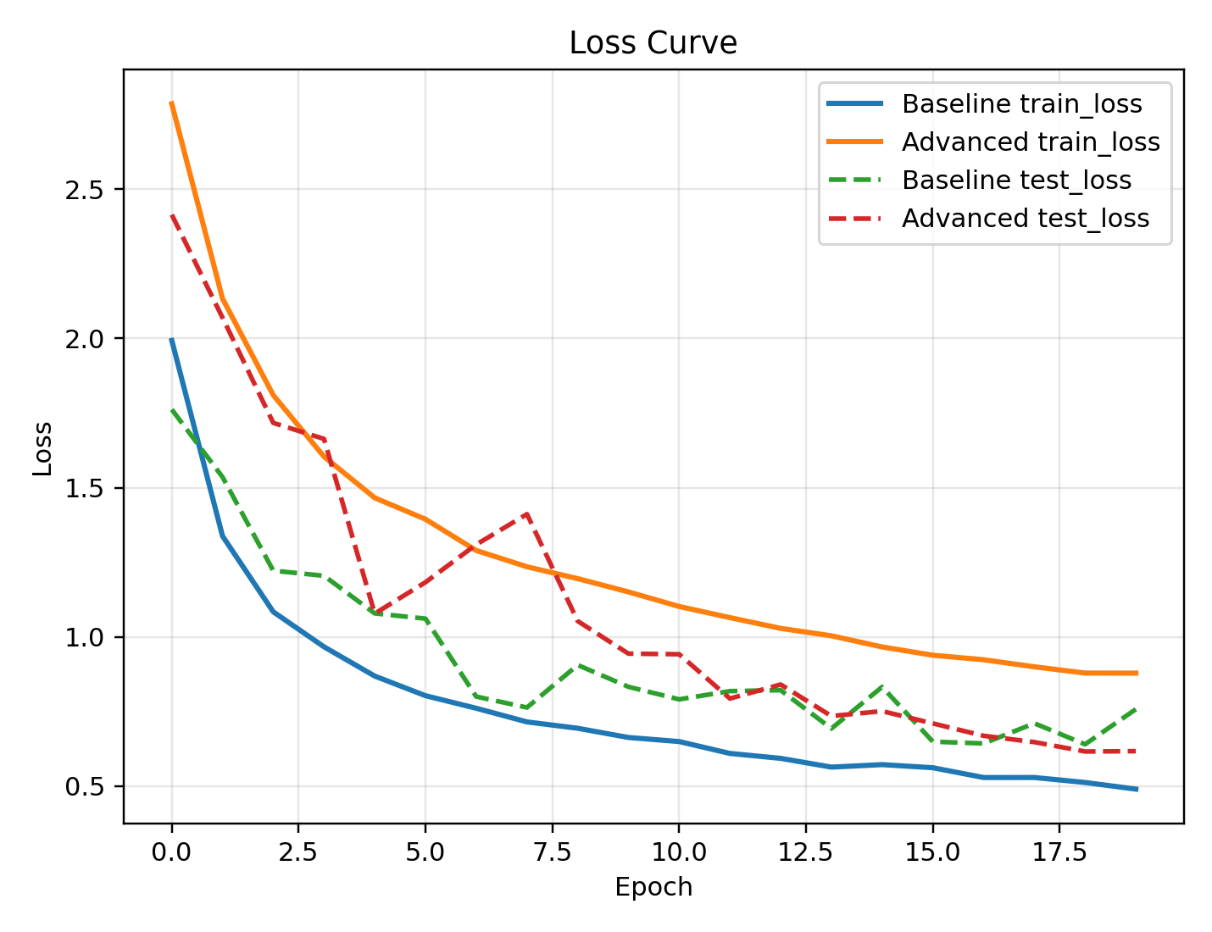
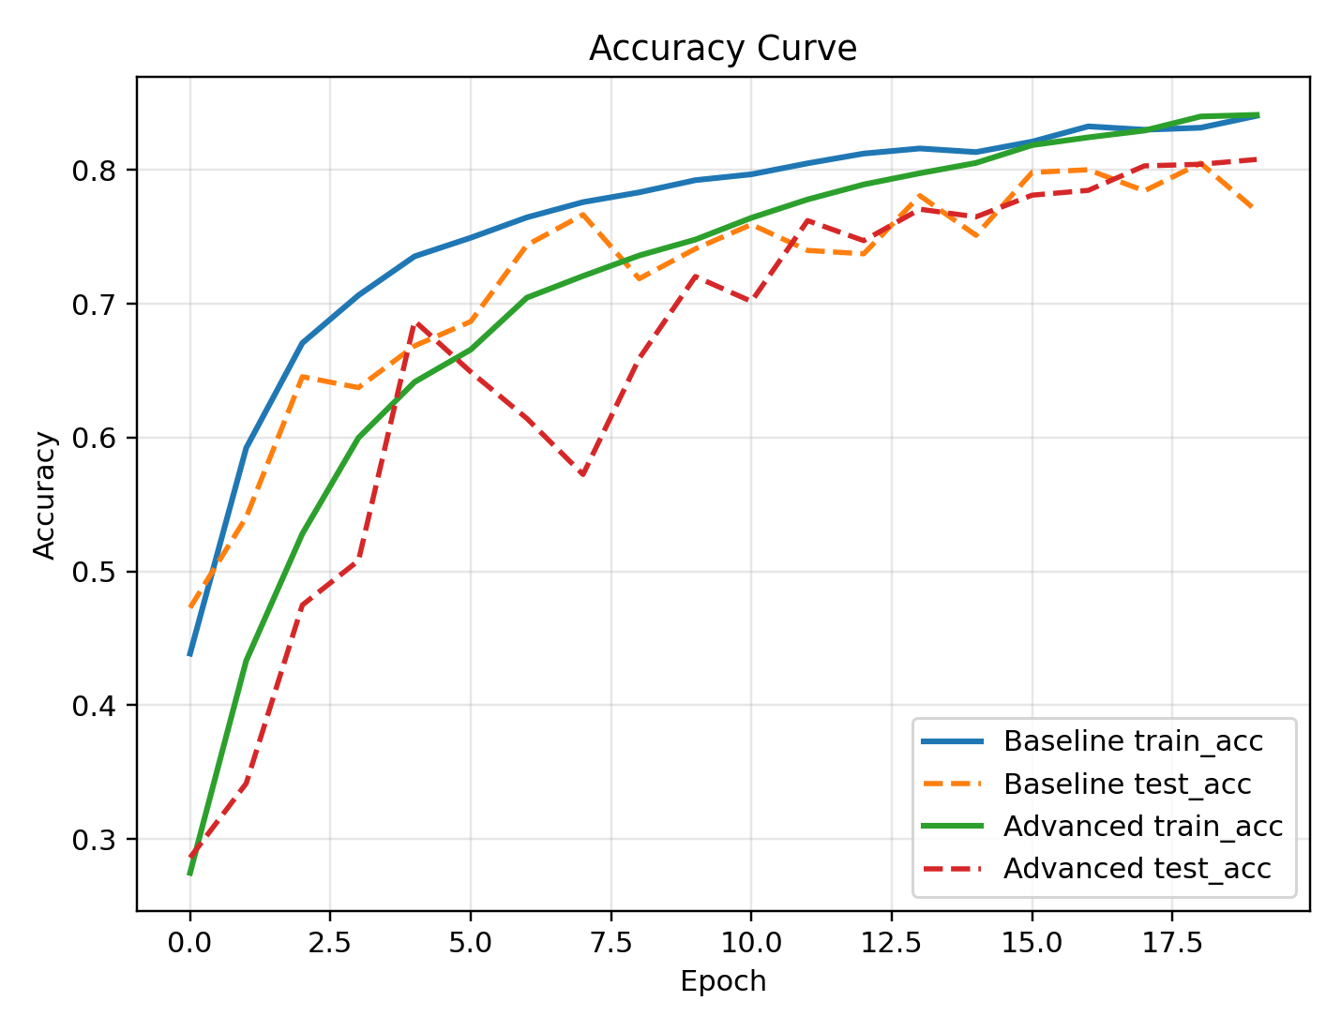
ModelNet40 Curves (Baseline vs Advanced)
Loss comparison
Accuracy comparison

Slide 5
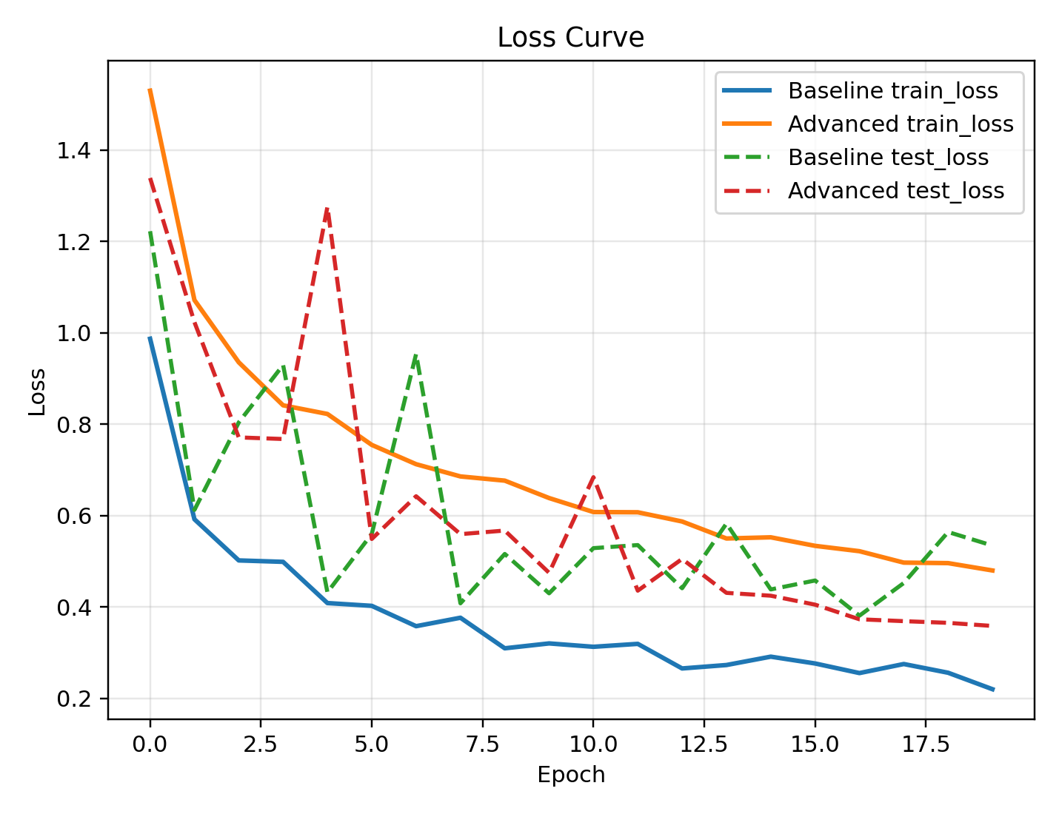
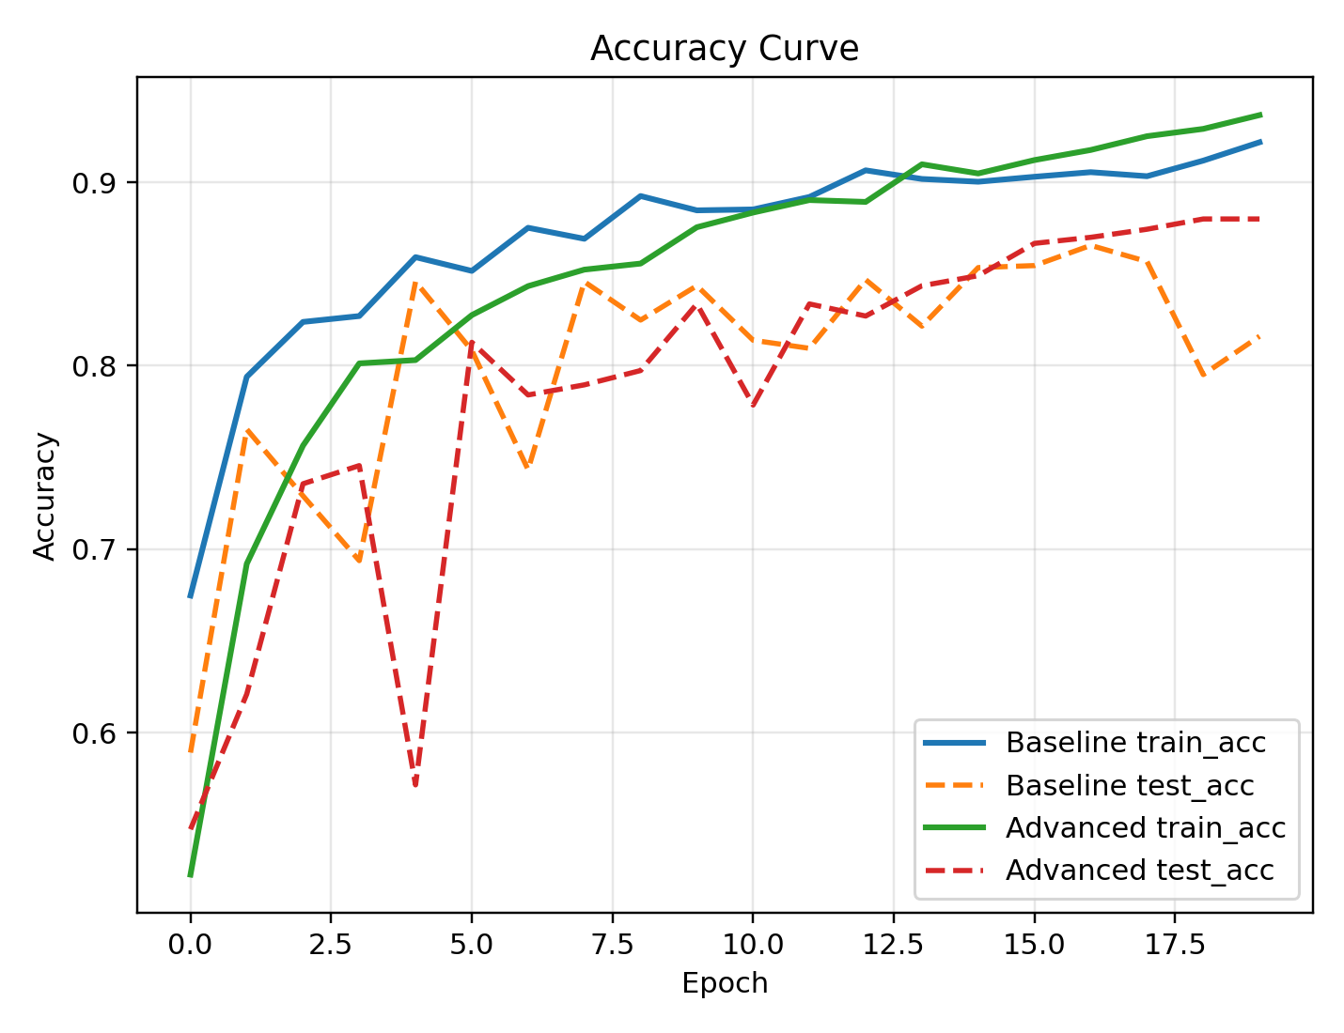
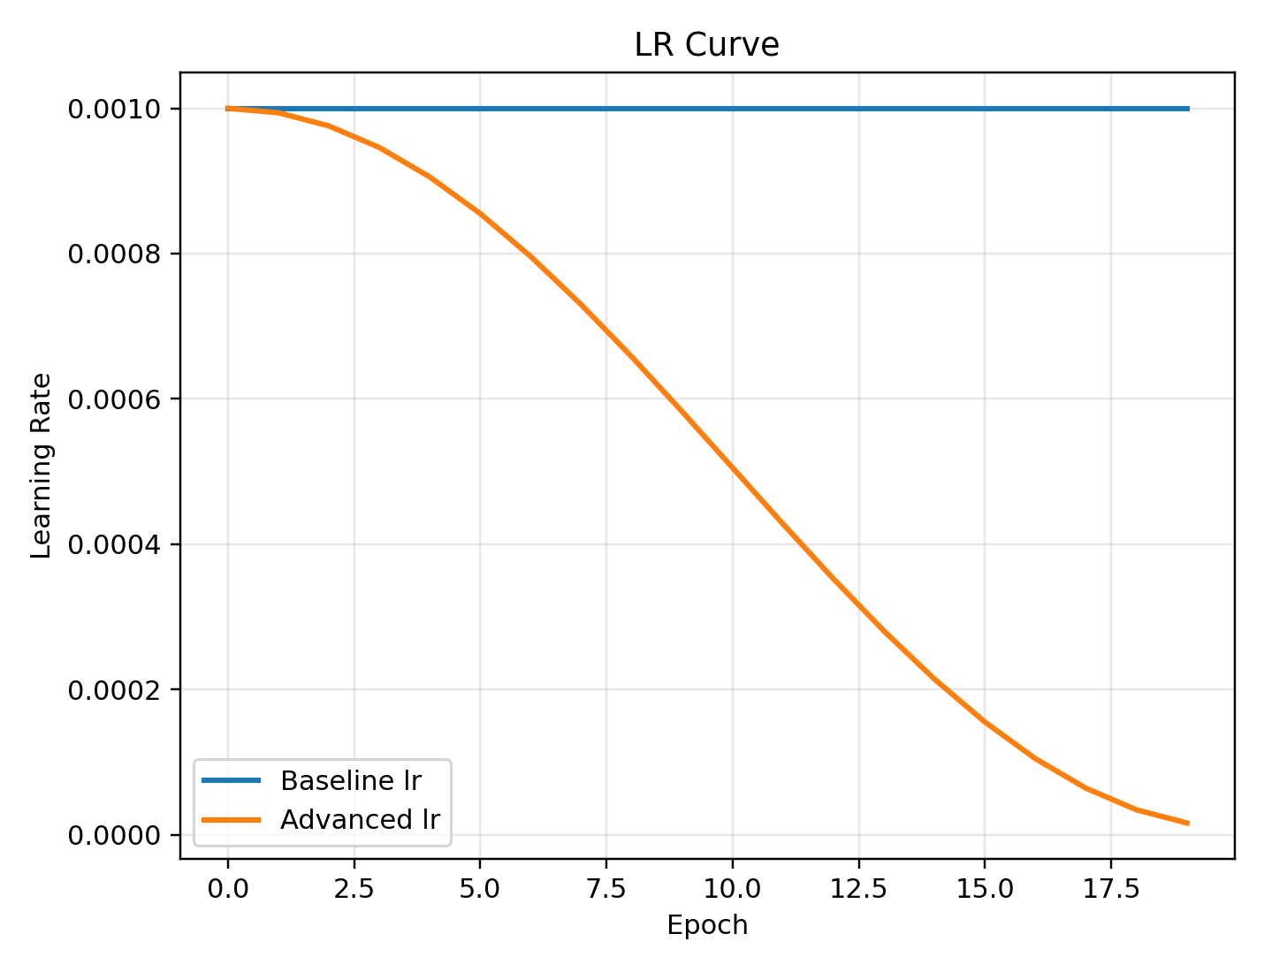
ModelNet10 Curves (Baseline vs Advanced)
Loss comparison
Accuracy comparison
Learning rate schedule

Slide 6
Key Takeaways
Curves visualize the effect of augmentation and attention on convergence.
ModelNet10 results highlight cross-dataset robustness and generalization.
Clean training logs and plots enable clear model comparisons.

