Slide 1
CS639: Data Management for Data Science
Lecture 4: Relational Algebra
Theodoros Rekatsinas

Slide 2
Announcements
Assignment 1
Hints and Grading

Slide 3
Today’s Lecture
The Relational Model & Relational Algebra
Relational Algebra Pt. II

Slide 4
1. The Relational Model & Relational Algebra

Slide 5
What you will learn about in this section
The Relational Model
Relational Algebra: Basic Operators

Slide 6
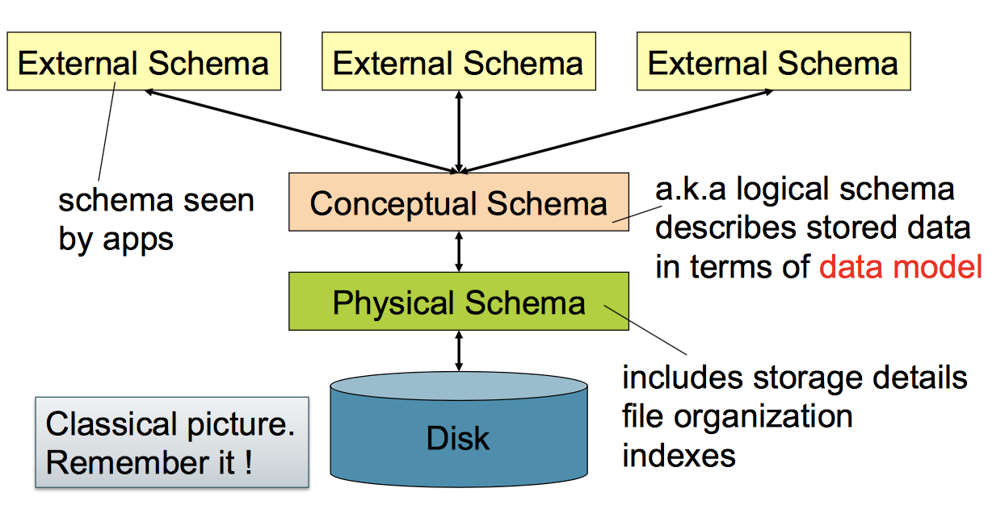
Levels of abstraction

Slide 7
Motivation
The Relational model is precise, implementable, and we can operate on it (query/update, etc.)
Database maps internally into this
procedural language.

Slide 8
The Relational Model: Schemata
Relational Schema:
Students(sid: string, name: string, gpa: float)
Relation name
String, float, int, etc. are the domains of the attributes
Attributes

Slide 9
The Relational Model: Data
Student
An attribute (or column) is a typed data entry present in each tuple in the relation
sid | name | gpa
001 | Bob | 3.2
002 | Joe | 2.8
003 | Mary | 3.8
004 | Alice | 3.5
The number of attributes is the arity of the relation

Slide 10
The Relational Model: Data
Student
sid | name | gpa
001 | Bob | 3.2
002 | Joe | 2.8
003 | Mary | 3.8
004 | Alice | 3.5
The number of tuples is the cardinality of the relation
A tuple or row (or record) is a single entry in the table having the attributes specified by the schema

Slide 11
The Relational Model: Data
Student
sid | name | gpa
001 | Bob | 3.2
002 | Joe | 2.8
003 | Mary | 3.8
004 | Alice | 3.5
In practice DBMSs relax the set requirement, and use multisets.
A relational instance is a set of tuples all conforming to the same schema

Slide 12
To Reiterate
A relational schema describes the data that is contained in a relational instance
Let R(f₁:Dom₁,…,f_{m}:Dom_{m}) be a relational schema then,
an instance of R is a subset of Dom₁ x Dom₂ x … x Dom_{n}
In this way, a relational schema R is a total function from attribute names to types

Slide 13
One More Time
A relational schema describes the data that is contained in a relational instance
A relation R of arity t is a function: R : Dom₁ x … x Dom_{t} → {0,1}
I.e. returns whether or not a tuple of matching types is a member of it
Then, the schema is simply the signature of the function
Note here that order matters, attribute name doesn’t…
We’ll (mostly) work with the other model (last slide) in which attribute name matters, order doesn’t!

Slide 14
A relational database
A relational database schema is a set of relational schemata, one for each relation
A relational database instance is a set of relational instances, one for each relation
Two conventions:
We call relational database instances as simply databases
We assume all instances are valid, i.e., satisfy the domain constraints

Slide 15
Remember the CMS
Note that the schemas impose effective domain / type constraints, i.e. Gpa can’t be “Apple”
Relation DB Schema
Students(sid: string, name: string, gpa: float)
Courses(cid: string, cname: string, credits: int)
Enrolled(sid: string, cid: string, grade: string)
Sid | Name | Gpa
101 | Bob | 3.2
123 | Mary | 3.8
Relation Instances
cid | cname | credits
564 | 564-2 | 4
308 | 417 | 2
Students
sid | cid | Grade
123 | 564 | A
Courses
Enrolled

Slide 16
2nd Part of the Model: Querying
SELECT S.name
FROM Students S
WHERE S.gpa > 3.5;
We don’t tell the system how or where to get the data- just what we want, i.e., Querying is declarative
“Find names of all students with GPA > 3.5”
To make this happen, we need to translate the declarative query into a series of operators… we’ll see this next!

Slide 17
Virtues of the model
Physical independence (logical too), Declarative
Simple, elegant clean: Everything is a relation

Slide 18
Relational Algebra

Slide 19
RDBMS Architecture
How does a SQL engine work ?
SQL Query
Relational Algebra (RA) Plan
Optimized RA Plan
Execution
Declarative query (from user)
Translate to relational algebra expression
Find logically equivalent- but more efficient- RA expression
Execute each operator of the optimized plan!

Slide 20
RDBMS Architecture
How does a SQL engine work ?
SQL Query
Relational Algebra (RA) Plan
Optimized RA Plan
Execution
Relational Algebra allows us to translate declarative (SQL) queries into precise and optimizable expressions!

Slide 21
Relational Algebra (RA)
Five basic operators:
Selection: σ
Projection: Π
Cartesian Product: ×
Union: ∪
Difference: -
Derived or auxiliary operators:
Intersection, complement
Joins (natural,equi-join, theta join, semi-join)
Renaming: ρ
Division

Slide 22
Keep in mind: RA operates on sets!
RDBMSs use multisets, however in relational algebra formalism we will consider sets!
Also: we will consider the named perspective, where every attribute must have a unique name
→attribute order does not matter…
Now on to the basic RA operators…

Slide 23
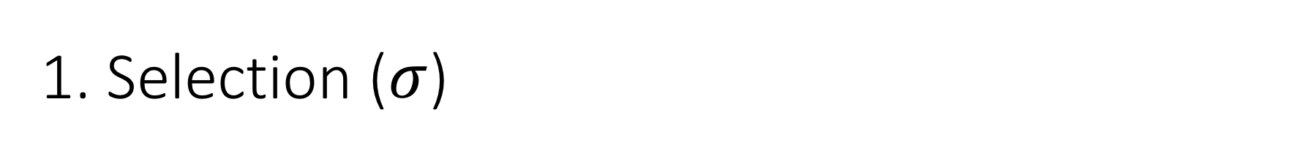

1. Selection ($σ$)
Students(sid,sname,gpa)
SQL:
Returns all tuples which satisfy a condition
Notation: σ_{c}(R)
Examples
σ_{Salary > 40000} (Employee)
σ_{name = “Smith”} (Employee)
The condition c can be =, <, ≤, >, ≥, <>
SELECT *
FROM Students
WHERE gpa > 3.5;
RA:
$$σ_{gpa >3.5}(Students)$$

Slide 24
Another example:
SSN | Name | Salary
1234545 | John | 20000
5423341 | Smith | 600000
4352342 | Fred | 500000
σ_{Salary > 40000} (Employee)
SSN | Name | Salary
5423341 | Smith | 600000
4352342 | Fred | 500000

Slide 25
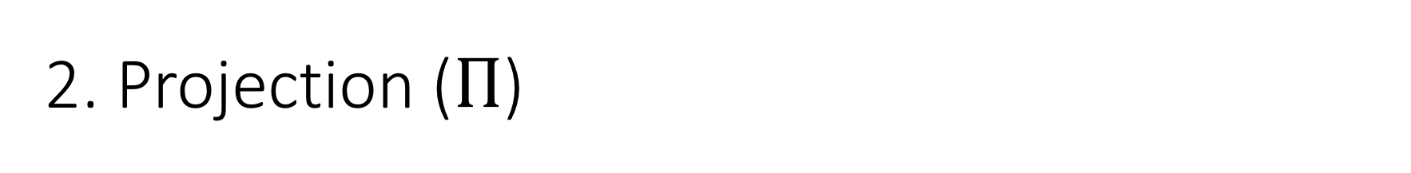

2. Projection ($Π$)
Students(sid,sname,gpa)
SQL:
Eliminates columns, then removes duplicates
Notation: Π _{A1,…,An} (R)
Example: project social-security number and names:
Π _{SSN, Name} (Employee)
Output schema: Answer(SSN, Name)
SELECT DISTINCT
sname,
gpa
FROM Students;
RA:
$$Π_{sname,gpa}(Students)$$

Slide 26
SSN | Name | Salary
1234545 | John | 200000
5423341 | John | 600000
4352342 | John | 200000
Another example:
Π _{Name,Salary} (Employee)
Name | Salary
John | 200000
John | 600000

Slide 27
Note that RA Operators are Compositional!
Students(sid,sname,gpa)
SELECT DISTINCT
sname,
gpa
FROM Students
WHERE gpa > 3.5;
$$Π_{sname,gpa}(σ_{gpa>3.5}(Students))$$
$${σ_{gpa>3.5}(Π}_{sname,gpa}( Students))$$
How do we represent this query in RA?
Are these logically equivalent?

Slide 28
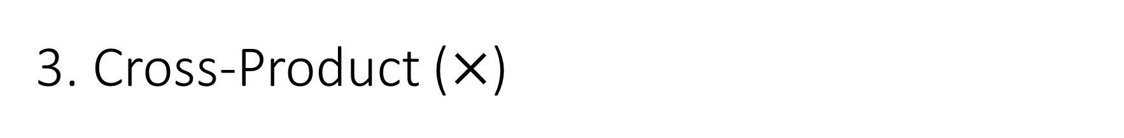

3. Cross-Product ($×$)
Students(sid,sname,gpa)
People(ssn,pname,address)
SQL:
Each tuple in R1 with each tuple in R2
Notation: R1 × R2
Example:
Employee × Dependents
Rare in practice; mainly used to express joins
SELECT *
FROM Students, People;
RA:
$$Students × People$$

Slide 29


Another example:
People
Students
ssn | pname | address
1234545 | John | 216 Rosse
5423341 | Bob | 217 Rosse
sid | sname | gpa
001 | John | 3.4
002 | Bob | 1.3
$$×$$
$$Students × People$$
ssn | pname | address | sid | sname | gpa
1234545 | John | 216 Rosse | 001 | John | 3.4
5423341 | Bob | 217 Rosse | 001 | John | 3.4
1234545 | John | 216 Rosse | 002 | Bob | 1.3
5423341 | Bob | 216 Rosse | 002 | Bob | 1.3

Slide 30


Renaming ($ρ$)
Students(sid,sname,gpa)
SQL:
Changes the schema, not the instance
A ‘special’ operator- neither basic nor derived
Notation: ρ _{B1,…,Bn} (R)
Note: this is shorthand for the proper form (since names, not order matters!):
ρ _{A1→B1,…,An→Bn} (R)
SELECT
sid AS studId,
sname AS name,
gpa AS gradePtAvg
FROM Students;
RA:
$$ρ_{studId,name,gradePtAvg}(Students)$$
We care about this operator because we are working in a named perspective

Slide 31
Another example:
Students
sid | sname | gpa
001 | John | 3.4
002 | Bob | 1.3
$$ρ_{studId,name,gradePtAvg}(Students)$$
Students
studId | name | gradePtAvg
001 | John | 3.4
002 | Bob | 1.3

Slide 32


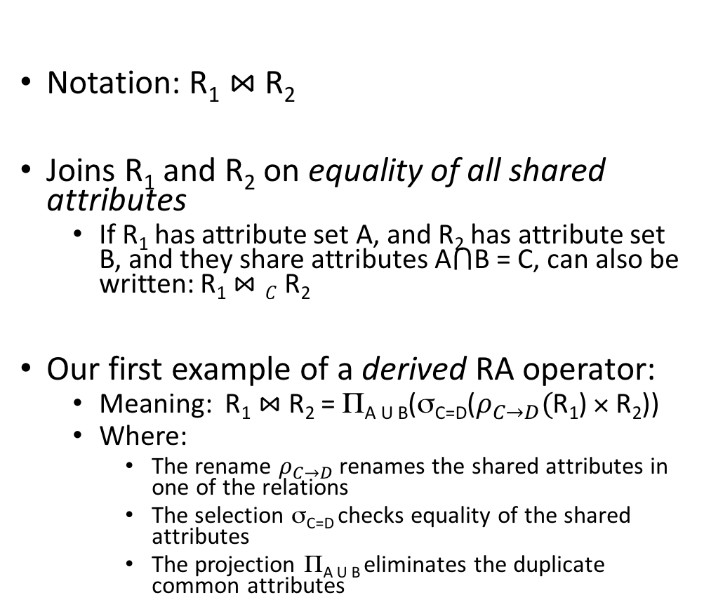
Natural Join ($⋈$)
Students(sid,name,gpa)
People(ssn,name,address)
SQL:
Notation: R₁ $⋈$R₂
Joins R₁ and R₂ on equality of all shared attributes
If R₁ has attribute set A, and R₂ has attribute set B, and they share attributes A$⋂$B = C, can also be written: R₁ $⋈C$R₂
Our first example of a derived RA operator:
Meaning: R₁ $⋈$ R₂ = Π_{A U B}(σ_{C=D}($ρ_{C→D}($R₁) × R₂))
Where:
The rename $ρ_{C→D}$ renames the shared attributes in one of the relations
The selection σ_{C=D} checks equality of the shared attributes
The projection Π_{A U B} eliminates the duplicate common attributes
SELECT DISTINCT
ssid, S.name, gpa,
ssn, address
FROM
Students S,
People P
WHERE S.name = P.name;
RA:
$$Students ⋈ People$$

Slide 33


Another example:
Students S
People P
sid | S.name | gpa
001 | John | 3.4
002 | Bob | 1.3
$$⋈$$
ssn | P.name | address
1234545 | John | 216 Rosse
5423341 | Bob | 217 Rosse
$$Students ⋈People$$
sid | S.name | gpa | ssn | address
001 | John | 3.4 | 1234545 | 216 Rosse
002 | Bob | 1.3 | 5423341 | 216 Rosse

Slide 34
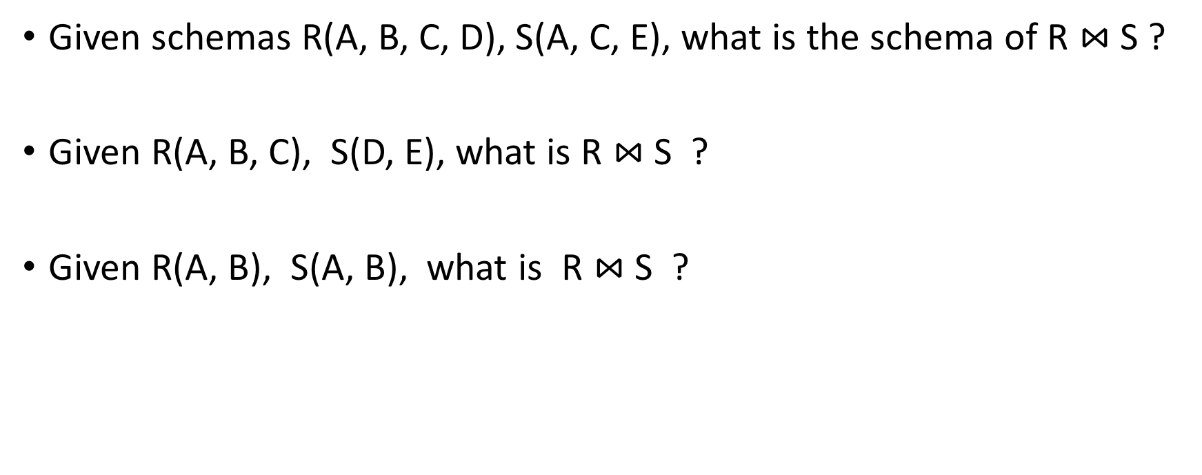
Natural Join
Given schemas R(A, B, C, D), S(A, C, E), what is the schema of R $⋈$S ?
Given R(A, B, C), S(D, E), what is R $⋈$S ?
Given R(A, B), S(A, B), what is R $⋈$S ?

Slide 35

Example: Converting SQL Query -> RA
Students(sid,sname,gpa)
People(ssn,sname,address)
SELECT DISTINCT
gpa,
address
FROM Students S,
People P
WHERE gpa > 3.5 AND
sname = pname;
$$Π_{gpa,address}(σ_{gpa>3.5}(S⋈P))$$

Slide 36
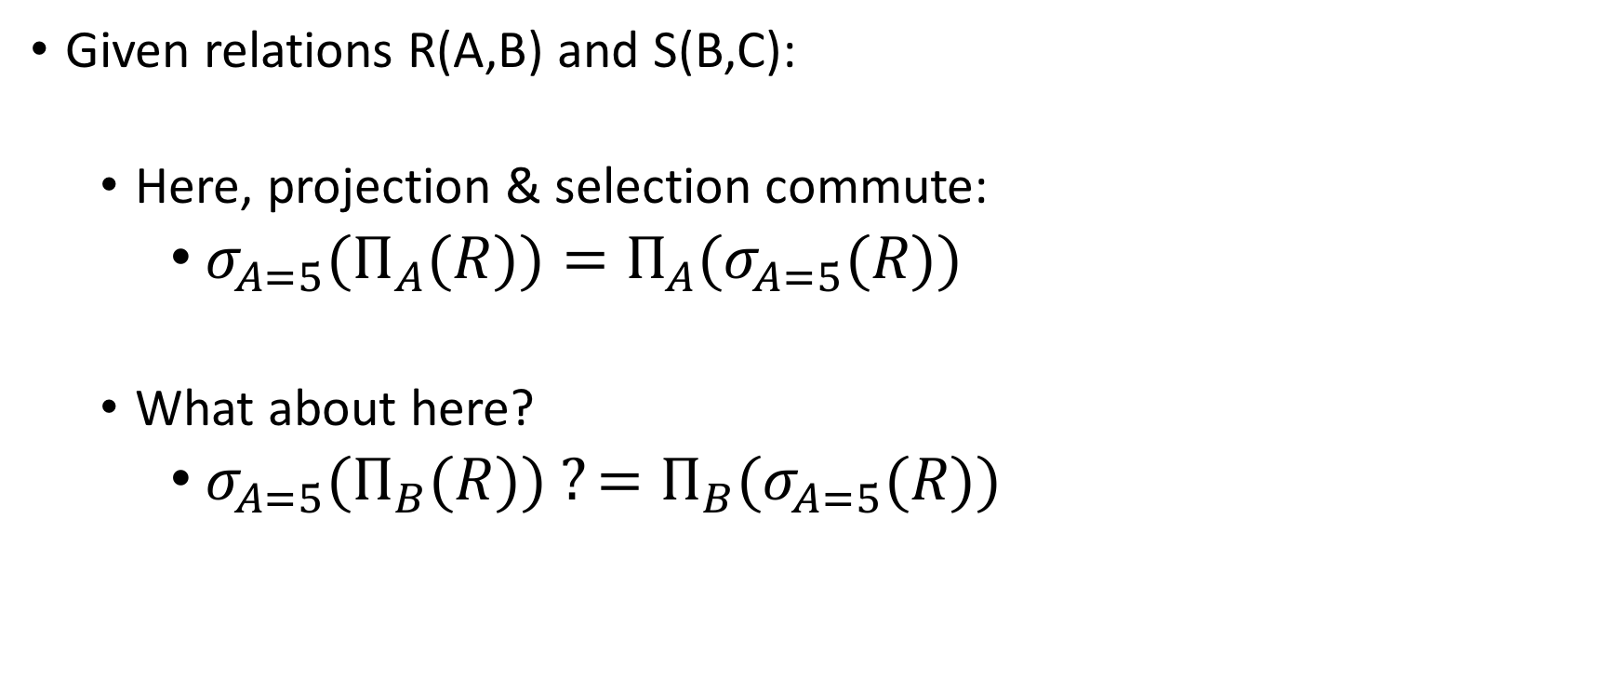
Logical Equivalence of RA Plans
Given relations R(A,B) and S(B,C):
Here, projection & selection commute:
${σ_{A=5}(Π}_{A}(R))=Π_{A}(σ_{A=5}(R))$
What about here?
${σ_{A=5}(Π}_{B}(R)) ?=Π_{B}(σ_{A=5}(R))$

Slide 37
1. Union (∪) and 2. Difference (–)
R1 ∪ R2
Example:
ActiveEmployees ∪ RetiredEmployees
R1 – R2
Example:
AllEmployees -- RetiredEmployees
R₁
R₂
R₁
R₂

Slide 38
What about Intersection (∩) ?
It is a derived operator
R1 ∩ R2 = R1 – (R1 – R2)
Also expressed as a join!
Example
UnionizedEmployees ∩ RetiredEmployees
R₁
R₂

Slide 39
RA Expressions Can Get Complex!
Π _{name}
buyer-ssn=ssn
pid=pid
seller-ssn=ssn
Π _{ssn}
Π _{pid}
σ_{name=fred}
σ_{name=gizmo}
Person Purchase Person Product

Slide 40
RA has Limitations !
Cannot compute “transitive closure”
Find all direct and indirect relatives of Fred
Cannot express in RA !!!
Need to write C program, use a graph engine, or modern SQL…
Name1 | Name2 | Relationship
Fred | Mary | Father
Mary | Joe | Cousin
Mary | Bill | Spouse
Nancy | Lou | Sister

