Slide 1
CS639: Data Management for Data Science
Lecture 4: SQL for Data Science
Theodoros Rekatsinas

Slide 2
Announcements
Assignment 1 is due tomorrow (end of day)
Any questions?
PA2 is out. It is due on the 19th
Start early ☺
Ask questions on Piazza
Go over activities and reading before attempting
Out of town for the next two lectures.
We will resume on Feb 13th.

Slide 3
Today’s Lecture
Finish Relational Algebra (slides in previous lecture)
Introduction to SQL
Single-table queries
Multi-table queries
Advanced SQL

Slide 4
1. Introduction to SQL

Slide 5
SQL Motivation
But why use SQL?
The relational model of data is the most widely used model today
Main Concept: the relation- essentially, a table
Logical data independence: protection from changes in the logical structure of the data
Remember: The reason for using the relational model is data independence!
SQL is a logical, declarative query language. We use SQL because we happen to use the relational model.

Slide 6
Basic SQL

Slide 7
SQL Introduction
SQL is a standard language for querying and manipulating data
SQL is a very high-level programming language
This works because it is optimized well!
Many standards out there:
ANSI SQL, SQL92 (a.k.a. SQL2), SQL99 (a.k.a. SQL3), ….
Vendors support various subsets
SQL stands for
Structured Query Language
Probably the world’s most successful parallel programming language (multicore?)

Slide 8
SQL is a…
Data Definition Language (DDL)
Define relational schemata
Create/alter/delete tables and their attributes
Data Manipulation Language (DML)
Insert/delete/modify tuples in tables
Query one or more tables – discussed next!

Slide 9
Tables in SQL
A relation or table is a multiset of tuples having the attributes specified by the schema
Product
PName | Price | Manufacturer
Gizmo | $19.99 | GizmoWorks
Powergizmo | $29.99 | GizmoWorks
SingleTouch | $149.99 | Canon
MultiTouch | $203.99 | Hitachi
Let’s break this definition down

Slide 10
Tables in SQL
A multiset is an unordered list (or: a set with multiple duplicate instances allowed)
Product
PName | Price | Manufacturer
Gizmo | $19.99 | GizmoWorks
Powergizmo | $29.99 | GizmoWorks
SingleTouch | $149.99 | Canon
MultiTouch | $203.99 | Hitachi
List: [1, 1, 2, 3]
Set: {1, 2, 3}
Multiset: {1, 1, 2, 3}
i.e. no next(), etc. methods!

Slide 11
Tables in SQL
Product
An attribute (or column) is a typed data entry present in each tuple in the relation
PName | Price | Manufacturer
Gizmo | $19.99 | GizmoWorks
Powergizmo | $29.99 | GizmoWorks
SingleTouch | $149.99 | Canon
MultiTouch | $203.99 | Hitachi
Attributes must have an atomic type in standard SQL, i.e. not a list, set, etc.

Slide 12
Tables in SQL
Product
PName | Price | Manufacturer
Gizmo | $19.99 | GizmoWorks
Powergizmo | $29.99 | GizmoWorks
SingleTouch | $149.99 | Canon
MultiTouch | $203.99 | Hitachi
A tuple or row is a single entry in the table having the attributes specified by the schema
Also referred to sometimes as a record

Slide 13
Tables in SQL
Product
PName | Price | Manufacturer
Gizmo | $19.99 | GizmoWorks
Powergizmo | $29.99 | GizmoWorks
SingleTouch | $149.99 | Canon
MultiTouch | $203.99 | Hitachi
The number of tuples is the cardinality of the relation
The number of attributes is the arity of the relation

Slide 14
Data Types in SQL
Atomic types:
Characters: CHAR(20), VARCHAR(50)
Numbers: INT, BIGINT, SMALLINT, FLOAT
Others: MONEY, DATETIME, …
Every attribute must have an atomic type
Hence tables are flat

Slide 15
Table Schemas
The schema of a table is the table name, its attributes, and their types:
A key is an attribute whose values are unique; we underline a key
Product(Pname: string, Price: float, Category: string, Manufacturer: string)
Product(Pname: string, Price: float, Category: string, Manufacturer: string)

Slide 16
Key constraints
A key is a minimal subset of attributes that acts as a unique identifier for tuples in a relation
A key is an implicit constraint on which tuples can be in the relation
i.e. if two tuples agree on the values of the key, then they must be the same tuple!
Students(sid:string, name:string, gpa: float)
1. Which would you select as a key?
2. Is a key always guaranteed to exist?
3. Can we have more than one key?

Slide 17
NULL and NOT NULL
To say “don’t know the value” we use NULL
NULL has (sometimes painful) semantics, more details later
Students(sid:string, name:string, gpa: float)
sid | name | gpa
123 | Bob | 3.9
143 | Jim | NULL
Say, Jim just enrolled in his first class.
In SQL, we may constrain a column to be NOT NULL, e.g., “name” in this table

Slide 18
General Constraints
We can actually specify arbitrary assertions
E.g. “There cannot be 25 people in the DB class”
In practice, we don’t specify many such constraints. Why?
Performance!
Whenever we do something ugly (or avoid doing something convenient) it’s for the sake of performance

Slide 19
Go over Activity 2-1

Slide 20
2. Single-table queries

Slide 21
SQL Query
Basic form (there are many many more bells and whistles)
SELECT <attributes> FROM <one or more relations> WHERE <conditions>
Call this a SFW query.

Slide 22
Simple SQL Query: Selection
PName | Price | Category | Manufacturer
Gizmo | $19.99 | Gadgets | GizmoWorks
Powergizmo | $29.99 | Gadgets | GizmoWorks
SingleTouch | $149.99 | Photography | Canon
MultiTouch | $203.99 | Household | Hitachi
Selection is the operation of filtering a relation’s tuples on some condition
SELECT * FROM Product WHERE Category = ‘Gadgets’
PName | Price | Category | Manufacturer
Gizmo | $19.99 | Gadgets | GizmoWorks
Powergizmo | $29.99 | Gadgets | GizmoWorks

Slide 23
Simple SQL Query: Projection
PName | Price | Category | Manufacturer
Gizmo | $19.99 | Gadgets | GizmoWorks
Powergizmo | $29.99 | Gadgets | GizmoWorks
SingleTouch | $149.99 | Photography | Canon
MultiTouch | $203.99 | Household | Hitachi
Projection is the operation of producing an output table with tuples that have a subset of their prior attributes
SELECT Pname, Price, Manufacturer FROM Product WHERE Category = ‘Gadgets’
PName | Price | Manufacturer
Gizmo | $19.99 | GizmoWorks
Powergizmo | $29.99 | GizmoWorks

Slide 24
Notation
Input schema
Product(PName, Price, Category, Manfacturer)
SELECT Pname, Price, Manufacturer FROM Product WHERE Category = ‘Gadgets’
Output schema
Answer(PName, Price, Manfacturer)

Slide 25
A Few Details
SQL commands are case insensitive:
Same: SELECT, Select, select
Same: Product, product
Values are not:
Different: ‘Seattle’, ‘seattle’
Use single quotes for constants:
‘abc’ - yes
“abc” - no

Slide 26
LIKE: Simple String Pattern Matching
SELECT * FROM Products WHERE PName LIKE ‘%gizmo%’
s LIKE p: pattern matching on strings
p may contain two special symbols:
% = any sequence of characters
_ = any single character

Slide 27
DISTINCT: Eliminating Duplicates
Category
Gadgets
Photography
Household
SELECT DISTINCT Category
FROM Product
Versus
Category
Gadgets
Gadgets
Photography
Household
SELECT Category
FROM Product

Slide 28
ORDER BY: Sorting the Results
SELECT PName, Price, Manufacturer
FROM Product
WHERE Category=‘gizmo’ AND Price > 50
ORDER BY Price, PName
Ties are broken by the second attribute on the ORDER BY list, etc.
Ordering is ascending, unless you specify the DESC keyword.

Slide 29
Go over Activity 2-2

Slide 30
3. Multi-table queries

Slide 31
Foreign Key constraints
Suppose we have the following schema:
And we want to impose the following constraint:
‘Only bona fide students may enroll in courses’ i.e. a student must appear in the Students table to enroll in a class
Students(sid: string, name: string, gpa: float)
Enrolled(student_id: string, cid: string, grade: string)
Students
Enrolled
student_id alone is not a key- what is?
sid | name | gpa
101 | Bob | 3.2
123 | Mary | 3.8
student_id | cid | grade
123 | 564 | A
123 | 537 | A+
We say that student_id is a foreign key that refers to Students

Slide 32
Declaring Foreign Keys
Students(sid: string, name: string, gpa: float)
Enrolled(student_id: string, cid: string, grade: string)
CREATE TABLE Enrolled(
student_id CHAR(20),
cid CHAR(20),
grade CHAR(10),
PRIMARY KEY (student_id, cid),
FOREIGN KEY (student_id) REFERENCES Students(sid)
)

Slide 33
Foreign Keys and update operations
Students(sid: string, name: string, gpa: float)
Enrolled(student_id: string, cid: string, grade: string)
What if we insert a tuple into Enrolled, but no corresponding student?
INSERT is rejected (foreign keys are constraints)!
What if we delete a student?
Disallow the delete
Remove all of the courses for that student
SQL allows a third via NULL (not yet covered)
DBA chooses (syntax in the book)

Slide 34
Keys and Foreign Keys
Company
What is a foreign key vs. a key here?
CName | StockPrice | Country
GizmoWorks | 25 | USA
Canon | 65 | Japan
Hitachi | 15 | Japan
Product
PName | Price | Category | Manufacturer
Gizmo | $19.99 | Gadgets | GizmoWorks
Powergizmo | $29.99 | Gadgets | GizmoWorks
SingleTouch | $149.99 | Photography | Canon
MultiTouch | $203.99 | Household | Hitachi

Slide 35
Joins
Product(PName, Price, Category, Manufacturer)
Company(CName, StockPrice, Country)
Note: we will often omit attribute types in schema definitions for brevity, but assume attributes are always atomic types
Ex: Find all products under $200 manufactured in Japan; return their names and prices.
SELECT PName, Price FROM Product, Company WHERE Manufacturer = CName
AND Country=‘Japan’ AND Price <= 200

Slide 36
Joins
Product(PName, Price, Category, Manufacturer)
Company(CName, StockPrice, Country)
Ex: Find all products under $200 manufactured in Japan; return their names and prices.
SELECT PName, Price FROM Product, Company WHERE Manufacturer = CName
AND Country=‘Japan’ AND Price <= 200
A join between tables returns all unique combinations of their tuples which meet some specified join condition

Slide 37
Joins
Product(PName, Price, Category, Manufacturer)
Company(CName, StockPrice, Country)
Several equivalent ways to write a basic join in SQL:
SELECT PName, Price FROM Product, Company WHERE Manufacturer = CName
AND Country=‘Japan’ AND Price <= 200
SELECT PName, Price FROM Product
JOIN Company ON Manufacturer = Cname
AND Country=‘Japan’ WHERE Price <= 200

Slide 38
Joins
Product
Company
PName | Price | Category | Manuf
Gizmo | $19 | Gadgets | GWorks
Powergizmo | $29 | Gadgets | GWorks
SingleTouch | $149 | Photography | Canon
MultiTouch | $203 | Household | Hitachi
Cname | Stock | Country
GWorks | 25 | USA
Canon | 65 | Japan
Hitachi | 15 | Japan
SELECT PName, Price FROM Product, Company WHERE Manufacturer = CName
AND Country=‘Japan’ AND Price <= 200
PName | Price
SingleTouch | $149.99

Slide 39
Tuple Variable Ambiguity in Multi-Table
Person(name, address, worksfor) Company(name, address)
Which “address” does this refer to?
Which “name”s??
SELECT DISTINCT name, address FROM Person, Company WHERE worksfor = name

Slide 40
Tuple Variable Ambiguity in Multi-Table
Person(name, address, worksfor) Company(name, address)
SELECT DISTINCT Person.name, Person.address FROM Person, Company WHERE Person.worksfor = Company.name
Both equivalent ways to resolve variable ambiguity
SELECT DISTINCT p.name, p.address FROM Person p, Company c WHERE p.worksfor = c.name

Slide 41
Meaning (Semantics) of SQL Queries
SELECT x₁.a₁, x₁.a₂, …, x_{n}.a_{k}
FROM R₁ AS x₁, R₂ AS x₂, …, R_{n} AS x_{n}
WHERE Conditions(x₁,…, x_{n})
Almost never the fastest way to compute it!
Answer = {}
for x₁ in R₁ do
for x₂ in R₂ do
…..
for x_{n} in R_{n} do
if Conditions(x₁,…, x_{n})
then Answer = Answer ∪ {(x₁.a₁, x₁.a₂, …, x_{n}.a_{k})}
return Answer
Note: this is a multiset union

Slide 42
An example of SQL semantics
SELECT R.A
FROM R, S
WHERE R.A = S.B
Output
A
3
3
A
1
3
A | B | C
1 | 2 | 3
1 | 3 | 4
1 | 3 | 5
3 | 2 | 3
3 | 3 | 4
3 | 3 | 5
Cross Product
Apply Projection
Apply Selections / Conditions
B | C
2 | 3
3 | 4
3 | 5
A | B | C
3 | 3 | 4
3 | 3 | 5

Slide 43
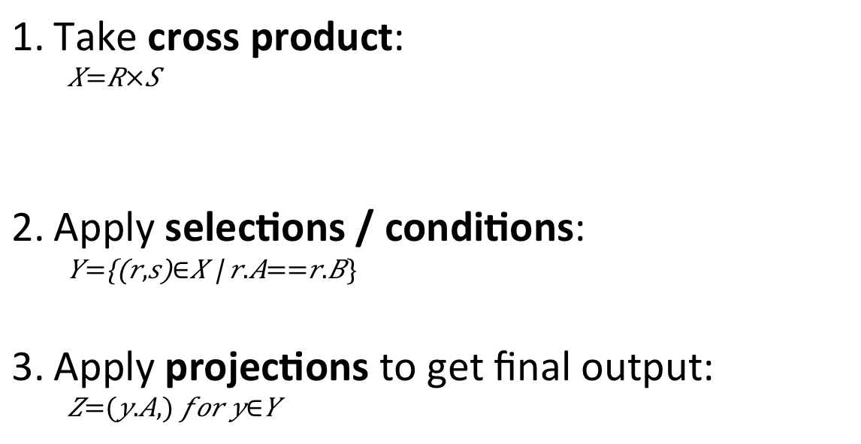
Note the semantics of a join
SELECT R.A
FROM R, S
WHERE R.A = S.B
Take cross product:
$$X=R×S$$
Apply selections / conditions:
$$Y=\left\{\left(r,s\right)∈X \right| r.A==r.B\}$$
Apply projections to get final output:
$$Z=(y.A,) for y∈Y$$
Recall: Cross product (A X B) is the set of all unique tuples in A,B
Ex: {a,b,c} X {1,2}
= {(a,1), (a,2), (b,1), (b,2), (c,1), (c,2)}
= Filtering!
= Returning only some attributes
Remembering this order is critical to understanding the output of certain queries (see later on…)

Slide 44
Note: we say “semantics” not “execution order”
The preceding slides show what a join means
Not actually how the DBMS executes it under the covers

Slide 45
Go over Activity 2-3

Slide 46
4. Advanced SQL

Slide 47
Set Operators and Nested Queries

Slide 48
An Unintuitive Query
SELECT DISTINCT R.A
FROM R, S, T
WHERE R.A=S.A OR R.A=T.A
What does it compute?
S
T
R
But what if S = φ?
Computes R ∩ (S ∪ T)
Go back to the semantics!

Slide 49
An Unintuitive Query
SELECT DISTINCT R.A
FROM R, S, T
WHERE R.A=S.A OR R.A=T.A
Recall the semantics!
Take cross-product
Apply selections / conditions
Apply projection
If S = {}, then the cross product of R, S, T = {}, and the query result = {}!
Must consider semantics here.
Are there more explicit way to do set operations like this?

Slide 50
What does this look like in Python?
S
T
SELECT DISTINCT R.A
FROM R, S, T
WHERE R.A=S.A OR R.A=T.A
R
R ∩ (S ∪ T)
Semantics:
Take cross-product
Apply selections / conditions
Apply projection
Joins / cross-products are just nested for loops (in simplest implementation)!
If-then statements!

Slide 51
What does this look like in Python?
S
T
SELECT DISTINCT R.A
FROM R, S, T
WHERE R.A=S.A OR R.A=T.A
R
R ∩ (S ∪ T)
output = {}
for r in R:
for s in S:
for t in T:
if r[‘A’] == s[‘A’] or r[‘A’] == t[‘A’]:
output.add(r[‘A’])
return list(output)
Can you see now what happens if S = []?

Slide 52
Multiset operations

Slide 53
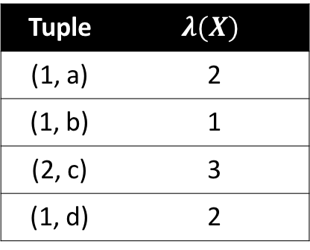
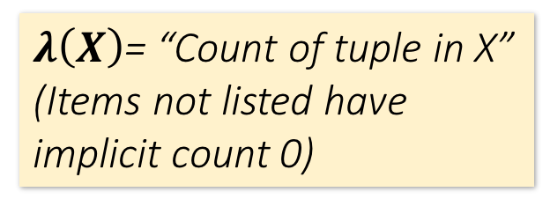
Recall Multisets
$λ\left(X\right)$= “Count of tuple in X”
(Items not listed have implicit count 0)
Multiset X
Tuple
(1, a)
(1, a)
(1, b)
(2, c)
(2, c)
(2, c)
(1, d)
(1, d)
Multiset X
Tuple | $$λ(X)$$
(1, a) | 2
(1, b) | 1
(2, c) | 3
(1, d) | 2
Equivalent Representations of a Multiset
Note: In a set all counts are {0,1}.

Slide 54
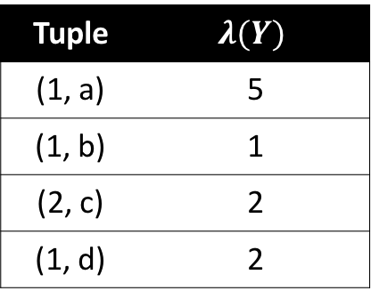


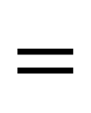


Generalizing Set Operations to Multiset Operations
Multiset X
Multiset Y
Multiset Z
Tuple | $$λ(X)$$
(1, a) | 2
(1, b) | 0
(2, c) | 3
(1, d) | 0
Tuple | $$λ(Y)$$
(1, a) | 5
(1, b) | 1
(2, c) | 2
(1, d) | 2
Tuple | $$λ(Z)$$
(1, a) | 2
(1, b) | 0
(2, c) | 2
(1, d) | 0
$$∩$$
$$=$$
For sets, this is intersection
$$λ\left(Z\right)=min(λ\left(X\right),λ\left(Y\right))$$

Slide 55



Generalizing Set Operations to Multiset Operations
Multiset X
Multiset Y
Multiset Z
Tuple | $$λ(X)$$
(1, a) | 2
(1, b) | 0
(2, c) | 3
(1, d) | 0
Tuple | $$λ(Y)$$
(1, a) | 5
(1, b) | 1
(2, c) | 2
(1, d) | 2
Tuple | $$λ(Z)$$
(1, a) | 5
(1, b) | 1
(2, c) | 3
(1, d) | 2
$$∪$$
$$=$$
For sets,
this is union
$$λ\left(Z\right)=max(λ\left(X\right),λ\left(Y\right))$$

Slide 56
Multiset Operations in SQL
s

Slide 57
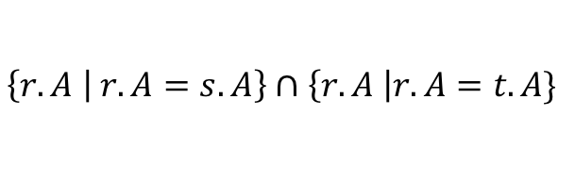
Explicit Set Operators: INTERSECT
SELECT R.A
FROM R, S
WHERE R.A=S.A
INTERSECT
SELECT R.A
FROM R, T
WHERE R.A=T.A
$$\left\{r.A | r.A=s.A\right\}∩\left\{r.A \right|r.A=t.A\}$$
Q₁
Q₂

Slide 58
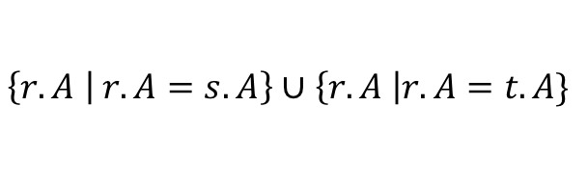
UNION
SELECT R.A
FROM R, S
WHERE R.A=S.A
UNION
SELECT R.A
FROM R, T
WHERE R.A=T.A
$$\left\{r.A | r.A=s.A\right\}∪\left\{r.A \right|r.A=t.A\}$$
Q₁
Q₂
Why aren’t there duplicates?
What if we want duplicates?

Slide 59
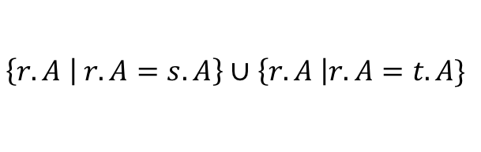
UNION ALL
s
SELECT R.A
FROM R, S
WHERE R.A=S.A
UNION ALL
SELECT R.A
FROM R, T
WHERE R.A=T.A
$$\left\{r.A | r.A=s.A\right\}∪\left\{r.A \right|r.A=t.A\}$$
Q₁
Q₂
ALL indicates the Multiset disjoint union operation

Slide 60


Generalizing Set Operations to Multiset Operations
Multiset X
Multiset Y
Multiset Z
Tuple | $$λ(X)$$
(1, a) | 2
(1, b) | 0
(2, c) | 3
(1, d) | 0
Tuple | $$λ(Y)$$
(1, a) | 5
(1, b) | 1
(2, c) | 2
(1, d) | 2
Tuple | $$λ(Z)$$
(1, a) | 7
(1, b) | 1
(2, c) | 5
(1, d) | 2
$$=$$
For sets,
this is disjoint union
$$λ\left(Z\right)= λ\left(X\right)+ λ\left(Y\right)$$

Slide 61
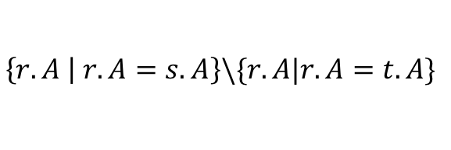
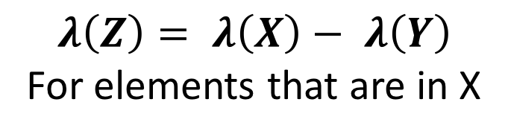
EXCEPT
SELECT R.A
FROM R, S
WHERE R.A=S.A
EXCEPT
SELECT R.A
FROM R, T
WHERE R.A=T.A
$$\left\{r.A | r.A=s.A\right\}\backslash \{r.A|r.A=t.A\}$$
Q₁
Q₂
What is the multiset version?
$$λ\left(Z\right)= λ\left(X\right)− λ\left(Y\right)$$
For elements that are in X

Slide 62
INTERSECT: Still some subtle problems…
Company(name, hq_city)
Product(pname, maker, factory_loc)
SELECT hq_city
FROM Company, Product
WHERE maker = name
AND factory_loc = ‘US’
INTERSECT
SELECT hq_city
FROM Company, Product
WHERE maker = name
AND factory_loc = ‘China’
“Headquarters of companies which make gizmos in US AND China”
What if two companies have HQ in US: BUT one has factory in China (but not US) and vice versa? What goes wrong?

Slide 63
INTERSECT: Remember the semantics!
s
Example: C JOIN P on maker = name
Company(name, hq_city) AS C
Product(pname, maker, factory_loc) AS P
C.name | C.hq_city | P.pname | P.maker | P.factory_loc
X Co. | Seattle | X | X Co. | U.S.
Y Inc. | Seattle | X | Y Inc. | China
SELECT hq_city
FROM Company, Product
WHERE maker = name
AND factory_loc=‘US’
INTERSECT
SELECT hq_city
FROM Company, Product
WHERE maker = name
AND factory_loc=‘China’

Slide 64
INTERSECT: Remember the semantics!
Example: C JOIN P on maker = name
Company(name, hq_city) AS C
Product(pname, maker, factory_loc) AS P
C.name | C.hq_city | P.pname | P.maker | P.factory_loc
X Co. | Seattle | X | X Co. | U.S.
Y Inc. | Seattle | X | Y Inc. | China
SELECT hq_city
FROM Company, Product
WHERE maker = name
AND factory_loc=‘US’
INTERSECT
SELECT hq_city
FROM Company, Product
WHERE maker = name
AND factory_loc=‘China’
X Co has a factory in the US (but not China)
Y Inc. has a factor in China (but not US)
But Seattle is returned by the query!
We did the INTERSECT on the wrong attributes!

Slide 65
One Solution: Nested Queries
s
Company(name, hq_city)
Product(pname, maker, factory_loc)
“Headquarters of companies which make gizmos in US AND China”
SELECT DISTINCT hq_city
FROM Company, Product
WHERE maker = name
AND name IN (
SELECT maker
FROM Product
WHERE factory_loc = ‘US’)
AND name IN (
SELECT maker
FROM Product
WHERE factory_loc = ‘China’)
Note: If we hadn’t used DISTINCT here, how many copies of each hq_city would have been returned?

Slide 66
High-level note on nested queries
We can do nested queries because SQL is compositional:
Everything (inputs / outputs) is represented as multisets- the output of one query can thus be used as the input to another (nesting)!
This is extremely powerful!

Slide 67
Nested queries: Sub-queries Returning Relations
Another example:
Company(name, city) Product(name, maker) Purchase(id, product, buyer)
SELECT c.city
FROM Company c
WHERE c.name IN (
SELECT pr.maker
FROM Purchase p, Product pr
WHERE p.product = pr.name
AND p.buyer = ‘Joe Blow‘)
“Cities where one can find companies that manufacture products bought by Joe Blow”

Slide 68
Nested Queries
Is this query equivalent?
SELECT c.city
FROM Company c,
Product pr,
Purchase p
WHERE c.name = pr.maker
AND pr.name = p.product
AND p.buyer = ‘Joe Blow’
Beware of duplicates!

Slide 69
Nested Queries
SELECT DISTINCT c.city
FROM Company c,
Product pr,
Purchase p
WHERE c.name = pr.maker
AND pr.name = p.product
AND p.buyer = ‘Joe Blow’
SELECT DISTINCT c.city
FROM Company c
WHERE c.name IN (
SELECT pr.maker
FROM Purchase p, Product pr
WHERE p.product = pr.name
AND p.buyer = ‘Joe Blow‘)
Now they are equivalent

Slide 70
Subqueries Returning Relations
You can also use operations of the form:
s > ALL R
s < ANY R
EXISTS R
ANY and ALL not supported by SQLite.
Ex:
Product(name, price, category, maker)
SELECT name
FROM Product
WHERE price > ALL(
SELECT price
FROM Product
WHERE maker = ‘Gizmo-Works’)
Find products that are more expensive than all those produced by “Gizmo-Works”

Slide 71
Subqueries Returning Relations
You can also use operations of the form:
s > ALL R
s < ANY R
EXISTS R
Ex:
Product(name, price, category, maker)
Find ‘copycat’ products, i.e. products made by competitors with the same names as products made by “Gizmo-Works”
SELECT p1.name
FROM Product p1
WHERE p1.maker = ‘Gizmo-Works’
AND EXISTS(
SELECT p2.name
FROM Product p2
WHERE p2.maker <> ‘Gizmo-Works’
AND p1.name = p2.name)
<> means !=

Slide 72
Nested queries as alternatives to INTERSECT and EXCEPT
INTERSECT and EXCEPT not in some DBMSs!
(SELECT R.A, R.B
FROM R) INTERSECT
(SELECT S.A, S.B
FROM S)
SELECT R.A, R.B
FROM R WHERE EXISTS(
SELECT * FROM S WHERE R.A=S.A AND R.B=S.B)
If R, S have no duplicates, then can write without sub-queries (HOW?)
(SELECT R.A, R.B
FROM R) EXCEPT
(SELECT S.A, S.B
FROM S)
SELECT R.A, R.B
FROM R WHERE NOT EXISTS(
SELECT * FROM S WHERE R.A=S.A AND R.B=S.B)

Slide 73
Correlated Queries
Movie(title, year, director, length)
Find movies whose title appears more than once.
SELECT DISTINCT title
FROM Movie AS m
WHERE year <> ANY(
SELECT year
FROM Movie
WHERE title = m.title)
Note the scoping of the variables!
Note also: this can still be expressed as single SFW query…

Slide 74
Complex Correlated Query
Product(name, price, category, maker, year)
SELECT DISTINCT x.name, x.maker
FROM Product AS x
WHERE x.price > ALL(
SELECT y.price
FROM Product AS y
WHERE x.maker = y.maker
AND y.year < 1972)
Find products (and their manufacturers) that are more expensive than all products made by the same manufacturer before 1972
Can be very powerful (also much harder to optimize)

Slide 75
Go over Activity 3-1

Slide 76
Basic SQL Summary
SQL provides a high-level declarative language for manipulating data (DML)
The workhorse is the SFW block
Set operators are powerful but have some subtleties
Powerful, nested queries also allowed.

