Slide 1
WEAVEHACKS DEMO NARRATIVE
Agentic A/B Lab
A self-improving product research loop that turns synthetic user behavior into promoted UX variants.
AGENT BUDGET
CANDIDATE SWARM
SCORE LIFT
DWELL SAVED
50
500
+6.39
17.2s
same synthetic users per generation
100 generated UX changes x 5 rounds
A to E projected UX score
less synthetic hesitation
User task -> A/B experiment -> feedback -> code candidate -> repeat
A
B
C
D
E

Slide 2
SYSTEM LOOP
The loop is the product
User task
Feedback
Promote
Goal, constraints, success criteria
Friction, dwell, completion, issues
Best candidate becomes next variant
A/B run
100 candidates
Repeat
Agents browse variants with traces
Generated UX/code changes scored
A -> B -> C -> D -> E
Every generation is evaluated against the same 50-session synthetic cohort.
The loop produces inspectable evidence: action scores, dwell breakdowns, candidate rationale, and promotion history.

Slide 3
IMPLEMENTATION
What changed in the repo
Engine
runSyntheticIterationLab adds fixed 50-agent sampling, 5 generations, and 100 candidates per generation.
UI
/synthetic now leads with an A -> E iteration panel and keeps the existing per-step behavior inspector.
Evidence
Generated screenshot assets prove the live A-E trajectory and can be used in the demo deck.
Tests
Playwright locks the 50-agent, 500-candidate, non-decreasing score contract.

Slide 4
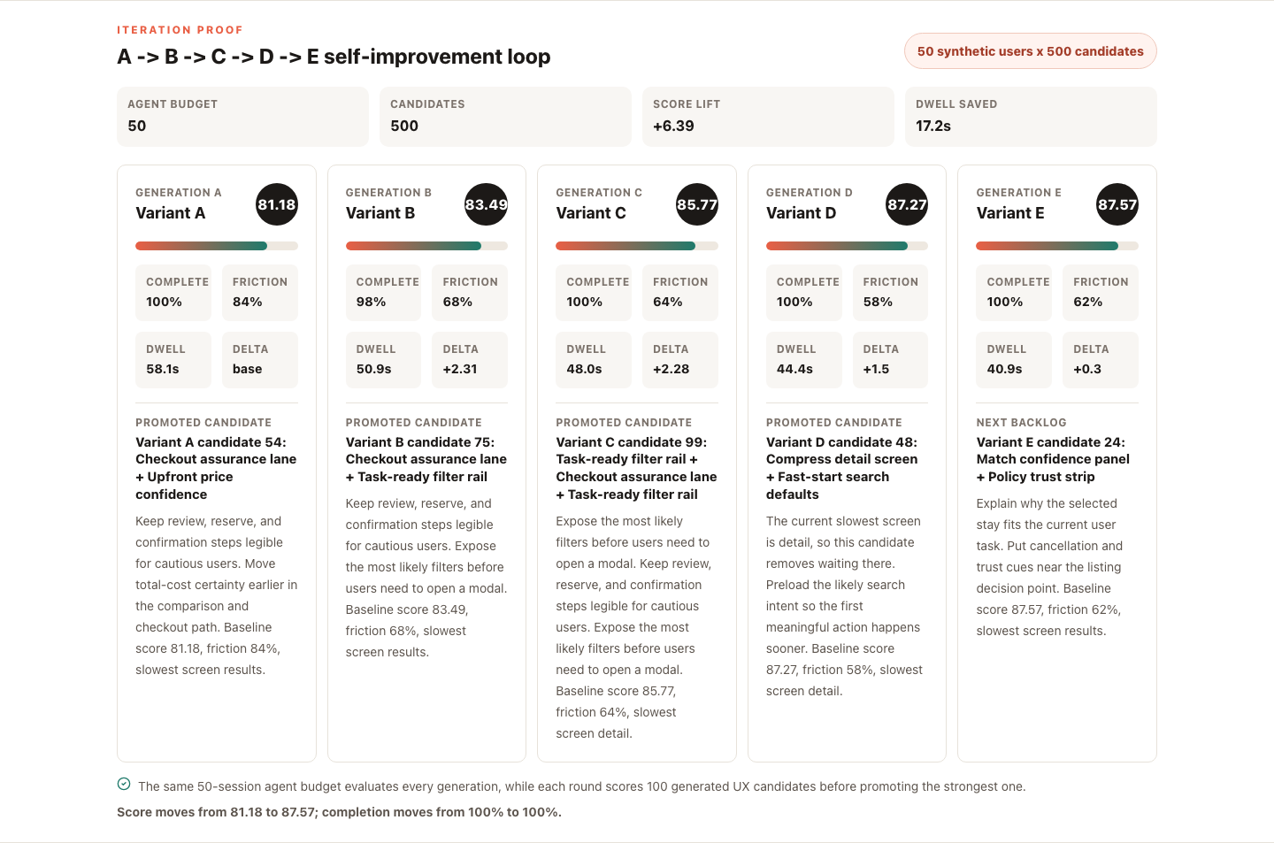
LIVE SCREENSHOT
Evidence: the product gets easier across A-E

Slide 5
HOW TO PITCH IT
Demo script and generalization path
Live demo in 90 seconds
CLAIM TO PROVE
Open /versionA and state the user task.
Given a webpage, task, and measurable UX signals, an agent loop can generate many candidate changes and promote variants that are easier for synthetic users to complete.
Open /synthetic and show A/B feedback plus A -> E promotion history.
Export JSON evidence to show this is not a static mock.
Explain the wrapper needed for any other product: observer, task adapter, success metric, friction signals.
The current repo proves the loop on a controlled booking product; the next step is plugging in browser observation and code-generation adapters for arbitrary apps.

