Slide 1
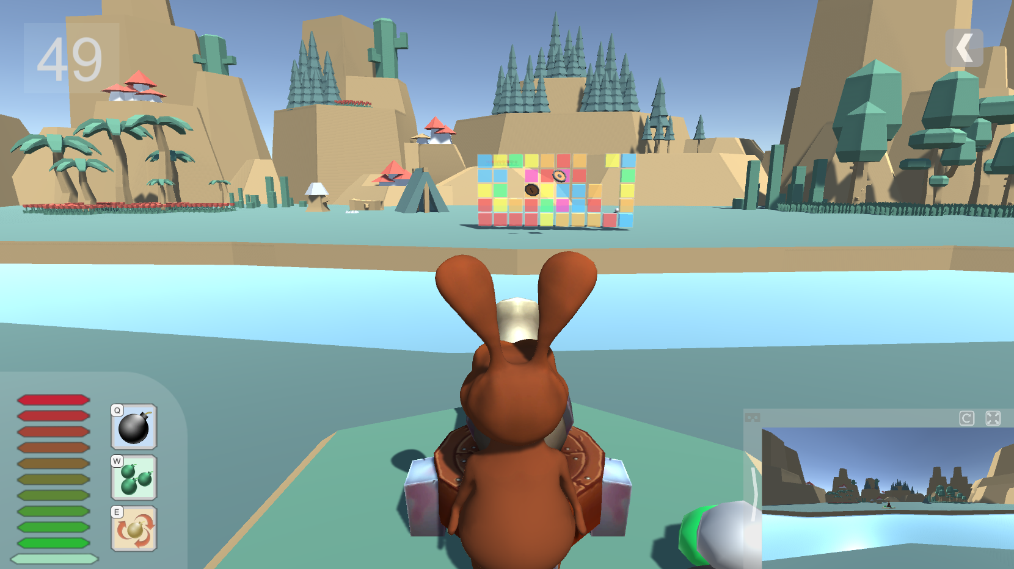
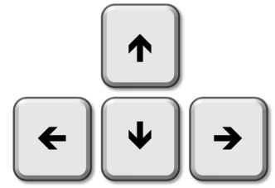
Try to BEAT these cubes
Hold [SPACE] button to gain power,
Release to FIRE!
Use to rotate your cannon
Press [Q][W][E] to activate skills

Slide 2
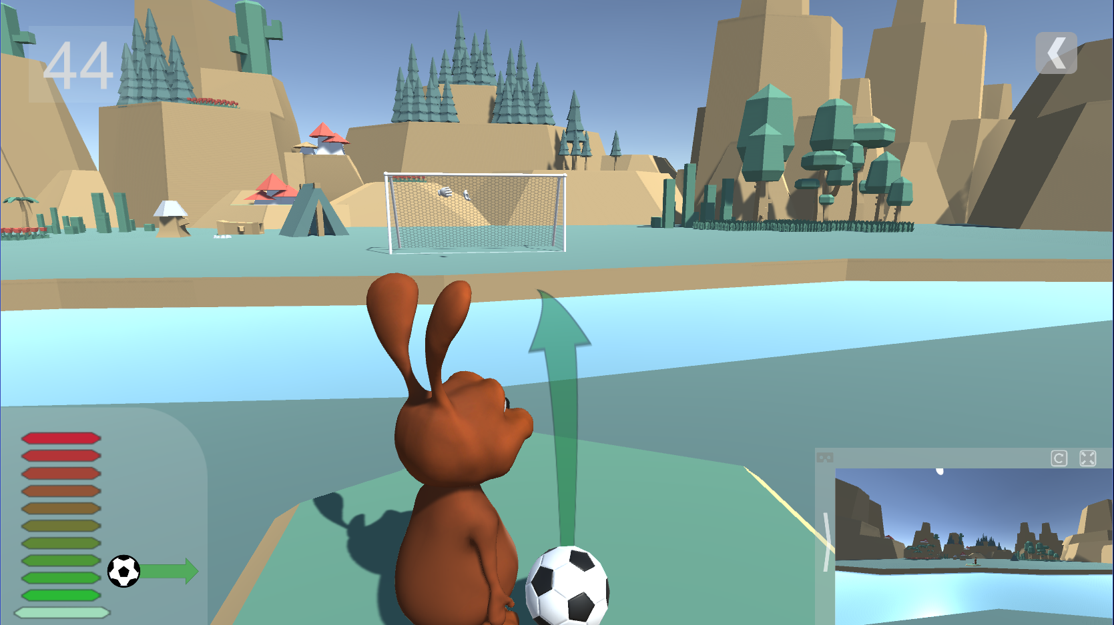
Try to GOAL !
Hold [SPACE] button to gain power,
Release to Kick!
Use to change your direction
Curled Free Kick: 1 or + [SPACE]

Slide 3






Slide 4
X
A
Y
B

Slide 5
VR Ready
Main Menu
PC Ready

