Slide 1
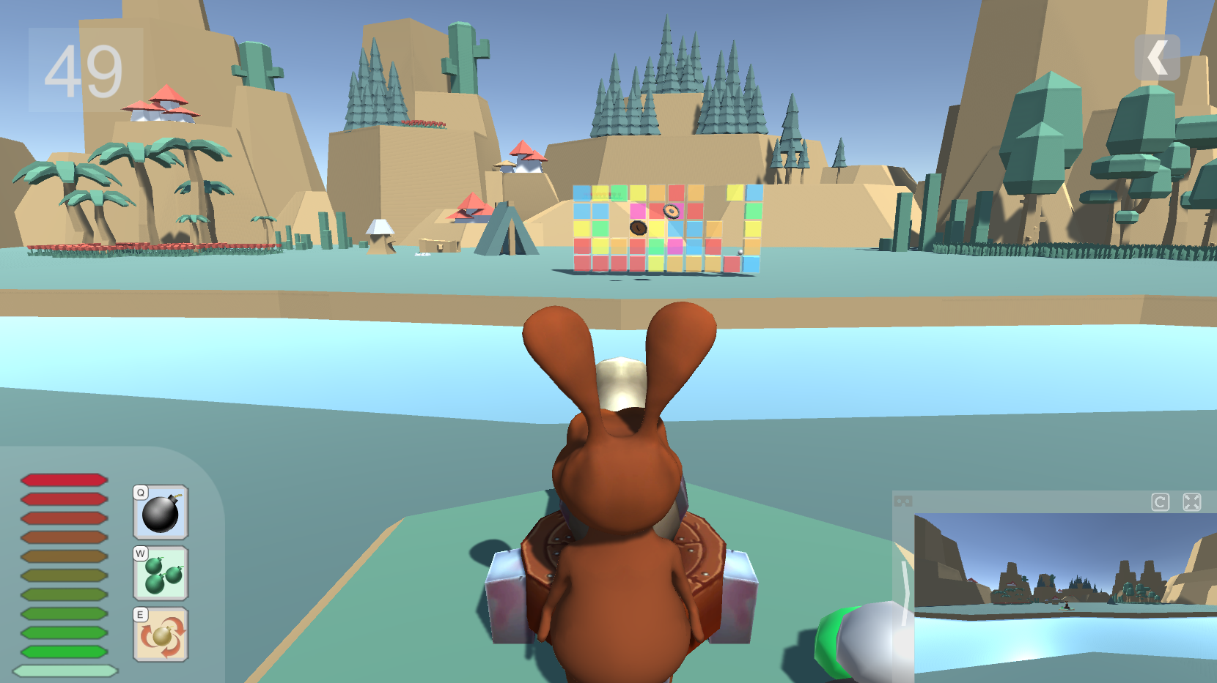
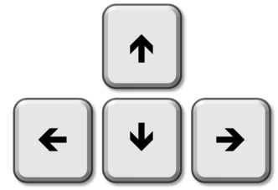
Try to BEAT these cubes
Hold [SPACE] button to gain power,
Release to FIRE!
Use to rotate your cannon
Press [Q][W][E] to activate skills

Slide 2
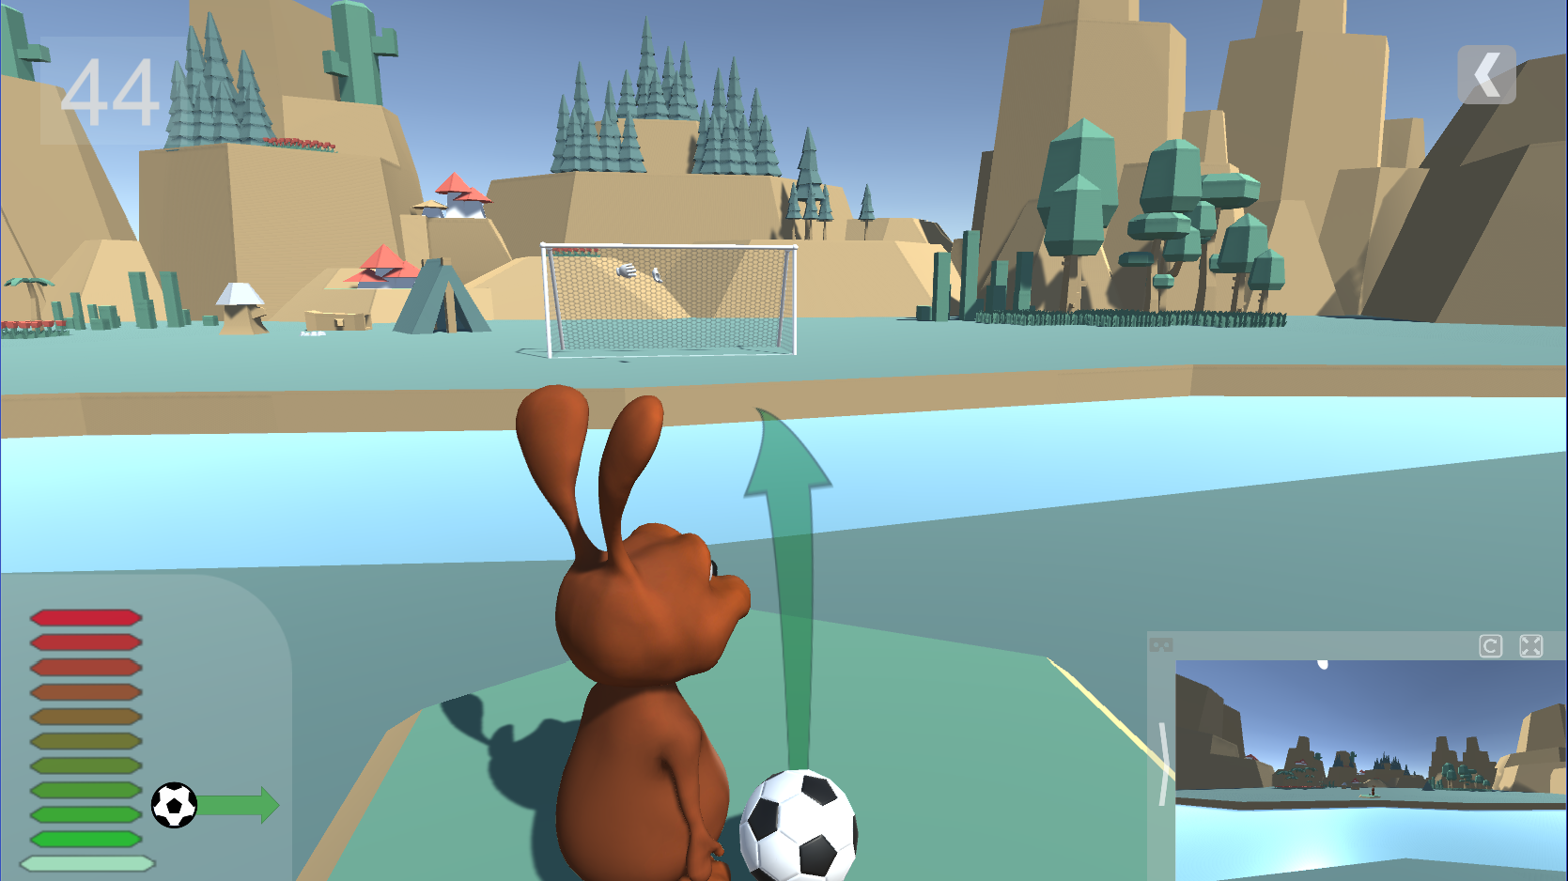
Try to GOAL !
Hold [SPACE] button to gain power,
Release to Kick!
Use to change your direction
Curled Free Kick: 1 or + [SPACE]

Slide 3
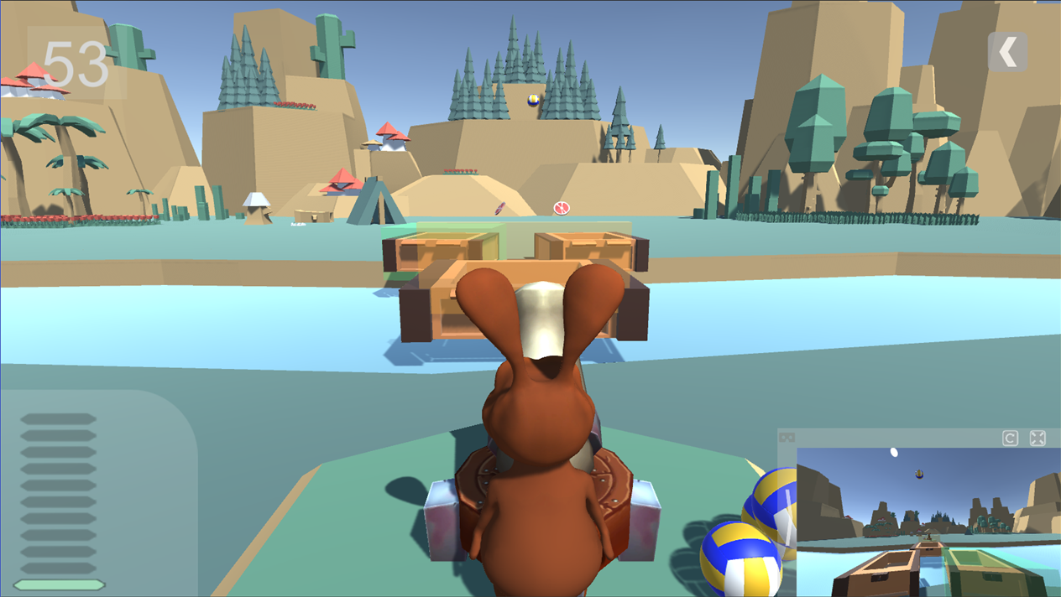
VR Player will try to bounce balls into baskets
Hold [SPACE] button to gain power,
Release to FIRE!
Use to rotate your cannon

Slide 4






Slide 5
X
A
Y
B

Slide 6

VR Ready
Main Menu
PC Ready

