Slide 1
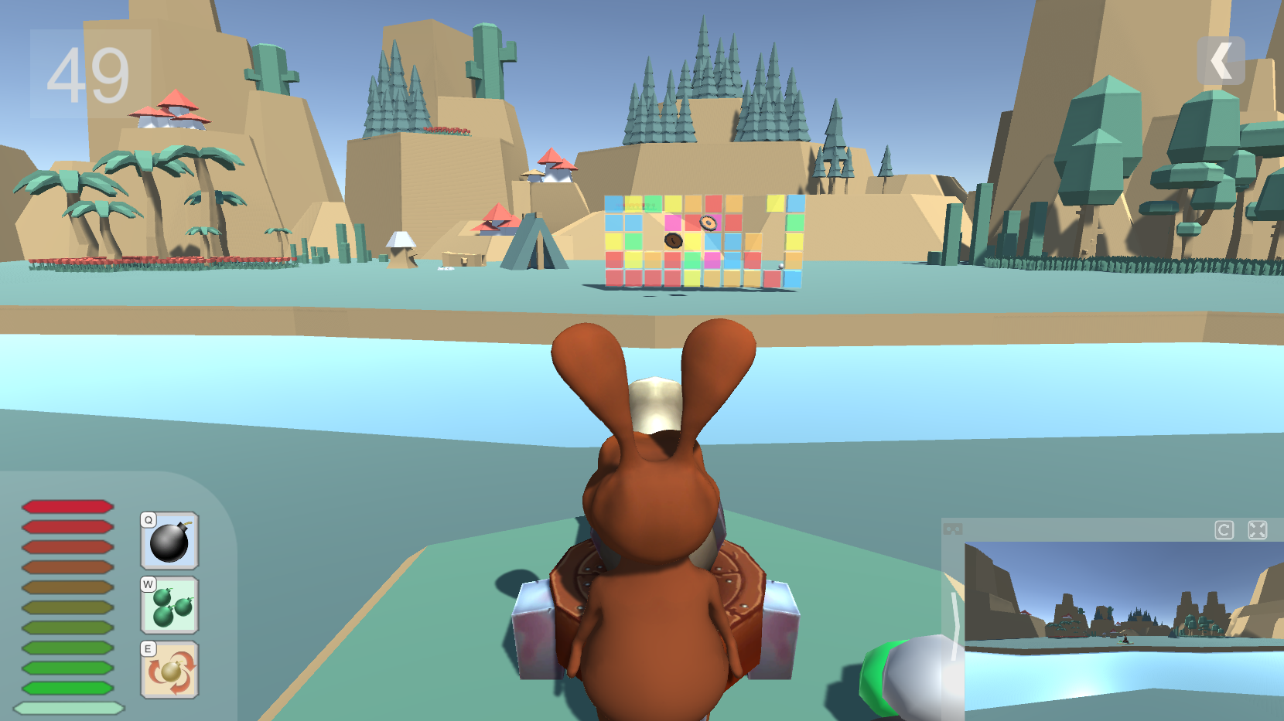
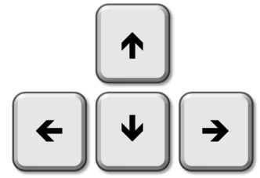
Try to BREAK these cubes
Hold [SPACE] button to gain power,
Release to FIRE!
Use to rotate your cannon
Press [Q][W][E] to activate skills

Slide 2
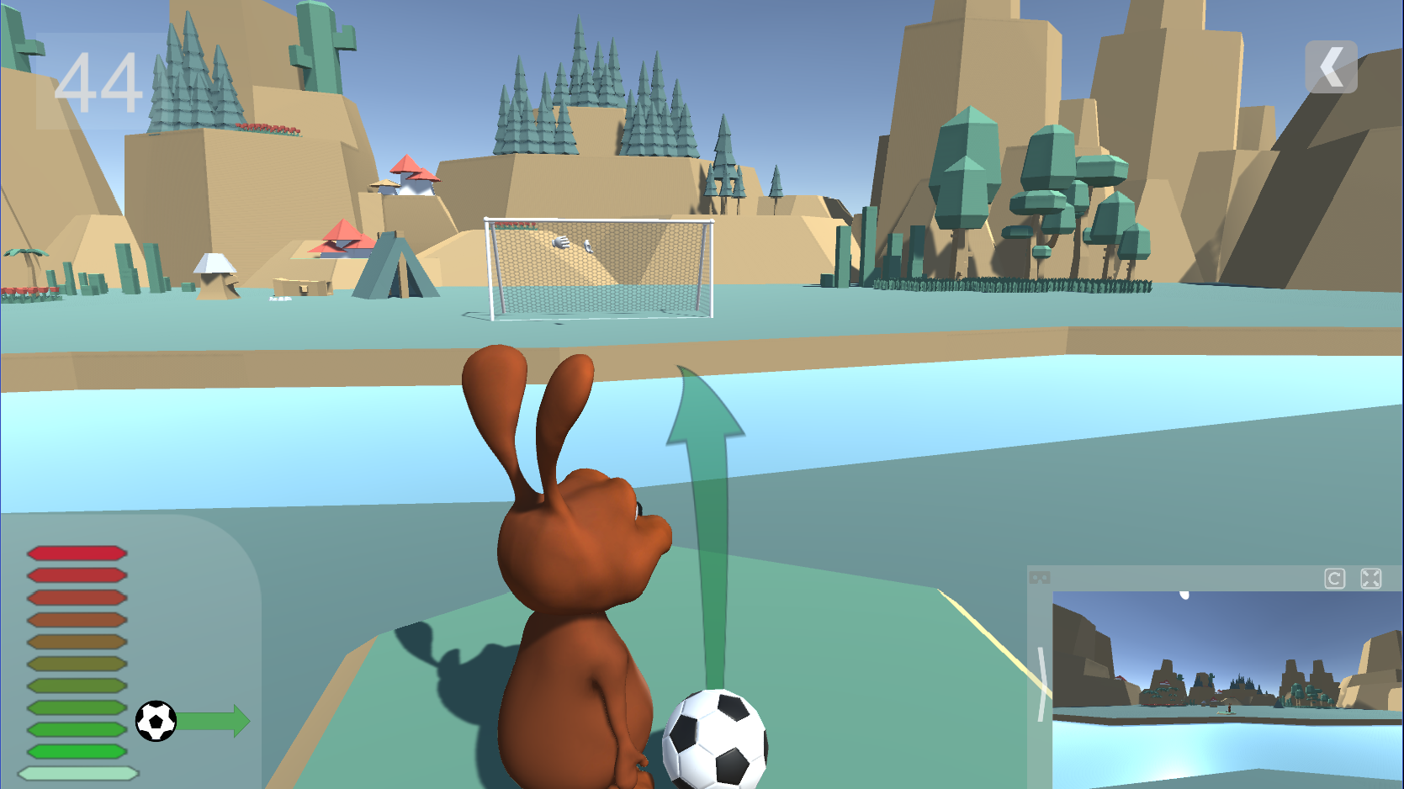
Try to GOAL !
Hold [SPACE] button to gain power,
Release to Kick!
Use to change your direction
Curled Ball: 1 or + [SPACE]

Slide 3
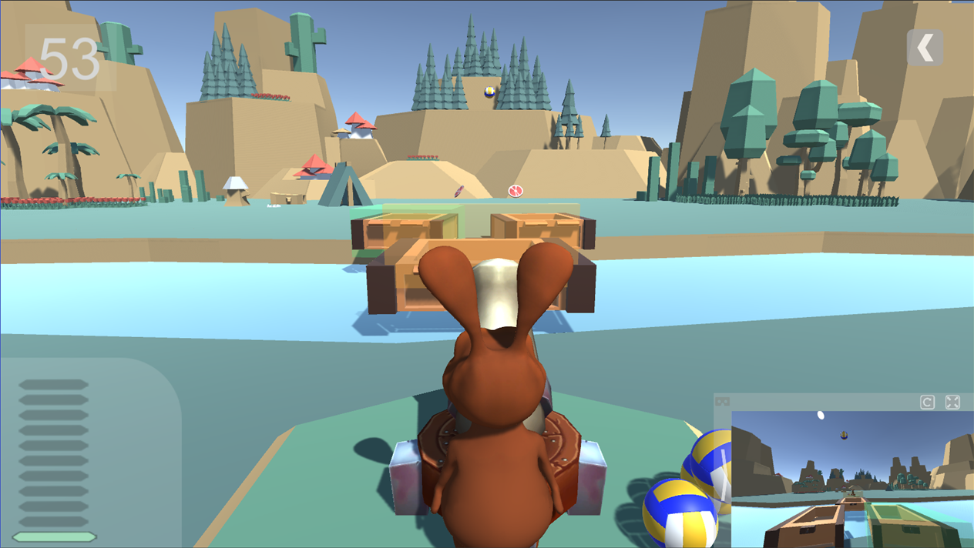
VR Player will try to bounce balls into baskets
Hold [SPACE] button to gain power,
Release to THROW the ball!
Use to change your direction

Slide 4


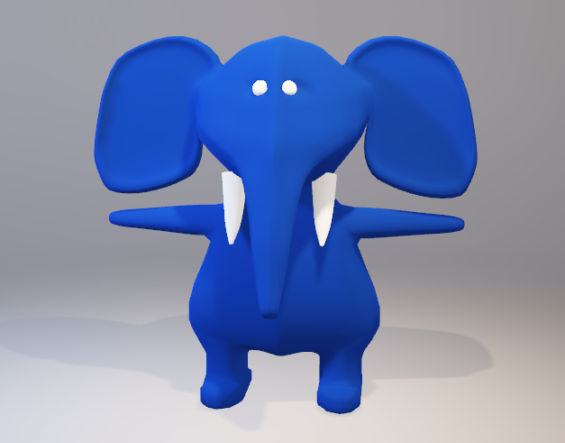
CAUTION
Safety Warning
Be careful of your surroundings.
Make sure you have enough room for VR

Slide 5

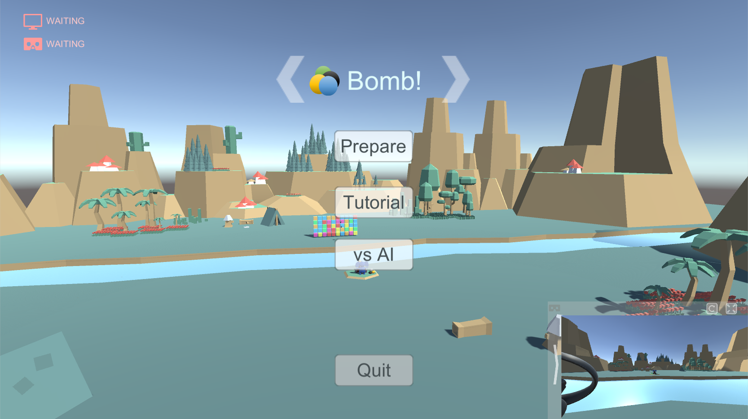
PC Player
Main Menu
Change Level
Prepare for a multiplayer game with VR player. Game will begin when both sides are ready
Re-center camera and full screen
VR Camera

Slide 6
PC Player
Level 1: Bombs!
Try to BEAT these cubes
Hold [SPACE] button to gain power,
Release to FIRE!
Use to rotate your cannon
Press [Q][W][E] to activate skills

Slide 7
PC Player
Level 2: Soccer
Try to GOAL !
Hold [SPACE] button to gain power,
Release to Kick!
Use to change your direction
Curled Free Kick: 1 or + [SPACE]

Slide 8
PC Player
Level 3: Basket
VR Player will try to bounce balls into baskets
Hold [SPACE] button to gain power,
Release to FIRE!
Use to rotate your cannon

Slide 9

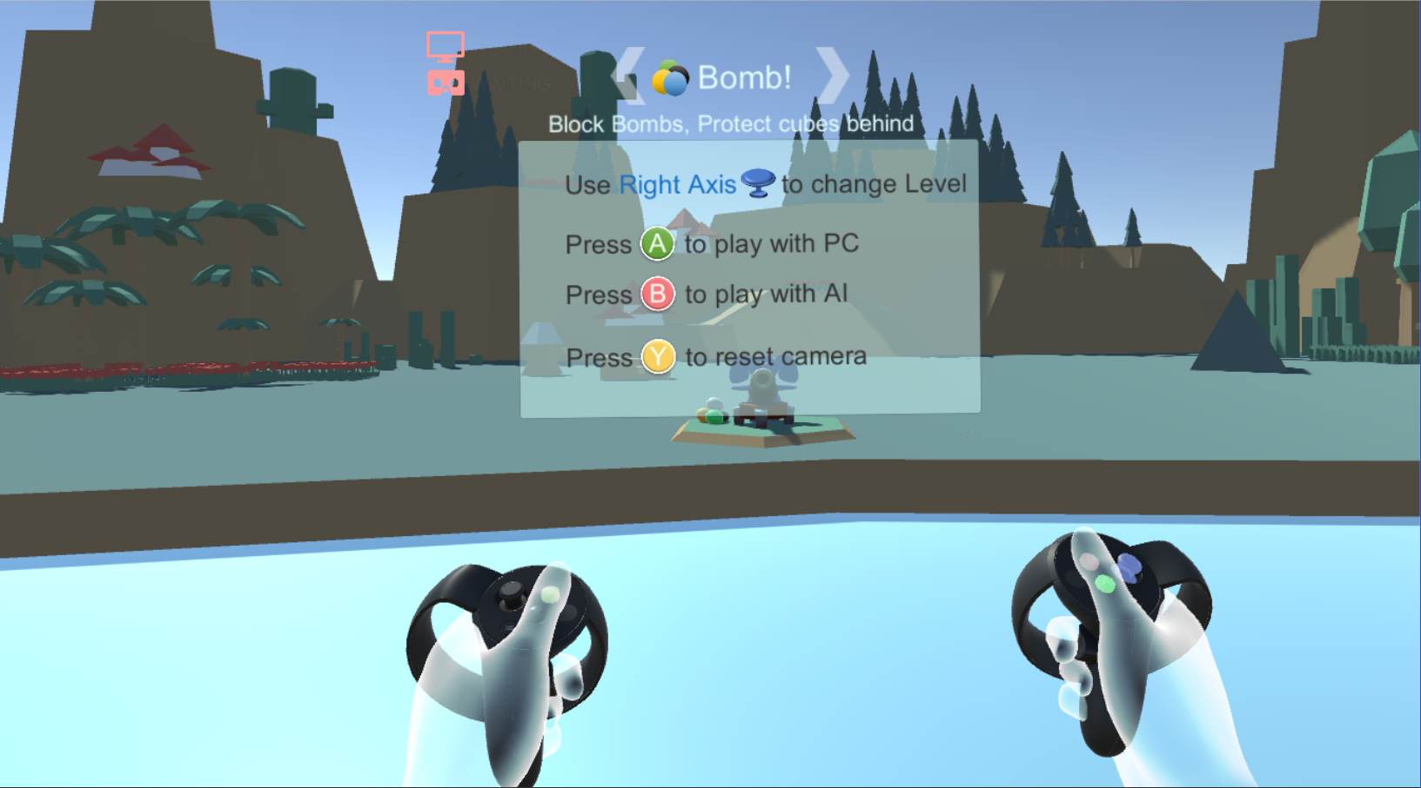
VR Player
Main Menu
VR tutorial
Your virtual hands

Slide 10






Slide 11
X
A
Y
B

Slide 12

VR Ready
Main Menu
PC Ready

