Slide 1
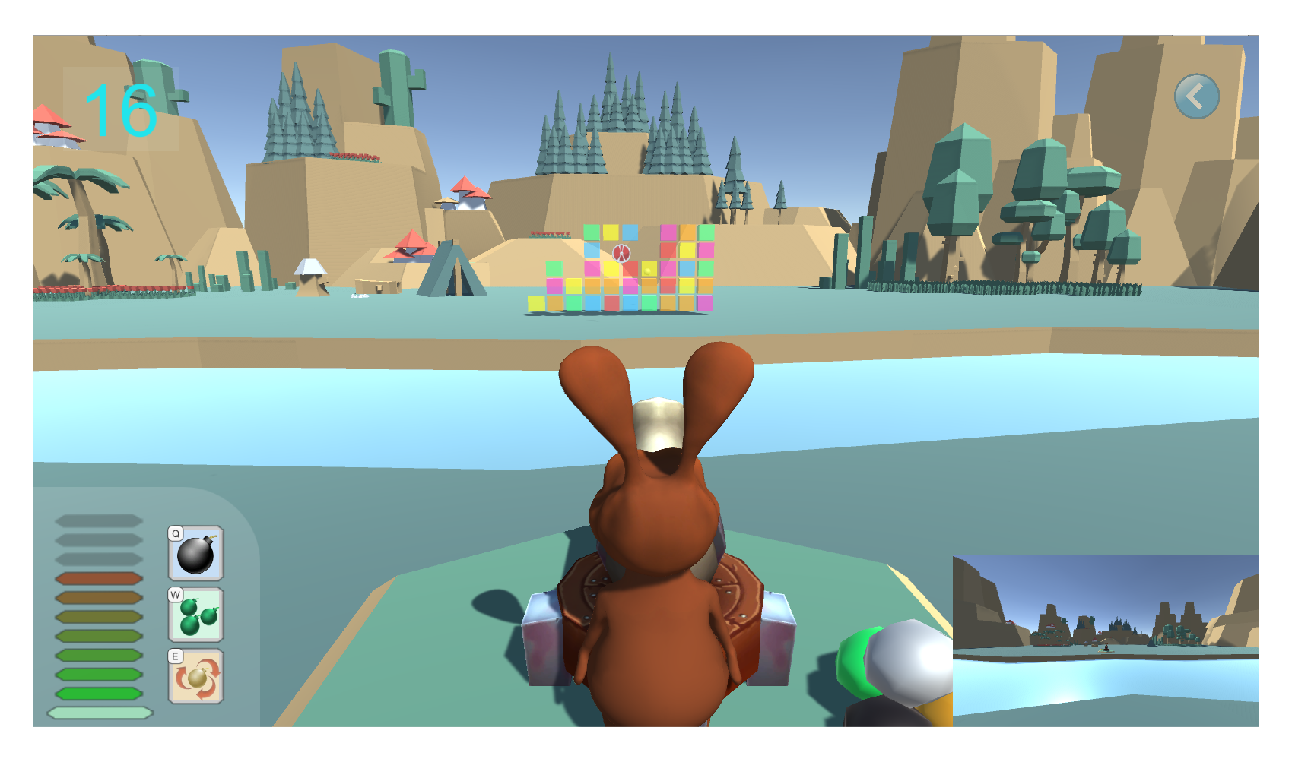
Try to HIT these cubes
Hold [SPACE] button to gain power,
Release to FIRE!
Press [Left Arrow] and [Right Arrow] to rotate your cannon
Press [Q][W][E] to activate skills

