Slide 1
The Technology Value Stream
CSD-380
Module 1.2 assignment
Dan Zhu
8/15/2025

Slide 2
Overview
What is the Technology Value Stream?
Defining Lead Time vs. Processing Time
The Common Scenario: Deployment Lead Times Requiring Months
Our DevOps Ideal: Deployment Lead Times of Minutes

Slide 3

What is the Technology Value Stream?
According to the book, The DevOps Handbook, technology value stream is the process required to convert a business requirement into a technology-enabled service that delivers value to customer.

Slide 4
Defining Lead Time vs. Processing Time
Lead Time
Processing Time
The lead time starts when a request is made and ends when it is delivered. The lead time provide an insight of how efficiency of the development process. It also could use to measure a team member’s deployment frequency and skill level by using lead time metrics.
The process time starts when developer start to work on the request exclude the time that the work is in queue, waiting to be process.

Slide 5
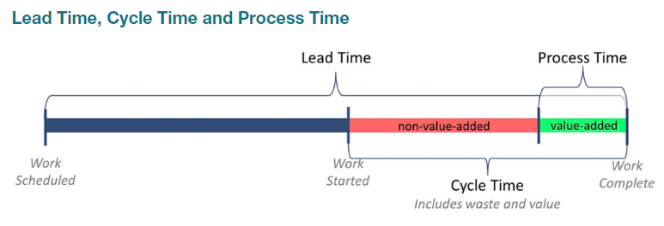
Lead Time vs. Processing Time

Slide 6
The Common `Scenario: Deployment Lead Times Requiring Months
Deployments lead times requiring months in many teams and organizations because the large, complex, and tightly coupled together. When long development lead time happens, heroics are required at most every stage pf the value stream. When all code put together, then nothing work. People have to spend a lot of extra time to investigate the issue and test all over again.
Over time, it will disappoint the customer and be less competitive.

Slide 7
Our DevOps Ideal: Deployment Lead Times of Minutes
The DevOps ideal measures the lead time in minutes, or, in the worst case, hours.
In the DevOps ideal, developers implement, integrate, and validate code constantly and get feedback frequently.
Developers deliver small code in version control and have it well tested before deploy it into production. Therefore, team have more confidence when deploy in production.

Slide 8
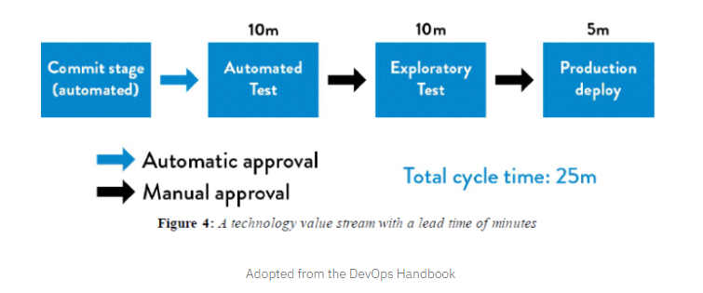

Slide 9
The DevOps Handbook 2nd Ed https://www.vsmconsortium.org/blog/what-is-a-value-stream https://humanitec.com/blog/lead-time-a-key-metric-in-devops

