Slide 1
Github 101 aka: how to share computers and stay friends Lab github link: https://github.com/HanLabBU
By Dana Zemel
05/08/2020

Slide 2
Outline
What is git/github?
Repositories
What is it?
gitignore, ssh keys
How to clone repository
Add, commit, stash
Push/Pull updates
Resolve conflicts
Branches
Compare files
Matlab integration
Search within all files

Slide 3

What is Git/Github?
Most popular Version Control System
Keep track on changes in files
Biggest alternatives are “Fossil” and “Mercurial” but disappearing quickly

Slide 4


What can git Do for you?
“Nooooo! I messed up my code, and nothing works anymore”
or
OMG I just erased all my code, everything I did is GONE
No worries! it is all backed up
And you can Easily go back to a pervious version

Slide 5

What can git Do for you?
“Did my code change? or do the data gods hates me today? ”
“I have 6 different files with the same name in different places.
I wonder if they are different?”
Easy to compare files,
Type one word to check which files changed since you last saved your work

Slide 6

What can git Do for you?
“This student wants all the code from a publication I wrote 3 years ago”
or
“Switched computers and need to copy all my code over”
All you need is a link and you can download the entire project

Slide 7

What can git Do for you?
“ we are sharing a computer, and disagree on what version of the code is best”
Use different branches, and switch between versions of the code easily

Slide 8
Repositories
Repository –
Should contain all code related to one project
Can contain multiple folders and sub folders
Should have everything you need to restart the project on another machine
Can be privet or open
Private = Only you, and users approved by you can see content
public = anyone on the internet can see it (meant for finished published work in our case)
Can have any user licensee you want
Shouldn’t Contain data!!!
In fact, git limits the size of files you can push into a repository. So make sure you have a .gitignore file

Slide 9
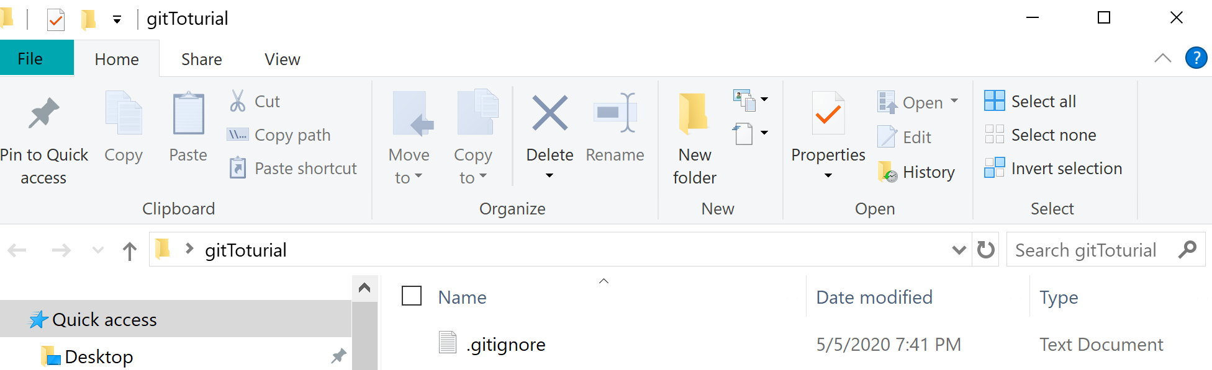
.gitignore file
The .gitignore file tells git to ignore certain files, folders, or file type
It is especially important for us, because:
git does not allow files larger 100MB
Repository max size 1GB
To create a gitignore file:
Open a new text file
Add the exception
Save as “.gitignore” (no extension)
Must be in the same folder as your repository

Slide 10
.gitignore file - syntax
**/folderName ← will ignore any folder with this name (even subfolders)
*.fileExtention ← will ignore all files with this extension
ex. *.tif will ignore all tiff files
filename ← ignore this specific file
/folderName ← ignore this folder and its subfolders
For full list: https://www.atlassian.com/git/tutorials/saving-changes/gitignore#git-ignore-patterns

Slide 11
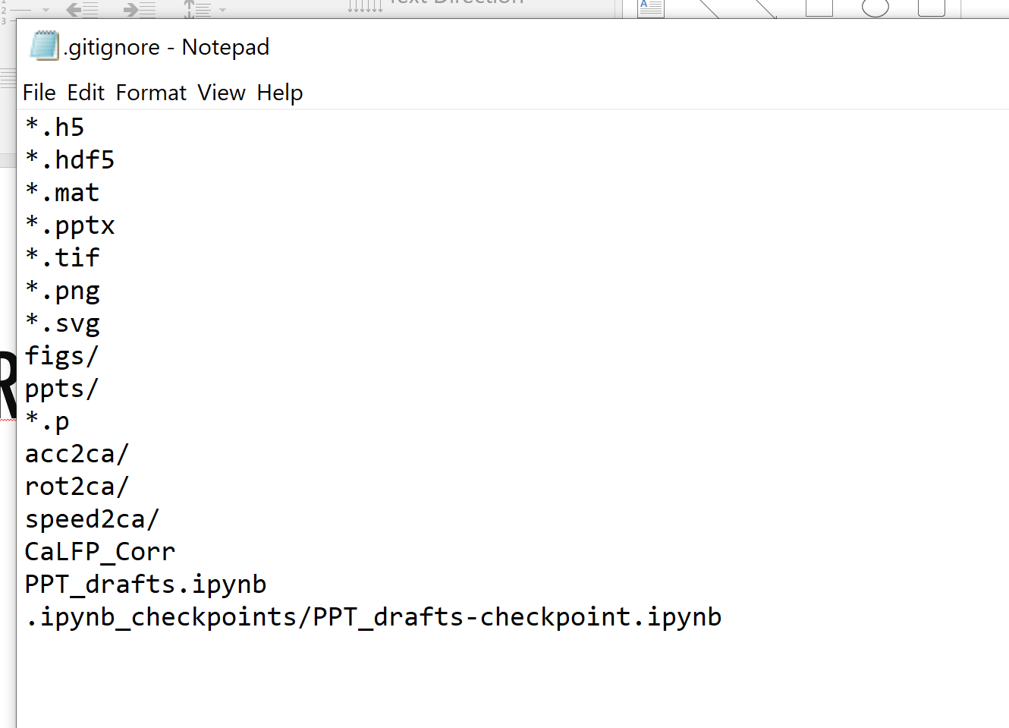
.gitignore file - example
This is my git ignore from my 6OHDA repository
Make sure you ignore:
big files (especially data)
folders with sensitive/privet information
Folders with “junk” you don’t want to track

Slide 12
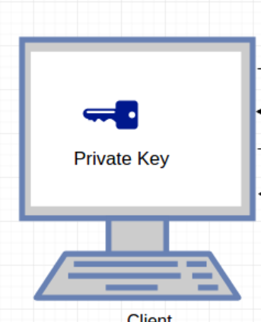
SSH keys
What?
A way to tell github that a certain computer is trusted
Think of it as a password you don’t need to keep typing
Purpose:
Make sure random people aren’t changing the code in your repository
Make sure no one downloads your privet repository without permission

Slide 13
Add your SSH key to git
You only need to do this once for every computer you use
Check that you have SSH key:
Open command window (you can do it!) and type:
cd ~/.ssh ← go to the folder that contains all ssh keys
ls ← Show all files in folder
If the folder doesn’t exists or empty ONLY (No ssh key, create a new one)
ssh-keygen -t rsa -b 4096 -C "your_email@example.com"
Go with default settings -> just press enter until it stop asking you questions
Activate SSH key:
eval $(ssh-agent –s) ← start the ssh agent
ssh-add ~/.ssh/id_rsa ← Show all files in folder

Slide 14
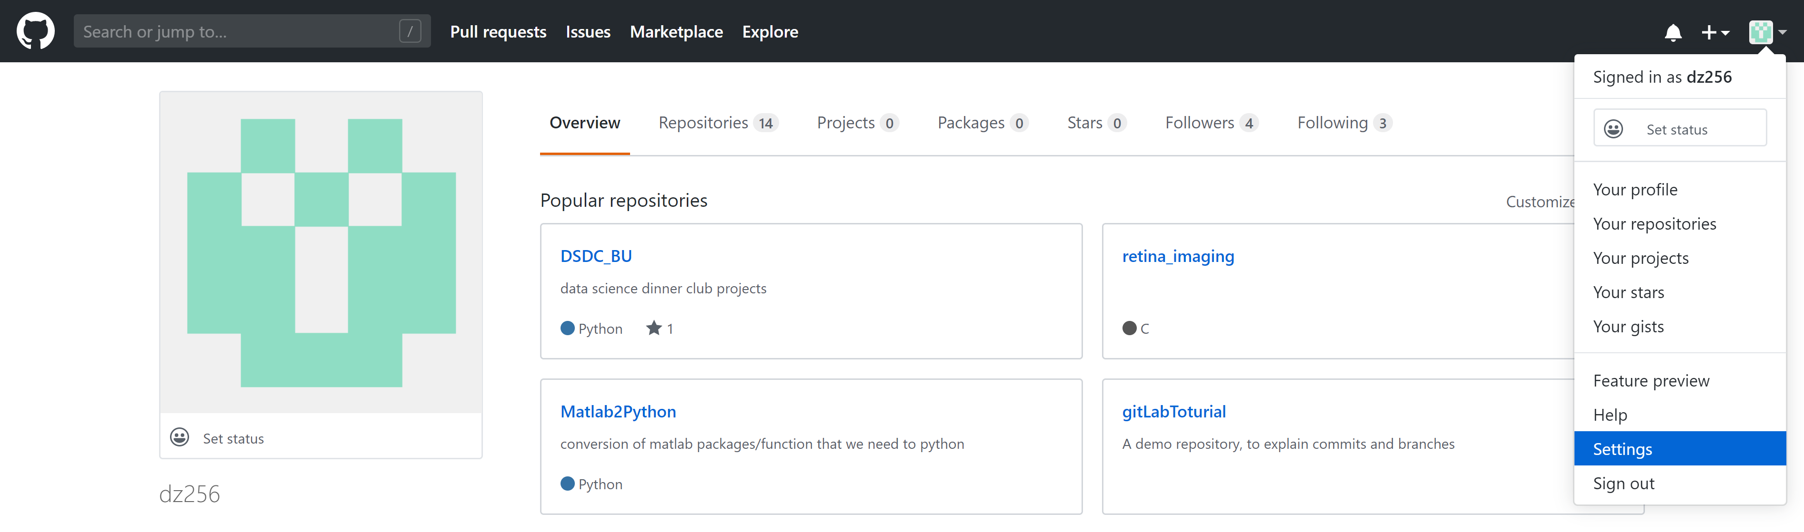
Add your SSH key to git - continue
Copy your SSH key’s public key and add to your github account:
(type In command line) ← this step will copy the content of your public key to cllipbord
For windows: clip <~/.ssh/id_rsa.pub
For Mac: pbcopy <~/.ssh/id_rsa.pub
Log in to your github profile and go to settings
Pressing you user icon will open the menu

Slide 15
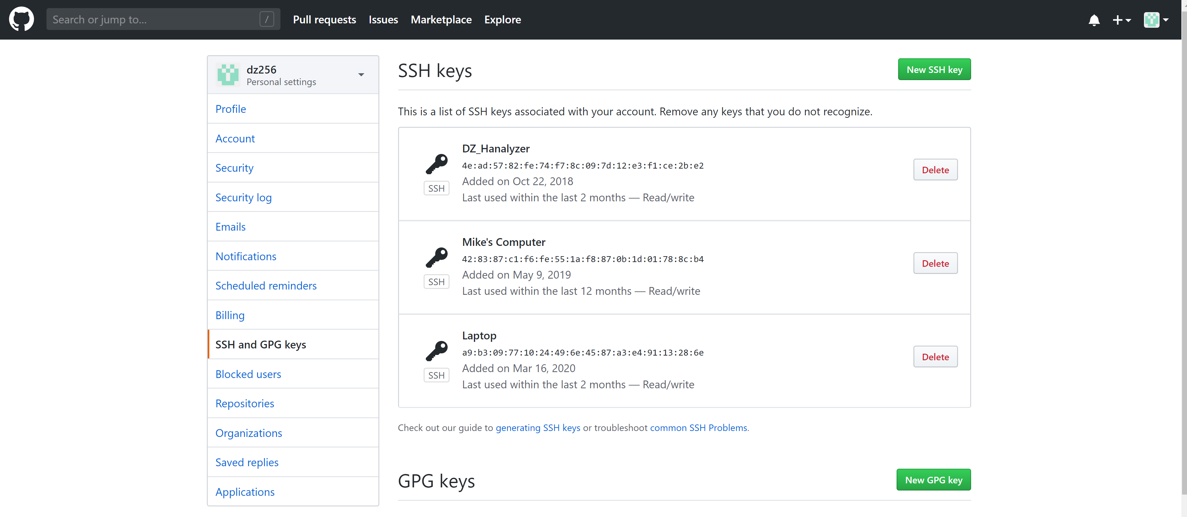
Add your SSH key to git - continue
Go to SSH and GPG keys
Click New SSH key
Step 4
Step 3

Slide 16
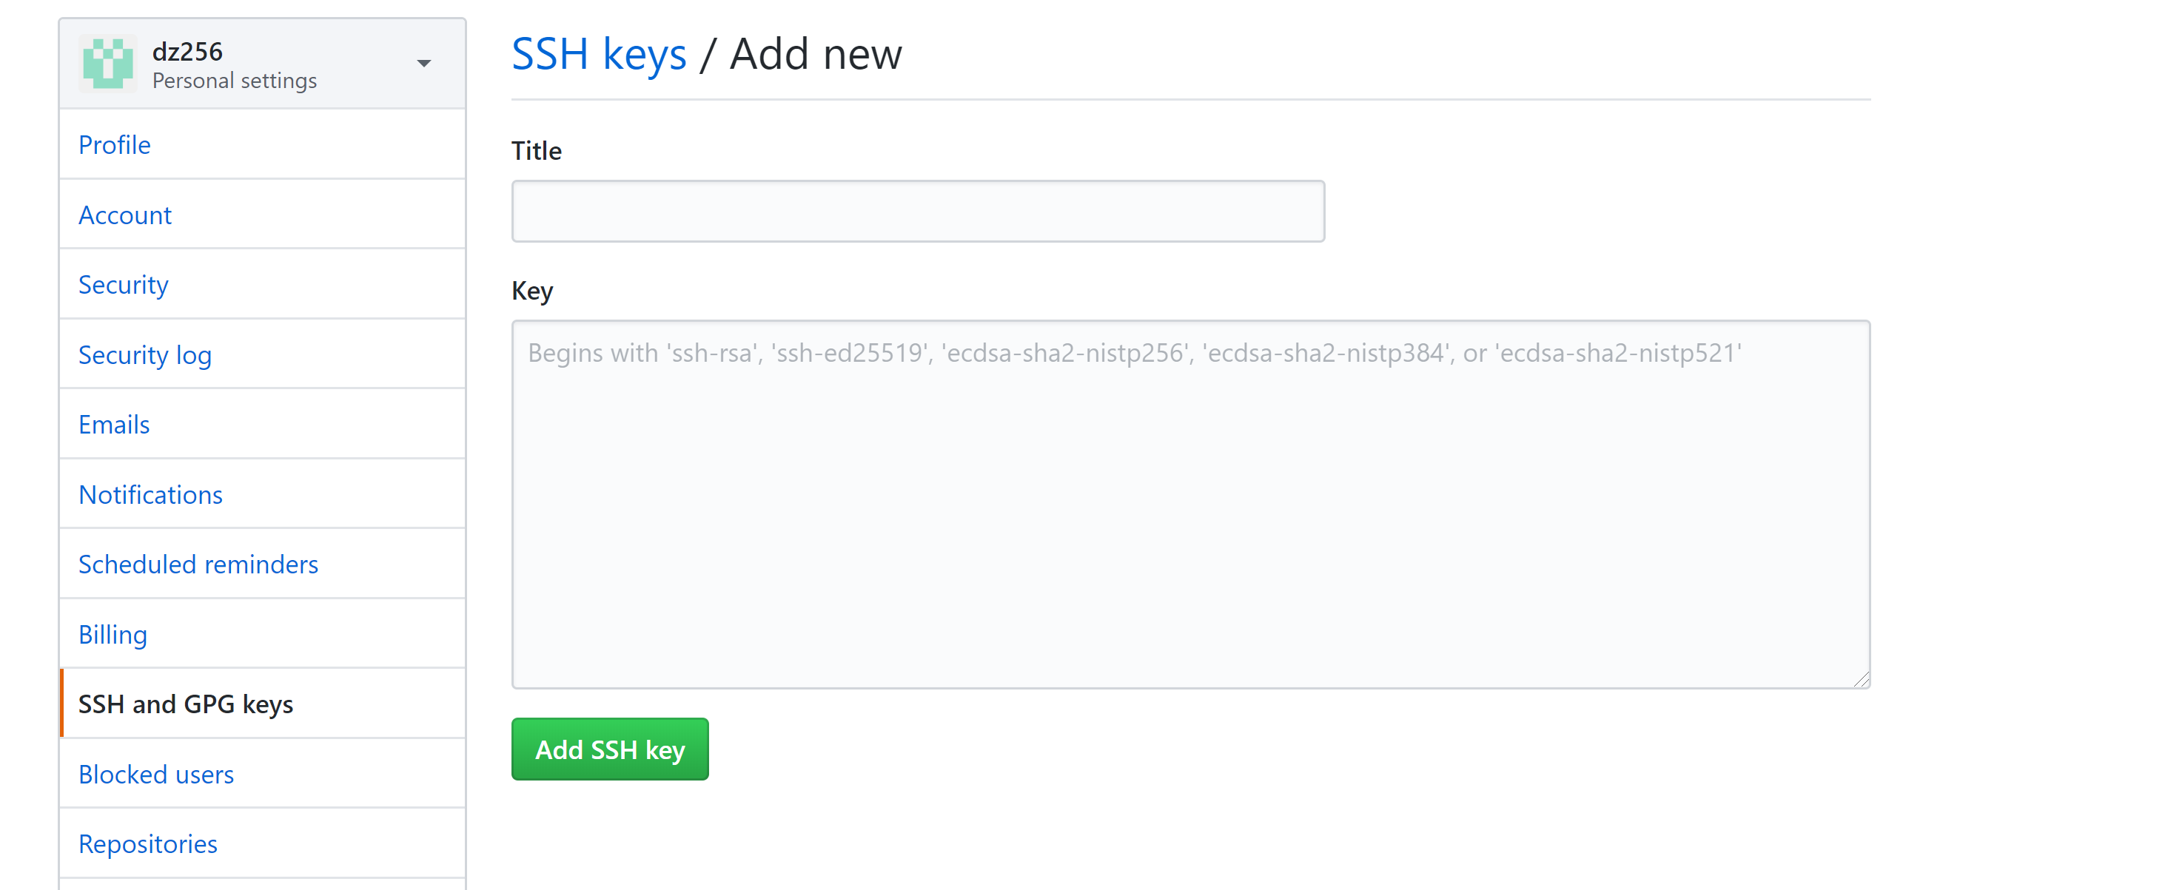
Add your SSH key to git - continue
Past the key into the key box, and name the computer however you like
Click “Add SSH key”
Name you computer
Paste you public key here
Save the key

Slide 17
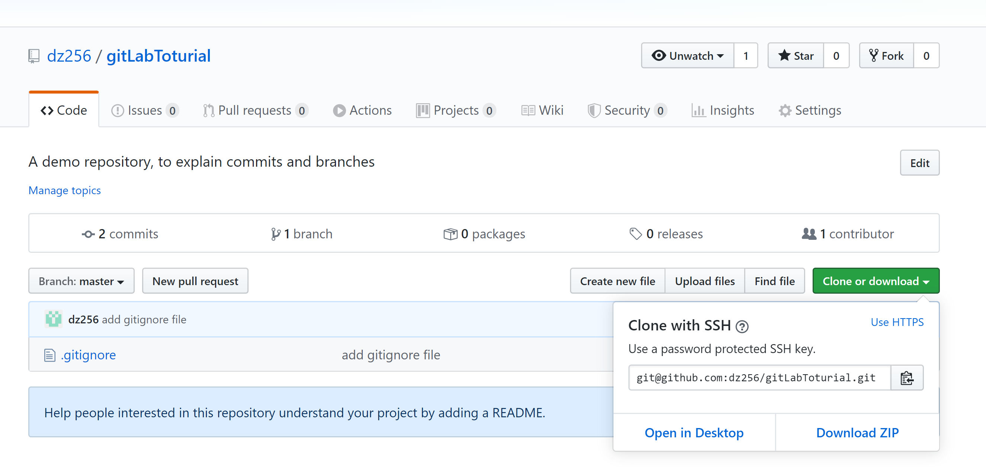
Cloning a library
In commend window, type:
cd folderPath ← go to the parent folder into which you want to clone the repository
git init ← will start a new git repository that monitor this folder + any subfolders
git clone repositoryAdress ← actually clone the repository
Ex. git clone git@github.com:dz256/gitLabToturial.git
To find the repository address:
Find the repository on github,
Press “Clone or download”
OR
git@github.com:GitUserName/ReposetoryName.git
This bottom will copy the address to your clipboard

Slide 18
Status, Add, commit, pull,push
git status ← will let you know what changed since you last committed your work
git add .← add ALL your changes to your git index
Replace . With file name to add only a specific file
git commit –m “message” ← commits your change to git history (local computer ONLY)
Make sure the message is informative enough so you and others know what you changed later!!!
git pull origin branchName ← get updates by other users into your local computer
git push origin branchName ← updated the online repository with your changes

Slide 19

Hand-On demonstration

Slide 20
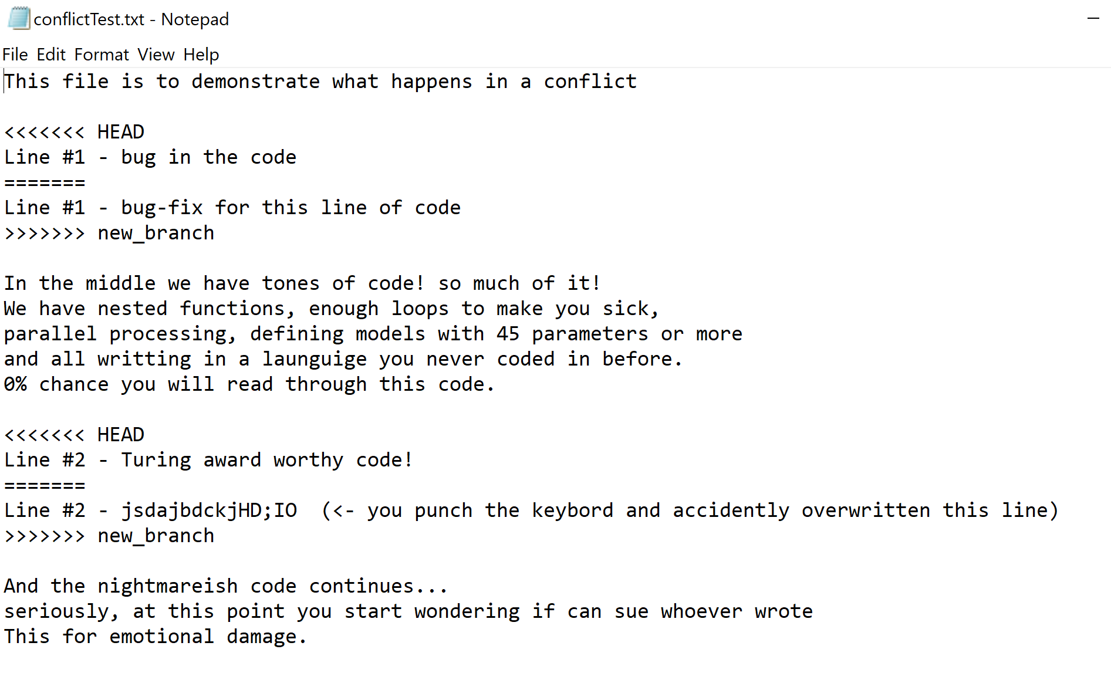
Resolve conflicts
If two people make incompatible changes to the same file, there is a conflict
To resolve a conflict:
Open file, you will see something like this:
Conflicted lines will be between
<<<<<<<<<<<<<<<
Version 1
==============
Version 2
>>>>>>>>>>>>>>>
Decide which lines of code you want to keep and earse redundant versions
Add and commit again

Slide 21
Switch branches
Brunch –
A (sometimes temporary) version of the repository
Change in each branch tracked separately
Often have development and production or main
git checkout –b branchName ← create a new branch and switch to it
git checkout branchName ← switch to existing branch
git merge branchName ← will add all commits and changes from branchName to your current branch

Slide 22
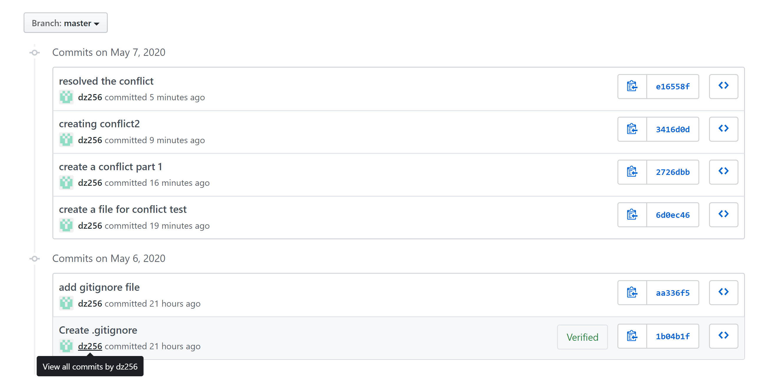
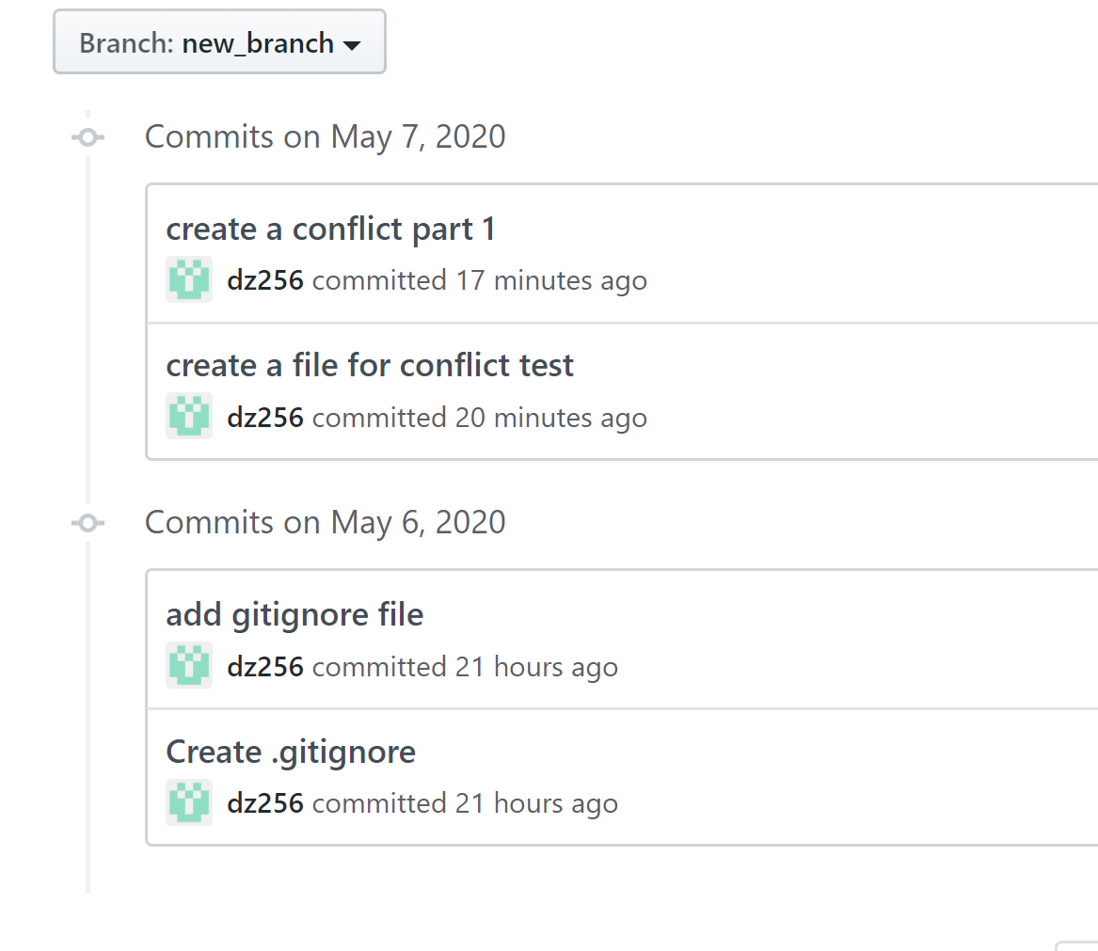
Example of commits history after merging:
Merged branch “new_branch” into branch “master”:
Merge only effect master.
These will not show in “new_branch”
Created the new branch here.
All commits before creating appear in branch history
This commit was done in new branch

Slide 23
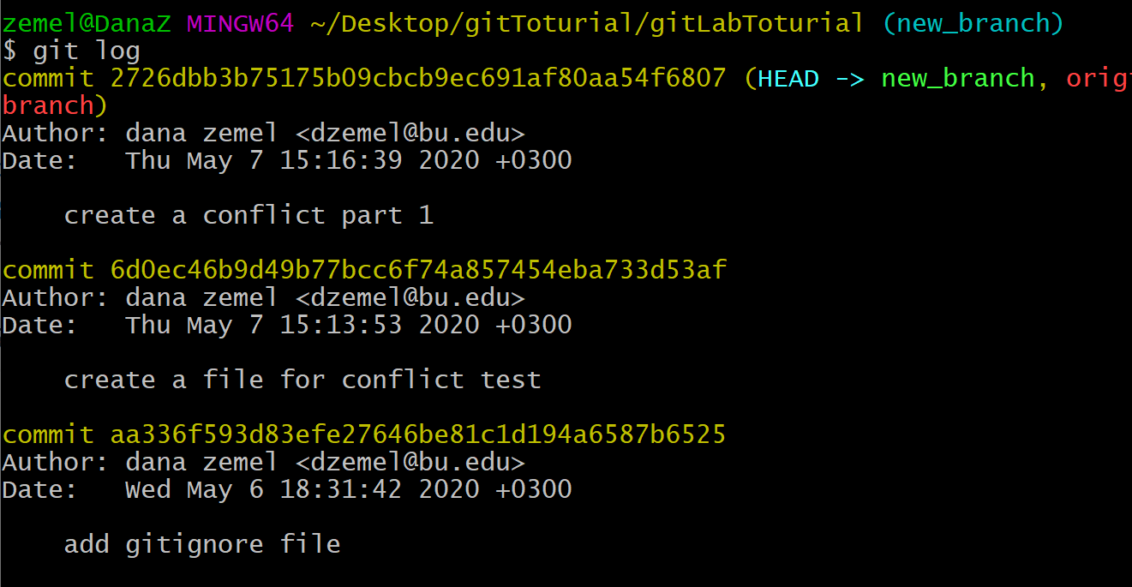
Look at past commits
git log ← Shows all past commits – tied to github
Commit ID to be used if you want to rollback changes
Your commit message (this is why it’s important you write an informative description of the commit)

Slide 24
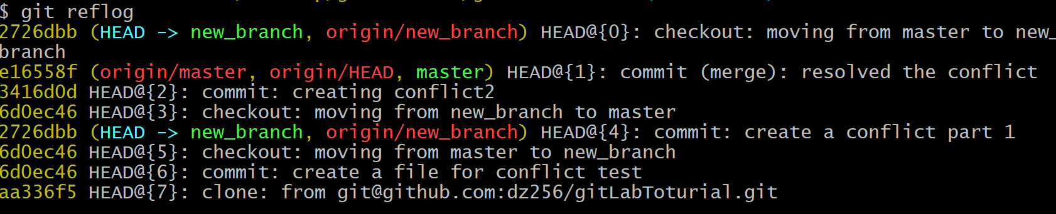
Look at past commits
git reflog ← Local only! Shows commits + actions that change files on your computer like checkout/clone allows to revert back to any past version on the computer, even if wasn’t pushed
Change ID
Action
message

Slide 25
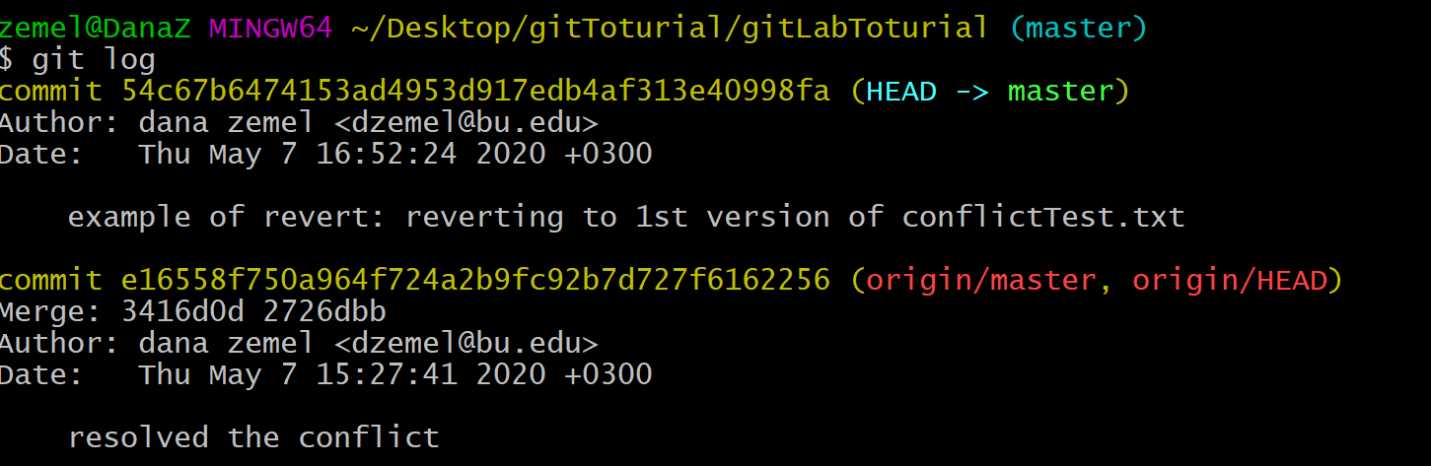
Roll back to past commit -REvert
There are several ways to go back to pervious version. We will talk about the two most basic ones: revert and reset.
Revert – The safe way to roll back changes.
git revert commitID ← This creates a new commit that return your repository to previous version. Will almost always create a conflict, solve it and commit.
All the commits after the one we reverted to still exists :)

Slide 26
Roll back to past commit -RESET
Reset – This command actually undo the commits. If you push your code, all commits after the one you reset to could be lost forever.
PLEASE DON’T USE RESET IF YOU WORK ON SHARED CODE!
What is unimportant to you, might be crucial for someone else…
There are three types of reset: --soft, --mixed, --hard. You can read more about it here: https://stackoverflow.com/questions/3528245/whats-the-difference-between-git-reset-mixed-soft-and-hard
Notes:
If you reset –mixed or –hard and push. Only way is to reset back using relog on your local computer. Local computer died? So did the changes.

Slide 27
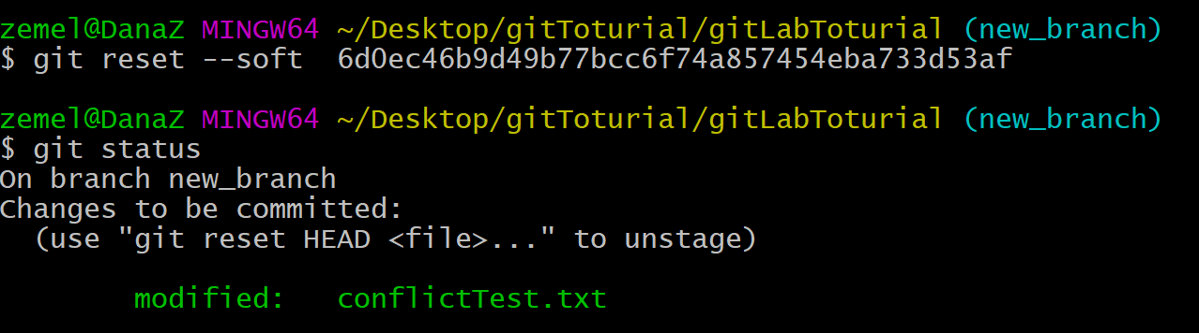
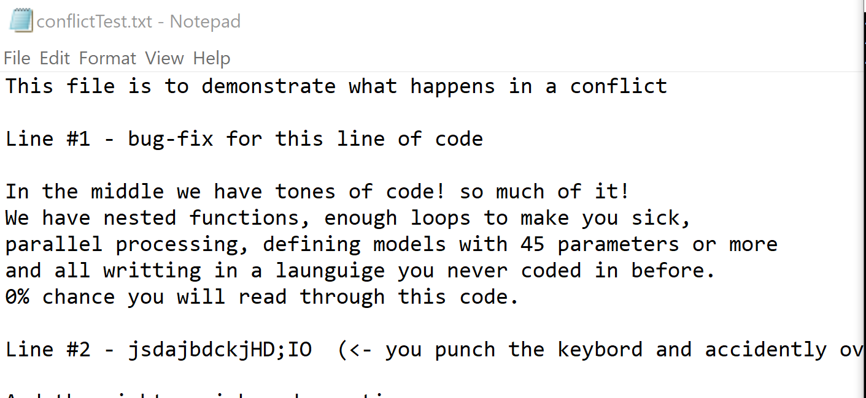
Roll back to past commit -RESET
Soft reset –
git reset --soft commitID ← This undo the commit, but leave the files in your local repository unchanged. If you do git status you’ll see them staged for commit.
git status result
File in local directory

Slide 28
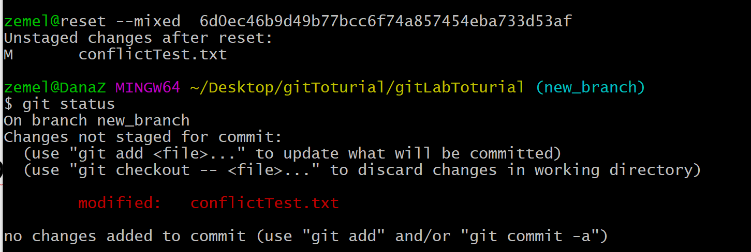
Roll back to past commit -RESET
Mixed reset –
git reset --mixed commitID ← This undo the commit, but leave the files in your local repository unchanged. If you do git status you’ll see they ARE NOT staged for commit.
git status result
File in local directory

Slide 29
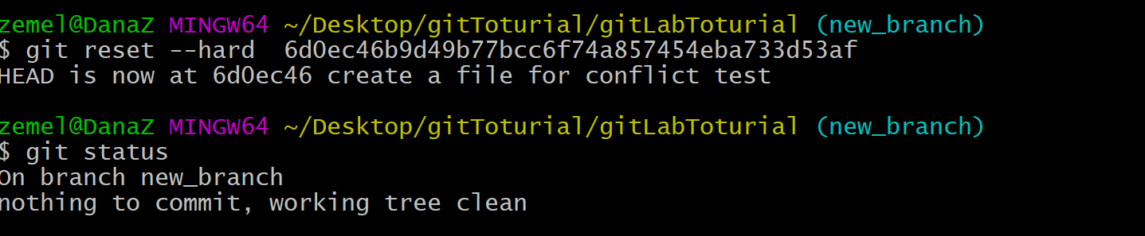
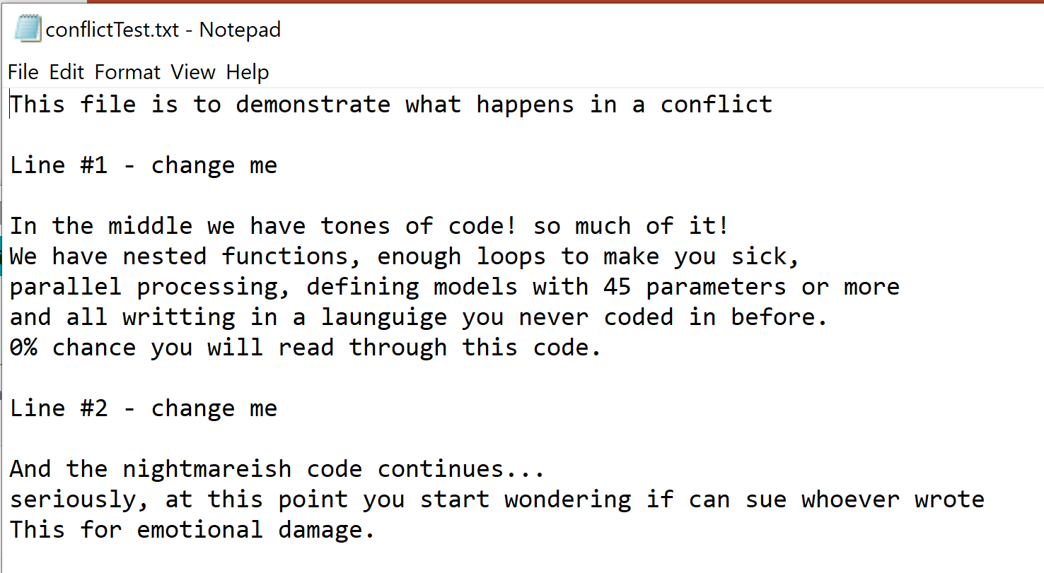
Roll back to past commit -RESET
Hard reset –
git reset --mixed commitID ← This undo the commit, AND change the files in your local repository
git status result
File in local directory

Slide 30
Compare files
To compare files we use git diff. This is a very powerful command.
We can compare:
2 different files in same repo
Same file in different branches
Files between different commits.
In this tutorial we will only look at comparing two files, but you can look up the rest of the case here: https://www.atlassian.com/git/tutorials/saving-changes/git-diff

Slide 31
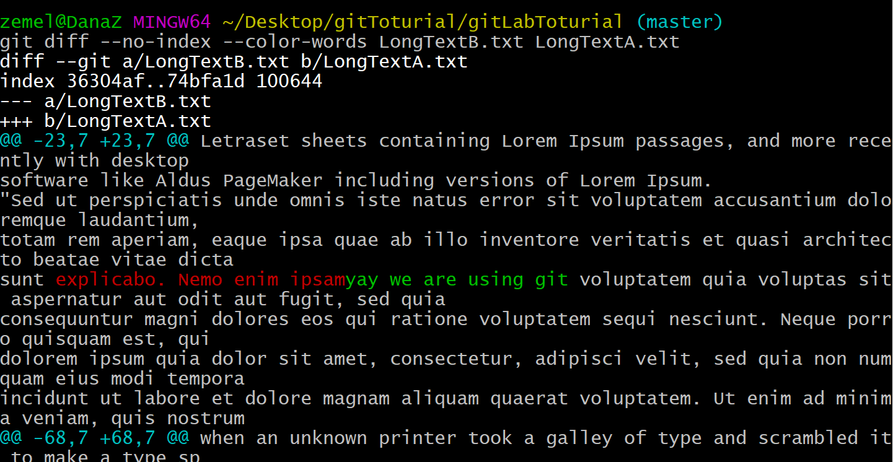
Compare files
git diff --no-index --color-words pathToFileA PathToFileB ← Compare 2 files

Slide 32
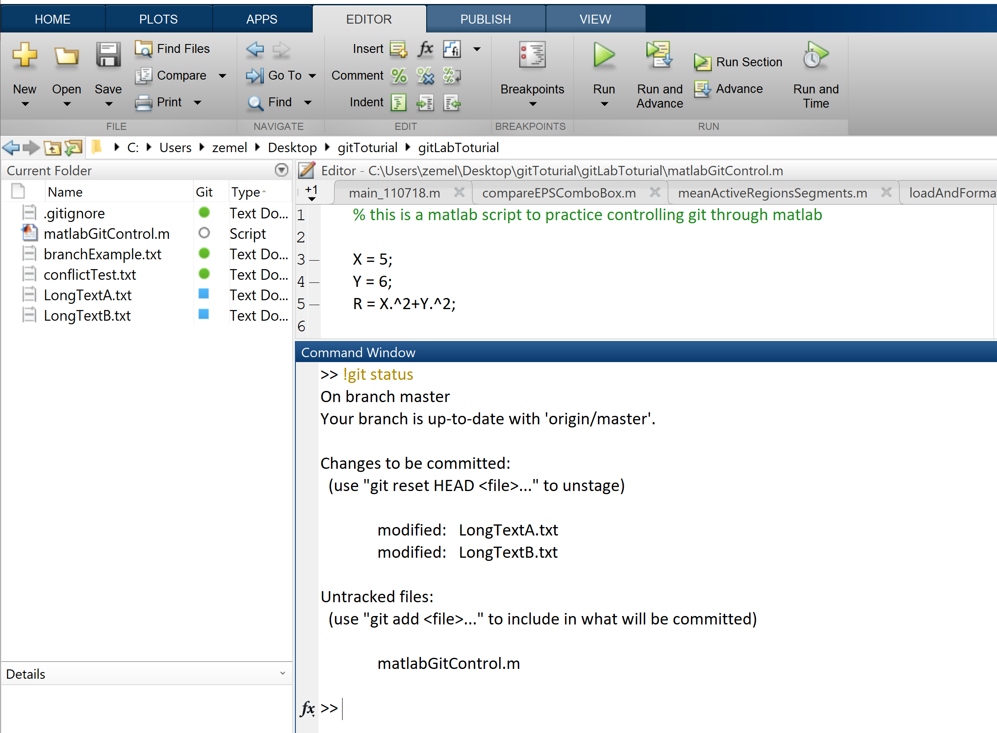
Control git from Matlab
Simply add ! Before the regular git commands in the matlab command window

Slide 33
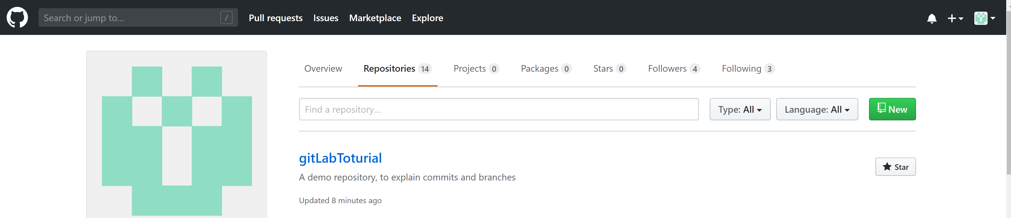
Opening a new repository
Start a new repository on the git website
Give it a name, description, and decide if privet or not.

Slide 34
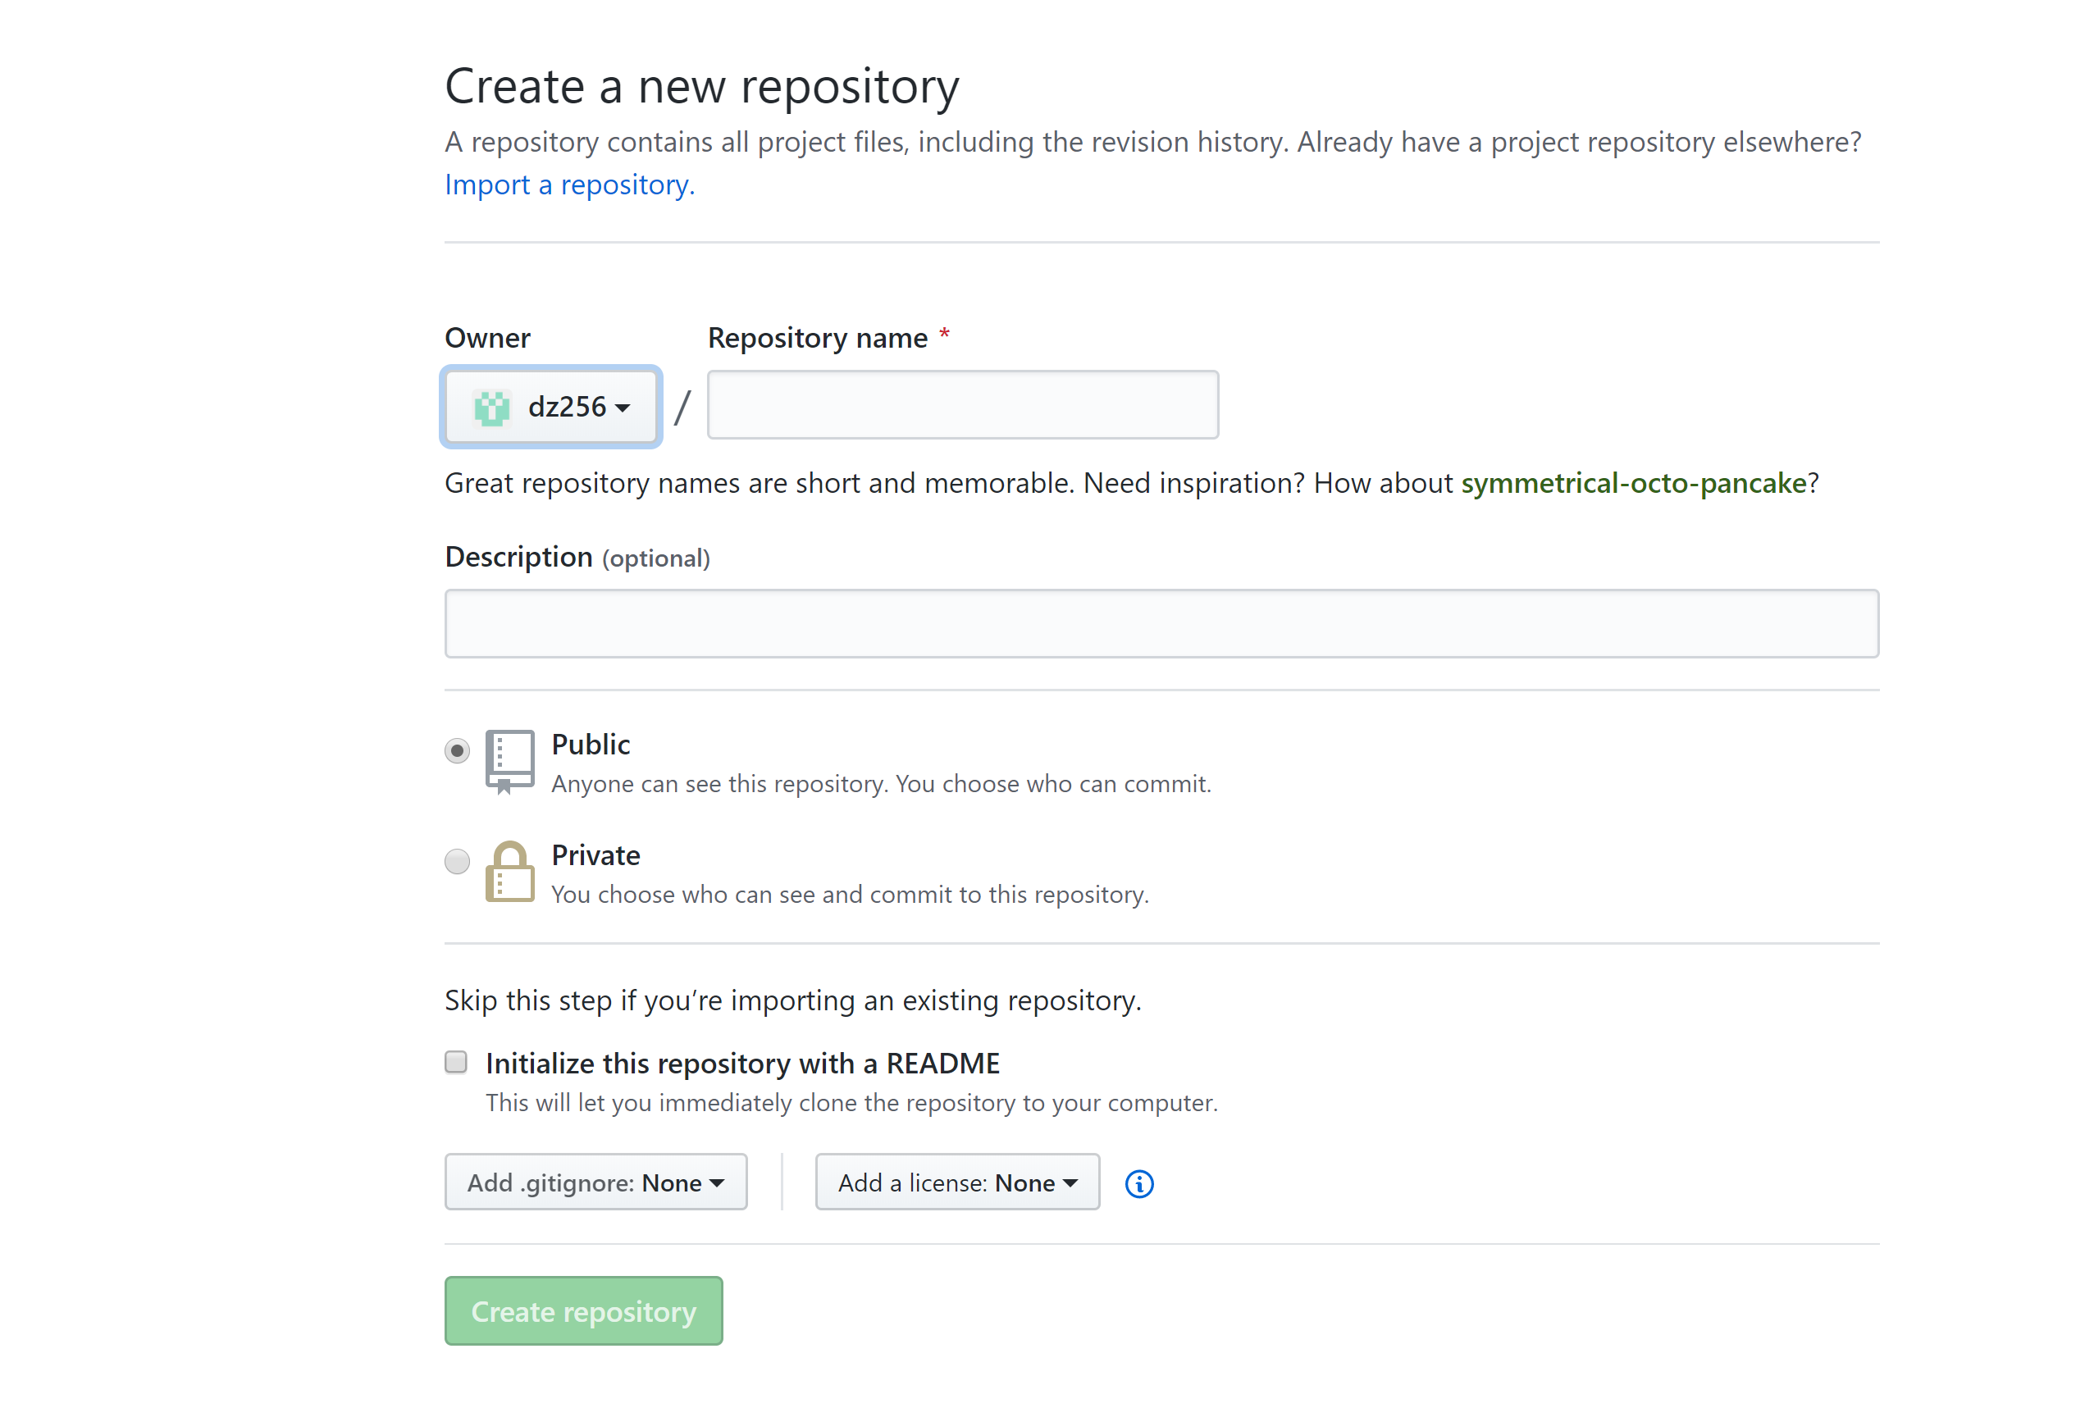
Opening a new repository
Give it a name, description, and decide if privet or not.

Slide 35
Opening a new repository
Open command window and type:
cd folderPath ← go to the folder that contains your code
git init ← will start a new git repository that monitor this folder + any subfolders
IMPORTANT: before continuing to next step make sure you created a “.gitignore” file , and it is updated and in the folder. ← this file will prevent git from uploading unwanted files to the repository. See next slide for details.
git add . ← this will add all the files in the folder to your git index
git commit –m “message” ← actually commit the files
Push to your new repository

